Slide 1
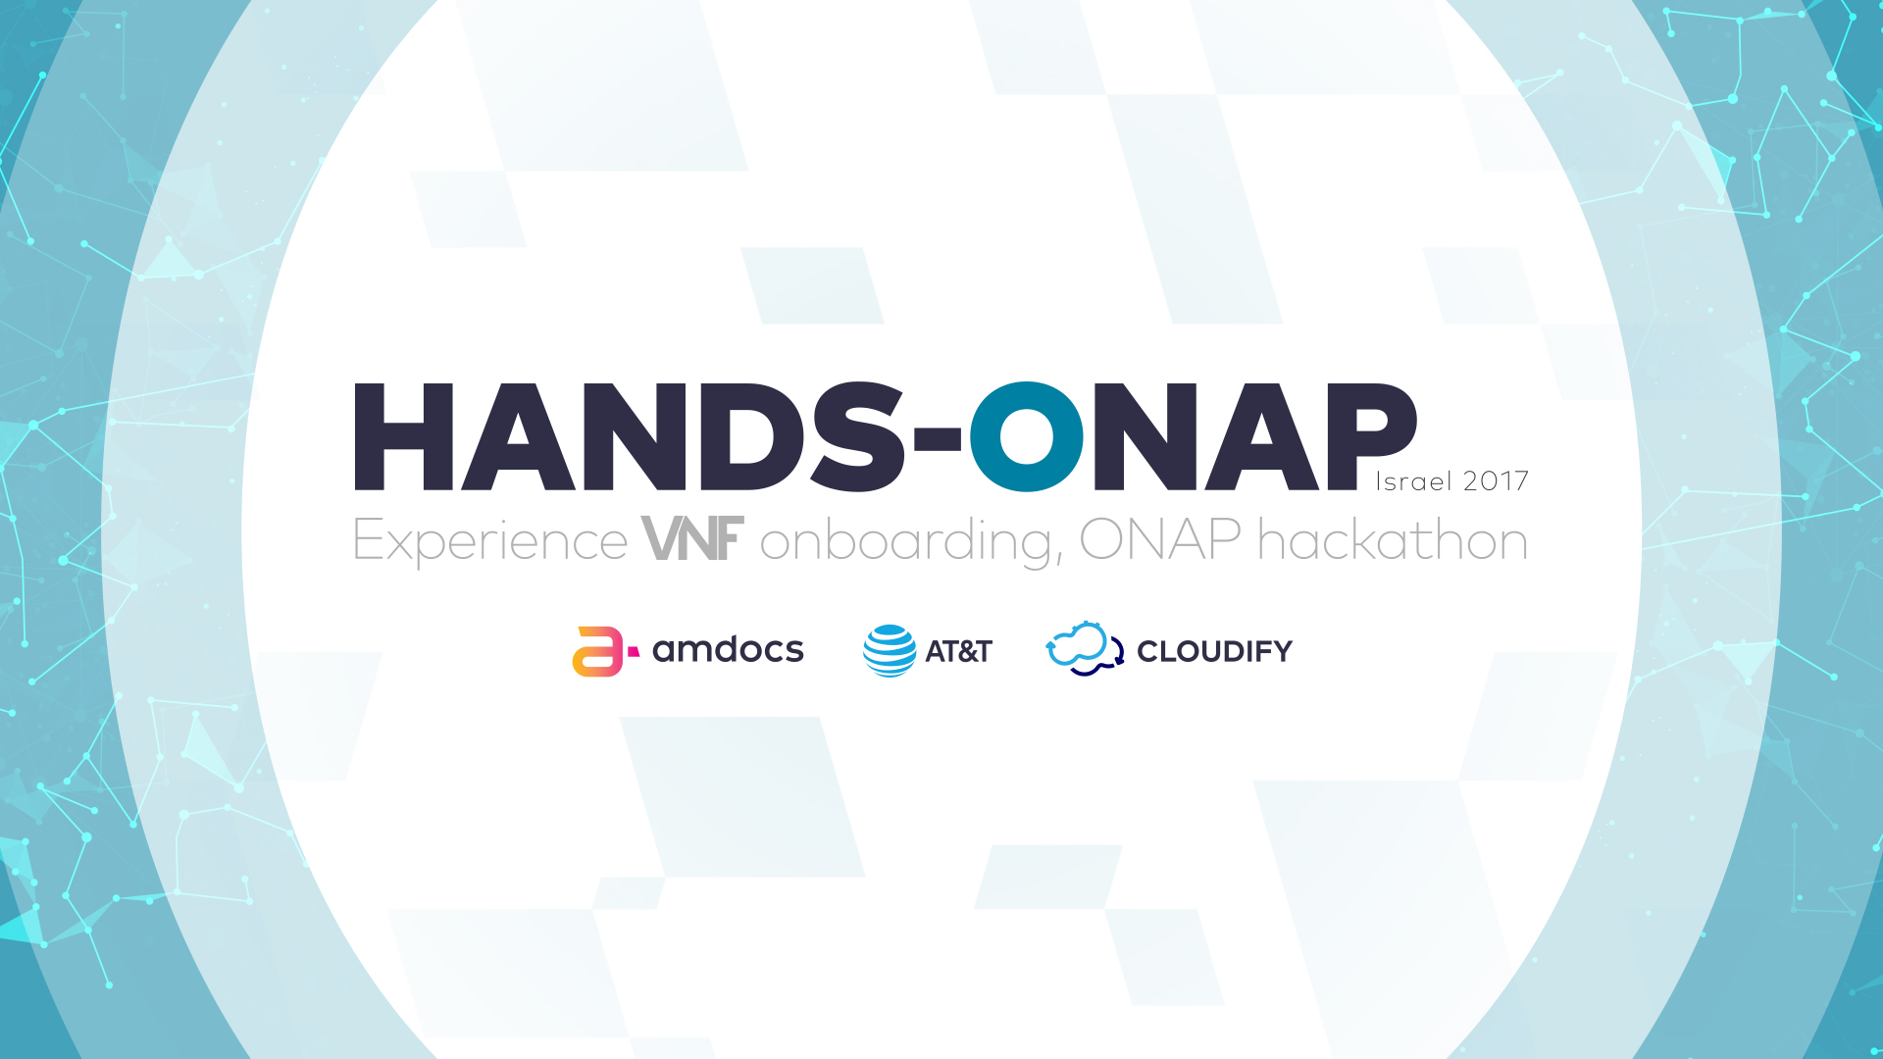

Slide 2

Model-driven Design
Eden Rozin

Slide 3

How can we make a leaner more agile networks ?
Vendor lock-in
Coupling of SW with HW
Long TTM
Manually built
Passively operated
Low-to-no reusability
Open Source
De-coupling of SW and HW
Short TTM: agility
Automatically built
Built-in network intelligent
Reusability is the key.
Design with Lego pieces not with snowflakes.

Slide 4
Multi-dimensional design was always our mission.
Deploy i.e., Local/geo-redundancy ? Both ? Which cloud environment ?
Orchestrate i.e., Can we use a generic orchestration flow ? Do we need anything specific
Connect i.e., Which type of networks to use ? Do we need IP addresses ? V4 ? 6 ? How many ?
Configure i.e., do we have VNF generic configuration ? do we have specific VNF configuration ?
Monitor i.e., on which standard are we going to do Monitoring ? SNMP ? Syslog ? what we would like to achieve ? an Alarm ? an automatic response ?
Operate
& Maintain i.e., How do we handle upgrades ? Fixes, patches ? How do we handle scale in/out ? Delete ?
Automate as much as you can.

Slide 5
A reusable network starts from the bottom.
Service
CS
N
Service
Service
Rely on standards.
Model-driven design
Well-defined “atoms”.
i.e., what is a port ? what is a network ?
Atoms build molecules, molecules build even more complex molecules (organisms).
VNF
Service
Capabilities
Requirements
Properties
VNF
VNF
VNF
Capabilities
Requirements
Properties
VFC
VFC
VFC

Slide 6
Abstract!
VNF
type
Use abstractions - well-defined model’s “first-class citizens”: VFC, VL, CP, VNF, Service, etc.
vFW
vR
vWANx
vMME
vendor
CP
FN
PA
J
deployment
DF#1
DF#2
DF#3
DF#3

Slide 7
Abstract!
CP
A
B
C
type
Unlock new ways to design the network and control runtime execution.
A
B
C
~~
X, Y
extCP
intCP
A
B
C
~~
E, D
Deployment
A
B
C
~~
X, Y
~~
c, d
extCP_#1
extCP_#2
A
B
C
~~
X, Y
~~
a, b

Slide 8
ONAP Service Design & Creation (SDC)
Automate onboarding of software-based network functions and applications in large quantities and with rapid speed.
Single master catalog, maintaining E2E Models for run-time metadata-driven execution.
Maximize model-driven and minimize code changes to the operating platform.
Compose, deploy, and operationalize services with shareable and reusable functional components. Flexibility is the key.
VNF Onboarding
Catalog
Design

Slide 9
VNF Onboarding
Create
Validate
Enrich
VNF-ready
Create Vendor Software Product (VSP):
Deployment artifacts, i.e., HEAT
License artifacts
Images
Monitoring artifacts, i.e., SNMP-MIB
Configuration artifacts
Documentation
…
Validation
Standard validation
Syntax validation
Security checks.
...
Enrichment with:
Operational requirements
Deployment requirements
Dependencies
Functional and non-functional requirements
Build license model

Slide 10
Let’s start.

Slide 11
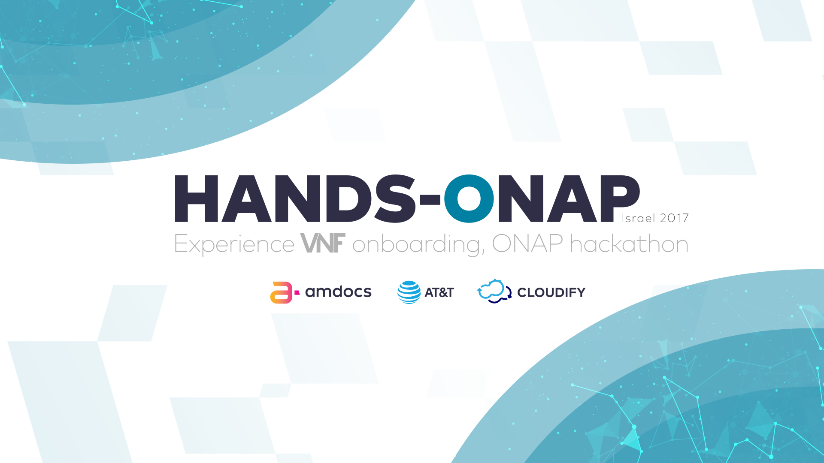

Slide 12


Slide 13


