Slide 1
E2E ONAP Target Architecture & Major Component View

Slide 2
Architecture Design Considerations
Architecture Principles Were Reviewed Earlier and Agreed Upon by the Architecture Team:
  https://wiki.onap.org/display/DW/Contributions?preview=/8225716/8232492/Architectural%20principles_v3.docx
ONAP is a layered architecture – Orchestration, Multi-Cloud, Controller, etc.
Functional role of each layer should be well defined per the architecture principles agreed by the architecture team (see the above link).
ONAP should support integrated design studio to capture full lifecycle management models (TOSCA models for NF, simple / nested services augmented with BPMN, Policy / Analytic design models, etc.)
ONAP Should Support Cloud Agnostic Model and Multi-Cloud adaption layer while hiding infrastructure details
ONAP Target Goal is: Modular, Model-driven, Microservices-based architecture
  Models drive interfaces between layers/components
ONAP should define well-described and consistent NB-APIs at all layers
Keep flexible capability for commercial solution (no vendor lock-in)
Agree to unified modeling for integration across all modules: VES in DCAE, Logging & monitor inside ONAP and more

Slide 3


ONAP Target Architecture
(High-Level Functional View)
OSS / BSS
CLI
U-UI
ONAP Portal
ONAP External APIs
DESIGN-TIME
Dashboard OA&M
RUN-TIME
Resource Onboarding
Common
Services
Policy Framework
Data Collection, Analytics, and Events
Event Correlation
Active & Available Inventory
External Registry
Common Services
Orchestration
Service Design
Application
Authorization
Framework
Policy Creation & Validation
ONAP Operations Manager
Analytic Application Design
Micro Services Bus / Data Movement (see Note 1)
VNF / PNF Onboarding
ONAP Optimization Framework
Closed Loop Design
Change Management Design
Generic NF Controllers (L4-L7)
Logging
Multi-Cloud
Adaptation
SDN Controller
(L0-L3)
Design Test & Certification
Configuration & Life Cycle Management
Others
CCSDK
(see Note 1)
(see Note 1)
Catalog
Optional External Systems
3rd Party Controller
Specific VNF Manager
Element Management System
…
Managed Environment
Network Function Layer
Recipe/Eng Rules & Policy Distribution
ONAP Optimization Framework
VNFs
PNFs
Hypervisor / OS Layer
OpenStack
VMware
Azure
Kubernetes
RackSpace
Note 1 – Consistent APIs between Orchestration layer and Controllers
MPLS
IP
Private
Edge Cloud
Private
DC Cloud
Public
Cloud

Slide 4
High Level Component View

Slide 5
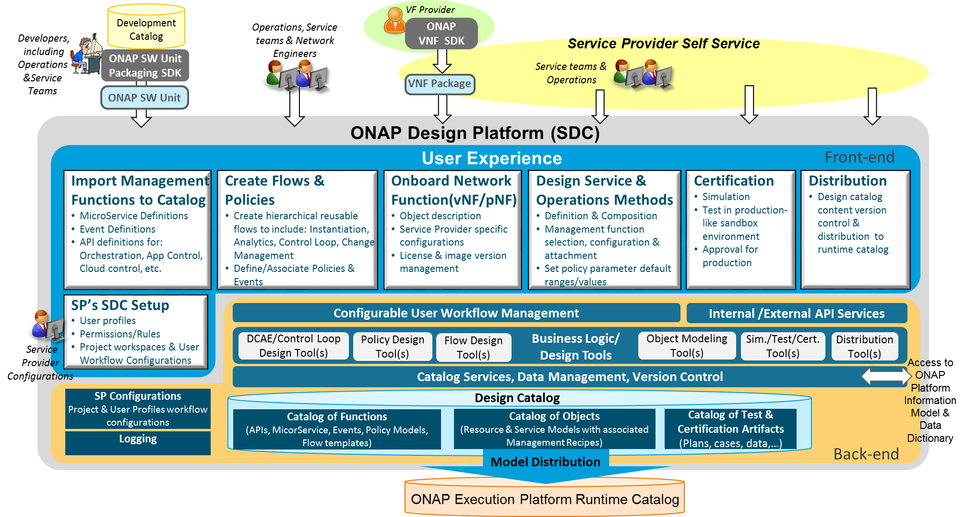
Service Design and Creation (SDC) Functional Architecture
Service Provider’s Design environment to: 1. Catalog management capabilities, 2. Onboard vendor provided Network Functions, 3. Design Services and Operations, 4. Test, certify, and distribute models for Runtime Execution
Import Management Functions
  Import ONAP base capability definitions from Development Catalog to Design Catalog as building blocks in a standard format
Create Flows & Policies
  Create reusable management flows using building blocks & associated events & Policies
Onboard Network Functions
  Create VF model to include vendor’s description, scripts, & license model
  Customize models to include Service Provider specific attributes
Design Service & Operations Methods
  Create Service models with resources
  Design and associate operations processes & policies (e.g., Instantiation, DCAE/Control Loop, Change Management, etc.) and configure them to be service specific
Certification
  Simulate & test the design in Sandbox environment
  Certify Readiness & Adherence to Standards
Metadata Distribution
  Publish certified models for distribution to runtime catalog
  Notifications & Version Control

Slide 6
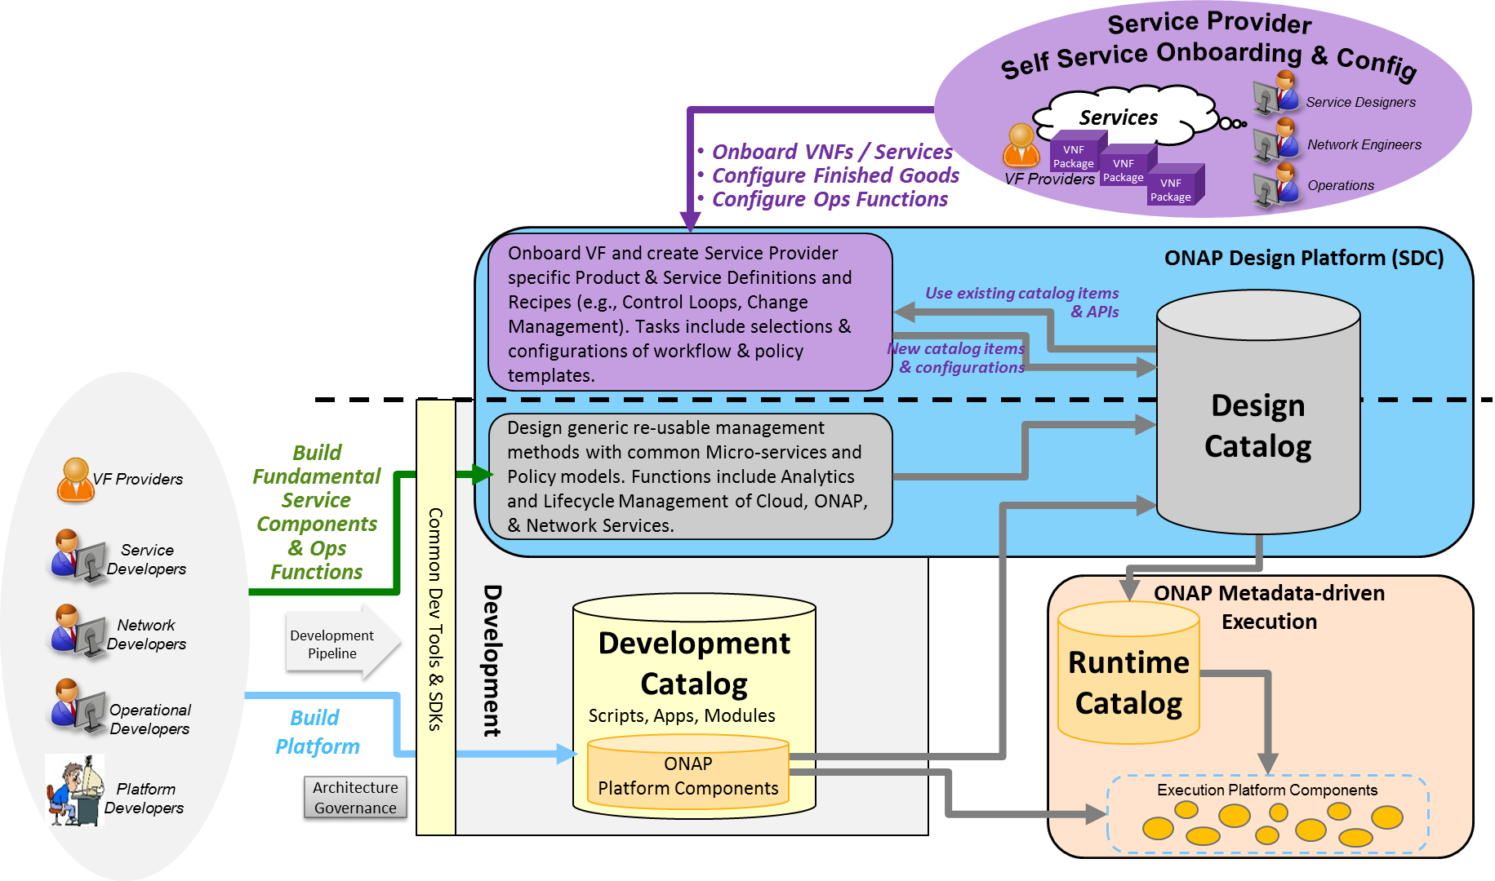
Catalog Architecture
The overall ONAP Catalog architecture includes Development Catalog, Design Catalog, and Runtime Catalog
Partially Existing:
Design Catalog (ONAP Design Platform - SDC)
  Catalog imported ONAP generic re-usable management software function & policy definitions
  Enable SP to onboard standard VNF packages
  Support SP users in design & lifecycle management of Resource and Service models
  Provide presentation to support service compositions & management flow associations
  Manages catalog’s elements versions, lifecycle and access policy
  All certified asset definitions available for re-use and composition
Yet to be implemented:
Development Catalog (ONAP Development)
  Common toolsets and data store for creation of ONAP software models & management flows/policies
  Interact with external software development teams and suppliers to onboard custom software, adapters or new capabilities
Runtime Catalog (ONAP Execution Platform)
  Provide a common data store for distributed certified models
  Provide ONAP runtime component’s subscription to access component view of the model data
  Maintain executable images and other runtime artifacts

Slide 7
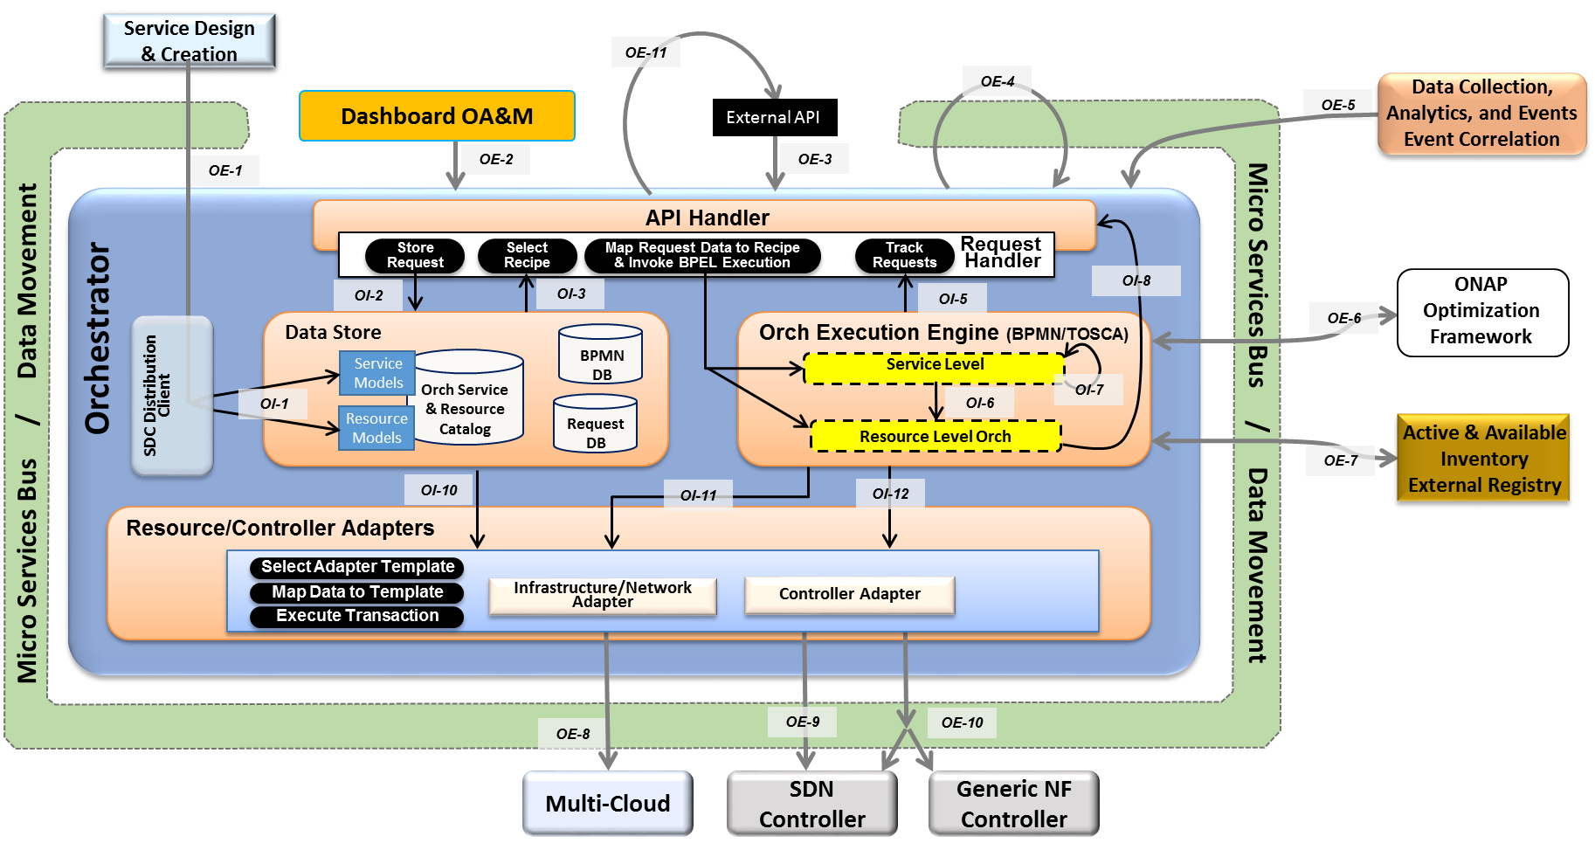
Orchestrator
The ONAP Orchestrator orchestrates service, resources and associated cross-controller activity driven by requests and events that indicate the need to create, modify or remove service and resource instances, or to perform multi-control layer remedy actions.
Model Driven Orchestration and APIs
  Runtime behavior driven by service and resource models and policies (including compound/nested services) designed in or onboarded into SDC
  Orchestrates service delivery, change management as well as open and closed-loop control actions
  Provides standard, model driven APIs for requested actions
  Tracks orchestrated activity for the life of the
  request, but doesn’t maintain state of
  orchestrated components
Processing of Service Requests:
  Performs Decomposition, Recipe Selection, Recipe Execution (including Rainy Day)
  Triggers and Records Results for:
  Homing
  Assign, Create, Configure
  (Controller/multi-cloud activity)
  Validation
  Monitoring
  Separate execution threads for service, decomposed resources, and any subtending service(s) provide nested service orchestration in a recursive manner
Orchestration of Controllers
  Coordinates activities across Multi-Cloud/
  SDN-C/Generic NF controllers, including data sourcing and mapping to Controller inputs

Slide 8
Orchestrator Functional Internal View
APIs labeled on slide relative to SO for reference only.
Key
OE-x
SO External API
OI-x
SO Internal API
SO-SO communication across ONAP instances looks like an External API.
SO-SO communication within a single ONAP instance is via Micro Services Bus.
Service Design & Creation
OE-11
OE-4
Data Collection, Analytics, and Events
Event Correlation
Dashboard OA&M
External API
OE-5
OE-1
OE-2
OE-3
API Handler
Request
Handler
Allotted Resources case
Store
Request
Select Recipe
Map Request Data to Recipe & Invoke BPEL Execution
Track
Requests
OI-2
OI-3
OI-5
OI-8
ONAP Optimization Framework
OI-4
OE-6
Orchestrator
Data Store
Orch Execution Engine (BPMN/TOSCA)
Service Models
Orch Service
& Resource
Catalog
BPMN
DB
Service Level
SDC Distribution Client
OI-7
Complex Services case
OI-1
Resource
Models
Request DB
OI-6
Micro Services Bus / Data Movement
Micro Services Bus / Data Movement
OI-9
Resource Level Orch
Active & Available Inventory
External Registry
OE-7
OI-10
OI-11
OI-12
Resource/Controller Adapters
Select Adapter Template
Controller Adapter
Map Data to Template
Infrastructure/Network Adapter
Execute Transaction
Controller functions common to both SDN-C and Generic NF Controller. Note that this may actually be 2 APIs and not a single.
Controller functions specific only to SDN-C. E.g., “Assign Network Resources” for the VNFs in a L4+ Service.
OE-8
OE-9
OE-10
Multi-Cloud
SDN Controller
Generic NF Controller

Slide 9
Generic NF Controller (L4-7) Architecture
Generic NF Controller for L4-7 configures and maintains the health of applications throughout its lifecycle.
  The Lifecycle Management Functions are a normalization of VF-C and APP-C functions into a common, extensible library
Programmable network application management platform
  Behavior patterns programmed via models and policies
  Standards based models & protocols for multi-vendor implementation
  Extensible SB adapter set including vendor specific VNF-Managers
  Operational control, version management, software updates, etc.
Manages the health of applications/VNFs/PNFs within its scope
  Policy-based optimization to meet SLAs
  Event-based control loop automation to solve local issues near real-time
Local source of truth
  Manages inventory within its scope
  All stages/states of lifecycle
  Configuration audits
Key Attributes of Generic NF Controllers
  Intimate with network protocols
  Manages the state of services
  Provide Deployment Flexibility to meet user scalability / resilience needs
Artifact Distribution
Orchestration
Closed Loop Actions
Inventory
Updates
Service Design & Creation
Orchestration
Data Collection, Analytics & Events
Active & Available Inventory
MSB/Data Movement
Generic NF
Controller
API Handler
Policy Cache & Event Matching
Operational/ Config Tree
(Service Model)
Repository
Service Logic Processing
VNF Descriptors
Lifecycle Mgmt. Functions/MicroServices (mS)
Config Templates
Service* Topology & VNF/PNF State
Config mS
Audit mS
SW Upgrade mS
Service Logic
…
…
…
Service Logic
Service Logic
Service Logic
Engineering Rules
*Not E2E service view. The “Service” view in the Generic VN Controller is limited its scope of control
Adapters
Netconf
Chef
Ansible
Multi-Cloud Adapter
External System Adapter (s)
…
Others
MSB/Data Movement
Applications
VNFs
PNFs
Multi-VIM/Cloud
External
3rd Party Controllers
Specific VNF Managers
Element Mgt. Systems

Slide 10
SDN-Controller Architecture
SDN Controller configures and maintains the health of L1-3 VNFs/PNFs and network services throughout their lifecycle
Programmable network application management platform
  Behavior patterns programmed via models and policies
  Standards based models & protocols for multi-vendor implementation
  Extensible SB adapter set supporting various network config protocols, including 3rd party controllers
  Operational control, coordinated state changes across devices, source of telemetry/events, etc.
Manages the health of network services & VNFs/PNFs in its scope
  Policy-based optimization to meet SLAs
  Event-based control loop automation to solve local issues near real-time
  Action executor for outer control loop automation
Local source of truth
  Manages inventory within its scope
  All stages/states of lifecycle
  Configuration audits
Key Attributes of Controllers
  Intimate with network protocols
  Manages the state of services
  Single service/network domain scope per instance
Artifact Distribution
Orchestration
Closed Loop Actions
Inventory
Updates
Service Design & Creation
Orchestration
Data Collection, Analytics & Events
Active & Available Inventory
MSB/Data Movement
SDN Controller
API Handler
Configuration Repository
Service Control
Interpreter
Network Resource
Controller
Svc Template A
Svc Comp 1
Access
Service
Features
Service
Element
Resources
Svc Template B
Svc Comp 2
Network/Service Design/Engineering Policies/Rules
Flow
Service
Features
Core &
Transport
Resources
Adapters
Multi-Cloud Network Adapter
NetConf/ YANG
BGP/
PCEP
External System Adapter (s)
…
Others
MSB/Data Movement
External
3rd Party Controllers
Specific VNF Managers
Element Mgt. Systems
Multi-VIM/Cloud

Slide 11
Data Collection, Analytics and Events (DCAE) Architecture
Analytic µServices
Managed Environment
Fault Correlation
Congestion Detection
Capacity Management
QoS Monitoring
Security Analysis
…
DCAE
VNFs / PNFs
Applications
VES
OOM – DCAE Controller
Streaming
Data
Networking
DMaaP (Pub/Sub for Events/Data within DCAE & across ONAP)
Analytic Frameworks:
Holmes, CDAP, Other
Stream Data Collection
Batch
Data
Events
Flows
Other
Multi-Cloud Telemetry Adaption
Compute
SNMP
Unstructured & Structured Data Persistence
Batch Data Collection
Syslog
Storage
Logs
Files
Other
Other
DCAE enables real-time fault, performance and other data/event collection from service, network and infrastructure
  Collect Data & Events once and make available to multiple applications
  Telemetry records from VNFs and PNFs (fault, performance, usage, etc.)
Makes collected data available to real-time analytic µ-services to:
  Identify anomalies and other events for closed loop remediation
  Enable closed-loop automation to remedy fault/performance conditions
  Enable closed-loop automation to scale resources up/down
  Enable analysis at edge and central locations
  Extensible framework to integrate applications from various sources
Provides Correlation & Analysis to manage service at various layers
  Multi-Cloud Infrastructure layer, network element layer, Network & Complex Services layer, Operational Management layer
  Cross-layer, Intra-domain and cross-domain correlation

Slide 12
Active and Available Inventory
A&AI tracks the global inventory of the networks, services & resources that ONAP manages.
  The what, where, when of the managed assets and their relationships, and which controller manages them, etc.
Real-time, logically centralized view of topology & inventory
  Map and broker of data sources in the global network
  Federates across controllers, cloud infrastructure, partners, etc.
  Real-time access to authoritative sources with ability to aggregate views
  Real-time awareness of network elements, applications and service instances
  Aware of all the assets in scope, organized by their type, state & location
  Keeps track of the dynamic relationships of the virtual assets
  Aware of resource assignments, availability & relationships to customer
Network events used to maintain the integrity of inventory
  Monitors network events to register services, networks & resources
  Tracks creation, modification or removal of entities and relationships
A&AI
API Handler
Metadata Engine
Inventory & Topology Management
API Generation
Entitlement
Service
Resource
Active
Available
Reference
Network
Infrastructure
Topology
Assignment
Schema Generation
Graph Layer
Version Management
A&AI Data Management Services
Entitlements & Reference
Inventory & Topology
Metadata Management
A&AI Application Management Functions
OA&M
History
Event Subscriptions
Notifications
Data Audits
Archival
Model-driven
  Schema, APIs, database views, data integrity mechanisms generated from models expressed in TOSCA.

Slide 13
ONAP SDK-Driven Sub-System Approach
Goal: Move toward a common platform architecture, starting with Controllers, Orchestration and Multi-Cloud
Improve agility for on-demand/situational creation of instances
Reduce software footprint of platform component instances
Reusable tool chain and framework across components
Facilitate agile introduction and swap-out of technologies
Consistent use of NB and SB APIs
Enable flexible options to add and extend platform capabilities

Slide 14
SDK-Driven Sub-System – Libraries (including CCSDK)
SDK Libraries
NB API SDK
API Handler
API Configurator
Orchestration APIs
Controller APIs
Cloud APIs
API Catalog
Orchestration Function SDK
Control Function SDK (CCSDK)
Multi-Cloud Adaptation SDK
Library of
Common Control/NFV Lifecycle Mgt. Functions
Library of
Common Cloud Translations (shims)
Library of Flows
Service, Resource, Etc.
Rebuild
A udit
VNF Configure
Assign
Cloud Resource
Instantiation
Telemetry
Scale
…
Stop/Start
Scale
Network Config.
…
Imperative Models
Declarative Models
Health Check
Register
Heal
LB
BPMN orchestration
engine
TOSCA orchestration
engine
Upgrade
Heal
Svc Function Chain
ODL
ONOS
Open
ROADM
…
Sub-Models
TOSCA-Cloud
Translation/Mapper
SB API SDK
(Adapters)
M-Cloud APIs
OSS APIs
Netconf/Yang
OpenStack
API Catalog
Controller APIs
μServices APIs
Ansible
Plugins/Adapters*
Azure
Resource Orchestration APIs
Collectors
AWS
etc.
Orchestrators
Controllers
μServices
OSSs
VNFs
PNFs
Multi-Cloud
OpenStack
Azure
AWS
Rackspace
IBM
Google
*Plugins/Adapters can include:
3rd party VNFM Drivers • 3rd party EMS Drivers
3rd party SFC Drivers • Ansible/Chef/Puppet
Netconf/Yang • CLI
SNMP • etc.

Slide 15
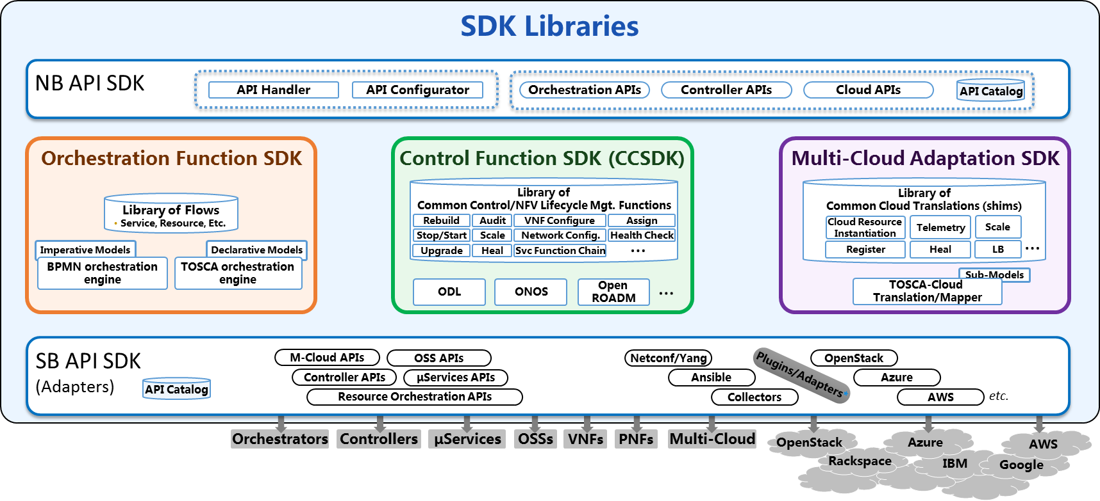
Controller Personas Based on SDK Libraries
SDK Libraries
SDN-C Persona
Generic VNF Controller Persona
NB API
NB API
Controller APIs
Controller APIs
Controller Personas Examples
(created from CCSDK)
Control Functions
LCM Functions
Library
Library
Assign
Network Config
Rebuild
Audit
VNF Configure
…
VNF Configure
…
Svc Function Chain
Stop/Start
Scale
Svc Function Chain
HealthCk
Heal
ODL
…
Other engines
ODL
SB
API
SB
API
Netconf/Yang
μServices APIs
…
…
Ansible
Netconf/Yang
3rd Party SFC
Other Adapters
OSS APIs
Other Adapters
OSS APIs
μServices APIs
3rd VNFM/EMS

