Slide 1
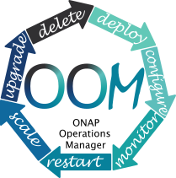
ONAP Operations Manager (OOM)
Definition: OOM is the life cycle manager of the ONAP platform (i.e. SDC, SO, SDNC, etc.). OOM uses the Kubernetes container management system and Consul to provide the following functionality:
  Deployment - with built-in component dependency management (including multiple clusters, federated deployments across sites, and anti-affinity rules)
  Configuration - unified configuration across all ONAP components
  Monitoring - real-time health monitoring feeding to a Consul GUI and Kubernetes
  Restart - failed ONAP components are restarted automatically
  Clustering and Scaling - cluster ONAP services to enable seamless scaling
  Upgrade - change-out containers or configuration with little or no service impact
  Deletion - cleanup individual containers or entire deployments
OOM supports a wide variety of cloud infrastructures to suit your individual requirements.
Interface 1
ONAP Operations Manager
Provided Interfaces: Consul GUI for health monitoring, Kubernetes CLI for platform management
Consumed interface Interfaces: None
Consumed Models: ONAP Deployment Specifications, ONAP Component Configuration Artifacts
Interface N

Slide 2
Interface Definitions
Draft
< interface name >
Provided Service
Supplementary Information
Interface Provider(s)
Provided Capabilities
N/A

