Slide 1
Functional Decomposition
Contributors : Manoj K Nair (NetCracker), Alex Vul (Intel), Parviz Yegani (Huawei) , Kevin McDonnel (Huawei)
Nigel Davis (Ciena), David Bainbridge (Ciena)
August 2018

Slide 2
Problem Statement : Why we are doing this exercise ?
Today ONAP functionality is grouped based on projects and decomposed based on per project discretion of software modules
Current model of grouping is not efficient enough in terms of
  Extensibility : Extend ONAP capability for introducing new features or support new use cases (Many projects impacted)
  Composability: To have a flexibility in composing ONAP capabilities in different deployment contexts, without any tight dependency – For example Low form factor ONAP, Integration of ONAP with legacy
  Modularity : Flexibility in segregating capabilities at a logical depth and breadth
  Cohesion/Coupling : High cohesion (independent responsibility and existence) and low coupling (low dependency) between functionalities
  Common guidelines, Patterns : New user onboarding is difficult as different projects follow different guidelines or lacks a common pattern
  Substitutability : ONAP components can be easily replaced with commercial alternatives (to have well defined interfaces) – For example legacy module integration
  Integration Complexity : Integration of different components is difficult as component inter dependencies are loosely defined or changed based on adhoc needs. There is also many bespoke pt to pt interaction.

Slide 3
Key Idea
Functional Decomposition : What function we are trying to decompose ? We need to have baseline functionalities. These functionalities should ideally be based on end user (operational) requirement
Main idea of functional decomposition : Identify Common Operational Functionalities and see if those functionalities are fulfilled by ONAP in terms of breadth and depth – and how efficiently it is done today
ONAP in terms of a master list of Operational Functionalities - come up with a matrix (called Operational Map) so that ONAP capabilities can be (re)grouped in a flexible manner – selection of functionality for grouping , microservice boundaries etc.
Bring-in Operational Context – i.e. How ONAP is used from Operational point of view and what is being operated on
Use Operational Context for functional decomposition

Slide 4
Functional Decomposition : What stage we are discussing
Operator Operational Needs
Relevance of Functional Decomposition, Operational Workflows
Define Operation Functions and associated activities
Relevance of Modularity Concepts
Input for Vendors and ONAP Projects to identify functional gaps
Modular Solution Design
Refactoring

Slide 5
Terminologies
Managed Objects : An entity being managed and operationalized by ONAP
Operational activities direct or indirect operations on managed objects – e.g. Package management, Artifact management,
Operational functionality: Operational activities logically grouped to form a feature or a functionality – e.g. Modelling, Pre-Onboarding Validation, Infra Readiness
Group of operational Functions sequenced based on business requirement form Operational Lifecycle
Modularity
  Grouping the functionalities into a manageable units based on a reason/requirement
Component:
  A software unit which fulfil a set of operational activities
  A Component may be built from a System of other components but this is not visible to the user of the component
Software FRU : Refer to Nigel’s deck on Modularity – A sellable/packaging/delivery entity that can exist on its own.
  Essentially a component with well defined business and operational context and can be deployed independently or with other FRUs as an assembly.
  Purchased as a single unit
  Installed as a single unit and upgraded as a single unit
Plug-ins
  For extension of existing services and for incorporation of special algorithms etc.
  Are plugged in to components

Slide 6
Key Idea Contd.
Operational Functionality 1
Operational Functionality 2
Operational Functionality 3
Managed Object 1
Activity 1
Activity 4
Activity 2
Activity 5
Activities associated with MO 1
Activity 3
Activity 6
Managed Object 2
Activity a
Activity m
Activity b
Activity n
Activities associated with MO 2
Activity b
Activity 0
Operational activities and their logical grouping influence the functional capabilities of ONAP components
A matrix called Operational Map can be created which maps the managed objects and the associated activities on managed objects. This operational map gives the global view of desired end user operational functionality expected
This helps in identifying the functional granularity currently supported (in terms of managing activities) and gaps

Slide 7
Key Idea Contd.
Operational Functionality 1
Operational Functionality 2
Operational Functionality 3
Managed Object 1
Activity 1
Activity 4
Realized as (assembly of) Software FRU
Activity 2
Activity 5
Activities associated with MO 1
Activity 3
Activity 6
Realized as (assembly of) Software FRU
Realized as (assembly of) Software FRU
Managed Object 2
Activity a
Activity m
Activity b
Activity n
Activities associated with MO 2
Activity b
Activity 0
Operational Activities are supported as features by specific ONAP components
For certain Operational functionalities the associated activities can be supported and realized using multiple ONAP components
One further step might be to map the activities/operational functionalities to ONAP component micro functionalities.

Slide 8
Operational Map Concepts : Managed Objects
Example 2: Reference CLI Project
Example 1: Generalized List
Managed Objects
Cloud
Customer
Ems
EP
License Group
License Mode
License-agreement
Logical Link
Microservice
PNF
Policy-Operational
Policy-Config
SDNC
Service
Service-Instance
Service-Model
Service Type
Subscription
Tenant
VF
VF-Model
VF Module
VIM
VNF
VNFM
VSP
Managed Objects
Service
Network Function
License
NFVI /Tenant
Policy
Platform
Release Version
Engaged Party
Entities whose lifecycle and behavior Managed or Orchestrated by ONAP
Entities which can be monitored by ONAP
Ideally this input should come from Modelling Subcommittee

Slide 9
Operational Map Concepts : Operational Functionalities
Operational Functionalities
Modelling
Pre-Onboarding Validation
Onboarding and Design
TechOps/DevOps - Operational Readiness (Making ONAP Ready)
Run Time Data Management
Model Distribution
Infra Readiness (Day 0)
Instantiation/Orchestration (Day 1)
Configuration , Activation & Control (Day 2)
Assurance & Cl Control
List of Operational Functionalities that ONAP may offer
These operational functionalities are expected to be supported/realized using ONAP components as operations on the managed objects
Operational Functionalities can be sequenced into workflows to create Operational Lifecycle

Slide 10
Operational Map – Draft (Open for feedback and changes)

Slide 11
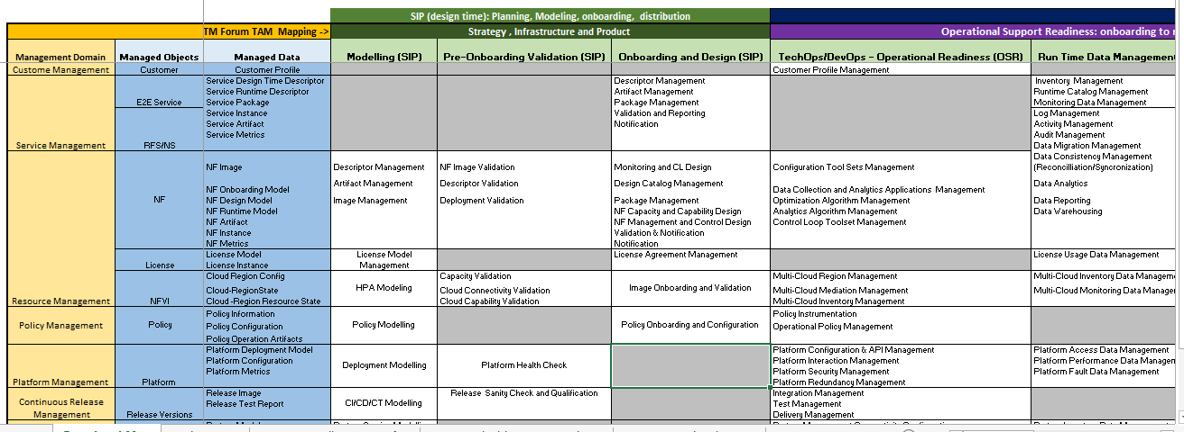
How it can be used ?
Verify the operational functionalities and associated activities in terms of breadth and depth
Identify what existing ONAP Component fulfil the associated operational functionality.
Check what functionalities /activities are currently supported and what are missing
Identify the need for ONAP capability grouping in terms of operational functionality or activities on managed objects
Refactoring based on identified functional grouping
This is a continuous process

Slide 12
Operational Map and Evolution to a Solution
If we have baseline Operational Functionalities, how it can help to define ONAP Component boundaries ?
Grouping of the functionalities into modular components should be based on a reason/requirement (input from Nigel) driven by Operator business needs (Part/Full ONAP deployment)
Functional Grouping Criteria (input from Nigel)
  Scalability
  Failure/restart granularity
  Variety of implementations because of complexity/constructive-competition etc.
  Upgrade/test units (can mix at FRU level but not within)

Slide 13
An Example – Service Runtime Management
Service Qualification
Service Orchestration
Service Inventory
Service Assurance
Workflow Engine
Run Time Catalog Management
Optimization and Control
Service Runtime Data Management
Service LCM Request Management
Service Closed Loop Management
Workflow Instrumentation
Recipe Management
Run Time Catalog Management
Service and NF Package Retrieval and Decomposition
Optimization and Control
Workflow Execution and Monitoring
Service Configuration Management
Service LCM Operation Request Handling
Service Quality Measurement
Service Monitoring Data Management
Jeopardy Management
Service Policy Enforcement
Service Test Management
Service Inventory Update
Resource Allocation
Operational Activities
Candidates for realization by Software FRU – Independent Sellable/Deployable/Replaceable units
Operational Activities that can be grouped to a Software FRU
Gaps to be addressed in ONAP

Slide 14
Thank You

Slide 15
Realization Guideline – To discuss
The grouping logic : Start with what we have in ONAP today in terms of the existing components. Check if the matrix gives any guidelines for regrouping the functionalities
Pattern: Common pattern for defining a component with common look and feel, well defined interfaces – IG1118 Component-System Pattern ?
How to decompose the functionality ? i.e. Enable flexibility to break the functionality into smaller independent units
  Follow grouping logic
  Identify smaller units with cohesion (can exist independently, low coupling/dependency)
  Separate units in terms of bounded context – i.e. separate management of entities based on identities in the operational/domain context
How about non-functional capabilities ? Those are inherent nature of components that need to be controlled using S3P guidelines

