Slide 1
ONAP Reference Architecture for Beijing
Tiger Team Report
Leader: Parviz Yegani – Futurewei Technologies
Contributors (R3+ Architecture): Vimal Begwani (AT&T), Lingli Deng (China Mobile), Jamil Chawki (Orange), Andrew Mayer (AT&T), Alex Vul (Intel), Gil Bullard (AT&T), Ramki Krishnan (VMware), Maopeng Zhang (ZTE), Stephen Terrill (Ericsson), Jianguo Zeng (Huawei), John Ng (AT&T), Fariborz Behi (AT&T), Chaker Al Hakim (Huawei), Nagel Davis (Ciena), Susana Sabator (Vodafone), Manoj K Nair (Netcracker), Huabing Zhao (ZTE), Nemes Denes (Nokia)
Other Contributors (Beijing Architecture): Project Technical Leaders (PTLs) of various ONAP projects
Jan. 30, 2018

Slide 2


ONAP Amsterdam Architecture (for reference)
ONAP Operations Manager (OOM)
Portal Framework, U-UI, ONAP CLI
DESIGN-TIME (SDC)
Dashboard OA&M (VID)
RUN-TIME
External API Framework
Resource Onboarding
Policy Framework
DCAE
Correlation Engine
(Holmes)
Service Orchestration
A&AI/ESR
Service & Product Design
Policy Creation & Validation
Common Services
DMaaP
CCSDK
Logging
Micro Services Bus (MSB)
AAF
VNF SDK
CLAMP
Multi-VIM/Cloud
Infrastructure Adaptation Layer
SDN-C
(L0-L3 Controller)
Application Controller
(L4-L7)
Virtual Function Controller
(ETSI-aligned)
Catalog
3rd Party Controller
sVNFM
EMS
External Systems
Managed Environment
…
Network Function Layer
VNFs
PNFs
…
Recipe/Eng Rules & Policy Distribution
Hypervisor / OS Layer
OpenStack
Commercial VIM
Public Cloud
Private
Edge Cloud
MPLS
Private
DC Cloud
IP
Public
Cloud
Notes:
Key points:
Unified framework for design-time & run-time
Common platform for service design and netops to drive collaboration
Simultaneous orchestration of physical and virtual networks
Vendor-agnostic orchestration can only happen in open source context
Real-time analytics and closed-loop automation
Easy re-use of service concepts
Iterative service improvements based on network feedback

Slide 3
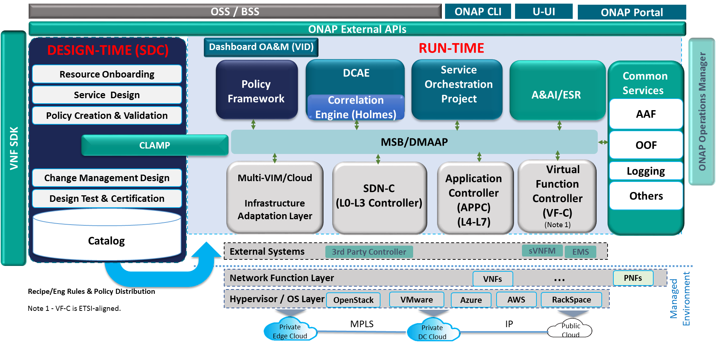
ONAP Beijing Architecture
(High-Level View with Projects)
Modeling (Utilities)
Integration
VNF Requirements
VNF Validation Program
PNFs
K8s
New projects to be added following TSC approval

Slide 4
Changes in Beijing Architecture
Since the Beijing release is focusing on Platform Maturity, the ARC has minimized changes to the functional architecture
  New projects approved by the TSC
  Formatting updates to provide clarity
As a foundation for the long-term target architecture, ONAP will strive for model-driven, microservices-based, modular architecture, and enable integration with other systems via MSB/proxy
  Enable secure communication between internal and external components
  Improve APIs for better consistency between components
  Align with models from Modeling subcommittee and external SDOs (as appropriate)
  Use OOM for instantiation and register with Microservices Bus

Slide 5
ONAP Beijing Architecture Recommendations

Slide 6
Recommendations for Beijing Release
Achievable Recommendations for Beijing to begin aligning with target architecture
  Key Architecture Principles: Modular, Microservices, Model-driven
  Modular:
    Improve APIs between components. Document them using Swagger.
    Align interfaces with industry standards, where available/appropriate (for example, ETSI SOL-003, SOL-005, MEF Interlude, Legato, etc.)
  Microservices-based
    Use OOM for onboarding, instantiation (support MSB natively), scalability
    Register with MSB
    Use microservices best practices (e.g., separate data from the component, use common KV stores/databases, for KV stores – prefer Consul, etc.)
  Model-driven
    Align with info/data models from the Modeling Subcommittee (to be published Feb 2018)
    Explore ways to use model-driven principles inside each component as well as across various components (SDC, SO, VFC, APPC, ..)
Release Theme is Platform Maturity/S3P
  S3P (see Jason Hunt 1/4 TSC presentation for list of projects providing support for S3P)
    Adhere to cloud-native principles (see https://martinfowler.com/, https://12factor.net/)
    Use common libraries/SDKs/common services where possible to improve overall system resiliency/reliability
    More focus on common services (where possible) also to help reduce testing
    MUSIC for managing various ONAP components states, DB replication in a consistent manner
    Enhanced AAF to support credential management for certificates
    Support Image Management service to enhance security, virus checking, etc.

Slide 7
Functional Description of Beijing Project Components
Note – The detailed description of features/capabilities/interfaces for each component planned for the Beijing release will be provided by respective projects.

Slide 8
Orchestration (1/2)
Definition:
Provides functionality for the execution of specified process and automated sequencing of activities, task, rules and policies needed for creation, modification, removal of network application, infrastructure services or resources.
Supports different specializations with specific orchestration scopes.
Specialization scopes include, but are not limited to, network service LCM (i.e., NFVO specialization), network slice specialization, domain specific specialization (beyond Beijing).
Service Management Interface
Network Service LCM Interface
Actuation Request Interface
Service Definition Reception interface
Orchestration
Provided Interfaces:
Service Management Interface
  Provides the interface to manage the services that orchestration provides.
Network Service LCM interface
  Provides the specific network service LCM interface.
Actuation Request Interface
  Provides support of actuation requests towards the services.
Service Management Interface
VNF LCM Interface
NF Config Interface
Optimization request Interface
Inventory Service Interface
Transport Service Interface
Network Service LCM interface

Slide 9
Orchestration (2/2)
Service Management Interface
Network Service LCM Interface
Actuation Request Interface
Service Definition Reception Interface
Consumed interface Interfaces:
Service Management Interface, from: Orchestration
VNF LCM Interface, from: Generic NF controller
Optimization Request Interface, from: Optimization Framework
NF Config Interface, from: Generic NF controller
Inventory Service Interface, from: Available and Active Inventory
Transport Service Interface, from: SDN Controller.
Network Service LCM interface, from: Orchestrator
Service Distribution interface, from: Service Design and Creation
Orchestration
Service Management Interface
VNF LCM Interface
NF Config Interface
Optimization request Interface
Inventory Service Interface
Transport Service Interface
Network Service LCM interface
Consumed Models:
Network Service Descriptor

Slide 10
Data Collection, Analytics, and Events
Definition:
DCAE is the ONAP subsystem that supports closed loop control and higher-level correlation for business and operations activities. DCAE collects performance, usage, and configuration data; provides computation of analytics; aids in trouble-shooting and management; and publishes event, data, and analytics to the rest of the ONAP system for FCAPS functionality.
Interface 1
Data Collection, Analytics, and Events
Provided Interfaces:
Interface 1: Data collection interface (used by VNFs and others from which data is collected)
  Interface for various FCAPS data entering DCAE/ONAP.
Interface 2: Deployment interface (used by CLAMP)
  Interface for triggering the deployment and changes of a control loop
Consumed interface Interfaces:
Interface 1: Data movement platform interface (provided by DMaaP)
  Interface for data transportation between DCAE subcomponents and between DCAE and other ONAP components
  This interface can also be used for publishing events to other ONAP components.
Interface 2: Data enrichment interface (provided by A&AI)
  Interface used by DCAE for enriching collected raw data by adding information not contained in original data, e.g. identifying the VNF type from VNF identity by querying this interface.
Interface 2: Service model change interface (Provided by SDC)
  Interface for fetching control loop models and updates.
Interface 4: Policy interface (Provided by Policy)
  Interface for fetching configuration and operation policies on control loop and control loop components into DCAE for application.
Interface N
Consumed Models: TOSCA models descripting control loop construction (e.g. collection and analytics apparatus)

Slide 11
Active & Available Inventory, External Registry
Definition:
AAI maintains a live view of services and resources in the network, providing the state and relationships of the service components
Maintains the view of the managed systems services and resources, as well as information of the external systems that ONAP will connect to.
It provides real-time views of a managed systems resources, services and relationships with each other.
AAI provides a GUI to provide users the ability to find and inspect inventory data. This includes a free-text search, inspection of specific entities and their relationships, and aggregated views of data.
Inventory Service Interface
External Register Interface
Active & Available Inventory, External Registry
Provided Interfaces:
Inventory Service Interfaces:
  AAI Resources REST API - Provides the ability to store, read, update inventory information
  Gizmo: a low-level REST CRUD API that provides targeted and simple access to entities, relationships, and their properties. Gizmo also provides lightweight collections, and transactional bulk write support
Complex Query Interface: AAI Traversal REST API – Provides the ability to perform complex traversals of the AAI Graph
External Register interface
  Provides the ability to provision and read external system information
Interface N
Consumed interface Interfaces:
DMaaP
SDC
Multivim
Consumed Models: TOSCA Service and Resource Models

Slide 12
AAF Functional Description
The purpose of AAF (Application Authorization Framework) is to organize software authorizations so that applications, tools and services can match the access needed to perform job functions. This is a critical function for Cloud environments, as Services need to be able to be installed and running in a very short time, and should not be encumbered with local configurations of Users, Permissions and Passwords.
To be effective during a computer transaction, Security must not only be secure, but very fast. Given that each transaction must be checked and validated for Authorization and Authentication, it is critical that all elements on this path perform optimally.
AAF contains some elements of Role Based Authorization, but includes Attribute Based Authorization elements as well.
Essential Functional Components:
The core component to deliver this Enterprise Access is a RESTful service, with runtime instances backed by a resilient Datastore (Cassandra as of release 1.3)
The Data is managed by RESTful API, with Admin functions supplemented by Character Based User interface and certain GUI elements.
The Service accessible by provided Caching Clients and by specialized plugins
CADI (A Framework for providing Enterprise Class Authentication and Authorization with minimal configuration to Containers and Standalone Services)
Cassandra (GRID Core)

Slide 13
AAF Functional Description
CADI stands for Code, Access, Data and Identity, This Framework addresses the Runtime Elements of Access and Identity.
Many other tools address elements of this vision. For instance, Sonar and Fortify evaluate code for maintainability and security problems, while Voltage provides encryption for Data at Rest.
However, CADI Framework contributes to these for runtime applications by:
Code - CADI provides reusable Security Client code, and ties in with appropriate Security Interfaces (i.e. J2EE Standard Filters)
Access - CADI provides links to Authorization tool(s) (AAF) for Fine-grained Authorization. Also, data from Identity servers is also made available to Coders easily. For instance, CADI provides a clean API to read the Course Grained Authorization information available within the CSP Cookie.
Data - CADI provides simple setup for certificates needed for TLS connectivity, so that barriers to using HTTPS are greatly reduced. It also ensures that no one using CADI uses clear-text passwords in Configuration files.
Identity - CADI Framework obtains the Identity of any callers by delegating to CSO approved Identity servers on behalf of the client, so that Applications can be assured of who is talking to them.

Slide 14
AAF Functional Description
Entities within AAF
Namespaces
A Namespace, in AAF, is the ensemble of Roles, Permissions and Identities controllable within the domain assigned to a member of the Organization's chain-of-command.
Namespaces are known by domain, in dot-delimited form. ex: com.att.aaf or com.att.wfa, and they are hierarchically managed.
People in Namespaces
Owner (Responsible)
A key feature of how AAF works for an Enterprise is by supporting federated responsibility. This responsibility is clearly delineated by the owner entry. Organizations (i.e. companies) may establish their own policies
Roles
I) "Roles" is a bit of an overloaded term in Security software. It has unfortunately been typically used as a flat, unscoped Group, known only to the Application.
Typical examples such as "user" and "admin" have no meaning outside the immediate context of the application. "admin"??? "admin" of what? What are the behaviors allowed for "admin"? Is the "admin" of Application A, the same as Application B? (answer, no!)
Permissions
Permissions are the other side of the decoupled Authorization equation. Permissions represent some resource that needs to be protected by the Application in question. examples:
A GUI Admin page should be available to only those who job function is to administer this app.
SPI Data that this App accesses should only be accessible to those who are allowed to see SPI data.
Full data reporting dumps should only be accessible to Audit teams.

Slide 15
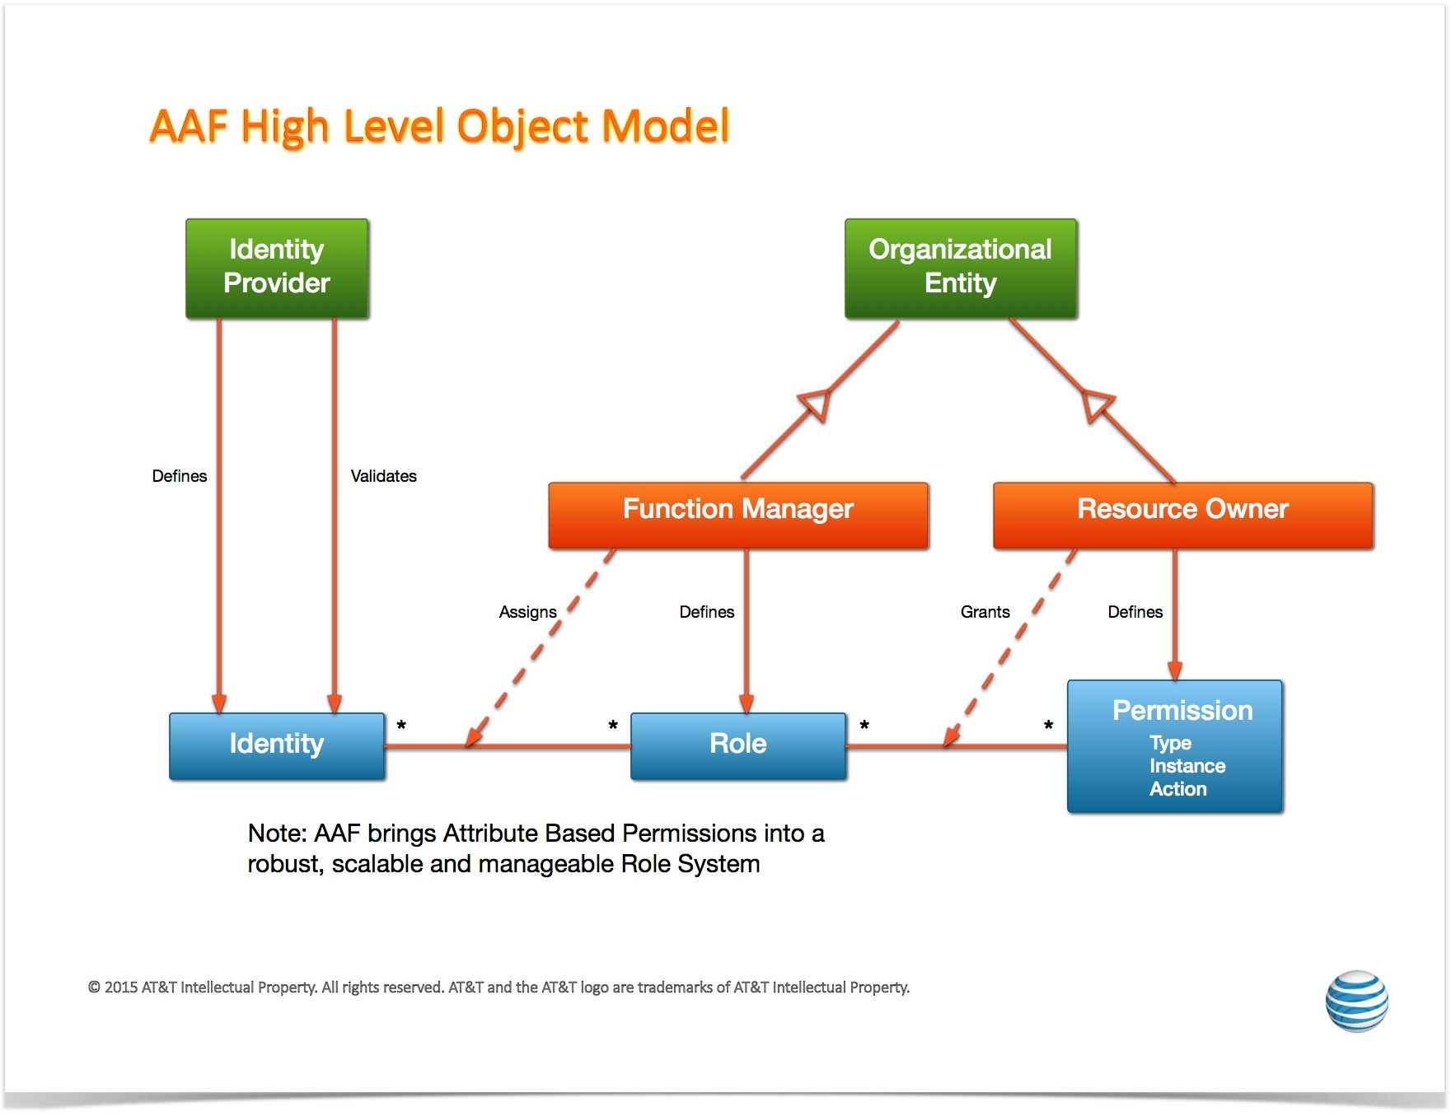
AAF Object Model

Slide 16
DMaaP Functional Description
Data movement as a platform(DMaaP) is a premier platform for high performing and cost effective data movement services that transports and processes data from any source to any target with the format, quality, security, and concurrency required to serve the business and customer needs.
DMaaP consists of three major functional areas:
  Data Filtering - the data preprocessing at the edge via data analytics and compression to reduce the data size needed to be processed.
  Data Transport - the transport of data intra & inter data centers. The transport will support both file based and event based data movement. The Data Transport process needs to provide the ability to move data from any system to any system with minimal latency, guaranteed delivery and highly available solution that supports a self-subscription model that lowers initial cost and improves time to market.
  Data Processing - the low latency and high throughput data transformation, aggregation, and analysis. The processing will be elastically scalable and fault-tolerant across data centers. The Data processing needs to provide the ability to process both batch and near real-time data.
This service is build using Apache Kafka and Restful API is created for message publishing, subscribing and admin activities

Slide 17
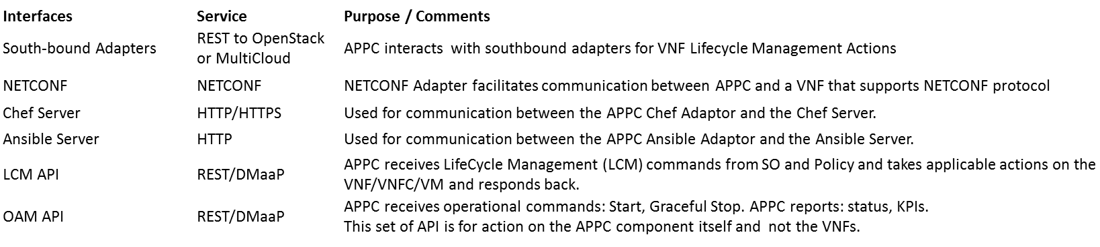
APPC (1/2)
Definition:
Application Controller (APPC) performs the functions to manage the lifecycle of VNFs and their components.
It provides a comprehensive set of controller actions such as Configure, Modify Configuration, Start, Stop, Migrate, Restart, Rebuild, and so on. Consult readthedocs documentation for the full set of APIs offered/supported.
It supports a set of standard VNF interfaces (Netconf, Chef, Ansible.), and
Is designed to be self-service using a model driven architecture that provides a layer of abstraction making APPC completely service, VNF, and site agnostic.
Information about the APPC architecture and provided APIs can be found in the APPC User Guide and LCM & OAM API Guides on readthedocs
.
Provided Interfaces: (refer to APPC User Guide for details)
APPC

Slide 18
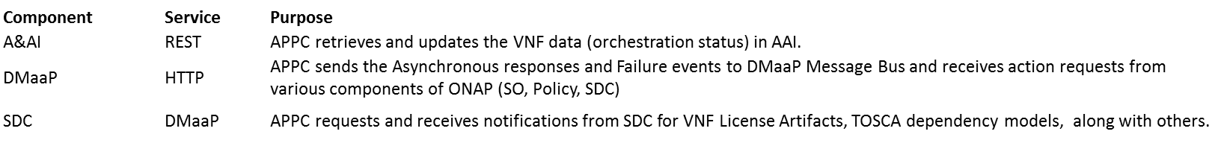
APPC (2/2)
Consumed Interfaces
APPC
Consumed Models:
TOSCA Dependency Model
APP-C also support a variety of models, most of which are created by the APPC Configuration Design Tool (CDT). Examples are:
  Reference Data Model (json)
  VNF Capabilities Model (json)
  Template Model (json or xml)
  Parameter Definition Model (yaml)

Slide 19
CLAMP (1/2)
Definition:
CLAMP is a platform for designing and managing control loops.
It is used to design a control loop, configure it with specific parameters for a particular network service,
then It interacts with other systems to deploy/undeploy and execute the control loop.
Information about the CLAMP architecture and provided APIs can be found in the CLAMP User Guide and LCM & OAM API Guides on readthedocs
Provided Interfaces: (CLAMP doesn’t expose functional relates API’s except the one below, refer to CLAMP documentation for more details)
Interfaces Service Purpose/Comments
HealthCheck REST Health Check of CLAMP instance
CLAMP

Slide 20
CLAMP (2/2)
Consumed Interfaces:
Interfaces Service Purpose/Comments
SDC REST Distribution of service to DCAE
DCAE REST Common Controller Framework
Policy REST(JSON data) Create Configuration and Operational policy
CLAMP
Consumed Models: (No specific models were used in the above interface except for Policy(json))

Slide 21
Use-case UI
Definition:
Provides portal for service life cycle management
Provides portal for VNF alarm and performance
Provides portal for VM alarm and performance
None
Usecase UI
Provided Interfaces:
None
Catalog Synchronization Interface
Service Orchestrator Interface
Inventory Service Interface
NS/VNF Onboard Interface
Service Registration Interface
Data Subscription Interface
Note: Can be more than one page

Slide 22
Use-case UI
Consumed Interfaces:
Catalog Synchronization Interface, from: SDC
Service Orchestrator Interface, from: SO
Inventory Service Interface, from: Available and Active Inventory
NS/VNF Onboard Interface, from: VF-C
Service Registration Interface, from: MSB
Data Subscription Interface, from: DMaaP
None
Usecase UI
Consumed Models:
Network Service Descriptor
VNF Descriptor
Catalog Synchronization Interface
Service Orchestrator Interface
Inventory Service Interface
NS/VNF Onboard Interface
Service Registration Interface
Data Subscription Interface
Note: Can be more than one page

Slide 23
ONAP CLI
Definition:
Provides Open CLI Platform (OCLIP) – Industry first Model-driven command line interface platform
Provides commands for performing end-end service on-boarding and life cycle management
Provides command console for Linux and web platforms.
micro-service discovery commands
external system and VNF cloud on-boarding commands
customer and subscription management commands
resource on-boarding commands
Product and service management commands
network service life-cycle management commands
Provided Interfaces:
micro-service discovery
  Provides commands for micro service discovery and registration
external system and VNF cloud on-boarding
  Provides commands for registering/unregistering VIM, VNFM, EMS and SDNC
customer and subscription management
  Provides commands for subscription and service-type life cycle management
resource on-boarding
  Provides commands for adding VNF modules
Product and service management
  Provides commands for design time creation and management of VF and NS
network service life-cycle management
  Provides commands for creating and managing Network services (NS)
ONAP CLI
micro-service discovery Interface (MSB)
external system and VNF cloud on-boarding interface (AAI)
customer and subscription management interface (AAI)
resource on-boarding interface (SDC)
Product and service management interface (SDC)
network service life-cycle management interface (SO)
Consumed interface Interfaces:
REST API from SDC, SO, AAI, MSB.
Consumed Models:
- Open Command Specification (OCS) 1.0

Slide 24
Microservices Bus (1/2)
Service Registration REST Interface
Service Discovery RES Interface
JAVA SDK for Service Registration/Access
Definition:
Provides a reliable, resilient and scalable communication and governance infrastructure to support ONAP Microservice Architecture(OMSA).
Provides RESTFul API for service registration/discovery
Provides JAVA SDK for service registration and access
Provides a transparent service registration proxy with OOM-Kube2MSB
Provides a transparent service communication proxy which handles service discovery, load balancing, routing, failure handling, and visibility-Internal API Gateway(Implemented) and Mesh Sidecar(WIP)
Provides an External API Gateway to expose ONAP services to the outside world
Micro Services Bus / Data Movement
Interface N

Slide 25
Microservices Bus (2/2)
Service Registration REST Interface
Service Discovery RES Interface
JAVA SDK for Service Registration/Access
Provided Interfaces:
Service Registration REST Interface
  Provides the RESTFul interface to register ONAP services.
Service Discovery REST Interface
  Provides the RESTFul interface to discover ONAP services.
JAVA SDK
  Provides JAVA SDK to register ONAP services.
  Provides JAVA SDK to access ONAP services.
  Note: ONAP components don' t need interfaces to leverage the transparent service registration proxy and communication proxy.
Micro Services Bus / Data Movement
Interface N
Consumed interface Interfaces: (None)
Consumed Models:
Swagger for RESTFul APIs definition
Service definition in kubernetes config files for Kube2MSB service registration

Slide 26
Microservices Bus Updated With Swagger SDK(1/2)
Service Registration REST Interface
Service Discovery RES Interface
JAVA SDK for Service Registration/Access
Swagger SDK
Definition:
Provides a reliable, resilient and scalable communication and governance infrastructure to support ONAP Microservice Architecture(OMSA).
Provides RESTFul API for service registration/discovery
Provides JAVA SDK for service registration and access
Provides a transparent service registration proxy with OOM-Kube2MSB
Provides a transparent service communication proxy which handles service discovery, load balancing, routing, failure handling, and visibility-Internal API Gateway(Implemented) and Mesh Sidecar(WIP)
Provides an External API Gateway to expose ONAP services to the outside world
Swagger SDK for auto-generate the client SDK in different languages for every micro-services in ONAP. Also it deploys the generated SDK into the nexus.
Micro Services Bus / Data Movement
Interface N

Slide 27
Microservices Bus Updated With Swagger SDK(2/2)
Service Registration REST Interface
Service Discovery RES Interface
JAVA SDK for Service Registration/Access
Swagger SDK
Provided Interfaces:
Service Registration REST Interface
  Provides the RESTFul interface to register ONAP services.
Service Discovery REST Interface
  Provides the RESTFul interface to discover ONAP services.
JAVA SDK
  Provides JAVA SDK to register ONAP services.
  Provides JAVA SDK to access ONAP services.
  Note: ONAP components don' t need interfaces to leverage the transparent service registration proxy and communication proxy.
Swagger SDK
  provides Mvn plug-in settings for (JAVA)client sdk generation
Micro Services Bus / Data Movement
Interface N
Consumed interface Interfaces: (None)
Consumed Models:
Swagger for RESTFul APIs definition
Service definition in kubernetes config files for Kube2MSB service registration

Slide 28
Optimization Framework - R2 (1/4)
Definition:
ONAP Optimization Framework (OOF) provides functionality for creating and running optimization applications by leveraging a policy-driven, declarative approach.
Supports different specializations (applications) with specific domain and optimization needs.
Initial specialization scopes include, but are not limited to, VNF placement support via Homing and Allocation Service (HAS) with different use cases, and change management scheduling service.
  For R2, the OOF will support vCPE use case (as a MVP).
  For R2, the OOF will demonstrate an example of Change Management Scheduling Optimization using the OOF design framework with simple, representative constraints.
Service Orchestrator (SO)
Change Management Portal
Optimization Framework (OOF)
Provided Interfaces:
Placement Optimization Interface
  Provides functionality for the Service Orchestrator to specify placement services [vCPE use case]
Change Management Portal Interface
  Provides functionality for calculating schedules that satisfy time constraints and conflicts [R2 focus on a demonstration of the design framework; alignment with Change Management scheduling use case]
Policy Interface
Inventory Service Interface
Service/Policy Models Interface
Infrastructure Metrics Interface
Consumed Interfaces:
Policy Interface, from: Policy
Inventory Service Interface, from: Available and Active Inventory
Service/Policy Models Interface, from: SDC
Infrastructure Metrics Interface, from: Multi Cloud
Consumed Models:
Policy Models (constraints) and License Models from: SDC
Infrastructure Metrics Models, from: Multi Cloud

Slide 29
Optimization Framework - R3+ (2/4)
Note on Functionality for R3 and beyond:
While the items listed below are not part of MVP for R2, the OOF team is initiating discussions and collaborations on these during the R2 time frame, so that the OOF is aligned with the use cases that will mature in R3 and beyond.
Service Orchestrator (SO)
Change Management Portal
Additional Definitions for R3 and beyond:
For R3 and beyond, the OOF will focus on supporting multiple R3 and beyond use case (along with R2 use cases)
[supporting VoLTE, VNF/Service scale-in/out (higher order control loop), and RAN-5G].
Synchronization with Change Management Scheduling use case.
Providing additional sample/example optimization applications as documentation.
Proving initial Knowledge Base on OOF (building blocks and recipes for creating complex applications).
Further alignment with S3P objectives.
Optimization Framework (OOF)
Additional Provided Interfaces for R3 and beyond:
Placement Optimization Interface
  For R2, the focus is on supporting vCPE use case;
  for R3 and beyond, the OOF will also support VoLTE, VNF/Service scale-in/out (higher order control loop), and RAN-5G.
Change Management Portal Interface
  For R2, the focus is on a demonstration of OOF with simple, representative constraints;
  this effort will be aligned with the Change Management scheduling use case (for R3 and beyond)
Policy Interface
Inventory Service Interface
Service/Policy Models Interface
Infrastructure Metrics Interface
R3 and Beyond
Application Metrics Interface
Additional Consumed Interfaces for R3 and Beyond:
Application Metrics Interface, from: DCAE [R3 and Beyond]
These are in addition to Policy, Inventory, SDC Models, and Infrastructure metrics from R2
Additional Consumed Models for R3 and beyond:
Application Metrics Models, from: DCAE

Slide 30
Optimization Framework - Interface Definitions (3/4)
Optimization Request Interface
Provided Service | Homing Service API (HAS-API)
Supplementary Information | The OOF will provide a list of possible candidates for placement, which the service orchestrator can use to instantiate the service
Interface Provider(s) | Optimization Framework
Provided Capabilities | Optimization Information Request

Slide 31
Optimization Framework - Interface Definitions (4/4)
Scheduling Optimization Request Interface
Provided Service | Change Management Scheduling API (CMSO API)
Supplementary Information | The OOF will provide a possible schedule of VNF actions (e.g. upgrades) that satisfy the constraints on availability periods and constraints related to conflicts
Interface Provider(s) | Optimization Framework
Provided Capabilities | Optimization Information Request

Slide 32
VNF SDK (VNF package validation) (1/2)
Here we put the services provided
Definition:
Provides functionality to upload, verify, and download VNFs
VNF Vendors upload VNFs through the Marketplace portal
Marketplace runs package validation tests
VNFs are made available for Onboarding
Marketplace API
Marketplace API:
Upload/Re-upload VNF
  Upload VNFs to the Marketplace
Download VNF
  Download VNFs
Query VNF
  Query VNFs by CSAR ID or conditions (name, version, type, provider)
Delete VNF
  Delete VNF from the Marketplace
VNF SDK Marketplace
Consumed Models: SOL-004 (Beijing)
Note: Can be more than one page

Slide 33
VNF SDK - Interface Definitions (2/2)
Marketplace API
Provided Service | Upload, Download, Query, Delete
Supplementary Information | The VNFSDK APIs are documented on the ONAP Wiki: https://wiki.onap.org/display/DW/API+Documentation
Interface Provider(s) | VNF SDK Marketplace
Provided Capabilities | VNF Pre-onboarding upload/download/validation/query/delete

Slide 34
VF-C Components
SO
Policy
UUI
Os-Ma-nfvo
NFVO Functions
Support NS Lifecycle Management including NS instantiate, scale, heal, operate (query /update/…)and terminate. In R1, most of NSLCM interfaces align with SOL005 Os-Ma-nfvo reference point
Support integration with multi VNFMs via drivers which include vendors VNFM and generic VNFM. The interfaces between NFVO and driver comply with Or-Vnfm reference point.
Support integration with multi VIM via Multi-Cloud
In R1, NFVO also supports integration with vendor EMS via driver
NFVO
VNF Package
( VNFD)
NS Package
( NSD)
Instantiate
Terminate
Scale
Operate
Heal
Or- Vnfm
Or- Vnfm
Driver
Driver
SVNFM
Or-Vi
GVNFM
EMS
Vi-Vnfm
Multi-Cloud
Vi-Vnfm
Vi-Vnfm
NFVI&VIM

Slide 35
VF-C – NFVO (1/2)
Network Service LCM Interface
VNF Operation Granting Interface
NS package management Interface
VNF package management interface
Definition:
Provides reference implementation of NFVO in ETSI MANO architecture
Provides Network service life cycle management
Provides NS/VNF layer’s FCAPS management
NFVO
Provided Interfaces:
Network Service LCM interface
  Provides Network Service LCM interface
  (NS create/instantiate/scale/heal/terminate/delete/query)
VNF Operation Granting interface
  Provides VNF Operation Granting interface and make granting decision
NS package management interface
  Provides runtime NS package management interface
VNF package management interface
  Provides runtime VNF package management interface
VNF LCM Interface
Inventory Service Interface
Catalog Synchronization interface
Generic VIM Interface
Date report interface
Tosca parser interface
Optimization Request Interface
Note: Can be more than one page

Slide 36
VF-C – NFVO (2/2)
Network Service LCM Interface
VNF Operation Granting Interface
NS package management interface
VNF package management interface
Consumed Interfaces:
VNF LCM Interface, from: Generic NF controller, SVNFM
Inventory Service Interface, from: Available and Active Inventory
Catalog Synchronization Interface, from: SDC
Generic VIM Interface, From: Multi-cloud
Data report Interface, From: DCAE
Tosca parser Interface, From: Modeling
Service registration and discovery, From: MSB
Optimization Request Interface, from: Optimization Framework -TBD
NFVO
VNF LCM Interface
Inventory Service Interface
Catalog Synchronization interface
Generic VIM Interface
Data report interface
Tosca parser interface
Optimization Request Interface
Consumed Models:
Network Service Descriptor
VNF Descriptor
VES data format
Bpmn Workflow
Note: Can be more than one page

Slide 37
VF-C - GVNFM
Definition:
Provides the Generic VNFM
Provides the VNF life cycle management
Supports NFVO to implement Network service LCM management
VNF LCM Interface
VNF Package management interface
GVNFM
Provided Interfaces:
VNF LCM interface
  Provides the VNF LCM interface(VNF instantiate/scale/terminate/query)
VNF Package Management interface
  Provides runtime VNF Package management interface
Catalog and notification Interface
Inventory Interface
Tosca parser Interface
Generic VIM Interface
VNF config interface
Consumed interface Interfaces:
Catalog and notification Interface, from: NFVO
Inventory Interface, from: A&AI
Tosca parser Interface, From: Modeling
Generic VIM Interface, From: Multi-cloud
Service registration and discovery, From: MSB
VNF Config interface: from VNF -TBD
:
Note: Can be more than one page
Consumed Models
VNFD

Slide 38
ONAP Portal
Definition:
Portal is a platform that provides the ability to integrate different ONAP applications into a centralized Portal Core.
It allows decentralized applications to run within their own infrastructure while providing common management services and connectivity.
It provides capabilities including application onboarding & user management, and hosted application widgets.
Using the provided SDK, application developers can leverage the built-in capabilities (Services / API / UI controls) along with bundled tools and technologies.
Portal Admin Interfaces
SDK Jars (Policy, VID, AAI, and SDC)
ONAP Portal
Provided Interfaces:
Portal Admin Interfaces
  Onboarding and User management
SDK Module
  SDK will be used as a base for any ONAP application being built.
  Components using SDK jars: Policy, VID, AAI, and SDC
  SDK bundles together a host of different tools, technologies, and standards that will assist the teams during the development phase.
  SDK includes reusable UI components, authentication & authorization components, visualization & reporting engine, collaborative services, workflow manager, GIS / Map, web component, and widget development framework.
AAF
Consumed interface Interfaces:
Restful APIs for fetching available roles to portal’s onboarded application users. from: AAF
38

Slide 39
Logging-analytics (1/2)
Definition:
Provides ELK stack where logs are streamed from filebeat sidecar containers per component
Kibana
Logging-analytics
Provided Interfaces:
Kibana UI:
  dashboard for indexed logs
Logstash:
  Consumes logs pushed by filebeat containers into elasticsearch indexer
filebeat
Consumed interface Interfaces:
Filebeat container per microservice exposing logs through a Kubernetes PV:
Consumed Models: none

Slide 40
Logging-analytics (2/2)
Logging-analytics Interface
Provided Service | Kibana dashboard, search service on top of elaticsearch index of ONAP logs – via filebeat
Supplementary Information
Interface Provider(s) | AA&I, APPC, SO, Policy, Portal, SDC, SDNC, VID
Provided Capabilities | Search logs using lucene search format Dashboard of configurable search views of logs

Slide 41
Multi-Cloud Adaptation (1/2)
Definition:
enable ONAP to deploy and run on multiple infrastructure environments, including OpenStack and its different distributions, public and private clouds, and micro services containers, etc.
provide a Cloud Mediation Layer supporting multiple infrastructures and network backends so as to effectively prevents vendor lock-in.
decouple the evolution of ONAP platform from the evolution of underlying cloud infrastructure, and minimizes the impact on the deployed ONAP while upgrading the underlying cloud infrastructures independently.
Resource LCM Interface
VIM registry/un-registry Interface
VIM FCAPS management Interface
  VIM capacity/capability query
Multi-Cloud adaptation
Provided Interfaces:
Resource LCM interface
    Support VNF instantiation/termination
    (Resource create/delete/update/query)
VIM registry/un-registry Interface
  Support registry/un-registry of multiple clouds
  (VIM create/delete/update)
VIM FCAPS management Interface
  Support FCAPS required data collection, event/alert/metrics federation functions
  (message pub/sub)
  VIM capacity/capability query
    Support placement and scheduling purpose
    (capacity/capability query/report)
ONAP Interface
  Inventory Service Interface
  DMAAP interface
  Logging interface
The third party Cloud interface
  OpenStack Interface
  VMware VIO interface
  Wind River Titanium Interface

Slide 42
Multi-Cloud Adaptation (2/2)
Consumed Interfaces:
ONAP
  Inventory Service Interface from Available and Active Inventory
  Message pub/sub interface from DMAAP
  Logging interface from Logging project
The third party Cloud API
    OpenStack Interface
      Ocata
      Mitaka
    VMware VIO interface (Ocata)
    Wind River Titanium Interface (Mitaka)
Resource LCM Interface
VIM registry/un-registry Interface
VIM FCAPS management Interface
  VIM capacity/capability query
Multi-Cloud adaptation
ONAP Interface
  Inventory Service Interface
  DMAAP interface
  Logging interface
The third party Cloud interface
  OpenStack Interface
  VMware VIO interface
  Wind River Titanium Interface
Consumed Models:
Existing
  VES data format
Underworking
  Hierarchical Infrastructure Resource Information Model
  FCAPS Data Model

Slide 43
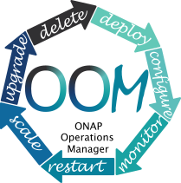
ONAP Operations Manager (OOM)
Definition: OOM is the life cycle manager of the ONAP platform (i.e. SDC, SO, SDNC, etc.). OOM uses the Kubernetes container management system and Consul to provide the following functionality:
  Deployment - with built-in component dependency management (including multiple clusters, federated deployments across sites, and anti-affinity rules)
  Configuration - unified configuration across all ONAP components
  Monitoring - real-time health monitoring feeding to a Consul GUI and Kubernetes
  Restart - failed ONAP components are restarted automatically
  Clustering and Scaling - cluster ONAP services to enable seamless scaling
  Upgrade - change-out containers or configuration with little or no service impact
  Deletion - cleanup individual containers or entire deployments
OOM supports a wide variety of cloud infrastructures to suit your individual requirements.
Interface 1
ONAP Operations Manager
Provided Interfaces: Consul GUI for health monitoring, Kubernetes CLI for platform management
Consumed interface Interfaces: None
Consumed Models: ONAP Deployment Specifications, ONAP Component Configuration Artifacts
Interface N

Slide 44
Policy Framework (1/2)
Policy CRUD interface
Policy deployment interface
Policy model CRUD interface
Definition:
Provides a logically centralized environment for the creation and management of modifiable configurations, rules, assertions and/or conditions to provide real-time decision making on conditions and events that underlie ONAP’s control, orchestration, and management functions
Supports specification, decomposition, distribution and enforcement for various types of policies such as microservice configuration policy, operational policy, decision policy, guard policy, etc.
Policy scopes include, but are not limited to, infrastructure/network management, products and services, operation automation, and security.
Policy Framework
Provided Interfaces:
Policy CRUD interface:
  Provide UI and API options to create/query/update/delete configuration, decision and operational policies
Policy deployment interface:
  - Provide UI and API options to deploy configuration, decision and operational policies
Policy model CRUD interface:
  Provide UI and API options to create, query, update and delete policy models
Message Router Pub/Sub Service Interface
Service Registration/Discovery Interface
VNF/VM LCM Interface
NF Config Interface
Inventory Service Interface
Network Service LCM Interface
Service Distribution Interface

Slide 45
Policy Framework (2/2)
Policy CRUD interface
Policy deployment interface
Policy model CRUD interface
Consumed interface Interfaces:
Message Router Pub/Sub Service Interface, from: Data Movement as a Platform
Service Registration/Discovery Interface, from: Microservices Bus
VNF/VM LCM Interface, from: Generic NF controller
NF Config Interface, from: Generic NF controller
Inventory Service Interface, from: Available and Active Inventory
Network Service LCM Interface, from: Service Orchestrator
Network Service LCM Interface, from: Virtual Controllers (APPC and VFC)
Service Distribution Interface, from: Service Design & Creation
Policy Framework
Message Router Pub/Sub Service Interface
Service Registration/Discovery Interface
VNF/VM LCM Interface
NF Config Interface
Inventory Service Interface
Network Service LCM Interface
Service Distribution Interface
Consumed Models
Operational policy model
Configuration policy model
Resource model in the catalog
Service model in the catalog

Slide 46
Backup Slides

Slide 47

ONAP Target Architecture
(High-Level Functional View)
OSS / BSS
CLI
U-UI
ONAP Portal
ONAP External APIs
DESIGN-TIME
Dashboard OA&M
RUN-TIME
Resource Onboarding
Common
Services
Policy Framework
Data Collection, Analytics, and Events
Event Correlation
Active & Available Inventory
External Registry
Common Services
Orchestration
Service Design
Application
Authorization
Framework
Policy Creation & Validation
ONAP Operations Manager
Analytic Application Design
Micro Services Bus / Data Movement (see Note 1)
VNF / PNF Onboarding
ONAP Optimization Framework
Closed Loop Design
Change Management Design
Generic NF Controllers (L4-L7)
Logging
Multi-Cloud
Adaptation
SDN Controller
(L0-L3)
Design Test & Certification
Configuration & Life Cycle Management
Others
CCSDK
(see Note 1)
(see Note 1)
Catalog
Optional External Systems
3rd Party Controller
Specific VNF Manager
Element Management System
…
Managed Environment
Network Function Layer
Recipe/Eng Rules & Policy Distribution
ONAP Optimization Framework
VNFs
PNFs
Hypervisor / OS Layer
OpenStack
VMware
Azure
Kubernetes
RackSpace
Note 1 – Consistent APIs between Orchestration layer and Controllers
MPLS
IP
Private
Edge Cloud
Private
DC Cloud
Public
Cloud

Slide 48
ONAP Orchestration Alignment

Slide 49
ONAP Orchestrator Functions (1/2)
Orchestrate Network Functions (VNF/PNF), and Network Services (NSes), and services provided by the managed environment
Coordinate cross-controller activities driven by orders and events to
  LCM (instantiate/modify/upgrade/configure/remove) VNFs/PNFs, Nses, and services from the managed environment
  perform multi-control layer remedy actions.
Key Attributes of Orchestrator:
Model Driven Orchestration
  Process behavior driven by resource / service model designed in SDC
  Orchestrates network functions and service LCM (Instantiations, ..) , including compound / nested services (parts already in R1)
    Nesting may be domain-specific orchestrator (does not require SO clone)
  Support software upgrade and planned change management
  Support open & closed-loop control actions initiated by DCAE /Policy or external API (e.g. OSS for Open Loop)
  Tracks orchestrated activity for the life of the request but doesn’t control state of orchestrated components

Slide 50
ONAP Orchestrator Functions (2/2)
Interfaces to External OSS / BSS Systems
  Standard APIs exposed northbound to create, modify or remove services and resources
  Request decomposition of service request into service / network function components
  Selects model / recipe that supports the request and maps order data to recipe / model
Coordinating Activities Across Various ONAP Controllers
  Manage recording of service configurations
Coordinating Activities across vendor-specific clouds using the Multi-Cloud adaptation layer
- Multi-Cloud Adaptation Layer supports a Cloud Agnostic Model while hiding infrastructure details
- Multi-Cloud Adaptation Layer is flexible to support Cloud vendor-specific capabilities if needed
Orchestrator Performs Following Additional Services
  Coordinates current inventories and placement/optimization recommendations
  Enforces business & technical policies
  Support standards-based workflows
  Validates and records network functions / service implementations

Slide 51
Examples of Orchestration Requests (1/2)
Install/Configure a single network function (VNF or PNF) – e.g. Deploy a new virtual PE / P router
  A virtual network element might have one or more components (e.g VNFCs or VDUs)
Install multiple copies of network functions in one or more data centers – e.g. Deploy new virtual PE / P routers across multiple locations
Deploy one or more instances of network services – e.g. RAN at Multiple sites, one or more sites of EPC, etc.
Deploy E2E network services (e.g. RAN + EPC + IMS) and services from the managed environment
Instantiate and LCM a customer services – e.g. multi-site VPN or IP SEC
  Could require deploying new instances of network elements (e.g. vCE) and using existing elements (e.g. vPE)
  Could be using existing elements without any new VNF / PNF being deployed (e.g. “Allocated Resources” – configuring a service to existing components)

Slide 52
Examples of Orchestration Requests (2/2)
Create a new instance of a network slice segment
  Could be leveraging existing network services (RAN, vEPC, etc.)
Create a new instance of a network service slice – e.g. IoT or eMBB slice
  Could be leveraging previously created network slice segments
Implement a software upgrade / change management
  Could require Coordination of activities across SDN-C/app-C/VF-C controllers
  Could require Coordination across vendor-specific clouds using the Multi-Cloud adaptation layer
Orchestrate remedial actions requested as part of Closed or open loop action
  Could require adding new compute / network resource to the existing functional elements (i.e. VNF)
  Create a new instance of VNF and migrate traffic
  Could require Coordination of activities across SDN-C/App-C/VF-C controllers
  Could require Coordination across vendor-specific clouds using the Multi-Cloud adaptation layer

Slide 53
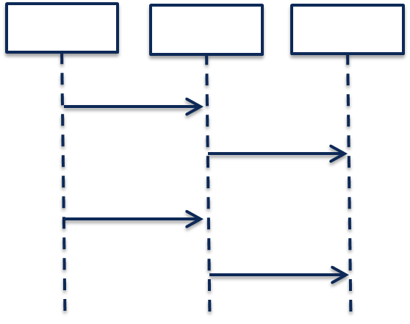
Model-Driven Orchestration (Recursive Structure)
“Generic” model-driven Service flow
Each Resource Type has its own “Generic” model-driven flow. There currently exist such flows for “VNF” and “Network” Resource Types.
Service Orchestration
Resource Orchestration
Cloud Resource Orchestration
PNF
Service X:
topology_template:
node_templates:
PNF
Network
VNF
Allotted Resource
Network
VF Module
Note recursion
VNF
Service Orchestration
Resource Orchestration
Allotted Resource
requirement: A
PNF
An Allotted Resource can be homed to an existing “underlying” network function or Service Instance, or homing could determine that a new network function Service Instance is needed. This would result in a 2nd level of Service Orchestration.
Service Y:
topology_template:
node_templates:
PNF
Network
VNF
Allotted Resource
capability: A
Network
Service Y is being treated as a “Resource” from the perspective of Service X.
VNF
Allotted Resource

Slide 54
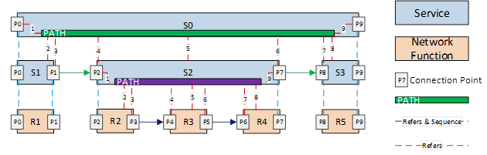
Nested / Compound Services:
Service W:
topology_template:
node_templates:
VNF_W
Service_X
Service X:
topology_template:
node_templates:
VNF_X
Service_Y
Service Y:
topology_template:
node_templates:
VNF_Y
Service_Z
Service Z:
topology_template:
node_templates:
VNF_Z

Slide 55
Conclusions
Service Providers require the ability to define Services that can be leveraged by higher order Services and other compounded services / segments / slices.
Consistent with ETSI MANO, ONAP should NOT separate Service Orchestration and Resource Orchestration into two separate named components, because each Resource can be exposed as a Service
      What appears as a “Resource” from one Service’s perspective, may actually be a Service from another perspective
      In Addition, ONAP scope is much broader than ETSI MANO (MANO limited to Cloud infrastructure services and management of VNF as a basic resource (ignoring the application of the VNF)), therefore SO should support full orchestration scope of ONAP
      To achieve alignment with MANO for common functionality, SO should expose APIs for basic resource onboarding/LCM (VNF) . This is SOL-001, SOL-004 and SOL-005.
      Or simple network service onboarding/LCM (composed of one or more VNFs) and related models. In addition, ONAP SO should Support “Service reuse” to drive model driven run-time behavior for complex services:
        Compounded Services (e.g. Residential vCPE, Network Slicing Segments, etc.)
        Nested Services (e.g., E2E Slice)
      ONAP should provide Service Providers deployment flexibility to address scalability, geographic distribution and redundancy / resiliency
        But should not impose extra complexity and cost on service providers by separating service / resource orchestration that provides little known benefit

