Slide 1
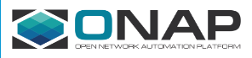
Achieving “Alignment” Between ONAP and ETSI MANO
DRAFT FOR DISCUSSION
Gil Bullard, AT&T
March 28, 2018

Slide 2
Scope of ETSI Relative to Scope of ONAP
ONAP and ETSI have differing scopes, with ETSI scope being a proper subset of ONAP scope
DRAFT FOR DISCUSSION
ONAP Functional Scope
BSS/OSS
Os-Ma-nfvo
NFV Orchestrator (NFVO)
ETSI Functional Scope
NFV
Service Catalog
VNF
Catalog
NFV Instances
NFVI Resources
Or-Vnfm
EM
Ve-Vnfm-em
VNF Manager (VNFM)
Intersecting Scope
VNF
Ve-Vnfm-vnf
Vi-Vnfm
Vn-Nf
Virtualised Infrastructure
Manager
(VIM)
NFVI
Or-Vi
Nf-Vi

Slide 3
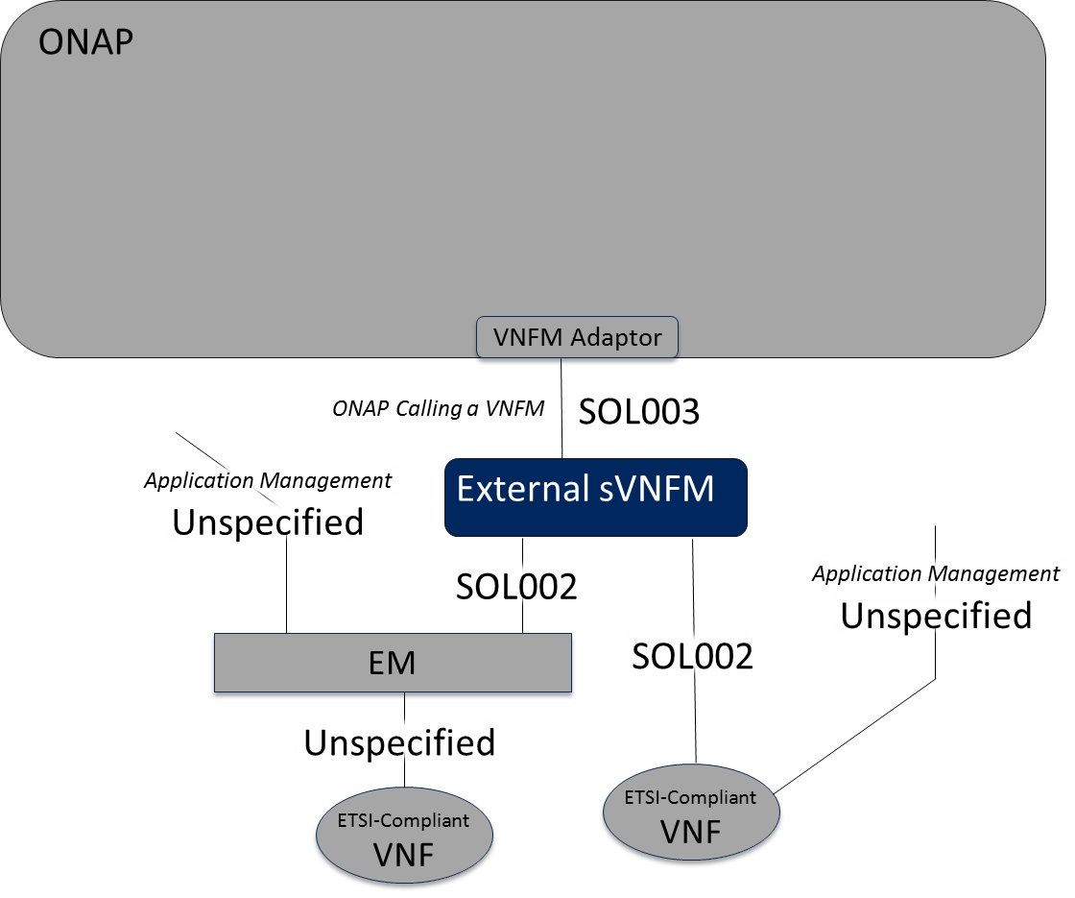
Role of the VNFM Adaptor
“Plugging In” a VNFM Into ONAP
Automatic “Ack” for any “Grant” request originating in ONAP (instantiate, terminate, scale)
Update A&AI
Determine and Route to Proper VNFM Instance
Map ONAP Data for VNFM Use
VNFM Adaptor
DRAFT FOR DISCUSSION
SOL003
Create/Delete VNF Identifier
Query VNF, LCN Notify
Grant Lifecycle Operation
Heal VNF
Operate VNF/Custom
Instantiate/Scale/Terminate VNF
Change VNF Flavor (Software)
Load VNF CSAR into VNFM
Modify VNF (Info, Connectivity)
External VNFM

Slide 4
Instantiate Example
“Plugging In” a VNFM Into ONAP
SO Service Level and VNF Loop Level Workflows not shown for simplicity.
SO
SO Internal: VNF Level Workflow
SO sends to a VNF-level request to a sub-orchestration process to “create” the VNF. The “Routing/Proxy” function determines the endpoint.
Instantiate VNF
(with optional
data attributes)
Gathers assignments and other input data and maps to VNFM format.
DRAFT FOR DISCUSSION
VNFM can ignore the VF Module structure if it likes, because the network assignments passed to it would be organized by VM.
Assign VNF
In the internal ONAP case, it is an SO sub-flow that loops through the modules and calls MultiVIM on a per-VF Module basis.
Routing
Proxy
VNF-Level
Configure VNF
(application level)
SDNC
VNFM Adaptor
VNF-Level
SOL003 (CreateVnfId, Instantiate, Grant)
SO Internal: VF Mod Loop Level WF
Loop through VF Modules
VNFM
Doesn’t necessarily care about VF Modules
The VF Module level looping would be moved down from the VNF Level Workflow to the sub-flow.
Gen NFC
Per VF-Module for Scaling (data attributes map to HEAT ENV for example)
Deployment Data
MultiCloud
VIM
VNF
Notes:
Takeaway: Implement a “Plug In” of a VNFM such that ONAP can perform that functionality that is outside of the scope of the VNFM. For example:
For a “plugged in” VNFM, ONAP OOF will perform homing, SDNC make assignments, and Gen NFC apply application level configuration.
Leverage ONAP telemetry collection (DCAE) and analytics (Policy) to determine the need to scale and the scale increments, and disable in the VNFM the “auto-scale” capability. (VNFM will support “Scale” and “ScaleToLevel”.)
ONAP would delegate the appropriate functionality to the entity (a black box) on the other side of the VNFM Adaptor. The SDC model would indicate whether a particular Service/VNF should have some of its management functionality delegated via this API, in this example the interactions with the VIM to create the cloud resources.

Slide 5
Terminate Example
“Plugging In” a VNFM Into ONAP
SO: VNF Level Workflow
SO sends to a VNF-level request to a sub-orchestration process to “delete” the VNF. The “Routing/Proxy” function determines the endpoint.
Delete VNF
DRAFT FOR DISCUSSION
Handles the “Grant” request (automatic “ack”)
VNFM can ignore the VF Module structure if it likes, because the network assignments passed to it would be organized by VM.
Deconfigure VNF
(application level)
(e.g., remove VNF from usage pool)
In the internal ONAP case, it is an SO sub-flow that loops through the modules and calls MultiVIM on a per-VF Module basis.
Routing
Proxy
VNF-Level
AppC
VNFM Adaptor
Release VNF Assignments
VNF-Level
SOL003 (Grant, Terminate, DeleteVnfId)
SO: VF Mod Loop Level WF
Loop through VF Modules
VNFM
Doesn’t necessarily care about VF Modules
This is new
SDNC
Delete VF Module
Per Whatever for Scaling
Deployment Data
…or…
MultiVIM
VIM
VNF

Slide 6
Scale to Level Example (Scale Out)
“Plugging In” a VNFM Into ONAP
vVNF Scaling Level Definitions
Level 1 = {1 “Base” VF Module, 1 “Add-On” VF Module}
Level 2 = {1 “Base” VF Module, 2 “Add-On” VF Modules}
Level 3 = {1 “Base” VF Module, 3 “Add-On” VF Modules}
Etc…
SO: VNF Level Workflow
SO sends to a VNF-level request to a sub-orchestration process to “scale” the VNF. The “Routing/Proxy” function determines the endpoint.
Scale VNF
(Scale to Level = 3)
(with delta VM-level
assignment attributes)
Gathers assignments and other input data and maps to VNFM format.
VNFM can ignore the VF Module structure if it likes, because the network assignments passed to it are organized by VM.
Assign VNF
(Scale to Level=3)
DRAFT FOR DISCUSSION
In the internal ONAP case, it is an SO sub-flow that loops through the modules and calls MultiVIM on a per-VF Module basis.
Routing
Proxy
SDNC
VNFM Adaptor
Configure VNF
(application level)
SOL003 (ScaleToLevel, Grant)
SO: VF Mod Loop Level WF
Loop through delta VF Modules in VNF
VNFM
Doesn’t necessarily care about VF Modules
Determines if any VF Modules need to be added/assigned.
This is new
AppC
Per VF-Module for Scaling (data attributes map to HEAT ENV for example)
Per Whatever for Scaling
Deployment Data
…or…
MultiVIM
VIM
VNF

Slide 7
LCM Software Upgrade Example
“Plugging In” a VNFM Into ONAP
Application
Healthcheck
ConfigBackup
UpgradeSoftware
Application
Healthcheck
SO: Software Upgrade
Change Management
The sequence of orchestrated activities in SO
ApplicationHealthCheck, ConfigBackup, UpgradeSoftware, ConfigRestore
DRAFT FOR DISCUSSION
Routing
UpgradeSoftware
Proxy
ApplicationHealthCheck, ConfigBackup, UpgradeSoftware, ConfigRestore
VNFM Adaptor
SOL003 (ChangeFlavor, GetOperationStatus, etc.)
Controller (SDNC or Gen NFC)
VNFM
VNF
VNF

Slide 8
An Example VNF
vVNF
KEY
“Add-On VF Module”
Service vVNF
VM_{Bn+1}
1
VFC_{Bn+1}
1
0..8
Resource vVNF
VM_{Bn}
VFC_{Bn}
Assigned by SDNC, provided to NFVO
Each vVNF instance is comprised of 2-18 VM_{B} backend server VNFs.
Assigned by VNFM or Cloud Provider
The Load Balancer VFC_{A} must be configured with the intdataplane IP Address of each backed server VFC_{Bn}. This configuration is delegated to the VNFM as part of its “deployment data” configuration.
VM_{B2}
VFC_{B2}
extoam_net_id
VM_{B1}
VFC_{B1}
intdataplane_net_id
DRAFT FOR DISCUSSION
extdataplane_net_id
“Base VF Module”
VM_{A}
VFC_{A}

Slide 9
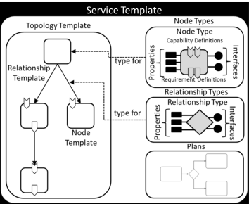
Distributed Orchestration Implementation Approach (Single ONAP Instance)
VNF & Sub-VNF Orchestration Federation Example
Orchestration Instance 1
The VNF-level flow calls the functional API “X” irrespective of Deployment Variation. The SDC Model drives a “routing function” which calls the specific implementation to be used per Resource type.
VNF-Level Flow
X
The equivalent functionality of BBx could alternately be implemented in something other than SO. This implementation also requires a local proxy to make the remote call and perhaps to map the interface. When calling a VNFM, BBx-p2 would adapt the “X” input to a (perhaps modified) SOL003 API call (“Y”).
DRAFT FOR DISCUSSION
Model Driven Routing Function
X
X
X
VF Module-Loop Level Flow
BBx
Remote Proxies
BBx-p1
BBx-p2
X
Y
Proxy encapsulates the application level interface in a remote API call.
Orchestration Instance 2 (Optional)
Non-SO Implementation (e.g., VNFM)
This subflow BBx implementation can execute either locally or remotely, though remote execution requires a local proxy to make the remote call.
Fx
Equivalent Sub-VNF Functionality
VF Module-Loop Level Flow
BBx

Slide 10
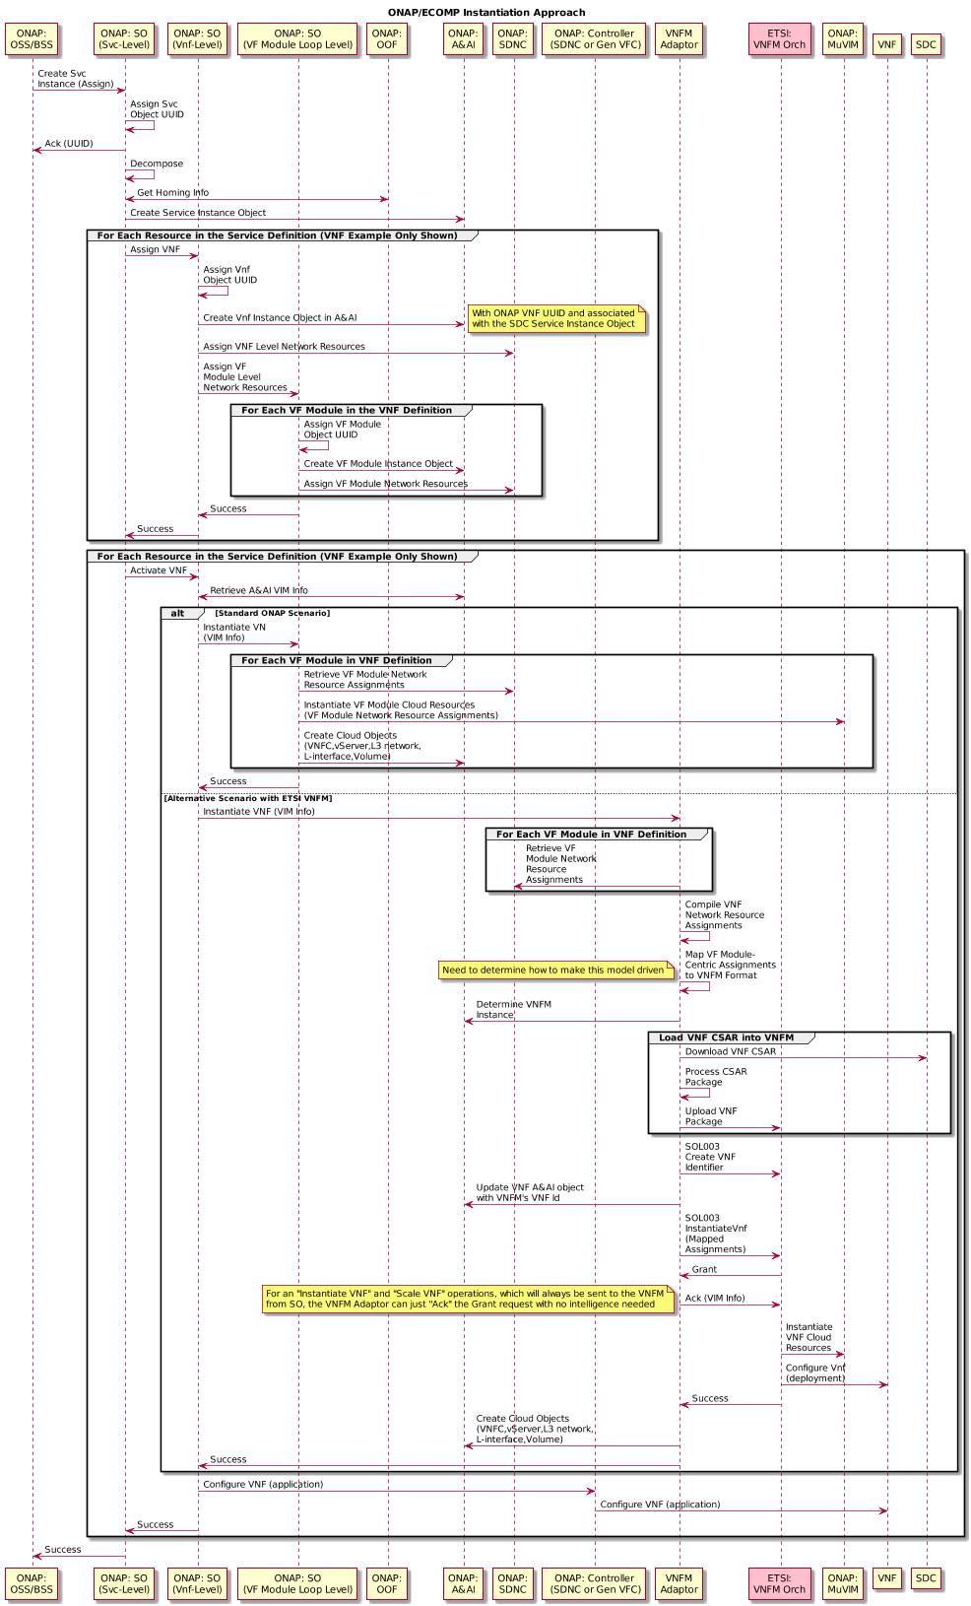
ONAP Standard Flow, with Alternative Flow Shown Whereby a VNFM Plugged into SO
DRAFT FOR DISCUSSION

Slide 11

Service Level and VNF Assignments
Level Processing
DRAFT FOR DISCUSSION
Continued on next slide

Slide 12
Standard ONAP Processing
VNF Creation (with optional deployment parameter configuration)
Continued from prior slide
DRAFT FOR DISCUSSION
Continued on next slide

Slide 13
Alternative Flow with VNFM
Plugged into SO (Part 1)
Continued from prior slide
DRAFT FOR DISCUSSION
Continued on next slide

Slide 14
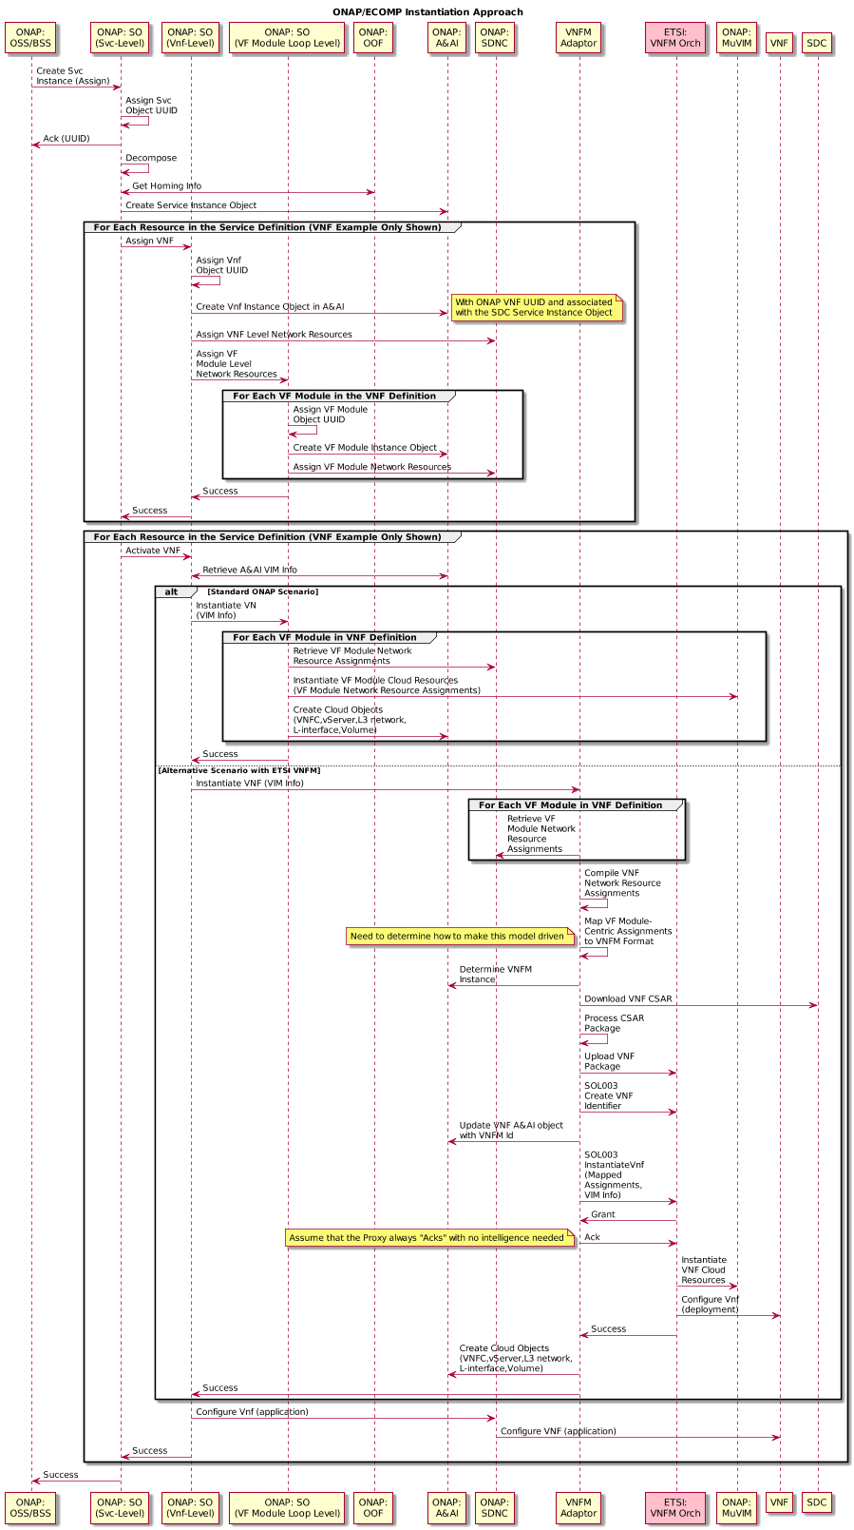
Alternative Flow with VNFM
Plugged into SO (Part 2)
Continued from prior slide
DRAFT FOR DISCUSSION
Continued on next slide

Slide 15
Return to Common Flow in ONAP for Application Configuration
Continued from prior slide
DRAFT FOR DISCUSSION

