Slide 1
ONAP Reference Architecture for R2 and Beyond
Tiger Team Presentation
Parviz Yegani – Futurewei Technologies
Contributors: Vimal Begwani (AT&T), Jamil Chawki (Orange), Andrew Mayer (AT&T)
Nov. 9, 2017

Slide 2
ONAP High-Level Architecture for R1 (Amsterdam)

Slide 3
Progress from the Architecture Subcommittee
For Amsterdam (R1), the architecture was agreed, as discussed since ONS.
  This was to reduce risk of late changes to the project teams, who have built their plans based on the current baseline.
Starting with R2, there is consensus to resolve the following two architectural inconsistencies:
  Orchestration Architecture
    - Architecture team agreed that Orchestration layer should be separate from Controller layer
  Consistent Controller Layer Architecture and better alignment between App-C & VF-C
  Projects are drilling down to the next level of detail on interfaces and project alignment, and then the projects will review their R2 plans with the ARC.
The next slide illustrates high-level architectures that was approved by TSC to meet R1 schedule.

Slide 4

High-Level Architecture Baseline for R1 (with projects)
ONAP Operations Manager
Portal
Frame-
work
Run-time
Dashboard OA&M
(VID)
External API Framework
Modeling (Utilities)
Integration
VNF Requirements
VNF Validation Program
Usecase UI
A&AI
Service
Orchestration
ONAP CLI
Design-time
ESR
SDC
Common Services
DMaaP
CCSDK
Logging
App. Auth. Framework
Microservice Bus
VNF SDK
Policy Frmwk
Alarm Correlation App (Holmes)
SDN-C
APP-C
VF-C
DCAE
Multi-VIM/Cloud
Controller driver
sVNFM/EMS driver
CLAMP
OOF
Cloud/
VIM driver
External components
OpenStack
VMware
RackSpace
Azure
......
Controller
VNFM
EMS
VNFs
Notes:
Architecture Baseline for R1. SO and VFC PTLs to talk and see if they can make additional progress towards longer-term architecture in R1 timeframe

Slide 5
ONAP Reference Architecture for R2 and Beyond

Slide 6
Architecture Design Considerations
Architecture Principles Were Reviewed Earlier and Agreed Upon by the Architecture Team:
  https://wiki.onap.org/display/DW/Contributions?preview=/8225716/8232492/Architectural%20principles_v3.docx
ONAP is a layered architecture – Orchestration, Multi-Cloud, Controller, etc.
Functional role of each layer should be well defined and overlaps should be avoided
ONAP should support integrated design studio to capture full lifecycle management models (TOSCA models for NF, simple / nested services augmented with BPMN, Policy / Analytic design models, etc.)
ONAP Should Support Cloud Agnostic Model and Multi-Cloud adaption layer while hiding infrastructure details
ONAP Target Goal is: Modular, Model-driven, Microservices-based architecture
  Models drive interfaces between layers/components
ONAP should define well described NB-APIs at both controller and orchestrator layers
Keep flexible capability for commercial solution (no vendor lock-in)
Agree to unified API & modeling for integration across all modules: VES in DCAE, Logging & monitor inside ONAP and more

Slide 7


ONAP Reference Architecture for R2 and Beyond
(High-Level View)
External Gateway
OSS / BSS
CLI
ONAP Portal
ONAP API
Design-time
Run-time
Dashboard OA&M
Resource Onboarding
Data Collection, Analytics, and Events
Event Correlation
Common
Services
Active & Available Inventory
External Registry
Policy Framework
Service Design
Orchestration
Application
Authorization
Framework
Policy Creation & Validation
ONAP Operations Manager
Analytic Application Design
Micro Services Bus / Data Movement (see note below)
ONAP Optimization Framework
VNF / PNF Onboarding
Closed Loop Design
Change Management Design
Multi-Cloud Adaptation
Generic VNF Controllers (L4-L7)
Logging
SDN Controller
(L0-L3)
Common Controller SDK
Design Test & Certification
Infrastructure Adaptation Layer
Life Cycle Management
Adaption Layer
Others
Catalog
External Systems
3rd Party Controller
Specific VNF Manager
Element Management System
…
Managed Environment
Network Function Layer
Recipe/Eng Rules & Policy Distribution
ONAP Optimization Framework
VNFs
PNFs
…
Hypervisor / OS Layer
OpenStack
VMware
Azure
AMZ
RackSpace
Note – Not all components use DMaaP (e.g., NFVO)
MPLS
IP
Private
Edge Cloud
Private
DC Cloud
Public
Cloud

Slide 8
ONAP Reference Architecture for R2 and Beyond
(High-Level View with Projects)
External Gateway
OSS / BSS
CLI
ONAP Portal
ONAP API
Design-time (SDC)
Run-time
Dashboard OA&M (VID)
Resource Onboarding
Common
Services
SO/NFVO(VF-C)
(hierarchical)
A&AI/ESR
Policy Framework
Service Design
DCAE
AAF
Policy Creation & Validation
OOM
Analytic Application Design
MSB / DMaaP (see Note 1)
OOF
VNF / PNF SDK
Closed Loop Design
Logging
Change Management Design
Generic VNF Controllers (L4-L7)
Multi-VIM/Cloud
CCSDK
Design Test & Certification
SDN-C
(L0-L3)
APPC / VF-C (GVNFM) (see Note 2)
Infrastructure Adaptation Layer
…
Adaptation Layer
Catalog
External Systems
3rd Party Controller
sVNFM
EMS
CLAMP
…
Managed Environment
Network Function Layer
Recipe/Eng Rules & Policy Distribution
ONAP Optimization Framework (OOF)
VNFs
PNFs
…
Hypervisor / OS Layer
OpenStack
VMware
Azure
AMZ
RackSpace
Note 1 – Not all components use DMaaP (e.g., NFVO).
Note 2 – Whether NFVO and GVNFM are separate projects is TBD.
Private
Edge Cloud
MPLS
Private
DC Cloud
IP
Public
Cloud

Slide 9
ONAP Reference Architecture for R2 and Beyond
(Detailed View with Projects)
External Gateway
OSS / BSS
CLI
ONAP Portal
ONAP API
Design-time (SDC)
Run-time
Dashboard OA&M (VID)
Resource Onboarding
A&AI
DCAE Analytic µServices
SO/NFVO(VF-C)
(hierarchical)
Active / Available
Policy Framework
Common
Services
CDAP
DCAE
Holmes
…
Service Design
Resource /Service Topology
Data Distribution
ESR
Data Collection Layer
CCSDK
OOM
Policy Creation & Validation
VNF/PNF SDK
Micro Services Bus/DMaaP (see note below)
AAF
Analytic Application Design
Multi-Cloud Adapt.
SDN-C (L0-L3)
Generic VNF Controller (L4-L7)
OOF
Catalog
Discovery
Workload
Networking
Telem. Coll.
Cloud Models
Config/
Oper. DB
SLI
SDN-C DB
SLI
LCM-DG
Config Database
Resources
Services
Logging
Eng. Rules
Policies
Adaptation Layer
Standard Adaptation Layer
VNFM/EMS
Driver
Cloud/VIM Drivers
Netconf
Yang
CLI
Controller
Driver
Chef
Netconf
Ansible
…
Analytics
External Systems
CLAMP
3rd Party Controller
sVNFM
EMS
…
Managed Environment
Network Function Layer
Recipe/Eng Rules & Policy Distribution
ONAP Optimization Framework (OOF)
VNFs
PNFs
…
Hypervisor / OS Layer
OpenStack
VMware
Azure
AMZ
RackSpace
Note – Not all components use DMaaP (e.g., NFVO)
MPLS
IP
Private
Edge Cloud
Private
DC Cloud
Public
Cloud

Slide 10
ONAP Orchestration Alignment:

Slide 11
ONAP Orchestrator Functions
Orchestrate Network Functions (VNF/PNF), and Network Services (NSes),
Coordinate cross-controller activities driven by orders and events to
  instantiate/modify/remove VNFs/PNFs, NSes
  perform multi-control layer remedy actions.
Key Attributes of Orchestrator:
Model Driven Orchestration
  Process behavior driven by resource / service model designed in SDC
  Orchestrates network functions and service Instantiations, including compound / nested services (parts already in R1)
    Nesting may be domain-specific orchestrator (does not require SO clone)
  Support software upgrade and planned change management
  Support open & closed-loop control actions initiated by DCAE /Policy or external API (e.g. OSS for Open Loop)
  Tracks orchestrated activity for the life of the request but doesn’t control state of orchestrated components
Interfaces to External OSS / BSS Systems
  Standard APIs exposed northbound to create, modify or remove services
  Request decomposition of service request into service / network function components
  Selects model / recipe that supports the request and maps order data to recipe / model
Coordinating Activities Across Various ONAP Controllers
  Coordinates activities across Multi-Cloud (infrastructure) / SDN-C / APPC / VF-C controllers
  Manage recording of service configurations
Orchestrator Performs Following Additional Services
  Coordinates current inventories and placement/optimization recommendations
  Enforces business & technical policies
  Support standards-based workflows
  Validates and records network functions / service implementations

Slide 12
Examples of Orchestration Requests
Install a single network function (VNF or PNF) – e.g. Deploy a new virtual PE / P router
  A virtual network element might have one or more components (e.g VNFCs or VDUs)
Install multiple copies of network functions in one or more data centers – e.g. Deploy new virtual PE / P routers across multiple locations
Deploy one or more instances of network services – e.g. RAN at Multiple sites, one or more sites of EPC, etc.
Deploy E2E network services (e.g. RAN + EPC + IMS)
Instantiate a customer services – e.g. multi-site VPN or IP SEC
  Could require deploying new instances of network elements (e.g. vCE) and using existing elements (e.g. vPE)
  Could be using existing elements without any new VNF / PNF being deployed (e.g. “Allocated Resources” – configuring a service to existing components)
Create a new instance of a network slice segment
  Could be leveraging existing network services (RAN, vEPC, etc.)
Create a new instance of a network service slice – e.g. IoT or eMBB slice
  Could be leveraging previously created network slice segments
Implement a software upgrade / change management
  Could require Coordination of activities across Multi-VIM (infrastructure)/SDN-C/app-C/VF-C controllers
Orchestrate remedial actions requested as part of Closed or open loop action
  Could require adding new compute / network resource to the existing functional elements (i.e. VNF)
  Create a new instance of VNF and migrate traffic
  Could require Coordination of activities across Multi-Cloud (infrastructure)/SDN-C/App-C/VF-C controllers)

Slide 13
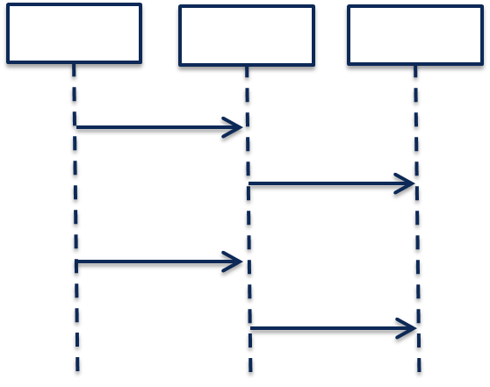
Model-Driven Orchestration (Recursive Structure)
“Generic” model-driven Service flow
Each Resource Type has its own “Generic” model-driven flow. There currently exist such flows for “VNF” and “Network” Resource Types.
Service Orchestration
Resource Orchestration
Cloud Resource Orchestration
PNF
Service X:
topology_template:
node_templates:
PNF
Network
VNF
Allotted Resource
Network
VF Module
Note recursion
VNF
Service Orchestration
Resource Orchestration
Allotted Resource
requirement: A
PNF
An Allotted Resource can be homed to an existing “underlying” network function or Service Instance, or homing could determine that a new network function Service Instance is needed. This would result in a 2nd level of Service Orchestration.
Service Y:
topology_template:
node_templates:
PNF
Network
VNF
Allotted Resource
capability: A
Network
Service Y is being treated as a “Resource” from the perspective of Service X.
VNF
Allotted Resource

Slide 14
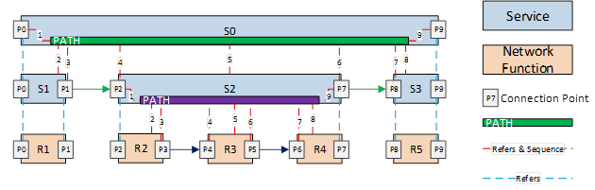
Nested / Compound Services:
Service W:
topology_template:
node_templates:
VNF_W
Service_X
Service X:
topology_template:
node_templates:
VNF_X
Service_Y
Service Y:
topology_template:
node_templates:
VNF_Y
Service_Z
Service Z:
topology_template:
node_templates:
VNF_Z

Slide 15
Conclusions
Service Providers require the ability to define Services that can be leveraged by higher order Services and other compounded services / segments / slices.
Consistent with ETSI MANO, ONAP should NOT separate Service Orchestration and Resource Orchestration into two separate named components, because each Resource can be exposed as a Service
      What appears as a “Resource” from one Service’s perspective, may actually be a Service from another perspective
      In Addition, ONAP scope is much broader than ETSI MANO (MANO limited to simple network services), therefore SO should support full orchestration scope of ONAP
      To achieve alignment with MANO for common functionality, SO should expose APIs for basic resource onboarding (VNF) or simple network service onboarding (composed of one or more VNFs)
      In addition, ONAP SO should Support “Service reuse” to drive model driven run-time behavior for complex services:
        Compounded Services (e.g. Residential vCPE, Network Slicing Segments, etc.)
        Nested Services (e.g. E2E Slice)
      ONAP should provide Service Providers deployment flexibility to address scalability, geographic distribution and redundancy / resiliency
      But should not impose extra complexity and cost on service providers by separating service / resource orchestration that provides little known benefit

Slide 16
ONAP R2+ Architecture – Merged View
ONAP Operations Manager (OOM)
Run-time
Portal Framework – UI,
ONAP CLI
Dashboard OA&M (VID)
External API
Design-time (SDC)
A&AI
DCAE Analytic µServices
Orchestration (SO)
(recursive)
  Service Level
  Resource Level
Common
Services
Resource Onboarding
Active / Available
CDAP
DCAE
Holmes
…
Policy Framework
Resource /Service Topology
Data Distribution
VNF/PNF SDK
Service Design
ESR
Data Collection Layer
CCSDK
Policy Creation & Validation
Micro Services Bus/DMaaP
AAF
Analytic Application Design
Multi-Cloud Adapt.
SDN-C (L0-L3)
Generic VNF Controller (L4-L7)
Discovery
Workload
Networking
Telem. Coll.
Cloud Models
Config/
Oper. DB
SDN-C DB
LCM-DG
OOF
SLI
Config Database
SLI
Catalog
Logging
Testing & Certification
Adaptation Layer
Standard Adaptation Layer
VNFM/EMS
Driver
Resources
Services
Cloud/VIM Drivers
Netconf
Yang
CLI
Controller
Driver
Ansible
Eng. Rules
Policies
Chef
Netconf
Analytics
External Systems
3rd Party Controller
sVNFM
EMS
…
Managed Environment
Recipe/Eng Rules & Policy Distribution
ONAP Optimization Framework (OOF)
Network Function Layer
VNFs
PNFs
…
Hypervisor / OS Layer
OpenStack
VMware
Azure
AMZ
RackSpace
Private
Edge Cloud
MPLS
Private
DC Cloud
IP
Public
Cloud

Slide 17
APPC & VF-C Convergence
Note – A major goal of the ONAP platform (R2 or a later release) is to specify a common set of functions to unify the APP-C and VF-C functionalities.

Slide 18
Role Of Controllers in ONAP
ONAP Controllers configure and maintain the health of network functional elements and services throughout their lifecycle.
Programmable network application management platform
  Behavior patterns programmed via models and policies
  Standards based models & protocols for multi-vendor implementation
  Operational control, coordinated state changes across devices, etc.
Manages the health of the network services & VNFs in its scope
  Policy-based optimization to meet SLAs
  Event-based control loop automation to solve local issues in near real-time
  Executes action for outer control loop automation (Driven by DCAE, Policy, etc.)
Local source of truth
  Manages inventory within its scope
  All stages/states of lifecycle
  Configuration audits
  ONAP has a layered architecture, with the role of controller clearly defined
  Need to avoid duplicating functions across layers within the controller layer (e.g. DCAE, Service/Resource Orchestration, etc.)

Slide 19
Role Of Controllers in ONAP
ONAP Controllers configure and maintain the health of network functional elements and services throughout their lifecycle.
Programmable network application management platform
  Behavior patterns programmed via models and policies
  Standards based models & protocols for multi-vendor implementation
  Operational control, coordinated state changes across devices, etc.
Manages the health of the network services & VNFs in its scope
  Policy-based optimization to meet SLAs
  Event-based control loop automation to solve local issues in near real-time
  Executes action for outer control loop automation (Driven by DCAE, Policy, etc.)
Local source of truth
  Manages inventory within its scope
  All stages/states of lifecycle
  Configuration audits
  ONAP has a layered architecture, with the role of controller clearly defined
  Need to avoid duplicating functions across layers within the controller layer (e.g. DCAE, Service/Resource Orchestration, etc.)

Slide 20
ONAP Orchestration Federation

Slide 21
External API Functional Requirements
The ONAP External API supports
  Interactions between ONAP and the Service Provider’s BSS/OSS,
  Interactions between ONAP of a Service Provider and other Partner Providers.
  MEF LSO characterizes these Service Provider to Partner Provider interactions at the Service Level as the Interlude Interface Reference Point
    This Interface Reference Point provides for the coordination of a portion of Services within the Partner domain that are managed by a Service Provider’s Orchestration Functionality within the bounds and policies defined for each Service.
It is envisioned that from a Service Provider to Partner Provider interaction context (i.e. MEF Interlude), the ONAP External API supports the following types of interacts:
  Service Provider controls aspects of the Service within the Partner domain (on behalf of the Customer) by requesting changes to dynamic parameters as permitted by service policies,
  Service Provider queries state of the Service,
  Service Provider requests change to administrative state or permitted attributes of a Service,
  Service Provider request creation of connectivity between two Service Interfaces as permitted by established business arrangement,
  Service Provider request instantiation of functional service components as permitted by established business arrangement,
  Service Provider queries the Partner for detailed information related to Services provided by the Partner to the Service Provider,
  Service Provider receives Service specific event notifications (e.g., Service Problem Alerts) from the Partner,
  Service Provider receives Service specific performance information from the Partner,
  Service Provider request Service related test initiation and receive test results from the Partner.

Slide 22
Next Steps
Agree and approve the proposed R2+ architecture
      Identify project impact to realize target orchestration implementation in R2
      Create a small team from VF-C, App-C and CCSDK teams to identify phased approach to achieve controller alignment in ONAP Platform

Slide 23
Backup Slides
Functional Description of ONAP Architecture Components
Under Review …

Slide 24
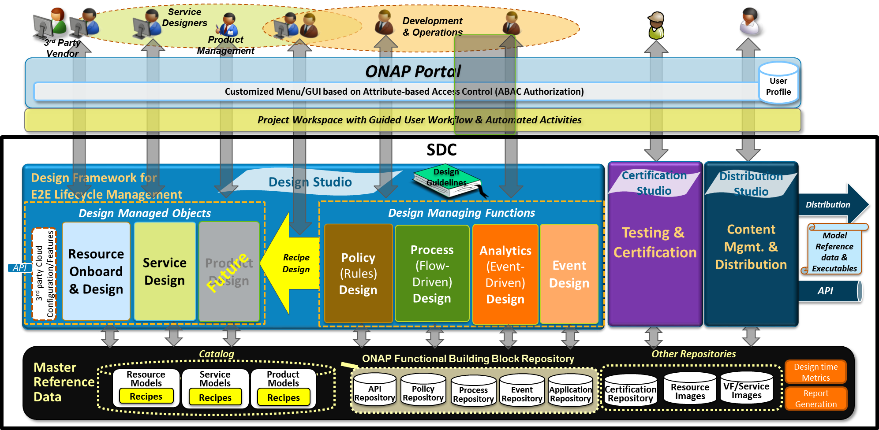
Service Design and Creation Architecture
Comprehensive design studio that enables technology integration
Design studio modules interoperate to enable complex relationships & models
Create or consume models to represent services, resources & management functions
Models, APIs/functions, flows, analytics & policies cataloged together or independently
Service Design & Creation
  Design Studio with Guided User Workflow
  Resource Onboarding
  Define/Compose Services & Products
  Define/Compose Policy-Driven Recipes
  Open Catalog-based Platform for Model/Object Reuse
Policy Creation Framework
  Policy Editor & Library
  Conflict Identification
  Closed-loop, Security & Audit Behavior
Analytic Application Design Environment
  Analytic App Design
  Tools for Analytic Development
  Security & Traffic Analytics
  Analytic Lifecycle Management
Certification
  Simulate, test, track & certify the create/mod processes
  Certify Readiness & Adherence to Standards
  Track and manage versions of models and catalog entries
Metadata Distribution
  Publish Definitions via SDK, API or Distribution
  Notifications & Version Control
  Real-Time Reference Data

Slide 25
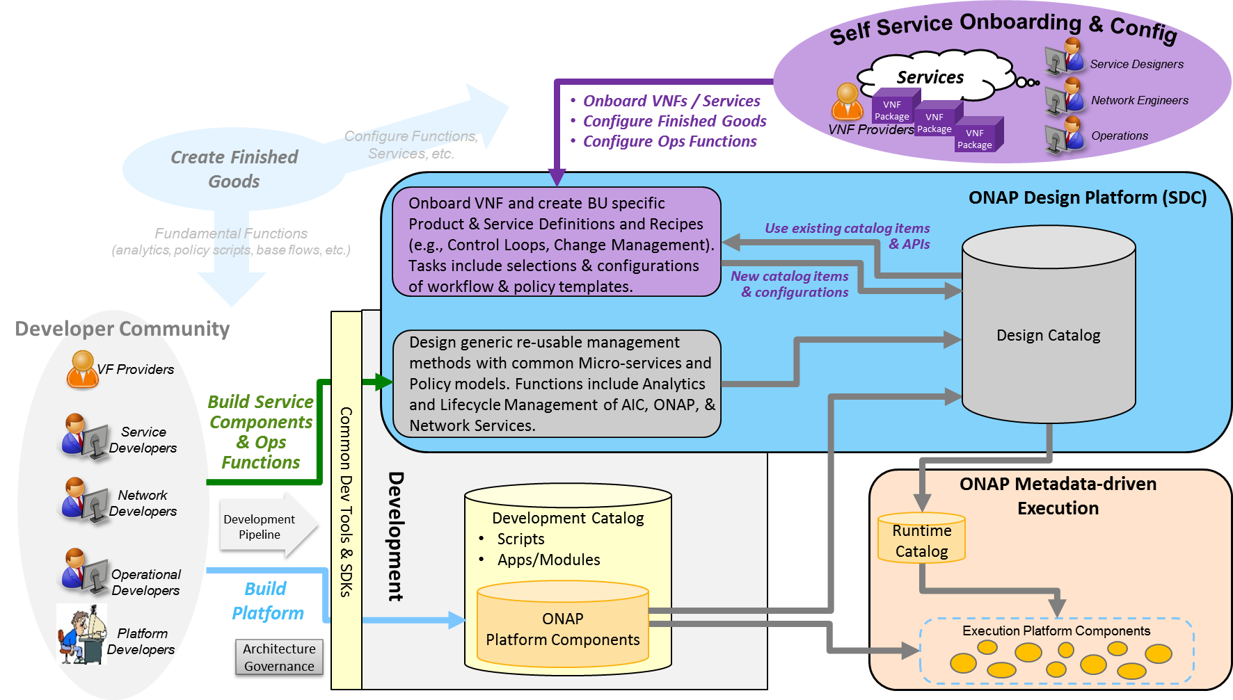
SDC Catalog Architecture
A smart repository for storing products ,services , resources and artifacts
Manages catalog’s elements versions, lifecycle and access policy
All certified asset definitions available for re-use and composition
Design Catalog
  Product/Service/Resource objects
  The instruction to manage D2 objects
  Resource and Service design lifecycle management processes
  Node based presentation to provide sequencing and relationships of different objects and technologies
  Generic re-usable management methods
Development Catalog
  Common toolsets for creation of ONAP capabilities and management procedures
  Interact with external software development teams and suppliers to onboard custom software, adapters or new VNFs
Runtime Catalog
  Certified models are distributed to runtime catalog for ONAP execution components runtime consumption
  Provide runtime access to models
Developer Contribution & Self-Serve Models

Slide 26
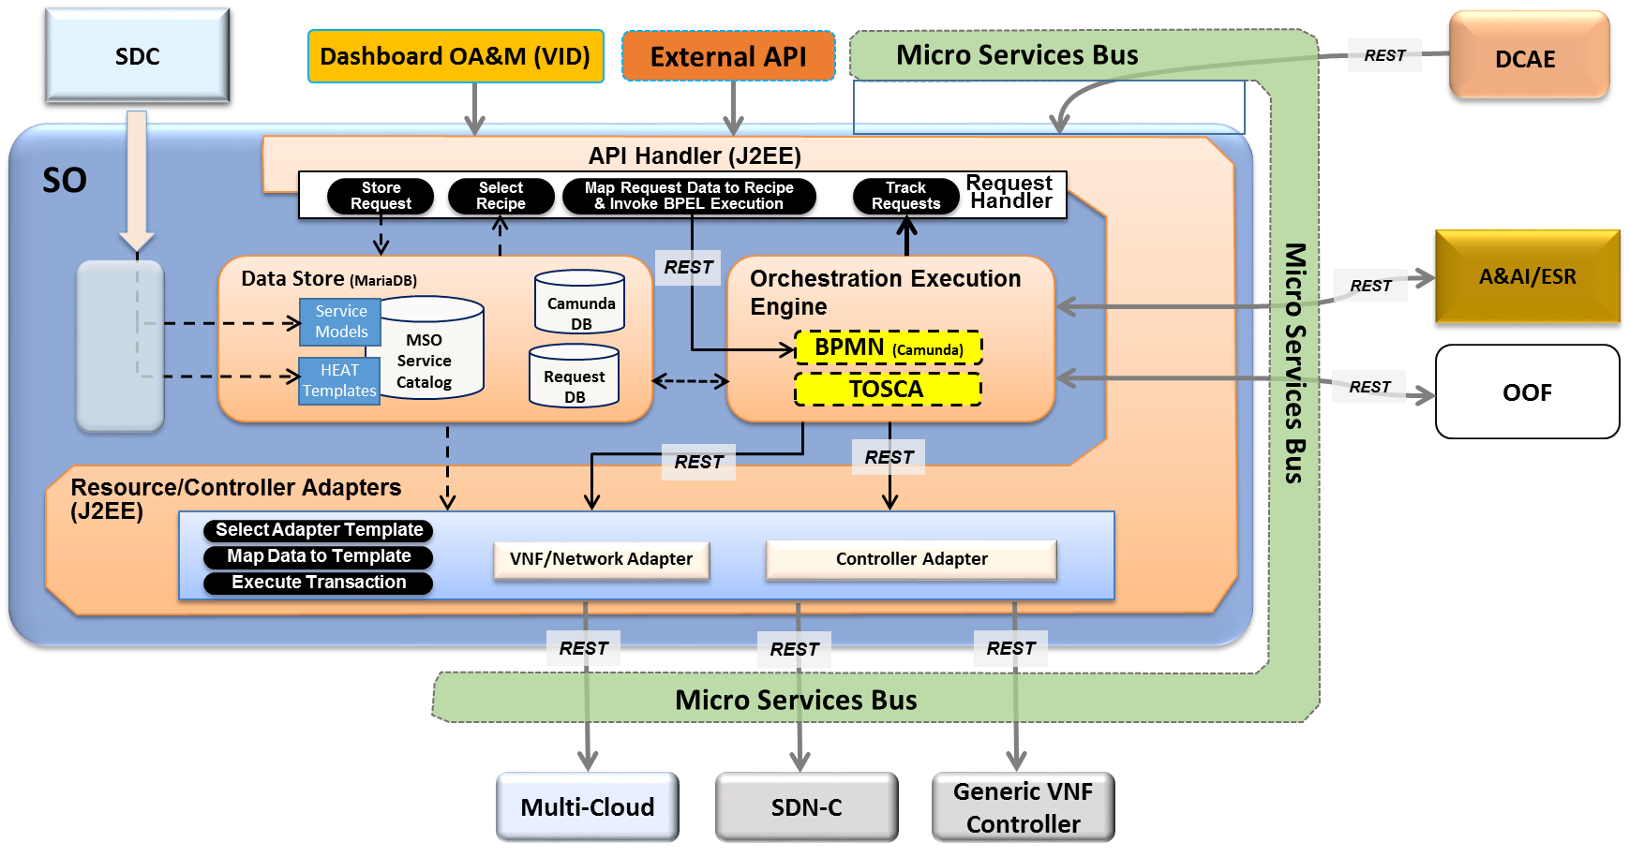
Service Orchestrator
Service Orchestrator (SO) orchestrates service, resources and associated cross-controller activity driven by requests and events that indicate the need to create, modify or remove service and resource instances, or to perform multi-control layer remedy actions.
Model Driven Orchestration and APIs
  Runtime behavior driven by service and resource models and policies (including compound/nested services) designed in SDC
  Orchestrates service delivery, change management as well as open and closed-loop control actions
  Provides standard, model driven APIs for requested actions
  Tracks orchestrated activity for the life of the
  request, but doesn’t control or maintain state
  of orchestrated components
Processing of Service Requests:
  Performs Decomposition, Recipe Selection, Recipe Execution (including Rainy Day)
  Triggers and Records Results for:
  Homing
  Assign, Create, Configure
  (Controller/multi-cloud activity)
  Validation
  Monitoring
  Separate execution threads for service, decomposed resources, and any subtending service(s) provide nested service orchestration in a recursive manner
Orchestration of Controllers
  Coordinates activities across Multi-Cloud/SDN-C/Generic VNF controllers, including data sourcing and mapping to Controller inputs

Slide 27
Generic VNF Controller (L4-7) Architecture
Generic VNF Controller for L4-7 configures and maintains the health of applications throughout its lifecycle.
  The Lifecycle Management Functions are a normalization of VF-C and APP-C functions into a common, extensible library
Programmable network application management platform
  Behavior patterns programmed via models and policies
  Standards based models & protocols for multi-vendor implementation
  Extensible SB adapter set including vendor specific VNF-Managers
  Operational control, version management, software updates, etc.
Manages the health of the applications/VNFs within its scope
  Policy-based optimization to meet SLAs
  Event-based control loop automation to solve local issues near real-time
Local source of truth
  Manages inventory within its scope
  All stages/states of lifecycle
  Configuration audits
Key Attributes of VNF Controllers
  Intimate with network protocols
  Manages the state of services
  Provide Deployment Flexibility to meet user scalability / resilience needs
SDC
A&AI
Generic VNF
Controller
API Handler
Policy Cache & Event Matching
Operational/ Config Tree
(Service Model)
REST
Configuration Repository
Service Logic Interpreter
Lifecycle Management mS Library
Service Topology & VNF State
Config mS
Audit mS
Auto-Recovery mS
Service Logic
Service Logic
Service Logic
…
Config Templates
Web Server
Adapters
Netconf
Chef
Ansible
Multi-Cloud Adapter
VNF Manager
Adapter (s)
…
Others

Slide 28
SDN-Controller Architecture
SDN Controller configures and maintains the health of L1-3 VNFs/PNFs and network services throughout their lifecycle
Programmable network application management platform
  Behavior patterns programmed via models and policies
  Standards based models & protocols for multi-vendor implementation
  Extensible SB adapter set supporting various network config protocols, including 3rd party controllers
  Operational control, coordinated state changes across devices, source of telemetry/events, etc.
Manages the health of network services & VNFs/PNFs in its scope
  Policy-based optimization to meet SLAs
  Event-based control loop automation to solve local issues near real-time
  Action executor for outer control loop automation
Local source of truth
  Manages inventory within its scope
  All stages/states of lifecycle
  Configuration audits
Key Attributes of Controllers
  Intimate with network protocols
  Manages the state of services
  Single service/network domain scope per instance
SDC
A&AI
SDN Controller
API Handler
Configuration Repository
Service Control
Interpreter
Network Resource
Controller
Svc Template A
Svc Comp 1
Access
Service
Features
Service
Element
Resources
Svc Template B
Svc Comp 2
Network/Service Design/Engineering Policies/Rules
Flow
Service
Features
Core &
Transport
Resources
Adapters
Multi-Cloud Network Adapter
NetConf/ YANG
BGPCEP
3rd Party
Controllers
…
Others

Slide 29
Data Collection, Analytics and Events (DCAE) Architecture
Analytic µServices
Managed Environment
Fault Correlation
Congestion Detection
Capacity Management
QoS Monitoring
Security Analysis
…
DCAE
VNFs / PNFs
Applications
VES
OOM – DCAE Controller
Streaming
Data
Networking
DMaaP (Pub/Sub for Events/Data within DCAE & across ONAP)
Analytic Frameworks:
Holmes, CDAP, Other
Stream Data Collection
Batch
Data
Events
Flows
Other
Multi-Cloud Telemetry Adaption
Compute
SNMP
Unstructured & Structured Data Persistence
Batch Data Collection
Syslog
Storage
Logs
Files
Other
Other
DCAE enables real-time fault, performance and other data/event collection from service, network and infrastructure
  Collect Data & Events once and make available to multiple applications
  Telemetry records from VNFs and PNFs (fault, performance, usage, etc.)
Makes collected data available to real-time analytic µ-services to:
  Identify anomalies and other events for closed loop remediation
  Enable closed-loop automation to remedy fault/performance conditions
  Enable closed-loop automation to scale resources up/down
  Enable analysis at edge and central locations
  Extensible framework to integrate applications from various sources
Provides Correlation & Analysis to manage service at various layers
  Multi-Cloud Infrastructure layer, network element layer, Network & Complex Services layer, Operational Management layer
  Cross-layer, Intra-domain and cross-domain correlation

Slide 30
Active and Available Inventory
A&AI tracks the global inventory of the networks, services & resources that ONAP manages.
  The what, where, when of the managed assets and their relationships, and which controller or orchestrator manages them.
Real-time, logically centralized view of topology & inventory
  Map and broker of data sources in the global network
  Federates across controllers, cloud infrastructure, partners, etc.
  Real-time access to authoritative sources with ability to aggregate views
  Real-time awareness of network elements, applications and service instances
  Aware of all the assets in scope, organized by their type, state & location
  Keeps track of the dynamic relationships of the virtual assets
  Aware of resource assignments, availability & relationships to customer
Network events used to maintain the integrity of inventory
  Monitors network events to register services, networks & resources
  Tracks creation, modification or removal of entities and relationships
A&AI
API Handler
Metadata Engine
Inventory & Topology Management
API Generation
Entitlement
Service
Resource
Active
Available
Reference
Network
Infrastructure
Topology
Assignment
Schema Generation
Graph Layer
Version Management
A&AI Data Management Services
Entitlements & Reference
Inventory & Topology
Metadata Management
A&AI Application Management Functions
OA&M
History
Event Subscriptions
Notifications
Data Audits
Archival
Model-driven
  Schema, APIs, database views, data integrity mechanisms generated from models expressed in TOSCA.

Slide 31
Multi-Cloud Adaption Layer
Ramki to provide this slide

