Slide 1
ONAP Target Architecture (R2 and Future Releases)
Presentation to OSDT Biweekly
Parviz Yegani – Leader, ONAP Architecture Tiger Team
Contributors: ONAP Architecture Tiger Team Members
Nov. 30, 2017

Slide 2
ONAP Architecture Tiger Team (led by Huawei)
AT&T Vimal Begwani vb1946@att.com;
China Mobile denglingli@chinamobile.com;
Orange jamil.chawki@orange.com;
Vodafone susana.sabater@vodafone.com;
VMware Ramki Krishnan ramkik@vmware.com;
Ciena Nigel Davis ndavis@ciena.com;
Amdocs avi.chapnic@amdocs.com;
Intel alex.vul@intel.com;
Netcracker manoj.k.nair@netcracker.com;
Ericsson stephen.terrill@ericsson.com;
Nokia timo.perala@nokia.com;
Huawei zengjianguo@huawei.com;
ZTE zhang.maopeng1@zte.com.cn;
Spirent doug.grinkemeyer@spirent.com
OAM Technology Consulting adolfo.perez-duran@oamtechnologies.com;
Dan Timoney dt5972@att.com;
Andy Mayer am803u@att.com;
Gil Bullard wb5674@att.com;
John Ng jn1287@att.com;
Christopher.Donley@huawei.com;
Patrick.Liu@huawei.com;
seshu.kumar.m@huawei.com;
denghui12@huawei.com;
habib.madani@huawei.com;
Parviz.Yegani@huawei.com
zhao.huabing@zte.com.cn;
li.zi30@zte.com.cn;
yuan.yue@zte.com.cn;

Slide 3
Progress from the Architecture Subcommittee
For Amsterdam (R1), the architecture was agreed, as discussed since ONS.
  This was to reduce risk of late changes to the project teams, who have built their plans based on the current baseline.
Starting with R2, there is consensus to resolve the following two architectural inconsistencies:
  Orchestration Architecture
    - Architecture team agreed that Orchestration layer should be separate from Controller layer
  Consistent Controller Layer Architecture and better alignment between App-C & VF-C
  Projects are drilling down to the next level of detail on interfaces and project alignment, and then the projects will review their R2 plans with the ARC.
The next slide illustrates high-level architectures that was approved by TSC to meet the R1 schedule.

Slide 4


ONAP Amsterdam Architecture
ONAP Operations Manager (OOM)
Portal Framework, U-UI, ONAP CLI
DESIGN-TIME (SDC)
Dashboard OA&M (VID)
RUN-TIME
External API Framework
Resource Onboarding
Policy Framework
DCAE
Correlation Engine
(Holmes)
Service Orchestration
A&AI/ESR
Service & Product Design
Policy Creation & Validation
Common Services
DMaaP
CCSDK
Logging
Micro Services Bus (MSB)
AAF
VNF SDK
CLAMP
Multi-VIM/Cloud
Infrastructure Adaptation Layer
SDN-C
(L0-L3 Controller)
Application Controller
(L4-L7)
Virtual Function Controller
(ETSI-aligned)
Catalog
3rd Party Controller
sVNFM
EMS
External Systems
Managed Environment
…
Network Function Layer
VNFs
PNFs
…
Recipe/Eng Rules & Policy Distribution
Hypervisor / OS Layer
OpenStack
Commercial VIM
Public Cloud
Private
Edge Cloud
MPLS
Private
DC Cloud
IP
Public
Cloud
Notes:
Key points:
Unified framework for design-time & run-time
Common platform for service design and netops to drive collaboration
Simultaneous orchestration of physical and virtual networks
Vendor-agnostic orchestration can only happen in open source context
Real-time analytics and closed-loop automation
Easy re-use of service concepts
Iterative service improvements based on network feedback

Slide 5
Architecture Design Considerations
Architecture Principles Were Reviewed Earlier and Agreed Upon by the Architecture Team:
  https://wiki.onap.org/display/DW/Contributions?preview=/8225716/8232492/Architectural%20principles_v3.docx
ONAP is a layered architecture – Orchestration, Multi-Cloud, Controller, etc.
Functional role of each layer should be well defined and overlaps should be avoided
ONAP should support integrated design studio to capture full lifecycle management models (TOSCA models for NF, simple / nested services augmented with BPMN, Policy / Analytic design models, etc.)
ONAP Should Support Cloud Agnostic Model and Multi-Cloud adaption layer while hiding infrastructure details
ONAP Target Goal is: Modular, Model-driven, Microservices-based architecture
  Models drive interfaces between layers/components
ONAP should define well described NB-APIs at both controller and orchestrator layers
Keep flexible capability for commercial solution (no vendor lock-in)
Agree to unified API & modeling for integration across all modules: VES in DCAE, Logging & monitor inside ONAP and more

Slide 6

ONAP Target Architecture for R2 and Beyond
(High-Level Functional View)
External Gateway
OSS / BSS
CLI
ONAP Portal
ONAP API
Design-time
Run-time
Dashboard OA&M
Resource Onboarding
Data Collection, Analytics, and Events
Event Correlation
Common
Services
Active & Available Inventory
External Registry
Policy Framework
Service Design
Orchestration
Application
Authorization
Framework
Policy Creation & Validation
ONAP Operations Manager
Analytic Application Design
Micro Services Bus / Data Movement (see Note 1)
ONAP Optimization Framework
VNF / PNF Onboarding
Closed Loop Design
Change Management Design
Multi-Cloud Adaptation
Generic VNF Controllers (L4-L7)
Logging
SDN Controller
(L0-L3)
Common Controller SDK
Design Test & Certification
Infrastructure Adaptation Layer
Life Cycle Management
Adaption Layer
Others
Catalog
External Systems
3rd Party Controller
Specific VNF Manager
Element Management System
…
Managed Environment
Network Function Layer
Recipe/Eng Rules & Policy Distribution
ONAP Optimization Framework
VNFs
PNFs
…
Hypervisor / OS Layer
OpenStack
VMware
Azure
AMZ
RackSpace
Note 1 – Not all components use DMaaP (e.g., NFVO)
MPLS
IP
Private
Edge Cloud
Private
DC Cloud
Public
Cloud

Slide 7
ONAP Beijing Architecture
(High-Level View with Projects)
External Gateway
OSS / BSS
CLI
ONAP Portal
ONAP API
Design-time (SDC)
Run-time
Dashboard OA&M (VID)
Resource Onboarding
Common
Services
DCAE
Service Orchestration project
A&AI/ESR
Policy Framework
Service Design
AAF
Policy Creation & Validation
OOM
Analytic Application Design
MSB / DMaaP (see Note 1)
OOF
VNF / PNF SDK
Closed Loop Design
Logging
Change Management Design
APPC
VF-C
CCSDK
Design Test & Certification
Multi-VIM/Cloud
SDN-C
(L0-L3)
…
Catalog
External Systems
3rd Party Controller
sVNFM
EMS
CLAMP
…
Managed Environment
Network Function Layer
Recipe/Eng Rules & Policy Distribution
ONAP Optimization Framework (OOF)
VNFs
PNFs
Hypervisor / OS Layer
OpenStack
VMware
Azure
AMZ
RackSpace
Note 1 – Not all components use DMaaP (e.g., NFVO).
Private
Edge Cloud
MPLS
Private
DC Cloud
IP
Public
Cloud

Slide 8
APPC & VF-C Convergence
Note – A major goal of the ONAP platform (R2 or a later release) is to specify a common set of functions to unify the APP-C and VF-C functionalities.

Slide 9
Role Of Controllers in ONAP
ONAP Controllers configure and maintain the health of network functional elements and services throughout their lifecycle.
Programmable network application management platform
  Behavior patterns programmed via models and policies
  Standards based models & protocols for multi-vendor implementation
  Operational control, coordinated state changes across devices, etc.
Manages the health of the network services & VNFs in its scope
  Policy-based optimization to meet SLAs
  Event-based control loop automation to solve local issues in near real-time
  Executes action for outer control loop automation (Driven by DCAE, Policy, etc.)
Local source of truth
  Manages inventory within its scope
  All stages/states of lifecycle
  Configuration audits
  ONAP has a layered architecture, with the role of controller clearly defined
  Need to avoid duplicating functions across layers within the controller layer (e.g. DCAE, Service/Resource Orchestration, etc.)

Slide 10
Role Of Controllers in ONAP
ONAP Controllers configure and maintain the health of network functional elements and services throughout their lifecycle.
Programmable network application management platform
  Behavior patterns programmed via models and policies
  Standards based models & protocols for multi-vendor implementation
  Operational control, coordinated state changes across devices, etc.
Manages the health of the network services & VNFs in its scope
  Policy-based optimization to meet SLAs
  Event-based control loop automation to solve local issues in near real-time
  Executes action for outer control loop automation (Driven by DCAE, Policy, etc.)
Local source of truth
  Manages inventory within its scope
  All stages/states of lifecycle
  Configuration audits
  ONAP has a layered architecture, with the role of controller clearly defined
  Need to avoid duplicating functions across layers within the controller layer (e.g. DCAE, Service/Resource Orchestration, etc.)

Slide 11
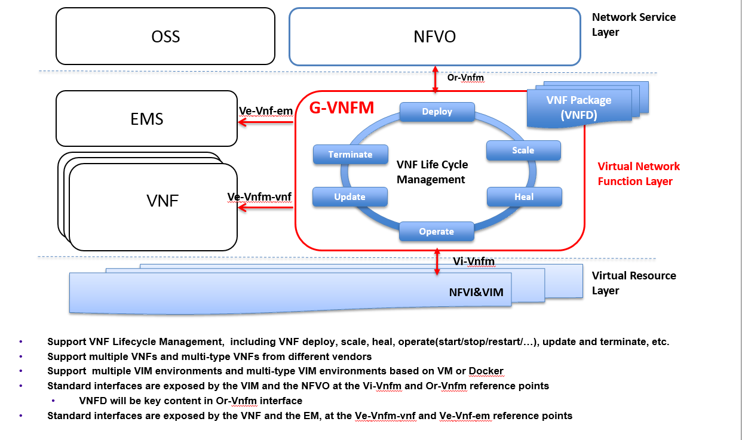
Generic VNFM Functions

Slide 12
Conclusions
Service Providers require the ability to define Services that can be leveraged by higher order Services and other compounded services / segments / slices.
Consistent with ETSI MANO, ONAP should NOT separate Service Orchestration and Resource Orchestration into two separate named components, because each Resource can be exposed as a Service
      What appears as a “Resource” from one Service’s perspective, may actually be a Service from another perspective
      In Addition, ONAP scope is much broader than ETSI MANO (MANO limited to simple network services), therefore SO should support full orchestration scope of ONAP
      To achieve alignment with MANO for common functionality, SO should expose APIs for basic resource onboarding (VNF) or simple network service onboarding (composed of one or more VNFs)
      In addition, ONAP SO should Support “Service reuse” to drive model driven run-time behavior for complex services:
        Compounded Services (e.g. Residential vCPE, Network Slicing Segments, etc.)
        Nested Services (e.g. E2E Slice)
      ONAP should provide Service Providers deployment flexibility to address scalability, geographic distribution and redundancy / resiliency
      But should not impose extra complexity and cost on service providers by separating service / resource orchestration that provides little known benefit

Slide 13
Next Steps
Agree and approve the proposed target architecture by
Feb 15, 2018 (M2 target date, Beijing Release)
Create a small team from SO, VF-C, App-C and CCSDK teams to identify phased approach to tackle the following tasks:
        Identify project impact to realize target orchestration implementation in R2
          Proper mapping of orchestration function to the R2 architecture components
          For example, the interaction between SO & NFVO (Flows and APIs)
        VNF controller alignment in ONAP Platform
          VF-C vs APPC
          Will NFVO and GVNFM split into two separate projects?

Slide 14
Backup Slides

Slide 15
ONAP Orchestrator Functions
Orchestrate Network Functions (VNF/PNF), and Network Services (NSes),
Coordinate cross-controller activities driven by orders and events to
  instantiate/modify/remove VNFs/PNFs, NSes
  perform multi-control layer remedy actions.
Key Attributes of Orchestrator:
Model Driven Orchestration
  Process behavior driven by resource / service model designed in SDC
  Orchestrates network functions and service Instantiations, including compound / nested services (parts already in R1)
    Nesting may be domain-specific orchestrator (does not require SO clone)
  Support software upgrade and planned change management
  Support open & closed-loop control actions initiated by DCAE /Policy or external API (e.g. OSS for Open Loop)
  Tracks orchestrated activity for the life of the request but doesn’t control state of orchestrated components
Interfaces to External OSS / BSS Systems
  Standard APIs exposed northbound to create, modify or remove services
  Request decomposition of service request into service / network function components
  Selects model / recipe that supports the request and maps order data to recipe / model
Coordinating Activities Across Various ONAP Controllers
  Coordinates activities across Multi-Cloud (infrastructure) / SDN-C / APPC / VF-C controllers
  Manage recording of service configurations
Orchestrator Performs Following Additional Services
  Coordinates current inventories and placement/optimization recommendations
  Enforces business & technical policies
  Support standards-based workflows
  Validates and records network functions / service implementations

Slide 16
Examples of Orchestration Requests
Install a single network function (VNF or PNF) – e.g. Deploy a new virtual PE / P router
  A virtual network element might have one or more components (e.g VNFCs or VDUs)
Install multiple copies of network functions in one or more data centers – e.g. Deploy new virtual PE / P routers across multiple locations
Deploy one or more instances of network services – e.g. RAN at Multiple sites, one or more sites of EPC, etc.
Deploy E2E network services (e.g. RAN + EPC + IMS)
Instantiate a customer services – e.g. multi-site VPN or IP SEC
  Could require deploying new instances of network elements (e.g. vCE) and using existing elements (e.g. vPE)
  Could be using existing elements without any new VNF / PNF being deployed (e.g. “Allocated Resources” – configuring a service to existing components)
Create a new instance of a network slice segment
  Could be leveraging existing network services (RAN, vEPC, etc.)
Create a new instance of a network service slice – e.g. IoT or eMBB slice
  Could be leveraging previously created network slice segments
Implement a software upgrade / change management
  Could require Coordination of activities across Multi-VIM (infrastructure)/SDN-C/app-C/VF-C controllers
Orchestrate remedial actions requested as part of Closed or open loop action
  Could require adding new compute / network resource to the existing functional elements (i.e. VNF)
  Create a new instance of VNF and migrate traffic
  Could require Coordination of activities across Multi-Cloud (infrastructure)/SDN-C/App-C/VF-C controllers)

Slide 17
Work in Progress

Slide 18
External API
External API Functional Requirements for Orchestration Federation
The ONAP External API supports
  Interactions between ONAP and the Service Provider’s BSS/OSS,
  Interactions between ONAP of a Service Provider and other Partner Providers.
  MEF LSO characterizes these Service Provider to Partner Provider interactions at the Service Level as the Interlude Interface Reference Point
    This Interface Reference Point provides for the coordination of a portion of Services within the Partner domain that are managed by a Service Provider’s Orchestration Functionality within the bounds and policies defined for each Service.
It is envisioned that from a Service Provider to Partner Provider interaction context (i.e. MEF Interlude), the ONAP External API supports the following types of interacts:
  Service Provider controls aspects of the Service within the Partner domain (on behalf of the Customer) by requesting changes to dynamic parameters as permitted by service policies,
  Service Provider queries state of the Service,
  Service Provider requests change to administrative state or permitted attributes of a Service,
  Service Provider request creation of connectivity between two Service Interfaces as permitted by established business arrangement,
  Service Provider request instantiation of functional service components as permitted by established business arrangement,
  Service Provider queries the Partner for detailed information related to Services provided by the Partner to the Service Provider,
  Service Provider receives Service specific event notifications (e.g., Service Problem Alerts) from the Partner,
  Service Provider receives Service specific performance information from the Partner,
  Service Provider request Service related test initiation and receive test results from the Partner.

Slide 19
ONAP High-Level Architecture for R1 (Amsterdam)

Slide 20
ONAP Reference Architecture for R2 and Beyond
(Detailed View with Projects)
External Gateway
OSS / BSS
CLI
ONAP Portal
ONAP API
Design-time (SDC)
Run-time
Dashboard OA&M (VID)
Resource Onboarding
A&AI
DCAE Analytic µServices
SO/NFVO
(hierarchical)
Active / Available
Policy Framework
Common
Services
CDAP
DCAE
Holmes
…
Service Design
Resource /Service Topology
Data Distribution
ESR
Data Collection Layer
CCSDK
OOM
Policy Creation & Validation
VNF/PNF SDK
Micro Services Bus/DMaaP (see Note 1)
AAF
Analytic Application Design
Multi-Cloud Adapt.
SDN-C (L0-L3)
Generic VNF Controller (L4-L7)
OOF
Catalog
Discovery
Workload
Networking
Telem. Coll.
Cloud Models
Config/
Oper. DB
SLI
SDN-C DB
SLI
LCM-DG
Config Database
Resources
Services
Logging
Eng. Rules
Policies
Adaptation Layer
Standard Adaptation Layer
VNFM/EMS
Driver
Cloud/VIM Drivers
Netconf
Yang
CLI
Controller
Driver
Chef
Netconf
Ansible
…
Analytics
External Systems
CLAMP
3rd Party Controller
sVNFM
EMS
…
Managed Environment
Network Function Layer
Recipe/Eng Rules & Policy Distribution
ONAP Optimization Framework (OOF)
VNFs
PNFs
Hypervisor / OS Layer
OpenStack
VMware
Azure
AMZ
RackSpace
Note 1 – Not all components use DMaaP (e.g., NFVO)
MPLS
IP
Private
Edge Cloud
Private
DC Cloud
Public
Cloud

