Slide 1
ONAP Reference Architecture for R2 and Beyond
Tiger Team Presentation
Parviz Yegani – Futurewei Technologies
Contributors: Vimal Begwani (AT&T), Jamil Chawki (Orange), Andrew Mayer (AT&T), Alex Vul (Intel), Ramki Krishnan (VMware), Maopeng Zhang (ZTE), Stephen Terrill (Ericsson), <more contributors to be added>
Jan. 9, 2018

Slide 2
ONAP High-Level Architecture for R1 (Amsterdam)

Slide 3
Progress from the Architecture Subcommittee
For Amsterdam (R1), the architecture was agreed, as discussed since ONS.
  This was to reduce risk of late changes to the project teams, who have built their plans based on the current baseline.
Starting with R2, there is consensus to resolve the following two architectural inconsistencies:
  Orchestration Architecture
    - Architecture team agreed that Orchestration layer should be separate from Controller layer
  Consistent Controller Layer Architecture and better alignment between App-C & VF-C
  Projects are drilling down to the next level of detail on interfaces and project alignment, and then the projects will review their R2 plans with the ARC.
The next slide illustrates high-level architectures that was approved by TSC to meet R1 schedule.

Slide 4


ONAP Amsterdam Architecture
ONAP Operations Manager (OOM)
Portal Framework, U-UI, ONAP CLI
DESIGN-TIME (SDC)
Dashboard OA&M (VID)
RUN-TIME
External API Framework
Resource Onboarding
Policy Framework
DCAE
Correlation Engine
(Holmes)
Service Orchestration
A&AI/ESR
Service & Product Design
Policy Creation & Validation
Common Services
DMaaP
CCSDK
Logging
Micro Services Bus (MSB)
AAF
VNF SDK
CLAMP
Multi-VIM/Cloud
Infrastructure Adaptation Layer
SDN-C
(L0-L3 Controller)
Application Controller
(L4-L7)
Virtual Function Controller
(ETSI-aligned)
Catalog
3rd Party Controller
sVNFM
EMS
External Systems
Managed Environment
…
Network Function Layer
VNFs
PNFs
…
Recipe/Eng Rules & Policy Distribution
Hypervisor / OS Layer
OpenStack
Commercial VIM
Public Cloud
Private
Edge Cloud
MPLS
Private
DC Cloud
IP
Public
Cloud
Notes:
Key points:
Unified framework for design-time & run-time
Common platform for service design and netops to drive collaboration
Simultaneous orchestration of physical and virtual networks
Vendor-agnostic orchestration can only happen in open source context
Real-time analytics and closed-loop automation
Easy re-use of service concepts
Iterative service improvements based on network feedback

Slide 5
ONAP Reference Architecture for R2 and Beyond

Slide 6
Architecture Design Considerations
Architecture Principles Were Reviewed Earlier and Agreed Upon by the Architecture Team:
  https://wiki.onap.org/display/DW/Contributions?preview=/8225716/8232492/Architectural%20principles_v3.docx
ONAP is a layered architecture – Orchestration, Multi-Cloud, Controller, etc.
Functional role of each layer should be well defined per the architecture principles agreed by the architecture team (see the above link).
ONAP should support integrated design studio to capture full lifecycle management models (TOSCA models for NF, simple / nested services augmented with BPMN, Policy / Analytic design models, etc.)
ONAP Should Support Cloud Agnostic Model and Multi-Cloud adaption layer while hiding infrastructure details
ONAP Target Goal is: Modular, Model-driven, Microservices-based architecture
  Models drive interfaces between layers/components
ONAP should define well-described and consistent NB-APIs at all layers
Keep flexible capability for commercial solution (no vendor lock-in)
Agree to unified modeling for integration across all modules: VES in DCAE, Logging & monitor inside ONAP and more

Slide 7

ONAP Target Architecture
(High-Level Functional View)
OSS / BSS
CLI
U-UI
ONAP Portal
ONAP External APIs
DESIGN-TIME
Dashboard OA&M
RUN-TIME
Resource Onboarding
Common
Services
Policy Framework
Data Collection, Analytics, and Events
Event Correlation
Active & Available Inventory
External Registry
Common Services
Orchestration
Service Design
Policy Creation & Validation
Application
Authorization
Framework
Analytic Application Design
Micro Services Bus / Data Movement (see Note 1)
ONAP Operations Manager
VNF / PNF Onboarding
ONAP Optimization Framework
Closed Loop Design
Change Management Design
Generic NF Controllers (L4-L7)
Logging
Multi-Cloud
Adaptation
SDN Controller
(L0-L3)
Design Test & Certification
Life Cycle Management & Config
Controller SDK
(see Note 1)
(see Note 1)
Catalog
Optional External Systems
3rd Party Controller
Specific VNF Manager
Element Management System
…
Managed Environment
Network Function Layer
Recipe/Eng Rules & Policy Distribution
ONAP Optimization Framework
VNFs
PNFs
Hypervisor / OS Layer
OpenStack
VMware
Azure
AMZ
RackSpace
Note 1 – Consistent APIs between Orchestration layer and Controllers
MPLS
IP
Private
Edge Cloud
Private
DC Cloud
Public
Cloud

Slide 8

ONAP Beijing Architecture
(High-Level View with Projects)
OSS / BSS
ONAP CLI
U-UI
ONAP Portal
ONAP External APIs
DESIGN-TIME (SDC)
Dashboard OA&M (VID)
RUN-TIME
Resource Onboarding
DCAE
Correlation
Engine (Holmes)
Service Orchestration
Project
Common
Services
Common Services
Policy Framework
Service Design
A&AI/ESR
ONAP Operations Manager
Policy Creation & Validation
AAF
VNF SDK
CLAMP
MSB/DMAAP
OOF
Virtual
Function Controller
(VF-C)
(Note 1)
Logging
Change Management Design
Multi-VIM/Cloud
Infrastructure Adaptation Layer
Application Controller
(APPC)
(L4-L7)
SDN-C
(L0-L3 Controller)
Others
Design Test & Certification
Catalog
External Systems
3rd Party Controller
sVNFM
EMS
…
Managed Environment
Network Function Layer
VNFs
PNFs
Recipe/Eng Rules & Policy Distribution
Hypervisor / OS Layer
OpenStack
VMware
Azure
AWS
RackSpace
Note 1 - VF-C is ETSI-aligned.
Private
Edge Cloud
MPLS
Private
DC Cloud
IP
Public
Cloud

Slide 9
ONAP Orchestration Alignment

Slide 10
ONAP Orchestrator Functions (1/2)
Orchestrate Network Functions (VNF/PNF), and Network Services (NSes), and services provided by the managed environment
Coordinate cross-controller activities driven by orders and events to
  LCM (instantiate/modify/upgrade/configure/remove) VNFs/PNFs, Nses, and services from the managed environment
  perform multi-control layer remedy actions.
Key Attributes of Orchestrator:
Model Driven Orchestration
  Process behavior driven by resource / service model designed in SDC
  Orchestrates network functions and service LCM (Instantiations, ..) , including compound / nested services (parts already in R1)
    Nesting may be domain-specific orchestrator (does not require SO clone)
  Support software upgrade and planned change management
  Support open & closed-loop control actions initiated by DCAE /Policy or external API (e.g. OSS for Open Loop)
  Tracks orchestrated activity for the life of the request but doesn’t control state of orchestrated components

Slide 11
ONAP Orchestrator Functions (2/2)
Interfaces to External OSS / BSS Systems
  Standard APIs exposed northbound to create, modify or remove services and resources
  Request decomposition of service request into service / network function components
  Selects model / recipe that supports the request and maps order data to recipe / model
Coordinating Activities Across Various ONAP Controllers
  Coordinates activities across Multi-Cloud (infrastructure) / SDN-C / APPC / VF-C controllers
  Manage recording of service configurations
Orchestrator Performs Following Additional Services
  Coordinates current inventories and placement/optimization recommendations
  Enforces business & technical policies
  Support standards-based workflows
  Validates and records network functions / service implementations

Slide 12
Examples of Orchestration Requests (1/2)
Install/Configure a single network function (VNF or PNF) – e.g. Deploy a new virtual PE / P router
  A virtual network element might have one or more components (e.g VNFCs or VDUs)
Install multiple copies of network functions in one or more data centers – e.g. Deploy new virtual PE / P routers across multiple locations
Deploy one or more instances of network services – e.g. RAN at Multiple sites, one or more sites of EPC, etc.
Deploy E2E network services (e.g. RAN + EPC + IMS) and services from the managed environment
Instantiate and LCM a customer services – e.g. multi-site VPN or IP SEC
  Could require deploying new instances of network elements (e.g. vCE) and using existing elements (e.g. vPE)
  Could be using existing elements without any new VNF / PNF being deployed (e.g. “Allocated Resources” – configuring a service to existing components)

Slide 13
Examples of Orchestration Requests (2/2)
Create a new instance of a network slice segment
  Could be leveraging existing network services (RAN, vEPC, etc.)
Create a new instance of a network service slice – e.g. IoT or eMBB slice
  Could be leveraging previously created network slice segments
Implement a software upgrade / change management
  Could require Coordination of activities across Multi-VIM (infrastructure)/SDN-C/app-C/VF-C controllers
Orchestrate remedial actions requested as part of Closed or open loop action
  Could require adding new compute / network resource to the existing functional elements (i.e. VNF)
  Create a new instance of VNF and migrate traffic
  Could require Coordination of activities across Multi-Cloud (infrastructure)/SDN-C/App-C/VF-C controllers)

Slide 14
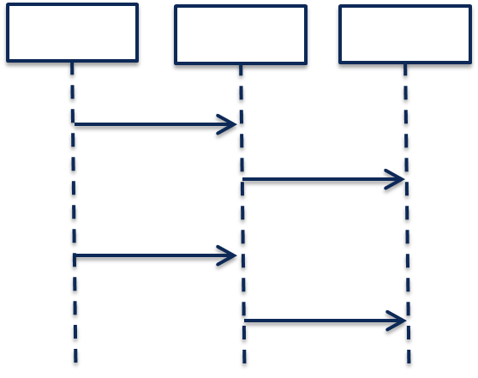
Model-Driven Orchestration (Recursive Structure)
“Generic” model-driven Service flow
Each Resource Type has its own “Generic” model-driven flow. There currently exist such flows for “VNF” and “Network” Resource Types.
Service Orchestration
Resource Orchestration
Cloud Resource Orchestration
PNF
Service X:
topology_template:
node_templates:
PNF
Network
VNF
Allotted Resource
Network
VF Module
Note recursion
VNF
Service Orchestration
Resource Orchestration
Allotted Resource
requirement: A
PNF
An Allotted Resource can be homed to an existing “underlying” network function or Service Instance, or homing could determine that a new network function Service Instance is needed. This would result in a 2nd level of Service Orchestration.
Service Y:
topology_template:
node_templates:
PNF
Network
VNF
Allotted Resource
capability: A
Network
Service Y is being treated as a “Resource” from the perspective of Service X.
VNF
Allotted Resource

Slide 15
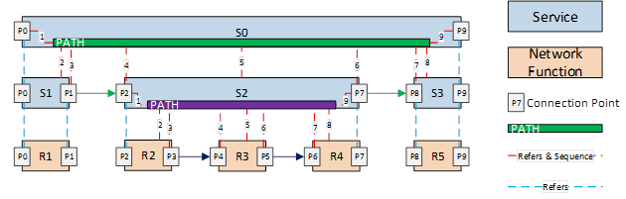
Nested / Compound Services:
Service W:
topology_template:
node_templates:
VNF_W
Service_X
Service X:
topology_template:
node_templates:
VNF_X
Service_Y
Service Y:
topology_template:
node_templates:
VNF_Y
Service_Z
Service Z:
topology_template:
node_templates:
VNF_Z

Slide 16
Conclusions
Service Providers require the ability to define Services that can be leveraged by higher order Services and other compounded services / segments / slices.
Consistent with ETSI MANO, ONAP should NOT separate Service Orchestration and Resource Orchestration into two separate named components, because each Resource can be exposed as a Service
      What appears as a “Resource” from one Service’s perspective, may actually be a Service from another perspective
      In Addition, ONAP scope is much broader than ETSI MANO (MANO limited to Cloud infrastructure services and management of VNF as a basic resource (ignoring the application of the VNF)), therefore SO should support full orchestration scope of ONAP
      To achieve alignment with MANO for common functionality, SO should expose APIs for basic resource onboarding/LCM (VNF) . This is SOL-001, SOL-004 and SOL-005.
      or simple network service onboarding/LCM (composed of one or more VNFs) and related modelsIn addition, ONAP SO should Support “Service reuse” to drive model driven run-time behavior for complex services:
        Compounded Services (e.g. Residential vCPE, Network Slicing Segments, etc.)
        Nested Services (e.g. E2E Slice)
      ONAP should provide Service Providers deployment flexibility to address scalability, geographic distribution and redundancy / resiliency
      But should not impose extra complexity and cost on service providers by separating service / resource orchestration that provides little known benefit

Slide 17
APPC & VF-C Convergence
Note – A major goal of the ONAP platform (R2 or a later release) is to specify a common set of functions to unify the APP-C and VF-C functionalities.

Slide 18
Role Of Controllers in ONAP
ONAP Controllers configure and maintain the health of network functional elements and services throughout their lifecycle.
Programmable network application management platform
  Behavior patterns programmed via models and policies
  Standards based models & protocols for multi-vendor implementation
  Operational control, coordinated state changes across devices, etc.
Manages the health of the network services & VNFs in its scope
  Policy-based optimization to meet SLAs
  Event-based control loop automation to solve local issues in near real-time
  Executes action for outer control loop automation (Driven by DCAE, Policy, etc.)
Local source of truth
  Manages inventory within its scope
  All stages/states of lifecycle
  Configuration audits
  ONAP has a layered architecture, with the role of controller clearly defined
  Need to avoid duplicating functions across layers within the controller layer (e.g. DCAE, Service/Resource Orchestration, etc.)

Slide 19
Functional Description of ONAP Components

Slide 20
VF-C Functions
SO
Policy
UUI
Os-Ma-nfvo
NFVO Functions
Support NS Lifecycle Management including NS instantiate, scale, heal, operate (query /update/…)and terminate. In R1, most of NSLCM interfaces align with SOL005 Os-Ma-nfvo reference point
Support integration with multi VNFMs via drivers which include vendors VNFM and generic VNFM. The interfaces between NFVO and driver comply with Or-Vnfm reference point.
Support integration with multi VIM via Multi-Cloud
In R1, NFVO also supports integration with vendor EMS via driver
NFVO
VNF Package
( VNFD)
NS Package
( NSD)
Instantiate
Terminate
Scale
Operate
Heal
Or- Vnfm
Or- Vnfm
Driver
Driver
SVNFM
Or-Vi
GVNFM
EMS
Vi-Vnfm
Multi-Cloud
Vi-Vnfm
Vi-Vnfm
NFVI&VIM

Slide 21
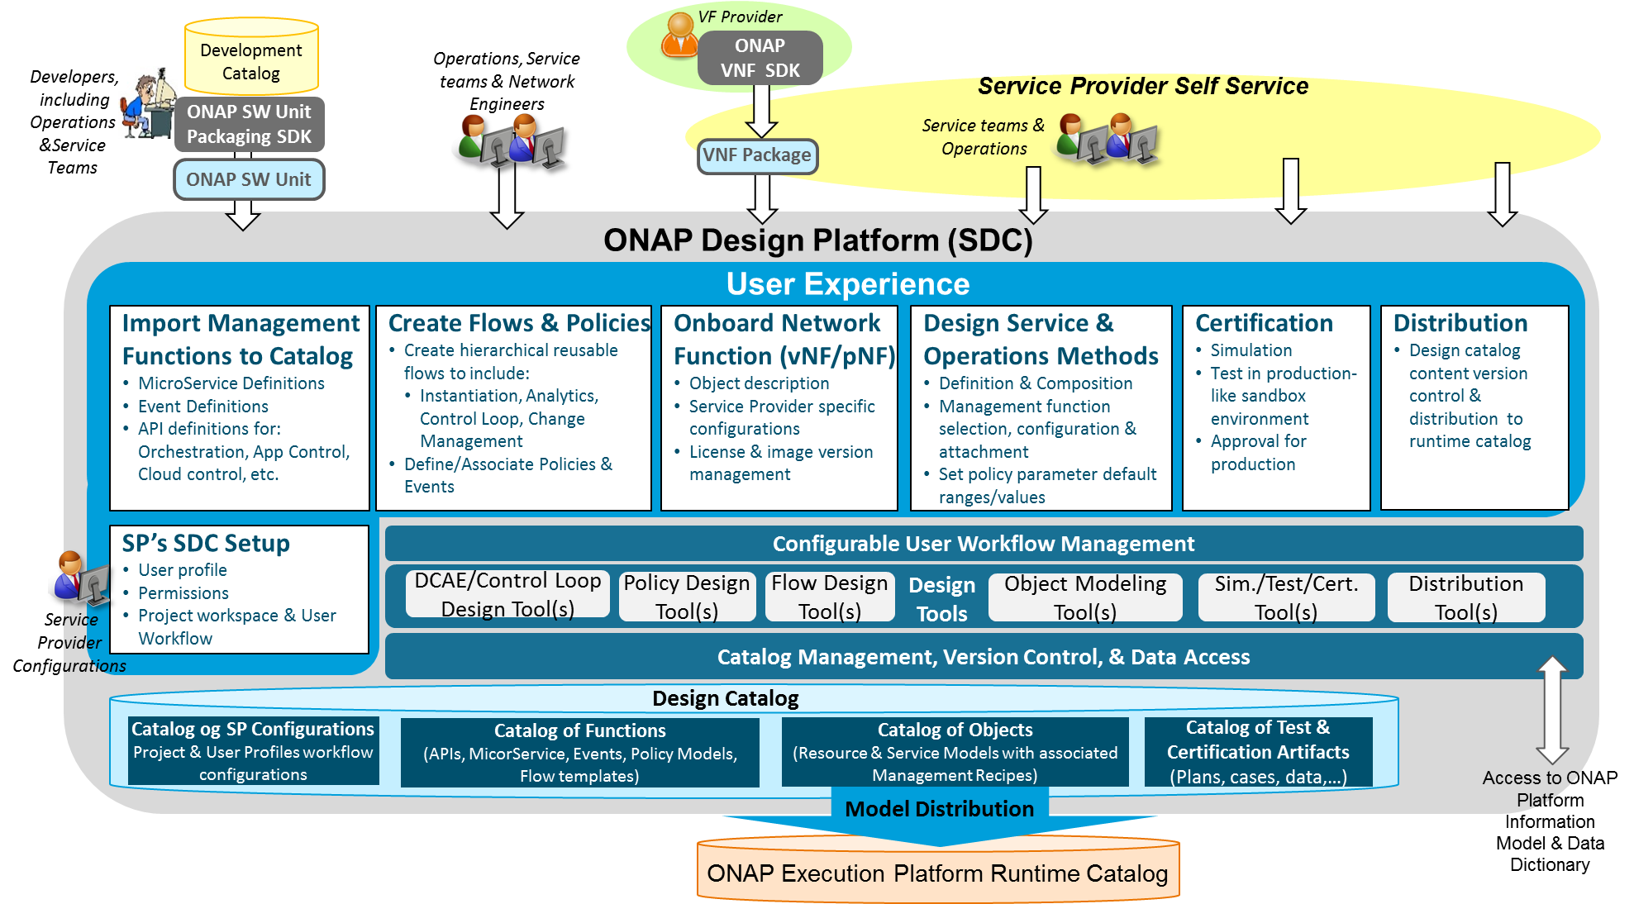
Service Design and Creation (SDC) Functional Architecture
Service Provider’s Design environment to: 1. Catalog management capabilities, 2. Onboard vendor provided Network Functions, 3. Design Services and Operations, 4. Test, certify, and distribute models for Runtime Execution
Import Management Functions
  Import ONAP base capability definitions from Development Catalog to Design Catalog as building blocks in a standard format
Create Flows & Policies
  Create reusable management flows using building blocks & associated events & Policies
Onboard Network Functions
  Create VF model to include vendor’s description, scripts, & license model
  Customize models to include Service Provider specific attributes
Design Service & Operations Methods
  Create Service models with resources
  Design and associate operations processes & policies (e.g., Instantiation, DCAE/Control Loop, Change Management, etc.) and configure them to be service specific
Certification
  Simulate & test the design in Sandbox environment
  Certify Readiness & Adherence to Standards
Metadata Distribution
  Publish certified models for distribution to runtime catalog
  Notifications & Version Control

Slide 22
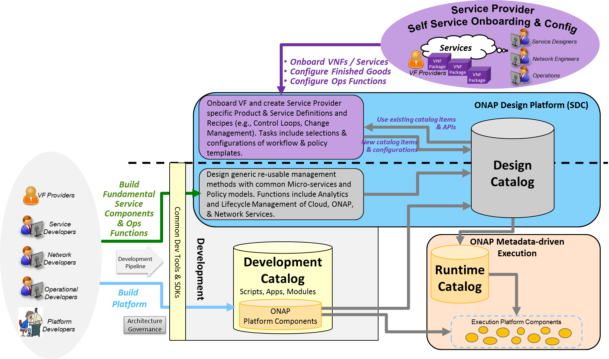
Catalog Architecture
The overall ONAP Catalog architecture includes Development Catalog, Design Catalog, and Runtime Catalog
Partially Existing:
Design Catalog (ONAP Design Platform - SDC)
  Catalog imported ONAP generic re-usable management software function & policy definitions
  Enable SP to onboard standard VNF packages
  Support SP users in design & lifecycle management of Resource and Service models
  Provide presentation to support service compositions & management flow associations
  Manages catalog’s elements versions, lifecycle and access policy
  All certified asset definitions available for re-use and composition
Yet to be implemented:
Development Catalog (ONAP Development)
  Common toolsets and data store for creation of ONAP software models & management flows/policies
  Interact with external software development teams and suppliers to onboard custom software, adapters or new capabilities
Runtime Catalog (ONAP Execution Platform)
  Provide a common data store for distributed certified models
  Provide ONAP runtime component’s subscription to access component view of the model data
  Maintain executable images and other runtime artifacts

Slide 23
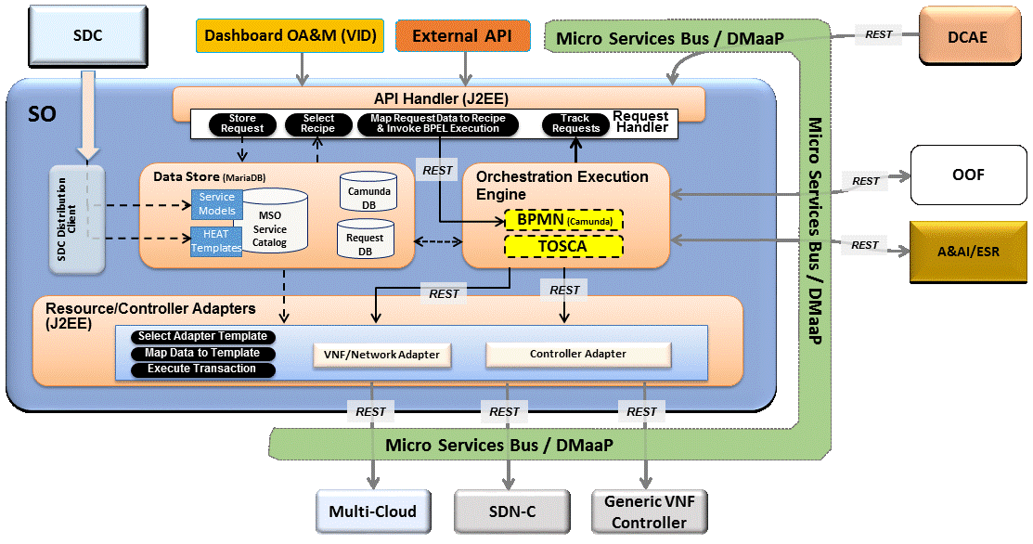
Service Orchestrator
Service Orchestrator (SO) orchestrates service, resources and associated cross-controller activity driven by requests and events that indicate the need to create, modify or remove service and resource instances, or to perform multi-control layer remedy actions.
Model Driven Orchestration and APIs
  Runtime behavior driven by service and resource models and policies (including compound/nested services) designed in SDC
  Orchestrates service delivery, change management as well as open and closed-loop control actions
  Provides standard, model driven APIs for requested actions
  Tracks orchestrated activity for the life of the
  request, but doesn’t maintain state of
  orchestrated components
Processing of Service Requests:
  Performs Decomposition, Recipe Selection, Recipe Execution (including Rainy Day)
  Triggers and Records Results for:
  Homing
  Assign, Create, Configure
  (Controller/multi-cloud activity)
  Validation
  Monitoring
  Separate execution threads for service, decomposed resources, and any subtending service(s) provide nested service orchestration in a recursive manner
Orchestration of Controllers
  Coordinates activities across Multi-Cloud/
  SDN-C/Generic VNF controllers, including data sourcing and mapping to Controller inputs

Slide 24
SO Internal Architecture (R2 Proposed)
SDC
Dashboard OA&M (VID)
External API
Micro Services Bus / DMaaP
REST
DCAE
SO
API Handler (J2EE)
Request
Handler
Store
Request
Select Recipe
Map Request Data to Recipe & Invoke BPEL Execution
Track
Requests
Data Store (MariaDB)
REST
Orchestration Execution Engine
Service Models
Camunda
DB
OOF
MSO
Service
Catalog
BPMN
REST
SDC Distribution Client
Service-Level Recipe
Micro Services Bus / DMaaP
HEAT Templates
Request DB
Model Driven Routing Function
BPMN
BPMN
TOSCA Orch
Resource-Level Recipe
Resource-Level Recipe
REST
A&AI/ESR
REST
REST
REST
Resource/Controller Adapters (J2EE)
Select Adapter Template
VNF/Network Adapter
Controller Adapter
Map Data to Template
REST
Execute Transaction
REST
REST
REST
Micro Services Bus / DMaaP
Cloudify/ARIA would be invoked by BPMN after “Assignments” have been obtained from SDNC, once a full “deployment” set of data is available across all Resources.
Multi-Cloud
Generic VNF Controller
SDN-C

Slide 25
Generic VNF Controller (L4-7) Architecture
Generic VNF Controller for L4-7 configures and maintains the health of applications throughout its lifecycle.
  The Lifecycle Management Functions are a normalization of VF-C and APP-C functions into a common, extensible library
Programmable network application management platform
  Behavior patterns programmed via models and policies
  Standards based models & protocols for multi-vendor implementation
  Extensible SB adapter set including vendor specific VNF-Managers
  Operational control, version management, software updates, etc.
Manages the health of the applications/VNFs within its scope
  Policy-based optimization to meet SLAs
  Event-based control loop automation to solve local issues near real-time
Local source of truth
  Manages inventory within its scope
  All stages/states of lifecycle
  Configuration audits
Key Attributes of VNF Controllers
  Intimate with network protocols
  Manages the state of services
  Provide Deployment Flexibility to meet user scalability / resilience needs
SDC
A&AI
Generic VNF
Controller
API Handler
Policy Cache & Event Matching
Operational/ Config Tree
(Service Model)
REST
Configuration Repository
Service Logic Interpreter
Lifecycle Management mS Library
Service Topology & VNF State
Config mS
Audit mS
Auto-Recovery mS
Service Logic
Service Logic
Service Logic
…
Config Templates
Web Server
Adapters
Netconf
Chef
Ansible
Multi-Cloud Adapter
VNF Manager
Adapter (s)
…
Others

Slide 26
SDN-Controller Architecture
SDN Controller configures and maintains the health of L1-3 VNFs/PNFs and network services throughout their lifecycle
Programmable network application management platform
  Behavior patterns programmed via models and policies
  Standards based models & protocols for multi-vendor implementation
  Extensible SB adapter set supporting various network config protocols, including 3rd party controllers
  Operational control, coordinated state changes across devices, source of telemetry/events, etc.
Manages the health of network services & VNFs/PNFs in its scope
  Policy-based optimization to meet SLAs
  Event-based control loop automation to solve local issues near real-time
  Action executor for outer control loop automation
Local source of truth
  Manages inventory within its scope
  All stages/states of lifecycle
  Configuration audits
Key Attributes of Controllers
  Intimate with network protocols
  Manages the state of services
  Single service/network domain scope per instance
SDC
A&AI
SDN Controller
API Handler
Configuration Repository
Service Control
Interpreter
Network Resource
Controller
Svc Template A
Svc Comp 1
Access
Service
Features
Service
Element
Resources
Svc Template B
Svc Comp 2
Network/Service Design/Engineering Policies/Rules
Flow
Service
Features
Core &
Transport
Resources
Adapters
Multi-Cloud Network Adapter
NetConf/ YANG
BGPCEP
3rd Party
Controllers
…
Others

Slide 27
Data Collection, Analytics and Events (DCAE) Architecture
Analytic µServices
Managed Environment
Fault Correlation
Congestion Detection
Capacity Management
QoS Monitoring
Security Analysis
…
DCAE
VNFs / PNFs
Applications
VES
OOM – DCAE Controller
Streaming
Data
Networking
DMaaP (Pub/Sub for Events/Data within DCAE & across ONAP)
Analytic Frameworks:
Holmes, CDAP, Other
Stream Data Collection
Batch
Data
Events
Flows
Other
Multi-Cloud Telemetry Adaption
Compute
SNMP
Unstructured & Structured Data Persistence
Batch Data Collection
Syslog
Storage
Logs
Files
Other
Other
DCAE enables real-time fault, performance and other data/event collection from service, network and infrastructure
  Collect Data & Events once and make available to multiple applications
  Telemetry records from VNFs and PNFs (fault, performance, usage, etc.)
Makes collected data available to real-time analytic µ-services to:
  Identify anomalies and other events for closed loop remediation
  Enable closed-loop automation to remedy fault/performance conditions
  Enable closed-loop automation to scale resources up/down
  Enable analysis at edge and central locations
  Extensible framework to integrate applications from various sources
Provides Correlation & Analysis to manage service at various layers
  Multi-Cloud Infrastructure layer, network element layer, Network & Complex Services layer, Operational Management layer
  Cross-layer, Intra-domain and cross-domain correlation

Slide 28
Active and Available Inventory
A&AI tracks the global inventory of the networks, services & resources that ONAP manages.
  The what, where, when of the managed assets and their relationships, and which controller manages them, etc.
Real-time, logically centralized view of topology & inventory
  Map and broker of data sources in the global network
  Federates across controllers, cloud infrastructure, partners, etc.
  Real-time access to authoritative sources with ability to aggregate views
  Real-time awareness of network elements, applications and service instances
  Aware of all the assets in scope, organized by their type, state & location
  Keeps track of the dynamic relationships of the virtual assets
  Aware of resource assignments, availability & relationships to customer
Network events used to maintain the integrity of inventory
  Monitors network events to register services, networks & resources
  Tracks creation, modification or removal of entities and relationships
A&AI
API Handler
Metadata Engine
Inventory & Topology Management
API Generation
Entitlement
Service
Resource
Active
Available
Reference
Network
Infrastructure
Topology
Assignment
Schema Generation
Graph Layer
Version Management
A&AI Data Management Services
Entitlements & Reference
Inventory & Topology
Metadata Management
A&AI Application Management Functions
OA&M
History
Event Subscriptions
Notifications
Data Audits
Archival
Model-driven
  Schema, APIs, database views, data integrity mechanisms generated from models expressed in TOSCA.

Slide 29
Active & Available Inventory, External Registry
Definition:
AAI maintains a live view of services and resources in the network, providing the state and relationships of the service components
Maintains the view of the managed systems services and resources, as well as information of the external systems that ONAP will connect to.
It provides real-time views of a managed systems resources, services and relationships with each other.
AAI provides a GUI to provide users the ability to find and inspect inventory data. This includes a free-text search, inspection of specific entities and their relationships, and aggregated views of data.
Inventory Service Interface
External Register Interface
Active & Available Inventory, External Registry
Provided Interfaces:
Inventory Service Interfaces:
  AAI Resources REST API - Provides the ability to store, read, update inventory information
  Gizmo: a low-level REST CRUD API that provides targeted and simple access to entities, relationships, and their properties. Gizmo also provides lightweight collections, and transactional bulk write support
Complex Query Interface: AAI Traversal REST API – Provides the ability to perform complex traversals of the AAI Graph
External Register interface
  Provides the ability to provision and read external system information
Interface N
Consumed interface Interfaces:
DMaaP
SDC
Multivim
Consumed Models: TOSCA Service and Resource Models

Slide 30
Microservices Bus (1/2)
Service Registration REST Interface
Service Discovery RES Interface
JAVA SDK for Service Registration/Access
Definition:
Provides a reliable, resilient and scalable communication and governance infrastructure to support ONAP Microservice Architecture(OMSA).
Provides RESTFul API for service registration/discovery
Provides JAVA SDK for service registration and access
Provides a transparent service registration proxy with OOM-Kube2MSB
Provides a transparent service communication proxy which handles service discovery, load balancing, routing, failure handling, and visibility-Internal API Gateway(Implemented) and Mesh Sidecar(WIP)
Provides an External API Gateway to expose ONAP services to the outside world
Micro Servies Bus / Data Movement
Interface N

Slide 31
Microservices Bus (2/2)
Service Registration REST Interface
Service Discovery RES Interface
JAVA SDK for Service Registration/Access
Provided Interfaces:
Service Registration REST Interface
  Provides the RESTFul interface to register ONAP services.
Service Discovery REST Interface
  Provides the RESTFul interface to discover ONAP services.
JAVA SDK
  Provides JAVA SDK to register ONAP services.
  Provides JAVA SDK to access ONAP services.
  Note: ONAP components don' t need interfaces to leverage the transparent service registration proxy and communication proxy.
Micro Servies Bus / Data Movement
Interface N
Consumed interface Interfaces: (None)
Consumed Models:
Swagger for RESTFul APIs definition
Service definition in kubernetes config files for Kube2MSB service registration

Slide 32
Optimization Framework (1/4)
Definition:
ONAP Optimization Framework (OOF) provides functionality for creating and running optimization applications by leveraging a policy-driven, declarative approach.
Supports different specializations (applications) with specific domain and optimization needs.
Initial specialization scopes include, but are not limited to, VNF placement support via Homing and Allocation Service (HAS) with different use cases, and change management scheduling service.
  For R2, the OOF will support vUCPE use case (as a MVP). From R3 and beyond, the OOF will also support VoLTE, VNF scale-in/out (higher order control loop), and RAN-5G.
  For R2, the OOF will demonstrate an example of Change Management Scheduling Optimization using the OOF design framework with simple, representative constraints. This effort will be will be closely aligned to support Change Management scheduling use case in R3 and beyond
Service Orchestrator (SO)
Change Management Portal
Optimization Framework (OOF)
Policy Interface
Inventory Service Interface
Service/Policy Models Interface
R3 and Beyond
Infrastructure Metrics Interface
Application Metrics Interface

Slide 33
Optimization Framework (2/4)
Provided Interfaces:
Placement Optimization Interface
  Provides functionality for the Service Orchestrator to specify placement services
  [initially to support vUCPE use case, but will support VoLTE, VNF scale-in/out (higher order control loop), and RAN-5G in R3 and beyond]
Change Management Portal Interface
  Provides functionality for schedules that satisfy different constraints on scheduling and conflicts
  [initially as a demonstration of he design framework with simple, representative constraints;
  will be closely aligned to support Change Management scheduling use case]
Service Orchestrator (SO)
Change Management Portal
Optimization Framework (OOF)
Consumed Interfaces:
Policy Interface, from: Policy
Inventory Service Interface, from: Available and Active Inventory
Service/Policy Models Interface, from: SDC
Infrastructure Metrics Interface, from: Multi Cloud [R3 and Beyond]
Application Metrics Interface, from: DCAE [R3 and Beyond]
Policy Interface
Inventory Service Interface
Service/Policy Models Interface
R3 and Beyond
Infrastructure Metrics Interface
Application Metrics Interface
Consumed Models:
Policy Models (constraints) and License Models from: SDC
Infrastructure Metrics Models, from: Multi Cloud [R3 and Beyond]
Application Metrics Models, from: DCAE [R3 and Beyond]

Slide 34
Interface Definitions (3/4)
Optimization Request Interface
Provided Service | Homing Service API (HAS-API)
Supplementary Information | The OOF will provide a list of possible candidates for placement, which the service orchestrator can use to instantiate the service
Interface Provider(s) | Optimization Framework
Provided Capabilities | Optimization Information Request

Slide 35
Interface Definitions (4/4)
Scheduling Optimization Request Interface
Provided Service | Change Management Scheduling API (CMSO API)
Supplementary Information | The OOF will provide a possible schedule of VNF actions (e.g. upgrades) that satisfy the constraints on availability periods and constraints related to conflicts
Interface Provider(s) | Optimization Framework
Provided Capabilities | Optimization Information Request

Slide 36
ONAP SDK-Driven Sub-System Approach
Goal: Move toward a common platform architecture, starting with Controllers, Orchestration and Multi-Cloud
Improve agility for on-demand/situational creation of instances
Reduce software footprint of platform component instances
Reusable tool chain and framework across components
Facilitate agile introduction and swap-out of technologies
Consistent use of NB and SB APIs
Enable flexible options to add and extend platform capabilities

Slide 37
SDK-Driven Sub-System – Libraries (including CCSDK)
SDK Libraries
NB API SDK
API Handler
API Configurator
Orchestration APIs
Controller APIs
Cloud APIs
API Catalog
Orchestration Function SDK
Control Function SDK (CCSDK)
Multi-Cloud Adaptation SDK
Library of
Common Control/NFV Lifecycle Mgt. Functions
Library of
Common Cloud Translations (shims)
Library of Flows
Service, Resource, Etc.
Rebuild
A udit
VNF Configure
Assign
Cloud Resource
Instantiation
Telemetry
Scale
…
Stop/Start
Scale
Network Config.
…
Imperative Models
Declarative Models
Health Check
Register
Heal
LB
BPMN orchestration
engine
TOSCA orchestration
engine
Upgrade
Heal
Svc Function Chain
…
Sub-Models
ODL
ONOS
Open
ROADM
TOSCA-Cloud
Translation/Mapper
SB API SDK
(Adapters)
M-Cloud APIs
OSS APIs
Netconf/Yang
OpenStack
API Catalog
Controller APIs
μServices APIs
Ansible
Plugins/Adapters*
Azure
Resource Orchestration APIs
Collectors
AWS
etc.
Orchestrators
Controllers
μServices
OSSs
VNFs
PNFs
Multi-Cloud
OpenStack
Azure
AWS
Rackspace
IBM
Google
*Plugins/Adapters can include:
3rd party VNFM Drivers • 3rd party EMS Drivers
3rd party SFC Drivers • Ansible/Chef/Puppet
Netconf/Yang • CLI
SNMP • etc.

Slide 38
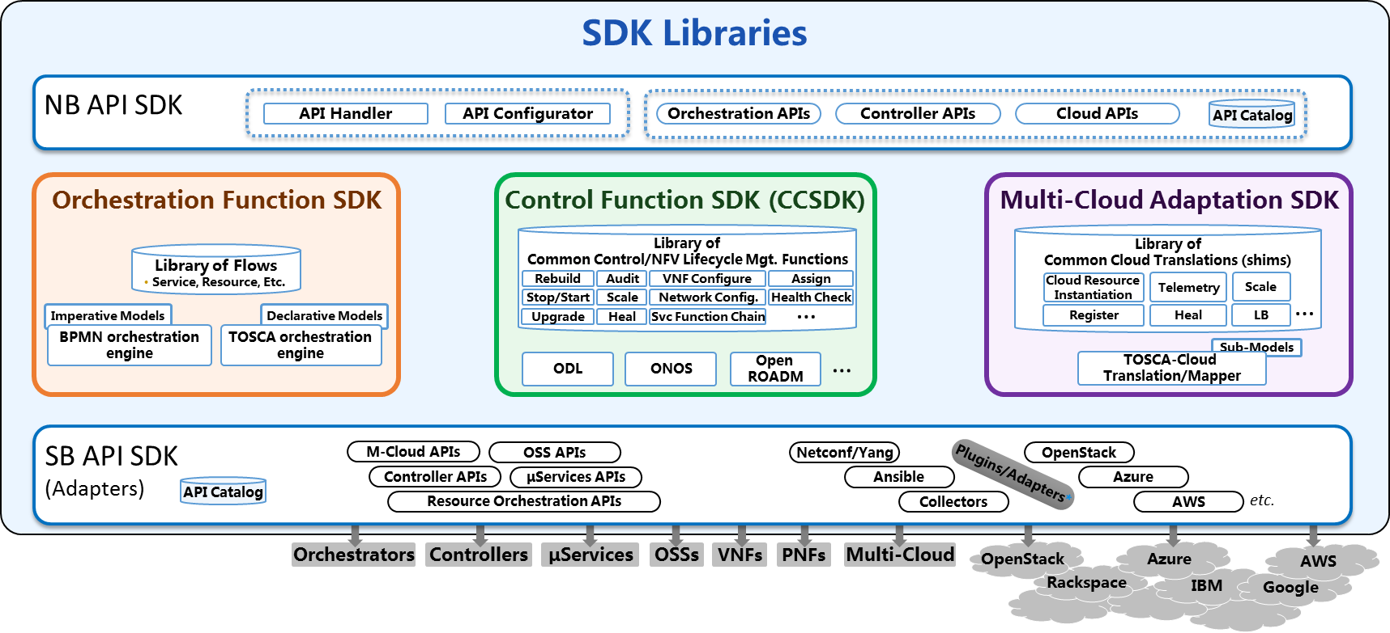
Controller Personas Based on SDK Libraries
SDK Libraries
SDN-C Persona
Generic VNF Controller Persona
NB API
NB API
Controller APIs
Controller APIs
Controller Personas Examples
(created from CCSDK)
Control Functions
LCM Functions
Library
Library
Assign
Network Config
Rebuild
Audit
VNF Configure
…
VNF Configure
…
Svc Function Chain
Stop/Start
Scale
Svc Function Chain
HealthCk
Heal
ODL
ODL
???
SB
API
SB
API
Netconf/Yang
μServices APIs
…
…
Ansible
Netconf/Yang
3rd Party SFC
Other Adapters
OSS APIs
Other Adapters
OSS APIs
μServices APIs
3rd VNFM/EMS

Slide 39
ONAP APIs
Work in Progress …

Slide 40
MEF and ONAP Joint Collaboration
Work jointly with MEF and ONAP External API Project in defining Use Cases and Information Model for Legato and Interlude
Leverage MEF Operational Threads and revise MEF 56, Interface Profile Specification: Service Configuration and Activation, to reflect consistent Use Cases
The Service Descriptor Model is key to Model Driven Orchestration
Work with ONAP and TM Forum define the Service Catalog and Service Instantiation API is a model driven and extensible fashion

Slide 41



E
REFERENCE ARCHITECTURE
Customer Domain
SP Domain
Partner Domain
Cantata
(CUS:BUS)
Business Applications
Sonata
(BUS:BUS)
Business Applications
Customer
Application Coordinator
LEGATO
(BUS:SOF)
LEGATO
(BUS:SOF)
Allegro
(CUS:SOF)
Service Orchestration Functionality
Interlude
(SOF:SOF)
Service Orchestration Functionality
Presto
(SOF:ICM)
Presto
(SOF:ICM)
Infrastructure Control
and Management
Infrastructure Control
and Management
ADAGIO (ICM:ECM)
ADAGIO (ICM:ECM)
Element Control
and Management
Element Control
and Management
Network Infrastructure

Slide 42
SOF Interface Reference Points
Service feasibility;
Service provisioning configuration & activation;
Request fallout;
Usage events & metrics;
License accounting;
Service performance & quality (e.g., KPI);
Service trouble management;
Service policy;
Capacity engineering;
Address allocation management;
LEGATO
Dynamic service control;
Service state info;
Service performance & quality;
Service related alerts;
Service Orchestration Functionality
Dynamic service control;
Service parameter config;
Service state info;
Service performance info;
Service problem alerts
ALLEGRO
INTERLUDE
PRESTO
Connectivity and network function feasibility;
Configuration, activation, and management of connectivity and logical network functions;
Topology and routing;
Performance and Fault;
Connectivity policy

Slide 43
The ONAP “Black Box” View
APIs
UX/CX
CLIs/SDKs
OOM Interfaces
External APIs (Service Centric)
Legato
Interlude
OOM
Design
Tools
OAP
ONAP Management Interfaces
Resource Interfaces
External APIs (Resource Centric)
Presto
PNFs
VIMs
IaaS
PaaS
SaaS

Slide 44
Legato Interface Reference Point
It is envisioned that from a Service Provider to BSS/OSS interaction context (i.e. MEF Legato), the ONAP External API will support the following types of interacts:
BSS/OSS retrieves Service Models
BSS/OSS requests service feasibility determination.
BSS/OSS requests reservations of capabilities related to a potential Service.
BSS/OSS requests activation of Service.
BSS/OSS receives Service activation tracking status updates.
BSS/OSS retrieves Service Inventory
BSS/OSS receives usage events due to a Customer initiating dynamic activity on their Service (e.g., increase in bandwidth).
BSS/OSS receives a summary of Service quality and usage information.
BSS/OSS receives Service state and fault event information
BSS/OSS receives Service Activation Testing results.
BSS/OSS receive capability information about the Service layer.
BSS/OSS manages Licenses
BSS/OSS receives License Usage information

Slide 45
Interlude Interface Reference Point
It is envisioned that from a Service Provider to Partner Provider interaction context (i.e. MEF Interlude), the ONAP External API will support the following types of interacts:
Service Provider controls aspects of the Service within the Partner domain (on behalf of the Customer) by requesting changes to dynamic parameters as permitted by service policies.
Service Provider queries state of the Service.
Service Provider requests change to administrative state or permitted attributes of a Service.
Service Provider request creation of connectivity between two Service Interfaces as permitted by established business arrangement.
Service Provider request instantiation of functional service components as permitted by established business arrangement.
Service Provider queries the Partner for detailed information related to Services provided by the Partner to the Service Provider.
Service Provider receives Service specific event notifications (e.g., Service Problem Alerts) from the Partner.
Service Provider receives Service specific performance information from the Partner.
Service Provider request Service related test initiation and receive test results from the Partner.

Slide 46
Information Domains in ONAP
Governance/Processes
Policy/Rule/Constraints, SLA/OLA Definition,
Asset/Capacity Management, Configuration/Change/Incident Management, Catalog Management
Service Design
Network function on-boarding
Service definition, including Service blueprints
Service Access
User/Tenant Management, Identity Management, RBAC
Entitlement Control
Offered Services
Policy/Rule/Constraints, SLA/OLA Definition
Asset/Capacity Management, Configuration/Change/Incident Management
Services Components
Decomposition/Instantiation/Assurance/Remediation
Service Level Optimization, QoS Optimization, Policy Enforcement,
Logical Resource
Resource Matchmaking/Optimization
Resource Reservations/Allocations, Installation/Configuration
Real Infrastructure
Provider Registration, Infrastructure Discovery/Monitoring
Capacity Optimization
External APIs
Service
Design
Micro-service Bus /Integration Backplane
Service Access
Offered Services
(What’s offered; Catalog)
Governance/Processes
Service Components
(Service Function Topology; Abstract Network Functions)
“Logical” Resource
(VNFs; VNF Forwarding Graphs)
“Real” Infrastructure
(Physical/Virtual/Cloud – On/Off-Premise)

Slide 47
Orchestration Approach Comparison
ONAP vs ETSI MANO (Gil)
Work in Progress …
Note - Attached slides provide a side-by-side comparison of the ETSI MANO approach to orchestration vs the ONAP (ECOMP) approach.

Slide 48
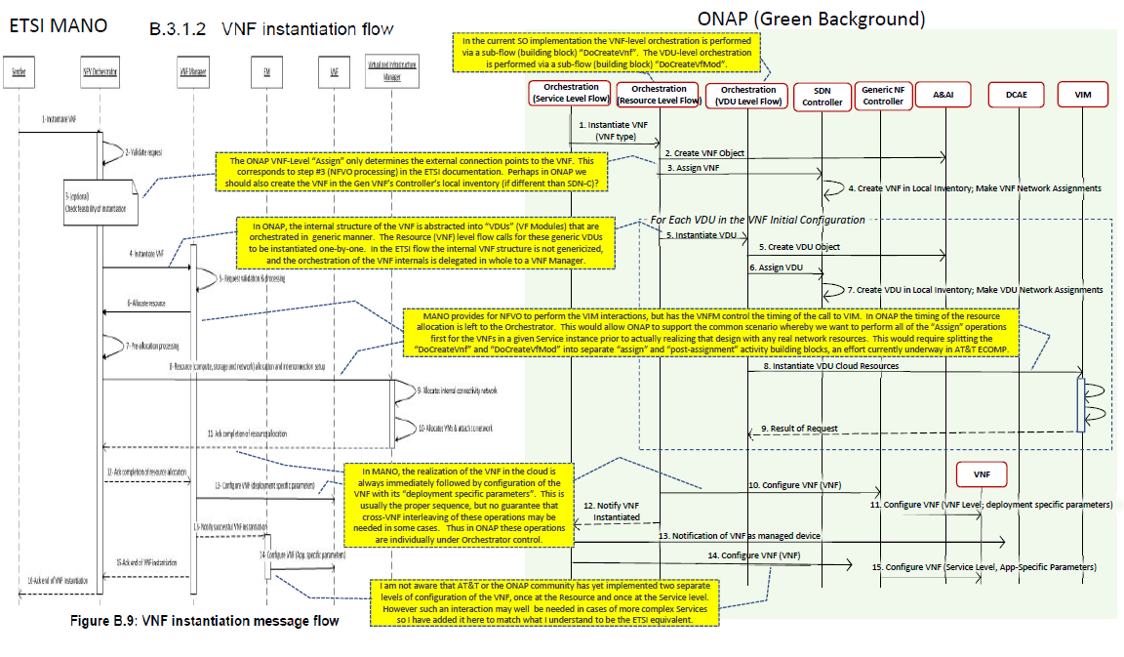

Slide 49
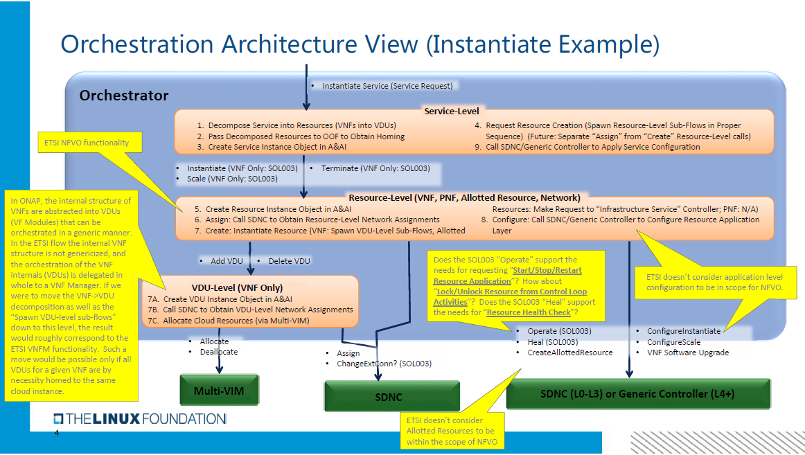

Slide 50
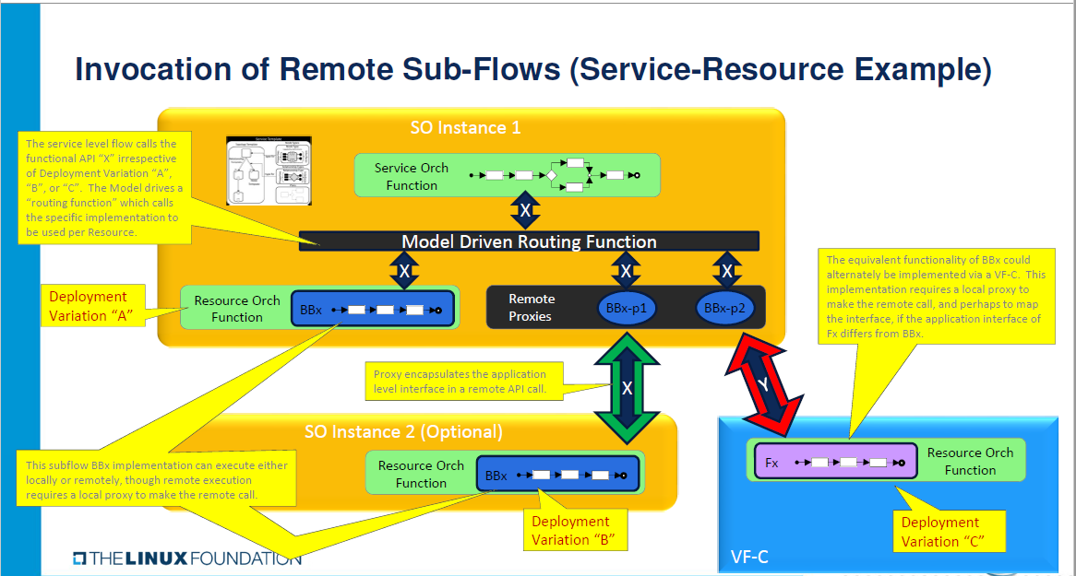

Slide 51
Vodafone Orchestration Proposal (Susana)
Work in Progress …

Slide 52

ONAP Target Architecture focus for orchestration/NF controller discussion
OSS / BSS
CLI
U-UI
ONAP Portal
ONAP External APIs
DESIGN-TIME
Dashboard OA&M
RUN-TIME
Resource Onboarding
Common
Services
Policy Framework
Data Collection, Analytics, and Events
Event Correlation
Active & Available Inventory
External Registry
Common Services
Orchestration
Service Design
Application
Authorization
Framework
Policy Creation & Validation
ONAP Operations Manager
Analytic Application Design
Micro Services Bus / Data Movement (see Note 1)
VNF / PNF Onboarding
ONAP Optimization Framework
Closed Loop Design
Change Management Design
Generic NF Controllers (L4-L7)
Logging
Multi-Cloud
Adaptation
SDN Controller
(L0-L3)
Design Test & Certification
Life Cycle Management & Config
Others
CCSDK
(see Note 1)
(see Note 1)
Catalog
Optional External Systems
3rd Party Controller
Specific VNF Manager
Element Management System
…
Managed Environment
Network Function Layer
Recipe/Eng Rules & Policy Distribution
ONAP Optimization Framework
VNFs
PNFs
Hypervisor / OS Layer
OpenStack
VMware
Azure
AMZ
RackSpace
Note 1 – Consistent APIs between Orchestration layer and Controllers
MPLS
IP
Private
Edge Cloud
Private
DC Cloud
Public
Cloud

Slide 53
ONAP Target Architecture for Orchestration layer and NF controller
(High-Level Functional View)
Domain/region versus end-to-end orchestration are depicted here for the sake of examples to depict interfaces. Expectation is to have a model driven orchestration functionality
VES and YANG not included in this figure for simplicity and also currently not in ETSI-NFV
ONAP External APIs
RUN-TIME
Orchestration
(domain/region)
Orchestration
(end-to-end)
Micro Services Bus / Data Movement
Generic NF Controllers (L4-L7)
Life Cycle Management & Config
Note
Optional External Systems
Specific VNF Manager
Element Management System
…
Network Function Layer
VNFs
VNFs
PNFs
Note: Both VNF and Element management may trigger actions to be executed by the generic NF controller

Slide 54
ONAP Target Architecture for Orchestration layer and NF controller
(APIs detailed)
Os-Ma nfvo (SOL 005)
ONAP additions
ONAP External APIs
Automation is key for the success of 5G
Management standards are partly incomplete and fragmented
ETSI MANO defines key interfaces (API)
ONAP creates an automation framework with the help of TMF/MEF
3GPP drives information models and network slices
Os-Ma nfvo (SOL 005)
ONAP additions
RUN-TIME
Orchestration
(domain/region)
Orchestration
(end-to-end)
Os-Ma nfvo (SOL 005)
ONAP additions
Micro Services Bus / Data Movement
Or-VNFM (SOL 003)
Generic NF Controllers (L4-L7)
Life Cycle Management & Config
Or-VNFM (SOL 003)
Ve-Vnfm-Vnf (SOL 002)
Optional External Systems
Ve-Vnfm-Vnf (SOL 002)
Specific VNF Manager
Element Management System
…
Network Function Layer
VNFs
VNFs
PNFs
Note: The depicted interfaces consists of sets of APIs that may be exposed by different ONAP modules. This needs to be detailed further

