Slide 1
ONAP Reference Architecture for R2 and Beyond
(Tiger Team Presentation)
Leader: Parviz Yegani – Futurewei Technologies
Contributors (R3+ Architecture): Vimal Begwani (AT&T), Lingli Deng (China Mobile), Jamil Chawki (Orange), Andrew Mayer (AT&T), Alex Vul (Intel), Gil Bullard (AT&T), Ramki Krishnan (VMware), Maopeng Zhang (ZTE), Stephen Terrill (Ericsson), Jianguo Zeng (Huawei), John Ng (AT&T), Fariborz Behi (AT&T), Chaker Al Hakim (Huawei), Nagel Davis (Ciena), Susana Sabator (Vodafone), Manoj K Nair (Netcracker), Huabing Zhao (ZTE), Nemes Denes (Nokia)
Other Contributors (Beijing Architecture): Project Technical Leaders (PTLs) of various ONAP projects
Jan. 19, 2018

Slide 2
ONAP High-Level Architecture for R1 (Amsterdam)

Slide 3
Progress from the Architecture Subcommittee
For Amsterdam (R1), the architecture was agreed, as discussed since ONS.
  This was to reduce risk of late changes to the project teams, who have built their plans based on the current baseline.
Starting with R2, there is consensus to resolve the following two architectural inconsistencies:
  Orchestration Architecture
    - Architecture team agreed that Orchestration layer should be separate from Controller layer
  Consistent Controller Layer Architecture and better alignment between App-C & VF-C
  Projects are drilling down to the next level of detail on interfaces and project alignment, and then the projects will review their R2 plans with the ARC.
The next slide illustrates high-level architectures that was approved by TSC to meet R1 schedule.

Slide 4


ONAP Amsterdam Architecture
ONAP Operations Manager (OOM)
Portal Framework, U-UI, ONAP CLI
DESIGN-TIME (SDC)
Dashboard OA&M (VID)
RUN-TIME
External API Framework
Resource Onboarding
Policy Framework
DCAE
Correlation Engine
(Holmes)
Service Orchestration
A&AI/ESR
Service & Product Design
Policy Creation & Validation
Common Services
DMaaP
CCSDK
Logging
Micro Services Bus (MSB)
AAF
VNF SDK
CLAMP
Multi-VIM/Cloud
Infrastructure Adaptation Layer
SDN-C
(L0-L3 Controller)
Application Controller
(L4-L7)
Virtual Function Controller
(ETSI-aligned)
Catalog
3rd Party Controller
sVNFM
EMS
External Systems
Managed Environment
…
Network Function Layer
VNFs
PNFs
…
Recipe/Eng Rules & Policy Distribution
Hypervisor / OS Layer
OpenStack
Commercial VIM
Public Cloud
Private
Edge Cloud
MPLS
Private
DC Cloud
IP
Public
Cloud
Notes:
Key points:
Unified framework for design-time & run-time
Common platform for service design and netops to drive collaboration
Simultaneous orchestration of physical and virtual networks
Vendor-agnostic orchestration can only happen in open source context
Real-time analytics and closed-loop automation
Easy re-use of service concepts
Iterative service improvements based on network feedback

Slide 5
ONAP Reference Architecture for R2 and Beyond

Slide 6
Architecture Design Considerations
Architecture Principles Were Reviewed Earlier and Agreed Upon by the Architecture Team:
  https://wiki.onap.org/display/DW/Contributions?preview=/8225716/8232492/Architectural%20principles_v3.docx
ONAP is a layered architecture – Orchestration, Multi-Cloud, Controller, etc.
Functional role of each layer should be well defined per the architecture principles agreed by the architecture team (see the above link).
ONAP should support integrated design studio to capture full lifecycle management models (TOSCA models for NF, simple / nested services augmented with BPMN, Policy / Analytic design models, etc.)
ONAP Should Support Cloud Agnostic Model and Multi-Cloud adaption layer while hiding infrastructure details
ONAP Target Goal is: Modular, Model-driven, Microservices-based architecture
  Models drive interfaces between layers/components
ONAP should define well-described and consistent NB-APIs at all layers
Keep flexible capability for commercial solution (no vendor lock-in)
Agree to unified modeling for integration across all modules: VES in DCAE, Logging & monitor inside ONAP and more

Slide 7

ONAP Target Architecture
(High-Level Functional View)
OSS / BSS
CLI
U-UI
ONAP Portal
ONAP External APIs
DESIGN-TIME
Dashboard OA&M
RUN-TIME
Resource Onboarding
Common
Services
Policy Framework
Data Collection, Analytics, and Events
Event Correlation
Active & Available Inventory
External Registry
Common Services
Orchestration
Service Design
Application
Authorization
Framework
Policy Creation & Validation
ONAP Operations Manager
Analytic Application Design
Micro Services Bus / Data Movement (see Note 1)
VNF / PNF Onboarding
ONAP Optimization Framework
Closed Loop Design
Change Management Design
Generic NF Controllers (L4-L7)
Logging
Multi-Cloud
Adaptation
SDN Controller
(L0-L3)
Design Test & Certification
Configuration & Life Cycle Management
Others
CCSDK
(see Note 1)
(see Note 1)
Catalog
Optional External Systems
3rd Party Controller
Specific VNF Manager
Element Management System
…
Managed Environment
Network Function Layer
Recipe/Eng Rules & Policy Distribution
ONAP Optimization Framework
VNFs
PNFs
Hypervisor / OS Layer
OpenStack
VMware
Azure
Kubernetes
RackSpace
Note 1 – Consistent APIs between Orchestration layer and Controllers
MPLS
IP
Private
Edge Cloud
Private
DC Cloud
Public
Cloud

Slide 8
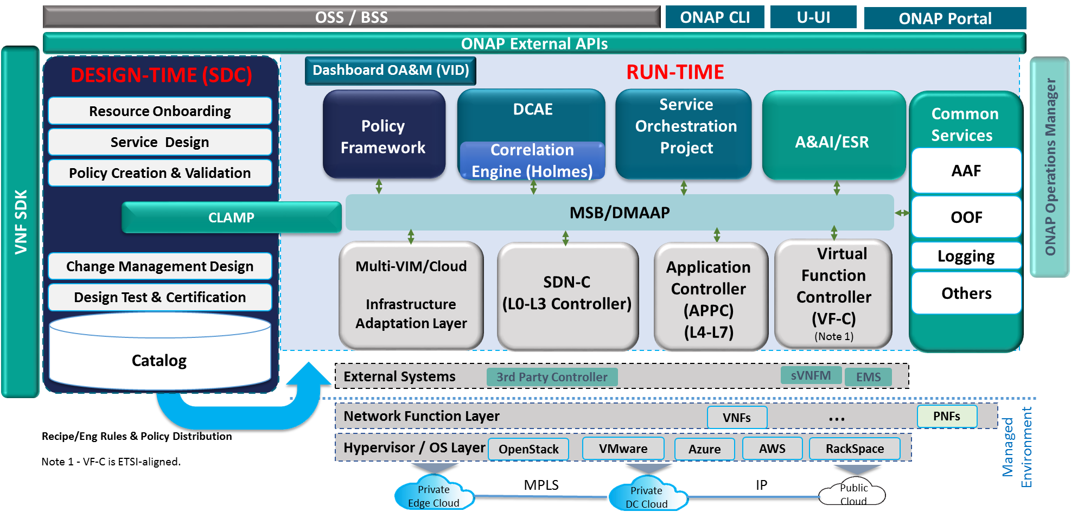
ONAP Beijing Architecture
(High-Level View with Projects)
Modeling (Utilities)
Integration
VNF Requirements
VNF Validation Program
PNFs
K8s
New projects to be added following TSC approval

Slide 9
ONAP Orchestration Alignment

Slide 10
ONAP Orchestrator Functions (1/2)
Orchestrate Network Functions (VNF/PNF), and Network Services (NSes), and services provided by the managed environment
Coordinate cross-controller activities driven by orders and events to
  LCM (instantiate/modify/upgrade/configure/remove) VNFs/PNFs, Nses, and services from the managed environment
  perform multi-control layer remedy actions.
Key Attributes of Orchestrator:
Model Driven Orchestration
  Process behavior driven by resource / service model designed in SDC
  Orchestrates network functions and service LCM (Instantiations, ..) , including compound / nested services (parts already in R1)
    Nesting may be domain-specific orchestrator (does not require SO clone)
  Support software upgrade and planned change management
  Support open & closed-loop control actions initiated by DCAE /Policy or external API (e.g. OSS for Open Loop)
  Tracks orchestrated activity for the life of the request but doesn’t control state of orchestrated components

Slide 11
ONAP Orchestrator Functions (2/2)
Interfaces to External OSS / BSS Systems
  Standard APIs exposed northbound to create, modify or remove services and resources
  Request decomposition of service request into service / network function components
  Selects model / recipe that supports the request and maps order data to recipe / model
Coordinating Activities Across Various ONAP Controllers
  Coordinates activities across Multi-Cloud (infrastructure) / SDN-C / APPC / VF-C controllers
  Manage recording of service configurations
Orchestrator Performs Following Additional Services
  Coordinates current inventories and placement/optimization recommendations
  Enforces business & technical policies
  Support standards-based workflows
  Validates and records network functions / service implementations

Slide 12
Examples of Orchestration Requests (1/2)
Install/Configure a single network function (VNF or PNF) – e.g. Deploy a new virtual PE / P router
  A virtual network element might have one or more components (e.g VNFCs or VDUs)
Install multiple copies of network functions in one or more data centers – e.g. Deploy new virtual PE / P routers across multiple locations
Deploy one or more instances of network services – e.g. RAN at Multiple sites, one or more sites of EPC, etc.
Deploy E2E network services (e.g. RAN + EPC + IMS) and services from the managed environment
Instantiate and LCM a customer services – e.g. multi-site VPN or IP SEC
  Could require deploying new instances of network elements (e.g. vCE) and using existing elements (e.g. vPE)
  Could be using existing elements without any new VNF / PNF being deployed (e.g. “Allocated Resources” – configuring a service to existing components)

Slide 13
Examples of Orchestration Requests (2/2)
Create a new instance of a network slice segment
  Could be leveraging existing network services (RAN, vEPC, etc.)
Create a new instance of a network service slice – e.g. IoT or eMBB slice
  Could be leveraging previously created network slice segments
Implement a software upgrade / change management
  Could require Coordination of activities across Multi-VIM (infrastructure)/SDN-C/app-C/VF-C controllers
Orchestrate remedial actions requested as part of Closed or open loop action
  Could require adding new compute / network resource to the existing functional elements (i.e. VNF)
  Create a new instance of VNF and migrate traffic
  Could require Coordination of activities across Multi-Cloud (infrastructure)/SDN-C/App-C/VF-C controllers)

Slide 14
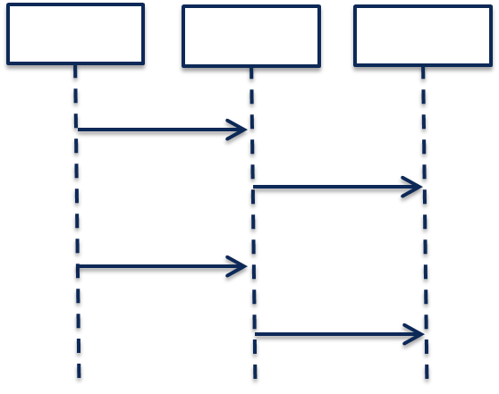
Model-Driven Orchestration (Recursive Structure)
“Generic” model-driven Service flow
Each Resource Type has its own “Generic” model-driven flow. There currently exist such flows for “VNF” and “Network” Resource Types.
Service Orchestration
Resource Orchestration
Cloud Resource Orchestration
PNF
Service X:
topology_template:
node_templates:
PNF
Network
VNF
Allotted Resource
Network
VF Module
Note recursion
VNF
Service Orchestration
Resource Orchestration
Allotted Resource
requirement: A
PNF
An Allotted Resource can be homed to an existing “underlying” network function or Service Instance, or homing could determine that a new network function Service Instance is needed. This would result in a 2nd level of Service Orchestration.
Service Y:
topology_template:
node_templates:
PNF
Network
VNF
Allotted Resource
capability: A
Network
Service Y is being treated as a “Resource” from the perspective of Service X.
VNF
Allotted Resource

Slide 15
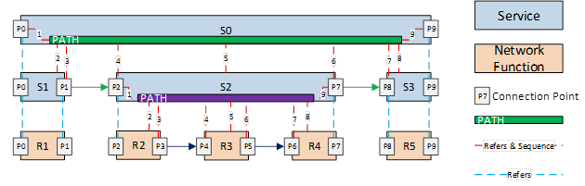
Nested / Compound Services:
Service W:
topology_template:
node_templates:
VNF_W
Service_X
Service X:
topology_template:
node_templates:
VNF_X
Service_Y
Service Y:
topology_template:
node_templates:
VNF_Y
Service_Z
Service Z:
topology_template:
node_templates:
VNF_Z

Slide 16
Conclusions
Service Providers require the ability to define Services that can be leveraged by higher order Services and other compounded services / segments / slices.
Consistent with ETSI MANO, ONAP should NOT separate Service Orchestration and Resource Orchestration into two separate named components, because each Resource can be exposed as a Service
      What appears as a “Resource” from one Service’s perspective, may actually be a Service from another perspective
      In Addition, ONAP scope is much broader than ETSI MANO (MANO limited to Cloud infrastructure services and management of VNF as a basic resource (ignoring the application of the VNF)), therefore SO should support full orchestration scope of ONAP
      To achieve alignment with MANO for common functionality, SO should expose APIs for basic resource onboarding/LCM (VNF) . This is SOL-001, SOL-004 and SOL-005.
      or simple network service onboarding/LCM (composed of one or more VNFs) and related modelsIn addition, ONAP SO should Support “Service reuse” to drive model driven run-time behavior for complex services:
        Compounded Services (e.g. Residential vCPE, Network Slicing Segments, etc.)
        Nested Services (e.g. E2E Slice)
      ONAP should provide Service Providers deployment flexibility to address scalability, geographic distribution and redundancy / resiliency
      But should not impose extra complexity and cost on service providers by separating service / resource orchestration that provides little known benefit

Slide 17
APPC & VF-C Convergence
Note – A major goal of the ONAP platform (R2 or a later release) is to specify a common set of functions to unify the APP-C and VF-C functionalities.

Slide 18
Role Of Controllers in ONAP
ONAP Controllers configure and maintain the health of network functional elements and services throughout their lifecycle.
Programmable network application management platform
  Behavior patterns programmed via models and policies
  Standards based models & protocols for multi-vendor implementation
  Operational control, coordinated state changes across devices, etc.
Manages the health of the network services & VNFs in its scope
  Policy-based optimization to meet SLAs
  Event-based control loop automation to solve local issues in near real-time
  Executes action for outer control loop automation (Driven by DCAE, Policy, etc.)
Local source of truth
  Manages inventory within its scope
  All stages/states of lifecycle
  Configuration audits
  ONAP has a layered architecture, with the role of controller clearly defined
  Need to avoid duplicating functions across layers within the controller layer (e.g. DCAE, Service/Resource Orchestration, etc.)

Slide 19
Functional Description of ONAP Components

Slide 20
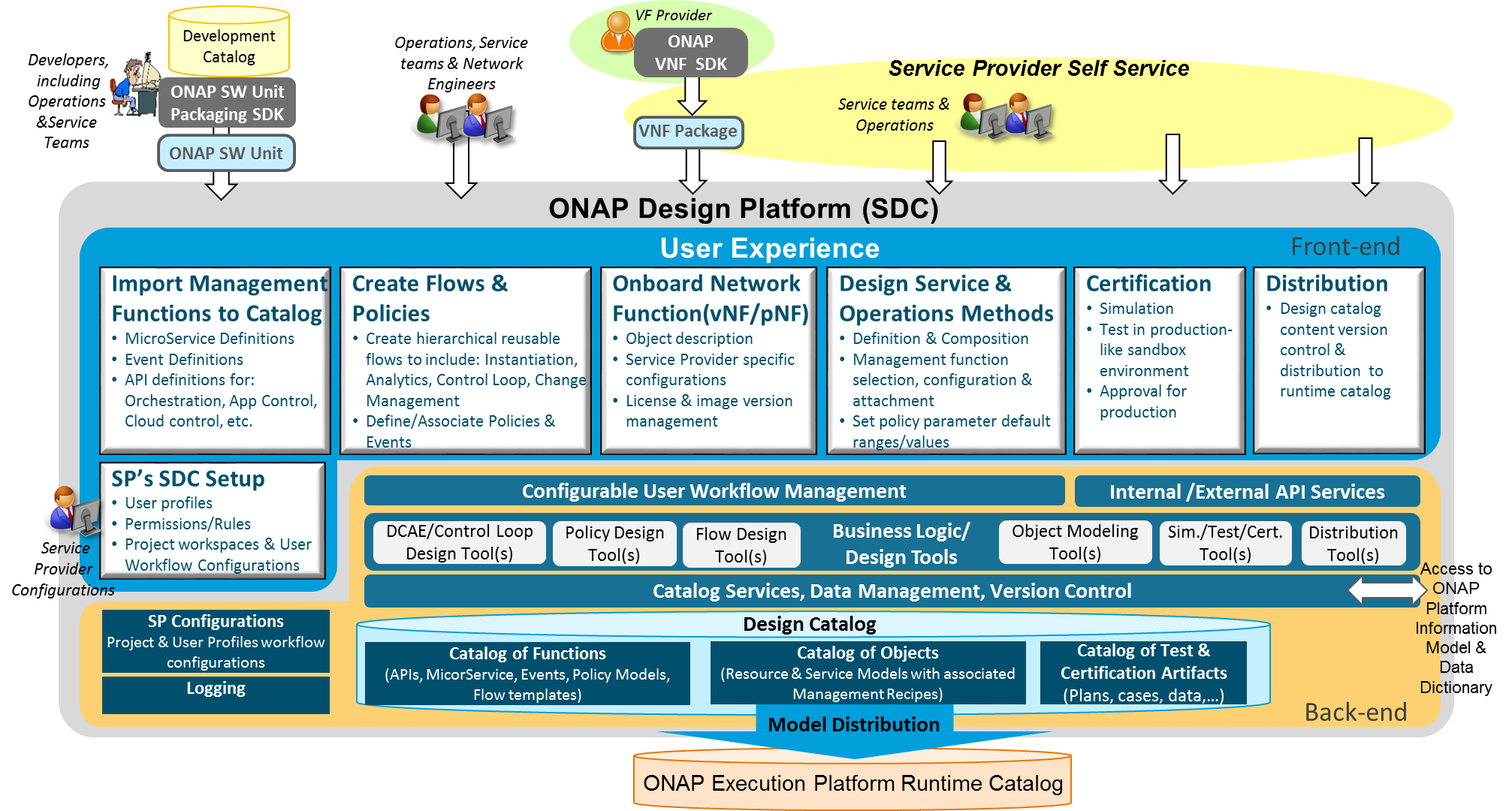
Service Design and Creation (SDC) Functional Architecture
Service Provider’s Design environment to: 1. Catalog management capabilities, 2. Onboard vendor provided Network Functions, 3. Design Services and Operations, 4. Test, certify, and distribute models for Runtime Execution
Import Management Functions
  Import ONAP base capability definitions from Development Catalog to Design Catalog as building blocks in a standard format
Create Flows & Policies
  Create reusable management flows using building blocks & associated events & Policies
Onboard Network Functions
  Create VF model to include vendor’s description, scripts, & license model
  Customize models to include Service Provider specific attributes
Design Service & Operations Methods
  Create Service models with resources
  Design and associate operations processes & policies (e.g., Instantiation, DCAE/Control Loop, Change Management, etc.) and configure them to be service specific
Certification
  Simulate & test the design in Sandbox environment
  Certify Readiness & Adherence to Standards
Metadata Distribution
  Publish certified models for distribution to runtime catalog
  Notifications & Version Control

Slide 21
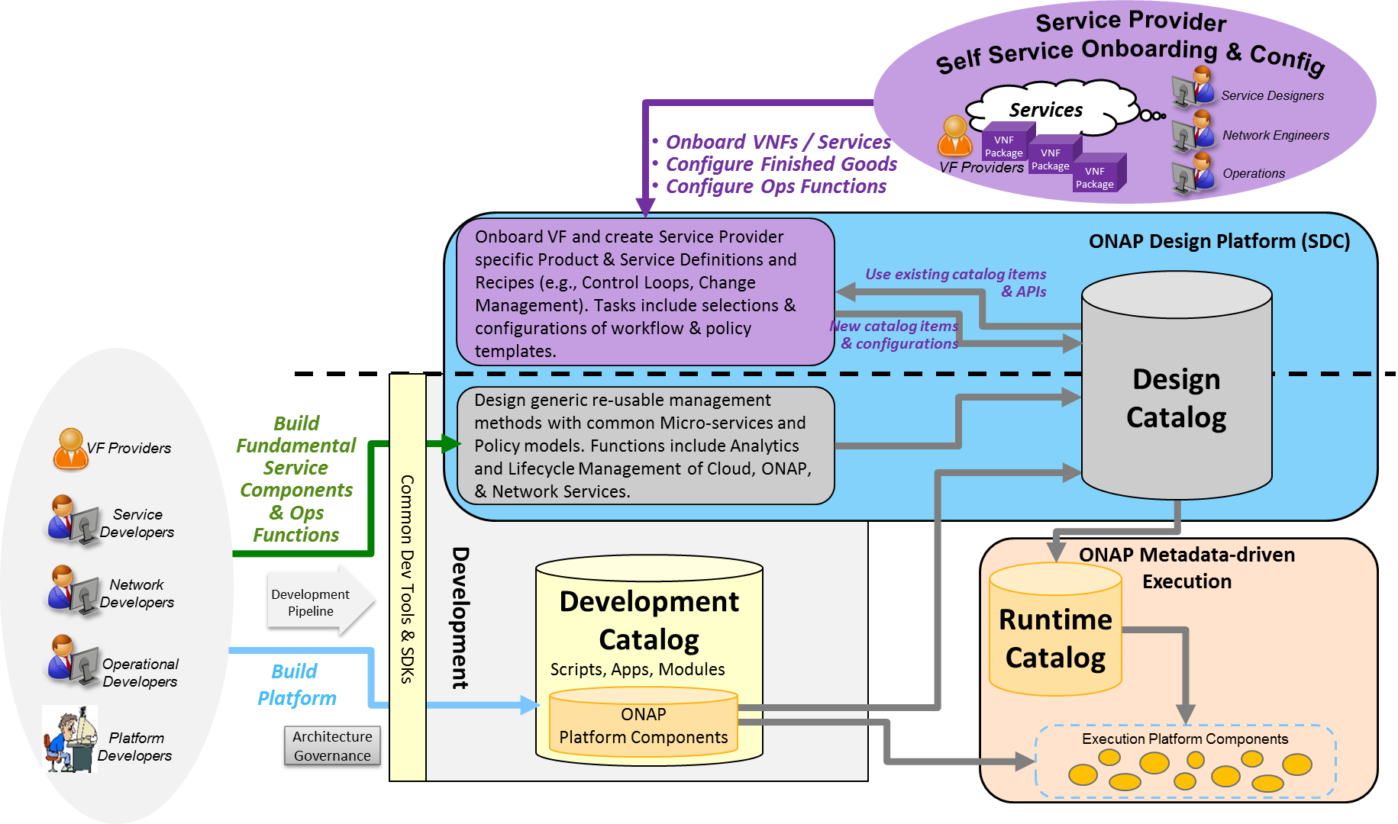
Catalog Architecture
The overall ONAP Catalog architecture includes Development Catalog, Design Catalog, and Runtime Catalog
Partially Existing:
Design Catalog (ONAP Design Platform - SDC)
  Catalog imported ONAP generic re-usable management software function & policy definitions
  Enable SP to onboard standard VNF packages
  Support SP users in design & lifecycle management of Resource and Service models
  Provide presentation to support service compositions & management flow associations
  Manages catalog’s elements versions, lifecycle and access policy
  All certified asset definitions available for re-use and composition
Yet to be implemented:
Development Catalog (ONAP Development)
  Common toolsets and data store for creation of ONAP software models & management flows/policies
  Interact with external software development teams and suppliers to onboard custom software, adapters or new capabilities
Runtime Catalog (ONAP Execution Platform)
  Provide a common data store for distributed certified models
  Provide ONAP runtime component’s subscription to access component view of the model data
  Maintain executable images and other runtime artifacts

Slide 22
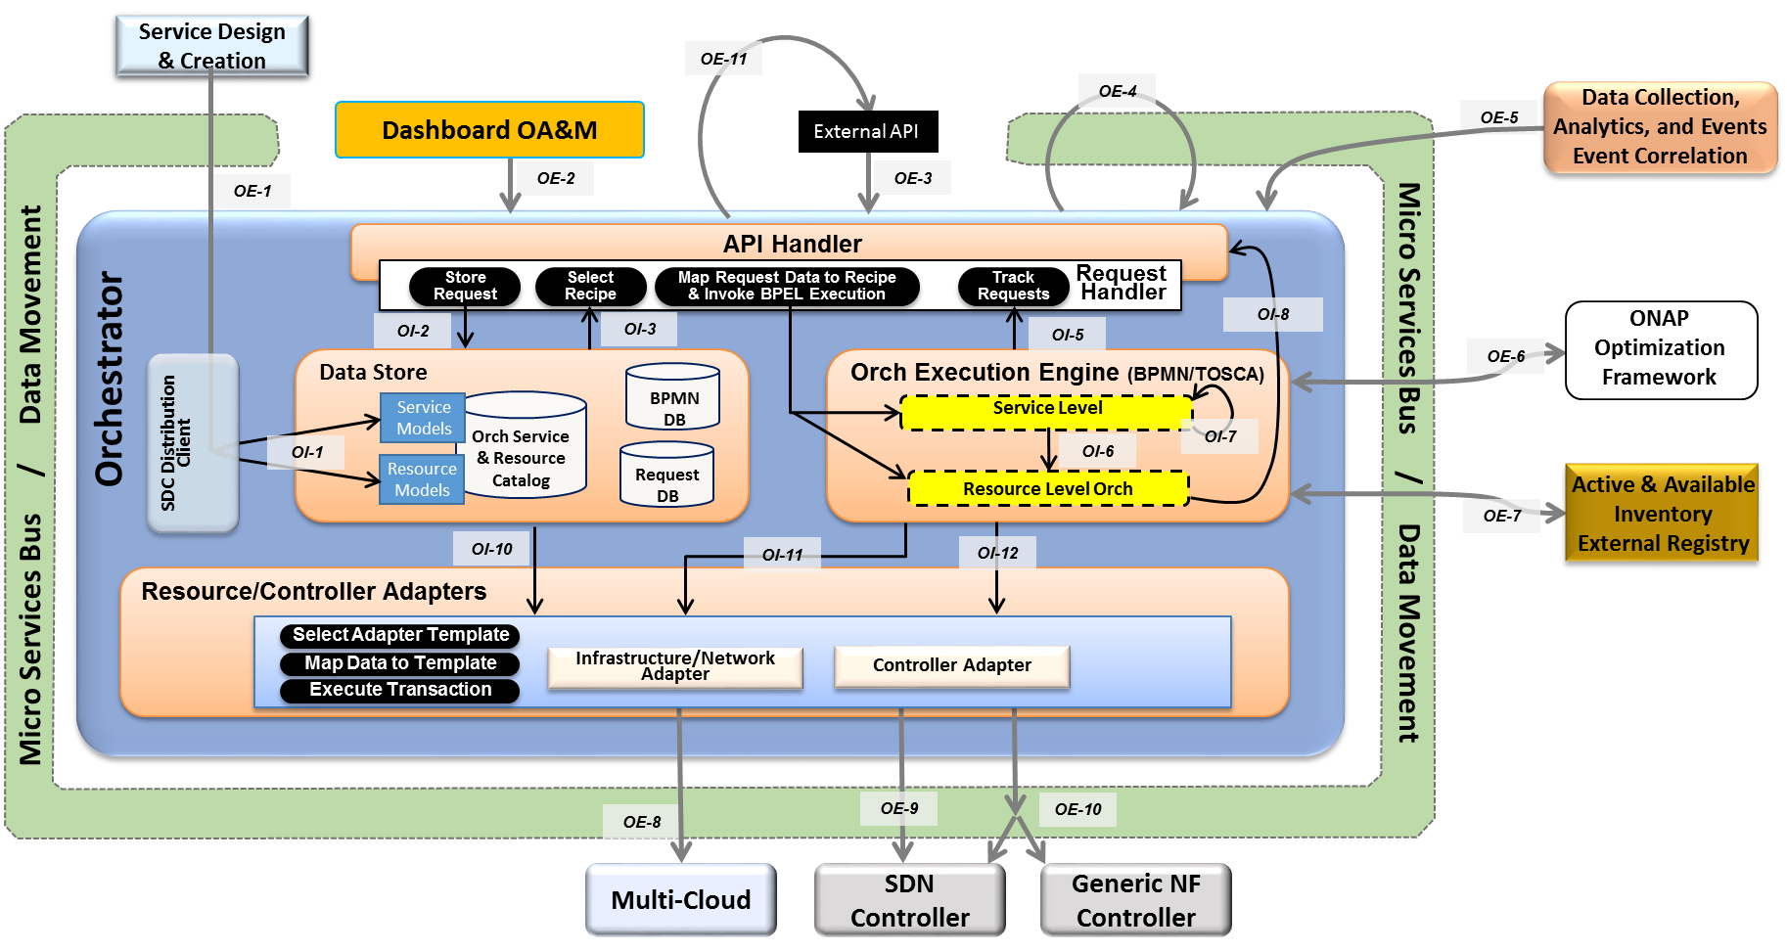
Orchestrator
The ONAP Orchestrator orchestrates service, resources and associated cross-controller activity driven by requests and events that indicate the need to create, modify or remove service and resource instances, or to perform multi-control layer remedy actions.
Model Driven Orchestration and APIs
  Runtime behavior driven by service and resource models and policies (including compound/nested services) designed in or onboarded into SDC
  Orchestrates service delivery, change management as well as open and closed-loop control actions
  Provides standard, model driven APIs for requested actions
  Tracks orchestrated activity for the life of the
  request, but doesn’t maintain state of
  orchestrated components
Processing of Service Requests:
  Performs Decomposition, Recipe Selection, Recipe Execution (including Rainy Day)
  Triggers and Records Results for:
  Homing
  Assign, Create, Configure
  (Controller/multi-cloud activity)
  Validation
  Monitoring
  Separate execution threads for service, decomposed resources, and any subtending service(s) provide nested service orchestration in a recursive manner
Orchestration of Controllers
  Coordinates activities across Multi-Cloud/
  SDN-C/Generic NF controllers, including data sourcing and mapping to Controller inputs

Slide 23
Orchestrator Functional Internal View
APIs labeled on slide relative to SO for reference only.
Key
OE-x
SO External API
OI-x
SO Internal API
SO-SO communication across ONAP instances looks like an External API.
SO-SO communication within a single ONAP instance is via Micro Services Bus.
Service Design & Creation
OE-11
OE-4
Data Collection, Analytics, and Events
Event Correlation
Dashboard OA&M
External API
OE-5
OE-1
OE-2
OE-3
API Handler
Request
Handler
Allotted Resources case
Store
Request
Select Recipe
Map Request Data to Recipe & Invoke BPEL Execution
Track
Requests
OI-2
OI-3
OI-5
OI-8
ONAP Optimization Framework
OI-4
OE-6
Orchestrator
Data Store
Orch Execution Engine (BPMN/TOSCA)
Service Models
Orch Service
& Resource
Catalog
BPMN
DB
Service Level
SDC Distribution Client
OI-7
Complex Services case
OI-1
Resource
Models
Request DB
OI-6
Micro Services Bus / Data Movement
Micro Services Bus / Data Movement
OI-9
Resource Level Orch
Active & Available Inventory
External Registry
OE-7
OI-10
OI-11
OI-12
Resource/Controller Adapters
Select Adapter Template
Controller Adapter
Map Data to Template
Infrastructure/Network Adapter
Execute Transaction
Controller functions common to both SDN-C and Generic NF Controller. Note that this may actually be 2 APIs and not a single.
Controller functions specific only to SDN-C. E.g., “Assign Network Resources” for the VNFs in a L4+ Service.
OE-8
OE-9
OE-10
Multi-Cloud
SDN Controller
Generic NF Controller

Slide 24
Generic NF Controller (L4-7) Architecture
Key
CE-x
Controller External API
CI-x
Controller Internal API
Generic NF Controller for L4-7 configures and maintains the health of applications throughout its lifecycle.
  The Lifecycle Management Functions are a normalization of VF-C and APP-C functions into a common, extensible library
Programmable network application management platform
  Behavior patterns programmed via models and policies
  Standards based models & protocols for multi-vendor implementation
  Extensible SB adapter set including vendor specific VNF-Managers
  Operational control, version management, software updates, etc.
Manages the health of applications/VNFs/PNFs within its scope
  Policy-based optimization to meet SLAs
  Event-based control loop automation to solve local issues near real-time
Local source of truth
  Manages inventory within its scope
  All stages/states of lifecycle
  Configuration audits
Key Attributes of Generic NF Controllers
  Intimate with network protocols
  Manages the state of services
  Provide Deployment Flexibility to meet user scalability / resilience needs
Artifact Distribution
Orchestration
Closed Loop Actions
Inventory
Updates
Service Design & Creation
Orchestration
Data Collection, Analytics & Events
Active & Available Inventory
MSB/Data Movement
CE-1
CE-2
CE-3
CE-4
Generic NF
Controller
API Handler
CI-1
CI-2
CI-3
Repository
Operational Tree/Config Tree
(Service Model)
Service Logic
Service Logic Processing
CI-5
VNF Descriptors
CI-4
Lifecycle Mgmt. Functions/MicroServices (mS)
Assigned Resources Inventory:
Service* Topology & VNF/PNF State
Config Templates
Config mS
Audit mS
SW Upgrade mS
Engineering Rules
…
…
…
MSB/Data Movement
Service Logic
Service Logic
Service Logic
Policy Cache/Event Match
CI-7
*Not E2E service view. The “Service” view in the Generic NF Controller is limited its scope of control
CI-6
Adapters
Multi-Cloud Adapter
Netconf
Chef
Ansible
…
Others
External System Adapter (s)
CE-5
CE-6
MSB/Data Movement
Applications
VNFs
PNFs
External
3rd Party Controllers
Specific VNF Managers
Element Mgt. Systems
Multi-VIM/Cloud

Slide 25
SDN-Controller Architecture
Key
CE-x
Controller External API
CI-x
Controller Internal API
SDN Controller configures and maintains the health of L1-3 VNFs/PNFs and network services throughout their lifecycle
Programmable network application management platform
  Behavior patterns programmed via models and policies
  Standards based models & protocols for multi-vendor implementation
  Extensible SB adapter set supporting various network config protocols, including 3rd party controllers
  Operational control, coordinated state changes across devices, source of telemetry/events, etc.
Manages the health of network services & VNFs/PNFs in its scope
  Policy-based optimization to meet SLAs
  Event-based control loop automation to solve local issues near real-time
  Action executor for outer control loop automation
Local source of truth
  Manages inventory within its scope
  All stages/states of lifecycle
  Configuration audits
Key Attributes of Controllers
  Intimate with network protocols
  Manages the state of services
  Single service/network domain scope per instance
Artifact Distribution
Orchestration
Closed Loop Actions
Inventory
Updates
Service Design & Creation
Orchestration
Data Collection, Analytics & Events
Active & Available Inventory
MSB/Data Movement
CE-1
CE-2
CE-3
CE-4
SDN
Controller
API Handler
CI-1
CI-2
CI-3
Repository
Service Control
Processing
Operational Tree/
Config Tree
(Service Model)
CI-5
NB Service/Network Yang Models
CI-4
Service Logic
Service Logic
IP/VRF Assign
L2 Service Create
L3 VPN Service Create
SD-WAN Create
TE Tunneling
BGP Config
SW Upgrade
…
Configuration Templates
Service/Network Design & Engineering Rules
Service Logic
MSB/Data Movement
…
Assigned Resources Inventory: Service* Topology &
VNF/PNF State
Policies
CI-7
SB Device Yang Models
Service Logic
*Not E2E service view. The “Service” view in the SDN Controller is limited its scope of control
CI-6
Adapters
Multi-Cloud Network Adapter
NetConf/ YANG
OpenFlow
BGP LS/
PCEP
…
Others
External System Adapter (s)
CE-5
CE-6
MSB/Data Movement
External
3rd Party Controllers
Element Mgt. Systems
Multi-VIM/Cloud
VNFs
PNFs

Slide 26
Data Collection, Analytics and Events (DCAE) Architecture
Analytic µServices
Managed Environment
Fault Correlation
Congestion Detection
Capacity Management
QoS Monitoring
Security Analysis
…
DCAE
VNFs / PNFs
Applications
VES
OOM – DCAE Controller
Streaming
Data
Networking
DMaaP (Pub/Sub for Events/Data within DCAE & across ONAP)
Analytic Frameworks:
Holmes, CDAP, Other
Stream Data Collection
Batch
Data
Events
Flows
Other
Multi-Cloud Telemetry Adaption
Compute
SNMP
Unstructured & Structured Data Persistence
Batch Data Collection
Syslog
Storage
Logs
Files
Other
Other
DCAE enables real-time fault, performance and other data/event collection from service, network and infrastructure
  Collect Data & Events once and make available to multiple applications
  Telemetry records from VNFs and PNFs (fault, performance, usage, etc.)
Makes collected data available to real-time analytic µ-services to:
  Identify anomalies and other events for closed loop remediation
  Enable closed-loop automation to remedy fault/performance conditions
  Enable closed-loop automation to scale resources up/down
  Enable analysis at edge and central locations
  Extensible framework to integrate applications from various sources
Provides Correlation & Analysis to manage service at various layers
  Multi-Cloud Infrastructure layer, network element layer, Network & Complex Services layer, Operational Management layer
  Cross-layer, Intra-domain and cross-domain correlation

Slide 27
Active and Available Inventory
A&AI tracks the global inventory of the networks, services & resources that ONAP manages.
  The what, where, when of the managed assets and their relationships, and which controller manages them, etc.
Real-time, logically centralized view of topology & inventory
  Map and broker of data sources in the global network
  Federates across controllers, cloud infrastructure, partners, etc.
  Real-time access to authoritative sources with ability to aggregate views
  Real-time awareness of network elements, applications and service instances
  Aware of all the assets in scope, organized by their type, state & location
  Keeps track of the dynamic relationships of the virtual assets
  Aware of resource assignments, availability & relationships to customer
Network events used to maintain the integrity of inventory
  Monitors network events to register services, networks & resources
  Tracks creation, modification or removal of entities and relationships
A&AI
API Handler
Metadata Engine
Inventory & Topology Management
API Generation
Entitlement
Service
Resource
Active
Available
Reference
Network
Infrastructure
Topology
Assignment
Schema Generation
Graph Layer
Version Management
A&AI Data Management Services
Entitlements & Reference
Inventory & Topology
Metadata Management
A&AI Application Management Functions
OA&M
History
Event Subscriptions
Notifications
Data Audits
Archival
Model-driven
  Schema, APIs, database views, data integrity mechanisms generated from models expressed in TOSCA.

Slide 28
ONAP SDK-Driven Sub-System Approach
For Further Study
Goal: Move toward a common platform architecture, starting with Controllers, Orchestration and Multi-Cloud
Improve agility for on-demand/situational creation of instances
Reduce software footprint of platform component instances
Reusable tool chain and framework across components
Facilitate agile introduction and swap-out of technologies
Consistent use of NB and SB APIs
Enable flexible options to add and extend platform capabilities

Slide 29
SDK-Driven Sub-System – Libraries (including CCSDK)
For Further Study
SDK Libraries
NB API SDK
API Handler
API Configurator
Orchestration APIs
Controller APIs
Cloud APIs
API Catalog
Orchestration Function SDK
Control Function SDK (CCSDK)
Multi-Cloud Adaptation SDK
Library of
Common Control/NFV Lifecycle Mgt. Functions
Library of
Common Cloud Translations (shims)
Library of Flows
Service, Resource, Etc.
Rebuild
A udit
VNF Configure
Assign
Cloud Resource
Instantiation
Telemetry
Scale
…
Stop/Start
Scale
Network Config.
…
Imperative Models
Declarative Models
Health Check
Register
Heal
LB
BPMN orchestration
engine
TOSCA orchestration
engine
Upgrade
Heal
Svc Function Chain
ODL
ONOS
Open
ROADM
…
Sub-Models
TOSCA-Cloud
Translation/Mapper
SB API SDK
(Adapters)
M-Cloud APIs
OSS APIs
Netconf/Yang
OpenStack
API Catalog
Controller APIs
μServices APIs
Ansible
Plugins/Adapters*
Azure
Resource Orchestration APIs
Collectors
AWS
etc.
Orchestrators
Controllers
μServices
OSSs
VNFs
PNFs
Multi-Cloud
OpenStack
Azure
AWS
Rackspace
IBM
Google
*Plugins/Adapters can include:
3rd party VNFM Drivers • 3rd party EMS Drivers
3rd party SFC Drivers • Ansible/Chef/Puppet
Netconf/Yang • CLI
SNMP • etc.

Slide 30
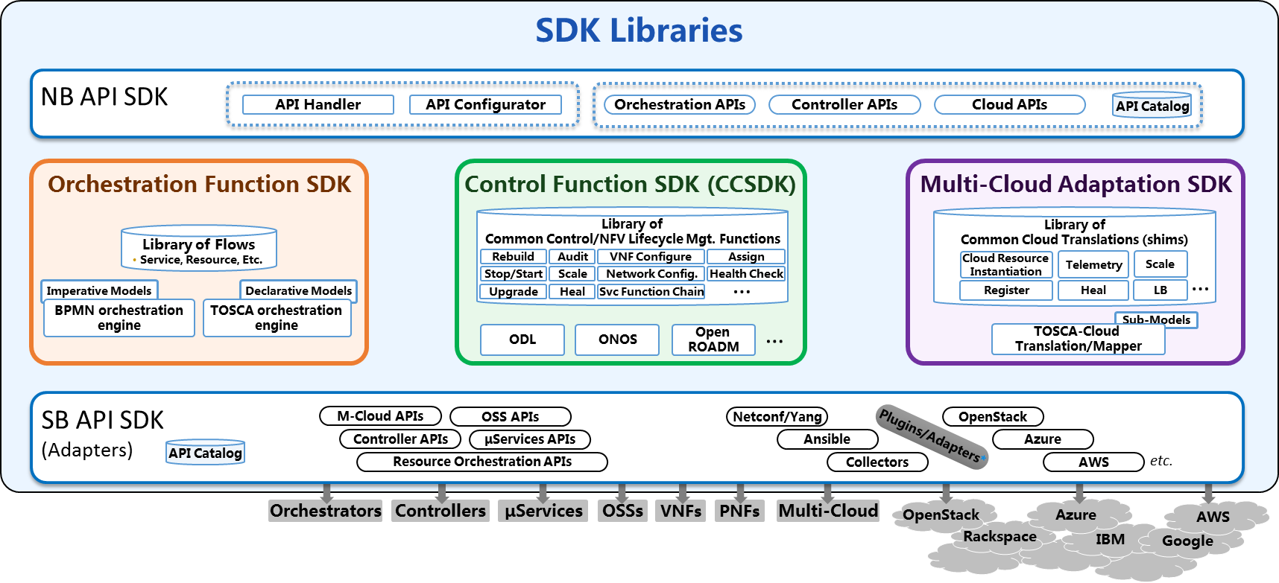
Controller Personas Based on SDK Libraries
For Further Study
SDK Libraries
SDN-C Persona
Generic VNF Controller Persona
NB API
NB API
Controller APIs
Controller APIs
Controller Personas Examples
(created from CCSDK)
Control Functions
LCM Functions
Library
Library
Assign
Network Config
Rebuild
Audit
VNF Configure
…
VNF Configure
…
Svc Function Chain
Stop/Start
Scale
Svc Function Chain
HealthCk
Heal
ODL
…
Other engines
ODL
SB
API
SB
API
Netconf/Yang
μServices APIs
…
…
Ansible
Netconf/Yang
3rd Party SFC
Other Adapters
OSS APIs
Other Adapters
OSS APIs
μServices APIs
3rd VNFM/EMS

Slide 31
ONAP High-Level Architecture for R2 (Beijing)

Slide 32
ONAP Beijing Architecture
(High-Level View with Projects)
Modeling (Utilities)
Integration
VNF Requirements
VNF Validation Program
PNFs
K8s
New projects to be added following TSC approval

Slide 33
Functional Description of Beijing Architecture Components
Note – The detailed description of features/capabilities/interfaces for each component planned for the Beijing release will be provided by respective projects.

Slide 34
Orchestration (1/2)
Definition:
Provides functionality for the execution of specified process and automated sequencing of activities, task, rules and policies needed for creation, modification, removal of network application, infrastructure services or resources.
Supports different specializations with specific orchestration scopes.
Specialization scopes include, but are not limited to, network service LCM (i..e VNFO specialization), network slice specialization, domain specific specialization.
Service Management Interface
Network Service LCM Interface
Actuation Request Interface
Service Definition Reception interface
Orchestration
Provided Interfaces:
Service Management Interface
  Provides the interface to manage the services that orchestration provides.
Network Service LCM interface
  Provides the specific network service LCM interface.
Actuation Request Interface
  Provides support of actuation requests towards the services.
Service Management Interface
VNF LCM Interface
NF Config Interface
Optimization request Interface
Inventory Service Interface
Transport Service Interface
Network Service LCM interface

Slide 35
Orchestration (2/2)
Service Management Interface
Network Service LCM Interface
Actuation Request Interface
Service Definition Reception Interface
Consumed interface Interfaces:
Service Management Interface, from: Orchestration
VNF LCM Interface, from: Generic NF controller
Optimization Request Interface, from: Optimization Framework
NF Config Interface, from: Generic NF controller
Inventory Service Interface, from: Available and Active Inventory
Transport Service Interface, from: SDN Controller.
Network Service LCM interface, from: Orchestrator
Orchestration
Service Management Interface
VNF LCM Interface
NF Config Interface
Optimization request Interface
Inventory Service Interface
Transport Service Interface
Network Service LCM interface
Consumed Models:
Network Service Descriptor
Rest to be filled in.

Slide 36
Data Collection, Analytics, and Events
Definition:
DCAE is the ONAP subsystem that supports closed loop control and higher-level correlation for business and operations activities. DCAE collects performance, usage, and configuration data; provides computation of analytics; aids in trouble-shooting and management; and publishes event, data, and analytics to the rest of the ONAP system for FCAPS functionality.
Interface 1
Data Collection, Analytics, and Events
Provided Interfaces:
Interface 1: Data collection interface (used by VNFs and others from which data is collected)
  Interface for various FCAPS data entering DCAE/ONAP.
Interface 2: Deployment interface (used by CLAMP)
  Interface for triggering the deployment and changes of a control loop
Consumed interface Interfaces:
Interface 1: Data movement platform interface (provided by DMaaP)
  Interface for data transportation between DCAE subcomponents and between DCAE and other ONAP components
  This interface can also be used for publishing events to other ONAP components.
Interface 2: Data enrichment interface (provided by A&AI)
  Interface used by DCAE for enriching collected raw data by adding information not contained in original data, e.g. identifying the VNF type from VNF identity by querying this interface.
Interface 2: Service model change interface (Provided by SDC)
  Interface for fetching control loop models and updates.
Interface 4: Policy interface (Provided by Policy)
  Interface for fetching configuration and operation policies on control loop and control loop components into DCAE for application.
Interface N
Consumed Models: TOSCA models descripting control loop construction (e.g. collection and analytics apparatus)

Slide 37
Active & Available Inventory, External Registry
Definition:
AAI maintains a live view of services and resources in the network, providing the state and relationships of the service components
Maintains the view of the managed systems services and resources, as well as information of the external systems that ONAP will connect to.
It provides real-time views of a managed systems resources, services and relationships with each other.
AAI provides a GUI to provide users the ability to find and inspect inventory data. This includes a free-text search, inspection of specific entities and their relationships, and aggregated views of data.
Inventory Service Interface
External Register Interface
Active & Available Inventory, External Registry
Provided Interfaces:
Inventory Service Interfaces:
  AAI Resources REST API - Provides the ability to store, read, update inventory information
  Gizmo: a low-level REST CRUD API that provides targeted and simple access to entities, relationships, and their properties. Gizmo also provides lightweight collections, and transactional bulk write support
Complex Query Interface: AAI Traversal REST API – Provides the ability to perform complex traversals of the AAI Graph
External Register interface
  Provides the ability to provision and read external system information
Interface N
Consumed interface Interfaces:
DMaaP
SDC
Multivim
Consumed Models: TOSCA Service and Resource Models

Slide 38
AAF Functional Description
The purpose of AAF (Application Authorization Framework) is to organize software authorizations so that applications, tools and services can match the access needed to perform job functions. This is a critical function for Cloud environments, as Services need to be able to be installed and running in a very short time, and should not be encumbered with local configurations of Users, Permissions and Passwords.
To be effective during a computer transaction, Security must not only be secure, but very fast. Given that each transaction must be checked and validated for Authorization and Authentication, it is critical that all elements on this path perform optimally.
AAF contains some elements of Role Based Authorization, but includes Attribute Based Authorization elements as well.
Essential Functional Components:
The core component to deliver this Enterprise Access is a RESTful service, with runtime instances backed by a resilient Datastore (Cassandra as of release 1.3)
The Data is managed by RESTful API, with Admin functions supplemented by Character Based User interface and certain GUI elements.
The Service accessible by provided Caching Clients and by specialized plugins
CADI (A Framework for providing Enterprise Class Authentication and Authorization with minimal configuration to Containers and Standalone Services)
Cassandra (GRID Core)

Slide 39
AAF Functional Description
CADI stands for Code, Access, Data and Identity, This Framework addresses the Runtime Elements of Access and Identity.
Many other tools address elements of this vision. For instance, Sonar and Fortify evaluate code for maintainability and security problems, while Voltage provides encryption for Data at Rest.
However, CADI Framework contributes to these for runtime applications by:
Code - CADI provides reusable Security Client code, and ties in with appropriate Security Interfaces (i.e. J2EE Standard Filters)
Access - CADI provides links to Authorization tool(s) (AAF) for Fine-grained Authorization. Also, data from Identity servers is also made available to Coders easily. For instance, CADI provides a clean API to read the Course Grained Authorization information available within the CSP Cookie.
Data - CADI provides simple setup for certificates needed for TLS connectivity, so that barriers to using HTTPS are greatly reduced. It also ensures that no one using CADI uses clear-text passwords in Configuration files.
Identity - CADI Framework obtains the Identity of any callers by delegating to CSO approved Identity servers on behalf of the client, so that Applications can be assured of who is talking to them.

Slide 40
AAF Functional Description
Entities within AAF
Namespaces
A Namespace, in AAF, is the ensemble of Roles, Permissions and Identities controllable within the domain assigned to a member of the Organization's chain-of-command.
Namespaces are known by domain, in dot-delimited form. ex: com.att.aaf or com.att.wfa, and they are hierarchically managed.
People in Namespaces
Owner (Responsible)
A key feature of how AAF works for an Enterprise is by supporting federated responsibility. This responsibility is clearly delineated by the owner entry. Organizations (i.e. companies) may establish their own policies
Roles
I) "Roles" is a bit of an overloaded term in Security software. It has unfortunately been typically used as a flat, unscoped Group, known only to the Application.
Typical examples such as "user" and "admin" have no meaning outside the immediate context of the application. "admin"??? "admin" of what? What are the behaviors allowed for "admin"? Is the "admin" of Application A, the same as Application B? (answer, no!)
Permissions
Permissions are the other side of the decoupled Authorization equation. Permissions represent some resource that needs to be protected by the Application in question. examples:
A GUI Admin page should be available to only those who job function is to administer this app.
SPI Data that this App accesses should only be accessible to those who are allowed to see SPI data.
Full data reporting dumps should only be accessible to Audit teams.

Slide 41
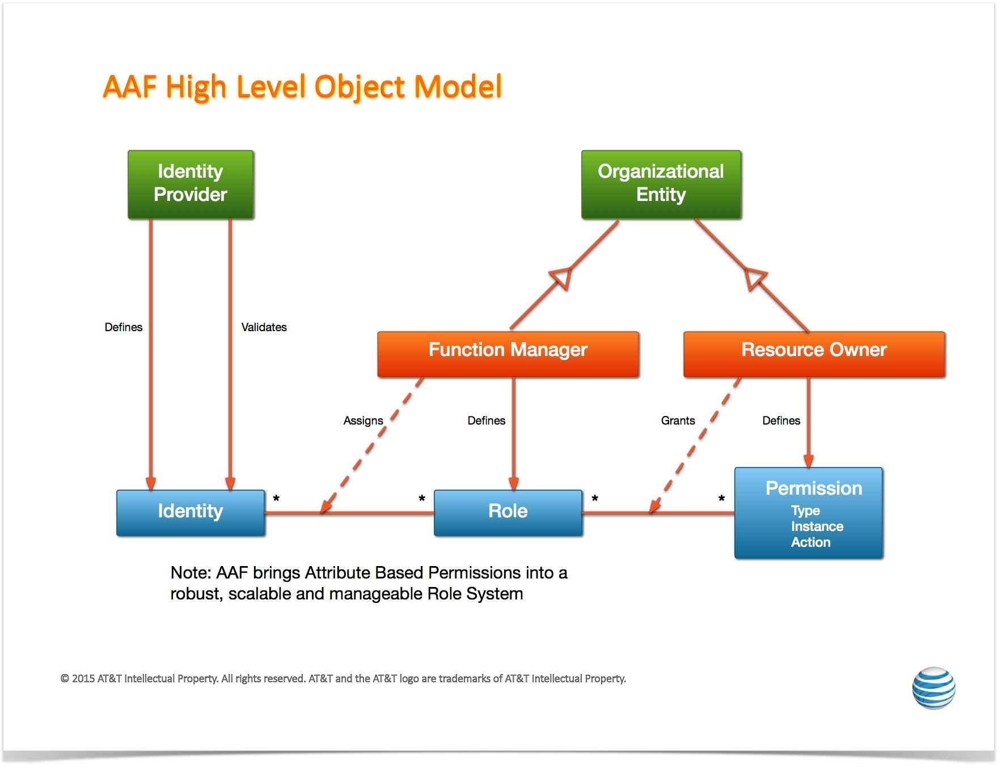
AAF Object Model

Slide 42
DMaaP Functional Description
Data movement as a platform(DMaaP) is a premier platform for high performing and cost effective data movement services that transports and processes data from any source to any target with the format, quality, security, and concurrency required to serve the business and customer needs.
DMaaP consists of three major functional areas:
1. Data Filtering - the data preprocessing at the edge via data analytics and compression to reduce the data size needed to be processed.
2. Data Transport - the transport of data intra & inter data centers. The transport will support both file based and event based data movement. The Data Transport process needs to provide the ability to move data from any system to any system with minimal latency, guaranteed delivery and highly available solution that supports a self-subscription model that lowers initial cost and improves time to market.
3. Data Processing - the low latency and high throughput data transformation, aggregation, and analysis. The processing will be elastically scalable and fault-tolerant across data centers. The Data processing needs to provide the ability to process both batch and near real-time data.
This service is build using Apache Kafka and Restful API is created for message publishing, subscribing and admin activities

Slide 43
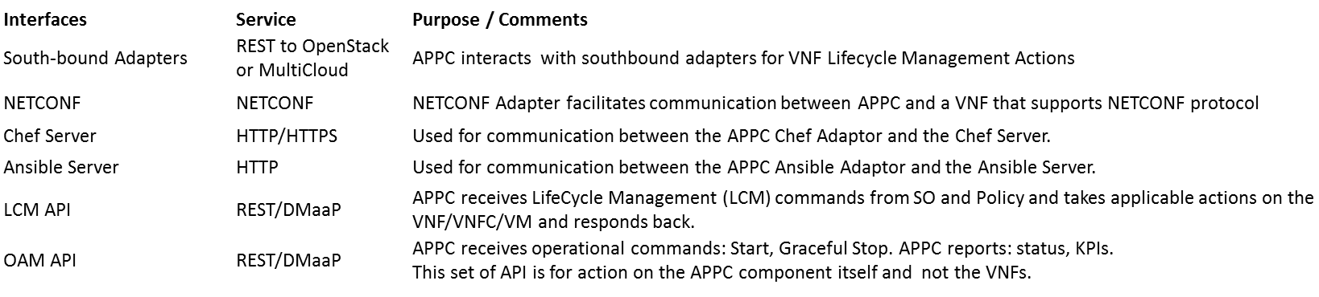
APPC (1/2)
Definition:
Application Controller (APPC) performs the functions to manage the lifecycle of VNFs and their components.
It provides a comprehensive set of controller actions such as Configure, Modify Configuration, Start, Stop, Migrate, Restart, Rebuild, and so on. Consult readthedocs documentation for the full set of APIs offered/supported.
It supports a set of standard VNF interfaces (Netconf, Chef, Ansible.), and
Is designed to be self-service using a model driven architecture that provides a layer of abstraction making APPC completely service, VNF, and site agnostic.
Information about the APPC architecture and provided APIs can be found in the APPC User Guide and LCM & OAM API Guides on readthedocs
.
Provided Interfaces: (refer to APPC User Guide for details)
APPC

Slide 44
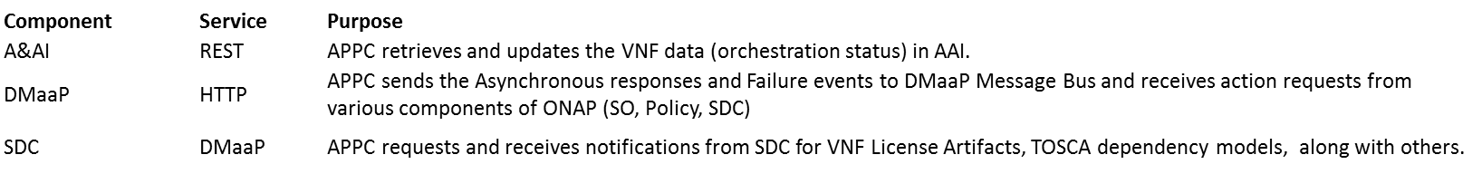
APPC (2/2)
Consumed Interfaces
APPC
Consumed Models:
TOSCA Dependency Model
APP-C also support a variety of models, most of which are created by the APPC Configuration Design Tool (CDT). Examples are:
  Reference Data Model (json)
  VNF Capabilities Model (json)
  Template Model (json or xml)
  Parameter Definition Model (yaml)

Slide 45
CLAMP (1/2)
Definition:
CLAMP is a platform for designing and managing control loops.
It is used to design a control loop, configure it with specific parameters for a particular network service,
then It interacts with other systems to deploy/undeploy and execute the control loop.
Information about the CLAMP architecture and provided APIs can be found in the CLAMP User Guide and LCM & OAM API Guides on readthedocs
Provided Interfaces: (CLAMP doesn’t expose functional relates API’s except the one below, refer to CLAMP documentation for more details)
Interfaces Service Purpose/Comments
HealthCheck REST Health Check of CLAMP instance
CLAMP

Slide 46
CLAMP (2/2)
Consumed Interfaces:
Interfaces Service Purpose/Comments
SDC REST Distribution of service to DCAE
DCAE REST Common Controller Framework
Policy REST(JSON data) Create Configuration and Operational policy
CLAMP
Consumed Models: (No specific models were used in the above interface except for Policy(json))

Slide 47
Use-case UI
Definition:
Provides portal for service life cycle management
Provides portal for VNF alarm and performance
Provides portal for VM alarm and performance
None
Usecase UI
Provided Interfaces:
None
Catalog Synchronization Interface
Service Orchestrator Interface
Inventory Service Interface
NS/VNF Onboard Interface
Service Registration Interface
Data Subscription Interface
Note: Can be more than one page

Slide 48
Use-case UI
Consumed Interfaces:
Catalog Synchronization Interface, from: SDC
Service Orchestrator Interface, from: SO
Inventory Service Interface, from: Available and Active Inventory
NS/VNF Onboard Interface, from: VF-C
Service Registration Interface, from: MSB
Data Subscription Interface, from: DMaaP
None
Usecase UI
Consumed Models:
Network Service Descriptor
VNF Descriptor
Catalog Synchronization Interface
Service Orchestrator Interface
Inventory Service Interface
NS/VNF Onboard Interface
Service Registration Interface
Data Subscription Interface
Note: Can be more than one page

Slide 49
ONAP CLI
Definition:
Provides Open CLI Platform (OCLIP) – Industry first Model-driven command line interface platform
Provides commands for performing end-end service on-boarding and life cycle management
Provides command console for Linux and web platforms.
micro-service discovery commands
external system and VNF cloud on-boarding commands
customer and subscription management commands
resource on-boarding commands
Product and service management commands
network service life-cycle management commands
Provided Interfaces:
micro-service discovery
  Provides commands for micro service discovery and registration
external system and VNF cloud on-boarding
  Provides commands for registering/unregistering VIM, VNFM, EMS and SDNC
customer and subscription management
  Provides commands for subscription and service-type life cycle management
resource on-boarding
  Provides commands for adding VNF modules
Product and service management
  Provides commands for design time creation and management of VF and NS
network service life-cycle management
  Provides commands for creating and managing Network services (NS)
ONAP CLI
micro-service discovery Interface (MSB)
external system and VNF cloud on-boarding interface (AAI)
customer and subscription management interface (AAI)
resource on-boarding interface (SDC)
Product and service management interface (SDC)
network service life-cycle management interface (SO)
Consumed interface Interfaces:
REST API from SDC, SO, AAI, MSB.
Consumed Models:
- Open Command Specification (OCS) 1.0

Slide 50
Microservices Bus (1/2)
Service Registration REST Interface
Service Discovery RES Interface
JAVA SDK for Service Registration/Access
Definition:
Provides a reliable, resilient and scalable communication and governance infrastructure to support ONAP Microservice Architecture(OMSA).
Provides RESTFul API for service registration/discovery
Provides JAVA SDK for service registration and access
Provides a transparent service registration proxy with OOM-Kube2MSB
Provides a transparent service communication proxy which handles service discovery, load balancing, routing, failure handling, and visibility-Internal API Gateway(Implemented) and Mesh Sidecar(WIP)
Provides an External API Gateway to expose ONAP services to the outside world
Micro Services Bus / Data Movement
Interface N

Slide 51
Microservices Bus (2/2)
Service Registration REST Interface
Service Discovery RES Interface
JAVA SDK for Service Registration/Access
Provided Interfaces:
Service Registration REST Interface
  Provides the RESTFul interface to register ONAP services.
Service Discovery REST Interface
  Provides the RESTFul interface to discover ONAP services.
JAVA SDK
  Provides JAVA SDK to register ONAP services.
  Provides JAVA SDK to access ONAP services.
  Note: ONAP components don' t need interfaces to leverage the transparent service registration proxy and communication proxy.
Micro Services Bus / Data Movement
Interface N
Consumed interface Interfaces: (None)
Consumed Models:
Swagger for RESTFul APIs definition
Service definition in kubernetes config files for Kube2MSB service registration

Slide 52
Microservices Bus Updated With Swagger SDK(1/2)
Service Registration REST Interface
Service Discovery RES Interface
JAVA SDK for Service Registration/Access
Swagger SDK
Definition:
Provides a reliable, resilient and scalable communication and governance infrastructure to support ONAP Microservice Architecture(OMSA).
Provides RESTFul API for service registration/discovery
Provides JAVA SDK for service registration and access
Provides a transparent service registration proxy with OOM-Kube2MSB
Provides a transparent service communication proxy which handles service discovery, load balancing, routing, failure handling, and visibility-Internal API Gateway(Implemented) and Mesh Sidecar(WIP)
Provides an External API Gateway to expose ONAP services to the outside world
Swagger SDK for auto-generate the client SDK in different languages for every micro-services in ONAP. Also it deploys the generated SDK into the nexus.
Micro Services Bus / Data Movement
Interface N

Slide 53
Microservices Bus Updated With Swagger SDK(2/2)
Service Registration REST Interface
Service Discovery RES Interface
JAVA SDK for Service Registration/Access
Swagger SDK
Provided Interfaces:
Service Registration REST Interface
  Provides the RESTFul interface to register ONAP services.
Service Discovery REST Interface
  Provides the RESTFul interface to discover ONAP services.
JAVA SDK
  Provides JAVA SDK to register ONAP services.
  Provides JAVA SDK to access ONAP services.
  Note: ONAP components don' t need interfaces to leverage the transparent service registration proxy and communication proxy.
Swagger SDK
  provides Mvn plug-in settings for (JAVA)client sdk generation
Micro Services Bus / Data Movement
Interface N
Consumed interface Interfaces: (None)
Consumed Models:
Swagger for RESTFul APIs definition
Service definition in kubernetes config files for Kube2MSB service registration

Slide 54
Optimization Framework - R2 (1/4)
Definition:
ONAP Optimization Framework (OOF) provides functionality for creating and running optimization applications by leveraging a policy-driven, declarative approach.
Supports different specializations (applications) with specific domain and optimization needs.
Initial specialization scopes include, but are not limited to, VNF placement support via Homing and Allocation Service (HAS) with different use cases, and change management scheduling service.
  For R2, the OOF will support vCPE use case (as a MVP).
  For R2, the OOF will demonstrate an example of Change Management Scheduling Optimization using the OOF design framework with simple, representative constraints.
Service Orchestrator (SO)
Change Management Portal
Optimization Framework (OOF)
Provided Interfaces:
Placement Optimization Interface
  Provides functionality for the Service Orchestrator to specify placement services [vCPE use case]
Change Management Portal Interface
  Provides functionality for calculating schedules that satisfy time constraints and conflicts [R2 focus on a demonstration of the design framework; alignment with Change Management scheduling use case]
Policy Interface
Inventory Service Interface
Service/Policy Models Interface
Infrastructure Metrics Interface
Consumed Interfaces:
Policy Interface, from: Policy
Inventory Service Interface, from: Available and Active Inventory
Service/Policy Models Interface, from: SDC
Infrastructure Metrics Interface, from: Multi Cloud
Consumed Models:
Policy Models (constraints) and License Models from: SDC
Infrastructure Metrics Models, from: Multi Cloud

Slide 55
Optimization Framework - R3+ (2/4)
Note on Functionality for R3 and beyond:
While the items listed below are not part of MVP for R2, the OOF team is initiating discussions and collaborations on these during the R2 time frame, so that the OOF is aligned with the use cases that will mature in R3 and beyond.
Service Orchestrator (SO)
Change Management Portal
Additional Definitions for R3 and beyond:
For R3 and beyond, the OOF will focus on supporting multiple R3 and beyond use case (along with R2 use cases)
[supporting VoLTE, VNF/Service scale-in/out (higher order control loop), and RAN-5G].
Synchronization with Change Management Scheduling use case.
Providing additional sample/example optimization applications as documentation.
Proving initial Knowledge Base on OOF (building blocks and recipes for creating complex applications).
Further alignment with S3P objectives.
Optimization Framework (OOF)
Additional Provided Interfaces for R3 and beyond:
Placement Optimization Interface
  For R2, the focus is on supporting vCPE use case;
  for R3 and beyond, the OOF will also support VoLTE, VNF/Service scale-in/out (higher order control loop), and RAN-5G.
Change Management Portal Interface
  For R2, the focus is on a demonstration of OOF with simple, representative constraints;
  this effort will be aligned with the Change Management scheduling use case (for R3 and beyond)
Policy Interface
Inventory Service Interface
Service/Policy Models Interface
Infrastructure Metrics Interface
R3 and Beyond
Application Metrics Interface
Additional Consumed Interfaces for R3 and Beyond:
Application Metrics Interface, from: DCAE [R3 and Beyond]
These are in addition to Policy, Inventory, SDC Models, and Infrastructure metrics from R2
Additional Consumed Models for R3 and beyond:
Application Metrics Models, from: DCAE

Slide 56
Optimization Framework - Interface Definitions (3/4)
Optimization Request Interface
Provided Service | Homing Service API (HAS-API)
Supplementary Information | The OOF will provide a list of possible candidates for placement, which the service orchestrator can use to instantiate the service
Interface Provider(s) | Optimization Framework
Provided Capabilities | Optimization Information Request

Slide 57
Optimization Framework - Interface Definitions (4/4)
Scheduling Optimization Request Interface
Provided Service | Change Management Scheduling API (CMSO API)
Supplementary Information | The OOF will provide a possible schedule of VNF actions (e.g. upgrades) that satisfy the constraints on availability periods and constraints related to conflicts
Interface Provider(s) | Optimization Framework
Provided Capabilities | Optimization Information Request

Slide 58
VNF SDK (VNF package validation) (1/2)
Here we put the services provided
Definition:
Provides functionality to upload, verify, and download VNFs
VNF Vendors upload VNFs through the Marketplace portal
Marketplace runs package validation tests
VNFs are made available for Onboarding
Marketplace API
Marketplace API:
Upload/Re-upload VNF
  Upload VNFs to the Marketplace
Download VNF
  Download VNFs
Query VNF
  Query VNFs by CSAR ID or conditions (name, version, type, provider)
Delete VNF
  Delete VNF from the Marketplace
VNF SDK Marketplace
Consumed Models: SOL-004 (Beijing)
Note: Can be more than one page

Slide 59
VNF SDK - Interface Definitions (2/2)
Marketplace API
Provided Service | Upload, Download, Query, Delete
Supplementary Information | The VNFSDK APIs are documented on the ONAP Wiki: https://wiki.onap.org/display/DW/API+Documentation
Interface Provider(s) | VNF SDK Marketplace
Provided Capabilities | VNF Pre-onboarding upload/download/validation/query/delete

Slide 60
VF-C Components
SO
Policy
UUI
Os-Ma-nfvo
NFVO Functions
Support NS Lifecycle Management including NS instantiate, scale, heal, operate (query /update/…)and terminate. In R1, most of NSLCM interfaces align with SOL005 Os-Ma-nfvo reference point
Support integration with multi VNFMs via drivers which include vendors VNFM and generic VNFM. The interfaces between NFVO and driver comply with Or-Vnfm reference point.
Support integration with multi VIM via Multi-Cloud
In R1, NFVO also supports integration with vendor EMS via driver
NFVO
VNF Package
( VNFD)
NS Package
( NSD)
Instantiate
Terminate
Scale
Operate
Heal
Or- Vnfm
Or- Vnfm
Driver
Driver
SVNFM
Or-Vi
GVNFM
EMS
Vi-Vnfm
Multi-Cloud
Vi-Vnfm
Vi-Vnfm
NFVI&VIM

Slide 61
VF-C – NFVO (1/2)
Network Service LCM Interface
VNF Operation Granting Interface
NS package management Interface
VNF package management interface
Definition:
Provides reference implementation of NFVO in ETSI MANO architecture
Provides Network service life cycle management
Provides NS/VNF layer’s FCAPS management
NFVO
Provided Interfaces:
Network Service LCM interface
  Provides Network Service LCM interface
  (NS create/instantiate/scale/heal/terminate/delete/query)
VNF Operation Granting interface
  Provides VNF Operation Granting interface and make granting decision
NS package management interface
  Provides runtime NS package management interface
VNF package management interface
  Provides runtime VNF package management interface
VNF LCM Interface
Inventory Service Interface
Catalog Synchronization interface
Generic VIM Interface
Date report interface
Tosca parser interface
Optimization Request Interface
Note: Can be more than one page

Slide 62
VF-C – NFVO (2/2)
Network Service LCM Interface
VNF Operation Granting Interface
NS package management interface
VNF package management interface
Consumed Interfaces:
VNF LCM Interface, from: Generic NF controller, SVNFM
Inventory Service Interface, from: Available and Active Inventory
Catalog Synchronization Interface, from: SDC
Generic VIM Interface, From: Multi-cloud
Data report Interface, From: DCAE
Tosca parser Interface, From: Modeling
Service registration and discovery, From: MSB
Optimization Request Interface, from: Optimization Framework -TBD
NFVO
VNF LCM Interface
Inventory Service Interface
Catalog Synchronization interface
Generic VIM Interface
Data report interface
Tosca parser interface
Optimization Request Interface
Consumed Models:
Network Service Descriptor
VNF Descriptor
VES data format
Bpmn Workflow
Note: Can be more than one page

Slide 63
VF-C - GVNFM
Definition:
Provides the Generic VNFM
Provides the VNF life cycle management
Supports NFVO to implement Network service LCM management
VNF LCM Interface
VNF Package management interface
GVNFM
Provided Interfaces:
VNF LCM interface
  Provides the VNF LCM interface(VNF instantiate/scale/terminate/query)
VNF Package Management interface
  Provides runtime VNF Package management interface
Catalog and notification Interface
Inventory Interface
Tosca parser Interface
Generic VIM Interface
VNF config interface
Consumed interface Interfaces:
Catalog and notification Interface, from: NFVO
Inventory Interface, from: A&AI
Tosca parser Interface, From: Modeling
Generic VIM Interface, From: Multi-cloud
Service registration and discovery, From: MSB
VNF Config interface: from VNF -TBD
:
Note: Can be more than one page
Consumed Models
VNFD

Slide 64
ONAP Portal
Definition:
Portal is a platform that provides the ability to integrate different ONAP applications into a centralized Portal Core.
It allows decentralized applications to run within their own infrastructure while providing common management services and connectivity.
It provides capabilities including application onboarding & user management, and hosted application widgets.
Using the provided SDK, application developers can leverage the built-in capabilities (Services / API / UI controls) along with bundled tools and technologies.
Portal Admin Interfaces
SDK Jars (Policy, VID, AAI, and SDC)
ONAP Portal
Provided Interfaces:
Portal Admin Interfaces
  Onboarding and User management
SDK Module
  SDK will be used as a base for any ONAP application being built.
  Components using SDK jars: Policy, VID, AAI, and SDC
  SDK bundles together a host of different tools, technologies, and standards that will assist the teams during the development phase.
  SDK includes reusable UI components, authentication & authorization components, visualization & reporting engine, collaborative services, workflow manager, GIS / Map, web component, and widget development framework.
AAF
Consumed interface Interfaces:
Restful APIs for fetching available roles to portal’s onboarded application users. from: AAF
64

Slide 65
ONAP Beijing Architecture Recommendations

Slide 66
Recommendations for Beijing Release
Release Theme is Platform Maturity/S3P, key Architecture Principles: Modular, Microservices, Model-driven
Achievable Recommendations for Beijing to begin aligning with target architecture
Modular:
  Improve APIs between components. Document them using Swagger.
  Align interfaces with industry standards, where available/appropriate (for example, ETSI SOL-003, SOL-005, MEF Interlude, Legato, etc.)
Microservices-based
  Use OOM for onboarding, instantiation (support MSB natively), scalability
  Register with MSB
  Use microservices best practices (e.g., separate data from the component, use common KV stores/databases, for KV stores – prefer Consul, etc.)
Model-driven
  Align with info/data models from the Modeling Subcommittee (published December 2017)
  Explore ways to use model-driven principles inside each component as well as across various components (SDC, SO, VFC, APPC, ..)
S3P (see Jason Hunt 1/4 TSC presentation for list of projects providing support for S3P)
  Use common libraries/SDKs/common services where possible to improve overall system resiliency/reliability
  More focus on common services (where possible) also to help reduce testing
  MUSIC for managing various ONAP components states, DB replication in a consistent manner
  Enhanced AAF to support credential management for certificates
  Support Image Management service to enhance security, virus checking, etc.

Slide 67
Suggestions for Casablanca (in progress)
Still WIP – shared here so PTLs can begin to think about roadmap items
External APIs: External actors view ONAP as a black box. This should simplify the ONAP architecture/interfaces, leveraging the APIs developed by the Ext API project (eg, MEF LSO, TM Forum etc).
Explore Database harmonization: Reduce number of databases in ONAP – perhaps one per type? (SQL/noSQL/KV store/etc).
  Support for DB as a service, rather than independent DB per component?
API Improvements: Currently, ONAP internal interactions are mostly handled via REST-like APIs. We need to enhance the ONAP architecture to support RESTFUL APIs. We also need to ensure that the ONAP platform can handle cloud-native APIs and models.
API Versioning Support
Support for Identity Management in SDC
Support for Security Management.
Support for Beijing->Casablanca upgrade. In-service upgrades per component?
Geo-redundancy – move from real-time (strong) consistency to eventual consistency model
Multi-tenancy support

Slide 68
ONAP APIs
Work in Progress (R3+ Capabilities)…

Slide 69
ONAP External APIs
ONAP External APIs expose the capabilities of ONAP. They allow ONAP to be viewed as a “black box” by providing an abstracted view of the ONAP capabilities.
They support that an external consumer of ONAP capabilities can be authenticated and authorized. They can also be used for connecting to systems where ONAP uses the capabilities of other systems.
Note 1: External API does not include all the B2B capabilities of exposure (e.g. partner management)
Note 2: The case where trusted providers of a service (e.g. operator owned transport, or cloud infrastructure) do not need to pass through External API.
For example, External APIs between ONAP and BSS/OSS allow Service Providers to utilize the capabilities of ONAP while using their existing BSS/OSS environment minimizing customization

Slide 70



E
REFERENCE ARCHITECTURE
Customer Domain
SP Domain
Partner Domain
Cantata
(CUS:BUS)
Business Applications
Sonata
(BUS:BUS)
Business Applications
Customer
Application Coordinator
LEGATO
(BUS:SOF)
LEGATO
(BUS:SOF)
Allegro
(CUS:SOF)
Service Orchestration Functionality
Interlude
(SOF:SOF)
Service Orchestration Functionality
Presto
(SOF:ICM)
Presto
(SOF:ICM)
Color Key
ONAP Service Centric External APIs
Infrastructure Control
and Management
Infrastructure Control
and Management
ONAP Resource Centric External APIs
ADAGIO (ICM:ECM)
ADAGIO (ICM:ECM)
Element Control
and Management
Element Control
and Management
Network Infrastructure

Slide 71
SOF Interface Reference Points
Service feasibility;
Service provisioning configuration & activation;
Request fallout;
Usage events & metrics;
License accounting;
Service performance & quality (e.g., KPI);
Service trouble management;
Service policy;
Capacity engineering;
Address allocation management;
LEGATO
Dynamic service control;
Service state info;
Service performance & quality;
Service related alerts;
Service Orchestration Functionality
Dynamic service control;
Service parameter config;
Service state info;
Service performance info;
Service problem alerts
ALLEGRO
INTERLUDE
PRESTO
Color Key
ONAP Service Centric External APIs
Connectivity and network function feasibility;
Configuration, activation, and management of connectivity and logical network functions;
Topology and routing;
Performance and Fault;
Connectivity policy
ONAP Resource Centric External APIs

Slide 72
E
ONAP Multi-Domain Federation
Customer Domain
SP Domain
Partner Domain
Cantata
(CUS:BUS)
Business Applications
Business Applications
BSS
Sonata
(BUS:BUS)
BSS
Customer
Application Coordinator
LEGATO
(BUS:SOF)
LEGATO
(BUS:SOF)
Service Orchestration Functionality
Interlude
(SOF:SOF)
Service Orchestration Functionality
Allegro
(CUS:SOF)
ONAP
ONAP or
Non-ONAP Orchestration
Presto
(SOF:ICM)
Presto
(SOF:ICM)
Color Key
ONAP Service Centric External APIs
Infrastructure Control
and Management
Infrastructure Control
and Management
ONAP Resource Centric External APIs
ADAGIO (ICM:ECM)
ADAGIO (ICM:ECM)
Element Control
and Management
Element Control
and Management
Network Infrastructure

Slide 73
The ONAP “Black Box” View
APIs
UX/CX
CLIs/SDKs
OOM Interfaces
External APIs (Service Centric)
Legato
Interlude
OOM
Design
Tools
OAP
ONAP Management Interfaces
Resource Interfaces
External APIs (Resource Centric)
Presto
PNFs
VIMs
IaaS
PaaS
SaaS

Slide 74
ONAP Target Architecture
(High-Level Functional View)
OSS / BSS
CLI
U-UI
ONAP Portal
Legato
Interlude
ONAP External APIs
DESIGN-TIME
Dashboard OA&M
RUN-TIME
Resource Onboarding
Common
Services
Policy Framework
Data Collection, Analytics, and Events
Event Correlation
Active & Available Inventory
External Registry
Common Services
Orchestration
Service Design
Policy Creation & Validation
Application
Authorization
Framework
Analytic Application Design
Micro Services Bus / Data Movement (see Note 1)
ONAP Operations Manager
VNF / PNF Onboarding
ONAP Optimization Framework
Closed Loop Design
Change Management Design
Generic NF Controllers (L4-L7)
Logging
Multi-Cloud
Adaptation
SDN Controller
(L0-L3)
Design Test & Certification
Life Cycle Management & Config
Presto
Controller SDK
(see Note 1)
(see Note 1)
Catalog
Optional External Systems
3rd Party Controller
Specific VNF Manager
Element Management System
…
Managed Environment
Network Function Layer
Recipe/Eng Rules & Policy Distribution
ONAP Optimization Framework
VNFs
PNFs
Hypervisor / OS Layer
OpenStack
VMware
Azure
Kubernetes
RackSpace
Note 1 – Consistent APIs between Orchestration layer and Controllers
MPLS
IP
Private
Edge Cloud
Private
DC Cloud
Public
Cloud

Slide 75

Related ONAP Beijing Projects
(High-Level View with Projects)
External Gateway
OSS / BSS
ONAP CLI
U-UI
ONAP Portal
ONAP External APIs
DESIGN-TIME (SDC)
Dashboard OA&M (VID)
RUN-TIME
Resource Onboarding
DCAE
Correlation
Engine (Holmes)
Service Orchestration
Project
Common
Services
Common Services
Policy Framework
Service & Product Design
A&AI/ESR
ONAP Operations Manager
Policy Creation & Validation
AAF
VNF SDK
CLAMP
MSB/DMAAP
OOF
Virtual
Function Controller
(VF-C)
(Note 1)
Logging
Change Management Design
Multi-VIM/Cloud
Infrastructure Adaptation Layer
Application Controller
(APPC)
(L4-L7)
SDN-C
(L0-L3 Controller)
Others
Design Test & Certification
Catalog
External Systems
3rd Party Controller
sVNFM
EMS
Color Key
…
Managed Environment
Network Function Layer
VNFs
PNFs
ONAP Service Centric External APIs
Recipe/Eng Rules & Policy Distribution
Hypervisor / OS Layer
OpenStack
VMware
Azure
AMZ
RackSpace
ONAP Resource Centric External APIs
Private
Edge Cloud
MPLS
Private
DC Cloud
IP
Public
Cloud

Slide 76
Orchestrator Functional Internal View Example
APIs labeled on slide relative to SO for reference only.
Key
OE-x
SO External API
OI-x
SO Internal API
SO-SO communication across ONAP instances is via External API.
Legato
Interlude
SO-SO communication within a single ONAP instance is via Micro Services Bus.
OE-11
OE-4
SDC
Dashboard OA&M (VID)
External API
OE-5
DCAE
OE-1
OE-2
OE-3
API Handler
Request
Handler
Store
Request
Select Recipe
Map Request Data to Recipe & Invoke BPEL Execution
Track
Requests
OI-4
OOF
Orchestrator
Data Store
OI-1
Orch Execution Engine (BPMN/TOSCA)
OE-6
Service Models
Orch Service
& Resource
Catalog
BPMN
DB
Service Level
SDC Distribution Client
OI-5
Micro Services Bus / Data Movement
Resource
Models
Request DB
Resource Level Orch
A&AI/ESR
OE-7
OI-2
OI-3
Resource/Controller Adapters
Select Adapter Template
Controller Adapter
Map Data to Template
VNF/Network Adapter
Execute Transaction
Controller functions common to both SDN-C and Generic NF Controller.
OE-8
OE-9
OE-10
Presto
Multi-Cloud
SDN-C
Generic NF Controller

Slide 77
Legato Interface Reference Point (BSS/OSS-ONAP)
It is envisioned that from a Service Provider to BSS/OSS interaction context (i.e. MEF Legato), the ONAP External API will support the following types of interacts:
BSS/OSS retrieves Service Models
BSS/OSS requests service feasibility determination.
BSS/OSS requests reservations of capabilities related to a potential Service.
BSS/OSS requests activation of Service.
BSS/OSS receives Service activation tracking status updates.
BSS/OSS retrieves Service Inventory
BSS/OSS receives usage events due to a Customer initiating dynamic activity on their Service (e.g., increase in bandwidth).
BSS/OSS receives a summary of Service quality and usage information.
BSS/OSS receives Service state and fault event information
BSS/OSS receives Service Activation Testing results.
BSS/OSS receive capability information about the Service layer.
BSS/OSS manages Licenses
BSS/OSS receives License Usage information

Slide 78
Interlude Interface Reference Point (ONAP-Partner)
It is envisioned that from a Service Provider to Partner Provider interaction context (i.e. MEF Interlude), the ONAP External API will support the following types of interacts:
Service Provider controls aspects of the Service within the Partner domain (on behalf of the Customer) by requesting changes to dynamic parameters as permitted by service policies.
Service Provider queries state of the Service.
Service Provider requests change to administrative state or permitted attributes of a Service.
Service Provider request creation of connectivity between two Service Interfaces as permitted by established business arrangement.
Service Provider request instantiation of functional service components as permitted by established business arrangement.
Service Provider queries the Partner for detailed information related to Services provided by the Partner to the Service Provider.
Service Provider receives Service specific event notifications (e.g., Service Problem Alerts) from the Partner.
Service Provider receives Service specific performance information from the Partner.
Service Provider request Service related test initiation and receive test results from the Partner.

Slide 79
Information Domains in ONAP
External APIs
Governance/Processes
Policy/Rule/Constraints, SLA/OLA Definition,
Asset/Capacity Management, Configuration/Change/Incident Management, Catalog Management
Service Design
Network function on-boarding
Service definition, including Service blueprints
Service Access
User/Tenant Management, Identity Management, RBAC
Entitlement Control
Offered Services
Policy/Rule/Constraints, SLA/OLA Definition
Asset/Capacity Management, Configuration/Change/Incident Management
Services Components
Decomposition/Instantiation/Assurance/Remediation
Service Level Optimization, QoS Optimization, Policy Enforcement,
Logical Resource
Resource Matchmaking/Optimization
Resource Reservations/Allocations, Installation/Configuration
Real Infrastructure
Provider Registration, Infrastructure Discovery/Monitoring
Capacity Optimization
Service
Design
Micro-service Bus /Integration Backplane
Service Access
Offered Services
(What’s offered; Catalog)
Governance/Processes
Service Components
(Service Function Topology; Abstract Network Functions)
“Logical” Resource
(VNFs; VNF Forwarding Graphs)
“Real” Infrastructure
(Physical/Virtual/Cloud – On/Off-Premise)
Color Key
ONAP Service Centric External APIs
ONAP Resource Centric External APIs

Slide 80
ONAP External API Project: Beijing Focus
Deliver points of interoperability between ONAP and External Systems
Development of ONAP External APIs to BSS/OSS (i.e., MEF Legato)
  Service Catalog
  Service Ordering (including Service Instantiation)
  Service Inventory (specification focus) (stretch goal: implementation)
  Service Topology (stretch goal) (specification focus)
  License Usage (stretch goal) (specification focus)
Specification of ONAP External APIs supporting Inter-Provider (i.e., MEF Interlude)
  Service Control (specification focus)
  Service State (operational state) (specification focus)
  Service Inventory / Details (specification focus)
Alignment with MEF Legato, MEF Interlude and TM Forum APIs (explore ETSI SOL005)
Architecture for External APIs
  Identification and involvement of stakeholder ONAP projects (e.g., SDC, SO, AAI, etc.)
  Describe key External API foundation functionalites
  Document the role and requirements of External APIs in Model Driven ONAP and Tool chaining
  Work with Modeling, Architecture and MSB projects

Slide 81
Orchestration Approach Comparison
ONAP vs ETSI MANO (Gil)
Work in Progress (R3+ Capabilities) …
Note - Attached slides provide a side-by-side comparison of the ETSI MANO approach to orchestration vs the ONAP (ECOMP) approach.

Slide 82
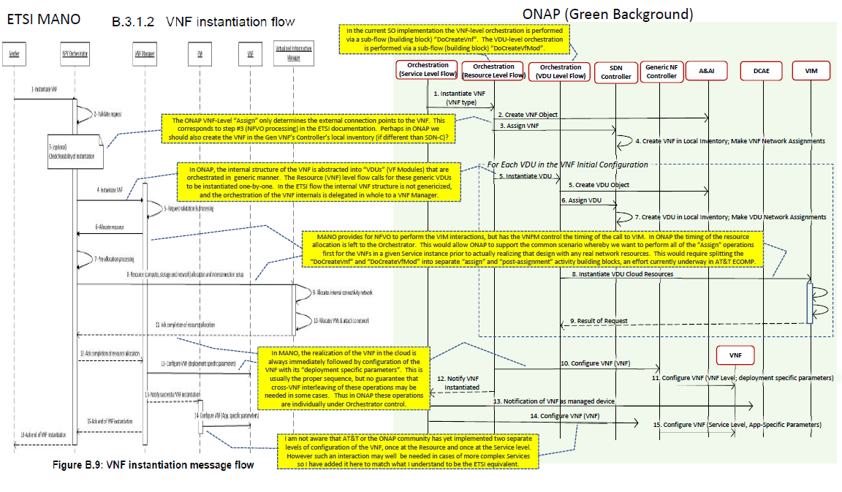

Slide 83
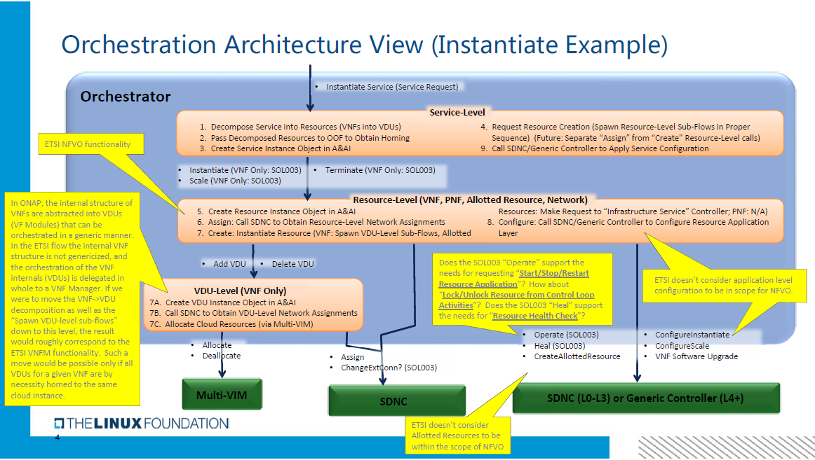

Slide 84
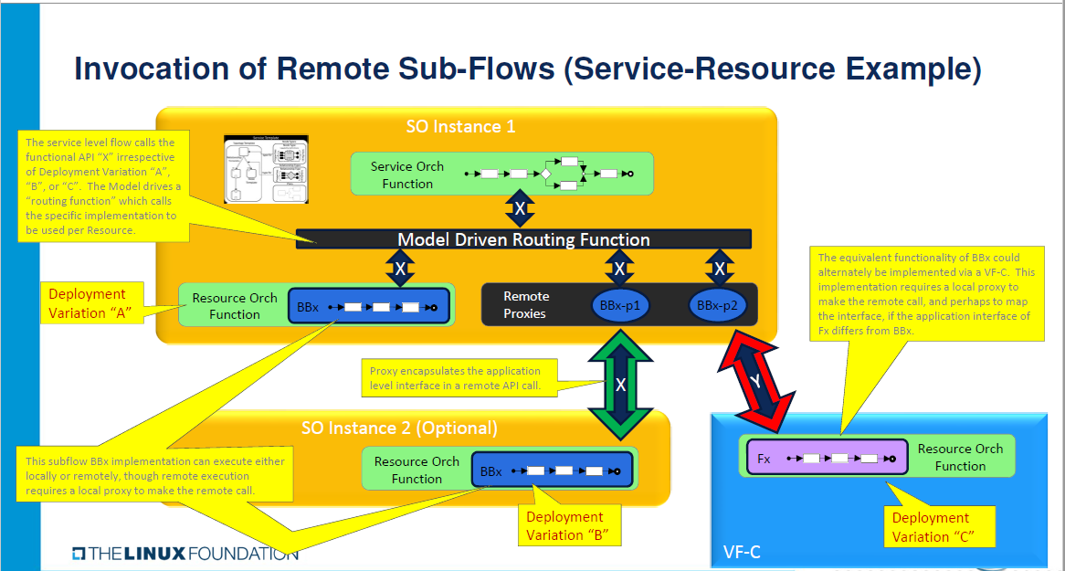

Slide 85
Vodafone Orchestration Proposal (Susana)
Work in Progress (R3+ Capabilities) …

Slide 86

ONAP Target Architecture focus for orchestration/NF controller discussion
OSS / BSS
CLI
U-UI
ONAP Portal
ONAP External APIs
DESIGN-TIME
Dashboard OA&M
RUN-TIME
Resource Onboarding
Common
Services
Policy Framework
Data Collection, Analytics, and Events
Event Correlation
Active & Available Inventory
External Registry
Common Services
Orchestration
Service Design
Application
Authorization
Framework
Policy Creation & Validation
ONAP Operations Manager
Analytic Application Design
Micro Services Bus / Data Movement (see Note 1)
VNF / PNF Onboarding
ONAP Optimization Framework
Closed Loop Design
Change Management Design
Generic NF Controllers (L4-L7)
Logging
Multi-Cloud
Adaptation
SDN Controller
(L0-L3)
Design Test & Certification
Life Cycle Management & Config
Others
CCSDK
(see Note 1)
(see Note 1)
Catalog
Optional External Systems
3rd Party Controller
Specific VNF Manager
Element Management System
…
Managed Environment
Network Function Layer
Recipe/Eng Rules & Policy Distribution
ONAP Optimization Framework
VNFs
PNFs
Hypervisor / OS Layer
OpenStack
VMware
Azure
AMZ
RackSpace
Note 1 – Consistent APIs between Orchestration layer and Controllers
MPLS
IP
Private
Edge Cloud
Private
DC Cloud
Public
Cloud

Slide 87
ONAP Target Architecture for Orchestration layer and NF controller
(High-Level Functional View)
Domain/region versus end-to-end orchestration are depicted here for the sake of examples to depict interfaces. Expectation is to have a model driven orchestration functionality
VES and YANG not included in this figure for simplicity and also currently not in ETSI-NFV
ONAP External APIs
RUN-TIME
Orchestration
(domain/region)
Orchestration
(end-to-end)
Micro Services Bus / Data Movement
Generic NF Controllers (L4-L7)
Life Cycle Management & Config
Note
Optional External Systems
Specific VNF Manager
Element Management System
…
Network Function Layer
VNFs
VNFs
PNFs
Note: Both VNF and Element management may trigger actions to be executed by the generic NF controller

Slide 88
ONAP Target Architecture for Orchestration layer and NF controller
(APIs detailed)
Os-Ma nfvo (SOL 005)
ONAP additions
ONAP External APIs
Automation is key for the success of 5G
Management standards are partly incomplete and fragmented
ETSI MANO defines key interfaces (API)
ONAP creates an automation framework with the help of TMF/MEF
3GPP drives information models and network slices
Os-Ma nfvo (SOL 005)
ONAP additions
RUN-TIME
Orchestration
(domain/region)
Orchestration
(end-to-end)
Os-Ma nfvo (SOL 005)
ONAP additions
Micro Services Bus / Data Movement
Or-VNFM (SOL 003)
Generic NF Controllers (L4-L7)
Life Cycle Management & Config
Or-VNFM (SOL 003)
Ve-Vnfm-Vnf (SOL 002)
Optional External Systems
Ve-Vnfm-Vnf (SOL 002)
Specific VNF Manager
Element Management System
…
Network Function Layer
VNFs
VNFs
PNFs
Note: The depicted interfaces consists of sets of APIs that may be exposed by different ONAP modules. This needs to be detailed further

