Slide 1
ONAP R3+ Architecture Update
ARC Presentation
Parviz Yegani – Leader, ONAP Architecture Tiger Team
Contributors: ONAP Architecture Tiger Team Members + Project PTLs
April 17 2018

Slide 2


ONAP Target Architecture
(High-Level Functional View)
OSS / BSS
CLI
U-UI
ONAP Portal
ONAP External APIs
DESIGN-TIME
Dashboard OA&M
RUN-TIME
Resource Onboarding
Common
Services
Policy Framework
Data Collection, Analytics, and Events
Event Correlation
Active & Available Inventory
External Registry
Common Services
Orchestration
Service Design
Application
Authorization
Framework
Policy Creation & Validation
ONAP Operations Manager
Analytic Application Design
Micro Services Bus / Data Movement (see Note 1)
VNF / PNF Onboarding
ONAP Optimization Framework
Closed Loop Design
Change Management Design
Generic NF Controllers (L4-L7)
Logging
Multi-Cloud
Adaptation
SDN Controller
(L0-L3)
Design Test & Certification
Configuration & Life Cycle Management
Others
CCSDK
(see Note 1)
(see Note 1)
Catalog
Optional External Systems
3rd Party Controller
Specific VNF Manager
Element Management System
…
Managed Environment
Network Function Layer
Recipe/Eng Rules & Policy Distribution
ONAP Optimization Framework
VNFs
PNFs
Hypervisor / OS Layer
OpenStack
VMware
Azure
Kubernetes
RackSpace
Note 1 – Consistent APIs between Orchestration layer and Controllers
MPLS
IP
Private
Edge Cloud
Private
DC Cloud
Public
Cloud

Slide 3
Architecture Design Considerations
Architecture Principles agreed by the Architecture Team:
  https://wiki.onap.org/display/DW/Contributions?preview=/8225716/8232492/Architectural%20principles_v3.docx
ONAP is a layered architecture - Orchestration, Multi-Cloud, Controllers, etc.
Functional architecture - the role of each layer should be well defined per the above architecture principles.
Integrated Design Studio - captures full lifecycle management models:
  TOSCA models for network function,
  Simple/nested services augmented with BPMN,
  Policy/Analytic design models, etc.
Multi-Cloud Support - ONAP should support cloud agnostic model and Multi-Cloud Adaption Layer while hiding infrastructure details.
ONAP Goal is: Modular, Model-driven, Microservices-based architecture
  Models drive interfaces between layers/components
ONAP APIs - should define well-described and consistent NB-APIs at all layers
Multi-vendor support - Keep flexible capability for commercial solution (no vendor lock-in)
Unified Modeling – needed for integration across all modules: VES in DCAE, Logging & monitor inside ONAP and more

Slide 4
Architecture Contributions Update

Slide 5
Tiger Team Architecture Contributions
(ONAP platform should be able to handle cloud-native APIs and models (far more than ONAP components registering with the MSB)
Generic NF Controller (L4-7) Architecture – pending final review.
ONAP Orchestrator – defined all internal and external interfaces. API Mapping (OIs/OEs) TBD
Controller Architecture - API Mapping (CIs/CEs - existing interfaces & new additions/extensions) (John Ng) – TBD
Service Design and Creation Functional Architecture – pending final review.
Catalog Architecture – pending final review.
Data Collection, Analytics and Events Architecture – pending final review.
Active and Available Inventory – pending final review.
ONAP Design Platform Reference Architecture (Ting Lu) – work in progress.
ONAP SDK-Driven Sub-System Approach – SDK Libraries – not review yet.
Modular ONAP Implementation and Integration to External Domain Management Systems (DMS) (Alex/Ramesh)
ONAP Microservices Approaches (Manoj) – work in progress (see attached slides).
Microservices Architecture & Service Mesh (Huabing) – initial proposal discussed but not decided yet.
Recursive Service Orchestration in ONAP (Gil) – near completion.
Plug an ETSI VNF Manager into the ONAP architecture (Gil) – discussion only, closed.
ETSI NFV update (TOSCA NFV profile, IFA, SOL, TOSCA-YANG mapping) (Thinh) – done.
Multi-Cloud Architecture update: SDN-OC, SDN-UC and SDN-GC integration (Ramki) – work in progress.
External ONAP APIs update beyond Beijing (Andy Mayer) – work in progress.
Real-time Data Events Streaming and Processing(RESP) (Parviz) – updated proposal to be reviewed on April 24th ARC call.
SO/DO orchestration architecture (Susana) - work in progress.

Slide 6
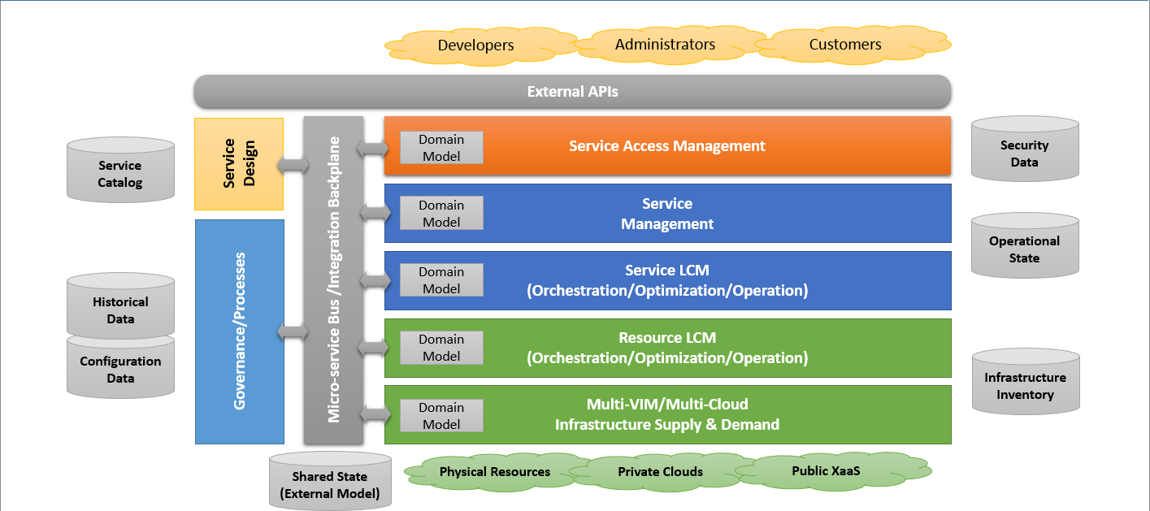
Modular and Model Driven Functional Domains (Alex’s Proposal)

Slide 7
ONAP Microservices Approaches (Manoj’s Proposal)
Three approaches to refine Microservice Architecture:
Approach 1: Model Driven Microservice which consolidates the configuration and operational models in a logically central place
  - Based on Other Open source implementations – ODL, ONOS etc, Model driven Microservices by Alex, Reference to OSM implementation.
Approach 2: Modular Microservices - Leverage TMForum IG1118 Management and Control Continuum and Future Mode of Operation concepts
  - Based on proposal by Alex and Ramesh on DMS, but enhancing it further with reference to a standard architecture.
  - Primarily focused on structuring microservices and components in a hierarchical “Lego blocks” like units which can be mixed and matched to create management and control functions.
Approach 3: Cloud Native Micro Service Design (Followed by MSB)
  - Based on the Service Mesh technique used in the cloud native world.
  - Mainly an implementation approach than a consistent microservice design methodology.
Above approaches are complementary to each other and not exclusive.

Slide 8
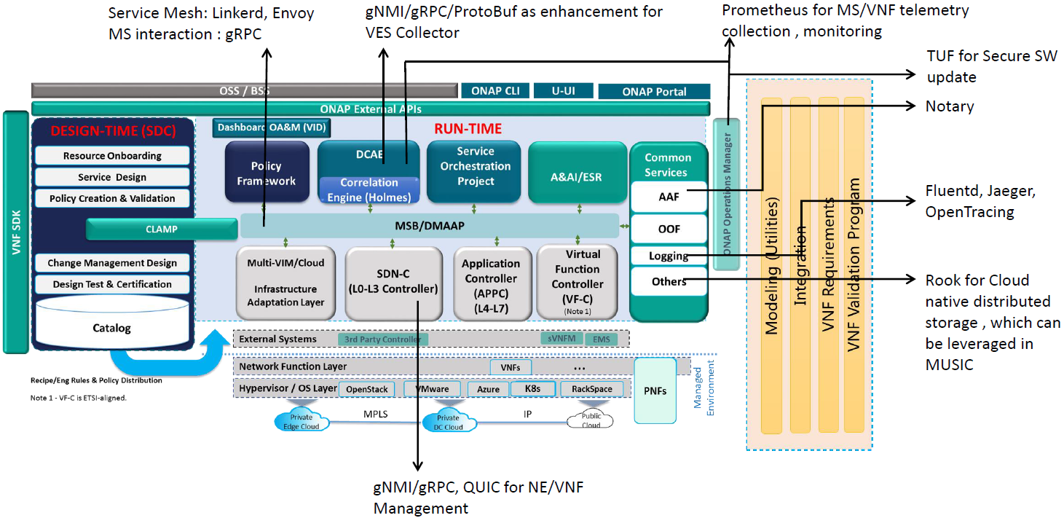
Cloud Native Computing Foundation (CNCF)
Cloud Native Computing Foundation (CNCF) and its implications on the ONAP architecture evolution – work in progress:
  gRPC/Protocol Buffers (Google)
  P4Runner
  gNMI
  gNOI
  Open Config DM Tools
From Manoj’s presentation

Slide 9
ONAP Microservices Architecture (Huabing’s Proposal)
A proposal for Microservices architecture for ONAP R3+ (Casablanca and beyond) presented by Huabing.
There are challenges with Monolithic software (lack of agility/innovation, scalability issues and more). To cope with these challenges a microservices-based architecture centered around the “service mesh” concept, leveraging the “Istio” open source project. The service mesh suggestions for Casablanca include:
Integrate Istio (see Note 1) with ONAP to provide infrastructure for communication (service discovery/retries/rate limiting/route rule/secured communication)
Keep it compatible with existing service communication approach (MSB API Gateway and Point 2 Point Communication)
Minimize the impacts to ONAP projects (Service mesh is designed as a transparent infrastructure layer, but in practice, some possible changes are foreseen on the application side, e.g., a need to pass the trace header through the service calling chain)
Integrate with Jaeger/Zipkin (see Note 2) to provide distributed tracing
Integration with Prometheus (see Note 3) and Grafana for metrics collection and display
Feedback the findings to the upstream project
Investigate any needed extension for ONAP itself
Istio will not be a mandatory deployment option for Casablanca
Leverage Istio to achieve close loop operation for ONAP system itself - long time goal.
Note 1 - Istio-enabled applications can be configured to collect trace spans using Zipkin or Jaeger.
Note 2 - Both Jaeger & Zipkin are distributed tracing systems with support for OpenTracing. The OpenTracing integration for both Jaeger and Zipkin build on the Jaeger client.
Note 3 - Prometheus delivers real-time monitoring, alerting and time-series database capabilities (including powerful queries and visualizations) for cloud-native applications, and integrates with many popular open source tools for data import/export. It is already the de facto standard for monitoring container-based infrastructure, and continues to add major features as user requirements mature. Prometheus provides needed visibility into and troubleshooting for cloud-native architectures, including Kubernetes and other next-generation components.

Slide 10
Multi-Cloud APIs (Ramki)
Update ONAP Controllers Architecture
  Capture the detailed interaction between the SDNC and the domain controllers (SDN-OC, SDN-UC and SDN-GC).
  The functionality of the new architecture should include a clear description of the role of the SDNC in controlling network resources (VNFs/PNFs) for each domain covering underlay, overlay and gateway infrastructure resources.
  An example use case like VoLTE should greatly help.
  Provide a detailed functional description of SDN-OC, SDN-UC and SDN-GC, resource inventory and relation to A&AI for each controller.
  Add separate figures (for both physical and logical views) to show call flows for setting up overlay tunnels (VxLAN, NVGRE, ..), underlay tunnels, integration aspects (tightly-coupled or not), etc.
Define ONAP Multi-Cloud APIs
  The APIs for ONAP MC is considered a challenge due to “Lack of standardized APIs for MC instance Underlay Networking”.
  The revised proposal should provide more details on the APIs needed for the MC adaptation layer to properly interact with the domain controllers, SDNC and other ONAP components as appropriate. This should also address the orchestration of infrastructure resources (public/private/hybrid clouds).

Slide 11
Slide Decks

Slide 12
Generic NF Controller (L4-7) Architecture
Key
CE-x
Controller External API
CI-x
Controller Internal API
Generic NF Controller for L4-7 configures and maintains the health of applications throughout its lifecycle.
  The Lifecycle Management Functions are a normalization of VF-C and APP-C functions into a common, extensible library
Programmable network application management platform
  Behavior patterns programmed via models and policies
  Standards based models & protocols for multi-vendor implementation
  Extensible SB adapter set including vendor specific VNF-Managers
  Operational control, version management, software updates, etc.
Manages the health of applications/VNFs/PNFs within its scope
  Policy-based optimization to meet SLAs
  Event-based control loop automation to solve local issues near real-time
Local source of truth
  Manages inventory within its scope
  All stages/states of lifecycle
  Configuration audits
Key Attributes of Generic NF Controllers
  Intimate with network protocols
  Manages the state of services
  Provide Deployment Flexibility to meet user scalability / resilience needs
Artifact Distribution
Orchestration
Closed Loop Actions
Inventory
Updates
Service Design & Creation
Orchestration
Data Collection, Analytics & Events
Active & Available Inventory
MSB/Data Movement
CE-1
CE-2
CE-3
CE-4
Generic NF
Controller
API Handler
CI-1
CI-2
CI-3
Repository
Operational Tree/Config Tree
(Service Model)
Service Logic
Service Logic Processing
CI-5
VNF Descriptors
CI-4
Lifecycle Mgmt. Functions/MicroServices (mS)
Assigned Resources Inventory:
Service* Topology & VNF/PNF State
Config Templates
Config mS
Audit mS
SW Upgrade mS
Engineering Rules
…
…
…
MSB/Data Movement
Service Logic
Service Logic
Service Logic
Policy Cache/Event Match
CI-7
*Not E2E service view. The “Service” view in the Generic NF Controller is limited its scope of control
CI-6
Adapters
Multi-Cloud Adapter
Netconf
Chef
Ansible
…
Others
External System Adapter (s)
CE-5
CE-6
MSB/Data Movement
Applications
VNFs
PNFs
External
3rd Party Controllers
Specific VNF Managers
Element Mgt. Systems
Multi-VIM/Cloud

Slide 13
Role Of Controllers in ONAP
ONAP Controllers configure and maintain the health of network functional elements and services throughout their lifecycle.
Programmable network application management platform
  Behavior patterns programmed via models and policies
  Standards based models & protocols for multi-vendor implementation
  Operational control, coordinated state changes across devices, etc.
Manages the health of the network services & VNFs in its scope
  Policy-based optimization to meet SLAs
  Event-based control loop automation to solve local issues in near real-time
  Executes action for outer control loop automation (Driven by DCAE, Policy, etc.)
Local source of truth
  Manages inventory within its scope
  All stages/states of lifecycle
  Configuration audits
  ONAP has a layered architecture, with the role of controller clearly defined
  Need to avoid duplicating functions across layers within the controller layer (e.g. DCAE, Service/Resource Orchestration, etc.)

Slide 14
SDN-Controller Architecture
Key
CE-x
Controller External API
CI-x
Controller Internal API
SDN Controller configures and maintains the health of L1-3 VNFs/PNFs and network services throughout their lifecycle
Programmable network application management platform
  Behavior patterns programmed via models and policies
  Standards based models & protocols for multi-vendor implementation
  Extensible SB adapter set supporting various network config protocols, including 3rd party controllers
  Operational control, coordinated state changes across devices, source of telemetry/events, etc.
Manages the health of network services & VNFs/PNFs in its scope
  Policy-based optimization to meet SLAs
  Event-based control loop automation to solve local issues near real-time
  Action executor for outer control loop automation
Local source of truth
  Manages inventory within its scope
  All stages/states of lifecycle
  Configuration audits
Key Attributes of Controllers
  Intimate with network protocols
  Manages the state of services
  Single service/network domain scope per instance
Artifact Distribution
Orchestration
Closed Loop Actions
Inventory
Updates
Service Design & Creation
Orchestration
Data Collection, Analytics & Events
Active & Available Inventory
MSB/Data Movement
CE-1
CE-2
CE-3
CE-4
SDN
Controller
API Handler
CI-1
CI-2
CI-3
Repository
Service Control
Processing
Operational Tree/
Config Tree
(Service Model)
CI-5
NB Service/Network Yang Models
CI-4
Service Logic
Service Logic
IP/VRF Assign
L2 Service Create
L3 VPN Service Create
SD-WAN Create
TE Tunneling
BGP Config
SW Upgrade
…
Configuration Templates
Service/Network Design & Engineering Rules
Service Logic
MSB/Data Movement
…
Assigned Resources Inventory: Service* Topology &
VNF/PNF State
Policies
CI-7
SB Device Yang Models
Service Logic
*Not E2E service view. The “Service” view in the SDN Controller is limited its scope of control
CI-6
Adapters
Multi-Cloud Network Adapter
NetConf/ YANG
OpenFlow
BGP LS/
PCEP
…
Others
External System Adapter (s)
CE-5
CE-6
MSB/Data Movement
External
3rd Party Controllers
Element Mgt. Systems
Multi-VIM/Cloud
VNFs
PNFs

Slide 15
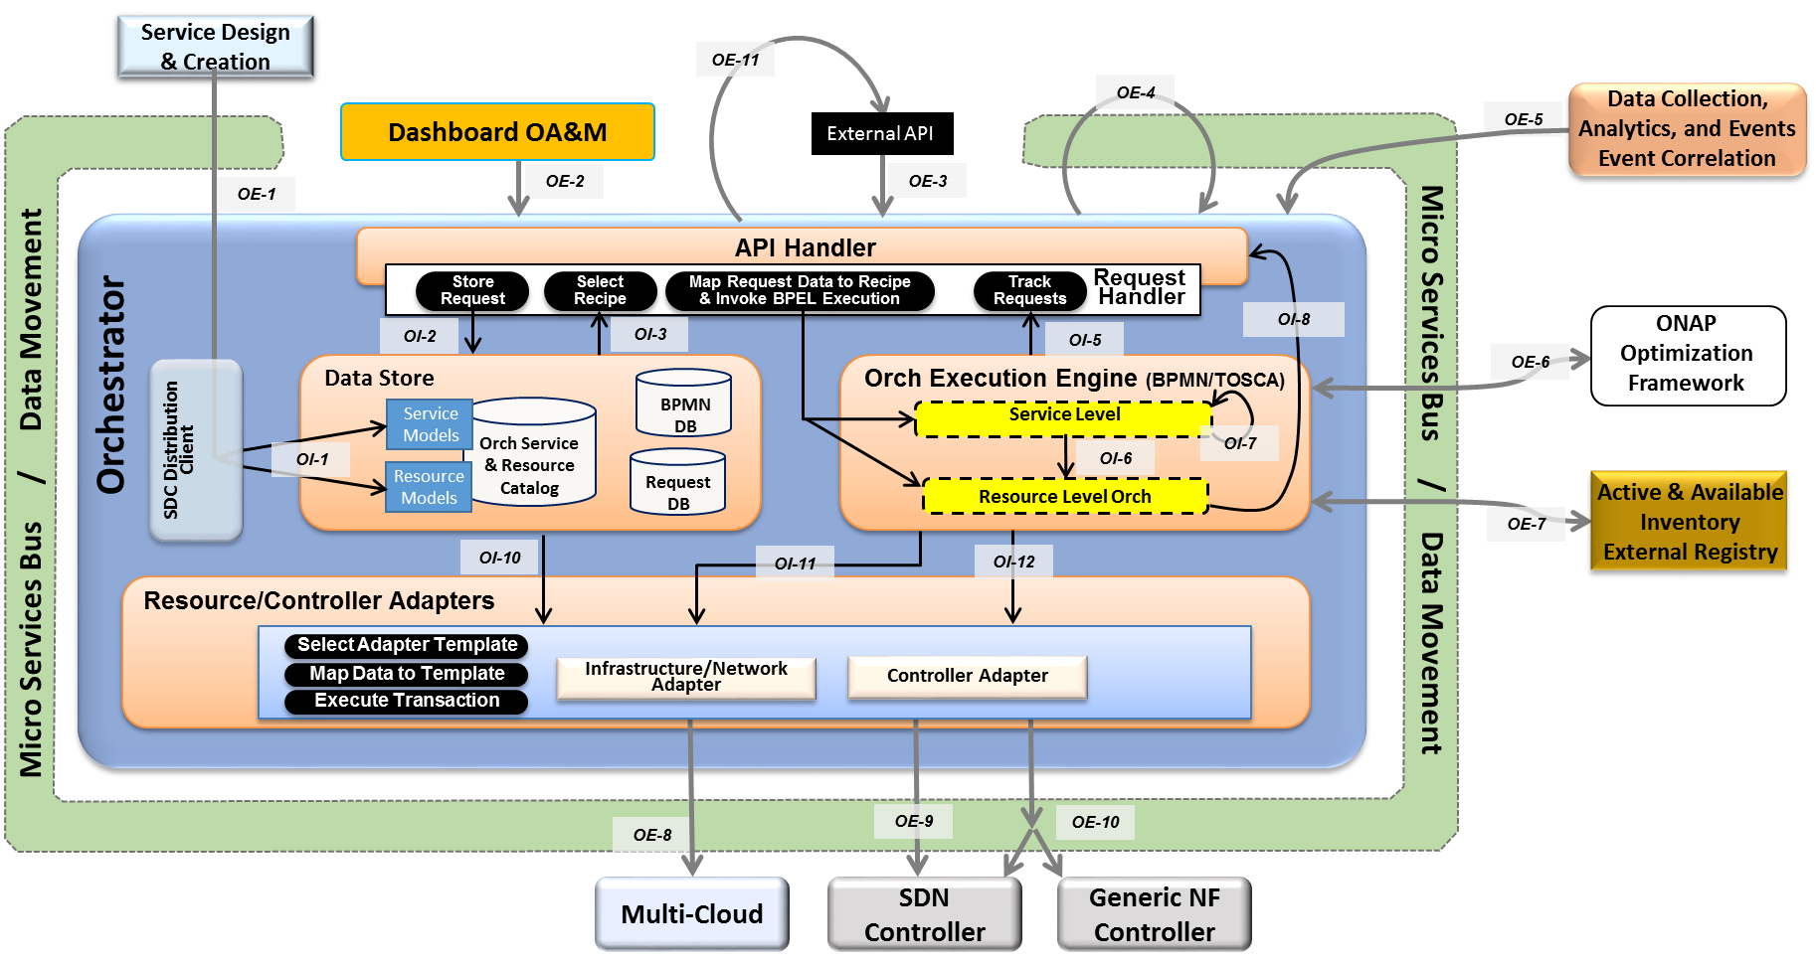
ONAP Orchestrator
The ONAP Orchestrator orchestrates service, resources and associated cross-controller activity driven by requests and events that indicate the need to create, modify or remove service and resource instances, or to perform multi-control layer remedy actions.
Model Driven Orchestration and APIs
  Runtime behavior driven by service and resource models and policies (including compound/nested services) designed in or onboarded into SDC
  Orchestrates service delivery, change management as well as open and closed-loop control actions
  Provides standard, model driven APIs for requested actions
  Tracks orchestrated activity for the life of the
  request, but doesn’t maintain state of
  orchestrated components
Processing of Service Requests:
  Performs Decomposition, Recipe Selection, Recipe Execution (including Rainy Day)
  Triggers and Records Results for:
  Homing
  Assign, Create, Configure
  (Controller/multi-cloud activity)
  Validation
  Monitoring
  Separate execution threads for service, decomposed resources, and any subtending service(s) provide nested service orchestration in a recursive manner
Orchestration of Controllers
  Coordinates activities across Multi-Cloud/
  SDN-C/Generic NF controllers, including data sourcing and mapping to Controller inputs

Slide 16
Orchestrator Functional Internal View (CNCF)
APIs labeled on slide relative to SO for reference only.
Key
OE-x
SO External API
OI-x
SO Internal API
SO-SO communication across ONAP instances looks like an External API.
SO-SO communication within a single ONAP instance is via Micro Services Bus.
Service Design & Creation
OE-11
OE-4
Data Collection, Analytics, and Events
Event Correlation
Dashboard OA&M
External API
OE-5
OE-1
OE-2
OE-3
API Handler
Request
Handler
Allotted Resources case
Store
Request
Select Recipe
Map Request Data to Recipe & Invoke BPEL Execution
Track
Requests
OI-2
OI-3
OI-5
OI-8
ONAP Optimization Framework
OI-4
OE-6
Orchestrator
Data Store
Orch Execution Engine (BPMN/TOSCA)
Service Models
Orch Service
& Resource
Catalog
BPMN
DB
Service Level
SDC Distribution Client
OI-7
Complex Services case
OI-1
Resource
Models
Request DB
OI-6
Micro Services Bus / Data Movement
Micro Services Bus / Data Movement
OI-9
Resource Level Orch
Active & Available Inventory
External Registry
OE-7
OI-10
OI-11
OI-12
Resource/Controller Adapters
Select Adapter Template
Controller Adapter
Map Data to Template
Infrastructure/Network Adapter
Execute Transaction
Controller functions common to both SDN-C and Generic NF Controller. Note that this may actually be 2 APIs and not a single.
Controller functions specific only to SDN-C. E.g., “Assign Network Resources” for the VNFs in a L4+ Service.
OE-8
OE-9
OE-10
Multi-Cloud
SDN Controller
Generic NF Controller

Slide 17
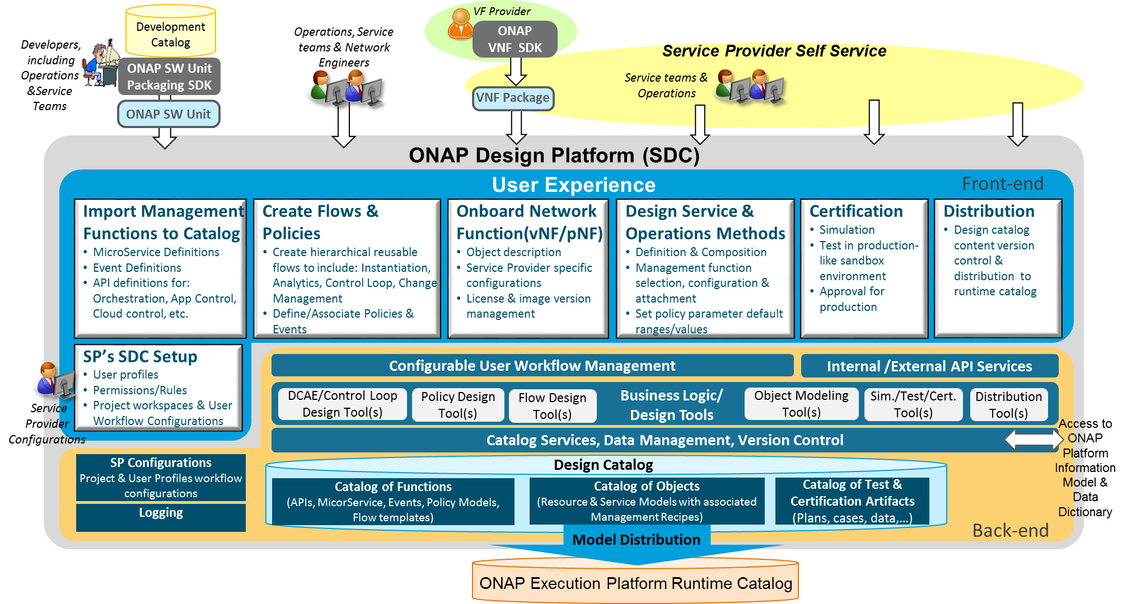
Service Design and Creation Functional Architecture
Service Provider’s Design environment to: 1. Catalog management capabilities, 2. Onboard vendor provided Network Functions, 3. Design Services and Operations, 4. Test, certify, and distribute models for Runtime Execution
Import Management Functions
  Import ONAP base capability definitions from Development Catalog to Design Catalog as building blocks in a standard format
Create Flows & Policies
  Create reusable management flows using building blocks & associated events & Policies
Onboard Network Functions
  Create VF model to include vendor’s description, scripts, & license model
  Customize models to include Service Provider specific attributes
Design Service & Operations Methods
  Create Service models with resources
  Design and associate operations processes & policies (e.g., Instantiation, DCAE/Control Loop, Change Management, etc.) and configure them to be service specific
Certification
  Simulate & test the design in Sandbox environment
  Certify Readiness & Adherence to Standards
Metadata Distribution
  Publish certified models for distribution to runtime catalog
  Notifications & Version Control

Slide 18
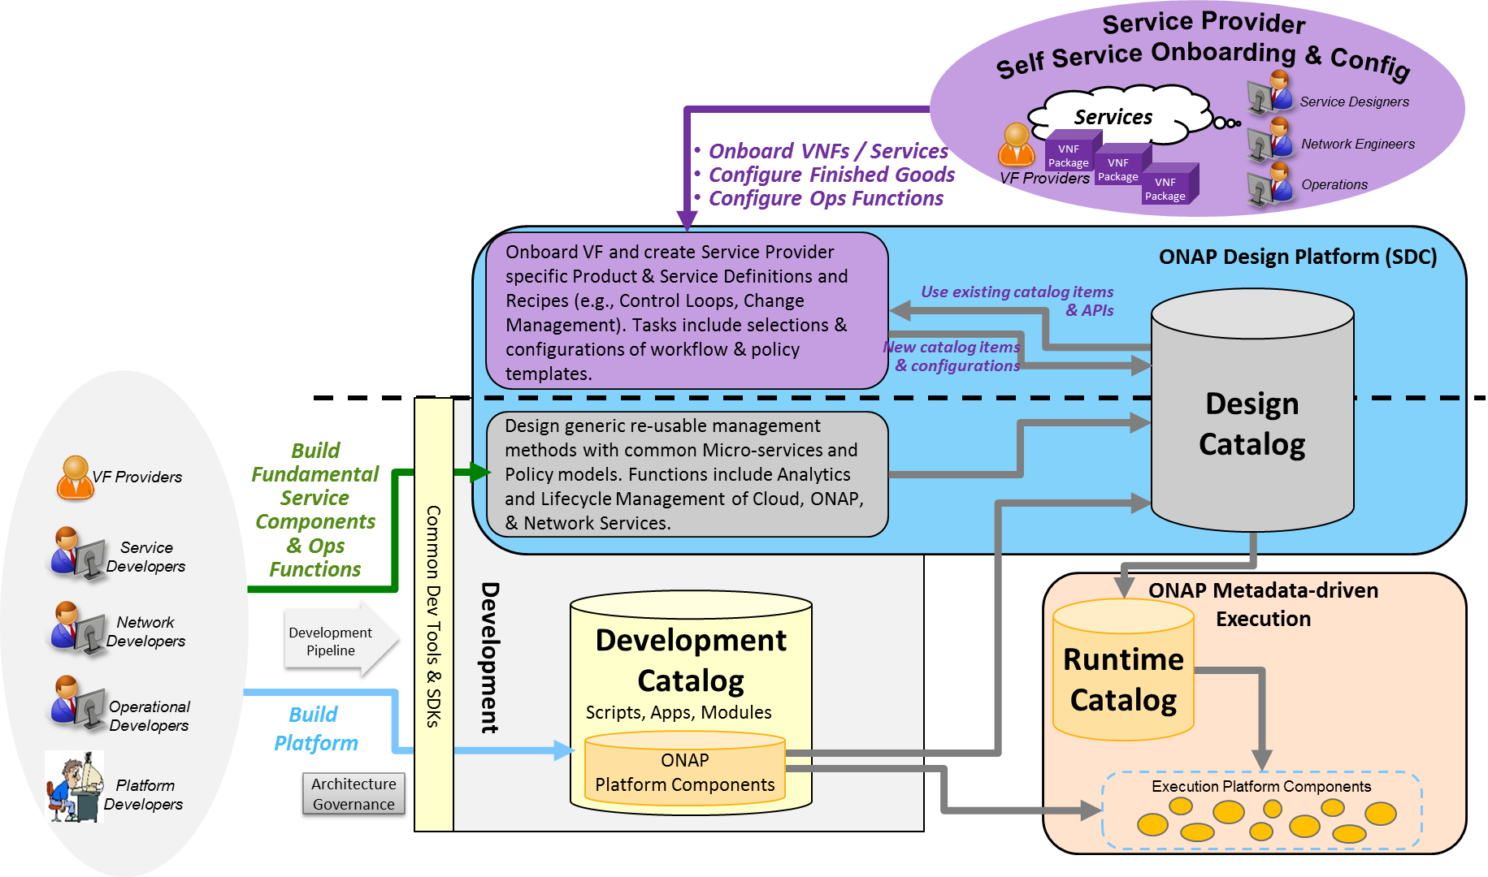
Catalog Architecture
The overall ONAP Catalog architecture includes Development Catalog, Design Catalog, and Runtime Catalog
Partially Existing:
Design Catalog (ONAP Design Platform - SDC)
  Catalog imported ONAP generic re-usable management software function & policy definitions
  Enable SP to onboard standard VNF packages
  Support SP users in design & lifecycle management of Resource and Service models
  Provide presentation to support service compositions & management flow associations
  Manages catalog’s elements versions, lifecycle and access policy
  All certified asset definitions available for re-use and composition
Yet to be implemented:
Development Catalog (ONAP Development)
  Common toolsets and data store for creation of ONAP software models & management flows/policies
  Interact with external software development teams and suppliers to onboard custom software, adapters or new capabilities
Runtime Catalog (ONAP Execution Platform)
  Provide a common data store for distributed certified models
  Provide ONAP runtime component’s subscription to access component view of the model data
  Maintain executable images and other runtime artifacts

Slide 19
Data Collection, Analytics and Events (DCAE) Architecture
Analytic µServices
Managed Environment
Fault Correlation
Congestion Detection
Capacity Management
QoS Monitoring
Security Analysis
…
DCAE
VNFs / PNFs
Applications
VES
OOM – DCAE Controller
Streaming
Data
Networking
DMaaP (Pub/Sub for Events/Data within DCAE & across ONAP)
Analytic Frameworks:
Holmes, CDAP, Other
Stream Data Collection
Batch
Data
Events
Flows
Other
Multi-Cloud Telemetry Adaption
Compute
SNMP
Unstructured & Structured Data Persistence
Batch Data Collection
Syslog
Storage
Logs
Files
Other
Other
DCAE enables real-time fault, performance and other data/event collection from service, network and infrastructure
  Collect Data & Events once and make available to multiple applications
  Telemetry records from VNFs and PNFs (fault, performance, usage, etc.)
Makes collected data available to real-time analytic µ-services to:
  Identify anomalies and other events for closed loop remediation
  Enable closed-loop automation to remedy fault/performance conditions
  Enable closed-loop automation to scale resources up/down
  Enable analysis at edge and central locations
  Extensible framework to integrate applications from various sources
Provides Correlation & Analysis to manage service at various layers
  Multi-Cloud Infrastructure layer, network element layer, Network & Complex Services layer, Operational Management layer
  Cross-layer, Intra-domain and cross-domain correlation

Slide 20
Active and Available Inventory (A&AI)
A&AI tracks the global inventory of the networks, services & resources that ONAP manages.
  The what, where, when of the managed assets and their relationships, and which controller manages them, etc.
Real-time, logically centralized view of topology & inventory
  Map and broker of data sources in the global network
  Federates across controllers, cloud infrastructure, partners, etc.
  Real-time access to authoritative sources with ability to aggregate views
  Real-time awareness of network elements, applications and service instances
  Aware of all the assets in scope, organized by their type, state & location
  Keeps track of the dynamic relationships of the virtual assets
  Aware of resource assignments, availability & relationships to customer
Network events used to maintain the integrity of inventory
  Monitors network events to register services, networks & resources
  Tracks creation, modification or removal of entities and relationships
A&AI
API Handler
Metadata Engine
Inventory & Topology Management
API Generation
Entitlement
Service
Resource
Active
Available
Reference
Network
Infrastructure
Topology
Assignment
Schema Generation
Graph Layer
Version Management
A&AI Data Management Services
Entitlements & Reference
Inventory & Topology
Metadata Management
A&AI Application Management Functions
OA&M
History
Event Subscriptions
Notifications
Data Audits
Archival
Model-driven
  Schema, APIs, database views, data integrity mechanisms generated from models expressed in TOSCA.

Slide 21
ONAP SDK-Driven Sub-System Approach
For Further Study
Goal: Move toward a common platform architecture, starting with Controllers, Orchestration and Multi-Cloud
Improve agility for on-demand/situational creation of instances
Reduce software footprint of platform component instances
Reusable tool chain and framework across components
Facilitate agile introduction and swap-out of technologies
Consistent use of NB and SB APIs
Enable flexible options to add and extend platform capabilities

Slide 22
SDK-Driven Sub-System – Libraries (including CCSDK)
For Further Study
SDK Libraries
NB API SDK
API Handler
API Configurator
Orchestration APIs
Controller APIs
Cloud APIs
API Catalog
Orchestration Function SDK
Control Function SDK (CCSDK)
Multi-Cloud Adaptation SDK
Library of
Common Control/NFV Lifecycle Mgt. Functions
Library of
Common Cloud Translations (shims)
Library of Flows
Service, Resource, Etc.
Rebuild
A udit
VNF Configure
Assign
Cloud Resource
Instantiation
Telemetry
Scale
…
Stop/Start
Scale
Network Config.
…
Imperative Models
Declarative Models
Health Check
Register
Heal
LB
BPMN orchestration
engine
TOSCA orchestration
engine
Upgrade
Heal
Svc Function Chain
ODL
ONOS
Open
ROADM
…
Sub-Models
TOSCA-Cloud
Translation/Mapper
SB API SDK
(Adapters)
M-Cloud APIs
OSS APIs
Netconf/Yang
OpenStack
API Catalog
Controller APIs
μServices APIs
Ansible
Plugins/Adapters*
Azure
Resource Orchestration APIs
Collectors
AWS
etc.
Orchestrators
Controllers
μServices
OSSs
VNFs
PNFs
Multi-Cloud
OpenStack
Azure
AWS
Rackspace
IBM
Google
*Plugins/Adapters can include:
3rd party VNFM Drivers • 3rd party EMS Drivers
3rd party SFC Drivers • Ansible/Chef/Puppet
Netconf/Yang • CLI
SNMP • etc.

Slide 23
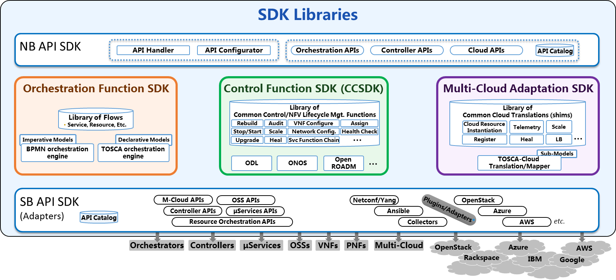
Controller Personas Based on SDK Libraries
For Further Study
SDK Libraries
SDN-C Persona
Generic VNF Controller Persona
NB API
NB API
Controller APIs
Controller APIs
Controller Personas Examples
(created from CCSDK)
Control Functions
LCM Functions
Library
Library
Assign
Network Config
Rebuild
Audit
VNF Configure
…
VNF Configure
…
Svc Function Chain
Stop/Start
Scale
Svc Function Chain
HealthCk
Heal
ODL
…
Other engines
ODL
SB
API
SB
API
Netconf/Yang
μServices APIs
…
…
Ansible
Netconf/Yang
3rd Party SFC
Other Adapters
OSS APIs
Other Adapters
OSS APIs
μServices APIs
3rd VNFM/EMS

Slide 24
ONAP Microservices - Approaches
Manoj Nair
NetCracker

Slide 25
Reference : Modular ONAP Implementation and Integration to External DMS (Alex and Ramesh)
This presentation’s focus
Improvements to Model Driven Approach proposed in Alex’s presentation, with reference to some best practices
How Modularity can be achieved (Reference to Alex’s proposal earlier) : Best Practices from TMF
Cloud Native Micro Services : Approaches and Views
References : https://wiki.onap.org/display/DW/Microservices+Industry+Perspectives

Slide 26
What is proposed here ?
Three approaches to refine Microservice Architecture
Microservice Architecture : Deals with how microservices are defined, realized and how they interact.
Approach 1: Model Driven Microservice – Approach based on DDD
  Other Open source implementations – ODL, OSM etc, Model driven Microservices by Alex, Reference to OSM implementation.
Approach 2: Modular Microservices - Leverage TMForum IG1118 Management and Control Continuum and Future Mode of Operation concepts
  Based on proposal by Alex and Ramesh on DMS, but enhancing it further with reference to a standard architecture.
  Primarily focused on structuring microservices and components in a hierarchical “Lego blocks” like units which can be mixed and matched to create management and control functions.
Approach 3: Cloud Native Micro Service Design (Followed by MSB)
  Based on the Service Mesh technique used in the cloud native world.
  Mainly an implementation approach than a consistent microservice design methodology.
Above approaches are complementary to each other and not exclusive

Slide 27
Approach 1: Model Driven Microservices
Notes:
A model driven approach shifts the approach away from vendor proprietary methods (e.g., command scripting) towards modularized models based on open standards. Using models facilitates common information across different layers of the network and operations hierarchy (business management layer down to network infrastructure layer). By u sing a common set of models along with tooling, rapid development and testing can be performed. Models can be specified in different standardized languages or syntax (e.g., UML) and transformed to other languages, syntax or executable software. Modeling languages provide a common platform for specifying architecture and design with validation capabilities. Models can capture both the static/structural and dynamic/behavioural concepts of the system. UML is a general purpose modelling language to visualize (through diagrams) the design of a system. UML is the modeling language being used by the MEF for Information Modeling purposes.

Slide 28
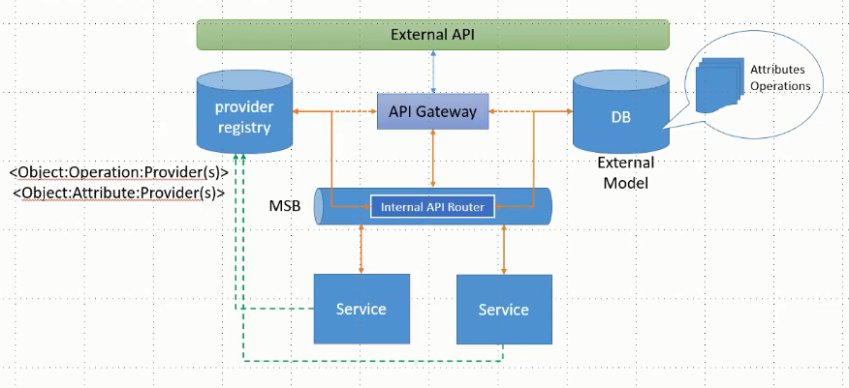
Reference : Model Driven Micro Services (Alex)

Slide 29
Domain Driven Design Concept
Top down approach of designing Microservices
Domain-driven design (DDD) advocates modeling based on the domain of business
In the ONAP context Domain may be - Hybrid Telecom Service Orchestration and Management
In the context of building applications, DDD talks about problems as domains
It describes independent problem areas as Bounded Contexts (each Bounded Context correlates to a microservice)
Bounded contexts own its own domain data, logic and behavior
In DDD to define the domain model for each Bounded Context,
  identify and define the entities (and other patterns if required)
  create a boundary around things that need cohesion
  build and refine domain model contained within the boundary that defines the context
  Each bounded context can be modelled as a microservice

Slide 30
Domain Entity Pattern
Entities represent domain objects and are primarily defined by their identity and not only by the attributes that comprise them
An entity’s identity can cross multiple microservices or Bounded Contexts.
  For example Policy in one microservice might be TCA Configuration in another microservice or Constraint in yet another microservice
The same entity can be modeled across multiple Bounded Contexts or microservices as different identities.
However, that does not imply that the same entity, with the same attributes and logic would be implemented in multiple Bounded Contexts.
Instead, entities in each Bounded Context limit their attributes and behaviors to those required in that Bounded Context’s domain.
Reference : link

Slide 31
An example
Bounded Contexts
DCAE
OOF
Closed loop policy
Constraint
PAP
Configuration Policy
PDP/PEP
All refers to same entity with different identities , different attributes and behavior
Operational Policy
Configuration Policy
Each bounded context owns the management of identities

Slide 32
Views on ONAP Current Microservice Architecture
ONAP’s current MS architecture is defined per component. So the domain as per DDD has to be looked at a per component level
  ONAP seem to limit domain scope to each component OR sometimes seem to refer to use cases in the context of domains.
  Microservices are bound to components than end to end business context (not loosely defined based on domain entities but bound within each component) or use cases.
  To realize business use case it has to be disintegrated at component level and then MS level.
  Multiple components and associated micro services need to be augmented to support end to end capability.
  In ONAP each component bounds the entities, domain data and associated identities. This creates a dependency and violates the independent development practices put forth by DDD through bounded context.
  Kubernetes seems to map microservice to Service and not Pods, but currently each component in ONAP is mapped to Kubernetes Service with associated Pods representing docker containers fulfilling the micro functionality. Reference : link , link

Slide 33
How DDD enables Model Driven Design
Encouraged to create domain entities and bounded contexts (Quite similar to what modelling team is doing with CIM, but might require further identification of bounded contexts)
Each bounded context has own domain model and ubiquitous language relevant in own boundary
A context map is formed representing interaction between bounded contexts
Microservice boundaries are defined based on bounded context

Slide 34
An Abstract View of Realizing DDD
Bounded context
API Endpoint Registration
ONAP Microservice
ONAP Micro Service
ONAP Microservice
ONAP Microservice
DMaaP
MSB
Pub/Sub
ONAP Microservice
Catalog
Inventory
Workflow
Policy
Common Information model
Based on Domain
Model
Distributed Data Store
Constraint
Configuration Policy
Closed Loop Policy
Specialization with alternate identities for entities – example for policy
ONAP Microservice
ONAP Microservice
ONAP Microservice
Pub/Sub
Action invocation/API End Point Registration

Slide 35
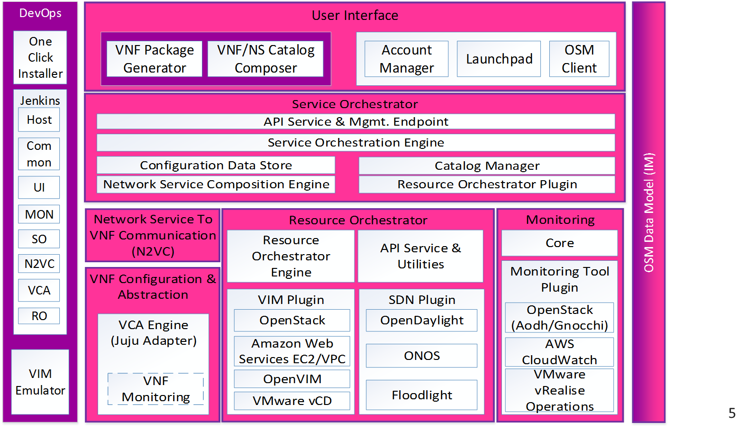
Example – Model driven approach by OSM
Models are centrally managed
Yang models are compiled to generate base classes used by all the components.
IM-NBI uses pyang tool set to generate python code, json schema and json message templates to be used by modules in OSM
Centralized management of data models helps in having a unified view across OSM and extensions are managed centrally

Slide 36
Example – Model driven and Event Driven MS in ODL
Micro services register with MD-SAL platform – about capabilities, interfaces, entities etc. Each MS is modelled using YANG and compiled to create skeleton code
Applications
API
API
Network Model
REST /NETCONF
REST API
ALTO
Network
Verifier Plugin
…
Topology
OpenDaylight MD-SAL – Framework stores Config and Operational data and enables interaction between MS.
NE
NE
NE
NE
Notifier Plugin
…
System
Flows
RIB
…
Tunnels
Paths
Nodes
Links
Table
…
Plugin
Table
Table
Config
Stats
Abstraction Layer
…
Flow
Flow
Flow
MD-SAL takes care of data storage , cluster data consistency, sharding, interaction between micro services, set of tools for project skeleton .
Any change in distributed config/operational tree is notified to subscribed MS
SB Protocol
OF-Config
OF x.y
PCEP
BGP-LS
Libs
Libs
Libs
Libs
Libs
Network Elements
Reference: Opendaylight MD-SAL Architecture

Slide 37
Model Driven Microservices – One possible implementation view
MS Registration
OOM
2
3
3
3
API Routing
External Domain Orchestrator/Controller
MSB
1
API Invocation (Actions)
8
ESR/ Ext GW
External System Registration
Generated API (Swagger)
Generated API
API
API
ONAP Microservice
ONAP Microservice
MS Deployment Unit
MS Deployment Unit
MS Configuration push to Distributed store
Meta Model
Or MS Configuration
Meta Model
Subscription for Data Change, Notification, Configuration and Operational State update
Configuration
read/sync
5
Geo-Distributed ONAP
7
4
Music
6
State update resulting in event
Distributed Configuration Store (OOM – Consul ? )
DMAAP/Real Time Data Event Streaming & Processing
Registration for topic + State change notified to subscribed MS
ONAP Primary Instance

Slide 38
Key Concepts 1/2
Microservice deployment unit consisting of the core MS software along with metafile which contains configuration and deployment descriptor (Can be modelled using SDC ?)
MUSIC for distributed , highly available storage for domain entities
Distributed Configuration Store for maintaining runtime configuration data of MS
Microservice Bus which act like a MS Endpoint Registry and API call routing GW
DMaaP or Real time data event streaming bus (based on RESP) which routes messages and file transfers across distributed MSs
OOM which reads the Metafile of MS and carries out deployment, registration.

Slide 39
Key Concepts 2/2
Micro services are packaged as deployment units – Packaging here is just logical in nature. Physically this can be an ONAP micro service component with a well-known (XML. YAML etc) configuration, deployment descriptors which acts like a metadata for MS. In practical sense the Metadata may be split to two files – deployment descriptor and configuration descriptor. Deployment descriptor is used as input for deployment by Kubernetes or Docker Engine. Configuration Descriptor captures following details
  MS configuration like DB connectivity details
  MSB registration including the capabilities
  DMaaP registration including the topics published and subscribed
  CHAP related configuration
  Domain data bound by MS
  Swagger for generating APIs for MS (which can be consumed by MSB)
During the microservice deployment (using deployment descriptor), metadata is read from the microservice predefined directory structure and pushed to the configuration data store. Rest of the configuration changes can be applied on the configuration store
OOM deploys MS and carries out registration of MS on MSB based on the registration data read from configuration store . Similar registration mechanism can be carried out for DMaaP as well.
MS carries out self-configuration or OOM initiates configuration of MS by reading the configuration data store
During the lifecycle of the MS the state is updated on the CHAP distributed DB which triggers notification on DMaaP
Notification forwarded to consumer by DMaaP
Consumer act upon state change : This is optional – indicating the event driven microservice behavior
Consumer potentially invokes action on Provider through an API call. : This is optional – indicating the event driven microservice behavior

Slide 40
Approach 1: Observations
The concepts described in this approach focus on the boundary, structure and interaction patterns of microservices
Microservices can be model driven following the domain driven design principle with bounded context mapped to a microservice. Each bounded context maintaining own domain model.
The reusability of the microservices and aggregation of microservices to form a system or a solution with a well defined grouping pattern is not covered well.
Require effort in refactoring the existing microservices to define context map, domain models etc.
Will enforce top down modelling of microservices with alignment to domain rather than independent projects or components.

Slide 41
Approach 2: Modular Microservices Design

Slide 42
TMForum IG1118 : Concepts
TMForum IG1118 defines the future mode of operations based on the concepts of management and control continuum.
FMO : The process and people involved in operating physical and virtualized digital services.
Future Mode of Operations (FMO) Architecture : E2E Architecture that allows delivery and operations of physical and virtualized digital services and leverages SDN and NFV related technologies
Management and Control Continuum: Operational actions take place at all levels in a E2E Service delivery and operations architecture. The operational aspect in E2E Architecture is realized using management and control functions. Management and Control Functions are essentially of the same nature and can be grouped into a common set called management and control continuum functions. This makes the traditional approach of separation of management and control functions obsolete.
MCC Stretches across BSS/OSS, NMS/EMS, MANO, and SDN Controllers down into physical and virtualized networks to embedded OAM, signaling, flow, policy and other network-level control functions
MCC Architecture : The part of FMO concept which is focused on lifecycle operations of services delivered using FMO architecture. Contains Components which focus on Management or Control functions.
Component : A unit of functionality that presents capabilities through its interfaces.
MCC Component: A component whose functional behavior would traditionally be considered as management or control or anywhere in between two.
System : Interconnected components interacting to collectively provide some desired behavior
SW Delivery Package: Bundling of software that is provided as a single deliverable. Consists of multiple SW deployment units
SW Deployment Unit : A single executable that when installed on an appropriate platform will run to produce emergent behavior that is considered as one or more FMO Component
Reference: TMForum IG1118 (Also referred in ETSI ZSM)

Slide 43
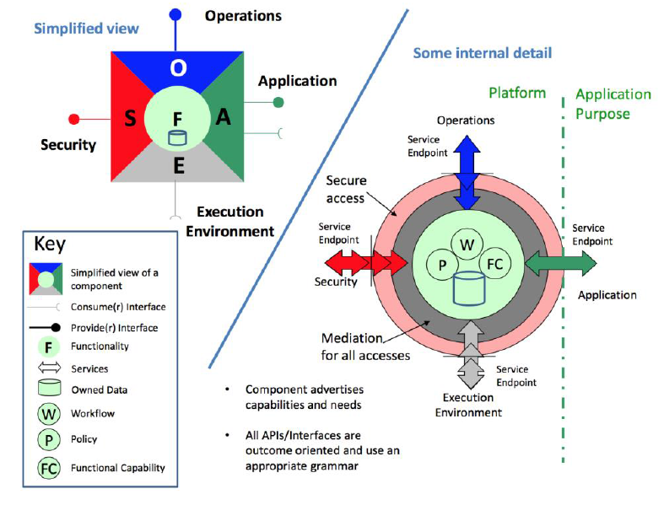
TMForum IG1118 : FMO Component (Concept)
Consumer Interface: Interface used by component to fulfil needs for tasks to be carried out related to its purpose. The tasks will include the evaluation of information and the providing of results.
Provider Interface: Interface through which a component offers a capability to carry out specific tasks related to its purpose.
Application Function: Exposed through Application API and provides access to all the related to the primary business purpose of the component
Operations Function: Exposed through operations API and implements the support for managing the lifecycle process for the component
Security Function: Exposed through security API and and provides security features for the component
Environment Function: Accessed through the execution environment APIs and used by the component to access the infrastructure resources that it needs to support its functionality or operations.
Reference: TMForum IG1118

Slide 44
Management and Control Continuum
A part of FMO Concept which focus on operational aspects of services in the target architecture built on NFV and SDN.
Deals with component that have management-control functions as their primary functions.
In traditional systems functions like EMS/NMS, Control Plane etc are considered as MCC functions.
In the MCC architecture MCC components can be assembled to form MCC Systems. An assembly of MCC components can be given a certain name/branding.
A collection of functional components can be packaged together and delivered as a solution to a particular problem.
Such an assembly in itself can be considered as a component.
Each component in an assembly is contributing its application function to the capabilities of the overall branded component
The same MCC component can be offered as part of different branded components.
Reference: TMForum IG1118

Slide 45
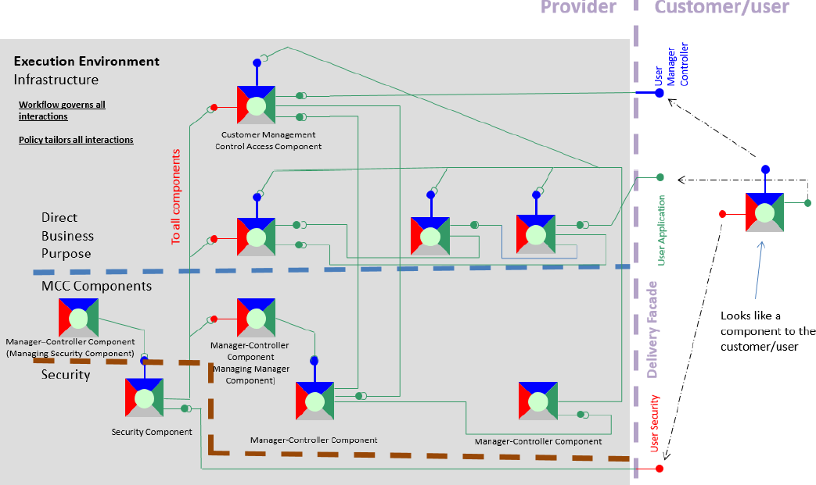
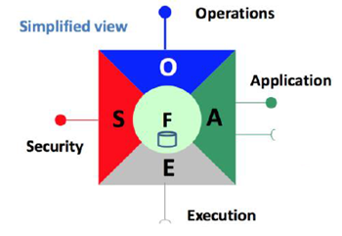
FMO Architecture: Composition of Components
Assembly of component perceived as a component by end user
Reference: TMForum IG1118

Slide 46
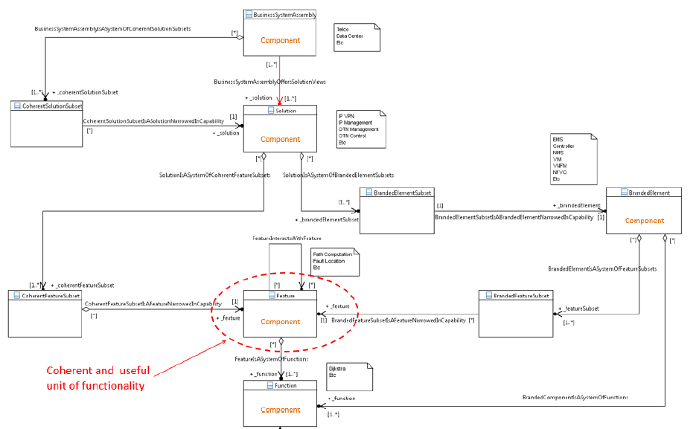
FMO Component : Positioning of a Component in a hierarchy of modular constructs
A component-system pattern is fractal, split a component and you get more components, combine components and you get a component.
MicroServices can be perceived as a component fulfilling a cohesive function.
A Branded Element constitutes of multiple features which in turn are realized through set of functions – all levels can be a composite component.
Reference: TMForum IG1118

Slide 47
FMO Component : Key characteristics
FMO component is a good way of visualizing the Microservices with well defined boundaries expressed through – Operations, Application, Security and Environment Functions
FMO Component supports a provider consumer pattern and interfaces for offering or consuming capabilities that can be expressed through APIs.
FMO Component may have multiple contexts – information context (e.g: software, image, descriptors), delivery context (packaging, modules), deployment context (deployable unit – as an assembly of functional components in a deployment unit), catalogue context (represented in a catalogue as a functional component along with delivery and deployment context), runtime context (component artifacts turned into runtime entities consuming resources and exposing APIs)
FMO component can be deployed in either a physical or a virtualized environment enabling the cloud nativeness
For ONAP, FMO Component can be interpreted as the basic unit of functionality that can be represented in a microservice and can be assembled to form a system or a branded component (for example DCAE).
Reference: TMForum IG1118

Slide 48
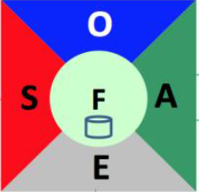
Relevance in ONAP – Assembly of Branded FMO/MCC Component
ONAP Branded Component (e.g. OOM, MSB, AAF)
ONAP Branded Component (e.g. External API)
ONAP Branded
Component (e.g A&AI)
ONAP Solution as an assembly of Branded Components
ONAP Branded Component (e.g. SO)
ONAP Branded
Component (SDNC)

Slide 49
ONAP as an assembly of Solution subsets
One layer’s capability is infrastructure to the next layer
ONAP with OSS/BSS MCC Components
(E2E Service Orchestration)
Layer 1
Layer n
ONAP Branded Component
ONAP as Domain Orchestrator Branded Component
ONAP as Domain Orchestrator Branded Component

Slide 50
ONAP Modularity and Standard Alignment through Proxy Component
Branded ONAP Component capabilities exposed though another component
A branded ONAP component (such as SO or DCAE) can be represented through the interfaces consolidated/exposed by a single component which acts like a proxy.
This proxy can be realized using ONAP MSB or can be dedicated microservice within ONAP Branded Component (e.g. side car exposing the component to the service mesh)
This approach can be used to enable standard alignment. For example if two SDO interfaces need to be supported based on different deployment models, two proxy components can be created with different component interfaces.
Modularity is ensured by the FMO component structure and the APIs exposed by micro/macro levels of components which are consolidated through proxy component
Multiple instances of this proxy component possible to align the branded component to multiple API flavors required for Standard alignment
Branded ONAP Component

Slide 51
Suggested changes in ONAP
Refactoring of ONAP Components , Microservices in-line with the FMO, MCC concepts
Refactoring of APIs across components/Microservices in the Security, Operation, Application and Environment categories
Alignment of Component/Microservice APIs in the Security/Operations/Application/Environment categories with External API
A means for the components/Microservices to express capabilities in a catalogue to enable appropriate assembly (MSB capability limited to end point registration, not capability registration)
Governance of interaction between components through policy (Already available through Configuration Policy ?)
To have capabilities built in to components to achieve lifecycle compatibility (API/Interfaces change and upgrade support) with relevant mediation functions or adaptors
A mechanism to express different context of Components/Microservices – Delivery context, Deployment Context, Information Context, Catalogue context, Runtime Context etc.
Microservices (a FMO or MCC component) and ONAP Components (a branded component) designed through the Bundle Context concept – i.e to identify the domain model being fulfilled by the microservice and then building APIs to enable the interaction with microservice (MCC or FMO Component).

Slide 52
Approach 3: Cloud Native Micro Services with Service Mesh – MSB Implementation

Slide 53
Cloud native microservices
Microservices designed with cloud native principles in mind
12 factor principles – link (need not be cloud native, but general MS principles)
CNCF currently is tool focused that work with COEs and dockerized containers.
ONAP already uses some of these tools sets
What is missing is the framework which integrates all these toolsets that can be readily used for implementing microservices
CNCF also does not define structure or modelling for MS other than what COE provides. Kubernetes seems to follow Helm as a popular MS modeling mechanism
Interfaces like gRPC, gNMI etc seem to be quite efficient compared to REST APIs and ONAP may start using this for microservices interaction and ONAP- VNF-NFVI interaction.

Slide 54
ONAP Context
Not all Micro services in ONAP are designed with an objective to be cloud-native. Some important characteristics that should be considered are
  Leverage the cloud characteristics like scaling, healing and migration (handling lifecycle management operations)
  Version and Update handling without impacting the functionality
  Always On Availability
  Portable across cloud infrastructure
  Inbuilt state management , consistency checking mechanisms
  Inbuilt health check mechanisms
  In built fault tolerance mechanisms
  Fault isolation capability
  Tracing of flows across microservices

Slide 55
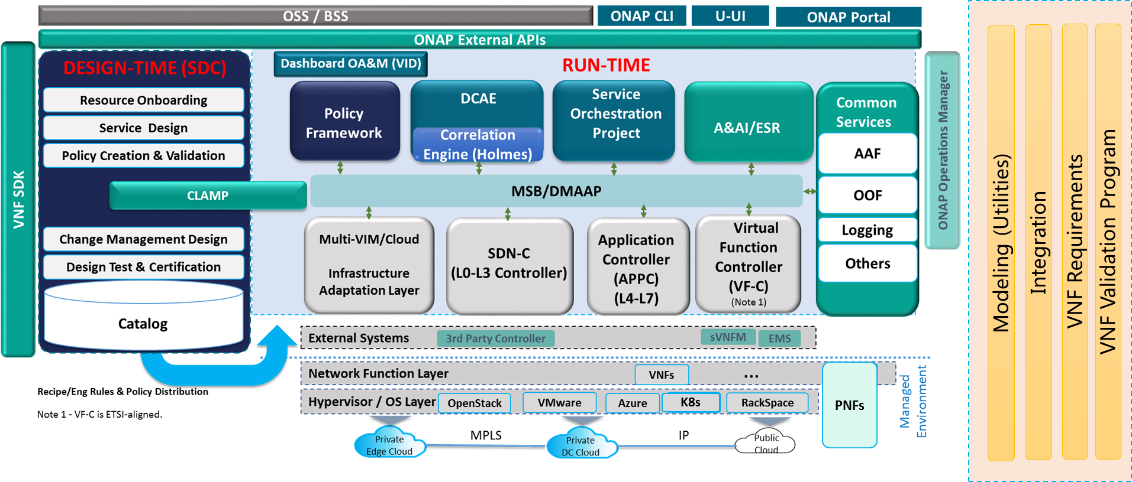
Cloud native tools that can be leveraged in ONAP – Reference CNCF, IETF
Service Mesh: Linkerd, Envoy
MS interaction : gRPC
gNMI/gRPC/ProtoBuf as enhancement for VES Collector
Prometheus for MS/VNF telemetry collection , monitoring
TUF for Secure SW update
Notary
Fluentd, Jaeger, OpenTracing
Rook for Cloud native distributed storage , which can be leveraged in MUSIC
Open Policy Agent
gNMI/gRPC, QUIC for NE/VNF Management

Slide 56
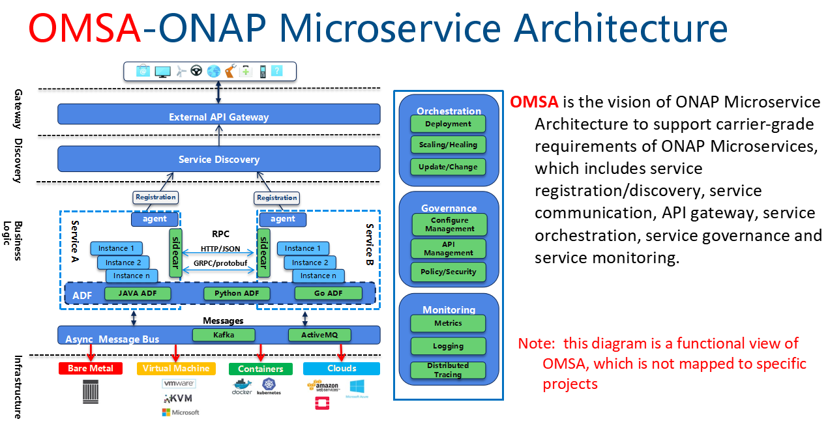
OMSA (By MSB team)

Slide 57
OMSA Observations
OMSA is primarily an implementation approach than dealing directly with the Microservices design principles –Modularity, Model Driven, Independent development concerns.
Limited Scope – i.e covering the Micro Service discovery, Interaction . How about nature and boundary of microservices ?

Slide 58
Our views
All approaches bring-in significant practical value
Among the three approaches , Approach 2 seems to be more favorable considering the ease of adoption and the modularity that can be achieved
  Approach 2 might be favorable from a component level standard API and model alignment point of view as flexible proxy components can be supported
  Approach 2 can also leverage some of the concept of domain context pattern described in approach 1
  Approach 1 might require a major revamp across projects - the way Model states are maintained, propagated and acted upon. So this approach may be considered for long term.
Approach 3 is more of an implementation approach with focus on discovery and interaction of MS. MS still need to be structured well, consistent and follow cloud native principles to leverage benefit of this approach.

Slide 59
ONAP Microservices Architecture for Casablanca and beyond
Huabing Zhao

Slide 60
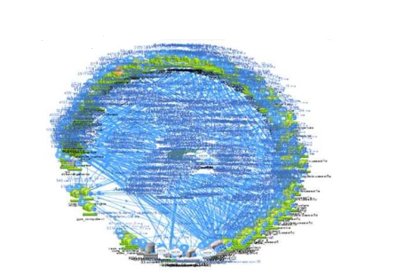
Service Mesh-Why
Microservice comes with a price
The complicity of a large distributed system
  Service discovery/load balancing
  How to secure the west-east communication
  How to get inside visibility of the systems(Metrics, Topology, tracing)
  How to improve operation efficiency(Canary deployment, Resiliency testing, Rate limiting, White list)
The Complicity of multi-tech stacks
  The common above infrastructure need to be implemented in every application services
  Management of libs for multiple languages/frameworks
  Management of multiple version of libs
  These challenges tend to break the multi-tech stack promise of Microservice Architecture
The deployment scale could be very large

Slide 61

Before
Service Mesh-How
Kubernetes pod

Slide 62

Before
App container
Kubernetes pod

Slide 63

Before
TLS
App container
Kubernetes pod

Slide 64

Before
TLS
App container
retries
Kubernetes pod

Slide 65

Before
TLS
App container
retries
metrics
Kubernetes pod

Slide 66
Before
TLS
App container
retries
metrics
Kubernetes pod

Slide 67
Before
TLS
App container
retries
metrics
Kubernetes pod

Slide 68




After
TLS
App container
Istio
Proxy
retries
metrics
Kubernetes pod

Slide 69
















Separation of concerns
The remote communication logic is move into the proxy and deployed as “sidecar”
Developers only need to take care of the business logic
TLS
App container
Istio
Proxy
retries
metrics
3. call
2. call
4. forward
client
server
client
Proxy
server
registry
registry
2. lookup
1. register
3. lookup
1. register

Slide 70
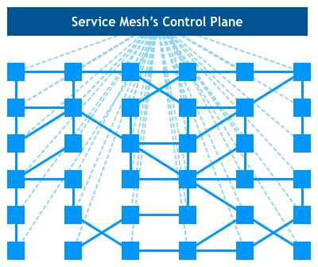
Network of Proxies: Service Mesh
A service mesh is a dedicated infrastructure layer for handling service-to-service communication. It’s responsible for the reliable delivery of requests through the complex topology of services that comprise a modern, cloud native application. In practice, the service mesh is typically implemented as an array of lightweight network proxies that are deployed alongside application code, without the application needing to be aware.
-William Morgan

Slide 71
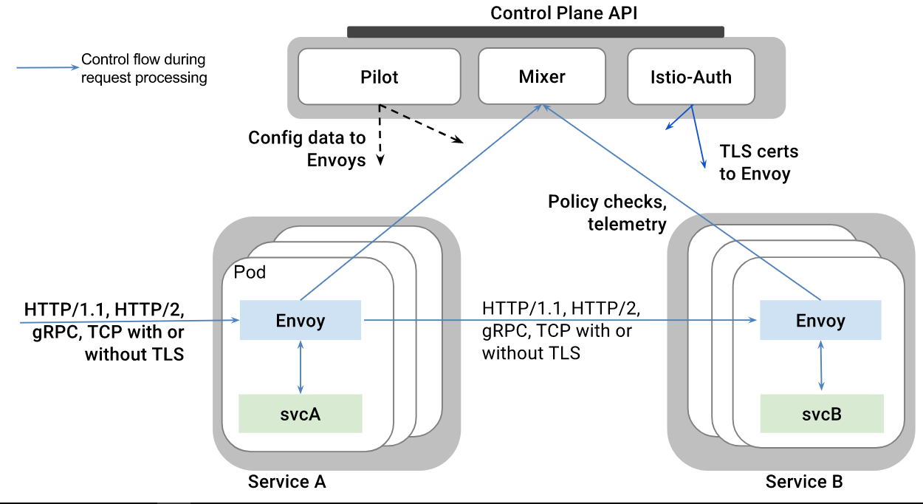
Istio service mesh
Istio is a open source service mesh project.
Istio features:
Istio Architecture
Stability and Reliability: Reliable communication with retries and circuit breaker
Security : Secured communication with TLS
Performance: Latency aware load balancing with warm cache
Observability: Metrics measurement and distributed tracing without instrumenting application
Manageability: Routing rule and rate limiting enforcement
Testability: Fault injection to test resilience of the services

Slide 72
Service Mesh suggestion for Casablanca
Integrate Istio with ONAP to provide infrastructure for communication(service discovery/retries/rate limiting/route rule/secured communication)
Keep it compatible with existing service communication approach(MSB API Gateway and Point 2 Point Communication)
Minimize the impacts to ONAP projects(Service mesh is designed as a trasparent infrastructure layer, but in practice, there may be some change needed to be done on the application side, for example, the trace header should be passed through the service calling chain)
Integrate with jaeger/zipkin to provide distributed tracing
Integration with prometheus and grafana for metrics collection and display
Feedback the findings to the upstream project
Investgate any needed extension for ONAP itself
Istio will not be a mandatory deployment option for casablanca
Leverage Istio to achieve close loop operation for ONAP system itself - long time goal

Slide 73
Centralized Auth - Why
ONAP is a huge system consisting of many services. Currently, different services such as AAI, SDC, Policy etc. have their own authentication process, which makes ONAP difficult to use and adds burden to the individual project to enforce the cross-project authentication logic. We might want to consider implementing some kind of centralized authentication and authorization, which means user login once and can access all the services. We also need to consider how to secure the access of 3-party systems by using API token or OAuth.

Slide 74
Centralized Auth - possible approach
Somethig to consider:
Auth at External API Gateway for user agent and external system
User Token for user access
API Token/OAuth for external system access
Sidecar/Internal API Gateway for the security of inter-service communication
Portal(access URL)
2
Assign a token to user
User login with credential
3
User send token along with the requested url to MSB External API Gateway
1
4
Validate token and permission
AAF
MSB External API Gateway
Plugin
5
Validation result
(allowed or rejected)
If authorization success continue to service
6
Validate token and permission (optional)
ONAP Services
7
Note: the request http method and uri is implicitly mapped to AAF permission by the plugin
Note: the project choose to do authorization itself or delegate to MSB base on its business requirement
74
74

Slide 75
Unified API Standard
Most of the projects produce RESTFul APIs for consuming, but in a none-consistent way, which is confusing to ONAP developer and user. We need to define some unified standards/best practices on the REST API definition across the ONAP projects such as versioning, url, error code. There is a draft in the wiki page:
https://wiki.onap.org/display/DW/RESTful+API+Design+Specification

Slide 76
Recursive Service Orchestration in ONAP (Gil)

Slide 77
ONAP Orchestrator Functions (1/2)
Orchestrate Network Functions (VNF/PNF), and Network Services, and services provided by the managed environment
Coordinate cross-controller activities driven by orders and events to
  Instantiate/modify/upgrade/configure/remove (LCM) VNFs/PNFs, network services, and services from the managed environment
  Perform multi-control layer remedy actions.
Key Attributes of Orchestrator:
Model Driven Orchestration
  Process behavior driven by resource / service model designed in SDC
  Orchestrates network functions and service LCM (Instantiations, ..) , including compound / nested services (parts already in R1)
    Nesting may be domain-specific orchestrator (does not require SO clone)
  Support software upgrade and planned change management
  Support open & closed-loop control actions initiated by DCAE /Policy or external API (e.g. OSS for Open Loop)
  Tracks orchestrated activity for the life of the request but doesn’t control state of orchestrated components

Slide 78
ONAP Orchestrator Functions (2/2)
Interfaces to External OSS / BSS Systems
  Standard APIs exposed northbound to create, modify or remove services and resources
  Request decomposition of service request into service / network function components
  Selects model / recipe that supports the request and maps order data to recipe / model
Coordinating Activities Across Various ONAP Controllers
  Coordinates activities across Multi-Cloud (infrastructure) / SDN-C / APPC / VF-C controllers
  Manage recording of service configurations
Orchestrator Performs Following Additional Services
  Coordinates current inventories and placement/optimization recommendations
  Enforces business & technical policies
  Support standards-based workflows
  Validates and records network functions / service implementations

Slide 79
Examples of Orchestration Requests (1/2)
Install/Configure a single network function (VNF or PNF)
  E.g., deploy a new virtual PE or P router
  A virtual network element might have one or more components (e.g., VNFCs or VDUs)
Install multiple copies of network functions in one or more data centers
  E.g., deploy new virtual PE or P routers across multiple locations
Deploy one or more instances of network services
  E.g., RAN at Multiple sites, one or more sites of EPC, etc.
Deploy E2E network services
  E.g., RAN + EPC + IMS and services from the managed environment
Instantiate and LCM a customer services
  E.g., multi-site VPN or IP SEC which may require deploying new instances of network elements (e.g., vCE) and using existing elements (e.g., vPE) or using existing elements without any new VNF/PNF being deployed (e.g. “Allocated Resources” – configuring a service to existing components)

Slide 80
Examples of Orchestration Requests (2/2)
Create a new instance of a network slice segment
  Could be leveraging existing network services (RAN, vEPC, etc.)
Create a new instance of a network service slice – e.g., IoT or eMBB slice
  Could be leveraging previously created network slice segments
Implement a software upgrade / change management
  Could require Coordination of activities across Multi-VIM (infrastructure)/SDN-C/app-C/VF-C controllers
Orchestrate remedial actions requested as part of Closed or open loop action
  Could require adding new compute / network resource to the existing functional elements (i.e. VNF)
  Create a new instance of VNF and migrate traffic
  Could require Coordination of activities across Multi-Cloud (infrastructure)/SDN-C/App-C/VF-C controllers)

Slide 81
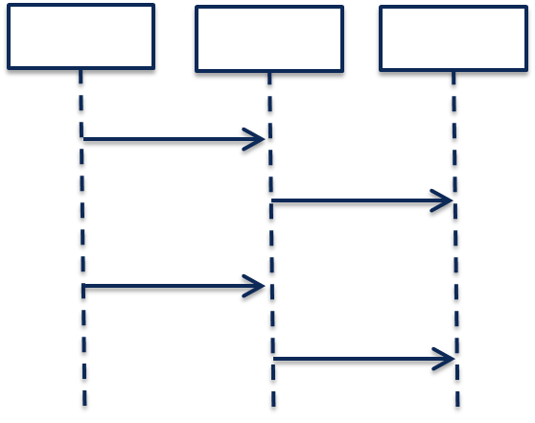
Model-Driven Orchestration (Recursive Structure)
“Generic” model-driven Service flow
Each Resource Type has its own “Generic” model-driven flow. There currently exist such flows for “VNF” and “Network” Resource Types.
Service Orchestration
Resource Orchestration
Cloud Resource Orchestration
PNF
Service X:
topology_template:
node_templates:
PNF
Network
VNF
Allotted Resource
Network
VF Module
Note recursion
VNF
Service Orchestration
Resource Orchestration
Allotted Resource
requirement: A
PNF
An Allotted Resource can be homed to an existing “underlying” network function or Service Instance, or homing could determine that a new network function Service Instance is needed. This would result in a 2nd level of Service Orchestration.
Service Y:
topology_template:
node_templates:
PNF
Network
VNF
Allotted Resource
capability: A
Network
Service Y is being treated as a “Resource” from the perspective of Service X.
VNF
Allotted Resource

Slide 82
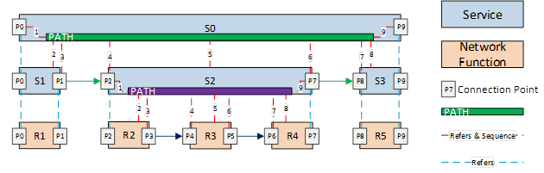
Nested / Compound Services
Service W:
topology_template:
node_templates:
VNF_W
Service_X
Service X:
topology_template:
node_templates:
VNF_X
Service_Y
Service Y:
topology_template:
node_templates:
VNF_Y
Service_Z
Service Z:
topology_template:
node_templates:
VNF_Z

Slide 83
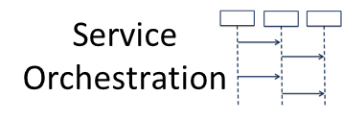
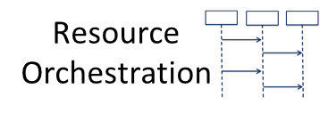
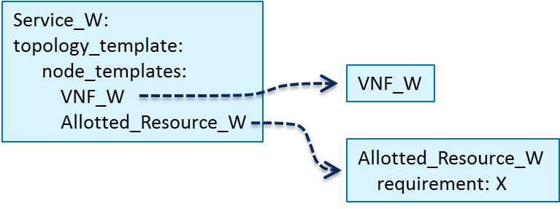
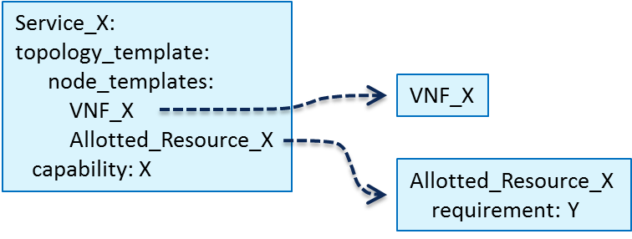
N-Level Run Time Nesting? Let The Service Providers Decide
Service_W Modeling Example 1
Each Service/Resource “reuse unit” results in a separate thread of orchestration. This would allow for “on demand” spin up of “lower level” (Infrastructure) Service instances.
Could be extended to allow multiple “higher level Services” to each have a “share” of a “lower level Service’s” instance
Provided by: Service_X
Separation of Concerns Boundary
Separation of Concerns Boundary
Provided by: Service_Z
Service Z:
topology_template:
node_templates:
VNF_Zj
VNF_Zk
capability: Z
VNF_Zj
VNF_Zk

Slide 84
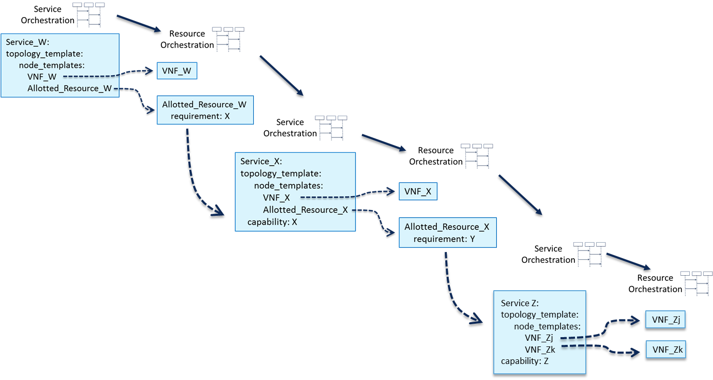
A&AI Instance Representation of Service_W Example 1
VNF_W VNF Instance
Instance “1”
Service_W Svc Instance
Instance “1”
AllottedResource_W AR Instance
Instance “1”
VNF_X VNF Instance
Instance “2”
Service_W’s Allotted Resource provided by Service_X
Service_X Svc Instance
Instance “2”
AllottedResource_X AR Instance
Instance “2”
Service_X’s Allotted Resource provided by Service_Z
Service_Z Svc Instance
Instance “3”
VNF_Zj VNF Instance
Instance “3”
VNF_Zk VNF Instance
Instance “3”
Provided by: Service_X
In this example, the entirety of VNF_W is dedicated to the Service_W Service Instance, but only a portion (represented in A&AI as AllottedResource_W) of the “lower level” Service_X Service Instance is dedicated to the Service_W Service Instance. This pattern repeats itself for the other Service Instances shown.
Provided by: Service_Z

Slide 85
SDC Model View
VNF_W VNF Resource:
VFC_W (VFC)
Service_W Service:
topology_template:
node_templates:
VNF_W (VNF):
Allotted_Resource_W (AllotRes):
Allotted_Resource_W AllottedResource:
Providing_Service:
Service_X
VNF_X VNF Resource:
VFC_X (VFC)
Service_X Service:
topology_template:
node_templates:
VNF_X (VNF):
Allotted_Resource_X (AllotRes):
Allotted_Resource_X AllottedResource:
Providing_Service:
Service_Z
VNF_Zj VNF Resource:
VFC_Zj (VFC)
Service_Z Service:
topology_template:
node_templates:
VNF_Zj (VNF):
VNF_Zk (VNF):
VNF_Zk VNF Resource:
VFC_Zk (VFC)

Slide 86
“VNF Chaining” Data Flow for Service_W Example 1
VNF_W
Service_X’s Allotted Resource provided by Service_Z
VNF_Zk
VNF_X
AR_X
AR_W
Service_W’s Allotted Resource provided by Service_X
VNF_Zj
AR_X

Slide 87
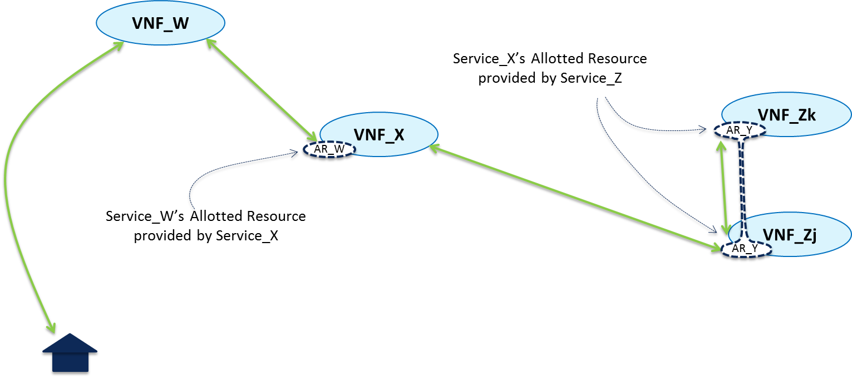
Modeling Network Latency Homing Constraints for Allotted Resources
If Service_W is sensitive to network latency beween VNF_W and the VNF_X that hosts AR_W, then the homing algorithm will need to select only VNF_X instances that meet the Service_W constraint. However, we don’t want to write any homing (or any other) policies for Service_W in terms of the internal structure of the underlying “lower order” Service type.
We can instead write the network latency constraint in terms of two policies, one a Service_W policy and one a Service_X policy.
Specifically, we will define the concept of an “SLA” that the lower order service will advertise. We will give the “higher order” Service a policy as to which SLA it requires from the “lower order” Service type. We will have the “lower order” Service type have a policy which indicates from which VNF the SLA is measured (mirroring the data path)

Slide 88
Defining Capability SLAs: Service Z Example
Seen from perspective of a “Consuming Service”, Service Z is a “black box” that provides a Capability Z that offers a (set of) SLA(s).
VNF_Zk
Capability Z Offers:
AR
SLA Z1
SLA Z2
Capability Z “Capability Access Point” as seen from outside of the Service Z model.
VNF_Zj
SLA Z1
When configuration “P” is applied to its Capability Z, Service Z will offer a ResponseTime<30ms, measured from its Capability Access Point (i.e., not counting network latency)
SLA Z2
When configuration “Q” is applied to its Capability Z, Service Z will offer a ResponseTime<20ms, measured from its Capability Access Point (i.e., not counting network latency)
AR
Inside the Service Z model is the definition as to how the Capability Z “Capability Access Point” maps to actual VNF external connection points.

Slide 89
SDC Modeling Tool for Service Designer
Key
“Lower Level Service Type” that can be instantiated in real time on an “on demand” basis
SLA W1
RspTime<65ms from VNF_W
VNF_W VNF Resource:
VFC_W (VFC)
Service_W Constraint:
Network Latency<30ms
Service_W Service:
topology_template:
node_templates:
VNF_W (VNF):
Allotted_Resource_W (AR):
Application Latency 5ms
Allotted_Resource_W AR:
Providing_Service:
Service_X
Use SLA X1
SLA X1
RspTime<30ms from VNF_X
Service_Z Constraint:
Affinity: Co-Located
SLA X1
Service_X Service:
topology_template:
node_templates:
VNF_X (VNF):
Allotted_Resource_X (AR):
VNF_X VNF Resource:
VFC_X (VFC)
Service_X Constraint:
Affinity: Co-Located
Application Latency 5ms
VNF_Zj VNF Resource:
VFC_Zj (VFC)
Service_W Constraint:
Network Latency<20ms
Allotted_Resource_X AR:
Providing_Service:
Service_Z
Service_Z Service:
topology_template:
node_templates:
VNF_Zj (VNF):
VNF_Zk (VNF):
Capabilities:
Capability_Z
VNF_Zk VNF Resource:
VFC_Zk (VFC)
Use SLA Z2
Requires Contrail
SLA Z1
SLA Z2
Service_Z Constraint:
Affinity: Must be within geo-political provincial/state boundary
SLA Z1
ResponseTime<30ms at VNF_Zj, if
SvcInstance created with configuration “P”
(not counting network latency)
SLA Z2
ResponseTime<20ms at VNF_Zj, if
SvcInstance created with configuration “Q”
(not counting network latency)

Slide 90
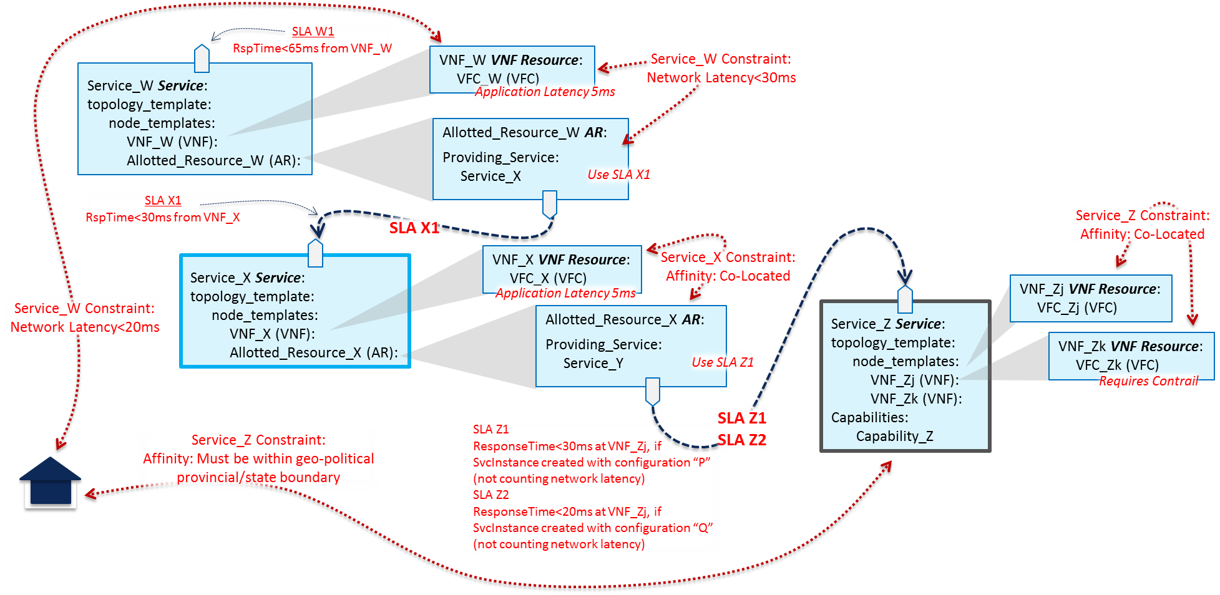
SDC Modeling Tool for Service Designer
 | Application Latency | Network Latency | Cumulative Latency | Advertised SLA
VNF_Zk
VNF_Zj
VNF_Zk <-> VNF_Zj |  | 0
Svc_Z | Unknown |  |  | 20
VNF_X | 5
VNF_X<->Svc_Z |  | 0
Svc_X |  |  | 25 | 30
VNF_W | 5
VNF_W<->Svc_X |  | 30
Svc_W |  |  | 65 | 65

Slide 91
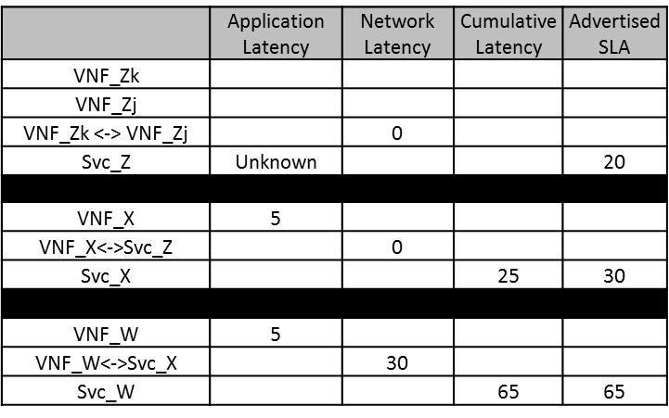
SDC Homing Policy Calculator
VNF_W
Service_W Constraint:
Network Latency<30ms
Service_W Constraint:
Network Latency<20ms
VNF_Zk
Instance
AR_W
AR_X
VNF_X
Instance
Service_W Policy:
Require SLA X1 from the hosted Service_X instance
Network Latency=0ms
Service_Z Policy:
SLA Z1 is provided from entry point VNF_Zj
Affinity: Collocated
VNF_Zj
Instance
AR_X
Service_X Policy:
SLA X1 is provided from entry point VNF_X
Service Y Policy:
Require SLA Z1 from the hosted Service_Z instance

Slide 92
Decomposition Structure for Service_W Example 1
Svc Type | Rsc Type | AR Prov Svc | Advertised SLA | Homing Constraints | Capab Svc Struct
Service_W |  |  | W1: RspTime 65ms end to end | Ntw Latency: VNF_W <-> AR_W < 30ms
Service_W | VNF_W |  |  | Ntw Latency: Residence <-> VNF_W< 20ms
Service_W | AR_W | Service_X |  | Require SLA X1 from Service_X instance
Svc Type | Rsc Type | AR Prov Svc | Advertised SLA | Homing Constraints | Capab Svc Struct
Service_X |  |  | X1: RspTime 30ms end to end | Affinity: VNF_X, AR_X Co-Located
Service_X | VNF_X
Service_X | AR_X | Service_Z |  | Require SLA Y1 from Service_Z instance
AR_W Provider’s Svc Struct
Svc Type | Rsc Type | AR Prov Svc | SLA Policies | Homing Constraints | Capab Svc Struct
Service_Z |  |  | Z1: <30ms with config “Q” Z2: <20ms with config “P” | Affinity: VNF_Zj, VNF_Zk Co-Located
Service_Z | VNF_Zj
Service_Z | VNF_Zk
AR_X Provider’s Svc Struct

Slide 93
Decomposition and Homing Approach
Note that, from a Service_W perspective, homing involves finding a cloud instance suitable for a new VNF_W instance such that the constraint:
Latency: [geographic point on map] <-> VNF_W < 20 ms
(where the geographic point is the location of the residence), and such that the “Network Latency” constraint of “VNF_W <-> AR_W < 30ms” is met. This involves knowing that the Providing Service for AR_W is Service_X. This processing would require decomposition to have created the Service_W rows in the decomposition example. If an appropriate cloud instance and Service_X service instance is found, then homing is complete.
However, if no such Service_X instance exists (i.e., OOF Service_X homing thread returns an exception), homing can determine that a new one should be created “on demand.” In such a case, we want to take a separation of concerns approach whereby the Service_W homing thread can delegate down to a Service_X homing thread for further solutioning.
Homing of a new Service_X instance would similarly require that decomposition of Service_X be performed (i.e., the Service_X rows of the table). OOF itself could trigger the decomposition microservice. One goal of this homing is to find a cloud instance suitable for a new VNF_X instance such that the Service_W constraint that VNF_W <-> AR_W < 30ms is met. However, we don’t want to violate separation of concerns between the Service_W and the Service_X processing, so we will have the Service_W homing thread pass to the Service_X homing thread a constraint that is written in terms that Service_X can understand:
Latency: [geographic point on map] <-> Service_X < 30 ms
(where the geographic point is a “proposed” location of the VNF_W yet to be created). Because the optimal location of VNF_W has not yet been determined, this will likely require that the Service_W homing thread spawns multiple Service_X homing thread to solve the overall homing problem. Step by step processing can be seen on the following slides.

Slide 94
Homing Example Illustrated
For the option whereby VNF_W is located in cloud instance B, look for a suitable Service_X instance in cloud instances A, B, C, or F. If none are found, then perhaps a Service X instance could be created in one of these.
For the option whereby VNF_W is located in cloud instance A, look for a suitable Service_X instance in cloud instances A, B, C, or D. If none are found, then perhaps a Service X instance could be created in one of these.
D
30ms
20ms
A
E
C
For the option whereby VNF_W is located in cloud instance C, look for a suitable Service_X instance in cloud instances A, B, C, E, or F. If none are found, then perhaps a Service X instance could be created in one of these.
30ms
B
30ms
F

Slide 95
Homing Example Illustrated
Service_W context homing:
Find the set of potential cloud locations for VNF_W as {A, B, C}.
For each potential cloud location (take “A” as an example), send a homing request to Service_X context homing to find a Service_X instance with the following constraints:
          Able to provide Capability “X” with SLA X1
          Within 30ms of the geographic location of “A”.
Service_X context homing:
Find the set of potential cloud locations within 30ms of the provided geographic location “A”: {A, B, C, D}
Look for a Service_X instance in those locations able to provide the desired Capability and SLA.
If no such instance is found, then determine whether it is admissible to create an instance on demand. In this case it is, so:
          Find the set of potential cloud locations for VNF_X as {A, B, C, D}
          For each potential cloud location (take “D” as an example), send a homing request to Service_Z context homing to find a Service_Z instance with the following constraints:
          Able to provide Capability “Z” to with SLA Z2
          Located within geographic location “D”.
D
30ms
20ms
A
C
Service_Z context homing:
Look for a Service_Z instance in location “D” able to provide the desired Capability and SLA.
B

Slide 96
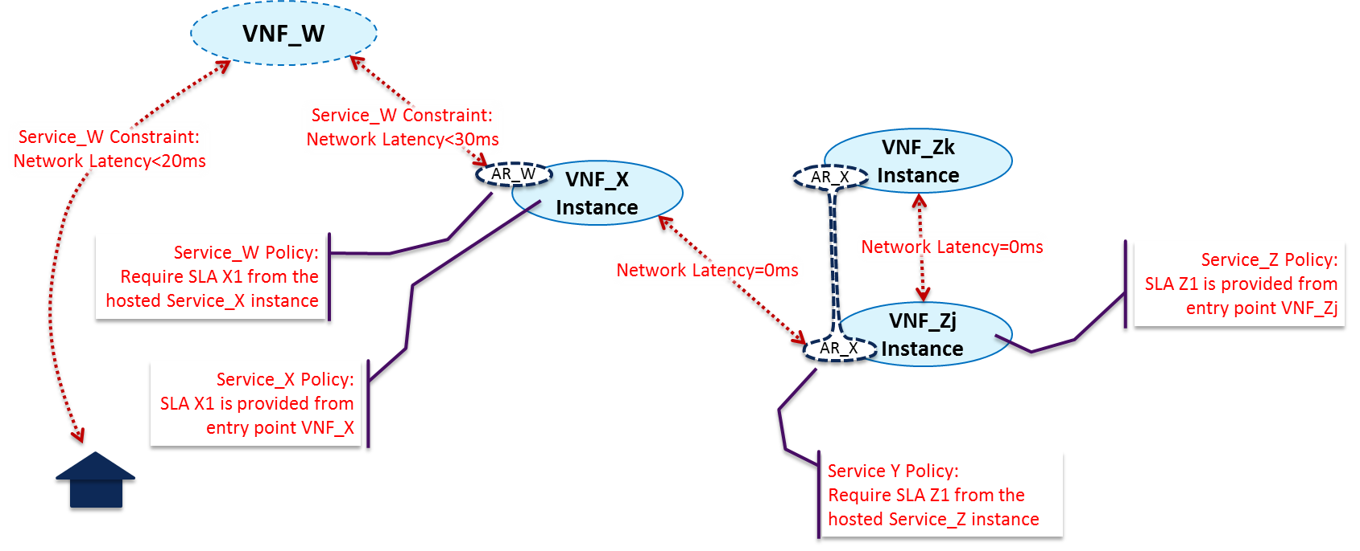
Homing Example Flow
SO sends OOF a Service_W homing request, providing
as an input constraint the geographic location of the residence. OOF Service_W homing will comprise homing for VNF_W and AR_W. OOF homing for VNF_W will find eligible VNF_W cloud
instances that meet the 20ms latency constraint with the residence. OOF homing for AR_W will, for each eligible VNF_W cloud instance, want to find the set of Service_X instances to provide that AR_W functionality that meet the 30ms latency constraint with that cloud instance.

Slide 97
Homing Example Flow (Cont’d)
However, we want to maintain a separate of concerns approach, and the Service_W processing thread shouldn’t know the implementation of AR_W such that it can measure latency to it. (This can be best seen in the Service_Z example to the right.) Thus, we will have the Service_W OOF
homing request thread delegate selection of the optimal Service_X instance to a subtending Service_X OOF thread. Thus, OOF can be seen as (logically) calling itself in parallel with multiple Service_X homing requests. Each such request can be seen as providing as input constraints the geographic location of the associated eligible VNF_W cloud instance and the SLA needed, in this case SLA X1.

Slide 98
Homing Example Flow (Cont’d)
Service_X homing knows that SLA X1 is measured from an access point on VNF_X. Thus Service_X homing is comprised of looking for the optimal Service_X instance whose VNF_X instance is within 30ms of the input geographic location. If at least one such Service_X instance is found, then
homing is done (except for optimization).
If no such Service_X instance can be found, then homing will determine whether the Service_X service definition allows for dynamic instantiation of new Service_X instances. In this case we will assume “yes”, so OOF would determine whether a new Service_X could be instantiated such that all constraints can be met.

Slide 99
Homing Example Flow (Cont’d)
OOF Service_X homing will comprise homing for VNF_X and AR_X. OOF homing for VNF_X will find eligible VNF_X cloud instances that meet the 30ms latency constraint with the input geographic location. OOF homing for AR_X will, for each eligible VNF_X cloud instance, want to find the set of Service_Z instances to
provide that AR_X functionality that meet the 0ms latency constraint with that cloud instance. The pattern recurs, however, that Service_X has no business understanding whether the 0ms latency constraint should be measured from VNF_Zj or VNF_Zk, or even in fact that there exists a VNF_Zj or VNF_Zk. In order to maintain separation of concerns, homing of AR_X will be delegated to a subtending request thread delegate selection of the optimal Service_Z instance to a subtending Service_Z OOF thread.

Slide 100
Homing Example Flow (Cont’d)
Service_Z homing will thus search for eligible Service_Z instances such that the 0ms constraint is measured from the input geographical location (in this case the potential cloud instance location for VNF_X) to an available VNF_Zj instance (the point from which the Service_Z SLA is measured.
If no such Service_Z instance can be found, then homing will determine whether the Service_Z service definition allows for dynamic instantiation of new Service_Z instances. In this case we will assume “no”, so the OOF Service_Z homing thread would return an exception to the calling Service_X homing thread. Such an exception would likely not result in failure of the entire Service_W homing, but rather simply result in pruning a branch of the overall potential homing solution tree.

Slide 101
Homing Solution Example for Service_W Example 1
Service Type | Resource Type | Allotted Resource Provider Service | Provider Service Struct | Homing Solution
Service_W | VNF_W |  |  | Cloud_Region_1
Service_W | Allotted_Resource_W | Service_X |  | Instantiation_Needed
Service Type | Resource Type | Allotted Resource Provider Service | Provider Service Struct | Homing Solution
Service_X | VNF_X |  |  | Cloud_Region_2
Service_X | Allotted_Resource_X | Service_Z |  | Service Z Instance Id
AR_W Homing Structure
Service Type | Resource Type | Allotted Resource Provider Service | Homing Solution
Service_Z | VNF_Zj |  | As Exists
Service_Z | VNF_Zk |  | As Exists
AR_X Homing Structure

Slide 102
Multi-Vendor & Multi-Cloud SDN Architecture (Ramki)
Work in Progress (R3+ Capabilities) …

Slide 103
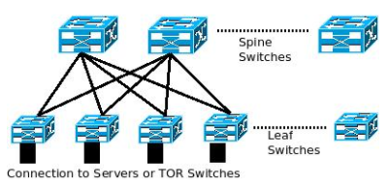
Multi-vendor SDN Architectural Approach
SDN Domain Mapping
1 physical DC could have multiple SDN Domains
Multiple latency bound physical DCs could map to a SDN Domain
One Domain Controller per SDN domain
Multi-vendor Interconnect DB
Store interconnect information between Multi-vendor Overlay/Underlay/Gateway Controllers, for e.g. Vlan
Function similar to SDN-C for connecting MC instance Gateway and WAN Controller
OpenStack Adaptor
Enable smooth transformation to new Modelling Language (TOSCA, YANG etc.)
Domain
Controller
SDN-DC
Model Translation Plugin(s)
Flexible Southbound
HW Switch/PNF Inventory
Multi-vendor Interconnect DB
OpenStack Adaptor
REST etc.
OVSDB, REST, Netconf etc.
OVSDB, REST, Netconf etc.
OpenStack Adaptor
Overlay
Controller
SDN-OC
Underlay
Controller
SDN-UC
Gateway
Controller
SDN-GC
HW Gateway
VM - SW Gateway
vSwitch Overlay

Slide 104
Multi-vendor & Cloud SDN ONAP Integration
SO
A&AI
ONAP SDN-C
ONAP Multi-Cloud (MC)
Model Translation Plugin(s)
SDN-DC
SDN-OC
SDN-UC
SDN-GC
SDN-OC
SDN-UC
SDN-GC
Full SDN Domain Abstraction (Azure, GCP etc.)
SDN-DC external to ONAP
Multi-vendor Interconnect DB in SDN-DC
HW Switch/PNF inventory exposed to ONAP SDN-C for common management and fine grained control
SDN-DC function implemented in ONAP SDN-C
Multi-vendor Interconnect DB in SDN-C
SDN-C fully aware of Overlay/Underlay/Gateway including HW Switch/PNF inventory
Overlay/Underlay/Gateway fully abstracted
HW Switch/PNF inventory *not* exposed to ONAP

Slide 105
MC Networking Challenges & Solution Direction
Challenge | Workflow | Need | Solution Direction
PNFs (HW Gateway etc.) and Underlay (HW Leaf/Spine switches/routers) not managed by MC instance | Day 1 & Beyond (Init and Deploy) | Foundation | PNFs and Underlay to be accounted in A&AI. SDN Domain controller function per MC instance (implemented in SDN-C or externally).
Lack of standardized APIs for MC instance Underlay Networking | All | Foundation | Standardized Data Models (TOSCA, YANG etc.), Semantics and Model-driven APIs for MC instance Underlay. Model Translation plugins translate to appropriate data model for specific Underlay Controller. Underlay configuration can be Layer 2 (MLAG etc.) or Layer 3 (eBGP etc.).
Underlay Network Configuration per MC instance not automated as part of common workflow | Day 1 (Init) | Foundation | Follow steps similar to WAN underlay Init; need to do this per MC instance.

Slide 106
ONAP External APIs
Work in Progress (R3+ Capabilities)…

Slide 107
ONAP External APIs
ONAP External APIs expose the capabilities of ONAP. They allow ONAP to be viewed as a “black box” by providing an abstracted view of the ONAP capabilities.
They support that an external consumer of ONAP capabilities can be authenticated and authorized. They can also be used for connecting to systems where ONAP uses the capabilities of other systems.
Note 1: External API does not include all the B2B capabilities of exposure (e.g. partner management)
Note 2: The case where trusted providers of a service (e.g. operator owned transport, or cloud infrastructure) do not need to pass through External API.
For example, External APIs between ONAP and BSS/OSS allow Service Providers to utilize the capabilities of ONAP while using their existing BSS/OSS environment minimizing customization

Slide 108



E
REFERENCE ARCHITECTURE
Customer Domain
SP Domain
Partner Domain
Cantata
(CUS:BUS)
Business Applications
Sonata
(BUS:BUS)
Business Applications
Customer
Application Coordinator
LEGATO
(BUS:SOF)
LEGATO
(BUS:SOF)
Allegro
(CUS:SOF)
Service Orchestration Functionality
Interlude
(SOF:SOF)
Service Orchestration Functionality
Presto
(SOF:ICM)
Presto
(SOF:ICM)
Color Key
ONAP Service Centric External APIs
Infrastructure Control
and Management
Infrastructure Control
and Management
ONAP Resource Centric External APIs
ADAGIO (ICM:ECM)
ADAGIO (ICM:ECM)
Element Control
and Management
Element Control
and Management
Network Infrastructure

Slide 109
SOF Interface Reference Points
Service feasibility;
Service provisioning configuration & activation;
Request fallout;
Usage events & metrics;
License accounting;
Service performance & quality (e.g., KPI);
Service trouble management;
Service policy;
Capacity engineering;
Address allocation management;
LEGATO
Dynamic service control;
Service state info;
Service performance & quality;
Service related alerts;
Service Orchestration Functionality
Dynamic service control;
Service parameter config;
Service state info;
Service performance info;
Service problem alerts
ALLEGRO
INTERLUDE
PRESTO
Color Key
ONAP Service Centric External APIs
Connectivity and network function feasibility;
Configuration, activation, and management of connectivity and logical network functions;
Topology and routing;
Performance and Fault;
Connectivity policy
ONAP Resource Centric External APIs

Slide 110
E
ONAP Multi-Domain Federation
Customer Domain
SP Domain
Partner Domain
Cantata
(CUS:BUS)
Business Applications
Business Applications
BSS
Sonata
(BUS:BUS)
BSS
Customer
Application Coordinator
LEGATO
(BUS:SOF)
LEGATO
(BUS:SOF)
Service Orchestration Functionality
Interlude
(SOF:SOF)
Service Orchestration Functionality
Allegro
(CUS:SOF)
ONAP
ONAP or
Non-ONAP Orchestration
Presto
(SOF:ICM)
Presto
(SOF:ICM)
Color Key
ONAP Service Centric External APIs
Infrastructure Control
and Management
Infrastructure Control
and Management
ONAP Resource Centric External APIs
ADAGIO (ICM:ECM)
ADAGIO (ICM:ECM)
Element Control
and Management
Element Control
and Management
Network Infrastructure

Slide 111
The ONAP “Black Box” View
APIs
UX/CX
CLIs/SDKs
OOM Interfaces
External APIs (Service Centric)
Legato
Interlude
OOM
Design
Tools
OAP
ONAP Management Interfaces
Resource Interfaces
External APIs (Resource Centric)
Presto
PNFs
VIMs
IaaS
PaaS
SaaS

Slide 112
EXT APIs - Architecture Impact
(High-Level Functional View)
OSS / BSS
CLI
U-UI
ONAP Portal
Legato
Interlude
ONAP External APIs
DESIGN-TIME
Dashboard OA&M
RUN-TIME
Resource Onboarding
Common
Services
Policy Framework
Data Collection, Analytics, and Events
Event Correlation
Active & Available Inventory
External Registry
Common Services
Orchestration
Service Design
Policy Creation & Validation
Application
Authorization
Framework
Analytic Application Design
Gen. Res. API
ONAP Operations Manager
Micro Services Bus / Data Movement (see Note 1)
ONAP Optimization Framework
VNF / PNF Onboarding
Closed Loop Design
Change Management Design
(see Note 1)
Generic NF Controllers (L4-L7)
Logging
Multi-Cloud
Adaptation
SDN Controller
(L0-L3)
Design Test & Certification
Life Cycle Management & Config
Controller SDK
Presto
(see Note 1)
Catalog
Optional External Systems
3rd Party Controller
Specific VNF Manager
Element Management System
…
Managed Environment
Network Function Layer
Recipe/Eng Rules & Policy Distribution
ONAP Optimization Framework
VNFs
PNFs
Hypervisor / OS Layer
OpenStack
VMware
Azure
Kubernetes
RackSpace
Note 1 – Consistent APIs between Orchestration layer and Controllers
MPLS
IP
Private
Edge Cloud
Private
DC Cloud
Public
Cloud

Slide 113

EXT APIs - Architecture Impact
(Projects View – Beijing Release)
External Gateway
OSS / BSS
ONAP CLI
U-UI
ONAP Portal
ONAP External APIs
DESIGN-TIME (SDC)
Dashboard OA&M (VID)
RUN-TIME
Resource Onboarding
DCAE
Correlation
Engine (Holmes)
Service Orchestration
Project
Common
Services
Common Services
Policy Framework
Service & Product Design
A&AI/ESR
ONAP Operations Manager
Policy Creation & Validation
AAF
VNF SDK
CLAMP
MSB/DMAAP
OOF
Virtual
Function Controller
(VF-C)
(Note 1)
Logging
Change Management Design
Multi-VIM/Cloud
Infrastructure Adaptation Layer
Application Controller
(APPC)
(L4-L7)
SDN-C
(L0-L3 Controller)
Others
Design Test & Certification
Catalog
External Systems
3rd Party Controller
sVNFM
EMS
Color Key
…
Managed Environment
Network Function Layer
VNFs
PNFs
ONAP Service Centric External APIs
Recipe/Eng Rules & Policy Distribution
Hypervisor / OS Layer
OpenStack
VMware
Azure
AMZ
RackSpace
ONAP Resource Centric External APIs
Private
Edge Cloud
MPLS
Private
DC Cloud
IP
Public
Cloud

Slide 114
Ext APIs – Orchestration API Mapping
APIs labeled on slide relative to SO for reference only.
Key
OE-x
SO External API
OI-x
SO Internal API
SO-SO communication across ONAP instances is via External API.
Legato
Interlude
SO-SO communication within a single ONAP instance is via Micro Services Bus.
OE-11
OE-4
SDC
Dashboard OA&M (VID)
External API
OE-5
DCAE
OE-1
OE-2
OE-3
API Handler
Request
Handler
Store
Request
Select Recipe
Map Request Data to Recipe & Invoke BPEL Execution
Track
Requests
OI-4
OOF
Orchestrator
Data Store
OI-1
Orch Execution Engine (BPMN/TOSCA)
OE-6
Service Models
Orch Service
& Resource
Catalog
BPMN
DB
Service Level
SDC Distribution Client
OI-5
Micro Services Bus / Data Movement
Resource
Models
Request DB
Resource Level Orch
A&AI/ESR
OE-7
OI-2
OI-3
Resource/Controller Adapters
Select Adapter Template
Map Data to Template
VNF/Network Adapter
Presto
Controller Adapter
Execute Transaction
Controller functions common to both SDN-C and Generic NF Controller.
OE-8
OE-9
OE-10
Multi-Cloud
SDN-C
Generic NF Controller

Slide 115
Legato Interface Reference Point (BSS/OSS-ONAP)
It is envisioned that from a Service Provider to BSS/OSS interaction context (i.e. MEF Legato), the ONAP External API will support the following types of interacts:
BSS/OSS retrieves Service Models
BSS/OSS requests service feasibility determination.
BSS/OSS requests reservations of capabilities related to a potential Service.
BSS/OSS requests activation of Service.
BSS/OSS receives Service activation tracking status updates.
BSS/OSS retrieves Service Inventory
BSS/OSS receives usage events due to a Customer initiating dynamic activity on their Service (e.g., increase in bandwidth).
BSS/OSS receives a summary of Service quality and usage information.
BSS/OSS receives Service state and fault event information
BSS/OSS receives Service Activation Testing results.
BSS/OSS receive capability information about the Service layer.
BSS/OSS manages Licenses
BSS/OSS receives License Usage information

Slide 116
Interlude Interface Reference Point (ONAP-Partner)
It is envisioned that from a Service Provider to Partner Provider interaction context (i.e. MEF Interlude), the ONAP External API will support the following types of interacts:
Service Provider controls aspects of the Service within the Partner domain (on behalf of the Customer) by requesting changes to dynamic parameters as permitted by service policies.
Service Provider queries state of the Service.
Service Provider requests change to administrative state or permitted attributes of a Service.
Service Provider request creation of connectivity between two Service Interfaces as permitted by established business arrangement.
Service Provider request instantiation of functional service components as permitted by established business arrangement.
Service Provider queries the Partner for detailed information related to Services provided by the Partner to the Service Provider.
Service Provider receives Service specific event notifications (e.g., Service Problem Alerts) from the Partner.
Service Provider receives Service specific performance information from the Partner.
Service Provider request Service related test initiation and receive test results from the Partner.

Slide 117
Information Domains in ONAP
External APIs
Governance/Processes
Policy/Rule/Constraints, SLA/OLA Definition,
Asset/Capacity Management, Configuration/Change/Incident Management, Catalog Management
Service Design
Network function on-boarding
Service definition, including Service blueprints
Service Access
User/Tenant Management, Identity Management, RBAC
Entitlement Control
Offered Services
Policy/Rule/Constraints, SLA/OLA Definition
Asset/Capacity Management, Configuration/Change/Incident Management
Services Components
Decomposition/Instantiation/Assurance/Remediation
Service Level Optimization, QoS Optimization, Policy Enforcement,
Logical Resource
Resource Matchmaking/Optimization
Resource Reservations/Allocations, Installation/Configuration
Real Infrastructure
Provider Registration, Infrastructure Discovery/Monitoring
Capacity Optimization
Service
Design
Micro-service Bus /Integration Backplane
Service Access
Offered Services
(What’s offered; Catalog)
Governance/Processes
Service Components
(Service Function Topology; Abstract Network Functions)
“Logical” Resource
(VNFs; VNF Forwarding Graphs)
“Real” Infrastructure
(Physical/Virtual/Cloud – On/Off-Premise)
Color Key
ONAP Service Centric External APIs
ONAP Resource Centric External APIs

Slide 118
Vodafone Orchestration Proposal (SO/DO Hierarchy)
Work in Progress (R3+ Capabilities) …

Slide 119

ONAP Target Architecture focus for orchestration/NF controller discussion
OSS / BSS
CLI
U-UI
ONAP Portal
ONAP External APIs
DESIGN-TIME
Dashboard OA&M
RUN-TIME
Resource Onboarding
Common
Services
Policy Framework
Data Collection, Analytics, and Events
Event Correlation
Active & Available Inventory
External Registry
Common Services
Orchestration
Service Design
Application
Authorization
Framework
Policy Creation & Validation
ONAP Operations Manager
Analytic Application Design
Micro Services Bus / Data Movement (see Note 1)
VNF / PNF Onboarding
ONAP Optimization Framework
Closed Loop Design
Change Management Design
Generic NF Controllers (L4-L7)
Logging
Multi-Cloud
Adaptation
SDN Controller
(L0-L3)
Design Test & Certification
Life Cycle Management & Config
Others
CCSDK
(see Note 1)
(see Note 1)
Catalog
Optional External Systems
3rd Party Controller
Specific VNF Manager
Element Management System
…
Managed Environment
Network Function Layer
Recipe/Eng Rules & Policy Distribution
ONAP Optimization Framework
VNFs
PNFs
Hypervisor / OS Layer
OpenStack
VMware
Azure
AMZ
RackSpace
Note 1 – Consistent APIs between Orchestration layer and Controllers
MPLS
IP
Private
Edge Cloud
Private
DC Cloud
Public
Cloud

Slide 120
ONAP Target Architecture for Orchestration layer and NF controller
(High-Level Functional View)
Domain/region versus end-to-end orchestration are depicted here for the sake of examples to depict interfaces. Expectation is to have a model driven orchestration functionality
VES and YANG not included in this figure for simplicity and also currently not in ETSI-NFV
ONAP External APIs
RUN-TIME
Orchestration
(domain/region)
Orchestration
(end-to-end)
Micro Services Bus / Data Movement
Generic NF Controllers (L4-L7)
Life Cycle Management & Config
Note
Optional External Systems
Specific VNF Manager
Element Management System
…
Network Function Layer
VNFs
VNFs
PNFs
Note: Both VNF and Element management may trigger actions to be executed by the generic NF controller

Slide 121
ONAP Target Architecture for Orchestration layer and NF controller
(APIs detailed)
Os-Ma nfvo (SOL 005)
ONAP additions
ONAP External APIs
Automation is key for the success of 5G
Management standards are partly incomplete and fragmented
ETSI MANO defines key interfaces (API)
ONAP creates an automation framework with the help of TMF/MEF
3GPP drives information models and network slices
Os-Ma nfvo (SOL 005)
ONAP additions
RUN-TIME
Orchestration
(domain/region)
Orchestration
(end-to-end)
Os-Ma nfvo (SOL 005)
ONAP additions
Micro Services Bus / Data Movement
Or-VNFM (SOL 003)
Generic NF Controllers (L4-L7)
Life Cycle Management & Config
Or-VNFM (SOL 003)
Ve-Vnfm-Vnf (SOL 002)
Optional External Systems
Ve-Vnfm-Vnf (SOL 002)
Specific VNF Manager
Element Management System
…
Network Function Layer
VNFs
VNFs
PNFs
Note: The depicted interfaces consists of sets of APIs that may be exposed by different ONAP modules. This needs to be detailed further

Slide 122
Suggestions for Casablanca (1/2)
Need to ensure that the ONAP platform can handle cloud-native APIs and models (far more than ONAP components registering with the MSB)
External APIs: This should simplify the ONAP architecture and interfaces, leveraging the APIs developed by the Ext API project (eg, MEF LSO, TM Forum etc). More specifically, this should support:
  orchestration federation (inter-carrier scenario using MEF Interlude)
  orchestration delegation (intra-carrier scenario using MEF Interlude w/ proper modifications/extensions)
  orchestration-BSS interactions (MEF Legato)
  orchestration-infrastructure interactions (MEF Presto)
Note that External actors view ONAP as a black box (i.e., no internal impact).
Explore Database Harmonization:
  Reduce number of databases in ONAP - perhaps one per type? (SQL/noSQL/KV store/etc)
  Support for DB as a service, rather than independent DB per component?

Slide 123
Suggestions for Casablanca (2/2)
API Improvements: Currently, ONAP internal interactions are mostly handled via REST-like APIs. We need to enhance the ONAP architecture to support RESTFUL APIs.
API Versioning Support – work in progress
Identity Management Support in SDC
Security Management Support
Support for Beijing to Casablanca upgrade. In-service upgrades per component?
Geo-redundancy – move from real-time (strong) consistency to eventual consistency model
Multi-tenancy support

Slide 124
Backup Slides

Slide 125
Modular ONAP Implementation and Integration to External Domain Management Systems (DMS) Proposal
Alex Vul and Ramesh Nagarajan
DMS Task Force
Participants: AT&T, Accenture, Amdocs, Ciena, Huawei, Intel, Netcracker

Slide 126
Motivation
Federated, distributed and decentralized ONAP deployments supporting large scale operations and global operators with separate administrative or geographic domains which are autonomously managed
Modular implementation allowing operators to mix and match ONAP components with other operator preferred components in order to develop custom solutions
Easy integration with external domain management systems (DMS) which implement ONAP like or subset of functionality targeted for specific technology domains, eg., SD-WAN, SD-Access, SD-Optical

Slide 127
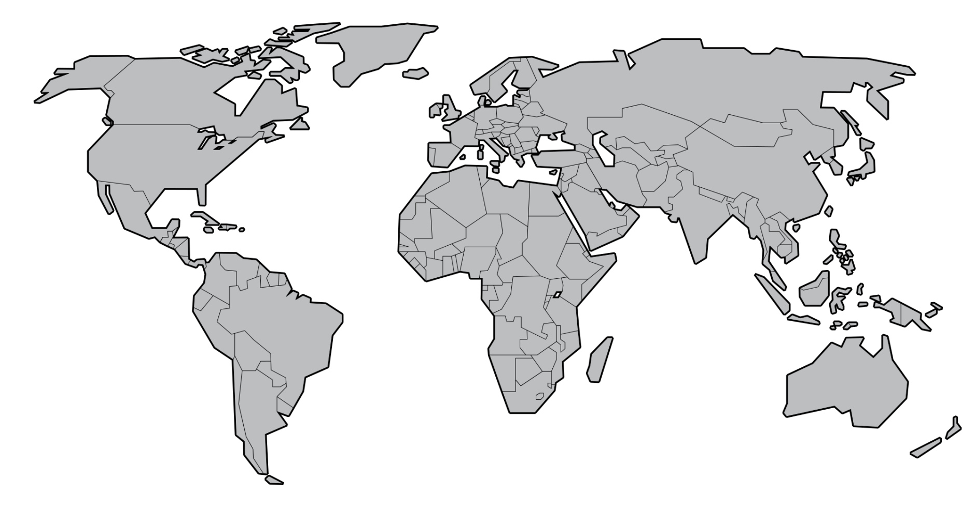
Distributed ONAP Deployment Scenarios

Slide 128
Distributed ONAP Deployments
Deployment follows a federated, decentralized model…
Management Components
  Software functions (services) responsible for ONAP management tasks
Management Control Points (MCP’s)
  Aggregate together multiple management components and manage their lifecycle
  Enable distribution of management control across complex ONAP deployment
  Deployed as needed across multiple sites
Management Interconnect
  Connects ONAP management components and MCP’s together over the network
  Enables both short and long haul communication
  Span multiple sites, locations and geographies
Site A
Site D
MCP
…
MCP
…
Management Interconnect
WAN
WAN
Site B
Site C
MCP
…
MCP
…

Slide 129
External Domain Management System Integration
External domain management systems (DMS)
  Includes a set of resources, virtual and physical, and provides full lifecycle management of resource facing services (RFS) supported by those resources
    Eg., A set of physical routers providing a MPLS service
    uCPE and SD-WAN VNFs providing a SD-WAN service between enterprise sites
  Typically includes ONAP like or subset of ONAP functionality targeted to specific domains
Various scenarios are envisaged for ONAP to interact with external DMS
  Multiple DMS within a single operator scope, eg., based on technology (sd-wan)/topology (access, core) domains
  Multiple DMS within single operator scope but based on geographic boundaries (regions/provinces, eg., china telecom)
  Multiple DMS within single operator scope but based on operating groups (eg., Vodafone)
  Multiple DMS based on multiple independent operator scope

Slide 130












Technology-based Domain Management Systems
Centralized E2E Service Management Interaction with Individual Technology Domain Management Systems
Third
Network Services
Orchestrated Connectivity Services
Orchestrated Cloud Services
E-Line
E-LAN
E-Tree
E-Access
E-Transit
IaaS
SaaS
PaaS
UCaaS
Wavelength
Internet Access
L3 VPNs
IP Transit
BIaaS
SECaaS
L4-L7 NFaaS
OpenLSO
Capabilities
Sonata APIs
Fulfillment
Performance
Control
Assurance
Usage
Analytics
Security
Policy
Interlude APIs
OpenCS
Technology Domains
Presto APIs
Data Center
Packet WAN
NFV
Optical Transport
SD-WAN
Cloud
Exchange
5G Wireless
Notes:
Version 2.0 – 2016.07.28

Slide 131
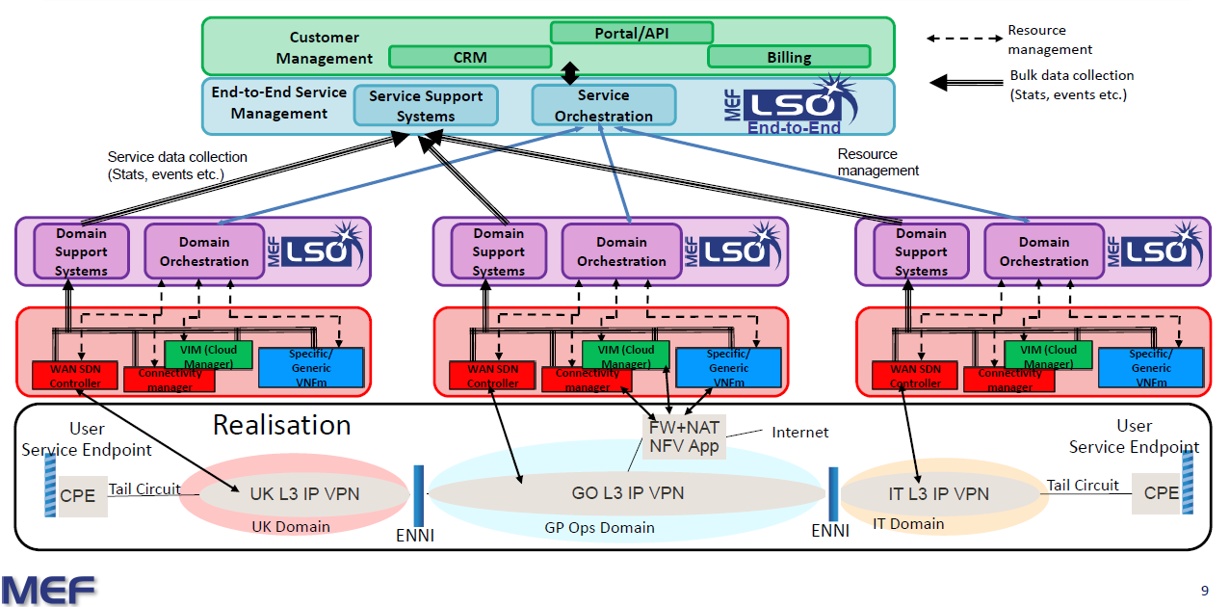
Operating Group Based Domain Management Systems
Centralized Group Level Service Management Interaction with Individual Operating Group Domain Management Systems

Slide 132
Goals
A normative way to implement ONAP functionality
  Orchestrators
  Factories
  Controllers/Managers
  Data Collectors
  Advisory Functions
Model driven
Hot Pluggable Integration Centric (interface consistency)
Permits policy driven choice (brokering) if multiple implementations are present
Single point of integration avoiding point to point integrations between components
ONAP components are isolated from other component specific details
A common way to manage lifecycle of ONAP and non-ONAP components

Slide 133
Modular and Model Driven Functional Domains
Developers
Administrators
Customers
External APIs
Service
Design
Micro-service Bus /Integration Backplane
Service Access Management
Security
Data
Service
Catalog
Domain Model
Service
Management
Domain Model
Governance/Processes
Operational
State
Service LCM
(Orchestration/Optimization/Operation)
Historical
Data
Domain Model
Resource LCM
(Orchestration/Optimization/Operation)
Configuration Data
Domain Model
Infrastructure
Inventory
Multi-VIM/Multi-Cloud
Infrastructure Supply & Demand
Domain Model
Shared State
(External Model)
Physical Resources
Private Clouds
Public XaaS

Slide 134
Modular and Model Driven Functional Domains
Developers
Administrators
Customers
External APIs
Service
Design
Micro-service Bus /Integration Backplane
Service Access
Management
Security
Data
Service
Catalog
SDC
Domain Model
Policy Enforcement
IDM/SSO/RBAC
AAF
On-Boarding
Service
Management
Domain Model
Catalog Management
Service
Management
Governance/Process Management
Operational
State
CLAMP
Service LCM
(O3)
Historical
Data
Policy Definition
Domain Model
Orchestration
Service
Controllers
(APP-C/VF-C)
Data Collection
AAI
Resource LCM
(O3)
Configuration Data
Domain Model
Resource
Controllers (VNFMs)
Optimization
I/F
Inventory
Multi-Cloud
Domain Model
Resource
Factories
Monitoring
FCAPS
Discovery
Shared State
(External Model)
Physical Resources
Private Clouds
Public XaaS

Slide 135
Key Principle – “Everything Is A Software FRU”
Provides a pattern for ONAP component integration…
Software FRU – a software “Field Replaceable Unit”
  Has well defined, normative interfaces for use and control
  Has an operational lifecycle
  Functionally stateless, operationally statefull
Model driven…
Supports in-service maintenance
INTEGRATION BACKPLANE
INTERGRATION DATA MODEL
Software
Component
(Greenfield)
Native FRU
Implementation
FRU Interface
FRU Adapter
API
Software
Component
(Brownfield)
FRU Adaptation
API
Software
Component
(Brownfield)
FRU Adapter
API
Software
Component
(Brownfield)
FRU
Refactoring
FRU Adapter
API
Software
Component
(Brownfield)
FRU Adapter

Slide 136
Conceptual Model of a Software Unit
Managed by OOM
Expose specific functional capabilities…
Interface End-Points
  Can be declarative or imperative
  Administrative end-points expose a normative operational lifecycle
  Consumption end-points are component specific
  Resource consumption EP’s are optional
Implementation
  Decoupled from interfaces
  Service end-point functionality implemented using components
  Administrative and consumption EP implementations can be physically or logically isolated
Resources
  Can be dedicated or shared
  Can be physically or logically isolated
Functional Capabilities
Administrative
End-Points
Consumption
End-Points
implements
implements
Service
Implementation
Administrative
End-Point Implementation
Consumption
End-Point Implementation
manages
uses
uses
Resource
End-Points
Resource
End-Points
Physical
Virtual
Cloud
Resources

Slide 137
Implementation Pattern
Must implement “standard” (normative) interfaces
  Lifecycle Management – enables consistent component operation
  (via OOM???)
  Capability Catalog – describes component capabilities
  (TMF 638???)
  Capability Requests – capability invocation
  (TMF 641???)
  Events – pub/sub asynchronous notifications
Catalog
Events
LCM
Requests
…
External “Service” Interfaces
Interface
Implementation
Implementation Broker (optional)
Resource Broker (optional)
External “Resource” Interfaces

Slide 138
A “Factory Controller”…
Catalog
Events
LCM
Requests
Inventory
External “Service” Interfaces
Interface Adapter
Factory Interface
  Catalog – “what can I make?”
  Inventory – “how many can I make?”
  Request – “make me a…”
  Events – state notifications
    Out of inventory
    Up/Down
    …
Providers are factory instances
Provider types:
  PNFs
  Compute/Storage/Network Resources
  IaaS
  PaaS
  FaaS (later)
Native Interface
Provider
(Native Implementation)
Adapted
Catalog
Events
LCM
Requests
Inventory
External “Service” Interfaces
Interface Adapter
Implementation Broker
Adapter
Adapter
Adapter
Adapter
Native Interface
Provider A
Provider B
Provider C
…
Adapted/Multi-Provider

Slide 139
Implementation Flavors…
Catalog
Events
LCM
Requests
…
Catalog
Events
LCM
Requests
…
External “Service” Interfaces
External “Service” Interfaces
Interface
Implementation
Interface Implementation
Implementation Broker
Impl A
Impl B
Impl C
…
Resource Broker (optional)
External “Resource” Interfaces
External “Resource” Interfaces
Native
Native/Multi-Provider
Catalog
Events
LCM
Requests
…
Catalog
Events
LCM
Requests
…
External “Service” Interfaces
External “Service” Interfaces
Interface Adapter
Interface Adapter
Implementation Broker
Native Interface
Adapter
Adapter
Adapter
Adapter
Native Implementation
Native Interface
Impl A
Impl B
Impl C
…
Adapted
Adapted/Multi-Provider

Slide 140
Management Hierarchies…
Catalog
Events
LCM
Requests
…
Interface Implementation
Implementation Broker
Impl A
Impl B
Impl C
External “Resource” Interfaces
Catalog
Events
LCM
Requests
…
Catalog
Events
LCM
Requests
…
Catalog
Events
LCM
Requests
…
Interface Implementation
Interface Implementation
Interface Implementation
Implementation Broker (optional)
Implementation Broker (optional)
Implementation Broker
Impl A
Impl B
Resource Broker (optional)
Resource Broker (optional)
External “Resource” Interfaces
External “Resource” Interfaces
External “Resource” Interfaces
Catalog
Events
LCM
Requests
…
Catalog
Events
LCM
Requests
…
Interface Adapter
Interface Implementation
Implementation Broker (optional)
Native Interface
NOTE – Direct acyclic graphs only!!!
Native Implementation
Resource Broker (optional)
External “Resource” Interfaces

Slide 141
ONAP Functional Organization
External (Service) APIs
Access
Boundary
API Gateway/Broker
External Model
Internal APIs
Management
Component
Management Component
Management Component
Management Component
Management Component
Model
Model
Model
Model
Model
DB
DB
Internal APIs
Access
Boundary
API Gateway/Broker
External Model
External (Resource) APIs
Physical
Virtual
Cloud

Slide 142
ONAP Functions…
System of record for infrastructure providers and their capabilities
Registers provider instances
Discovers provider topology and capability
DB
Provider
Registry
Provider
Discovery
AA&I
DB
WAN
Catalog
Events
LCM
Requests
…
Catalog
Events
LCM
Requests
…
Catalog
Events
LCM
Requests
…
Catalog
Events
LCM
Requests
…
Resource-As-A-Service Factory
IaaS Factory
PaaS Factory
Kubernetes-as-a-Service Factory
Interface Adapter
Interface Adapter
Interface Adapter
Interface Adapter
Implementation Broker
Native Interface
Native Interface
Implementation Broker
Adapter
Adapter
Adapter
Adapter
Azure
Docker
Adapter
Adapter
Adapter
Adapter
Native Interface
Native Interface
OS
WR
VIO
K8S
GCE
AWS
One micro-service per provider instance

Slide 143




ONAP and SD-WAN DMS Detailed View
OSS/BSS/GUI
DMS Adapter maps external
API to domain specific APIs
E2E Operations
ONAP NB API
Portal
Dashboard
OA&M
(VID)
External Data Movement & APIs
(GUI/CLI)
A&AI
Service
Orchestration
Domain Service Descriptors
Domain Service Descriptors
Design-time
ESR
Common Service
SDC
DMaaP
Auth.
Microservice Bus
…
Ext SB API
VNF SDK
DCAE
Policy
Alarm Correlation
(Holmes)
…
Multi-VIM/
Cloud
SDN
NFV
Controllers
CLAMP
Cloud & WAN
OpenStack
VMware
RackSpace
Azure
......
SD-WAN Domain Management System
Alarms/Events
SD-WAN DMS can include multiple components depending on resources and services offered by the domain eg.,
Manager – Configuration of resources
Controller – BGP Control Plane
Analytics – SD-WAN Domain Events/Metrics
Domain Service Orchestrator
DMS Adapter
Analytics
Manager
Controller
REST APIs for
Provisioning

Slide 144
Design Time Integration: Service Onboarding and Design
  DMS provided service is a black box and ONAP only knows/sees the external connection points to the box, attributes of the service and lifecycle operations for those services
  Eg., SD-WAN DMS includes uCPE PNF and SD-WAN VNF (resources) and provides
    Services
      Enterprise sites (as a service)
      VPN/overlay connection between sites and to internet
    Attributes include
      QoS and Application Aware Routing configuration
    Connection Points: IP address assigned to uCPE to connect to underlay
  LCM operations include CRUD operations on sites, connections and configurations
  ONAP uses the DMS service to potentially construct more complex services, eg., SD-WAN service with MPLS underlay (provided by ONAP) for site to site physical connection
Service Descriptor
Attributes
Connection
Points
ONAP Service Catalog
TMF 633 Service
Catalog Mngmt
API
DMS Adapter
Domain Specific
API
DMS Service Catalog

Slide 145
Run Time Integration: Service Fulfilment
ONAP decomposes the service into components to be fulfilled by ONAP and external DMS. It routes the requests accordingly based on components
For example, Composite Service is Create SD-WAN site 1, site 2, Create connection to MPLS underlay for both sites, Create overlay VPN between sites 1 and 2
  Create SD-WAN site ½, Overlay connection is sent to SD-WAN DMS and Connect to MPLS underlay is sent to SDN-C after we know the connection point (IP address of the SD-WAN sites)
ONAP Service Inventory is updated with metadata about the DMS service
ONAP
SO
Cntrl
TMF 641 Service Ordering API
TMF 638 Service Inventory
Management API
DMS Adapter
MEF Presto API
Domain Specific API
DMS Service Orchestration

Slide 146
Run Time Integration: Service Assurance
ONAP becomes a single source of truth for the health of the overall service
  SD-WAN DMS feeds health info to ONAP, up/down, performance metrics for sites and overlay connection, alarms
  SDN-C provides health info for MPLS connections, alarms
  ONAP correlates across services, eg., alarm in MPLS connection is correlated to alarms from overlay (which overlay goes over which MPLS connection ..)
DCAE
??
DMS Adapter
MEF Presto API
DMS Service Assurance

Slide 147
Appendix: Industry Standards

Slide 148
MEF LSO and Technology Domains
Third
Network Services
Orchestrated Connectivity Services
Orchestrated Cloud Services
E-Line
E-LAN
E-Tree
E-Access
E-Transit
IaaS
SaaS
PaaS
UCaaS
Wavelength
Internet Access
L3 VPNs
IP Transit
BIaaS
SECaaS
L4-L7 NFaaS
OpenLSO
Capabilities
Sonata APIs
Fulfillment
Performance
Control
Assurance
Usage
Analytics
Security
Policy
Interlude APIs
OpenCS
Technology Domains
Presto APIs
Data Center
Packet WAN
NFV
Optical Transport
SD-WAN
Cloud
Exchange
5G Wireless
Notes:
Version 2.0 – 2016.07.28

Slide 149
MEF LSO and SD-WAN Domain Architecture
LSO Presto Focus Areas

Slide 150
VOLTHA Access Doman Integration to E2E Orchestration
Source: Open Access, Att Presentation to Open Compute Foundation, May 15, 2017

Slide 151

TM Forum Open APIs
TM Forum’s suite of 40+ REST-based Open APIs has been collaboratively developed to be used in a range of scenarios, internally enabling service providers to transform their IT and operational agility and customer-centricity, while externally delivering a practical approach to seamless end-to-end management of complex digital services.
To date, 28 of the world’s leading service providers and technology ecosystem participants have signed the Open API Manifesto publicly demonstrating their endorsement of TM Forum’s suite of Open APIs

