Slide 1
Real Time Data Event Streaming & Processing ( RESP)
ARC Presentation
Habib Madani Habib.Madani@huawei.com
Parviz Yegani Parviz.Yegani@huawei.com
April 24, 2018

Slide 2
Q&A Action Items
Q1: What are the End point Use Cases I & II?
A1: Use Case I is a simple smart end point scenario, showing streaming interconnect between publishers( producers) and subscribers(consumers). Use Case II, however, is a full streaming, collection and analytics use case, representing an end-to-end real-time data pipeline for streaming via RESP proposed solution.
Q2: Why asynchronous communication?
A2: The DDS middleware handles asynchronous communications via a backpressure mechanism coupled with the DDS QoS feature configurations. This takes the burden off the application code for handling any retries by enabling an end-to-end RESP-based data processing pipeline with backpressure capability (DDS<-Akka<-Beam + Flink).
Q3: What do you mean by real-time?
A3: The DDS middleware enables end-to-end real-time pub/sub streaming for data-centric events from wire protocol to middleware through DDS QoS feature settings (the QoS profile can be configured by taking into account the requirements of the user data (either real-time or near real-time)
Q4: Does DDS support the WAN traffic?
A4: Yes, it supports it very effectively, via the concept of “DDS Links”.
Q5: Does the existing DCAE flow change?
A5: No, this is complementary to the existing ONAP DCAE flows. Design-time and run-time enhancements are made to meet the RESP functional requirements (S7,S11)
Q6: Message guaranteed delivery; how is this handled?
A6: DDS with proper QoS configuration ensures that any lost event to be delivered due to the “Eventual Consistency” capability.
Q7: Does VNF need to be updated?
A7: The VES collector is updated to handle DDS-based real-time streaming (both southbound and northbound). On the southbound a VNF (a sensor, etc) can push data/measurements to the collector which in turn uses DDS to generate a real-time stream to be processed by the analytics engine.

Slide 3
What is RESP?
Real-time data event streaming and processing pipeline comprised of:
Real-time Event Streaming Middleware
  QoS-based reliable real-time end-to-end event streaming
  Non-blocking, highly available collection and routing of events
  Asynchronous pub/sub based communication
  Consistent synchronization to accurately represent network states
  Model-driven approach through data models for consistent structure
Real-time Processing for Data Analytics
  Efficient and reliable processing of data in motion
  (via reducing a huge amount of data influx through tiered deployment)
  In-memory very fast, efficient and reliable processing
Geo-data Store and Synchronization
  Services that need states preserved with consistent geo-data event store and event streaming-based data synchronization

Slide 4
Why RESP?
ONAP Current Operation
RESP Pipeline
Consumers
Consumers
Consumers
Consumers
Consumers
Pub/sub Event DB/cache agent
Consumers
Data information embedded in message as text
(Use Case II) Real-time Pub/Sub and Processing
DDS
Real-time Data Event Stream->
Collection-> Aggregation, Filter-> Transformation->
Message Server
Modeled logical data objects based pub/sub stream achieve declarative system through auto synchronization
Collect and push to Message Bus for Pull
DDS
(Use Case I) Real-time Asynchronous Pub/Sub
End-Point
End-Point
Consumers
End-Point
Consumers
API-based end-point collection
Consumers
DDS
Dynamic strongly typed event message-based pub/sub
Static API/REST Pull
End-Point
End-Point
End-Point
End-Point
Pub/sub topics

Slide 5
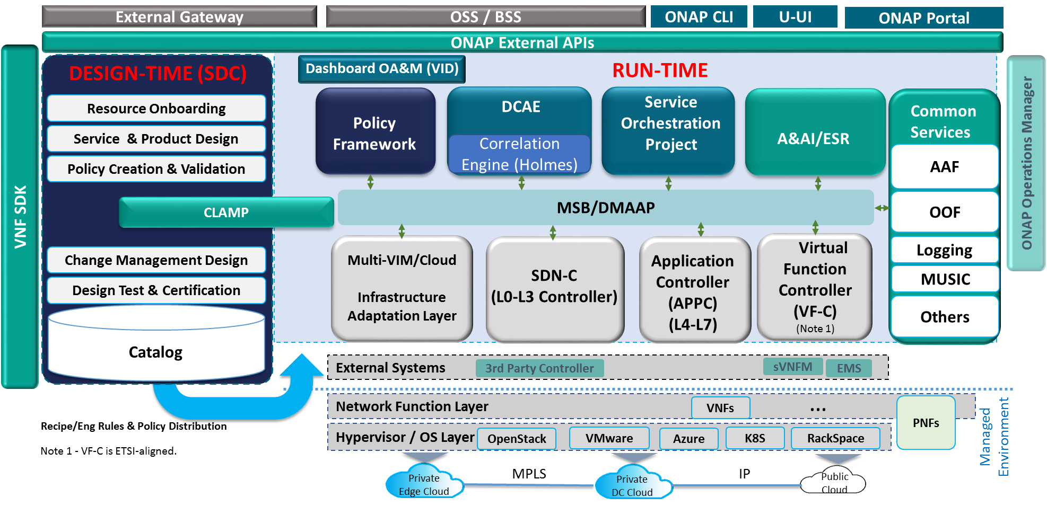
ONAP Architecture + RESP
Modeling (Utilities)
Integration
VNF Requirements
VNF Validation Program
RESP

Slide 6
RESP Proposal (1/3)
Building on DCAE Base Platform (DCAEGEN3)
DCAEGEN3: Focus on building a platform which is adaptable to changing environment
Data Collection: interfaces keep evolving – Data Streaming, gRPC, etc
Analytics: AI, Machine Learning, Capacity, Cost, Perf., … (real value-add)
Common Platform: 5G (Network Slicing), Wireline, IOT, Cloud, etc
ONAP Platform is used as a base to build from
Flink: Real-time event streaming Analytics
DDS: Real time Data centric middleware
Beam: An advanced unified( Batch + Real-time) programing model
Design-Time / Run-Time separation principles
Microservices-based architecture
Data Collector: collects data from the element (5G network elements, IOT apps,..)
  Events/traps, statistics, logs, control plane, data plane
Data Storage: collected data will be stored
Pipeline Design: transforms raw data into meaningful data

Slide 7

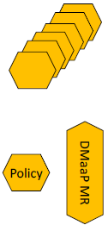
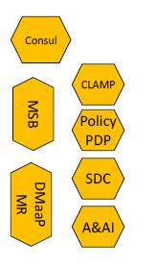

RESP Proposal (2/3)
Building on DCAE Base Platform (DCAEGEN3)
VM
K8S Pods
Non-DCAE stretch ONAP components
DCAE components
DCAE stretch goal components
CBS
Beam
Flink
RESP
VES
SNMP
Trap
DDS VES
Realtime Streams
Akka
RESP proposed components
DH
DDS
Akka
Mapper
PH
Collection Tier
PRH
Platform Components
Service Components
TCA
SCH
…
IoT
Realtime Usecase MSrvc
Inv
Holmes
Analytics Tier
CM
PG
*DCAE R2 presentation

Slide 8
RESP Proposal (3/3)
Building on DCAE Base Platform (DCAEGEN3)
RESP a new functional entity for DCAEGEN3 Platform
RESP can co-exist with existing Bus and ONAP components
RESP impacts ONAP Design-time and Run-time using ONAP APIs (with extensions as necessary)
All ONAP components potentially can communicate in real-time with common library
CLAMP
Policy
APPC/SDNC/VFC/MC
DMaaP Kafka
I5
AKKA Actor Concurrent Message Handling
I4
FLINK
Microservices
AKKA Actor Concurrent Message Handling
BEAM
FLINK
Mrsv1
Mrsrv2
VES Collector
I3
RESP
I2
DDS Event Bus
NOTE:
IoT device/VNF can push DDS- based event stream
Proxy can push DDS-based event streams with legacy backend interface
VES DDS TCA event
I1
Proxy
Control Action
vLB
vFW
IoT
OS
OS
I6
DDS Real-time Streaming Interfaces
DDS Domain
Edge
DC
Ix

Slide 9
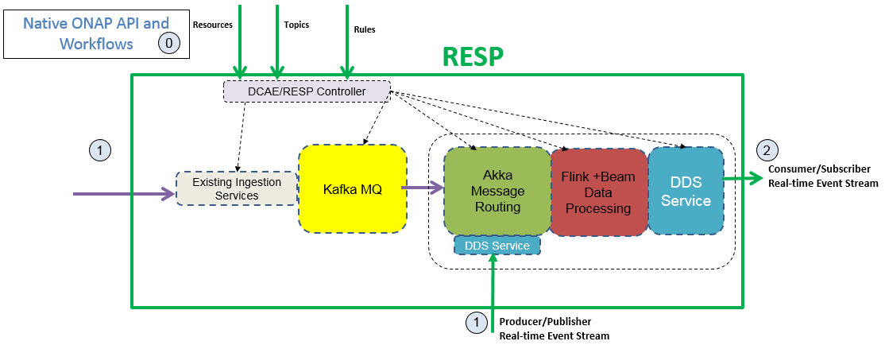
RESP – Data Analytics and Processing Pipeline
Natively with RESP, mechanisms are provided to
0. Native ONAP APIs leveraged with RESP related metadata and model extensions/additions
1a. Ingress, Exactly-Once and Eventually Consistent synchronization mechanism available with DDS-based event streaming between peers.
1b. DDS provides fine-grained control over the QoS setting for each of the entities involved in the system.
1c. Ingress and Egress Integration with DMaaP/Kafka Bus and other ingestion needs
Non-blocking and concurrent routing/handling of data streaming ( Akka)
Handle bursty stream processing, in parallel and quickly (Beam -> Flink)
2. Egress real-time DDS-based data stream publish

Slide 10
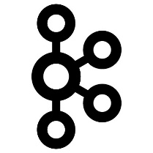




RESP Components
Cloud Native
DDS for Realtime Data Distribution BUS
Akka+Kafka for HA Collection Framework
Beam & Flink for Transformation & Analytics Framework
DB Persistence Storage
P2P Tiered Geo Distributed PUB/SUB ( Blood Stream )
Rich QoS support for reliability, extreme low latency support through light wire protocol
Asynchronous/Synchronous
Strong Typing(binary), data model/IDL
Inherent Security
Discovery, Query and Filter
Streams/Events/Logs/Payload
Connectionless optimized
Publisher/Consumer through a Relationship model
Reduce Chatter
Real-time Streaming and Batch collectors
Concurrent, Actor model, Non-blocking
Distributed, Resilient, parallel processing, Back Pressure
Collection/Aggregation possible from many streams
Load Balancing and Partitioning with reliability, HA and error handling
Time Series and Other
Unified Data Streaming Programming Model and DSL and pipelining
Realtime Streaming and Batch Processing
Rich Parallel processing with rich API
Resilient Distributed Data processing, with in-memory Cache analytics for huge stream input
ML analytics &Graph/R predictive modeling and analytics
Rich Query and Time Series
Beam allows integration with other runners ( Spark, Storm )for compatibility
DDS Cache/Event Store
Need based DB use for backend store
Geo Distributed
Consistency( ✓ Eventual) for supporting statefull entities
Backend Connectors for integration of huge K,V store

Slide 11
RESP Design-time and Run-time Operations
On-boarding new Platform components
Platform On-boarding of new Templates
Design Service Creation
Runtime
DDS VES Collector
Inputs Output Configuration
TOSCA model Templates created for Cloudify blueprint
Import into SDC
Saved in Catalog
Data Streaming
  VES Event Data formats created
  DCAE template populate to drive Use Case Microservices ( IoT, VoLTE, TCA, Other ..)
DCAE Controller pushes instantiations configurations and policies for new services as defined in the new DACE Orchestration ( Cloudify) Blueprints
Run-Time VES Real-Time Event processing by use cases Microservices
DDS Proxy Collector
Flink
Design -Time Deployment
Platform Deployment
Design -Time Deployment
Run -Time Deployment
Beam enabled MSrvc
Akka enabled MSrvc

Slide 12
ONAP Gaps (1/2)
Real-time Data Streaming and Data Processing Pipeline
Real-time Model-driven data stream
Collect & Route specific data reliably
Query, Filter and Join data
Guaranteed processing of data in sequence and exactly once
Perform huge stream of data reliably and efficiently in real-time
ONAP Applications
Real-time Data Model based event Streaming for north to south
Collection real-time data event stream and routing of stream for actionable processing
SQL operations capability on the real-time data stream
Exact once streaming of real-time event data for sequential processing
Fire hose event data streams processing in real-time and reliably
ONAP applications enablement through real-time library-based pub/sub
Rich Complementing Common Service Beyond a BUS

Slide 13
ONAP Gaps (2/2)
MSB BUS | DMaaP /Kafka | DDS Real Time Streaming
Microservices Operations API centric | N/A | N/A
JMS capability to handle microservices health operations | Pub/Sub Message oriented middleware, JSON based payload, centralized | Provides a rich Model driven binary Data centric Pub/Sub Geo Distributed Domain based capability to provide full microservices interconnectivity beyond Java
No Native Data Synchronization | No Native Data synchronization | Logical data Objects, changes automatically track to make the system track states and self synchronizing
Client/server | TCP | UDP/TCP with a QoS based wire protocol for optimization and reliability fine grain flow control, for very fast binary data type delivery and tracking of events
 |  | Concurrent, non-blocking, back-pressure handling end to end real-time pipelined system

Slide 14
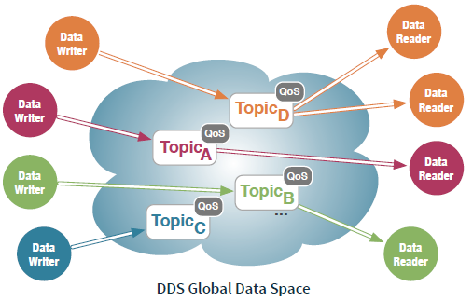
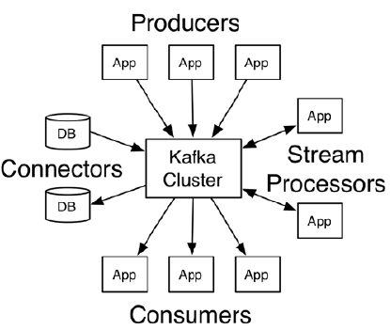
Comparison: DDS vs Kafka
Geo Distributed Global Data Centricity and Synchronization
Low latency Pub/Sub P2P, Broker(optional) and N2M
Push to Subscribers
Query and Filter on data-value
Data Centric
Best effort, last-n, reliable and exactly-once
20+ QoS settings
Broker Based
Pull from Cluster
Opaque Data
Message Centric
At least once, at most once, exactly once
Controlled reliability and durability

Slide 15
RESP Interfaces and API calls (1/2)
Configuration & Operations
  Artifact design and creation mapping to model-driven network services/VNFs for pub/sub topics (e.g., VES and other ingestion sources)
  A&AI – resource inventory
  Service and resource orchestration
  Ongoing real-time updates for new services and/or changes to existing services
Run-time Operations
  Real-time event streams based on pub/sub configurations from VNF
  Main application Akka actor-based concurrent handling of streaming event with DDS embedded library real-time event streams, and cache DB store
  HA and error handling
  Real-time Beam SDK calls to Flink real-time analytics tools
Interfaces
  API calls to push configuration information to the RESP controller
  Pub/Sub topic push
    Analytics
    Filter, Search, Group by resources
    Rules for actions for component interactions
  Input run-time real-time event streams
  Output real-time event streams
  API calls (if needed)

Slide 16
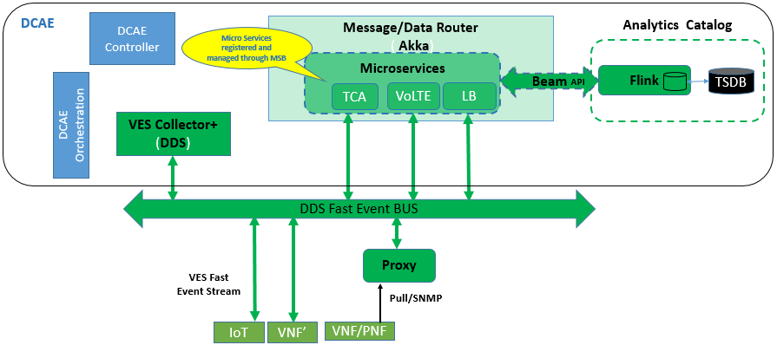
RESP Interfaces and API calls (2/2)
CLAMP
Policy
0. DCAE Control components
  Driven through new TOSCA blueprints by Cloudify/Orchestration
DDS Enabled with VES Event Streaming Topics
VES Collector
RESP Service Components
  Use Case Microservices
RESP Platform Components
  Flink with Beam API
RESP Microservices interact with DMaaP/Kafka
DMaaP Kafka
5
3
4
0
IoT
2
1

Slide 17
DDS Domain-based Network Slicing Example
Enterprise Use Case
Mediation collector
proxy
RESP instance receiving Pub/Sub telemetry data from vLB, vFW, vCPE
Cust. Branch Office
vFW
Domain 1
vCPE
ONAP
NID
Domain 4
RESP
vLB
ONAP
RESP
Domain 0
Cloud DC
AGG
IaaS
NPE
vFW
PE
MPLS Core
Cust. Branch Office
vCPE
IaaS/PaaS/SaaS
AGG
Carrier Ethernet
Domain 2
vLB
NID
NPE
Achieve a declarative model
Virtual devices scale horizontally in vertical customers domains addressing demarcated handling for deployments, configuration , running and operations
Isolate Issues by Honey potting
Deploy using red-blue army approach
Unify heterogeneous systems with strong typing support as ‘services’
Multi-tenancy enabler
PE
*Cust. Branch Office
AGG
NID
vFW
vCPE
Domain 3
vLB

Slide 18
Thank You

Slide 19
Backup Slides

Slide 20
RESP Functional Description for Casablanca
Definition:
RESP is ONAP/DCAE subsystem that enables Fast Data Event Streaming, Fast Data Event Stream based higher level analytics and correlation for business and operations activities. RESP functionality will allow for fast data based collection of performance, usage and configuration data; provides handling of fire-hose event source in real time along with analytical processing for supporting operational decisions, trouble shooting and management; provides fast track results through pub/sub data event stream publications to rest of the ONAP system for FCAPs and other functionality
Data Collection interface
Deployment Interface
Config binding interface
Provided Interfaces:
Interface 1: Data collection interface (provided by DCAE collectors, consumed by VNFs and others)
  Interface for various FCAPS data entering DCAE/ONAP.
Interface 2: Deployment interface (provided by DCAE Deployment Handler, used by CLAMP and other northbound applications/services)
  Interface for triggering the deployment and changes of a control loop
Interface 3: Configuration Binding Service
  Interface for querying the information of the services that are registered to DCAE Consul
-Interface 4: Data collection interface (provided by RESP/DDS collectors VES, Proxy and others)
  Interface for various FCAPs, IoT other data entering DCAE/ONAP.
Interface 5: Deployment interface (provided by DCAE/RESP Deployment Handler, used by IoT and other northbound applications/services)
  Interface for triggering the deployment and changes of a control loops, IoT TCA and other use cases
Interface 6: Configuration Binding Service
  Interface for querying the information of the Fast Event based services that are registered to DCAE/RESP Consul
Real time Data Event Streaming & Processing
DCAE interfaces leveraged & extended
VNF/Proxy Fast Data event stream
Data enrichment interface (A&AI)
Service model change interface (SDC)
Consumed Interfaces:
Interface 1: Data movement platform interface (provided by DMaaP)
  Interface for data transportation between DCAE subcomponents and between DCAE and other ONAP components
  This interface can also be used for publishing events to other ONAP components.
Interface 2: Data enrichment interface (provided by A&AI)
  Interface used by DCAE collectors and analytics for querying A&AI for VNF information for the purpose of enriching collected raw data by adding information not contained in original data.
Interface 3: Service model change interface (Provided by SDC)
  Interface for DCAE/RESP Service Change Hander fetching control loop models and model updates for RESP apparatus ( Akka enabled microservices, BEAM SDK, Flink, TSDB)
DCAE interfaces leveraged & extended
Consumed Models: TOSCA models descripting IoT & control loop construction (e.g. collection and analytics apparatus)

Slide 21
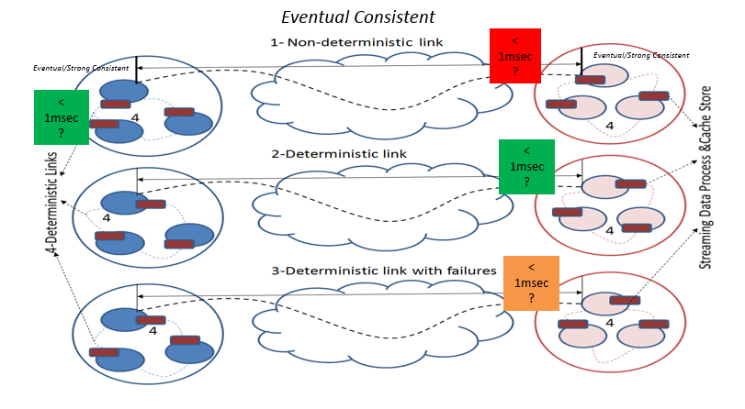
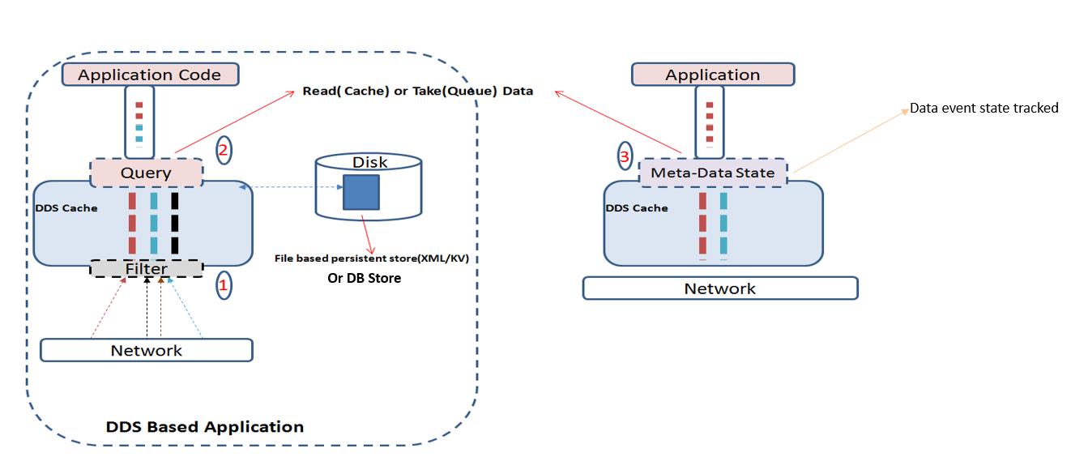
DDS for Geo Distributed Data Synchronization ( DB )
Figure 1 depicts cross DC deployment
  Scenarios 1-4 reflect the network link state
  The data flow across network tracked reliably for both Deterministic and Non-Deterministic network links
  Geo Data synchronization guaranteed through Eventual Consistency for apps as shown in Figure to provide Geo distributed Event store
  Light wire protocol allows for low latency times in the order of < 1msec over connectionless interconnect and with binary strongly typed data with QoS for reliability
Figure 2 depicts a DDS based application deployment
  Shows efficient query & filtering capability
  Event DB store as Cache/persistent for logical objects
  Very Rich meta-data information on each event
  Each App has an embedded library
apps
apps
apps
apps
apps
apps
Figure 1
Figure 2

Slide 22
Unifying Fabric – Microservices Centralized and Edge Interconnect
(Logical Object based State Synchronization)
MSB BUS Internal and External Event based BUS
DDS fully supports intelligent Interconnect needs for IoT and SDN, PNFs, VNFs, a unifying fabric
Logical local objects at the Publishers/Subscribers dynamically reflect/ track Endpoint Telemetry/State/Other in real-time asynchronously
Centralized NB systems, Controller/s, NE/VNFs, Service Discovery, E2E Operations all connected through DDS Data Domains
A Key DDS based interconnects can be sharded and tiered per Pub/Sub to provide a microservices loosely coupled env.
Centralized/NB
Logical Close Control Loop
through DDS
Orchestration/Tasks
Logical Local Objects Reflecting
Endpoint
DevOps
MICROSERVICES
Controller/s
Policies
Tiered
Monitoring
Intelligent Service
End point/NE
NE/VNF
Analytics
Intelligent Service
End point
DB
DB
DB
.
.
OSS/CEM
Circuit
Breaker
Circuit
Breaker
End2END Service Operations
DDS RT. PUB/SUB communication BUS
Asynchronous msg.
Stateful Collector app
Query Service
Service
Discovery/Registry
Synchronous msg.
Microservices Entity
Logical Local Objects Reflecting
Endpoint
DB/Persistence App Specific
DB

Slide 23
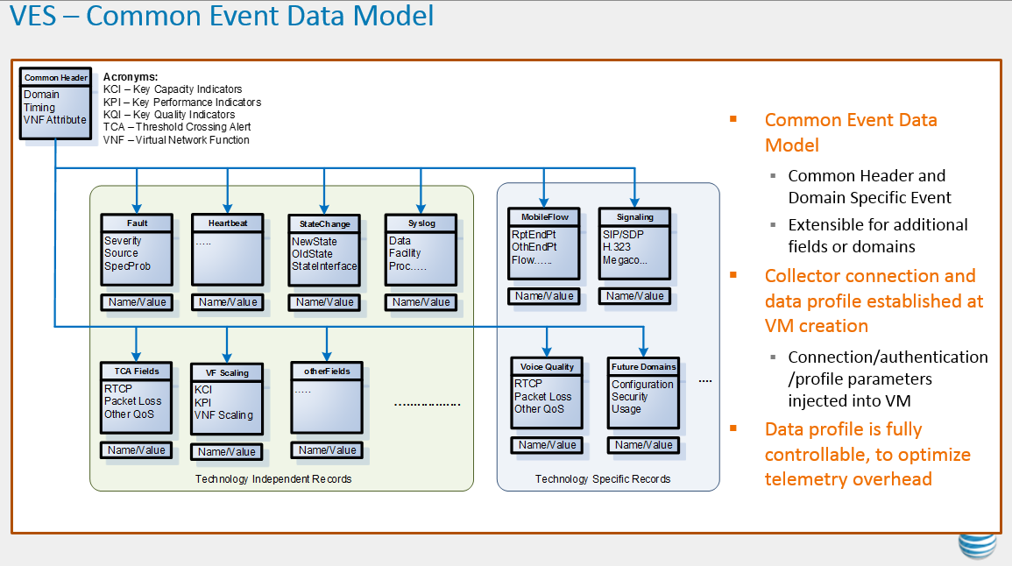
VES Mapping
VES Requirements Mapping
✓ Overall common Event Data model, Event Stream and collection architecture
✓ OPNFV support for the VES Common Event Data Model
✓Consisting of a Header and an Event Specific Block, with additional Name/Value fields for extensibility
✓A VNF Event Stream (VES) Common Event Data Model
✓A VES Agent that can collect the VNF Event Stream data from the VNF and deliver it to the VES Collector
✓A VES Collector that can consume the VNF Event Stream data, and store the data in a database backend
✓VES plugins for integration with OpenStack infrastructure services such as Monasca and Vitrage (
✓Common Event Data Model:(Fault, Custom, programmable), authentication, access
DDS for Common Data Bus | RTDESP
Common Data model with declarative IDL, Extensible types P2P Pub/Sub | Common Event Stream, and beyond
Same API exposed for all HW, OS Language bindings ( Java, C++,C,C#) | Reactive real-time Processing and Batch Processing
Dynamic Discovery across Domains & Topics accommodating common header with profile creation through IDL , fulll control | Distributed
Rich QoS policies, allow for fine grain communication control beyond Transport(very low latency support, jitter support) . Many knobs for fine tuning | Concurrent , HA , Secure
Strong Type support, , application read(), write() calls with specific data types, can support different payload with defined types ( different protocols as payload) | Scalable end to end processing for edge, Lake
Open standard and proven Interoperability | Many to Many ( tiered model), shards, partitioning, Domain based
Query support for Real time filtering of Events, Complex Event Processing, UDP, TCP | Persistence/Store ( Cache, DB)
Secure ( SSL/TLS) | Integrated collection and integrations beyond Telemetry for heterogeneous networks
Auto Data Endpoint changes discovered, with high Priority (QoS) | Flexible extensible framework through DDS enhance Agents and VNFs

Slide 24
ONAP Gaps for Distributed Streaming and Data Synchronization
Core features | DDS | Kafka | Kafka Streaming
In Memory Distributed DB | ✓ Data/Object Centric DB Store, with Data Query Language support | Log based, Message Store, no visibility at the Data level | Query layer based on Message Store, no visibility at the Data level | Further DDS provides “Eventual Consistency” based data synchronization in Global Space providing consistent state
Integrated Efficient secure publish-subscribe binary-level communication | ✓ Asynchronous Pub/Sub with distributed Domain based partitioning, data event Pub/Sub is strongly typed(binary) and state oriented | Text-based events, JSON based encoding , overhead communication and processing | Text-based events, JSON based encoding , overhead communication and processing | Further DDS DB cache and pub/sub are intelligent, as DDS tracks state of the data events stored. It allows for application to become model driven through well structure data models
System event reporting and logging | ✓ Data/Object Centric DB Store, with Data Query Language support Rich Pub/Sub event tracking, reporting and logging with fine tuning through knobs for optimizing the data event traffic | Relies on TCP for flow control | Relies on TCP for flow control | DDS provides rich event tracking metrics for optimal data event traffic in the network on both Publisher and Subscriber end

Slide 25
ONAP Gaps for Distributed Streaming and Data Synchronization
Core Features | DDS | Kafka | Kafka Streaming
Distributed authentication and access control | ✓ Distributed Authentication and Access control | ✓ Authentication | ✓ Authentication | DDS allows fine grain access and control Domain->Partition-> QoS/Topic-> Subs/Pubs
Distributed scheduling and Processing management | ✓ Process management is present, DDS tracks the Publishers and Subscribers and re-syncs data upon recovery/re-start | Not present | Not present | **DDS auto scheduling and re-start is an overlay, not present natively

Slide 26

End to End Geo-Distributed System ( RESP )
Achieve an Equilibrium State through a Model Driven Realtime event Stream interconnect
Synchronize Reliably
Global Processing Center
Core Processing Center
Push Action Stream
DDS Global/Central Domain
DDS Core Domain
Clustered, Distributed , Reliable, HA, Cloud Native
Edge Processing Center
Edge Processing Center
Collectors
Kafka
Akka Actor
Beam Flink
Analytic/Other App
Push Data Stream
Push Data Action Stream
DDS Edge Domain 1
DDS Edge Domain 2
NE
NE
NE
NE
Location 1
Location 2
System Engineered to be SLA compliant

Slide 27
Geo-Distributed Tiered Deployment
(inter-Carrier Use Case)
Access control segregation for Global data share
Global/Central Monitoring System
DDS Regional Domain 2
Regional Monitoring 3
Regional Monitoring 1
DDS Global Domain
DDS Regional Domain 1
Regional Monitoring System
Regional Monitoring 3
Region Domain 1
DDS Regional Domain 3
Region Domain 2
Region Domain 3

Slide 28
DCAE & RESP Integration
Configuration and policy
DCAE+ ( RESP)
DCAE
DCAE
Controller
Message/Data Router
( Akka)
Analytics Catalog
Micro Services registered and managed through MSB
Microservices
Beam
Flink
TSDB
API
TCA
VoLTE
LB
DCAE Orchestration
VES Collector+
(DDS)
DDS Fast Event BUS
Proxy
VES Fast
Event Stream
Pull/SNMP
IoT
VNF’
VNF/PNF
(DDS/Kafka)

Slide 29
DCAE & RESP Integration
Data Streamed from southbound devices
VES collector receives RT stream & existing pull based measured data (acts as a proxy)
RT Stream can be directly received by DMaaP with Akka based routing
Microservices receive events and perform analytics processing using Flink through Beam APIs
Flink processing( Beam)
Microservices return processed result out of DCAE
As DMaaP Kafka/DDS event for Policy etc
Note: both existing and new DDS flows co-exist
Configuration and policy
7
Event Handler
DCAE+ ( RESP)
(Kafka/DDS)
DCAE
Controller
DMaaP+
Message/Data Router
( Akka)
3
Measurement
Data
Event
Data
DCAE Orchestration
Micro Services registered and managed through MSB
6
Event Stream
(DDS/Kafka)
Microservices
4
2
TCA
VoLTE
LB
VES Collector+
(DDS’)
API
Analytics Framework
Fast
Event Stream
5
CDAP
Pull/SNMP
Beam
1
Flink
KV
DB
IoT
VNF’
VNF/PNF

Slide 30
ONAP RESP Logical Interface Flow
RESP Logical Software building block tools
  DDS, Akka, Beam & Flink
Figure shows a flow sequence for RESP and some ONAP components
  A new end to end Realtime event streaming flow
  Current event flow can co-exist
  2,3 internal RESP Routing and Processing
  1,4,5,6 show external RT. and current event flow Close Loop
VNF can push DDS based event stream
Proxy can push DDS based event stream
Microservices
4
DMaaP
(Kafka)
1
Policy
App1
App2
1
DMaaP
(Kafka)
VES DDS
TCA event
2
3
DMaaP
(Kafka)
AKKA Actor Concurrent Message Handling
FLINK
VES DDS
FM event
AKKA Actor Concurrent Message Handling
BEAM
FLINK
DDS
DCAE
1
4
RESP
CLAMP
Real time pipeline processing
5
APP-C
Proxy
Action
vLB
vFW
6
OS
OS
DDS Realtime Streaming Event flow & LC
DDS Domain
Collection & Current Event flow & LC
Edge
DC

