Slide 1
ONAP Microservices Architecture
Tiger Team Architecture Update
Parviz Yegani: ONAP Architecture Tiger Team Leader
Contributors:
Manoj Nair (Netcracker), Huabing Zhao (ZTE), Alex Vul (Intel), Nigel Davis (Ciena), Ramki Krishnan (VMware)
May 1, 2018

Slide 2
Architecture Contributions
[1] Modular ONAP Implementation and Integration to External Domain Management Systems (DMS) Proposal,
Alex Vul and Ramesh Nagarajan, DMS Task Force.
[2] ONAP Microservices Architecture for Casablanca and beyond, Huabing Zhao
[3] ONAP_MicroServices_v0.7, Manoj Nair (see a short description of the TMF IG11118 MCC reference architecture below)
  TMForum - Management Control Continuum: https://wiki.onap.org/display/DW/Microservices+Industry+Perspectives
  TMForum specification IG1118 (R15.5.1) https://www.tmforum.org/resources/exploratory-report/ig1118-ossbss-futures-architecture-r15-5-1/
  OSS, BSS Future architecture gives the concept of a Management and Control Continuum (MCC) where in the Management functions and Control functions are NOT looked separately but as one continuum.
  This is considered as one of the key building block for the Future Mode of Operation (FMO) meant for the uniform operations across hybrid services (spanning physical and virtual resources).
  The specification also gives an architectural view of such a management and control continuum component which does not demarcate management and control components/functional capabilities and has potential to stretch across BSS/OSS, NMS/EMS, MANO, SDN Controller functional blocks.
  In the proposed MCC architecture an MCC component can be composed into an MCC System or MCC Solution – for example an SDN Controller forming a MCC solution assembly, composed of many MCC components. The architecture also gives flexibility to compose MCC components in to another MCC component assembly which can be a branded component – for example EMS. The composition of such MCC components, Solutions, Systems can form MCC Application.
  Mapping the MCC architecture to ONAP, the notion of MCC Component can be mapped either to an ONAP component such as DCAE or A&AI, or it can be mapped to a sub function (microservice) for example DCAE controller in DCAE.
  TMForum suggests defining the minimum functionality to exist as an MCC component which can be assembled to form MCC solution, MCC System, MCC application or another assembled MCC application itself.
  The context of MCC Component can vary as it is composed into different domain functions. This is more akin to the bounded context pattern in Domain Driven Design (link) – i.e. defining boundaries based on domain functions. So MCC Component can be used as a base for defining/identifying microservices boundaries. Additionally the TMForum specification discussed above also elaborates future mode of operation component requirement (such as APIs, intent based interface, virtualization) which may be useful in defining the capabilities to be exposed by a microservice.
ARC Presentations:
[4] Service Mesh and Related Microservice Technologies in ONAP, Ramki Krishnan, et al. presented to ARC April 24, 2018.
[5] OPNFV Clover Project (https://wiki.opnfv.org/display/PROJ/Clover) to be presented to the ARC call on May 1, 2018.

Slide 3
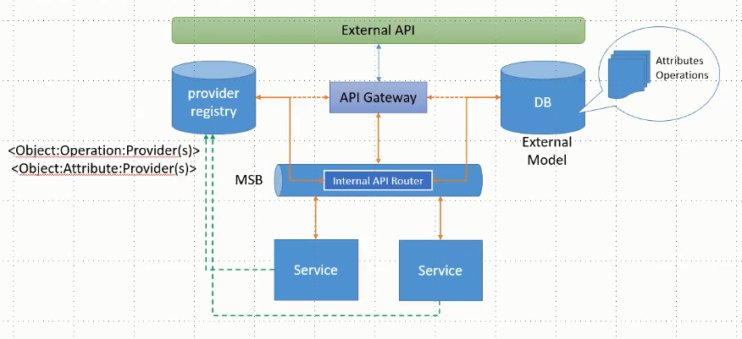
Model Driven Micro Services [1]

Slide 4
ONAP Microservices Architecture [2]
A proposal for Microservices architecture for ONAP R3+ (Casablanca and beyond) presented by Huabing.
There are challenges with Monolithic software (lack of agility/innovation, scalability issues and more). To cope with these challenges a microservices-based architecture centered around the “service mesh” concept, leveraging the Istio [5] open source project. The service mesh suggestions for Casablanca include:
Integrate Istio (see Note 1) with ONAP to provide infrastructure for communication (service discovery/retries/rate limiting/route rule/secured communication)
Keep it compatible with existing service communication approach (MSB API Gateway and Point 2 Point Communication)
Minimize the impacts to ONAP projects (Service mesh is designed as a transparent infrastructure layer, but in practice, some possible changes are foreseen on the application side, e.g., a need to pass the trace header through the service calling chain)
Integrate with Jaeger/Zipkin (see Note 2) to provide distributed tracing
Integration with Prometheus (real-time monitoring, see Note 3) and Grafana for metrics collection and display
Feedback the findings to the upstream project
Investigate any needed extension for ONAP itself
Istio will not be a mandatory deployment option for Casablanca
Leverage Istio to achieve close loop operation for ONAP system itself - long time goal.
Note 1 - Istio-enabled applications can be configured to collect trace spans using Zipkin or Jaeger.
Note 2 - Both Jaeger & Zipkin are distributed tracing systems with support for OpenTracing. The OpenTracing integration for both Jaeger and Zipkin build on the Jaeger client.
Note 3 - Prometheus delivers real-time monitoring, alerting and time-series database capabilities (including powerful queries and visualizations) for cloud-native applications, and integrates with many popular open source tools for data import/export. It is already the de facto standard for monitoring container-based infrastructure, and continues to add major features as user requirements mature. Prometheus provides needed visibility into and troubleshooting for cloud-native architectures, including Kubernetes and other next-generation components.

Slide 5
Centralized Authentication: Why? [2]
ONAP is a huge system consisting of many services.
Currently, different services such as AAI, SDC, Policy etc. have their own authentication process,
This makes ONAP difficult to use and adds burden to the individual project to enforce the cross-project authentication logic.
We might want to consider implementing some kind of centralized authentication and authorization, which means user login once and can access all the services.
We also need to consider how to secure the access of 3rd-party systems by using API token or OAuth.

Slide 6
Centralized Authentication - Possible Approach [2]
Something to consider:
Auth at External API Gateway for user agent and external system
User Token for user access
API Token/OAuth for external system access
Sidecar/Internal API Gateway for the security of inter-service communication
Portal(access URL)
2
Assign a token to user
User login with credential
3
User send token along with the requested url to MSB External API Gateway
1
4
Validate token and permission
AAF
MSB External API Gateway
Plugin
5
Validation result
(allowed or rejected)
If authorization success continue to service
6
Validate token and permission (optional)
ONAP Services
7
Note: the request http method and uri is implicitly mapped to AAF permission by the plugin
Note: the project choose to do authorization itself or delegate to MSB base on its business requirement
6
6

Slide 7
Unified API Standard [2]
Most of the projects produce RESTFul APIs for consuming, but in a none-consistent way, which is confusing to ONAP developer and user.
We need to define some unified standards/best practices on the REST API definition across the ONAP projects such as versioning, url, error code.
See wiki page below on RESTful API Design Specification:
https://wiki.onap.org/display/DW/RESTful+API+Design+Specification

Slide 8
ONAP Microservices Approaches [3]
Three approaches to refine Microservices Architecture proposed by Manoj [3]:
Approach 1: Model Driven Microservices which consolidates the configuration and operational models in a logically central place
  - Based on Other Open source implementations – ODL, ONOS etc, Model driven Microservices by Alex & Ramesh [1], Reference to OSM implementation.
Approach 2: Modular Microservices - Leverage TMForum IG1118 Management and Control Continuum (MCC) and Future Mode of Operation (FMO) concepts
  - Based on DMS proposal [1], but enhancing it further with reference to a standard architecture.
  - Primarily focused on structuring microservices and components in a hierarchical “Lego blocks” like units which can be mixed and matched to create management and control functions.
Approach 3: Cloud Native Micro Service Design (Followed by MSB)
  - Based on the Service Mesh [4][5] techniques used in the cloud native world.
  - Mainly an implementation approach than a consistent microservice design methodology.
Above approaches are complementary to each other and not exclusive.

Slide 9
Approach 1: Model Driven Microservices
Notes:
A model driven approach shifts the approach away from vendor proprietary methods (e.g., command scripting) towards modularized models based on open standards. Using models facilitates common information across different layers of the network and operations hierarchy (business management layer down to network infrastructure layer). By u sing a common set of models along with tooling, rapid development and testing can be performed. Models can be specified in different standardized languages or syntax (e.g., UML) and transformed to other languages, syntax or executable software. Modeling languages provide a common platform for specifying architecture and design with validation capabilities. Models can capture both the static/structural and dynamic/behavioural concepts of the system. UML is a general purpose modelling language to visualize (through diagrams) the design of a system. UML is the modeling language being used by the MEF for Information Modeling purposes.

Slide 10
Domain Driven Design Concept
Top down approach of designing Microservices
Domain-driven design (DDD) advocates modeling based on the domain of business
In the ONAP context Domain may be - Hybrid Telecom Service Orchestration and Management
In the context of building applications, DDD talks about problems as domains
It describes independent problem areas as Bounded Contexts (each Bounded Context correlates to a microservice)
Bounded contexts own its own domain data, logic and behavior
In DDD to define the domain model for each Bounded Context,
  identify and define the entities (and other patterns if required)
  create a boundary around things that need cohesion
  build and refine domain model contained within the boundary that defines the context
  Each bounded context can be modelled as a microservice

Slide 11
Domain Entity Pattern
Entities represent domain objects and are primarily defined by their identity and not only by the attributes that comprise them
An entity’s identity can cross multiple microservices or Bounded Contexts.
  For example Policy in one microservice might be TCA Configuration in another microservice or Constraint in yet another microservice
The same entity can be modeled across multiple Bounded Contexts or microservices as different identities.
However, that does not imply that the same entity, with the same attributes and logic would be implemented in multiple Bounded Contexts.
Instead, entities in each Bounded Context limit their attributes and behaviors to those required in that Bounded Context’s domain.
Reference : link

Slide 12
Bounded Context - An Example
Bounded Contexts
DCAE
OOF
Closed loop policy
Constraint
PAP
Configuration Policy
PDP/PEP
All refers to same entity with different identities , different attributes and behavior
Operational Policy
Configuration Policy
Each bounded context owns the management of identities

Slide 13
Views on ONAP Current Microservice Architecture
ONAP’s current MS architecture is defined per component. So the domain as per DDD has to be looked at a per component level
  ONAP seem to limit domain scope to each component OR sometimes seem to refer to use cases in the context of domains.
  Microservices are bound to components than end to end business context (not loosely defined based on domain entities but bound within each component) or use cases.
  To realize business use case it has to be disintegrated at component level and then MS level.
  Multiple components and associated microservices need to be augmented to support end to end capability.
  In ONAP each component bounds the entities, domain data and associated identities. This creates a dependency and violates the independent development practices put forth by DDD through bounded context.
  Kubernetes seems to map microservice to Service and not Pods, but currently each component in ONAP is mapped to Kubernetes Service with associated Pods representing docker containers fulfilling the micro functionality. Reference : link , link

Slide 14
How DDD enables Model Driven Design
Encouraged to create domain entities and bounded contexts (quite similar to what modelling team is doing with CIM, but might require further identification of bounded contexts)
Each bounded context has own domain model and ubiquitous language relevant in own boundary
A context map is formed representing interaction between bounded contexts
Microservice boundaries are defined based on bounded context

Slide 15
An Abstract View of Realizing DDD
FFS
Bounded context
API Endpoint Registration
ONAP Microservice
ONAP Micro Service
ONAP Microservice
ONAP Microservice
DMaaP
MSB
Pub/Sub
ONAP Microservice
Catalog
Inventory
Workflow
Policy
Common Information model
Based on Domain
Model
Distributed Data Store
Constraint
Configuration Policy
Closed Loop Policy
Specialization with alternate identities for entities – example for policy
ONAP Microservice
ONAP Microservice
ONAP Microservice
Pub/Sub
Action invocation/API End Point Registration

Slide 16
Model-Driven Microservices
(One possible implementation view)
FFS
MS Registration
OOM
2
3
3
3
API Routing
External Domain Orchestrator/Controller
MSB
1
API Invocation (Actions)
8
ESR/ Ext GW
External System Registration
Generated API (Swagger)
Generated API
API
API
ONAP Microservice
ONAP Microservice
MS Deployment Unit
MS Deployment Unit
MS Configuration push to Distributed store
Meta Model
Or MS Configuration
Meta Model
Subscription for Data Change, Notification, Configuration and Operational State update
Configuration
read/sync
5
Geo-Distributed ONAP
7
4
Music
6
State update resulting in event
Distributed Configuration Store (OOM – Consul ? )
DMAAP/Real Time Data Event Streaming & Processing
Registration for topic + State change notified to subscribed MS
ONAP Primary Instance

Slide 17
Key Concepts 1/2
Microservice deployment unit consisting of the core MS software along with metafile which contains configuration and deployment descriptor (can be modelled using SDC ?)
MUSIC for distributed , highly available storage for domain entities
Distributed Configuration Store for maintaining runtime configuration data of MS
Microservice Bus which act like a MS Endpoint Registry and API call routing GW
DMaaP or Real time data event streaming bus (based on RESP) which routes messages and file transfers across distributed MSs
OOM which reads the Metafile of MS and carries out deployment, registration.

Slide 18
Key Concepts 2/2
FFS
Micro services are packaged as deployment units – Packaging here is just logical in nature. Physically this can be an ONAP micro service component with a well-known (XML. YAML etc) configuration, deployment descriptors which acts like a metadata for MS. In practical sense the Metadata may be split to two files – deployment descriptor and configuration descriptor. Deployment descriptor is used as input for deployment by Kubernetes or Docker Engine. Configuration Descriptor captures following details
  MS configuration like DB connectivity details
  MSB registration including the capabilities
  DMaaP registration including the topics published and subscribed
  CHAP related configuration
  Domain data bound by MS
  Swagger for generating APIs for MS (which can be consumed by MSB)
During the microservice deployment (using deployment descriptor), metadata is read from the microservice predefined directory structure and pushed to the configuration data store. Rest of the configuration changes can be applied on the configuration store
OOM deploys MS and carries out registration of MS on MSB based on the registration data read from configuration store . Similar registration mechanism can be carried out for DMaaP as well.
MS carries out self-configuration or OOM initiates configuration of MS by reading the configuration data store
During the lifecycle of the MS the state is updated on the CHAP distributed DB which triggers notification on DMaaP
Notification forwarded to consumer by DMaaP
Consumer act upon state change : This is optional – indicating the event driven microservice behavior
Consumer potentially invokes action on Provider through an API call. : This is optional – indicating the event driven microservice behavior

Slide 19
Approach 1: Observations
The concepts described in this approach focus on the boundary, structure and interaction patterns of microservices
Microservices can be model driven following the domain driven design principle with bounded context mapped to a microservice. Each bounded context maintaining own domain model.
The reusability of the microservices and aggregation of microservices to form a system or a solution with a well-defined grouping pattern is not covered well.
Require effort in refactoring the existing microservices to define context map, domain models etc.
Will enforce top down modelling of microservices with alignment to domain rather than independent projects or components.

Slide 20
Approach 2: Modular Microservices Design

Slide 21
TMForum IG1118 : Concepts
FFS
TMForum IG1118 defines the future mode of operations based on the concepts of management and control continuum.
FMO : The process and people involved in operating physical and virtualized digital services.
Future Mode of Operations (FMO) Architecture : E2E Architecture that allows delivery and operations of physical and virtualized digital services and leverages SDN and NFV related technologies
Management and Control Continuum: Operational actions take place at all levels in a E2E Service delivery and operations architecture. The operational aspect in E2E Architecture is realized using management and control functions. Management and Control Functions are essentially of the same nature and can be grouped into a common set called management and control continuum functions. This makes the traditional approach of separation of management and control functions obsolete.
MCC Stretches across BSS/OSS, NMS/EMS, MANO, and SDN Controllers down into physical and virtualized networks to embedded OAM, signaling, flow, policy and other network-level control functions
MCC Architecture : The part of FMO concept which is focused on lifecycle operations of services delivered using FMO architecture. Contains Components which focus on Management or Control functions.
Component : A unit of functionality that presents capabilities through its interfaces.
MCC Component: A component whose functional behavior would traditionally be considered as management or control or anywhere in between two.
System : Interconnected components interacting to collectively provide some desired behavior
SW Delivery Package: Bundling of software that is provided as a single deliverable. Consists of multiple SW deployment units
SW Deployment Unit : A single executable that when installed on an appropriate platform will run to produce emergent behavior that is considered as one or more FMO Component
Reference: TMForum IG1118 (Also referred in ETSI ZSM)

Slide 22
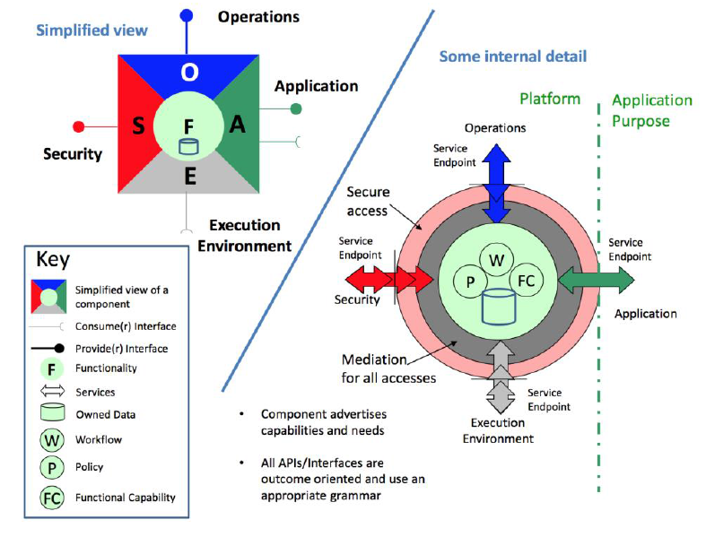
TMForum IG1118 : FMO Component (Concept)
Consumer Interface: Interface used by component to fulfil needs for tasks to be carried out related to its purpose. The tasks will include the evaluation of information and the providing of results.
Provider Interface: Interface through which a component offers a capability to carry out specific tasks related to its purpose.
Application Function: Exposed through Application API and provides access to all the related to the primary business purpose of the component
Operations Function: Exposed through operations API and implements the support for managing the lifecycle process for the component
Security Function: Exposed through security API and and provides security features for the component
Environment Function: Accessed through the execution environment APIs and used by the component to access the infrastructure resources that it needs to support its functionality or operations.
Reference: TMForum IG1118

Slide 23
Management and Control Continuum
FFS
A part of FMO Concept which focus on operational aspects of services in the target architecture built on NFV and SDN.
Deals with component that have management-control functions as their primary functions.
In traditional systems functions like EMS/NMS, Control Plane etc are considered as MCC functions.
In the MCC architecture MCC components can be assembled to form MCC Systems. An assembly of MCC components can be given a certain name/branding.
A collection of functional components can be packaged together and delivered as a solution to a particular problem.
Such an assembly in itself can be considered as a component.
Each component in an assembly is contributing its application function to the capabilities of the overall branded component
The same MCC component can be offered as part of different branded components.
Reference: TMForum IG1118

Slide 24
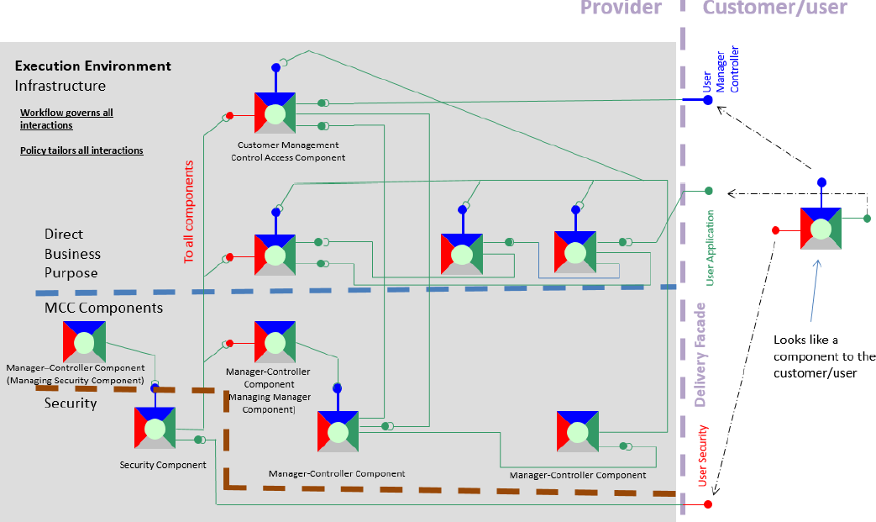
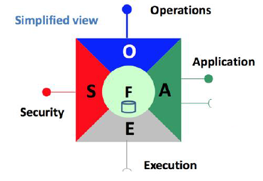
FMO Architecture: Composition of Components
FFS
Assembly of component perceived as a component by end user
Reference: TMForum IG1118

Slide 25
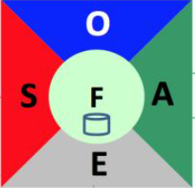
ONAP Modularity and Standard Alignment through Proxy Component
FFS
Branded ONAP Component capabilities exposed though another component
A branded ONAP component (such as SO or DCAE) can be represented through the interfaces consolidated/exposed by a single component which acts like a proxy.
This proxy can be realized using ONAP MSB or can be dedicated microservice within ONAP Branded Component (e.g. side car exposing the component to the service mesh)
This approach can be used to enable standard alignment. For example if two SDO interfaces need to be supported based on different deployment models, two proxy components can be created with different component interfaces.
Modularity is ensured by the FMO component structure and the APIs exposed by micro/macro levels of components which are consolidated through proxy component
Multiple instances of this proxy component possible to align the branded component to multiple API flavors required for Standard alignment
Branded ONAP Component

Slide 26
Suggested changes in ONAP
FFS
Refactoring of ONAP Components , Microservices in-line with the FMO, MCC concepts
Refactoring of APIs across components/Microservices in the Security, Operation, Application and Environment categories
Alignment of Component/Microservice APIs in the Security/Operations/Application/Environment categories with External API
A means for the components/Microservices to express capabilities in a catalogue to enable appropriate assembly (MSB capability limited to end point registration, not capability registration)
Governance of interaction between components through policy (Already available through Configuration Policy ?)
To have capabilities built in to components to achieve lifecycle compatibility (API/Interfaces change and upgrade support) with relevant mediation functions or adaptors
A mechanism to express different context of Components/Microservices – Delivery context, Deployment Context, Information Context, Catalogue context, Runtime Context etc.
Microservices (a FMO or MCC component) and ONAP Components (a branded component) designed through the Bundle Context concept – i.e to identify the domain model being fulfilled by the microservice and then building APIs to enable the interaction with microservice (MCC or FMO Component).

Slide 27
Approach 3: Cloud Native Micro Services with Service Mesh
(MSB Implementation)

Slide 28
Cloud Native Microservices
Microservices designed with cloud native principles in mind
12 factor principles – link (need not be cloud native, but general MS principles)
CNCF currently is tool focused that work with COEs and dockerized containers.
ONAP already uses some of these tools sets
What is missing is the framework which integrates all these toolsets that can be readily used for implementing microservices
CNCF also does not define structure or modelling for MS other than what COE provides. Kubernetes seems to follow Helm as a popular MS modeling mechanism
Interfaces like gRPC, gNMI etc seem to be quite efficient compared to REST APIs and ONAP may start using this for microservices interaction and ONAP- VNF-NFVI interaction.

Slide 29
ONAP Context
Not all Microservices in ONAP are designed with an objective to be cloud-native. Some important characteristics that should be considered are
  Leverage the cloud characteristics like scaling, healing and migration (handling lifecycle management operations)
  Version and Update handling without impacting the functionality
  Always On Availability
  Portable across cloud infrastructure
  Inbuilt state management , consistency checking mechanisms
  Inbuilt health check mechanisms
  In built fault tolerance mechanisms
  Fault isolation capability
  Tracing of flows across microservices

Slide 30
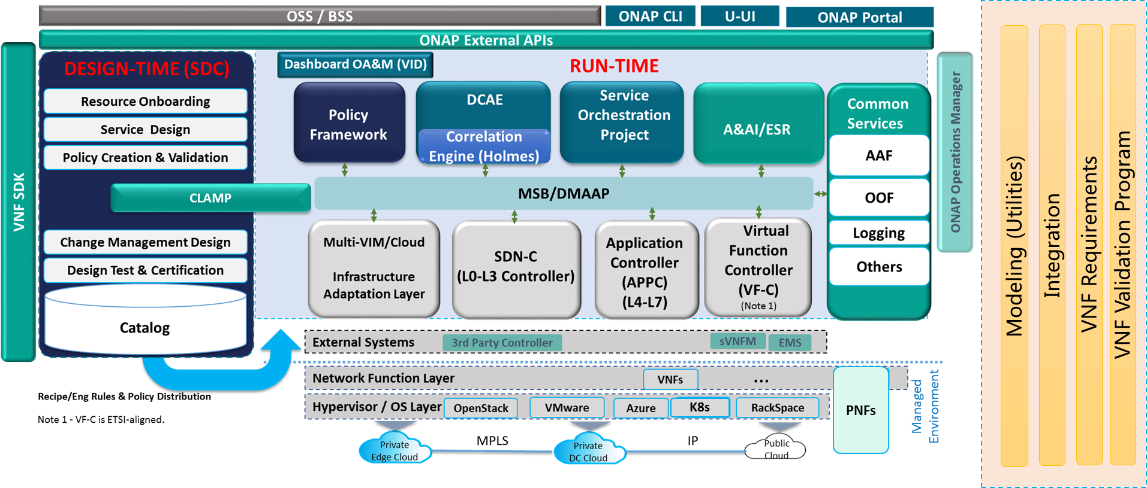
Cloud Native Tools that can be leveraged in ONAP
(Reference CNCF, IETF)
Service Mesh: Linkerd, Envoy
MS interaction : gRPC
gNMI/gRPC/ProtoBuf as enhancement for VES Collector
Prometheus for MS/VNF telemetry collection , monitoring
TUF for Secure SW update
Notary
Fluentd, Jaeger, OpenTracing
Rook for Cloud native distributed storage , which can be leveraged in MUSIC
Open Policy Agent
gNMI/gRPC, QUIC for NE/VNF Management

Slide 31
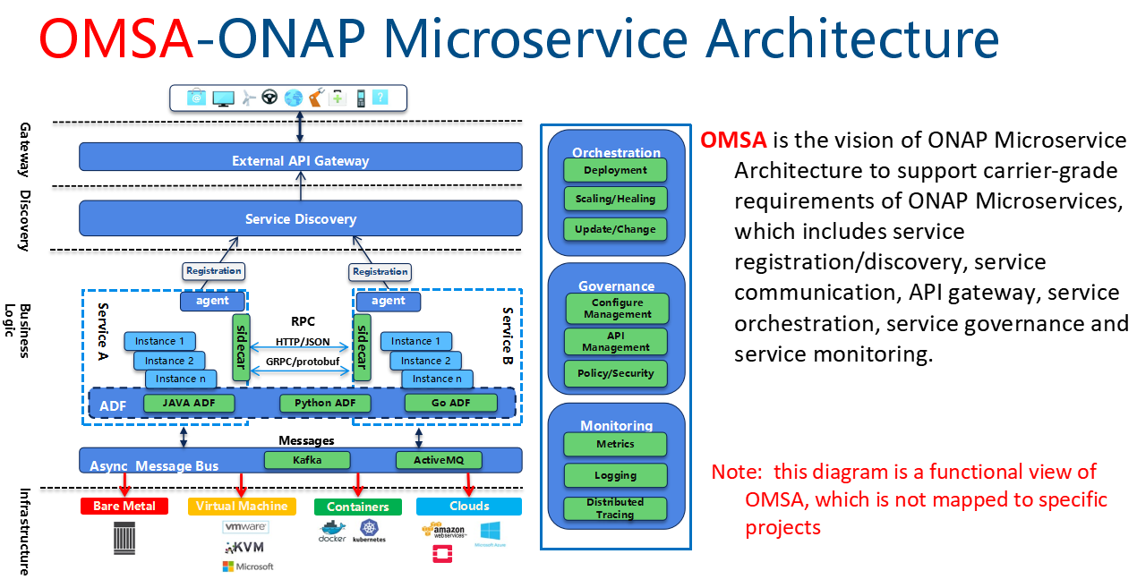
ONAP Microservice Architecture (OMSA)
(MSB Project)

Slide 32
ONAP MS Arch Observations
ONAP MS Arch is primarily an implementation approach than dealing directly with the Microservices design principles:
  Modularity,
  Model Driven,
  Independent development concerns.
Limited Scope – i.e covering the Microservice discovery, Interaction .
Scope/functionality and boundary of microservices are TBD?

Slide 33
Conclusions
All approaches bring in significant practical value
Among the three approaches , Approach 2 seems to be more favorable considering the ease of adoption and the modularity that can be achieved
  Approach 1 might require a major revamp across projects - the way Model states are maintained, propagated and acted upon.
  So this approach may be considered for long term.
  Approach 2 might be favorable from a component level
    standard API and
    model alignment point of view as flexible proxy components can be supported
  Approach 2 can also leverage some of the concept of domain context pattern described n approach 1
  Approach 3 is more of an implementation approach with focus on discovery and interaction of MS.
    MS still need to be structured well, consistent and follow cloud native principles to leverage benefit of this approach.

Slide 34
Backup Slides – Service Mesh

Slide 35
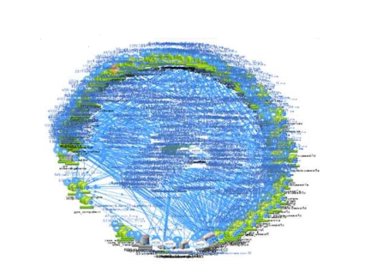
Why Service Mesh?
(see [2] & [4])
Microservice comes with a price
The complicity of a large distributed system
  Service discovery/load balancing
  How to secure the west-east communication
  How to get inside visibility of the systems(Metrics, Topology, tracing)
  How to improve operation efficiency(Canary deployment, Resiliency testing, Rate limiting, White list)
The Complicity of multi-tech stacks
  The common above infrastructure need to be implemented in every application services
  Management of libs for multiple languages/frameworks
  Management of multiple version of libs
  These challenges tend to break the multi-tech stack promise of Microservice Architecture
The deployment scale could be very large

Slide 36
























Separation of concerns
The remote communication logic is move into the proxy and deployed as “sidecar”
Developers only need to take care of the business logic
TLS
App container
Istio
Proxy
retries
metrics
3. call
2. call
4. forward
client
server
client
Proxy
server
registry
registry
2. lookup
1. register
3. lookup
1. register

Slide 37
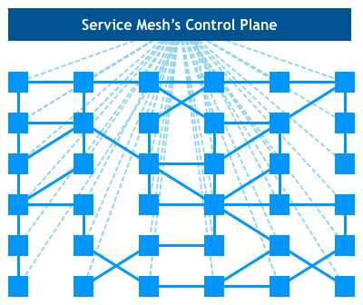
Network of Proxies: Service Mesh
A service mesh is a dedicated infrastructure layer for handling service-to-service communication. It’s responsible for the reliable delivery of requests through the complex topology of services that comprise a modern, cloud native application. In practice, the service mesh is typically implemented as an array of lightweight network proxies that are deployed alongside application code, without the application needing to be aware.
-William Morgan

Slide 38
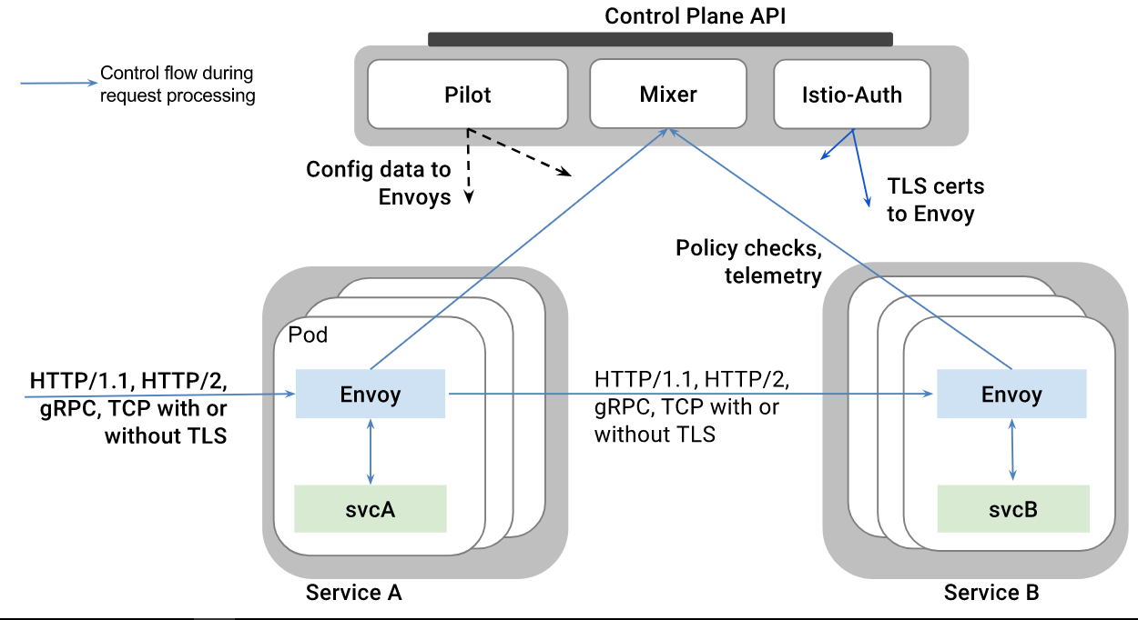
Istio Service Mesh [2] & [5]
Istio is a open source service mesh project.
Istio features:
Istio Architecture
Stability and Reliability: Reliable communication with retries and circuit breaker
Security : Secured communication with TLS
Performance: Latency aware load balancing with warm cache
Observability: Metrics measurement and distributed tracing without instrumenting application
Manageability: Routing rule and rate limiting enforcement
Testability: Fault injection to test resilience of the services

Slide 39
Service Mesh suggestion for Casablanca [2]
Integrate Istio with ONAP to provide infrastructure for communication(service discovery/retries/rate limiting/route rule/secured communication)
Keep it compatible with existing service communication approach(MSB API Gateway and Point 2 Point Communication)
Minimize the impacts to ONAP projects(Service mesh is designed as a trasparent infrastructure layer, but in practice, there may be some change needed to be done on the application side, for example, the trace header should be passed through the service calling chain)
Integrate with jaeger/zipkin to provide distributed tracing
Integration with prometheus and grafana for metrics collection and display
Feedback the findings to the upstream project
Investgate any needed extension for ONAP itself
Istio will not be a mandatory deployment option for casablanca
Leverage Istio to achieve close loop operation for ONAP system itself - long time goal

