Slide 1
ONAP R3+ Architecture
(including Microservices)
Tiger Team Report
Parviz Yegani: ONAP Architecture Tiger Team Leader
Contributors:
Architecture Tiger Team Members
ONAP Architecture F2F Meeting (collocated with OpenStack Summit)
Vancouver, Canada
May 23, 2018

Slide 2


ONAP Target Architecture
(High-Level Functional View)
OSS / BSS
CLI
U-UI
ONAP Portal
ONAP External APIs
DESIGN-TIME
Dashboard OA&M
RUN-TIME
Resource Onboarding
Common
Services
Policy Framework
Data Collection, Analytics, and Events
Event Correlation
Active & Available Inventory
External Registry
Common Services
Orchestration
Service Design
Application
Authorization
Framework
Policy Creation & Validation
ONAP Operations Manager
Analytic Application Design
Micro Services Bus / Data Movement (see Note 1)
VNF / PNF Onboarding
ONAP Optimization Framework
Closed Loop Design
Change Management Design
Generic NF Controllers (L4-L7)
Logging
Multi-Cloud
Adaptation
SDN Controller
(L0-L3)
Design Test & Certification
Configuration & Life Cycle Management
Others
CCSDK
(see Note 1)
(see Note 1)
Catalog
Optional External Systems
3rd Party Controller
Specific VNF Manager
Element Management System
…
Managed Environment
Network Function Layer
Recipe/Eng Rules & Policy Distribution
ONAP Optimization Framework
VNFs
PNFs
Hypervisor / OS Layer
OpenStack
VMware
Azure
Kubernetes
RackSpace
Note 1 – Consistent APIs between Orchestration layer and Controllers
MPLS
IP
Private
Edge Cloud
Private
DC Cloud
Public
Cloud

Slide 3
ONAP Architecture Design Considerations
Architecture principles agreed by the Architecture Team:
ONAP is a layered architecture - Orchestration, Multi-Cloud, Controllers, etc.
Functional architecture - the role of each layer should be well defined per the above architecture principles.
Integrated Design Studio - captures full lifecycle management models.
Multi-Cloud Support - ONAP should support cloud agnostic model and Multi-Cloud Adaption Layer while hiding infrastructure details.
ONAP Goal is: Modular, Model-driven, Microservices-based architecture
  Models drive interfaces between layers/components
ONAP APIs - should define well-described and consistent NB-APIs at all layers
Multi-vendor support - Keep flexible capability for commercial solution (no vendor lock-in)
Unified Modeling – needed for integration across all modules: VES in DCAE, Logging & monitor inside ONAP and more
  TOSCA models for network function,
  Simple/nested services augmented with BPMN,
  Policy/Analytic design models, etc.

Slide 4
ONAP R3+ Architecture Contributions (1/3)
Generic NF Controller (L4-7) Architecture – pending final review.
ONAP Orchestrator – defined all internal and external interfaces. API Mapping (OIs/OEs) TBD
Controller Architecture - API Mapping (CIs/CEs - existing interfaces & new additions/extensions) (John Ng) – TBD
Service Design and Creation Functional Architecture – pending final review.
Catalog Architecture – pending final review.
Data Collection, Analytics and Events Architecture – pending final review.
Active and Available Inventory – pending final review.
ONAP Design Platform Reference Architecture (Ting Lu) – work in progress.
ONAP SDK-Driven Sub-System Approach – SDK Libraries – not reviewed yet.

Slide 5
ONAP R3+ Architecture Contributions (2/3)
CNCF - ONAP Microservices Approaches (Manoj/Alex) – work in progress.
Microservices Architecture & Service Mesh (Huabing) – initial proposal discusses but not decided yet.
  (Need to ensure that the ONAP platform can handle cloud-native APIs and models (far more than ONAP components registering with the MSB)
Recursive Service Orchestration in ONAP (Gil) – near completion (revise & resubmit).
Plug an ETSI VNF Manager into the ONAP architecture (Gil) – discussion only, closed.
ETSI NFV update (TOSCA NFV profile, IFA, SOL, TOSCA-YANG mapping) (Thinh) – done.
Multi-Cloud Architecture update: SDN-OC, SDN-UC and SDN-GC integration (Ramki) – work in progress.
External ONAP APIs update beyond Beijing (Andy Mayer) – work in progress.
Real-time Data Events Streaming and Processing(RESP) (Parviz) – updated proposal was presented at the ARC call on April 24th.
SO/DO orchestration architecture (Susana) - work in progress.

Slide 6
ONAP R3+ Architecture Contributions (3/3)
(Microservices)
REFERENCES:
Modular ONAP Implementation and Integration to External Domain Management Systems (DMS) Proposal, Alex Vul and Ramesh Nagarajan, DMS Task Force.
ONAP Microservices v0.8, Manoj Nair
ONAP Microservices Architecture for Casablanca and beyond, Huabing Zhao
MSB Architecture Implications, Denes Nemeth
Modularity - Functional Decomposition Draft_v04 Manoj Nair (work in progress)
ARC Presentations:
Service Mesh and Related Microservice Technologies in ONAP, Ramki Krishnan, et al. presented at the ARC call on April 24, 2018.
OPNFV Clover Project, Wenjing Chu (https://wiki.opnfv.org/display/PROJ/Clover) presented at the ARC call on May 1, 2018.

Slide 7
Part I – Microservices
What is it? Why is it needed?

Slide 8
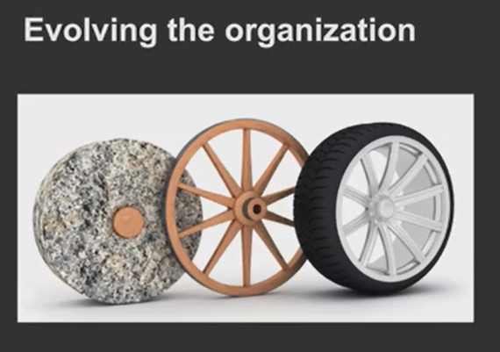
ONAP Arch Transformation
Iterative application refactoring according to the 12-factor principles towards a cloud-native microservices pattern
Incremental decoupling of the monolith into a microservices-based application whenever a more profound transformation of the customer’s development lifecycle is required
ONAP Platform Transformation

Slide 9
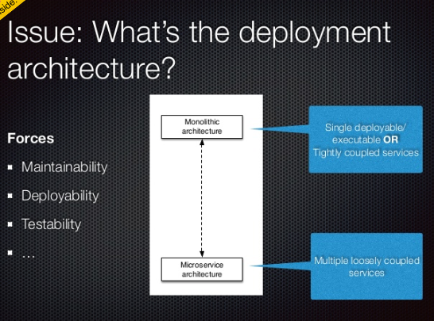
http://microservices.io/patterns/microservices.html
Microservices.io by Chris Richardson

Slide 10
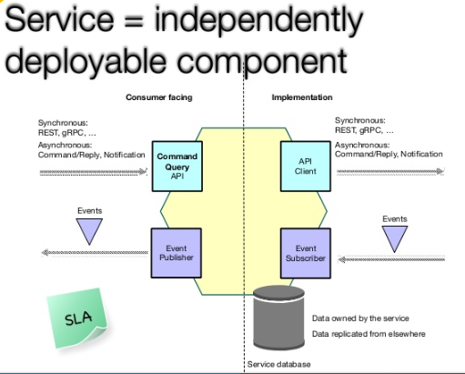
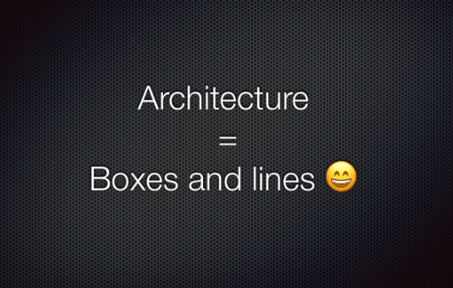
Architecture Migration

Slide 11
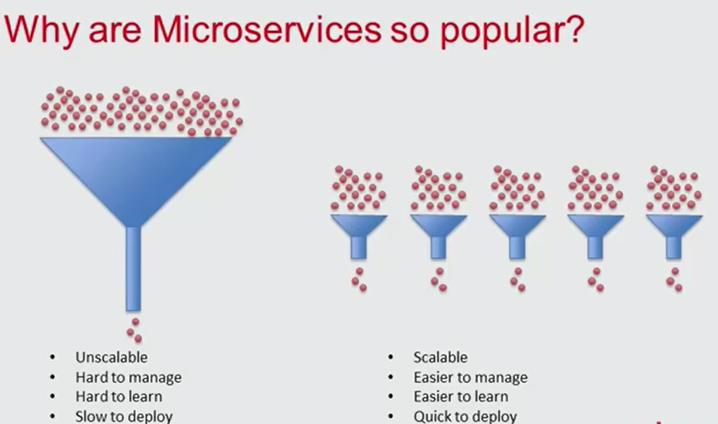

Slide 12
Microservices Architecture
Microservices:
decompose monolithic business systems into
a number of independently deployable services;
each service represents a business capability, or
the smallest, “atomic” unit of service that delivers business value.
Microservices Architecture:
enables speed, safety, and scale via decoupling
business domain into independently deployable
  “bounded contexts” of capabilities; and
  associated change cycles;
each service is deployed independently(a self-service paradigm);
offers independent, and efficient scaling of services.
incremental change is facilitated allowing incremental deployment of new functionality
Tooling System:
DevOps teams need some operational capabilities:
automated and on-demand scaling of apps instances;
application health management;
dynamic routing/load balancing of requests to/across apps instances;
aggregation of logs and metrics.

Slide 13
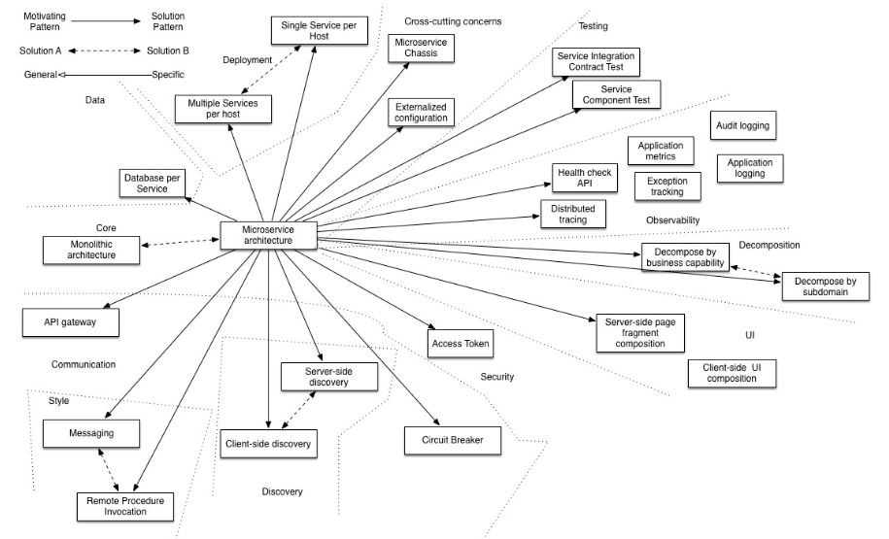
Pattern: Microservices Architecture
http://microservices.io/patterns/microservices.html
Microservices.io by Chris Richardson

Slide 14
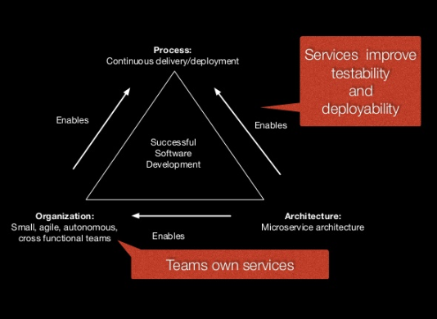
Microservices Architecture (MSA)
MSA design principle:
  a given microservice should have a very few operations/functionalities and simple message format.
REST
  provides a simple messaging style implemented with HTTP request-response, based on resource API style
  widely used
  details will be provided later.
Message Formats:
  in most microservices based applications use JSON and XML (text message format) on top of HTTP resource API style.
  Microservices can also leverage binary message formats such as binary Google ProtoBuf (GPB).
Service Contract:
  microservices use the standard REST API definition languages such as Swagger to define the service contracts.
Smart End-points:
  in micoservices the business logic is moved to the services and client (known as Smart Endpoints).
MSB:
  a lightweight message bus or gateway with minimal routing capabilities and just acting as a ‘dumb pipe’ w/o any business logic.

Slide 15
Messaging in Microservices
Synchronous Messaging — REST, Thrift
  REST with HTTP is widely used (as it provides a simple messaging style)
    client expects a timely response from the service and waits till it get it
  Thrift used as an alternative to REST/HTTP synchronous messaging.
Asynchronous Messaging — AMQP, STOMP, MQTT
  For some microservices scenarios asynchronous messaging is needed
    client doesn’t expects a response immediately, or not accepts a response at all
    asynchronous protocols used widely include: AMQP, STOMP or MQTT
Message Formats — JSON, XML, Thrift, ProtoBuf, Avro
  most microservices-based applications use simple text-based message formats such as JSON and XML on top of HTTP resource API style.
  if text messages becomes verbose in some use cases, microservices can leverage binary message formats such as binary Thrift, ProtoBuf or Avro.

Slide 16
Communication Patterns

Slide 17
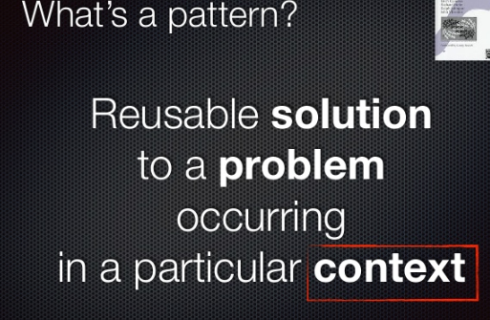
Communications Patterns

Slide 18
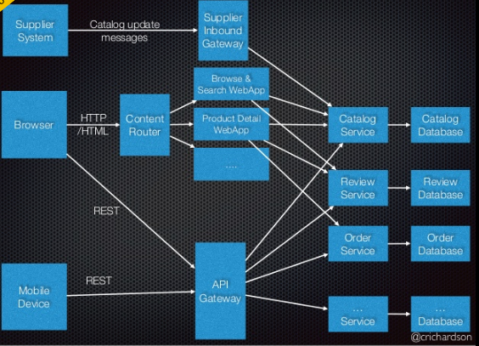
The most widely used pattern – API Gateway
API-GW Advantages
  The API-GW style could well be the most widely used pattern in most microservices implementations.
  Ability to provide the required abstractions at the gateway level for the existing microservices:
    for example, rather than provide a one-size-fits-all style API, the API gateway can expose a different API for each client
  Lightweight message routing/transformations at gateway level.
  Central place to apply non-functional capabilities such as security, monitoring and throttling
  With the use of API-GW pattern, the microservice become even more lightweight as all the non-functional requirements are implemented at the GW level.

Slide 19
Decentralized Data Management
Advantages
Here are the key aspect of implementing decentralized data management in microservices architecture.
  Each microservice can have a private DB to persist the data that requires to implement the business functionality it offers.
  A given microservice can only access the dedicated private database but not the databases of other microservices.
  Some business scenarios may require updating several DBs for a single transaction
    In such scenarios, the DBs of other microservices should be updated through its service API only (not allowed to access the database directly)
  Other benefits of the decentralized data management:
    allows microservices to be fully decoupled, ie,
    can choose disparate data management techniques (SQL or NoSQL etc., different database management systems for each service)
    however, for complex transactional use cases that involves multiple microservices, the transactional behavior has to be implemented using the APIs offered from each service and the logic resides either at the client or intermediary (GW) level.

Slide 20
Security Pattern
API-Security standards such as OAuth2 and OpenID Connect are widely used to solve Microservices security problem.
OAuth2 (an access delegation protocol)
  The client authenticates with authorization server and get an opaque token which is known as ‘Access token’.
  Access token has zero information about the user/client.
  It only has a reference to the user info that can only be retrieved by the Authorization server.
  The token is known as a ‘by-reference token’ and
  It’s safe to use it even in the public network/internet.
OpenID Connect
  Behaves similar to OAuth
  It’s issued by the authorization server and contains information about the user
  This is often implemented by a JWT (JSON Web Token), and signed by authorization server.
  The token ensures the trust between the authorization server and the client.
  It’s also called ‘by-value token’ as it contains the info of the user
  It’s not safe to use it in the public network.

Slide 21
Transactions Support in MSA
It’s not easy to support distributed transactions across multiple microservices
In designing an MSA transaction-less coordination between services is highly desirable
Note 1 - given that a service is fully self-contained and designed based on the single responsibility principle, any need to have distributed transactions across multiple microservces is often a symptom of a design flaw in MSA. This can be sorted out by refactoring the scopes of microservices.
Note 2 - if there is a mandatory requirement to have distributed transactions across multiple services, then such scenarios can be realized with the introduction of ‘compensating operations’ at each microservice level.
  The key idea is, if a microservice failed to execute a given operation, we can consider that as a failure of that entire microservice. Then all the other (upstream) operations has to be undone by invoking the respective compensating operation of those microservice. The details is FFS.

Slide 22
Design for Failures
MSA introduces dispersed set of services
  compared to monolithic design, that increases the possibility of having failures at each service level
A given microservice can fail due to
  network issues,
  unavailability of the underlying resources, etc
An unavailable or unresponsive MS should not bring the whole microservices-based application down
  microservices should be fault tolerant, be able to recover when that is possible and the client has to handle it gracefully
Services can fail at any time, it’s important to be able to detect (real-time monitoring) the failures quickly and, if possible, automatically restore the services
  There are several commonly used patterns in handling errors in Microservices context. The details will be provided later.
Failures of one part of the microservices-based application should not affect the rest of the application
  Bulkhead pattern is about isolating different parts of an application so that a failure of a service in such part of the application does not affect any of the other services.

Slide 23
Other Patterns
Timeout Pattern/Circuit Breaker
  this pattern is a mechanism that allows one to stop waiting for a response from the microservice, assuming that it doesn’t come.
  can configure the wait time interval at the Gateway level, ie,
    can decide at the GW level whether to send the request to the microservice using circuit breaker or timeout pattern
  This pattern is quite useful to avoid unnecessary resource consumption, request delay due to timeouts and also facilitates the monitoring of the system (based on the active open circuits states).
Bulkhead Pattern
  this pattern must be implemented at the GW level too as its the single entry point for all the client requests
    guarantees a failure in a give service will not affect the invocation of the other microservices
Central Monitoring
  Gateway can also be used as the central point for obtaining the status and
  monitor of each microservice while each microservices is invoked through the Gateway.

Slide 24
Cloud-Native Microservices
Notes:
A model driven approach shifts the approach away from vendor proprietary methods (e.g., command scripting) towards modularized models based on open standards. Using models facilitates common information across different layers of the network and operations hierarchy (business management layer down to network infrastructure layer). By u sing a common set of models along with tooling, rapid development and testing can be performed. Models can be specified in different standardized languages or syntax (e.g., UML) and transformed to other languages, syntax or executable software. Modeling languages provide a common platform for specifying architecture and design with validation capabilities. Models can capture both the static/structural and dynamic/behavioural concepts of the system. UML is a general purpose modelling language to visualize (through diagrams) the design of a system. UML is the modeling language being used by the MEF for Information Modeling purposes.

Slide 25
Cloud-Native Microservices
What’s Cloud-Native
  uses an open source software stack to
  deploy applications as microservices,
  packaging each part into its own container, and dynamically;
  orchestrating those containers to optimize resource utilization.
Why Cloud-Native?
  is horizontally scalable,
  no single point of failure,
  resilient and self-healing,
  minimal operators overhead,
  decoupled from the underlying platform
The twelve-factor principles
  Not necessarily cloud native, but general Microservices principles.
CNCF currently is tool-focused (see next slide)
  work with COEs and dockerized containers;
  heavily K8s focused
ONAP already uses
  K8s in OOM (+),
  Tracing tools in Logging (+)

Slide 26
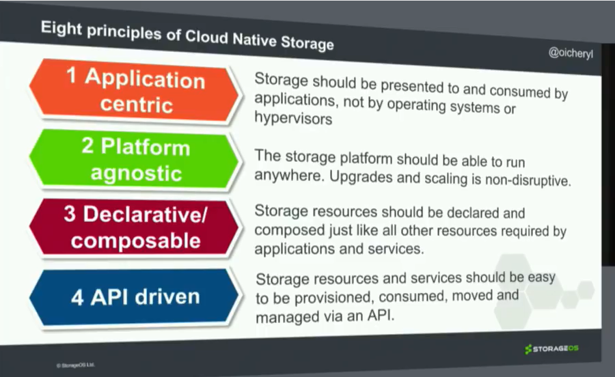
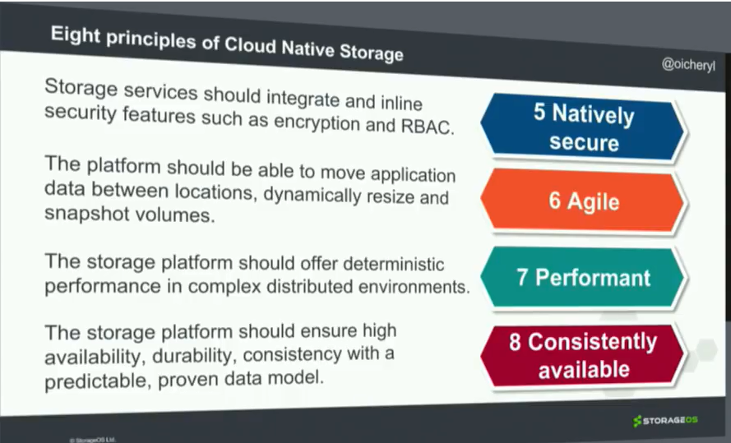
Cloud-Native Microservices

Slide 27
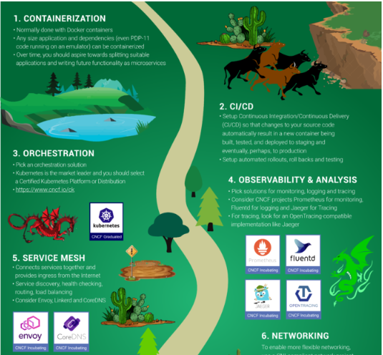
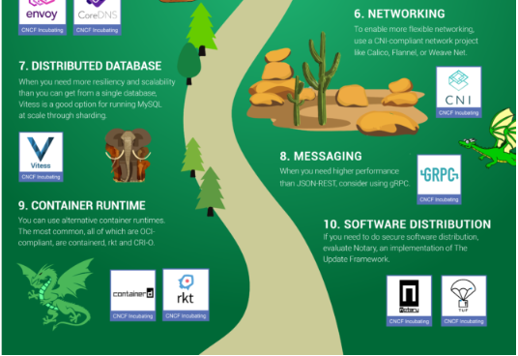
Cloud Native Computing Foundation (CNCF)
Need to ensure that the ONAP platform can handle cloud-native APIs and models (far more than ONAP components registering with the MSB)

Slide 28
ONAP API-Based Collaboration
ONAP cloud-native applications must interact via
  published and
  versioned APIs
Such APIs are
  typically HTTP REST style with
  JSON serialization,
  but can use other protocols and serialization formats.
ONAP projects can deploy
  new functionality w/o synchronizing with other teams,
  as long as they do not break any existing API contracts.
The primary interaction model:
  for the self-service infrastructure platform is also an API,
  just as it is with the business services.
Rather than submitting tickets to
  provision, scale, and maintain application infrastructure,
The same requests are submitted to an API that
  automatically services the requests.

Slide 29
Service Mesh
Notes:
A model driven approach shifts the approach away from vendor proprietary methods (e.g., command scripting) towards modularized models based on open standards. Using models facilitates common information across different layers of the network and operations hierarchy (business management layer down to network infrastructure layer). By u sing a common set of models along with tooling, rapid development and testing can be performed. Models can be specified in different standardized languages or syntax (e.g., UML) and transformed to other languages, syntax or executable software. Modeling languages provide a common platform for specifying architecture and design with validation capabilities. Models can capture both the static/structural and dynamic/behavioural concepts of the system. UML is a general purpose modelling language to visualize (through diagrams) the design of a system. UML is the modeling language being used by the MEF for Information Modeling purposes.

Slide 30
Cloud Native Model – Service Mesh
Cloud native model combines the microservices approach of many small services with two additional factors:
  containers (e.g., Docker), which provide resource isolation and dependency management, and an
  orchestration layer (e.g., Kubernetes), which abstracts away the underlying hardware into a homogenous pool.
These components allow applications to
  adapt with natural mechanisms for scaling under load and
  for handling the ever-present partial failures of the cloud environment
The library approach is no longer feasible
  with hundreds of services or thousands of instances, and
  an orchestration layer that’s rescheduling instances from moment to moment,
  the path that a single request follows through the service topology can be incredibly complex, and since
  containers make it easy for each service to be written in a different language.
This combination of complexity and criticality motivates the need for service mesh a dedicated layer for:
  a safe, fast and reliable service-to-service communication decoupled from application code,
  service mesh is able to capture the highly dynamic nature of the underlying environment and
  it’s needed for building a cloud native application
  service mesh is typically implemented as an array of lightweight network proxies (sidecar) that are deployed alongside application code, without the application needing to be aware
  The requirements for serverless computing (e.g. Amazon’s Lambda) fit directly into the service mesh’s model of naming and linking, and form a natural extension of its role in the cloud native ecosystem.
High-traffic companies like Paypal, Ticketmaster, and Credit Karma have all added a service mesh to their production applications
  this January, Linkerd, the open source service mesh for cloud native applications, became an official project of the Cloud Native Computing Foundation.
REF: Pragmatic Microservices by Kasun Indrasiri

Slide 31
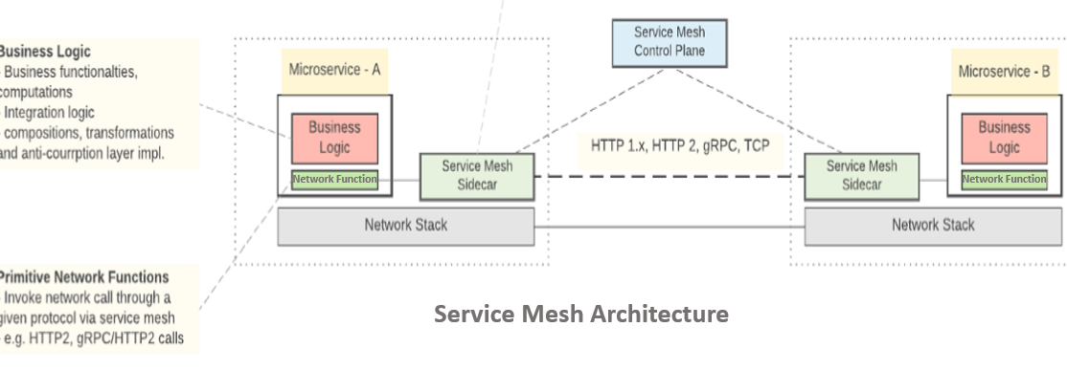
Service Mesh …
Service Mesh (sidecar proxy):
a critical component of the cloud-native stack
a networking model, a layer of abstraction sitting above TCP/IP
L3/L4 network is always present and capable of delivering bytes from point-to-point
assumes the network is unreliable
  ie, must be capable of handling network failures
service mesh is decoupled from the application code but
  can capture the highly dynamic nature of the underlying environment
REF - https://medium.com/microservices-in-practice/service-mesh-for-microservices-2953109a3c9a

Slide 32
Service Mesh
Business Logic
Implements the business functionalities,
Computations and service composition, integration logic,
Complex routing logic,
Mapping logic between different message types, etc.
Network Functions
Inter-service communications
  basic service invocation through a given protocol,
Resiliency for inter-service communications,
Service discovery
  Discovery of service endpoints through a dedicated service registry
Network Functions (cont’d)
Routing
  Primitive routing capabilities, but no routing logics related to the business functionality of the service
Observability:
  Metrics, monitoring, distributed logging, distributed tracing.
Security:
  Transport level security (TLS) and key management.
Access Control:
  Simple blacklist and whitelist based access control.
Deployment:
  Native support for containers. Docker and Kubernetes.
Interservice communication protocols:
  HTTP1.x, HTTP2, gRPC
Network Stack
network functions are built on top of the underlying OS level network stack.
Network Libraries
service implementations will have to use a given network library to initiate network calls (to service mesh only).
Service Mesh is language agnostic

Slide 33
Service Mesh Pros & Cons
Pros
Commodity features are implemented outside microservice code and they are reusable.
Solves most of the problems in Microservices architecture which we used to have ad-hoc solutions: Distributed tracing, logging, security, access control etc.
More freedom when it comes to selecting a microservices implementation language: You don’t need to worry about whether a given language supports or has libraries to build network application functions.
Cons
Complexity: Having a service mesh drastically increase the number of runtime instances that you have in a given microservice implementation.
Adding extra hops: Each service call has to go through an extra hop(through service mesh sidecar proxy).
Service Meshes address a subset of problems: Service mesh only address a subset of inter-service communication problems, but there are a lot of complex problems such as complex routing, transformation/type mapping, integrating with other services and systems, to be solved at your microservice’s business logic.
Immature: Service mesh technologies are relatively new to be declared as full production ready for a large scale deployments.

Slide 34
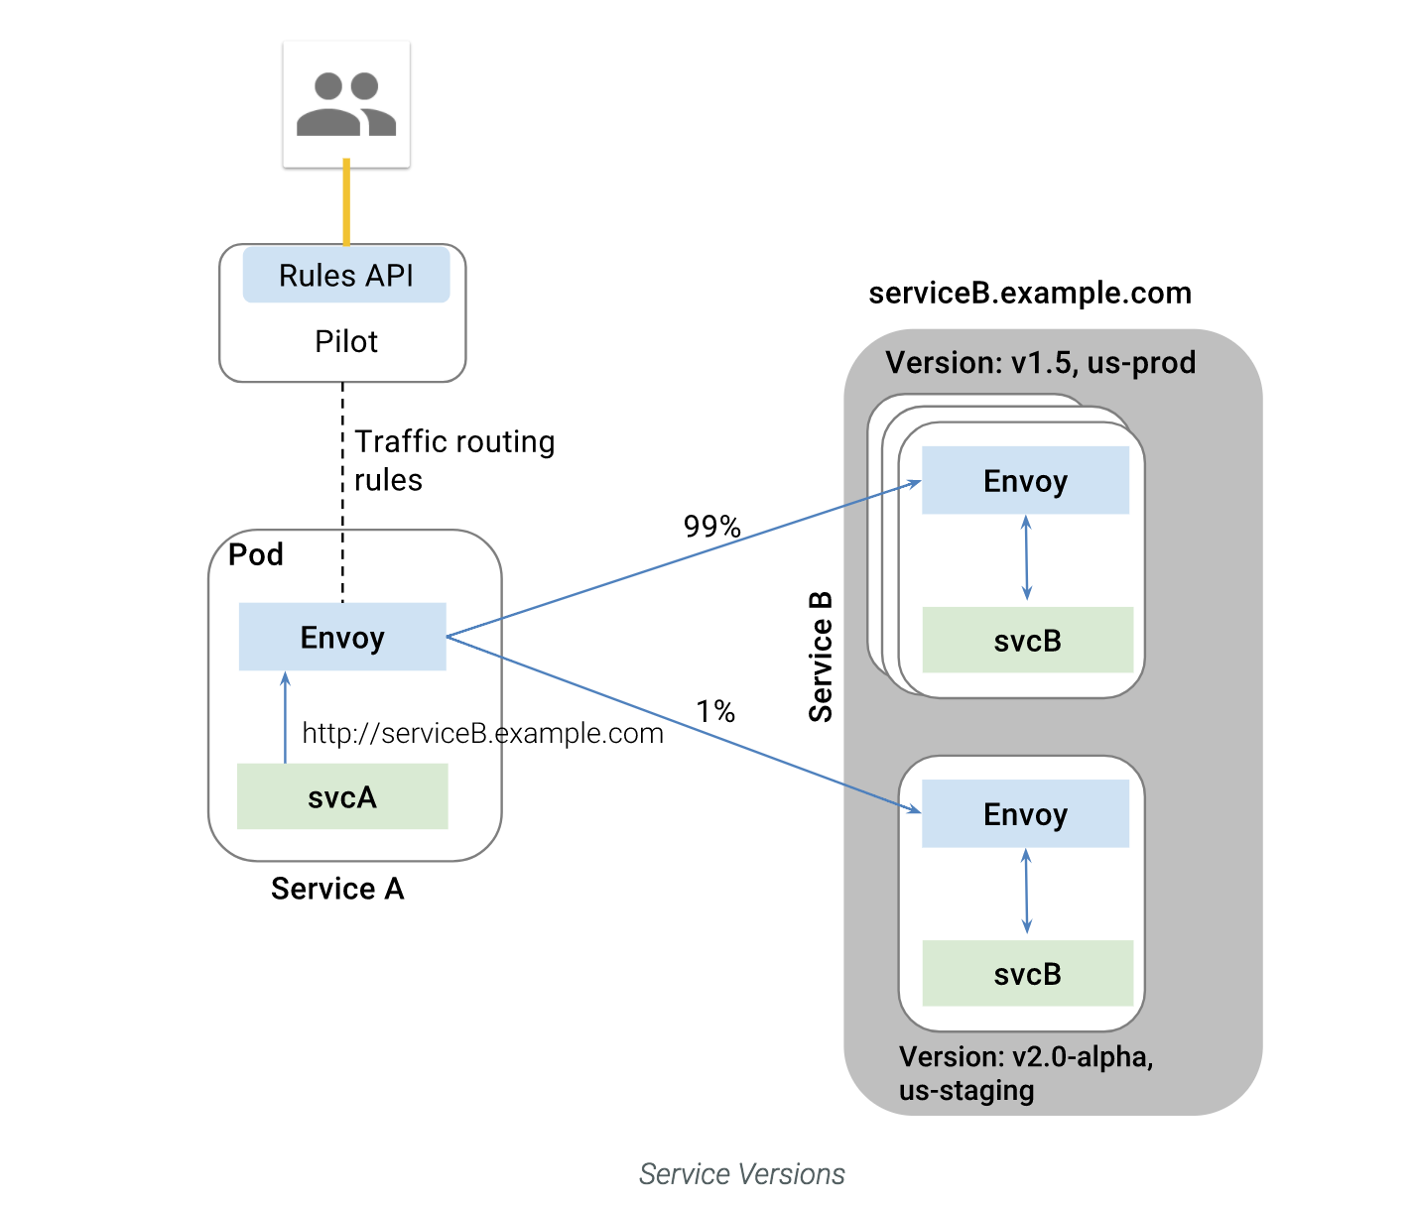
Service Mesh Implementations
Linkerd and Istio are two popular open source service mesh implementations,
Both follow a similar architecture, but different implementation mechanisms,
Linkerd (latest release) supports gRPC and HTTP/2!
  applications that speak gRPC can take full advantage of Linkerd capabilities:
  load balancing,
  service discovery,
  circuit breaking, and
  distributed tracing logic
Istio (Clover Project)
[6] Service Mesh and Related Microservice Technologies in
ONAP, Ramki Krishnan, et al. presented to ARC April 24, 2018.

Slide 35
Part II – How to migrate ONAP towards a microservices-based architecture?
Notes:
A model driven approach shifts the approach away from vendor proprietary methods (e.g., command scripting) towards modularized models based on open standards. Using models facilitates common information across different layers of the network and operations hierarchy (business management layer down to network infrastructure layer). By u sing a common set of models along with tooling, rapid development and testing can be performed. Models can be specified in different standardized languages or syntax (e.g., UML) and transformed to other languages, syntax or executable software. Modeling languages provide a common platform for specifying architecture and design with validation capabilities. Models can capture both the static/structural and dynamic/behavioural concepts of the system. UML is a general purpose modelling language to visualize (through diagrams) the design of a system. UML is the modeling language being used by the MEF for Information Modeling purposes.

Slide 36
ONAP Microservices Approaches - REF [1-2]
Three approaches are being proposed to refine Microservices Architecture:
Approach 1: Model-Driven Microservices
  Consolidates configuration and operational models in a logically central place
  Open source implementations examples – ODL, ONOS etc,
  See “DMS proposal” by Alex & Ramesh, referring to OSM implementation.
Approach 2: Modular Microservices - Leverage TMForum IG1118 Management and Control Continuum (MCC) and Future Mode of Operation (FMO) concepts
  Based on DMS proposal,
  DMS enhancements using a standardized architecture.
  Primarily focused on structuring microservices and components in a hierarchical “Lego blocks”
  These units can be mixed and matched to create management and control functions.
Approach 3: Cloud Native Microservices Design
  - Based on the Service Mesh techniques used in the cloud native world.
  - Mainly an implementation approach than a consistent microservices design methodology.
Above approaches are complementary to each other and not exclusive.

Slide 37
Approach 1: Model-Driven Microservices
Notes:
A model driven approach shifts the approach away from vendor proprietary methods (e.g., command scripting) towards modularized models based on open standards. Using models facilitates common information across different layers of the network and operations hierarchy (business management layer down to network infrastructure layer). By u sing a common set of models along with tooling, rapid development and testing can be performed. Models can be specified in different standardized languages or syntax (e.g., UML) and transformed to other languages, syntax or executable software. Modeling languages provide a common platform for specifying architecture and design with validation capabilities. Models can capture both the static/structural and dynamic/behavioural concepts of the system. UML is a general purpose modelling language to visualize (through diagrams) the design of a system. UML is the modeling language being used by the MEF for Information Modeling purposes.

Slide 38

Approach 1 - Domain-Driven Design (DDD) Concept
What’s DDD? Domain-Driven Design software modeling delivers powerful results in practice
A Top-down approach of designing Microservices
  modeling is based on the domain of business
Microservices are ideally mapped to Bounded Context
Bounded contexts own its own
  domain data,
  logic and behavior
Domain model for each Bounded Context is defined to
  identify and define the entities (and other patterns if required)
  create a boundary around things that need cohesion
  build and refine domain model contained within the boundary that defines the context

Slide 39
An Abstract View of Realizing DDD – REF [2]
Bounded context
API Endpoint Registration
ONAP Microservice
ONAP Micro Service
ONAP Microservice
ONAP Microservice
DMaaP
MSB
Pub/Sub
ONAP Microservice
Catalog
Inventory
Workflow
Policy
Common Information model
Based on Domain
Model
Distributed Data Store
Constraint
Configuration Policy
Closed Loop Policy
Specialization with alternate identities for entities – example for policy
ONAP Microservice
ONAP Microservice
ONAP Microservice
Pub/Sub
Action invocation/API End Point Registration

Slide 40
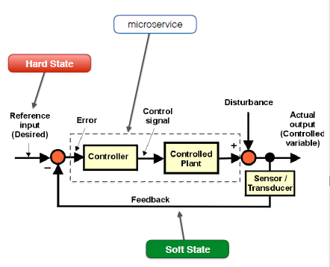
Domain Entity Pattern
Each entity represents a domain object
  primarily defined by its identity and
  attributes that comprise it
An entity’s identity can cross multiple microservices (Bounded Contexts), for example
  Policy in one microservice,
  TCA configuration in another microservice, or
  Constraint in yet another microservice.
Same entity can be modeled across multiple Bounded Contexts or microservices as different identities.
However, that does not imply that the same entity, with the same attributes and logic would be implemented in multiple Bounded Contexts.
Instead, entities in each Bounded Context limit their attributes and behaviors to those required in that Bounded Context’s domain.
Example: Control Loop Operation
Two states are defined:
  Desired state (input) and
  Actual state (output)
The desired state is asserted by writing a
topic,
The actual state is monitored/measured,
Control action is taken when the two states differ!
Reference : link

Slide 41
DDD Mapping to ONAP Microservices Architecture
ONAP’s current microservices architecture is defined per component:
Microservices are bound to components than end to end business context
  I.e., limits the domain scope to each component OR sometimes seem to refer to use cases in the context of domains.
To realize business use case it has to be disintegrated at component level and then the micoservice level.
Multiple components and associated microservices need to be augmented to support end-to-end capability.
In ONAP each component bounds the entities, domain data and associated identities.
  This creates a dependency and violates the independent development practices put forth by DDD through bounded context.
Kubernetes seems to map microservice to Service and not Pods,
  but currently each component in ONAP is mapped to Kubernetes Service with associated Pods representing docker containers fulfilling the micro functionality.

Slide 42
How does DDD Enable Model Driven Design?
Encouraged to create domain entities and bounded contexts
  quite similar to what modelling team is doing with CIM, but
  might require further identification of bounded contexts
Each bounded context has its own domain model and ubiquitous language relevant in own boundary
A context map is formed representing interaction between bounded contexts
Microservice boundaries are defined based on bounded context

Slide 43
Microservices - Key Concepts
Microservice deployment unit consisting of the core microservice software along with metafile which contains
  configuration and deployment descriptors
MUSIC is expected to be used for distributed, highly available storage for domain entities
Distributed Configuration Store for maintaining runtime configuration data of microservice
Microservice Bus (MSB) acts like an MS Endpoint Registry and API call routing GW
DMaaP or Real time data event streaming bus (based on RESP) which routes messages and file transfers across distributed microservices
OOM reads the metafile of the microservice and carries out deployment, registration.
For an extended list of the “Key Concepts” refer to REF [2]

Slide 44
Approach 1: ONAP GAP
The concepts described in this approach focus on the boundary, structure and interaction patterns of microservices
Microservices can be model-driven following the DDD principle with bounded context mapped to a microservice.
Each bounded context maintains its own domain model.
The reusability of the microservices and aggregation of microservices to/form a system or a solution with a well-defined grouping pattern is not covered well.
Requires effort in refactoring the existing microservices to define context map, domain models, etc.
Will enforce top-down modelling of microservices with alignment to domain rather than independent projects or components.

Slide 45
ONAP Microservices Architecture Gaps
ONAP microservices architecture:
Primarily an implementation approach
  Not based on microservices design principles:
    Modularity,
    Model Driven,
    Independent development concerns.
Has limited scope
  only covers microservices discovery, iteractions, etc.
Need to redefine scope/functionality/boundary of the ONAP microservices

Slide 46
Approach 2: Modular Microservices Design
Notes:
A model driven approach shifts the approach away from vendor proprietary methods (e.g., command scripting) towards modularized models based on open standards. Using models facilitates common information across different layers of the network and operations hierarchy (business management layer down to network infrastructure layer). By u sing a common set of models along with tooling, rapid development and testing can be performed. Models can be specified in different standardized languages or syntax (e.g., UML) and transformed to other languages, syntax or executable software. Modeling languages provide a common platform for specifying architecture and design with validation capabilities. Models can capture both the static/structural and dynamic/behavioural concepts of the system. UML is a general purpose modelling language to visualize (through diagrams) the design of a system. UML is the modeling language being used by the MEF for Information Modeling purposes.

Slide 47
Approach 2: Modular Microservices Design
TMForum IG1118 : Concepts
TMF defines two concepts:
  future mode of operations (FMO)
  mngmnt and control continuum (MCC).
FMO Architecture:
  E2E service delivery and operations architecture based on MCC
  leverages emerging technologies (SDN, NFV, ..)
MCC:
  Operational actions take place at all levels.
  Based on a common set of management and control functions.
  This makes separation of management and control functions obsolete.
  MCC stretches across BSS/OSS, NMS/EMS, MANO, and SDN Controllers down into physical and virtualized networks to embedded OAM, signaling, flow, policy and other network-level control functions.
Reference: TMForum IG1118 (Also referred in ETSI ZSM)

Slide 48
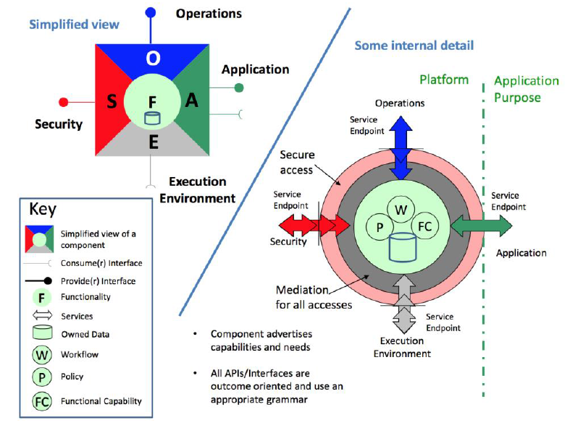
TMForum IG1118 : FMO Component (Concept)
Consumer Interface: Interface used by component to fulfil needs for tasks to be carried out related to its purpose. The tasks will include the evaluation of information and the providing of results.
Provider Interface: through which a component offers a capability to carry out specific tasks related to its purpose.
Application Function: Exposed through Application API and provides access to all the related to the primary business purpose of the component
Operations Function: Exposed through operations API and implements the support for managing the lifecycle process for the component
Security Function: Exposed through security API and and provides security features for the component
Environment Function: Accessed through the execution environment APIs and used by the component to access the infrastructure resources that it needs to support its functionality or operations.
Reference: TMForum IG1118

Slide 49
TMForum IG1118 : Concepts
MCC (Management & Control Continuum):
Focuses on lifecycle operations of services delivered using FMO architecture.
MCC component: a component whose functional behavior would traditionally be considered as management or control or anywhere in between two.
System: interconnected components interacting to collectively provide some desired behavior
SW Delivery Package: bundling of software that is provided as a single deliverable:
  Consists of multiple SW deployment units
  SW Deployment Unit: a single executable that when installed on an appropriate platform will run to produce emergent behavior that is considered as one or more FMO components
Reference: TMForum IG1118 (Also referred in ETSI ZSM)

Slide 50
Suggested Changes in ONAP
Refactoring of ONAP miroservices inline with the
  FMO, and
  MCC concepts
Refactoring of APIs across microservices in several categories:
  Security,
  Operation,
  Application and
  Environment
Alignment of microservices APIs with External API
A means for microservices to express capabilities in a catalog
  to enable appropriate assembly
  MSB capability limited to end-point registration, not capability registration
Interaction between components governed through policy
  already available through configuration Policy

Slide 51
Approach 3: Cloud Native Microservices

Slide 52
Cloud Native Microservices
Microservices designed with cloud native principles in mind
Twelve factor principles (see backup slides)
  not necessarily cloud native, but general MS principles
CNCF currently is tool-focused that work with
  COEs and dockerized containers
  ONAP already uses some of these toolsets (+)
What is missing?
  A framework integrating these toolsets for implementing MS
  No CNCF modelling tools for MS other than what COE provides
Helm Charts: simplifies packaging/deployment of apps on K8S
gRPC/gNMI/etc: more efficient than REST APIs
  ONAP may start using this for microservices communications

Slide 53
ONAP Migration towards a Cloud-Native Architecture
ONAP microservices are not designed to be cloud-native.
Important design considerations:
  Leverage the cloud characteristics like scaling, healing and migration (handling lifecycle management operations)
  Version and Update handling without impacting the functionality
  Always On Availability
  Portable across cloud infrastructure
  Inbuilt state management, consistency checking mechanisms
  Inbuilt health check mechanisms
  Inbuilt fault tolerance mechanisms
  Fault isolation capability
  Tracing of flows across microservices

Slide 54
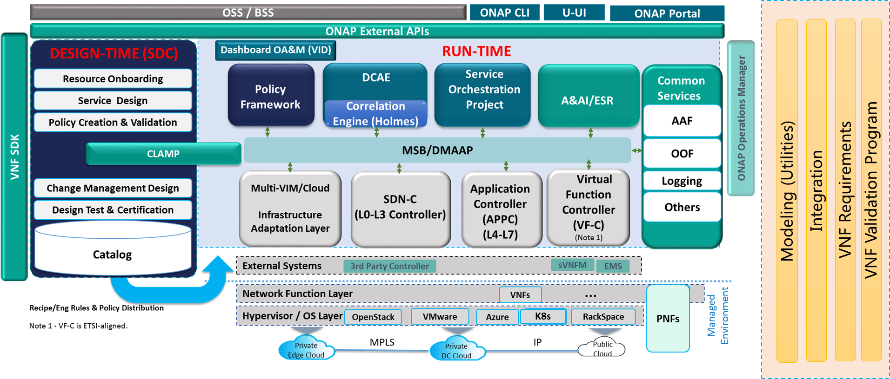
How to Leverage Cloud Native Tools in ONAP?
(Reference CNCF, IETF)
Under Review
Service Mesh: Linkerd, Envoy
MS interaction : gRPC
gNMI/gRPC/ProtoBuf as enhancement for VES Collector
Prometheus for MS/VNF telemetry collection , monitoring
TUF for Secure SW update
Notary
Fluentd, Jaeger, OpenTracing
Rook for Cloud native distributed storage , which can be leveraged in MUSIC
Open Policy Agent
gNMI/gRPC, QUIC for NE/VNF Management

Slide 55
How Cloud Native is ONAP ?
Under Review
Not all Microservices in ONAP are designed with an objective to be cloud-native. Some important characteristics that should be considered are
  Leverage the cloud characteristics like scaling, healing and migration (handling lifecycle management operations) (Some components supports this – e.g. DCAE)
  Version and Update/Upgrade handling without impacting the functionality (?)
  Portable across cloud infrastructure (No dependency on Cloud Infrastructure – Intel vs AMD, AWS vs OS vs GC vs Azure vs VMWare vs COE)
  Inbuilt state management , consistency checking mechanisms (Project specific, How each project mitigates CAP)
  Inbuilt health check mechanisms (Supported by OOM ? )
  In built fault tolerance mechanisms (Supported by OOM ?)
  Fault isolation capability (OOM/MSB?)
  Secure interactions – internal /external (aaf?)
  Tracing of flows across microservices (Planned to be supported by Logging?)
Not all microservices endpoints plugged into MSB
Each project use own model of state management and consistency mechanism across distributed instances of MS
Scaling/Healing and Migration of Microservices are not consistent and in the early stages.
No consistent deployment mechanism - mix of blueprint, heat templates, helm charts, docker files for microservice onboarding
No consistent configuration formats – Consul , YAML templates, Helm, XML, JSON, HOT
Version Portability (Amsterdam to Beijing)? Lossless Software Update?

Slide 56
CNCF Projects Maturity Levels (Subjective Assessment) 1/2
Under Review
Project | Relevant application in ONAP | Maturity level | Backing companies | Recommended ?
Kubernetes (COE) | OOM, DCAE | High | Google + many others | Yes . But troubleshooting, monitoring, deployment seem to be complex.
Prometheus (Monitoring) | DCAE, OOM | Medium? | Robust Perceptions, Container Solutions , Independent Contractors | Can be used for container monitoring at least for time being. Roadmap is not clear.
Fluentd (Log data collector) , Jaeger (Distributed trace analysis), OpenTracing (Distributed trace collector) | Logging | Medium (currently at 1.0 Release) | Jaeger from Uber, Opentracing – Lightstep. Github contributors – Fluentd, Jaeger | Distributed tracing using Jaeger or OpenTracing might be useful for ONAP. (Requires instrumentation in code)
Envoy (edge proxy, Service Mesh Data plane) | MSB , ONAP Projects, OOM , AAF | High | Strong contributor base, originally built by Lyft | Microservice proxy might be relevant while adapting service mesh. But need to debate if service mesh is good enough for ONAP. Istio Service Mesh (Control Plane) works well with envoy.
Linkerd (Edge proxy, Service Mesh Data Plane) | MSB, ONAP Projects, OOM , AAF | High | Healthy contribution base, Buoyant | As per comparison provided Linkerd seems to be feature rich , but consumes more CPU and memory compared to Envoy. Supports HTTP/1.1, Thrift, ThriftMux, HTTP/2 (experimental) and gRPC (experimental). MSB team to comment suitability of Linkerd.
Istio – Service Mesh (control plane) | MSB, OOM ? | High | Google, IBM, Lyft | Preferred if there is a plan to adapt Service Mesh in ONAP. How this will be integrated ? As a separate project ? As part of MSB/OOM ?
Notes:
Service Mesh DP :
Service discovery: What are all of the upstream/backend service instances that are available
Health checking: Are the upstream service instances returned by service discovery healthy and ready to accept network traffic?
Routing: Given a REST request for /foo from the local service instance, to which upstream service cluster should the request be sent?
Load balancing: Once an upstream service cluster has been selected during routing, to which upstream service instance should the request be sent? With what timeout? With what circuit breaking settings?
Authentication and authorization: For incoming requests, can the caller be cryptographically attested using mTLS or some other mechanism?
Observability: For each request, detailed statistics, logging, and distributed tracing data should be generated so that operators can understand distributed traffic flow and debug problems as they occur.
Service Mesh CP:
Workload scheduler: Services are run on an infrastructure via some type of scheduling system (e.g., Kubernetes or Nomad). The scheduler is responsible for bootstrapping a service along with its sidecar proxy.
Service discovery: As the scheduler starts and stops service instances it reports liveness state into a service discovery system.
Sidecar proxy configuration APIs: The sidecar proxies dynamically fetch state from various system components in an eventually consistent way without operator involvement. The entire system composed of all currently running service instances and sidecar proxies eventually converge.

Slide 57
CNCF Projects Maturity Levels (Subjective Assessment) 2/2
Under Review
Project | Relevant application in ONAP | Maturity level | Backing companies | Recommended ?
Notary (secure content sharing) , TUF (secure software update spec) | AAF (Not sure), VNF SDK, OOM (software update – to be confirmed), SDC Package manager (to be confirmed) | Low ( Not yet in a major release) | Healthy contributor base (60+) | AAF team or Security subcommittee to comment . Might be relevant for software upgrade, image upload, Marketplace, VNF SDK (all external facing)
Vitess (Clustering of MySQL, Sharding) | Many projects – that use MySQL or MariaDB | Medium | Healthy contributor base (100+) | Project teams to comment. May be relevant for distributed deployment of ONAP components, Scalability enhancements etc.
Rook (Cloud native distributed persistent store) | MUSIC, Other projects that require distributed persistent store | Low (Not yet in major Release) | No known companies . Good contributor base (70) | Not recommended. Low maturity and no known deployment.
SPIFFE (Spec) SPIRE (Implementation) – Service Identity Mgmnt | MSB,AAF (Service Identity Management) | Low | Scytale , Istio | No. Similar capabilities in MSB and AAF. But low maturity level. Istio- Auth seems to incorporate this. AAF and MSB to comment.
Open Policy Agent | Policy, MSB | Low | No known companies | No. This is primarily meant for controlling the MS behavior through policy with a daemon deployed along side the service. Not recommended immediately due to maturity issues. Based on maturity can be considered to position this as a PDP per component (Policy team to confirm)
NATS (NAT Server) - Messaging, Publish/Subscribe, Request Reply, Queuing | MSB | Medium | Healthy contributor base – used by Ericsson, HTC, Siemens, VMWare | Require evaluation. Similar capabilities like MSB. Supports different types of communication models. Uses a proprietary messaging format (gnatd) which is claimed to be efficient. May be useful if we want to unify communication models under single project (but will require lot of refactoring)
Core DNS (DNS functionality, Service discovery) | MSB , DNS VM | Medium | Healthy contributor base (80+). Used by Sound Cloud, MIT | Require evaluation. Already part of K8S v 1.9 onwards. Need to see if the scope is limited to K8S cluster and containers.
Notes:
With Notary, publishers can sign their content offline using keys kept highly secure. Once the publisher is ready to make the content available, they can push their signed trusted collection to a Notary Server.
Consumers, having acquired the publisher's public key through a secure channel, can then communicate with any Notary server or (insecure) mirror, relying only on the publisher's key to determine the validity and integrity of the received content.
The Open Policy Agent (OPA) is an open source, general-purpose policy engine that enables unified, context-aware policy enforcement across the entire stack. OPA using an interactive shell or REPL (read-eval-print loop).
Running OPA as an interactive shell/REPL.
Writing ad-hoc queries in Rego.
Unless you embed OPA as a Go library, you will deploy it alongside your service – either directly as an operating system daemon or inside a container. In this way, transactions will have low latency and availability will be determined through shared fate with your service.
OPA’s RESTful APIs use JSON over HTTP so you and your users can integrate OPA with any programming language. At a high level, integrating OPA into your service involves:
Deploying OPA alongside your service
Pushing relevant data about your service’s state into OPA’s document store
Offloading some or all decision-making to OPA by querying

Slide 58
gRPC/gNMI/gNOI Views
Under Review
Characteristic | gNOI | gNMI | gRPC
What is the focus | gRPC based operational interfaces to network devices | gRPC based protocol for modification and retrieval of configuration from target device | Generic RPC mechanism
What is available ? | Microservices which can be reused for enabling the interface | Client library implementing network management interface | Many implementations in different languages
Who is driving ? | Open Config | Open Config | Driven by CNCF
Contributors ? | Limited | Limited | Many
Where is it relevant in ONAP | SDNC, App-C, VF-C, DCAE (all SBI) | SDNC, DCAE, App-C, VF-C (all SBI) | Between MS , ONAP and external systems
Dependency | gRPC, protobuf | gRPC, protobuf | gRPC Stub/Service implementation , protobuf. HTTP/2
Why it is relevant ? | gRPC based, efficient communication, ready to use operational protobuf specs | gRPC based, efficient communication, ready to use operational protobuf specs | Bidirectional, Asynchronous, Can be used for notifications or RPCs, low latency, can support many communication patterns , Can also support REST HTTP1.1 (proxy) . Very low dev overhead.
Recommended for ONAP ? | Need to check how many VNF vendors support this. May not be immediately. SDOs do not seem to endorse this yet | Need to check how many VNF vendors support this. May not be immediately. SDOs do not seem to endorse this. yet | May be some wrapper rather than exposing gRPC directly to MS ? (Service Mesh ?)
All options above may require Kubernetes

Slide 59
gRPC vs REST
Under Review
Characteristic | gRPC | REST
Performance | Impressive | Relatively slow
Development overhead | Low (Stubs can be auto generated) | High
Limitation | Version management, Compatibility, Requirement for retooling , Stub/Service Management | Processing overhead
Compelling capabilities | Low development overhead, performance, communication patterns | Wide adoption, tool sets, Developer familiarity
Where it best fits | Internal ONAP MS communication | ONAP External communication

Slide 60
Conclusions
All three approaches bring in significant practical values.
Among the three approaches, Approach 2 seems to be more favorable considering the ease of adoption and the modularity that can be achieved
  Approach 1 might require a major revamp across projects - the way Model states are maintained, propagated and acted upon.
    so this approach may be considered for long-term.
  Approach 2 might be favorable from a component level
    standard API and
    model alignment point of view as flexible proxy components can be supported
    this approach can also leverage some of the concept of domain context pattern described in approach 1
  Approach 3 is more of an implementation approach with focus on discovery and interaction of the microservices.
    Microservices still need to be structured well, consistent and follow cloud-native principles to leverage benefit of this approach.

Slide 61
Recommendations for Casablanca and Beyond

Slide 62
Design Guidelines for Microservices
Bounded Context
Single Responsibility Principle (very important)
    Having a limited and a focused business scope for a microservice greatly helps meet the agility in development and delivery of services.
  During the designing phase of the microservices, we should find their boundaries and align them with the business capabilities aka bounded context in Domain-Driven-Design (DDD).
Microservices design must ensure the agile/independent development and deployment of the service.
Need to focus on the scope of the microservice, but not about making the service smaller
  The size of the service is chosen to facilitate the target business capability.
Unlike service in SOA, a given microservice should have a very few operations/functionalities and simple message format.
It is often a good practice to start with relatively broad service boundaries to begin with, refactoring to smaller ones (based on business requirements) as time goes on.
REF: https://medium.com/microservices-in-practice/microservices-in-practice-7a3e85b6624c

Slide 63
Recommendations for Casablanca and Beyond
ONAP Architecture Transformation
Iterative application refactoring according to the 12-factor principles towards a cloud-native microservices pattern
Incremental decoupling of the monolith into a microservices-based application whenever a more profound transformation of the customer’s development lifecycle is required
The transformation process will take multiple releases to complete.

Slide 64
Recommendations for Casablanca (Not Decided Yet)
Right mapping of Microservice – Pod? Service? Docker? API Endpoint? Component? Project? (or TMF IG1118 based Component System pattern)
Model Driven Microservice: (can be for long term based on community view)
  Central model repository referenced by all components
  Common library of model-based classes used by components
  Anything else ?
Modularity of Microservice (can be for long term based on community view)
  API Refactoring – consistency in representation of APIs across microservices and components.
  Policy tailoring all interaction between microservices/components.
Communication between Microservice
  Service Mesh or gRPC, RESP, DMaaP or REST?
Testability of ONAP components based on Cloud Native-Principles (enhance S3P)
Define guidelines for creating cloud-native microservices
Microservices Meta Modelling through SDC? (to ensure consistency)

Slide 65
Recommendations for Future Releases (Not Decided Yet)
Best practices incorporated from Approach 1 and/or Approach 2
How does microservices architecture support the following?
  Different deployment models – Brown field, Green field
  Different Integration models – point-to-point , geo-distributed
  Different testing models – unit testing, integration testing, CI/CD
How are the following requirements supported?
  In-service software update (SP3+)
  ONAP release upgrade (Versioning?)
  Model/Policy/Workflow tuning
  Troubleshooting – Remote, Local, ONAP-specific OAM KPIs

Slide 66
Service Mesh – Architectural Recommendation - REF [6]
Service Mesh Component Implementation Recommendation (Metrics: maturity, ease of use)
  Service Mesh Control Plane - Istio - Foundational
  Service Mesh Data Plane - Envoy - Foundational
  Tracing - Zipkin/Jaeger addon - Istio Integration
  Service Assurance - Prometheus addon - Istio Integration
  Metric Visualization - Grafana addon - Istio/Prometheus Integration
  Service Graph - Servicegraph addon - Istio/Prometheus Integration
Related Component Implementation Recommendation
  Logging Collector - Fluentd daemon - Fluentd K8S Integration
  REF [6]: Service Mesh and Related Microservice Technologies in ONAP, Ramki Krishnan, et al. presented to ARC April 24, 2018.

Slide 67
Service Mesh – Mapping to ONAP S3P - REF [6]
Under Review
Cloud-native Feature set | Service Mesh Data Plane for K8S | Service Mesh Control Plane for K8S | ONAP S3P Mapping
Resiliency (timeouts, circuit breakers, etc.) – (F) in FCAPS | Envoy, Linkerd … | Istio Pilot, Conduit … | Resiliency Level 2 – single site automated recovery
Troubleshooting/Tracing – (F) in FCAPS | Envoy, Linkerd … | Istio integrated with Zipkin/Jaeger, Conduit … | Manageability Level 2 – tracing across components
Fine-grained routing/load-balancing across multiple SW versions – (C) in FCAPS | Envoy, Linkerd … | Istio Pilot, Conduit … | Manageability Level 2 – single component upgrade; Live upgrade (ONAP S3P+) Scalability Level 1 – single site horizontal scaling
Visibility/Telemetry – (A) (P) in FCAPS | Envoy, Linkerd … | Istio Mixer with Prometheus/Grafana, Conduit … | Performance Level 2 & 3 Manageability Level 2 – single logging system
Hop-by-hop security – (S) in FCAPS | Envoy, Linkerd … | Istio Auth, Conduit … | Security Level 2 -- internal communication encrypted

Slide 68
Service Mesh – ONAP Architectural Recommendation – REF [6]
Casablanca - Service Mesh & Related Technologies for at least some ONAP Components on K8S
  ONAP Project Impact & Value Proposition
    MSB
      Istio integration (automatic sidecar injection etc.) discussion in progress
    AAF
      Leverage Envoy and Istio Auth as a holistic alternative to the current implementation of secure communication between microservices
    OOM
      Leverage Istio etc. for reusable DBaaS components, e.g. MariaDB Galera
    Logging
      Leverage Fluentd K8S integration
    Integration
      Leverage Istio etc. Live Upgrade capability for key ONAP components
Casablanca+ - Service Mesh & Related Technologies for all ONAP Components on K8S
  Expand on Casablanca work - TBD
Service Mesh for ONAP Containerized Workloads (VNFs etc.)
  Leverage Clover project (per REF [6])

Slide 69
Backup Slides
Notes:
A model driven approach shifts the approach away from vendor proprietary methods (e.g., command scripting) towards modularized models based on open standards. Using models facilitates common information across different layers of the network and operations hierarchy (business management layer down to network infrastructure layer). By u sing a common set of models along with tooling, rapid development and testing can be performed. Models can be specified in different standardized languages or syntax (e.g., UML) and transformed to other languages, syntax or executable software. Modeling languages provide a common platform for specifying architecture and design with validation capabilities. Models can capture both the static/structural and dynamic/behavioural concepts of the system. UML is a general purpose modelling language to visualize (through diagrams) the design of a system. UML is the modeling language being used by the MEF for Information Modeling purposes.

Slide 70
Cloud Native: The Twelve Factors
Notes:
A model driven approach shifts the approach away from vendor proprietary methods (e.g., command scripting) towards modularized models based on open standards. Using models facilitates common information across different layers of the network and operations hierarchy (business management layer down to network infrastructure layer). By u sing a common set of models along with tooling, rapid development and testing can be performed. Models can be specified in different standardized languages or syntax (e.g., UML) and transformed to other languages, syntax or executable software. Modeling languages provide a common platform for specifying architecture and design with validation capabilities. Models can capture both the static/structural and dynamic/behavioural concepts of the system. UML is a general purpose modelling language to visualize (through diagrams) the design of a system. UML is the modeling language being used by the MEF for Information Modeling purposes.

Slide 71
Cloud Native: The Twelve Factors
I. Codebase
One codebase tracked in revision control, many deploys
II. Dependencies
Explicitly declare and isolate dependencies
III. Config
Store config in the environment
IV. Backing services
Treat backing services as attached resources
V. Build, release, run
Strictly separate build and run stages
VI. Processes
Execute the app as one or more stateless processes
VII. Port binding
Export services via port binding
VIII. Concurrency
Scale out via the process model
IX. Disposability
Maximize robustness with fast startup and graceful shutdown, enabling the underlying platform to automatically recover from failure events very quickly
X. Dev/prod parity
Keep development, staging, and production as similar as possible - enables cloud platforms to provide rich visibility into all aspects of the application’s runtime fabric
XI. Logs
Treat logs as event streams which greatly enables visibility into the underlying behavior of the applications at runtime
XII. Admin processes
Run admin/management tasks as one-off processes

Slide 72
Cloud Native Application Patterns
Application patterns enable us to optimize for speed and scale (scale up/down) in a very simple and elastic manner.
Codebase
Each deployable app is tracked as one codebase tracked in revision control. It may have many deployed instances across multiple environments.
Dependencies
An app explicitly declares and isolates dependencies via appropriate tooling (e.g., Maven, Bundler, NPM) rather than depending on implicitly realized dependencies in its deployment environment.
Config
Configuration, or anything that is likely to differ between deployment environments (e.g., development, staging, production) is injected via operating system-level environment variables.
Backing services
Backing services, such as databases or message brokers, are treated as attached resources and consumed identically across all environments.
Build, release, run
The stages of building a deployable app artifact, combining than artifact with configuration, and starting one or more processes from that artifact/configuration combination, are strictly separated.
Processes
The app executes as one or more stateless processes (e.g., master/ workers) that share nothing. Any necessary state is externalized to backing services (cache, object store, etc.).

Slide 73
Cloud Native Application Patterns
Port binding
The app is self-contained and exports any/all services via port binding (including HTTP).
Concurrency
Concurrency is usually accomplished by scaling out app processes horizontally (though processes may also multiplex work via internally managed threads if desired).
Disposability
Robustness is maximized via processes that start up quickly and shut down gracefully. These aspects allow for rapid elastic scaling, deployment of changes, and recovery from crashes.
Dev/prod parity
Continuous delivery and deployment are enabled by keeping development, staging, and production environments as similar as possible.
Logs
Rather than managing log files, treat logs as event streams, allowing the execution environment to collect, aggregate, index, and analyze the events via centralized services.
Admin processes
Administrative or managements tasks, such as database migrations, are executed as one-off processes in environments identical to the app’s long-running processes.

