Slide 1
ONAP Integration Through Information and Data Modeling
24 OCT 2017
Andy Mayer, Ph.D.
Arun Gupta
Kevin Scaggs

Slide 2
ONAP Information Integration GOAL
We need a cohesive way to have a shared view of information across ONAP (and likely third party clouds) that can be used for or be input into a model driven process whereby the cost of delivering platform functionality is drastically reduced and the time to delivery is dramatically decreased.

Slide 3
ONAP Information Integration Challenges
Currently there are a number of information and data modeling efforts of varying similarity covering overlapping problem spaces
These models often apply different names for the same concept or the same name for different concepts
The modeling patterns differ. E.g., some are inheritance based, others are composition based, etc.

Slide 4
So…. What’s an Information Model?
Information Models define managed objects at a conceptual level, independent of any specific implementations or protocols used to transport the data
A semantically meaningful representation of concepts (classes of entities)
Described in an implementation independent manner
Class characteristics (attributes)
Relationships among classes
Operations (actions) performed on classes by actors
Useful to describe the managed environment, and as a guide to the information and behavior that will be described and coded in the Data Models.
May be represented in Unified Modeling Language (UML)

Slide 5
Benefits of Information Modeling
Common Terminology and Definitions: The Information Model captures common terms, semantics, and definitions for shared information.
Stewardship of Information: Identifies the domain of information to be managed and controlled by a stewarding system and the contexts associated with each;
Management of Information Integrity and Redundancy: Identify where information is produced and made available. An Integrated Information Strategy should identify the processes for maintaining the integrity of Information;
Interface / Microservice Characterization: Integrated Information Model will be used to describe and characterize interfaces / microservices and separations of concern;
Consistent Methodology, Tools, and Processes: Define and establish the methodology, processes, and supporting tools;

Slide 6
Information Model Guiding Principles
Abstractions and Constructs: described in terms of information categories and high level information classes including properties (e.g., attributes, states, associations, etc.)
Focus on Shared Information that is exchanged among the interoperable components within ONAP and with external actors.
Document properties behavior and semantics in Integrated Information Model
Define a common platform independent representation of shared information, while providing the means to extend the model in a semantically rich fashion
Ensure that ONAP functionality and information is developed in a logically consistent fashion, allowing rapid integration
Enablement of Model Driven Architecture and Design

Slide 7
What about Data Models?
Data Models define managed objects at a lower level of abstraction than Information Models. Data Models include implementation and may include protocol specific details.
A Data Model formally describes the structure and the semantics of all the data that are (a) stored in data management systems, and/or (b) accessed and manipulated by data-centric applications across APIs.
The information exchanged across an API is described within a data model that is specified in a data modeling language, for example YANG or YAML
An API also defines the encoding format that is used to encode data into a representation and format that can be exchanged across the interface according to the structure described by the data model, and the protocol that is used to carry the encoded interface data (e.g. NETCONF, RESTCONF or REST/HTTP).

Slide 8



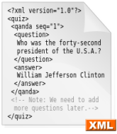

IISOMI
(Informal Inter-SDO Open Model Initiative)
UML to DS Mapping
Guidelines
IISOMI 531: UML
to YANG Mapping Guidelines
multi
SDO
IISOMI 515:
Papyrus Guidelines
IISOMI 514: UML
Modeling Guidelines
Pruning/Re-factoring
Process Guidelines
UML
|
YANG
UML
|
XML
Guidelines
UML
|
JSON
guide
guide
guide
UML
|
TOSCA
guide
Common Information Model
pruning
re-factoring
a
mapping
b
YANG
xx
pruning
re-factoring
mapping
Technology
specific
c
UML Models
xx
TR-512: Core Network (Forwarding, Topology, Termination, Foundation, …)
…
pruning
re-factoring
mapping
App
specific
z
TOSCA
xx
Core Fragment
Specific
Fragments
Purpose-specific
IMs
Interface-specific
Data Schemas
Interface-specific
Encodings
guide
guide
guide
guide
guide
guide
guide
Tooling
TR-513: Common Information Model Overview
(structure, development process)

Slide 9
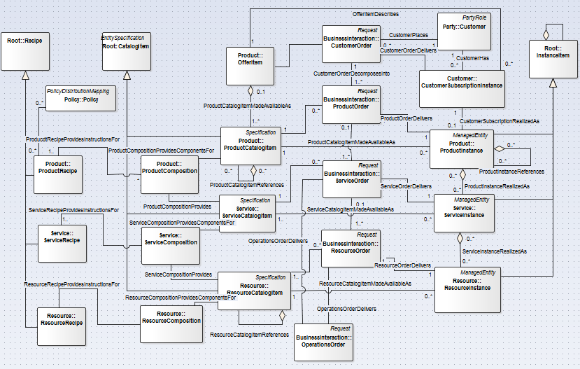
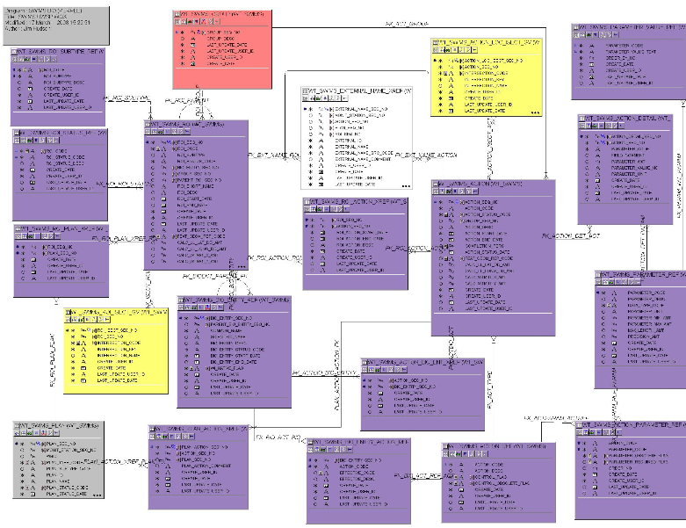
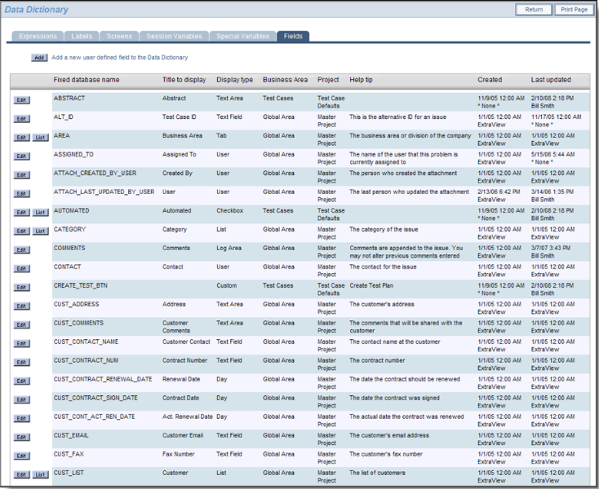
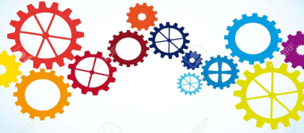
The ONAP Pieces
ONAP Common
Information Model
ONAP Purpose-
Specific Information Model
ONAP Data Models
ONAP Component Design & Development

Slide 10
Information Domains in ONAP
Governance/Processes
Policy/Rule/Constraints, SLA/OLA Definition,
Asset/Capacity Management, Configuration/Change/Incident Management, Catalog Management
Service Design
Network function on-boarding
Service definition, including Service blueprints
Service Access
User/Tenant Management, Identity Management, RBAC
Entitlement Control
Services
Policy/Rule/Constraints, SLA/OLA Definition
Asset/Capacity Management, Configuration/Change/Incident Management
Services Components
Decomposition/Instantiation/Assurance/Remediation
Service Level Optimization, QoS Optimization, Policy Enforcement,
Logical Infrastructure
Resource Matchmaking/Optimization
Resource Reservations/Allocations, Installation/Configuration
Real Infrastructure
Provider Registration, Infrastructure Discovery/Monitoring
Capacity Optimization
External APIs
Service
Design
Micro-service Bus /Integration Backplane
Service Access
Services
(What’s offered; Catalog)
Governance/Processes
Service Components
(Service Function Chaining; Network Functions)
“Logical” Infrastructure
(VNFs; VNF Forwarding Graphs)
“Real” Infrastructure
(Physical/Virtual/Cloud – On/Off-Premise)

Slide 11
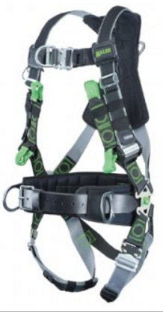
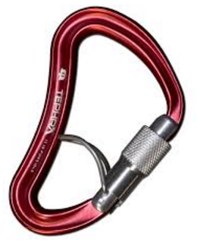
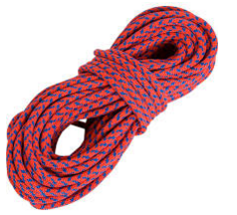

General Methodology
Identify Information Constructs from an ONAP wide perspective using Use Case interactions, data models, accepted Standards, and interface definitions as input.
Continuous Integration with appropriate standards and relevant ONAP efforts related to architecture, data modeling, interfaces, and micro-services
Use UML tools (e.g., Eclipse Papyrus) to capture living ONAP Common Information Model and Use Cases
Revise Common Information Model by adding additional details as they are discovered
Identify main consumers and producers / stewards of the Shared Information from a functional standpoint
Share and gather feedback of model content with key project stakeholders
Apply model when designing and developing data models for APIs and microservices

Slide 12
Proposed ONAP Information Model Topics Timeline
Draft Release, October 31, 2017:
Network Updates: Connection Points; Virtual Link Descriptors; VNF Forwarding Graph Descriptor
VNF Descriptor Model (w/ initial Deployment Flavors)
Initial Service Descriptor / Service Component
Draft Release, Mid-December, 2017:
Multi-VIM
Element Scaling & Homing
Refinement of Deployment Flavors
Service Descriptor Refinement
VNF Descriptor Refinement (e.g., Extensions, Event Descriptors, Healthcheck, etc.)
License Descriptor and Usage
Virtual Resource Elements
Service and Resource State (initial)
Service and Resource Lifecycle Management
2018 Backlog:
Service Path as a Service
Policy Model
Assurance (including control loop management)
Address Space Management

