Slide 1
Centralize Image Management for ONAP
2017-11-20

Slide 2
Overview
Project Name: Image Manager
Project Description
Image Manager provide a reliable, visualized and logically centralized image management for ONAP at both design time and run time, including VM images, docker images and application binaries. With image manager, system users can upload images to the target VIM from uniform server instead of private repositories. The system security will be improved by checking the VVP/VNF-SDK validation result before the images uesed in ONAP. ONAP operators can also read the image details easily, such as the provider/version/status/deploy-location, etc.

Slide 3
Image Manager to Address Carrier Grade Requirements
- Manageability/Usability:
Onap modules can not get the image information at both the design time and run time due to lack of logically centralied image management. Image Manager address this by Store/Manage image metadata information and provide APIs for the other modules and portal for ONAP operators.
- Performance:
Images usually are big file, the efficiency of upload/download should be considered. Image Manager address this by provide centrolized management for VM/docker images and application binaries across design time and run time.
- Security:
In current solution, images are uploaded to VIM manually without validation. Image Manager can ensure that the VVP/VNF-SDK validation result by checking the signing/certification along with the images before uploading images to ONAP.

Slide 4
Scope
Provide centrolize management for VM/docker images and application binaries across design time and run time.
Provide image management portal to manage images, including image query/upload/download/delete/update.
Provide image information management.
Check image signing & attestation when upload images.

Slide 5
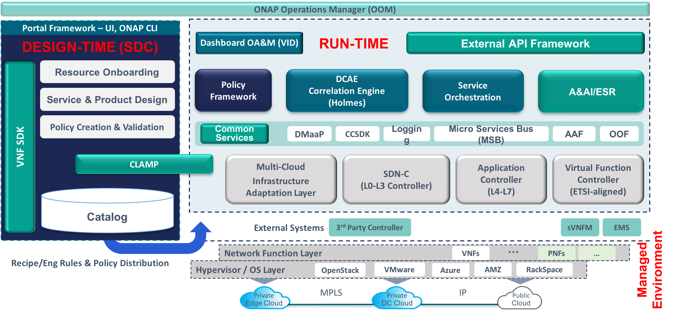
Architecture Alignment
IM

Slide 6
Image Manager Interface to other Module
- User upload images with Image Manager after signing & attestation with VNF-SDK/VVP.
- SDC upload image to Image Manager when import a VNF package and image.
- SDC query image information to design VNF.
- SO/VFC/VNFM query image deploy location information.
- SO/VFC/VNFM notify Image Manager the image deployed information.
VNF-SDK/VVP
SDC
SO/VFC/VNFM
upload image
query image info
image
query image info
image onboarding notification
Image Manager
DB
(metadata)
portal
Image storage backend: Multi-VIM to store VM/docker images and app binaries
Metadata DB：uuid, name, description, format, version, vendor, deploy location, etc.
Multi-VIM (image service)
VM/docker images, app binaries
Design Time
Run Time

Slide 7
Image Upload at Design Time
Multi-VIM
VNF-SDK/VVP
SDC
Img Manager
(Image Repository)
VNF Package and Image
Image validation
(integrity and security)
1 Certificate images with VNF-SDK/VVP before images used in ONAP
certification with signature
Issue a certification
VNF Package and image with certification
upload image
Check the certification issued by VVP/VNF-SDK
save images to repository
2.1 Scenario 1: Import Vendor VNF package
Save image metadata
Image Address
Update image reference in the VNF model and save it to SDC Catalog
upload image
Check the certification issued by VVP/VNF-SDK
2.2 Scenario 2: Design VNF in SDC
save images to repository
VNF design
query image information to design VNF

Slide 8
Image Upload at Design Time(Updated according to the discussion)
Multi-VIM
VVP
SDC
Img Manager
(Image Repository)
Vendor VNF Package and image
VNF package and Image validation
upload image
save images to repository
Save image metadata
Image Address
Update image reference in the VNF model and save it to SDC Catalog

Slide 9
Download Image at Run Time
UUI
SO/VFC
Img Manager
Multi-VIM
User request
VNF package onboarding/instantiation
Query image deployment information
Image URL(If the image not been deployed to the target VIM)
image dispather from Image Repository to target VIM
Image uploading notification
Update the image-VIM onboarding relationship

Slide 10
Key Facts
Project name: Image Manager
  Jira project name:
  Jira project prefix:
Repo name:
Lifecycle state:Proposal
Primary contact: li.zi30@zte.com.cn
Project lead:
Mailing list tag:
Committers:
  TBA

Slide 11
Thank you !

