Slide 1
ONAP SDC VoLTE Model Support
Huabing Zhao

Slide 2
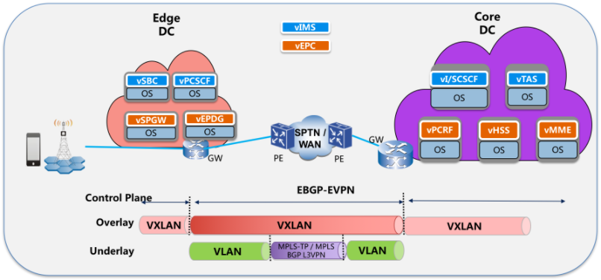
VoLTE Service Model
VoLTE Service
vIMS NS
vEPC NS
VNF1
VNF2
VNFN
VNF1
VNF2
VNFN
layering modeling: VNF->NS->Service
Using TOSCA NFV as Model language
Cross two Data Centers: edge DC and core DC

Slide 3

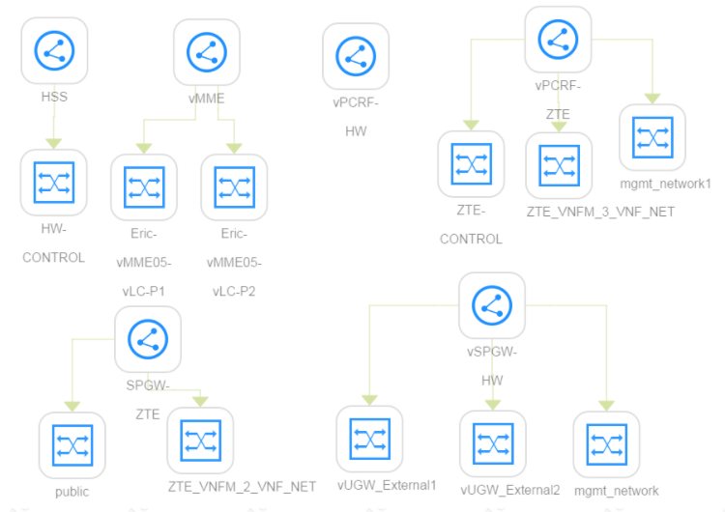
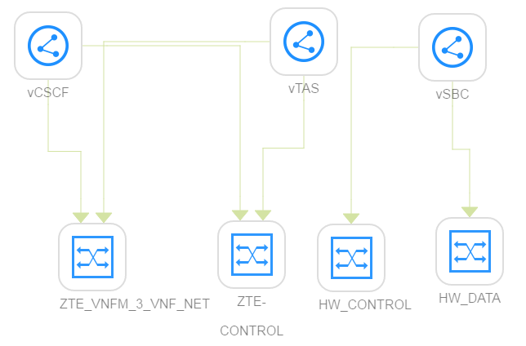
VoLTE Service Topology
This is designed in Model Designer and distributed to Orchestrator as there CSAR packages: VoLTE.csar, vIMS.csar and vEPC.csar
tosca.nodes.nfv.NS.vEPC_NS
tosca.nodes.nfv.NS.vIMS_NS
Substitution mapping

Slide 4
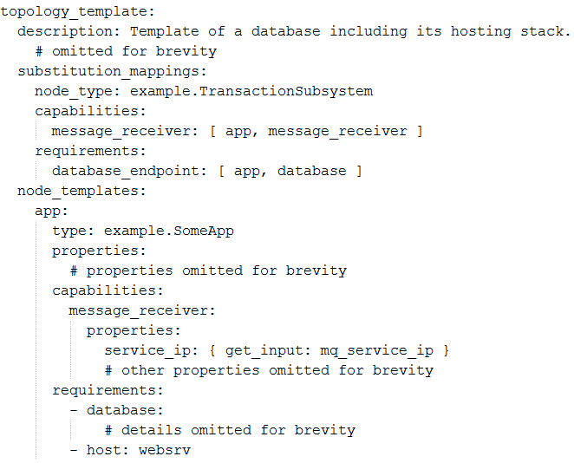
Substitution Definition in TOSCA
An optional declaration that exports the topology template as an implementation of a Node type.
This also includes the mappings between the external Node Types named capabilities and requirements to existing implementations of those capabilities and requirements on Node templates declared within the topology template."
But I can't find the corresponding node template for the defined capabilities and requirements in the substitution_mappings part of the TOSCA template designed by SDC.

Slide 5
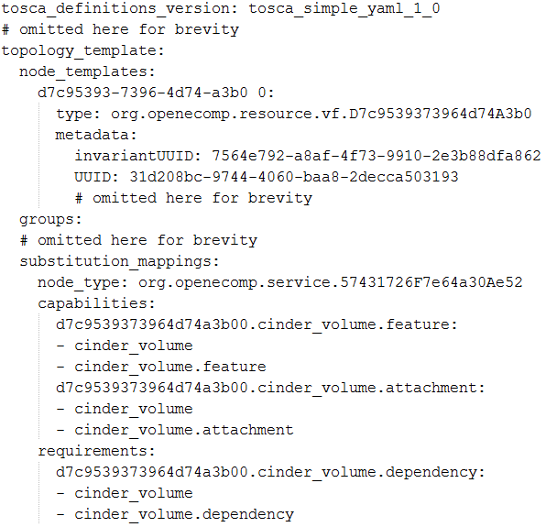
Substitution mapping issue in SDC
No corresponding node template for the defined capabilities and requirements in the substitution_mappings

Slide 6
The Used TOSCA features and Identified Gaps
No. | Category | Feature | Identified Gap
1 | substitution_mappings | capabilities mapping | No mapping between the substitued node type and Topo template[bug]
2 |  | requirements mapping | No mapping between the substitued node type and Topo template[bug]
3 | Node | import node type | Can't import node type to SDC [??? Please explain scenario you can import a yaml(VFC/CP/VL) basic building blocks for vf use on boarding. Vf can be designed in onboarding manually]
4 |  | define node type | Can't define node type in SDC [can be done menually using add vf scenario]
5 |  | property setting | To be verified [support property add/remove/modify from UI]
6 |  | metadata setting | To be verified [explain scenario]
7 |  | artifact setting | To be verified [artifact from tosca spec is not supported, the artifact are external to model]
8 |  | attribute setting | To be verified [supported]
9 |  | requirement setting | To be verified [not supported]
10 |  | capability setting | To be verified [not supported]
11 | Relationship | import relationship type | Can't import relationship type to SDC [not supported]
12 |  | define relationship type | Can't define relationship type to SDC [not supported]
13 |  | property setting | To be verified [not supported]
14 | Group | import group type | Can't import group type to SDC [can be done using api]
15 |  | define group type | Can't define group type in SDC [not supported]

Slide 7
The Used TOSCA features and Identified Gaps
No. | Category | Feature | Identified Gap
16 |  | property setting | Supported [supported]
17 |  | metadata setting | Supported [minuemal support]
18 |  | members setting | To be verified [not supported]
23 | Inputs | input setting | Supported
24 |  | input mapping | Supported
25 | data type | Complex Data Type | To be verified [supported]
26 | NFV | NFV node type | Not support [we are aligned with the openecomp model]
29 |  | Nested Service design | To be verified [not supported]
30 | Workflow design | Workflow design | To be verified

Slide 8
Functionalities of Identified Gaps before deadline
Import TOSCA VNF package to SDC
Use TOSCA VNF package to design the vIMS NS, vEPC NS and VoLTE service
All the gaps should be Identified by the end of this week
All the identified gaps should be add to the work plan of Amsterdam Release before functional freeze Milestone
SDC
Heat VNF packages
Import VNF Package
Service Design
catalogue
Distribution
SO
VFC
import
CSAR
APPC
…….
TOSCA VNF packages
Functionalities of Identified Gaps

Slide 9
Plan B
Model Designer as the backup plan to avoid risk
Model Designer design the VoLTE Service, including the vIMS NS, vEPC NS and VoLTE service
Model Designer save the designed model to SDC catalog and distribute model to other components
SDC
Distribution
Heat VNF packages
Import VNF (heat and simple TOSCA) package
Service Design
catalogue
SO
VFC
CSAR
…….
APPC
Import
TOSCA VNF packages
important VNF (VOLTE TOSCA ) PACKAGE
TOSCA Model Designer

Slide 10
Suggestion for Next Steps
Design an example VoLTE model with SDC and export the model as CSAR (use OPEN-O VoLTE CSARs as reference) – this week
Analyze the gaps for VoLTE model design supporting – next Monday
Add the work items to Amsterdam Release to address all the identified gaps. -August 3.
Note:
If there are risks in this plan, use the plan b to support VoLTE use case in Amsterdam release
The repo for model designer and workflow designer should be created immediately so developer can start coding . If we don’t need plan b, the model designer will not be released.

