Slide 1
Microservices Bus Tutorial
Huabing Zhao

Slide 2
Agenda
MSB Overview
Service Registration
Service Discovery
Example & Demo
How to integrate with MSB in Amsterdam

Slide 3
MSB Overview-Introduction
MSB(Microservices Bus) provide a comprehensive, end to end solution to support ONAP microservice architecture including service registration/discovery, external gateway, internal gateway, client SDK. It's a pluggable architecture so it can integrate with auth service provider to provide centralized Authentication & Authorization. MSB also provides a service portal to manage the REST APIs.
MSB doesn’t depend on a specific environment. It can work in bare metal, virtual machine or containerized environment.

Slide 4



MSB Overview-Components
MSB
ONAP Microservices
MSB Discovery
1 Service discovery
Microservice A
Registry
MSB Discovery
MSB SDK
External service
Internal service
2 Service request
Microservice C
1 Service request
External Gateway
Internal Gateway
Microservice B
External Gateway
Internal Gateway
External service request
2 Route request to service provider
Mobile
Desktop
External Systems
Registry
Service information storage, MSB leverage Consul as service registry.
MSB Discovery
Provides REST APIs for service discovery and registration
Service Gateway
Provide service request routing, load balancing and centralized Auth. It can be deployed as external Gateway or Internal Gateway.
MSB SDK
Java SDK for point to point communication

Slide 5
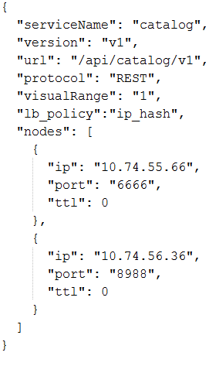
Service Endpoint Information Model
Attribute | Description
serviceName | Service Name
version | Service Version
url | the actual URL of the service to be registered
protocol | supported protocols: 'REST', 'UI', 'HTTP','TCP'
visualRange | Visibility of the service. External(can be accessed by external systems):0 Internal(can only be accessed by ONAP microservices):1
path | The customized publish path of this service. If path parameter is specified when registering the service, the service will be published to api gateway under this path. Otherwise, the service will be published to api gateway using a fixed format: api/{serviceName} /{version}. The customized publish path should only be used for back-compatible.
lb_policy | Load balancing method, Currently two LB methods are supported, round-robin and ip-hash.
enable_ssl | True if the registered service is based on https. False if the registered service is based on http.
nodes | ip: the ip of theservice instance node port: the port of the service instance node ttl: time to live, this parameter is reserved for later use

Slide 6
Service Registration –RESTFul API
http method: POST
url: http://{msb_ip}:{msb_port}/api/microservices/v1/services
Example:
curl -X POST \
-H "Content-Type: application/json" \
-d '{"serviceName": "test", "version": "v1", "url": "/","protocol": "REST", "lb_policy":"round-robin","nodes": [ {"ip": "127.0.0.1","port": "9090"}]}' \
"http://127.0.0.1:10081/api/microservices/v1/services”

Slide 7

Service Registration-OOM Registrator
k8s
deployment specs
(annotation)
MSB
ONAP Operations Manager
2 Register Service
Update Service
Registry
MSB Discovery
Registrator
External service
Internal service
1 Pod Even (Start, Stop etc.)
External Gateway
Internal Gateway
ONAP
Policy
SO
A&AI
VF-C
SDC
VF-C
OOM Registrator can register service endpoints for the microservices deployed by OOM
OOM deploy/start/stop ONAP components.
Registrator watches the kubernetes pod event .
Registrator registers service endpoint info to MSB. It also updates the service info to MSB when ONAP components are stopped/restarted/scaled by OOM

Slide 8
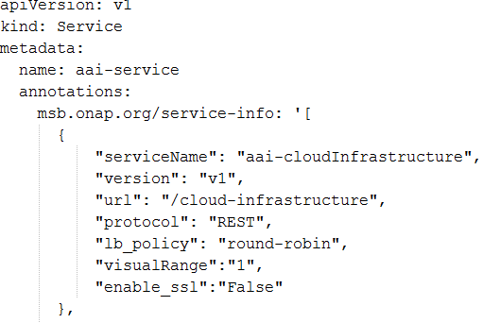
OOM Registrator-Service endpoint configuration
Use Kubernetes annotations to attach service endpoint metadata to objects.
Service endpoint can be defined at Pod level or Service level
Pod level: leverage the LB capabilities of MSB to distribute requests to multiple pods
Service level: MSB send the request to service(Cluster IP), K8s dispatch the request to the backend Pod
Register at service level
Pod
Register
Service
MSB
Pod
Register at pod level
Pod
Register
MSB
Pod

Slide 9
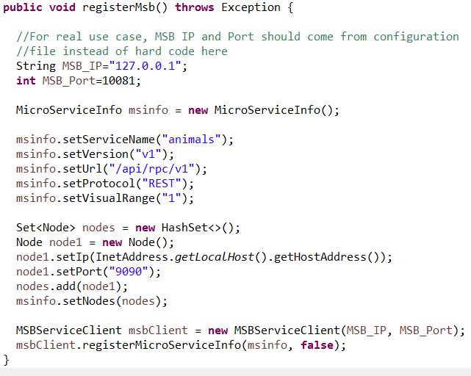
Service Registration-MSB SDK
Microservices can use SDK to register themselves to MSB.

Slide 10

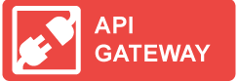
Service Discovery-Gateway
External service gateway
Expose the services(Rest API, UI pages, etc.)which need to be accessed by external systems
Solve the cross-domain issue for web app
Protocol transformation/translation between external reques and internal service
Centralized Auth
SProtocol translation(eg. https->http)
Centralized Auth
…
Load balancing
Load balancing
Internal API gateway
Routing and load balancing of the API calls within the system
Minimize the codes modification for service consumer
Discovery
Registry
Both the external and internal gateway can be deployed as a cluster(multiple instances) to avoid single point of failure

Slide 11
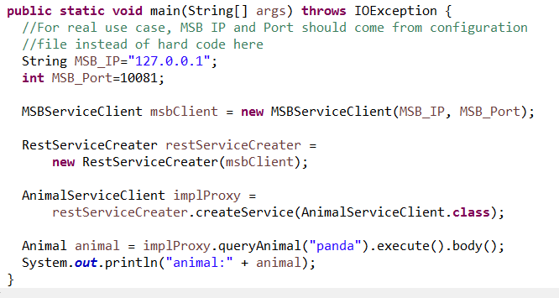
Service Discovery-MSB SDK
Microservices can use SDK to MSB SDK to discovery and access other microservices within ONAP.

Slide 12
Example & Demo
Start MSB services
1. Run the Consul dockers.
sudo docker run -d --net=host --name msb_consul consul agent -dev
2. Run the MSB dockers.
Login the ONAP docker registry first: docker login -u docker -p docker nexus3.onap.org:10001
sudo docker run -d --net=host --name msb_discovery nexus3.onap.org:10001/onap/msb/msb_discovery
sudo docker run -d --net=host -e "ROUTE_LABELS=visualRange:1" --name msb_internal_apigateway nexus3.onap.org:10001/onap/msb/msb_apigateway
Explore the MSB portal.
http://127.0.0.1/msb
Use MSB SDK to register/access services
https://gerrit.onap.org/r/gitweb?p=msb/java-sdk.git;a=tree;f=example;h=1c331f86cbcbdb8cc2935d8ac41169da1a523ec5;hb=refs/heads/master

Slide 13
How to integrate with MSB in Amsterdam
Register the service endpoints to the wiki page
Use annotations to attach service endpoint metadata to Kubernetes pod or service objects
Use MSB SDK/Internal API Gateway to access services
Useful resources
https://wiki.onap.org/display/DW/ONAP+Services+List
https://wiki.onap.org/display/DW/MSB+Test+Environment+Setup
https://wiki.onap.org/display/DW/Microservice+Bus+API+Documentation

