Slide 1
Radio Access Network Function Configuration Management (CM) Update in ONAP London Release
Feb 16, 2023
Contributors: N. K. Shankaranarayanan, Vishal Varvate, Priyank Maheshwari,
CPS Team (Toine Siebelink, Tony Finnerty et al), Murali Parthasarthy, Tarashree Mulge,
Martin Skorupski, John Keeney, Ahila Pandaram, Dharani S, Malarvizhi P, Krishna M
Companies: CapGemini, Ericsson, Wipro, highstreet technologies, Rutgers Winlab, AT&T
contact info: nkshankarlfn@gmail.com, vishal-vasantrao.varvate@capgemini.com, priyank.maheshwari@est.tech

Slide 2






ONAP SON Use Case
Co-ordination, Decisions
(Policy)
ONAP SON Use Case focus: control loop flow for management and optimization of O-RAN network
Aligned with O-RAN interfaces and architecture
“ONAP Layer” maps to
O-RAN SMO
O1 interface supported for several ONAP releases
A1 interface added in Kohn release
Optimization (OOF)
Data Collection,
& Analysis
(DCAE)
Action
(SDN-R)
Control loop
A1
O1
VES Collector
CM
FM
PM
A1
O1
RAN App
A1
Termn
O1
CM
CU/DU NFs
RAN-Sim (O-RAN)

Slide 3
ONAP SON Use Case
Data Analysis,
SON Algorithm
SDN-R (SDN-C)
SON
Handler
MS
A1 PMS
Policy
Simulated
RAN
OOF
A1
SLI
A1 Policy
Control
Loop
O1
RAN-Sim
FM/PM DB
Config
Change
A1
RAN App
DES
MS
TBDMT
VES
Coll
O1
Data
Lake
O1
FM, PM, CM
CU/DU
DMI
DMaaP
NCMP
REST API
CPS DB
O1
For more info and updates see:
https://wiki.onap.org/display/DW/R12+SON+Use+Case
RAN configuration
datastore
A1
Notes:
When is CPS updated with new PCI values?

Slide 4
ONAP SON Use Case – FM and PM event data
Data Analysis,
SON Algorithm
Configuration (O1) and
Policy Guidance (A1)
from SMO to RAN
SDN-R (SDN-C)
SON
Handler
MS
A1 PMS
Policy
Simulated
RAN
OOF
A1
FM/PM to μS
SLI
A1 Policy
Control
Loop
O1
RAN-Sim
FM/PM DB
Config
Change
A1
RAN App
DES
MS
TBDMT
VES
Coll
O1
Data
Lake
O1
FM, PM, CM
CU/DU
DMI
O-RAN O1
FM, PM
Info from RAN
DMaaP
NCMP
REST API
CPS DB
O1
RAN configuration
datastore
A1
Notes:
When is CPS updated with new PCI values?

Slide 5
ONAP SON Use Case – CM event data
Data Analysis,
SON Algorithm
Configuration (O1) and
Policy Guidance (A1)
from SMO to RAN
SDN-R (SDN-C)
SON
Handler
MS
A1 PMS
Policy
Simulated
RAN
OOF
A1
SLI
A1 Policy
CM Notifn
to μS
Control
Loop
O1
RAN-Sim
FM/PM DB
Config
Change
A1
RAN App
DES
MS
TBDMT
VES
Coll
O1
Data
Lake
O1
FM, PM, CM
CU/DU
DMI
O-RAN O1
CM update
to CPS DB
CM Info
from RAN
DMaaP
NCMP
REST API
CPS DB
O1
RAN configuration
datastore
A1
Notes:
When is CPS updated with new PCI values?

Slide 6
RAN NF Configuration Management Updates: Problem formulation
CPS DB keeps a consistent copy of RAN NF configuration
RAN NF config change may be done by SDN-R over O1, or other mechanism
All RAN NF config changes generate CMNotify VES event message over O1
CPS DB consistency requires efficient updates based on CMNotify VES message
After config update to CPS DB, CPS publishes CPS update notification on DMaaP
  Used by use case applications as needed
CPS DB uses same yang model as RAN NF – “primary yang model”
CPS DB can also have supplementary information:
  RAN NF config-like information which is not in the “primary” yang model
  Pending or planned config changes
  Solution for secondary yang model (using TBDMT) out of scope for London release

Slide 7
ONAP SON Use Case – London release focus on CM update process
SDN-R (SDN-C)
SON
Handler
MS
A1 PMS
Policy
Simulated
RAN
OOF
A1
SLI
A1 Policy
CM Notifn
to μS
Control
Loop
O1
RAN-Sim
FM/PM DB
Config
Change
A1
RAN App
DES
MS
TBDMT
VES
Coll
O1
Data
Lake
O1
FM, PM, CM
CU/DU
DMI
O-RAN O1
Update RAN config
in CPS DB
- efficient
- model-driven
- reusable
Generate CM VES event message
- aligned with O-RAN O1 spec
- aligned with 3GPP models
DMaaP
NCMP
REST API
CPS DB
O1
RAN configuration
datastore
A1
Notes:
When is CPS updated with new PCI values?

Slide 8
CM VES Event Generation

Slide 9

CM VES Event Message Generation
RAN Simulator generates a CM VES event whenever any config change happens on the RAN Simulator whether its O1(direct) or A1(indirect) config change request.
As the data tree gets modified, RAN simulator CU/DU triggers the CM event generation and sends it over the configured VES collector endpoint.
CM VES event message format aligned with 3GPP 28.532 specification
SDN-R (SDN-C)
RAN-Sim
Action Request
(O1-Config, A1-Policy etc)
A1
A1 Policy
A1
RAN App
O-RAN A1
RAN-Sim
Controller
O1
Config change
Config change
O-RAN O1
CU
DMaaP
VES
Coll
DU
O1
CM Notify VES event
DU
Topic: unauthenticated.SEC_3GPP_PROVISIONING_OUTPUT
CU
RAN NFs

Slide 10
CM VES Message Specification
RAN Simulator generates CM Notification VES message of type notifyMOIChanges (28.532 clause 11.1.1.11) which can report different types of possible NRM updates:
Creation and deletion of an object.
Creation and deletion of an attribute, attribute field, attribute element and attribute field element.
Replacement of an attribute value, attribute field value, attribute element and attribute field element.
Below are the input parameters that will be reported in notifyMOIChanges notification (from 3GPP clause 11.1.1.11.2).
Parameter Name | S | Information Type / Legal Values | Comment
objectClass | M | It shall carry the ManagedEntity class name. | Identifies the classe name of a common ancestor object of the objects for which changes are reported. A MnS producer may set this parameter always to the class name of the parent of the local root object in the MIB.
objectInstance | M | It shall carry the DN of the ManagedEntitiy. | Identifies the instance of a common ancestor object of the objects for which changes are reported. A MnS producer may set this parameter always to the instance of the parent of the local root object in the MIB.
notificationId | M | This is an identifier for the notification, which may be used to correlate notifications. | See clause 11.1.1.7.2
notificationType | M | It specifies the type of provisioning management services related notifications. The value “notifyMOIChanges” shall be carried. | See clause 11.1.1.7.2
eventTime | M | It indicates the MOI change event time. | See clause 11.1.1.7.2
systemDN | M | See clause 11.1.1.7.2 | See clause 11.1.1.7.2
mOIChanges | M | SEQUENCE OF SET {notificationId (M), correlatedNotifications (O), additionalText (O), sourceIndicator (O), path (M), operation (M), value (CM)} | This parameter describes the NRM updates to be reported. The notificationId is an identifier of one MOI change. The path specifies the MOI created or deleted, or the MOI with replaced attribute values. The path may identify also parts of an attribute in case the attribute is a structured data type. … See 3GPP clause 11.1.1.11.2 for remaining text …

Slide 11
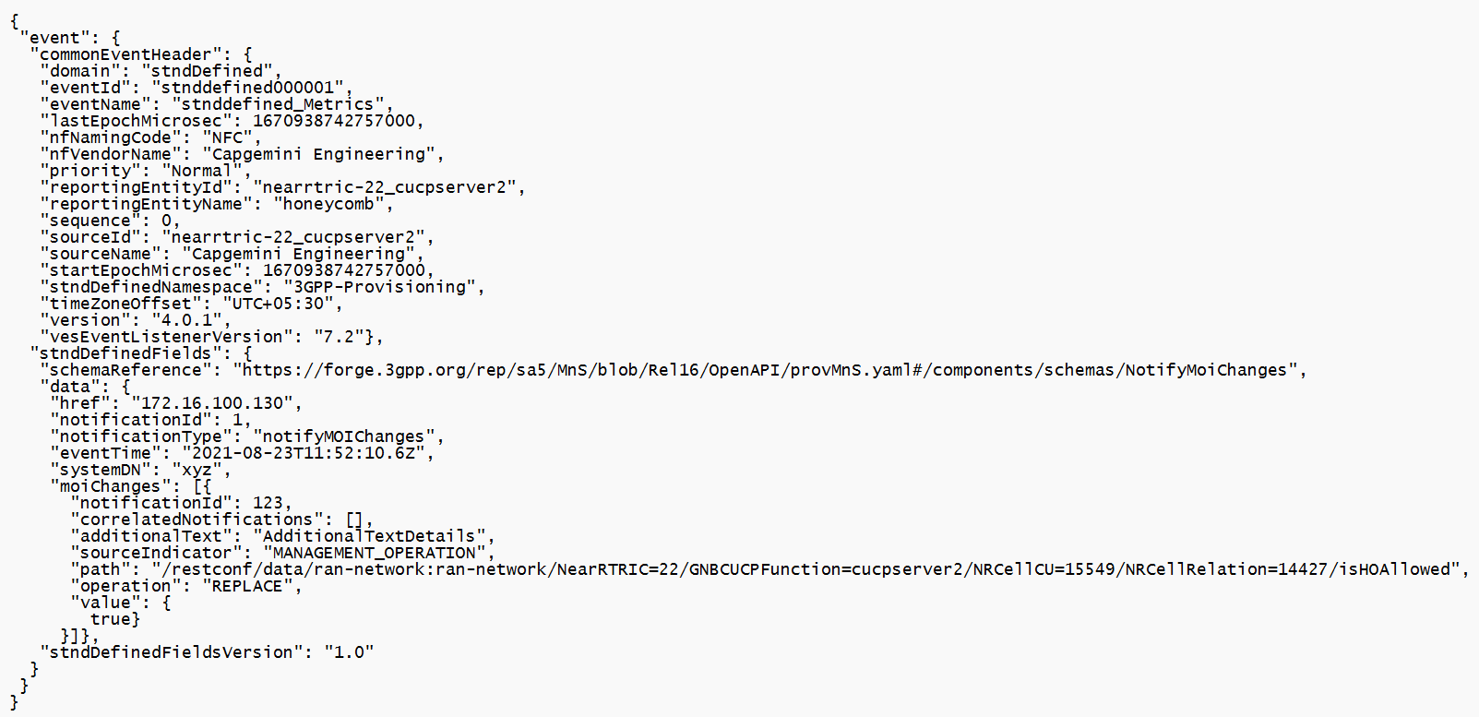
CM VES Event Message Format
We have a fully specified sample for O-RAN O1 CM VES event message format (Thanks to @Martin and @John!)
Details will be refined in ongoing implementation work.
We hope it will be useful to other projects, and will plan to contribute example to O-RAN O1 Spec (Annex)

Slide 12
CM VES Event Message
Selected fields showing object and its attribute change (“isHOAllowed” modified with new value as “true”)
{
"event": {
"commonEventHeader": {
"domain": "stndDefined",
"version": "4.0.1",
"vesEventListenerVersion": "7.2"
},
"stndDefinedFields": {
"schemaReference": "https://forge.3gpp.org/rep/sa5/MnS/blob/Rel16/OpenAPI/provMnS.yaml#/components/schemas/NotifyMoiChanges",
"data": {
"href": "172.16.100.130",
"notificationId": 1,
"notificationType": "notifyMOIChanges",
"eventTime": "2021-08-23T11:52:10.6Z",
"systemDN": "xyz",
"moiChanges": [
{
"notificationId": 123,
"correlatedNotifications": [],
"additionalText": "AdditionalTextDetails",
"sourceIndicator": "MANAGEMENT_OPERATION",
"path": "/restconf/data/ran-network:ran-network/NearRTRIC=22/
GNBCUCPFunction=cucpserver2/NRCellCU=15549/NRCellRelation=14427/isHOAllowed",
"operation": "REPLACE",
"value": {
"isHOAllowed": "true"
}}]
}}}
}

Slide 13
CPS DB CM Update

Slide 14
CPS Components
NCMP
CPS-Core
CPS – Configuration and Persistency Service
NCMP – Network Configuration Model Proxy
DMI – Data Model Inventory
DMI-Plugin
CPS Data Store
Device
Notes:
CPS Components Overview
---------------------------------------
(CPS) Configuration Persistence Service
Cloud native , YANG native persistence
Handles any YANG modelled data
Add new YANG modules & data at run-time
Validation , CRUD and Query Support
Data Separation using Dataspaces ( user application ) and Anchors (instance model) separation.
-----------------------------------
(NCMP)Network Configuration Model Proxy
Proxy to harmonize access to network CM data
Hides the complexity of addressing using concept of cm-handle
Provides Yang Data and device models (YANG Modules)
Leverages CPS-Core for its own and CM Data
-----------------------------------
(DMI-Plugin)Data Model Inventory Plugin
DMI provides abstract view of:
Data – CM data as published by the network function – always YANG
Models – YANG models that describe the network functions
Inventory – Network functions that will be exposed by NCMP.
Enables Integration with:
Multi-vendor EMS.
Network Functions (e.g. ORAN O1 functions)

Slide 15
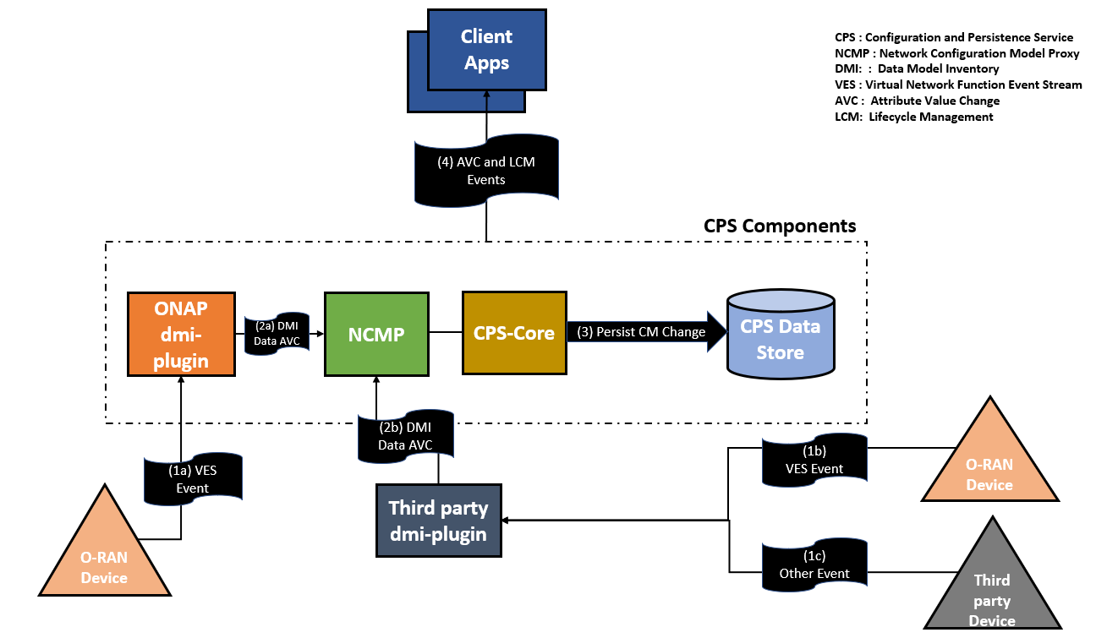
CPS Datastore CM Update
Notes:
SON Use case requires upto-date data view of the network , hence we have this use case.
ONAP DMI plugin will be receiving VES standard events from the ORAN device.
DMI plugin would map the identity required by CPS and translate it to a DMI Data AVC.
DMI Data AVC will be consumed by NCMP which internally uses CPS-Core APIs to persist the changes in the CPS Data Store.
Also once the changes are persisted we emit the AVC and LCM events to be used by other interested client apps.

Slide 16
DMI Data AVC
DMI Data AVC follows the RFC-8641 specification (Subscription to YANG Notifications for Datastore Updates)
{
"eventId" : "9999",
“eventCorrelationId” : “cmhandleId-001”,
"eventTime" : "2021-11-16T16:42:25-04:00",
"eventSource" : "org.onap.ncmp",
"eventType" : "org.onap.ncmp.cm-network-avc-event",
”eventSchema” : “org.onap.ncmp:cm-network-avc-event.rfc8641",
”eventSchemaVersion” : “1.0",
"event": {
<RFC 8641-yang-datastore-notification-payload>
}
}
Notes:
Check with vishal if he intends to talk about href and path from the VES event which is required before this.
Above is the DMI data AVC format schema.
Event payload is complaint with RFC-8641 format ( Subscription to YANG Notifications for Datastore Updates )

Slide 17
DMI Data AVC Example
{
"eventId" : "9999",
“eventCorrelationId” : “cmhandleId-001”,
"eventTime" : "2022-12-16T16:42:25-04:00",
"eventSource" : "ncmp-datastore:passthrough-operational",
"eventType" : "org.onap.ncmp.cm-network-avc-event",
”eventSchema” : “org.onap.ncmp:cm-network-avc-event.rfc8641",
”eventSchemaVersion” : “1.0",
"event": {
"push-change-update" : {
"datastore-changes" : {
"ietf-yang-patch:yang-patch" : {
"patch-id" : "34534ffd98", # Some unreadable patch id generated by the machine
"edit" : [
{
"edit-id" : "ded43434-1",
"operation" : "create",
"target" : "/_3gpp-common-managed-element:ManagedElement=XYZ-001/_3gpp-nr-nrm-gnbdufunction:GNBDUFunction=1/_3gpp-nr-nrm-nrcelldu:NRCellDU=1",
"value" : {
"_3gpp-nr-nrm-nrcelldu:NRCellDU" : [
{
"id" : 1,
}
]
}
}
]
}
}
}
}
}
Notes:
Here specifically talk about the href maps to eventCorrelationId
And path from VES maps to target.

Slide 18
Conclusion
RAN rApps and use cases require availability of
consistent RAN NF configuration - provided here by CPS DB
We have converged on a good design for CM update of RAN NF configuration data in CPS DB
  CM VES message notification from RAN NF in alignment
  with O-RAN O1 and 3GPP
  Efficient update of configuration in CPS DB based on CM VES message
  Implementation details will be finalized as part of ongoing work
Our work should be reusable for:
  CM of RAN NF in other use cases in ONAP, OSC, LFN projects, etc
  CM of any yang-based NF in ONAP
For more info, see: https://wiki.onap.org/display/DW/R12+SON+Use+Case

