Slide 1
A General Implementation with Intent-based network in ONAP presented by Lingli Deng on behalf of Keguang He and Chuanyu Chen hekeguang@chinamobile.com chenchuanyu@huawei.com
@twitter
Notes:
Good afternoon, everyone. This is Lingli from China Mobile, and I am here to present to you the Intent-based network implementation in ONAP that we have been partnering with Huawei and integrated into K release.

Slide 2
Contents
01
Requirements introduction
02
Implementation Introduction
03
Use Case Introduction
04
Future Plans
05
Discussion and Question
Notes:
To start with, why we are doing IBN in ONAP.

Slide 3




Relationship between intent and autonomous network
Intent is a must for
autonomous Networks
1
2
Evolution of autonomous domain interface
Based on the user specified intent goal, combined with AI technology to achieve automatic closed-loop, and independent evolution, finally achieve autonomous operation.
The interface between autonomous domains has evolved from rule based/policy based to intent based.
Key technologies of closed-loop management automation
Intent defines what an autonomous domain is expected to achieve
Closed loop realizes and maintains explicitly intent goals through perception, analysis, decision-making and execution.
Leave details of how to design and operate network to the internal operation of the autonomous domain.
3
4
Notes:
We believe intent is a must for autonomous networks, as the northbound interface of the autonomous domain by defining what an autonomous domain is expected to achieve with minimal human efforts. In other words, its presence represents key technologies of close-loop management automation.

Slide 4
Requirements introduction
Oct 2018
September 2019
October 2019
February 2021
May 2021
June 2022
IRTF NMRG
Network intents
ENI 005
Intent policy
NFV-IFA 041
Enhancement to the framework of NFV-MANO
ZSM-011
Intent-driven management interfaces in ZSM framework
TM Forum IG1253
Intent in Autonomous Networks
3GPP TS 28.312
Intent driven management for service or network management
Consensus
Above SDOs agree that the intent is used to describe “what”, not “how”. It is easy to get the consensus of all SDOs that the “goal” is included in “what”.
Try to implement a general intent solutions by studying key technologies, reference implementations, and industry standards for intent network management. In the future, will continue to conduct in-depth research and lead implementation on intent standards and open source solutions to ensure the operation of the intent network meets the overall expectations of operators.
Objective
Notes:
Due to its importance to advancing automation toward autonomy in realizing autonomous networks, various SDOs started study and specifications around the concept and invented many variations in their specific context.
According to ENI study, the industry reaches consensus on the concept being “intent is used to describe “what”, not “how””. But that is pretty much all we have in common. Instead we see deviations for its representation, operation and workflows, which could manifest as a headache to end-to-end orchestration systems like ONAP where unified service intent representation is required for machine-to-machine automation.
To address the issue, we sent out to provide a reference implementation in ONAP for IBN, to verify SDO proposals and upstream to streamline its development and adoption.

Slide 5





Overall plan
R&D of IBN
01
Cooperate with SDOs
Research the intent use case, intent model and intent management of autonomous network.
Improve interoperability between components/systems via standarded intent description.
Make all intents(especially machine-machine intents) in the system operate in the same way.
Decompose the complex intent into sub intents of different dimensions.
Support use case related to intents to demonstrate our requirements.
ETSI ENI: Reporter of ENI 013 and important contributor of ENI 015.
ETSI NFV: Reporter of NFV-IFA 050.
3GPP: Actively contribute to 3GPP R17 and R18.
TMF: Actively contribute to autonomous network and intent project.
CCSA: As the reporter, created five intent projects in the field of autonomous network and core network.
02
January 2021
June 2021
August 2021
February 2022
March 2022
ENI
TM Forum
3GPP
NFV
CCSA
Notes:
And that is why the thread has been carried out in parallel with two dimensions respectively.
On the one hand, study is conducted on use cases, representation models, management function design and their implementation.
On the other hand, collaboration has been conducted along the way with various SDOs.

Slide 6
Contents
01
Requirements introduction
02
Implementation Introduction
03
Use Case Introduction
04
Future Plans
05
Discussion and Question
Notes:
As of how it is implemented in ONAP.

Slide 7
Important concepts
Intent:
Intent is the formal specification of all expectations including requirements, goals, and constraints given to a technical system. (TMF IG1253)
Intent Object:
Intent object is an object described in the format after the two parties of the requirement negotiate the intent.
Intent Instance:
Intent instance is the carrier of formatted intent and intent fullfillment status.
Intent Owner:
Intent owner is the creator of the intent object and is responsible for managing the life cycle of the intent object.
Intent Handler:
Intent handler is the receiver of the intent object, responsible for the realization and satisfaction of the intent object, and managing the life cycle of the intent instance.
Notes:
Before we delve into any details, understanding basic concepts is essential to evaluating our implementation .
According to TMF IG1253, Intent is the formal specification of all expectations including requirements, goals, and constraints given to a technical system. Which could be represented by an intent object conveyed from the intent owner to the intent handler as a kind of agreement after the two parties’s negotiation. And an intent instance is the carrier of formatted intent and fulfillment status.

Slide 8
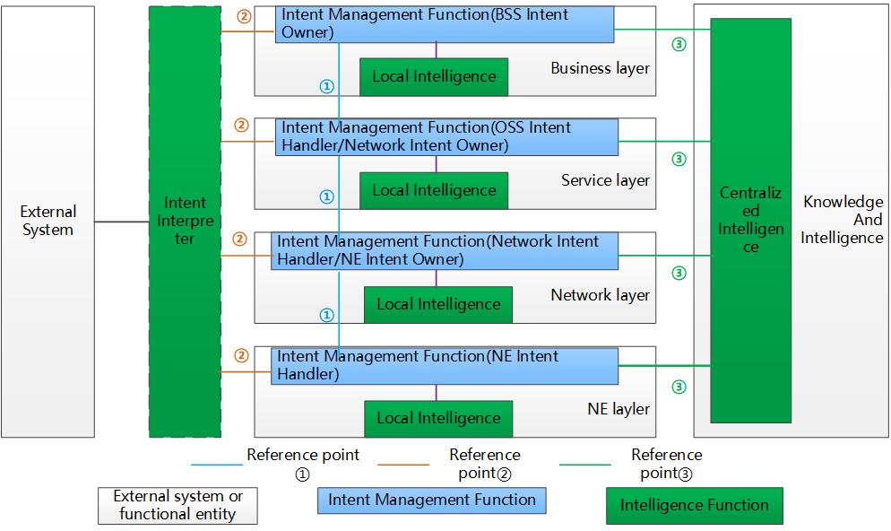
Autonomous network intent management framework
The intent management function of the intent owner interacts with the intent management function of the intent handler.
Format intent input interface provided by intent management function.
Intent management functions interact with centralized intelligence functions.
Notes:
In the target architecture of the autonomous network, from bottom to top, it includes four levels: network element management, network management , service operation , and business operation.
The intent management function can be introduced into each layer, and the interface between layers can be simplified and abstracted.
It can be seen from the figure that there are three types of reference points.
①The intent management function of the intent owner interacts with the intent management function of the intent handler.
②Format intent input interface provided by intent management function.
③Intent management functions interact with centralized intelligence functions..

Slide 9
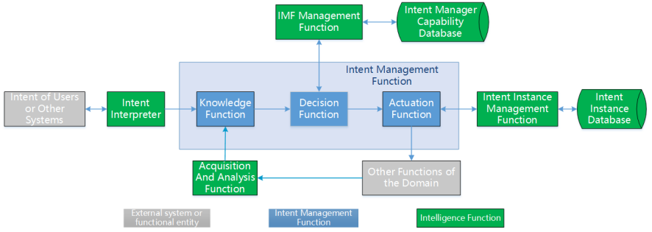
Functional architecture related to intent management
IMF:
Intent Management Function
Intent Format Funciton: Receive intent from external users or other systems, and format it into a general intent model definition form.
Acquisition And Analysis Funciton: Collect and analyze the corresponding information of the system, and monitor the operation status.
Intent Function Management Funciton: Provide intent management function registration mechanism, and support the query function .
Intent Instance Management Funciton: Perform lifecycle management on intent instances.
Notes:
In order to support the above architecture in ONAP, some new functions are introduced, including:
Intent Interpreter Function: Receive the intent from external users (natural language) or other systems, and format it into a general intent model definition form that can be recognized by the intent management function .
Data collection and analysis Function: Collect and analyze the corresponding information of the system, and monitor the operation status of the management domain.
IMF Management Function: The intent management function registration mechanism is provided, and support the query of intent management.
Intent Instance Management Function: Perform lifecycle management on intent instances, including add/modify/delete/query intent instances.

Slide 10
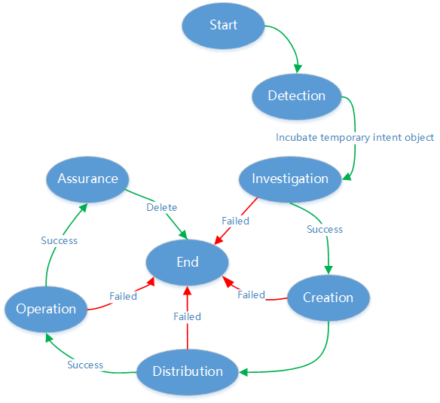
General intent processing flow
Detection stage: Intent owner determines whether to define new intent or change existing intent.
Investigation stage: Intent owner and intent handler complete investigation and negotiation to check feasibility.
Creation stage: Formal intent object is created.
Distribution stage: Intent owner sends the intent object to the intent handler.
Operation stage: Intent handler operates its responsibility domain according to the accepted intent object.
Assurance stage: Intent handler continuously ensures that the expectations corresponding to the intent are met.
Notes:
From another perspective, the processing of intent includes the following stages:
Detection, the intent owner determines whether to issue new intent or change existing intent by detecting the satisfaction of requirements, and incubates new temporary intent objects.
Investigation, the intent owner and intent handler complete the revision of the temporary intent object through investigation and negotiation to determine whether the incubated temporary intent object is feasible.
Creation, the corresponding formal intent object is created.
Distribution, the intent owner sends the intent object to the intent handler. If the intent handler accepts the intent, then an intent instance is created and recorded through the intent instance management function; Otherwise, the intent life cycle ends.
In the operation stage, the intent handler operates its management domain according to the accepted intent to achieve the desired goal.
In the assurance stage, the intent handler continuously ensures that the expectations corresponding to the intent or report its fulfillment status until the intent is deleted by the intent owner.

Slide 11
General intent inerface
Mandatory Interface
A
Create：Intent owner requests intent handler to create a new intent instance.
Update：Intent owner requests intent handler to update the intent instance.
Delete：Intent owner requests intent handler to delete the intent instance.
Query：Intent owner and intent handler query the existing intent instances information from the intent instance management function.
Report(TBD): Used for intent handler to report intent execution status and reasons for dissatisfaction to intent owner.
Optional Interface
B
Probe(TBD)：Explore whether intent handler can implement the specific intent, and verify the effect and possible impact of the intent in advance.
Negotiate(TBD): Intent owner and intent handler negotiate necessary modifications to the content of the intent object to ensure the realization of the intent.
Notes:
Mandatory interfaces implemented in this initial version include:
Create：Intent owner requests intent handler to create a new intent instance.
Update：Intent owner requests intent handler to update the intent instance.
Delete：Intent owner requests intent handler to delete the intent instance.
Query：Intent owner and intent handler query the existing intent instances information from the intent instance management function.
Report: Used for intent handler to report intent execution status and reasons for dissatisfaction to intent owner.
Optional interfaces to be included in future versions include:
Probe：Explore whether the intent handler can implement the specific intent, and verify the effect and possible impact of the intent in advance.
Negotiate: Intent owner and intent handler negotiate necessary modifications to the content of the intent object to ensure the realization of the intent.
And For Report, Probe and Negotiate interfaces, we hwill try to implement them in future releases.

Slide 12
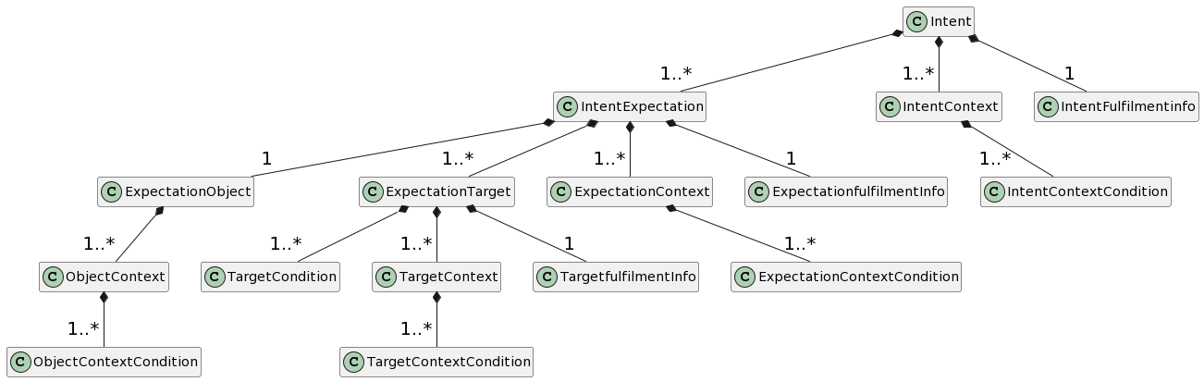
General intent model
TM Forum
3GPP
ONAP
Notes:
The general intent model we used is a combination of different SDO proposals with adaptations in ONAP context.
For example, we took the elements of Expectation, Expectation Target from TM Forum, design of context, ExpectationObject, Fulfilmentinfo from 3GPP, and invented contextCondition, targetCondition to address composite condition issue in implementation.

Slide 13
Interaction with existing ONAP components
Usecase-UI
VFC
GUI
SERVER
Monitor Events
LCM Events
Intent Management Module
......
SO
Customer Management
Package Management
Service Management
Network Topology
Monitor
Intent format input
DCAE
POLICY
NLP SERVER
Database
A&AI
NLP Module
NLP Model
INTENT ANALYSIS SERVER
SDC
Intent decomposition
Intent orchestration
Expression and analysis of general intent model
Support general intent interface
Intent mapping function
MSB
......
Notes:
In order to implement the above functions, we make some changes in the UUI component of ONAP.
The current architecture of UUI includes three main services:GUI、Server、NLP Server.
A new microservice, INTENT ANAlYSIS SERVER is introduced to provide five main functions:
1. Intent decomposition : Decompose complex intents into combinations of sub intents
2. Intent orchestration: Arrange the execution sequence of sub intents
3. Expression and analysis of general intent model: Use the general intent model to describe and parse the formatting intent
4. Support general intent interface: Provides an intent form of interaction with other components or third-party components
5. Intent mapping function: The intent described by the general intent model is mapped into specific execution actions
An GUI page is also added to support intent format input.
The user can enter the formatted intent information here, then send it to INTENT ANAlYSIS SERVER for processing.

Slide 14
Contents
01
Requirements introduction
02
Implementation Introduction
03
Use Case Introduction
04
Future Plans
05
Discussion and Question
Notes:
Before we go to the demo, spare me 2 minutes to do a quick introduction of the illustrative case it demonstrates.

Slide 15
Use case description
User Requirement: Operators provide intent based cloud leased line services, and provide corresponding assurance measures based on user requirements.
Delivery Expectation: Configure the cloud leased line with a bandwidth of 1G.
Exclusive Assurance Expectation: When the bandwidth utilization rate exceeds 80%, the bandwidth will be expanded by 60% to ensure the user experience; when the traffic returns to normal (the utilization rate is 30%), the service bandwidth will be restored to 1G.
Notes:
In this case, the Operator provides intent based cloud leased line services, with corresponding assurance measures based on user requirements. An enterprise user orders a cloud leased line with a bandwidth of 1G. In order to meet this intent, the intent handler will configure the cloud leased line with a bandwidth of 1G . At the same time, provides some high level service quality assurance technology. For example, When the bandwidth utilization rate exceeds 80%, the bandwidth will be expanded by 60% to ensure the user experience. At the same time, when the traffic returns to normal (the utilization rate is 30%), the service bandwidth will be restored to 1G.
The internal processes are shown in the right side
First, we input the user's intent information through Format intent input. Then send the corresponding information to INTENT ANAlYSIS SERVER. And INTENT ANAlYSIS SERVER decomposes the user's complex intent into two sub intents：intent for service delivery, and intent for service assurance.
For delivery intent, the INTENT ANAlYSIS SERVER calls service orchestrator to create cloud leased line service.
And for exclusive assurance intent, the INTENT ANAlYSIS SERVER calls DCAE to assure cloud leased line service with high level service quality assurance.
Through the above process, the intent use case described earlier is finally completed.
保障闭环是SO调用DCAE吗？

Slide 16
Use case demonstration
Create a new intent includes two expectations: one is delivery expectation, and the other is exclusive assurance expectation.
Notes:
Now it finally time for the demo, enjoy the video with me.

Slide 17
Contents
01
Requirements introduction
02
Implementation Introduction
03
Use Case Introduction
04
Future Plans
05
Discussion and Question

Slide 18








Future Plans
Improve the R&D of IBN
Cooperate with open source projects
Improve AI driven capabilities
01
Introduce more AI related technologies in intent analysis, translation, decomposition and other processes.
Upstream to standards organizations
01
Analyze new technologies related to intent in SDO(TMF/3GPP/ETSI/CCSA) for improvements in the next release.
Implement more intent interfaces
02
The interface of intent negotiation stage shall be formulated and relevant processing flow shall be realized.
Cooperate with nephio
02
Try to cooperate with open source projects such as nephio to realize end-to-end intent.
Provide intent verification function
Verify the effect and possible impact of the intent in advance.
03
Provide more use cases
03
Provide more usage scenarios and use case implementations to support our solutions.
Notes:
As you can see, this is an staring point with minimal functions for IBN.
Our future plan is two-folded.
On the one side, we will continue to improve the R&D of IBN in the following ways
First: We will Introduce more AI related technologies in intent analysis, translation, decomposition and other processes.
Second: We will implement more intent interface. Particular, the interface of intent negotiation shall be formulated and relevant processing flow shall be realized.
Third: We will provide intent verification function to verify the effect and possible impact of the intent in advance.
On the other side, we will continue to cooperate with open source projects .
First: We will continuous analyze new technologies related to intent in major standards organizations (TMF/3GPP/ETSI) and consider introducing into the next release.
Second: We will try to cooperate with open source projects such as nephio to realize end-to-end intent .
Third: We will provide more usage scenarios and use case implementations to support our solutions.

Slide 19
Contents
01
Requirements introduction
02
Implementation Introduction
03
Use Case Introduction
04
Future Plans
05
Discussion and Question
Notes:
Any questions that I can take?

Slide 20

Q&A

Slide 21
Thanks！ hekeguang@chinamobile.com chenchuanyu@huawei.com
Notes:
Thank you for your time and attention.

