Slide 1
Automation of Intent-based Cloud Leased Line Service (PoC#3)
Henry Yu
Layer123 World Congress 2022
Dec 2022

Slide 2
Agenda
Background of ONAP and the driver for ONAP-ZSM collaboration
Intent-based Cloud Leased Line solution on ONAP
ETSI ZSM POC #3 demonstration

Slide 3
Background of ONAP
ONAP is an open source platform for network automation (started in 2017)
Large and diverse community (a total of 100 organizations committed code in last 5 years)
Large code base (over 14M lines of code)
Cloud-based architecture containing many containerized microservices

Slide 4
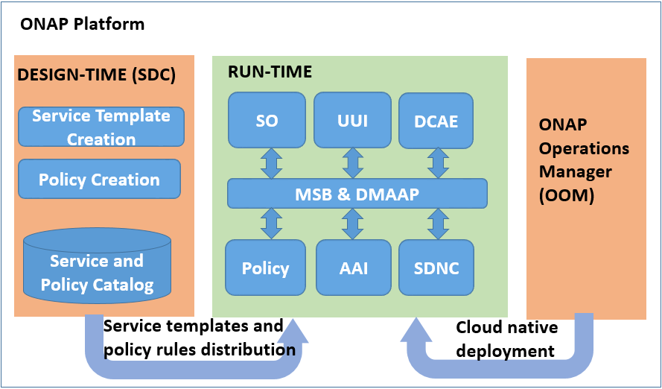
ONAP Archiecture
SDNC | SDN Controller
DCAE | Data Collection, Analytics and Events
Policy | Policy Framework
AAI | Active and Available Inventory
MSB | Microservices Bus
DMaaP | Data Movement as a Platform

Slide 5
ONAP Use Cases
Year 2018
Year 2019
Year 2020
Year 2021
Year 2022
Release
Beijing
Casablanca
Dublin
El Alto
Frankfurt
Guilin
Honolulu
Istanbul
Jakarta
Kohn
E2E Network Slicing
Phase I
Phase II
Phase III
CSMF, NSMF
E2E network slicing across AN, TN, and CN
Modify Slice
CCVPN (transport network service)
Phase I
Phase II
Phase III
Phase IV
E-LINE service
OTN service
Transport Slicing
Integrated with E2E network slicing
Cloud leased line service
Intent support for CCVPN, integrated with IBN
Intent-based Networking
Phase I
Phase II
IBN Lifecycle
Intent-based Cloud Leased Line

Slide 6
How ZSM Standards Help Implement ONAP Use Cases
ONAP use case requirements/challenges (not exhaustive list) | Solutions inspired by ZSM standards
Use cases collaborate on new services and yet still keep their independence. E.g., IBN and CCVPN collaborate on Intent-based Cloud Leased Line | Apply Management Domain construct to use case design (e.g., CCVPN as Transport MD) Use case collaboration are achieved by management domain interactions
Use cases need to allow development of solutions from different standards (e.g., 3GPP, IETF, MEF, TMF, etc.) | Design a federated solution using ZSM architecture
Closed-loop automation | Use solutions in ZSM009 (Closed loop enablers and solutions)

Slide 7


Cloud Lease Line (CLL) Service Illustration
Objective: CLL service automation based on user’s intent
ODUFlex
User IP over CLL
Protection ODUFlex
ODUFlex
Ethernet Virtual Connection (EVC) realizing CLL
Underlay OTN tunnels carrying EVC traffic
Cloud 1
Enterprise A
VLAN1
VPC
A
LAN
VLAN1
VLAN2
Cloud POP
VPC
Lan
ONU A
OTN
OTN
OTN PE
Enterprise B
B
LAN
Cloud 2
Lan
VLAN1
VLAN2
OLT PE
VLAN2
VPC
ONU B
OTN
Cloud POP
VPC
OTN
OTN PE

Slide 8
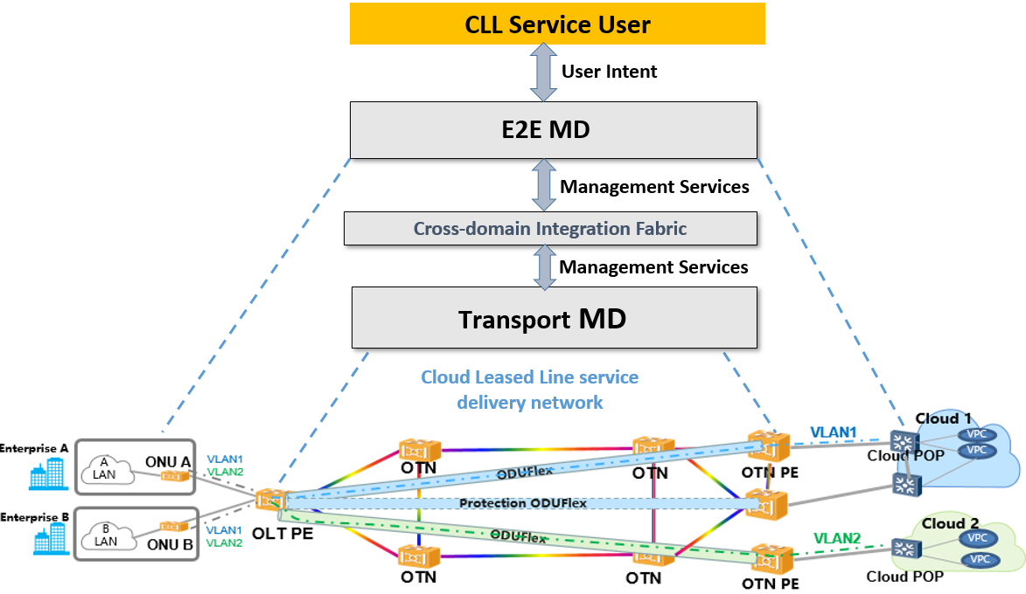
Intent-based CLL Solution Using ZSM Framework

Slide 9
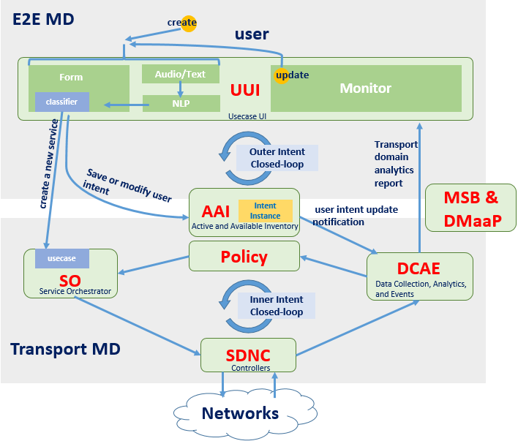
Intent-based CLL Implementation on ONAP

Slide 10
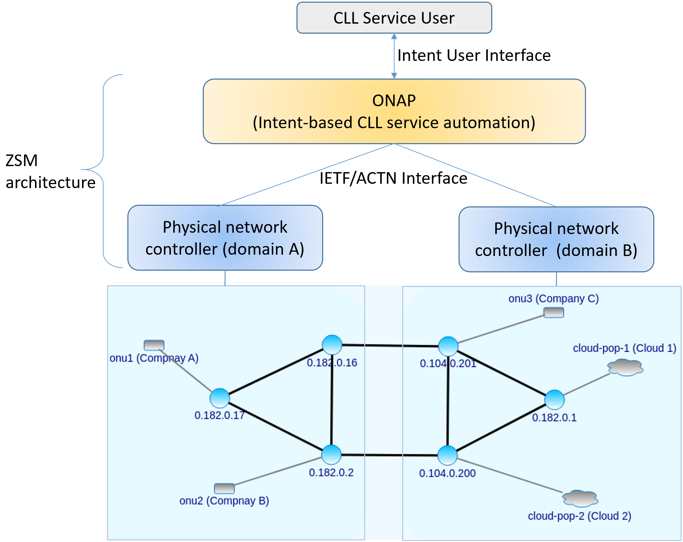
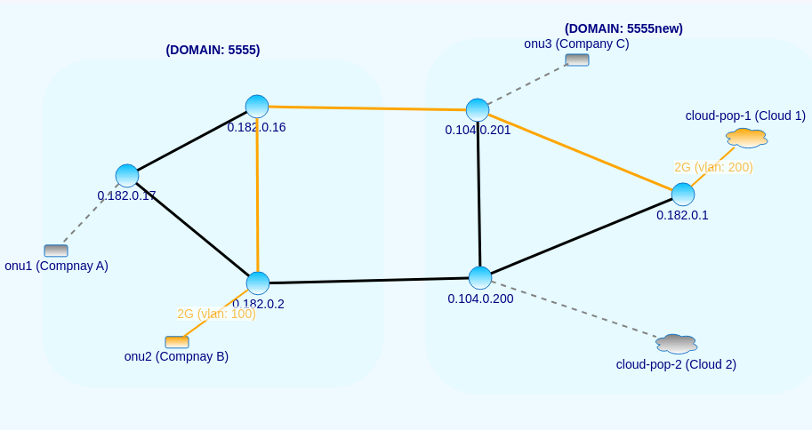
ZSM PoC#3 Demo Setup
I need a connection from company B to Cloud one, with a bandwidth of 2Gbps
automation

Slide 11
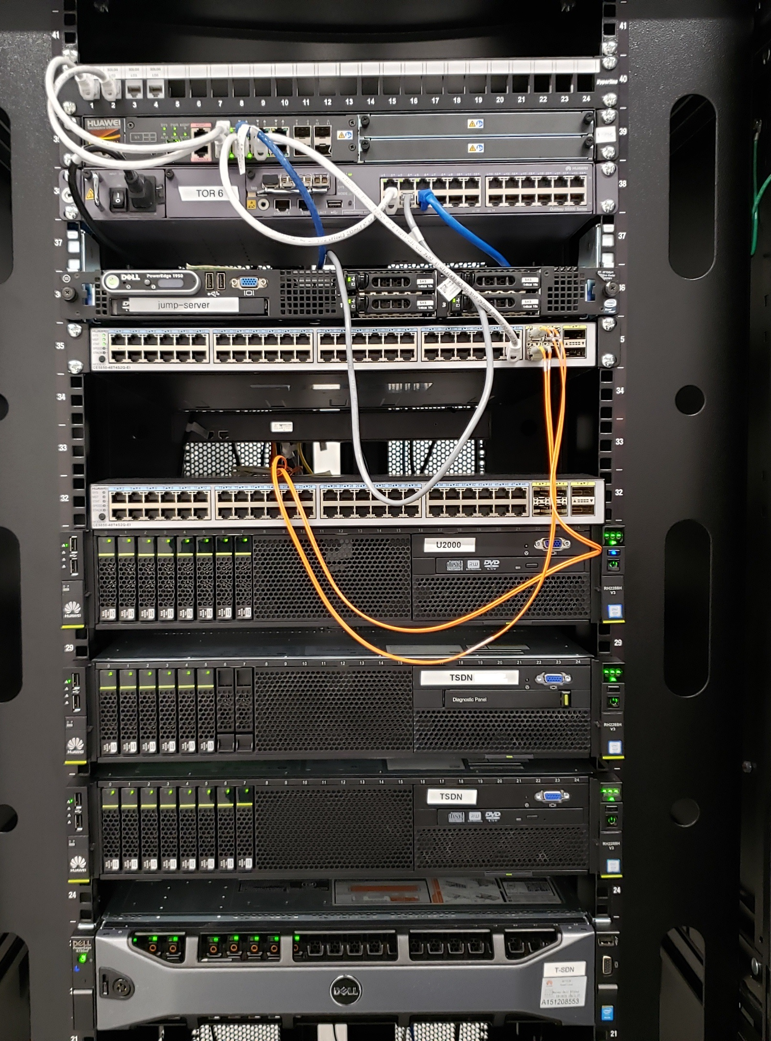
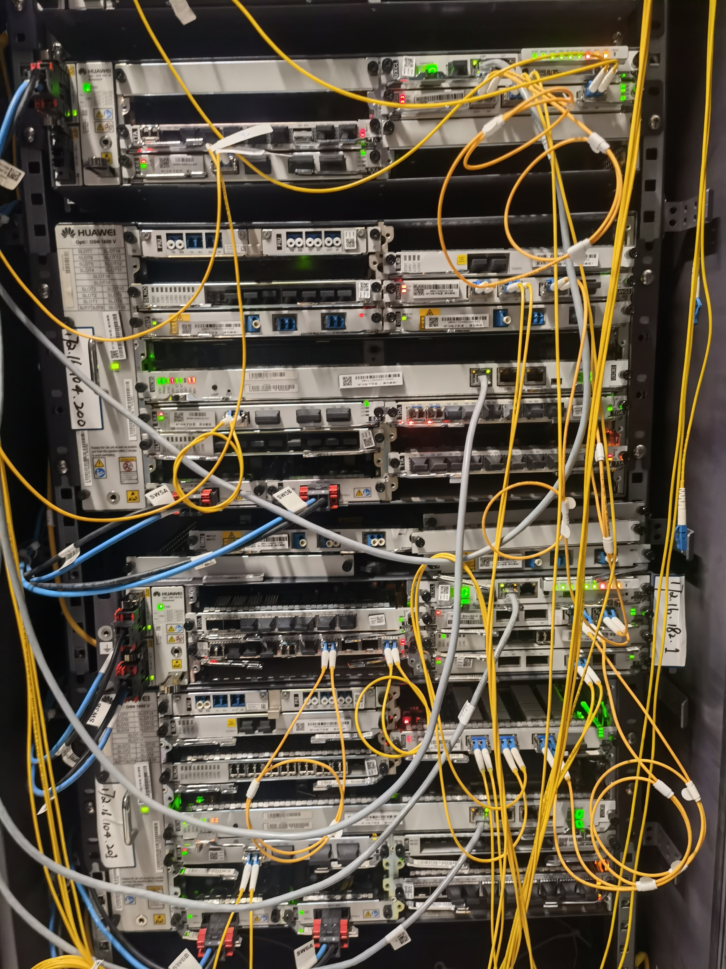
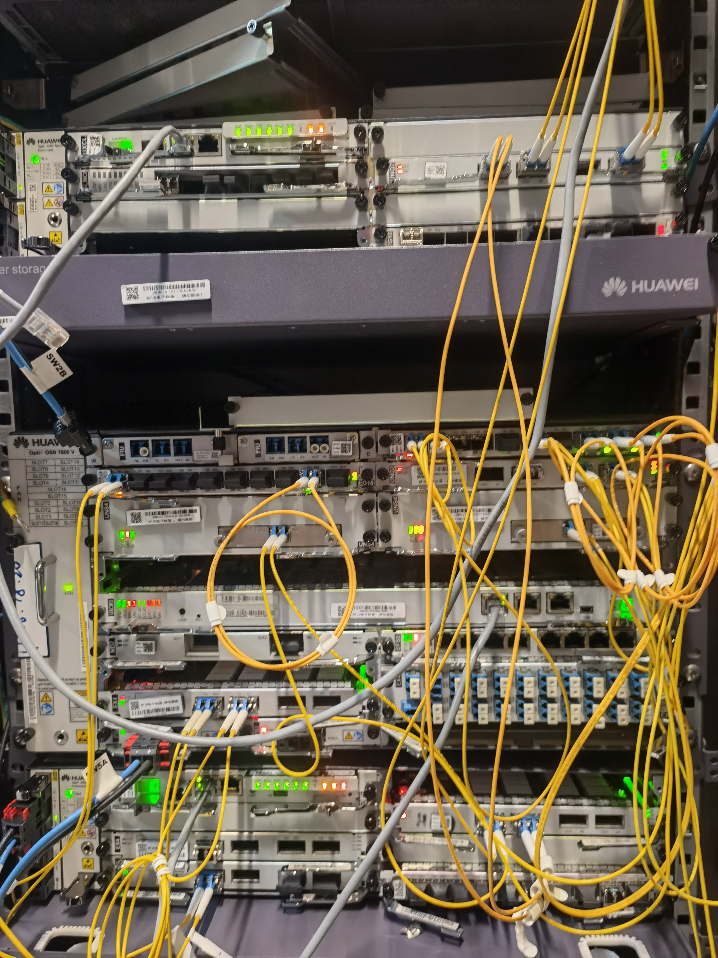
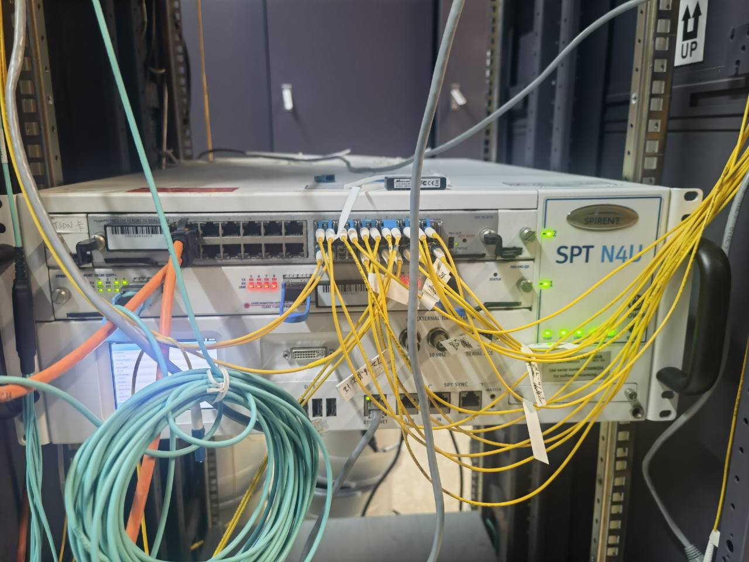
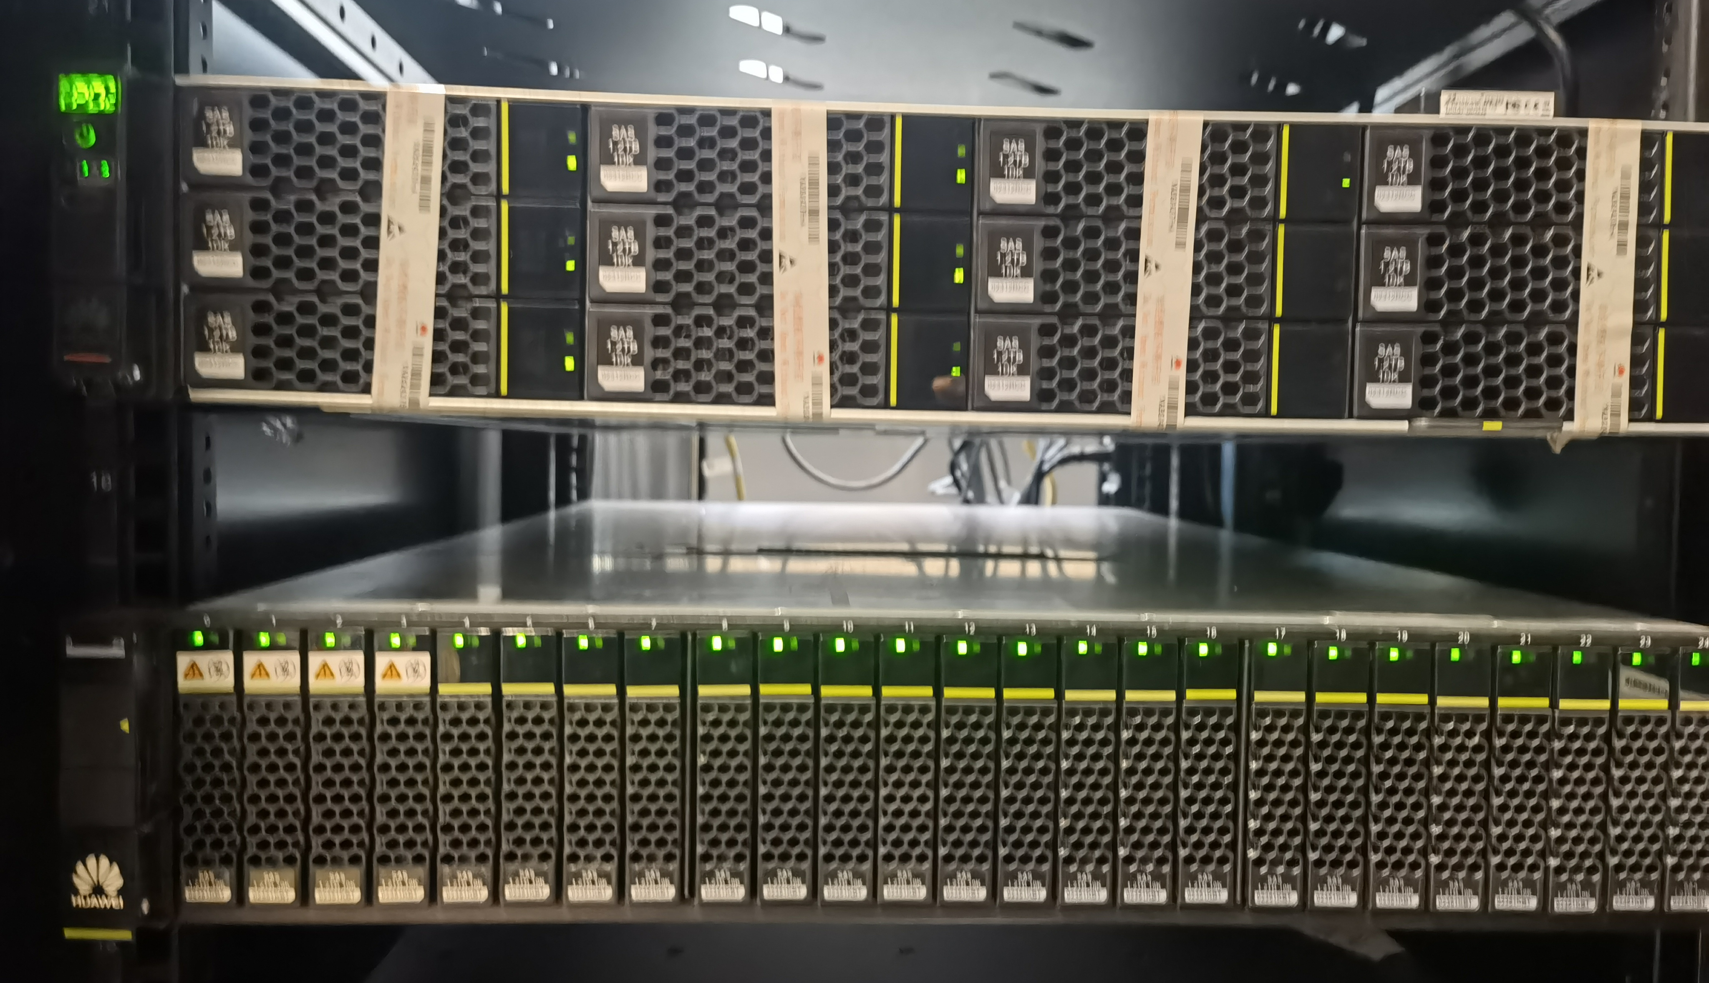
Lab Equipments
China Unicom and Huawei Joint Lab in Wuhan China
Huawei Canada Lab in Ottawa
Six Network Nodes (providing Ethernet over OTN service)
Traffic Generator (Ethernet packets)
ONAP Servers
SDN Controller Servers

Slide 12
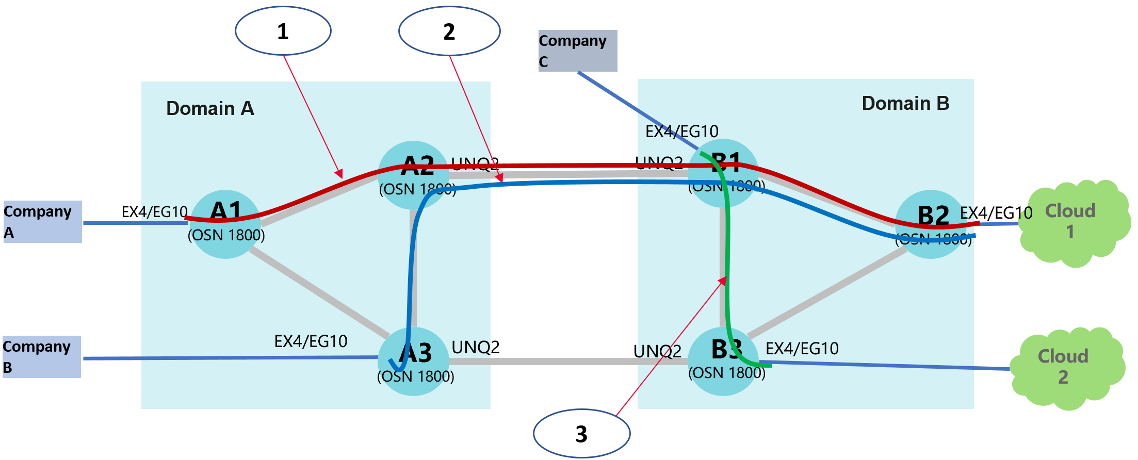
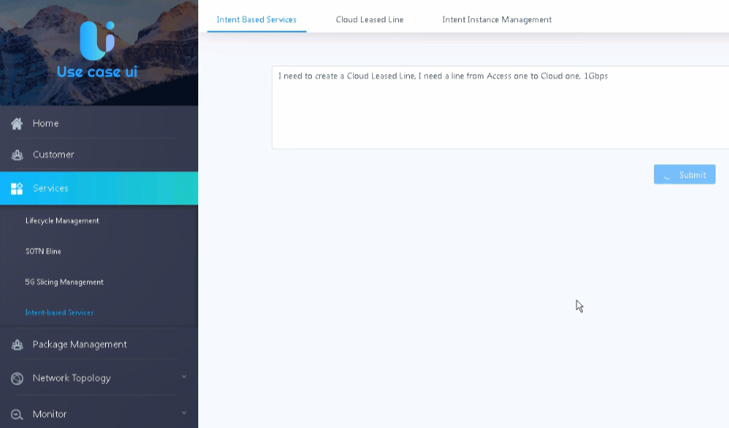
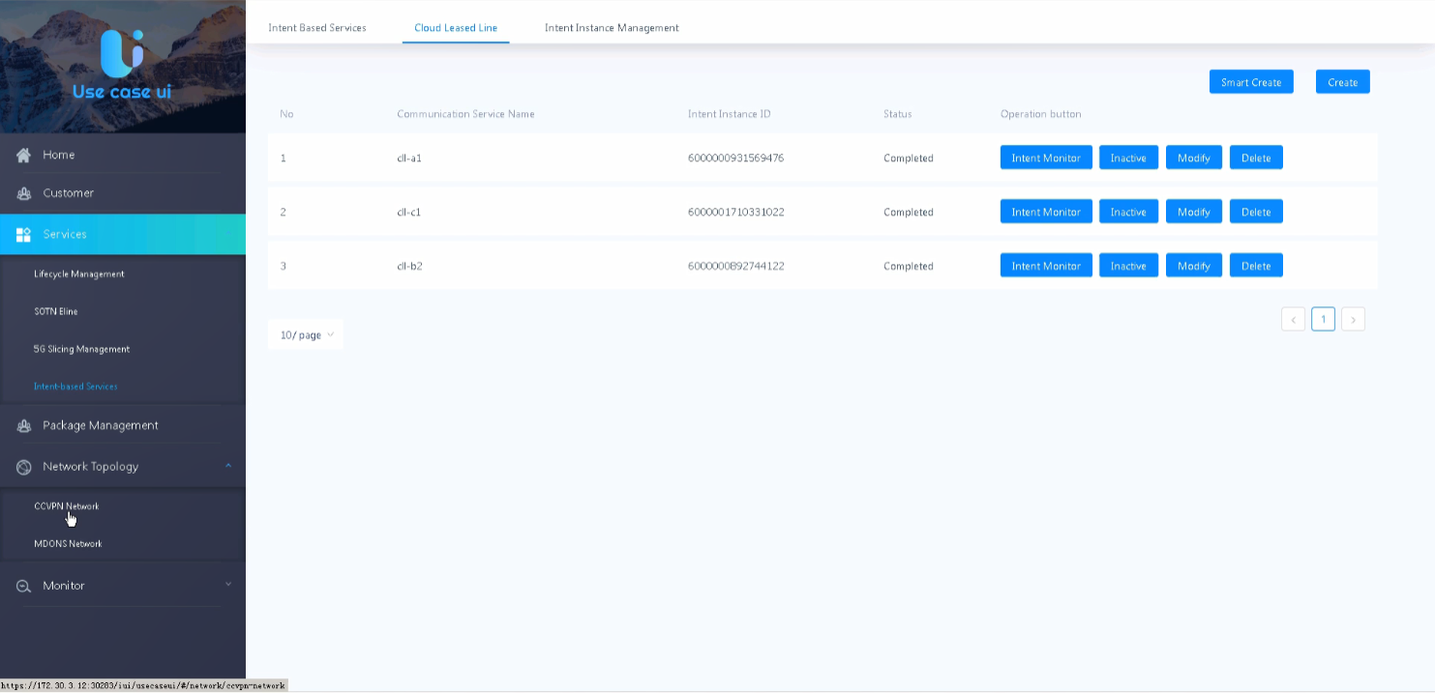
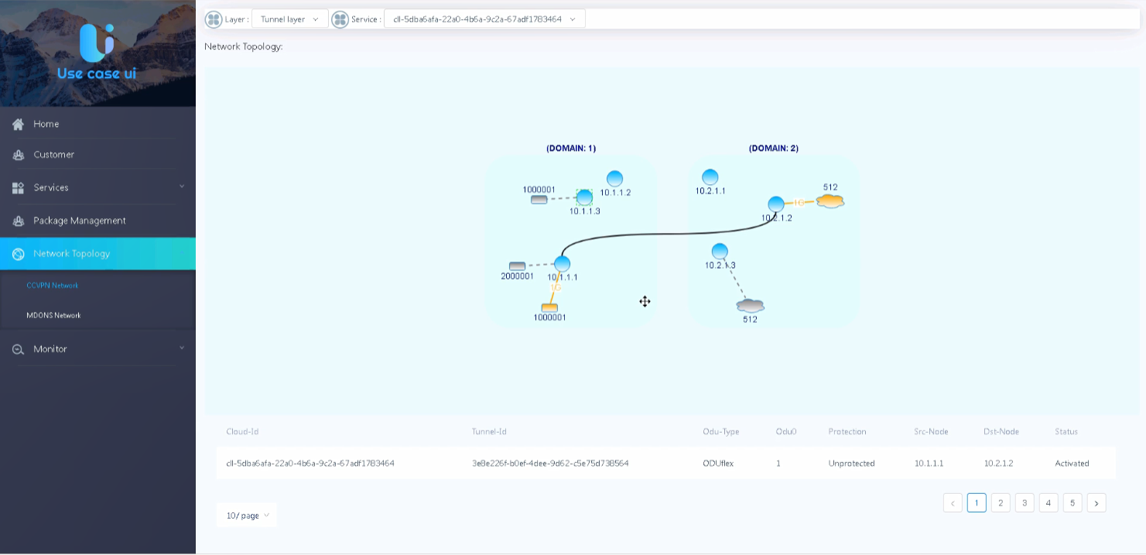
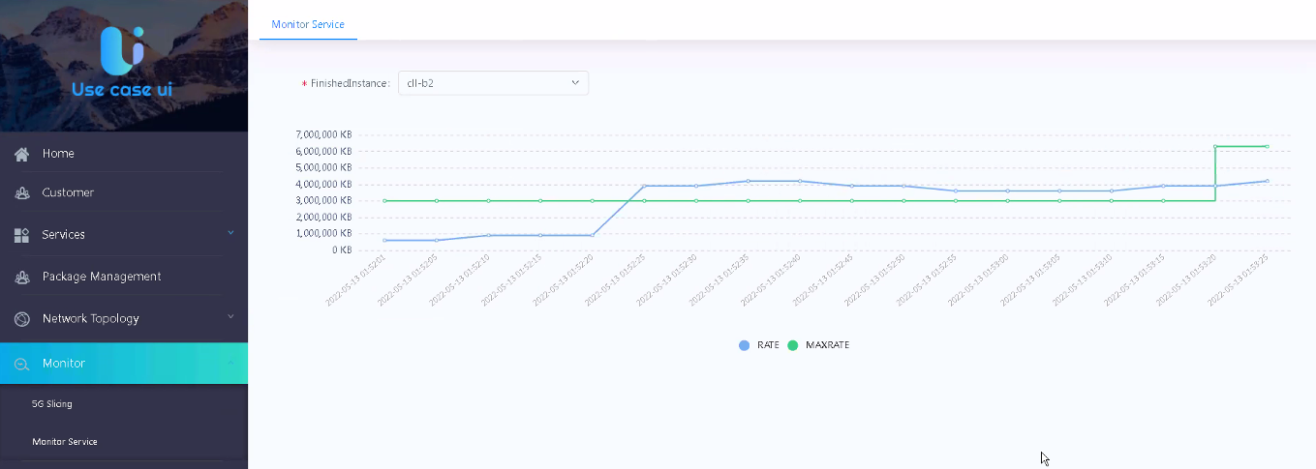
Content of the Demo
1. NLP Translation of User Intent
Text: I need a service from Company A to Cloud one, with a bandwidth of 1Gbps.
2. Intent creation and deletion
3. Intent modification
4. Bandwidth monitor & closed-loop

Slide 13
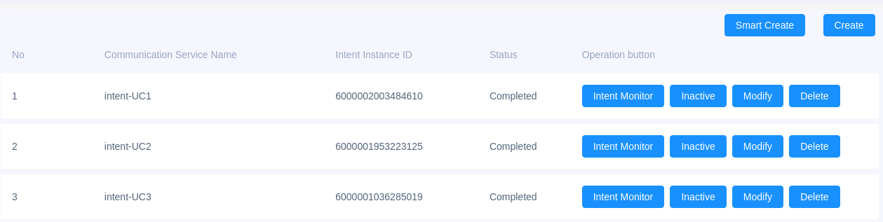
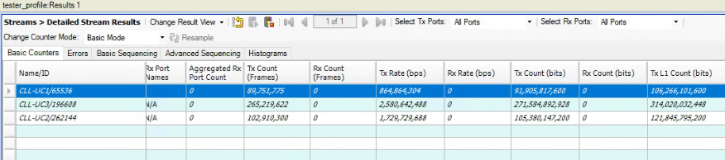
Three-level Verification of Each Test Case
Intent Management Level: Verify user intent model values and life cycle operation
Network Configuration Level: Verify network inventory and configuration data are correct and consistent with the Intent operation
Datapath Level: Verify data traffic patterns are consist with the network configurations

Slide 14






ZSM PoC#3 Milestones
Milestone | Date
PoC project start | Jan 2022
Demo 1: Automated CLL service creation, modification and deletion (simulated hardware) | May 2022 (ZSM#19)
Demo 2: Closed-loop operations for CLL service assurance (simulated hardware) | May 2022 (ZSM#19)
Demo 3: CLL service automation and closed-loop operations with real hardware and real data traffic | Nov 2022 (ZSM#21)
Final report: Contribution on lessons learned from the PoC | Dec 2022
PoC project end | Dec 2022
ZSM PoC#3 Team Members
China Telecom
China Mobile
China Unicom
Huawei Technologies
AsiaInfo Technologies
Xidian University

