Slide 1
Intent-driven Operating for Cloud-network Convergence Services
Usecase Subcommittee Review
16th Jan, 2023
REQ Owners: Dong Wang (China Telecom), Henry Yu (Huawei), Lei Shi (AsiaInfo), Yaohua Sun (BUPT),
Ahila Pandaram (Wipro), Kevin Tang (STL), Keguang He (CMCC), Chungang Yang (XDU)

Slide 2
Outline
1
Intent-driven Closed-loop Autonomous Networks
2
Implementation of IBN from R8 (Honolulu) to R11 (Kohn)
3
REQ of R12 Intent-driven Operating for Cloud-network Convergence

Slide 3

Intent-driven Closed-loop Autonomous Networks based on ONAP Projects
create
user
A self-driving network that uses decoupling network control logic and closed-loop orchestration techniques to automate application intents.
An intelligent network, which can automatically convert, verify, deploy, configure, and optimize itself to achieve target network state according to the intent of the operators, and can automatically solve abnormal events to ensure the network reliability.
Audio/Text
update
Form
UUI
Monitor
usecase
NLP
Usecase UI
create a new service
Intent Interaction
save into intent instance
AAI
listen in updated intent
Intent
Instance
usecase
Active and Available Inventory
DCAE
SO
Data Collection, Analytics, and Events
Service Orchestrator
Policy
Intent Guarantee
SDN-C
Controllers
Networks
Architecture of Intent-driven Closed-loop Autonomous Networks

Slide 4
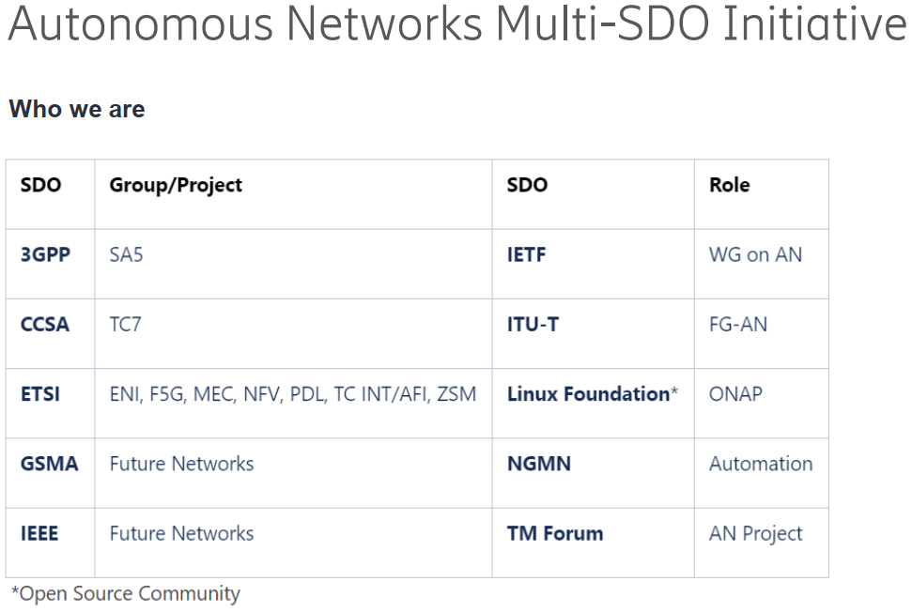








Collaborations among Academics, SDOs and ONAP
A Survey on Intent-Driven Networks
A Brief Survey and Implementation on Refinement for Intent-Driven Networking
Academics
Academic exchanges
Open-source
Align with Multi-SDO
SDOs
IETF/IRTF:
Intent-Based Networking - Concepts and Definitions
Intent Classification
ETSI ZSM/ENI:
ZSM 011 Intent-driven autonomous networks; Generic aspects
ENI 008 InTent Aware Network Autonomicity (ITANA)
TMF:
IG1234 Intent Oriented Customer Engagement (IoCE) Guide
IG1253 Intent in Autonomous Networks
3GPP SA5:
TS 28.312 Intent driven management services for mobile networks
TR 28.812 Study on scenarios for Intent driven management services for mobile networks
ITU-T:
Scenarios and Requirements of Intent-Based Network for network evolution
functional architecture of NGN evolution by adoption of Intent-Based Network
CCSA:
2015B58 Network Intelligent Capability Enhancement for SDN/NFV: Study of Key Technologies of Intent Network

Slide 5

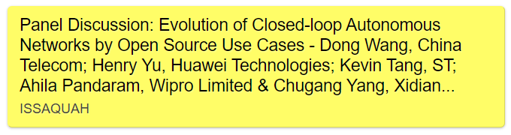
Outputs and Vision
Key Functions and Developments of Intent-based Networking in ONAP:
https://sched.co/1BKrX
REQ-453/ONAPARC-641 Smart Operator Intent Translation in UUI based on IBN - R8 5G Slicing Support
REQ-861/ONAPARC-701 Smart Intent Guarantee based on IBN - R9 Intent Instance
REQ-1074/ONAPARC-729 Smart Intent Guarantee based on Closed-loop in R10
REQ-1075/ONAPARC-730 Network Services without Perception for Users based on IBN
REQ-1214/ONAPARC-744 Maintenance and Enhancement of Intent-driven Closed-loop Autonomous Networks in R11
Focus on the evolution of future networks, and study new technologies, services and applications; based on the R&D of ONAP, provide a reference for the deployment of operators, verify new technologies with academics and promote the development of standardizations.
For intent-driven closed-loop autonomous networks, verify the key technologies of intelligent networks based on the scenes of fixed networks, mobile networks and cloud-network convergence by CCVPN and E2E Slicing use cases.
Collaborations and Outputs with SDOs (TMF / ETSI ZSM / ITU-T):
TMF Catalyst 2023: Intent-driven closed-loop autonomous services towards next-generation networks
ETSI ZSM PoC #3: Automation of Intent-based cloud leased line service
ITU-T: Scenarios and Requirements of Intent-Based Network for network evolution

Slide 6
Outline
1
Intent-driven Closed-loop Autonomous Networks
2
Implementation of IBN from R8 (Honolulu) to R11 (Kohn)
3
REQ of R12 Intent-driven Operating for Cloud-network Convergence

Slide 7
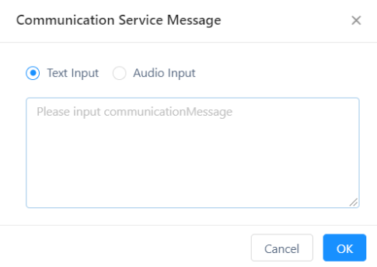
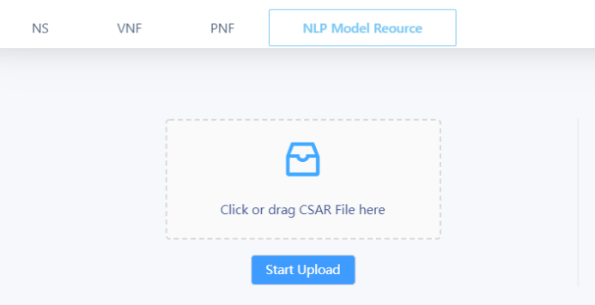
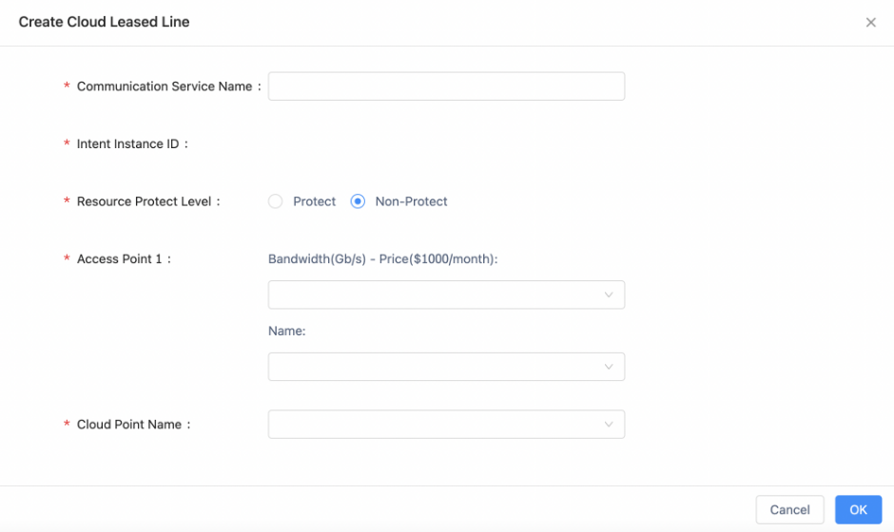
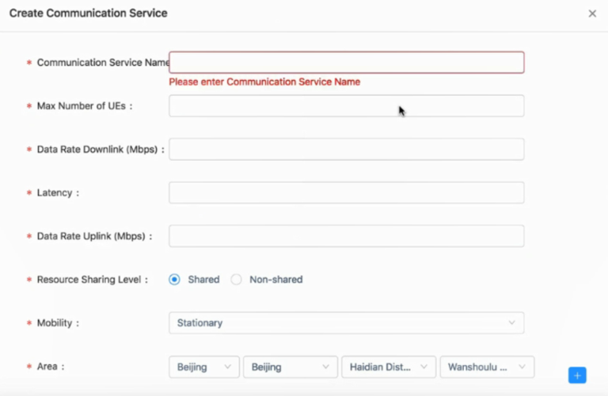
2.1 Intent Translation by NLP Algorithms
UUI
Target: translate from human inputs to network parameters based on NLP in UUI, choose a suitable usecase and then run the usecase in ONAP.
Parameter1: network service
(5G / Fixed network)
Input
Parameter2: scenario
Nature Language Processing
Text
Parameter3: throughput
Parameter4: latency
Voice
…
…
Parameter x: …
Parameter x+1: …
5G E2E Slicing
CCVPN

Slide 8
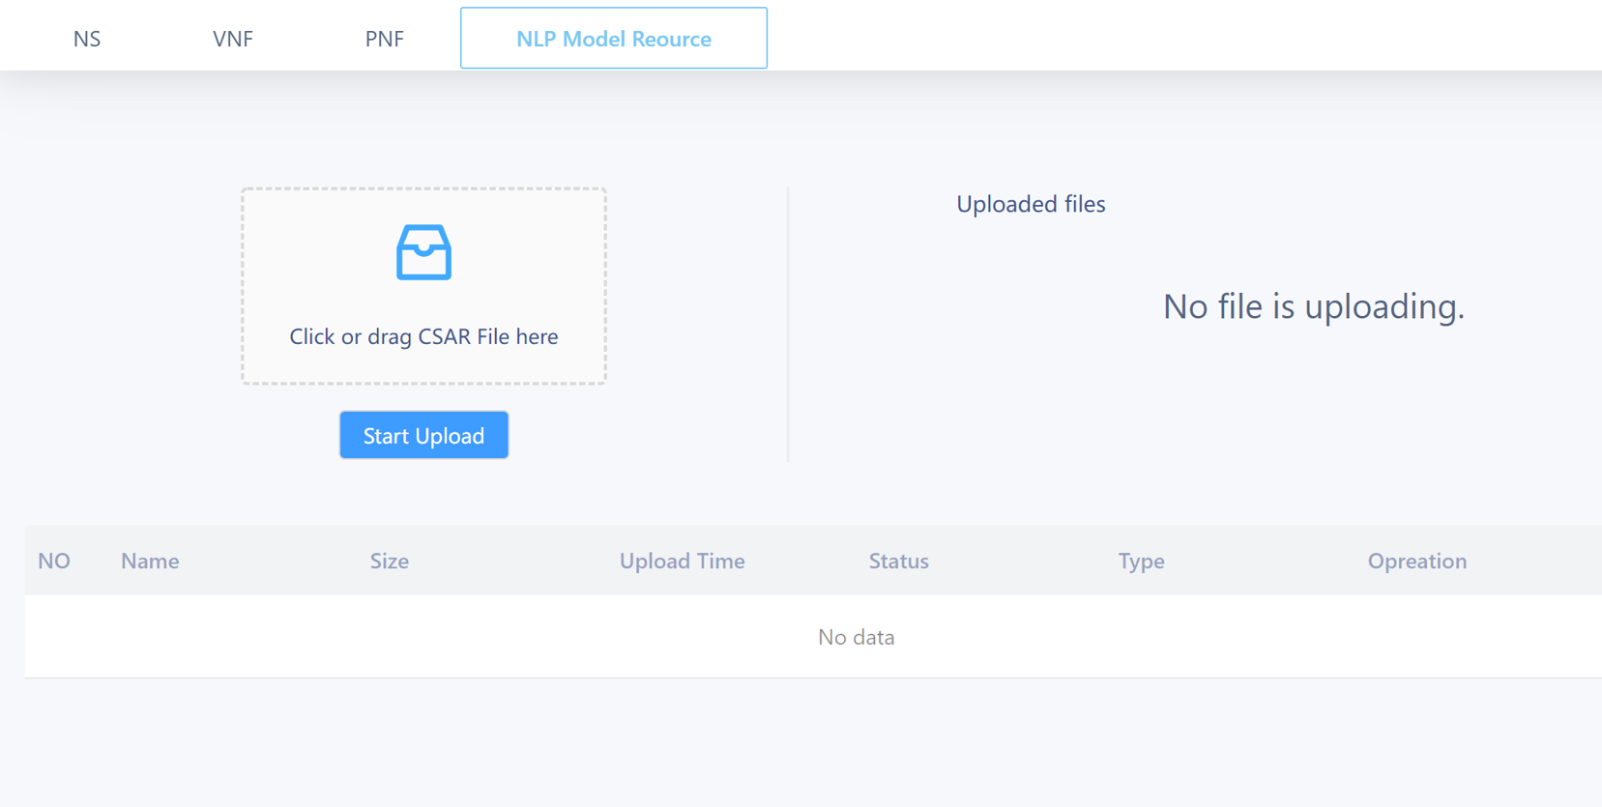
2.1 NLP Model Management
Key Features
NLP Model Management
Upload model
Delete model
Active/Inactive model
Select model for different usecases in same AI framework and microservice
Screenshot of NLP Model Management

Slide 9
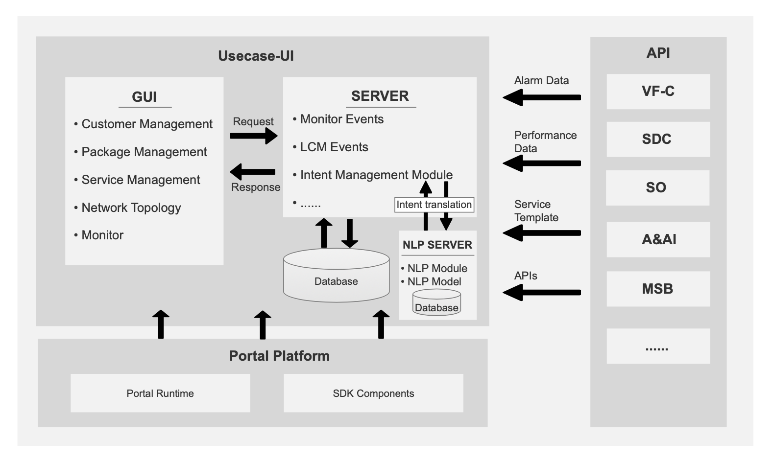
2.1 Enhancement of NLP platform and model in UUI
Support both TenserFlow and PyTorch frameworks to support more models
NLP SERVER
NLP Module 1
TenserFlow Framework
NLP Module 2
PyTorch Framework
Speech to Text Model
Intent Translation Model
Speech to Text Model
Intent Translation Model
Database
Components of UUI since Honolulu Release
Enhancement of NLP microservice in UUI
Acknowledgement: This work is supervised by the research team of GUIDE (Game, Utility, artificial Intelligent Design for Emerging Communications) in Xidian University.

Slide 10
2.2 Intent Instance in AAI
Functions: Intent Instance is created to save the users’ real-time intent (network parameters) and connected service ID (CCVPN service ID / E2E Slicing CSI ID) in AAI.
Intent Instance Applied in AAI:
1. Intent Instance is created to save the users’ real-time intent in Active and Available Inventory. The other records related to the intents are not real-time, which are saved in the independent database in UUI, and will be saved in CPS in further releases.
2. The target of Intent-based Networking is to develop to support multiple usecase services, so it is not a sub-node of any usecase in AAI. And IBN provides network services without perception for users. Multiple usecase services could be switched by IBN for a same user.
3. DCAE keeps listening to the updated intent from AAI for monitoring.
UUI
DCAE
Service-instance (Intent Instance)
serviceID: String
serviceType: String
intentContent: String
AAI
serviceType: ‘CCVPN’, ‘E2ESlicing’

Slide 11
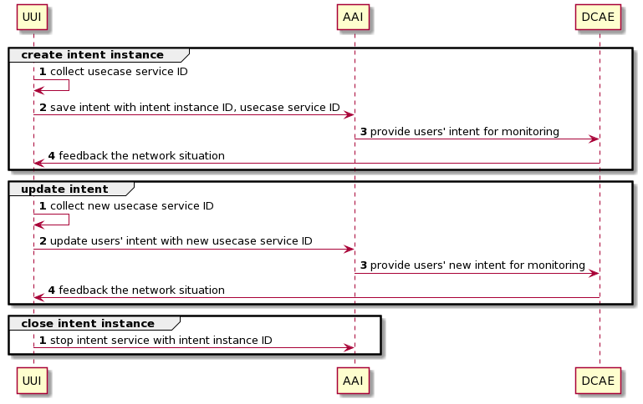
2.2 Workflow of Intent Management
*1. A usecase service ID includes the service instance ID of CCVPN or CSI ID of E2E Slicing, which is collected in UUI after creating a new service.

Slide 12









2.3 Intent-driving E2E Slicing Usecase
New service
Optimization (OOF)
Co-ordination, Decisions
(Policy)
User
UUI
DCAE
Update intent
Usecase UI
5G Slicing KPI Monitor
SO action when create a new service
Data Collection,
& Analysis
(DCAE)
Save into Intent Instance
Action
(SO)
AAI
Intent
Instance
Listen in updated intent
Control loop
Active & Available Inventory
Domain
Controllers
5G network
FM, PM data
Intent-based Networking
5G Network
Closed-loop Autonomous Networks

Slide 13
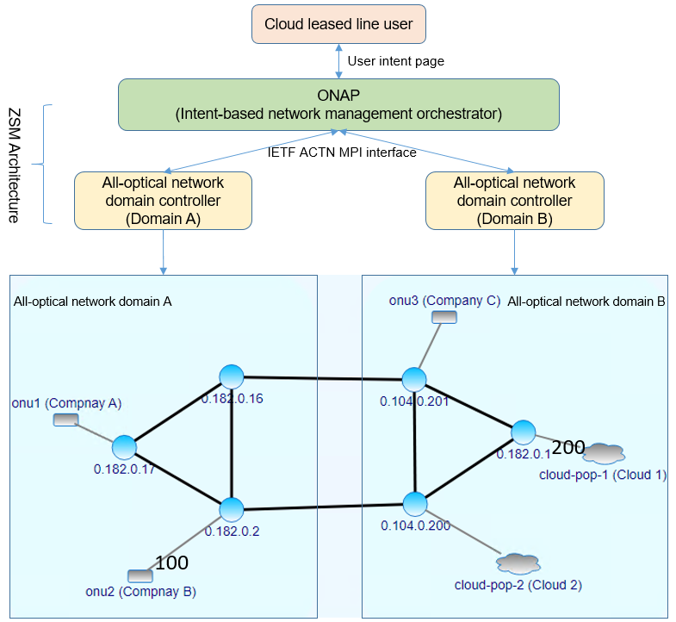
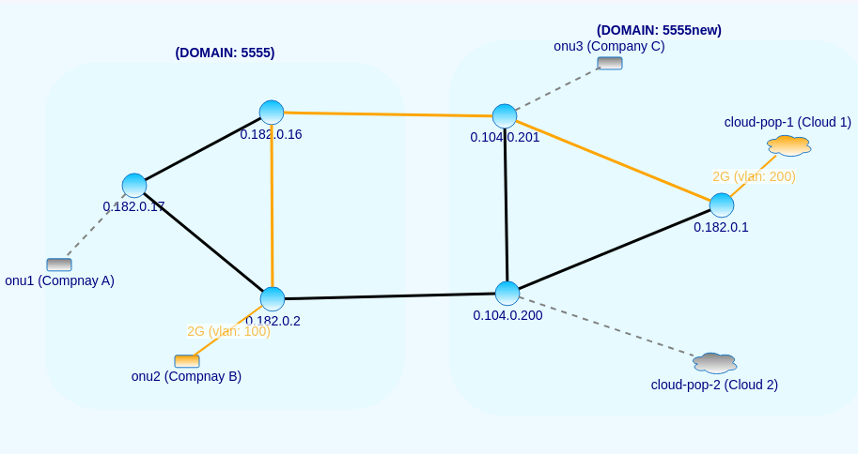
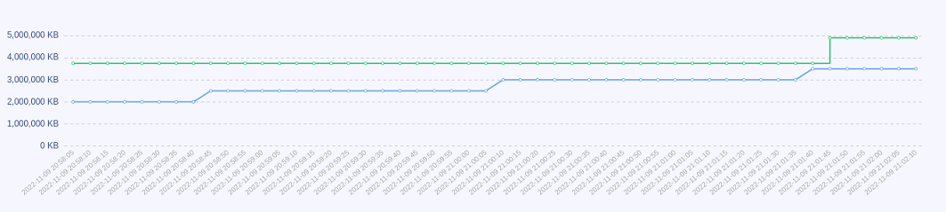
2.4 CCVPN: Automation of Intent-based cloud leased line service
I need a connection from company B to Cloud one, with a bandwidth of 2Gbps
Translate and create
Bandwidth monitoring and guarantee
ETSI ZSM PoC #3: Automation of Intent-based cloud leased line service

Slide 14
Outline
1
Intent-driven Closed-loop Autonomous Networks
2
Implementation of IBN from R8 (Honolulu) to R11 (Kohn)
3
REQ of R12 Intent-driven Operating for Cloud-network Convergence

Slide 15
3. Cloud-network Convergence by extending CCVPN usecase
create
user
Cloud leased line service:
Audio/Text
update
Form
UUI
Monitor
usecase
NLP
Bandwidth
Reliability
Delay
Usecase UI
create a new service
Intent Interaction
+
save into intent instance
AAI
listen in updated intent
Intent
Instance
usecase
Active and Available Inventory
DCAE
SO
Data Collection, Analytics, and Events
Service Orchestrator
Policy
Intent Guarantee
Cloud service:
CPU
GPU
Memory
Hard-drive
SDN-C
Controllers
REST API
Network
Cloud
Cloud-network Convergence Services by ONAP
ITU-T Y.2501 Computing power network - Framework and architecture
ITU-T Y.NGNe-O-CPN-reqts: Requirements and framework of NGNe orchestration enhancements for supporting computing power network

Slide 16
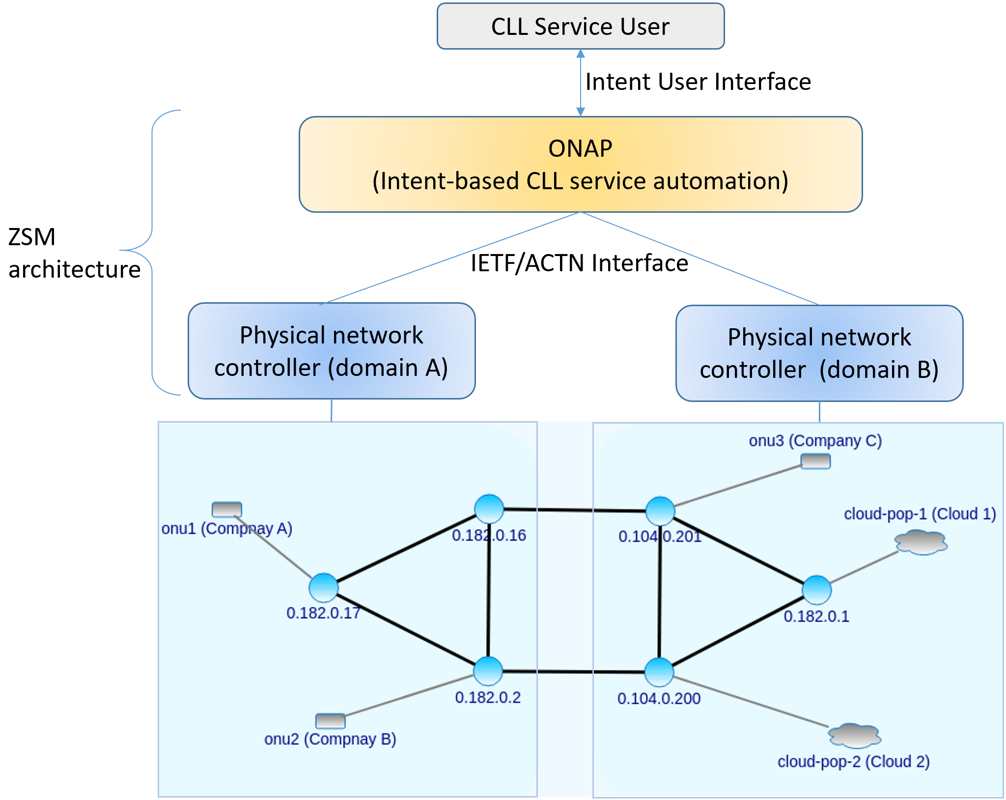
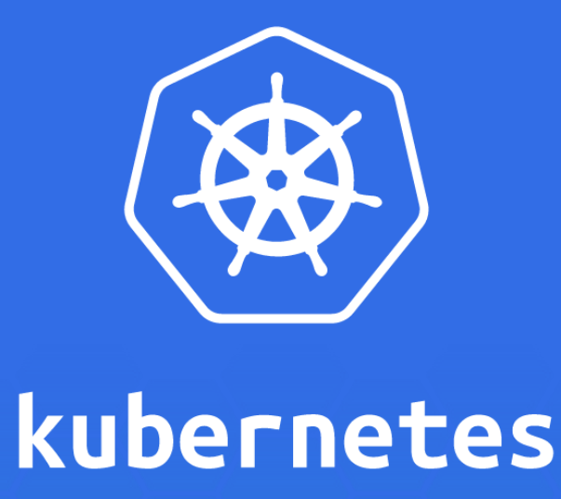

3. Cloud-network Convergence by extending CCVPN usecase
REST API
kube-api-server
Cloud 1
cloud-pop-1
ETSI ZSM PoC #3: Automation of Intent-based cloud leased line service
Acknowledgement: This work is supervised by the research team of Prof. Mugen Peng in Beijing University of Posts and Telecommunications.

Slide 17
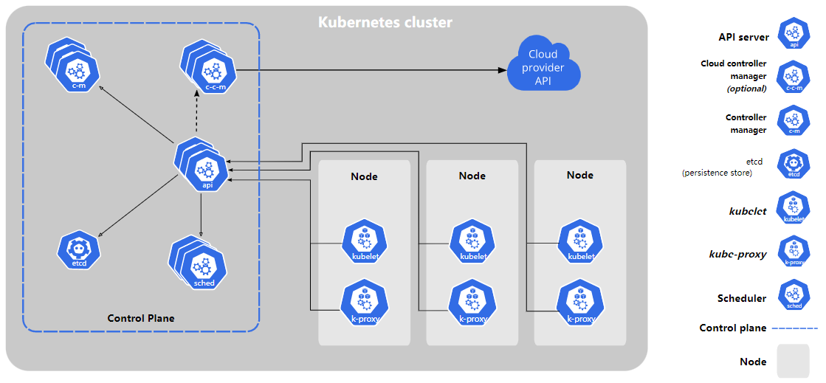
3. Functions of SDN-C/Kubernetes API
SDN-C
REST API
Functions:
Deployment, access & authentication
Pods creation & lifetime management
Network access configuration
https://kubernetes.io/docs/concepts/overview/kubernetes-api/

Slide 18
Thanks!

Slide 19
REQ-1411: Intent-driven Operating for Cloud-network Convergence Services
Intent-based networking is applied to support the smart interaction between users (customers/operators) and networks. Based on the closed-loop automation of ONAP, the proposal of Intent-driven Closed-loop Autonomous Networks is proposed for the smart operation of networks. In R12, the proposal enhances the functions of Intent-driven Operating for Cloud-network Convergence Services based on CCVPN usecase.
Key Contacts - Dong Wang (China Telecom), Henry Yu (Huawei), Lei Shi (AsiaInfo), Yaohua Sun (BUPT)
Executive Summary - Intent-based networking (IBN) is a self-driving network that uses decoupling network control logic and closed-loop orchestration techniques to automate application intents. An IBN is an intelligent network, which can automatically convert, verify, deploy, configure, and optimize itself to achieve target network state according to the intent of the operators, and can automatically solve abnormal events to ensure the network reliability. In R12, the proposal enhances the functions of Intent-driven Operating for Cloud-network Convergence Services based on CCVPN usecase.
Business Impact - It is a challenging problem for networks to satisfy users’ intents in real time. The REQ intent-based networking provides intent interaction and guarantee functions for users.
Business Markets - This REQ provides a novel solution of Intent-driven Closed-loop Autonomous Networks with two closed-loops, intent interaction closed-loop and intent guarantee closed-loop. And intent instance is used to manage users’ real-time intents.
Funding/Financial Impacts - Intent-based networking simplifies interaction and network configuration to save OPEX cost. It also provides the services to satisfy users’ real-time intents, so as to increase the income of operators with few investments.
Organization Mgmt, Sales Strategies - There is no additional organizational management or sales strategies for this requirement outside of a service providers "normal" ONAP deployment and its attendant organizational resources from a service provider.

Slide 20
Projects Impact
Project | Impact | Notes
UUI | Enhance the functions of intent translation for Cloud-network Convergence Services
AAI | n/a | re-use the Intent Instance node
SO | Enhance parameters of CCVPN | By CCVPN team
SDN-C | Rest API communicating with kube-api-server

