Slide 1
Alignment with 3GPP SA5 for Intent-driven Autonomous Services of E2E Slicing Usecase in R13
Architecture Subcommittee Review
11th July, 2023
REQ Owners: Dong Wang, Zhen Li (China Telecom), Xiqing Liu (BUPT)
Rongpeng Li (Zhejiang University), Chungang Yang (Xidian University)

Slide 2
Outline
1
Implementation of IBN with E2E Slicing Use case
2
Implementation of 3GPP SA5 about IBN and E2E Slicing
3
REQ of R13 Alignment with 3GPP SA5 for IBN with E2E Slicing

Slide 3
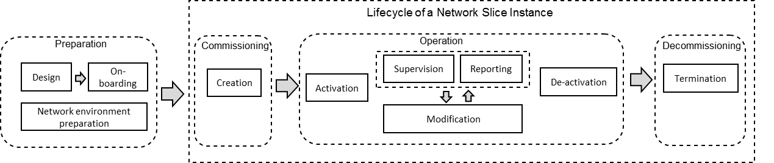
ONAP-based Slice Management - NSI Life Cycle View
Objective: Demonstrate e2e slice design instantiation and operation, including RAN, core and transport slice sub-nets
Ref.: 3GPP TS 28.530
Design and pre-provision: Creation of necessary slice/slice sub-net templates.
Instantiation/Configuration & Activation/Deactivation of NSIs, including instantiation/mapping of its constituent slice sub-nets (RAN, Core and Transport).

Slide 4










Intent-driving E2E Slicing Usecase
New service
Optimization (OOF)
Co-ordination, Decisions
(Policy)
User
UUI
DCAE
Update intent
Usecase UI
5G Slicing KPI Monitor
SO action when create a new service
Data Collection,
& Analysis
(DCAE)
Save into Intent Instance
Action
(SO)
AAI
Intent
Instance
Listen in updated intent
Control loop
Active & Available Inventory
Domain
Controllers
5G network
FM, PM data
Intent-based Networking
5G Network
Closed-loop Autonomous Networks

Slide 5
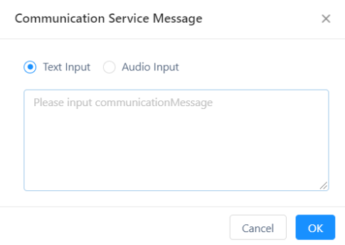
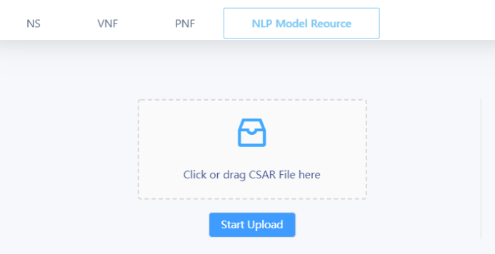
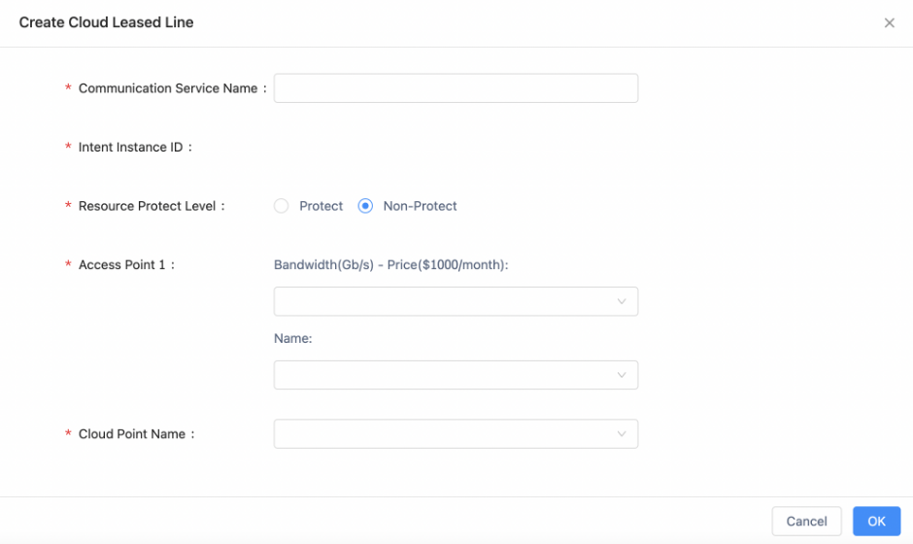
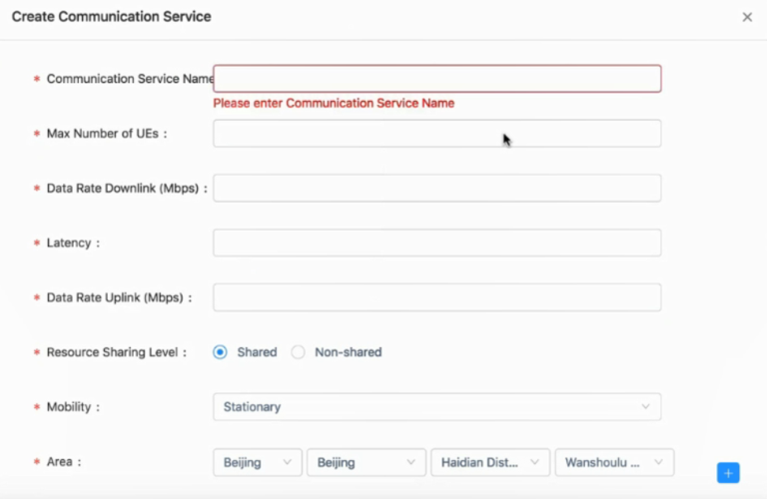
Intent Translation by NLP Algorithms
UUI
Target: translate from human inputs to network parameters based on NLP in UUI, choose a suitable usecase and then run the usecase in ONAP.
Parameter1: network service
(5G / Fixed network)
Input
Parameter2: scenario
Nature Language Processing
Text
Parameter3: throughput
Parameter4: latency
Voice
…
…
Parameter x: …
Parameter x+1: …
5G E2E Slicing
CCVPN

Slide 6
Outline
1
Implementation of IBN with E2E Slicing Use case
2
Implementation of 3GPP SA5 about IBN and E2E Slicing
3
REQ of R13 Alignment with 3GPP SA5 for IBN with E2E Slicing

Slide 7
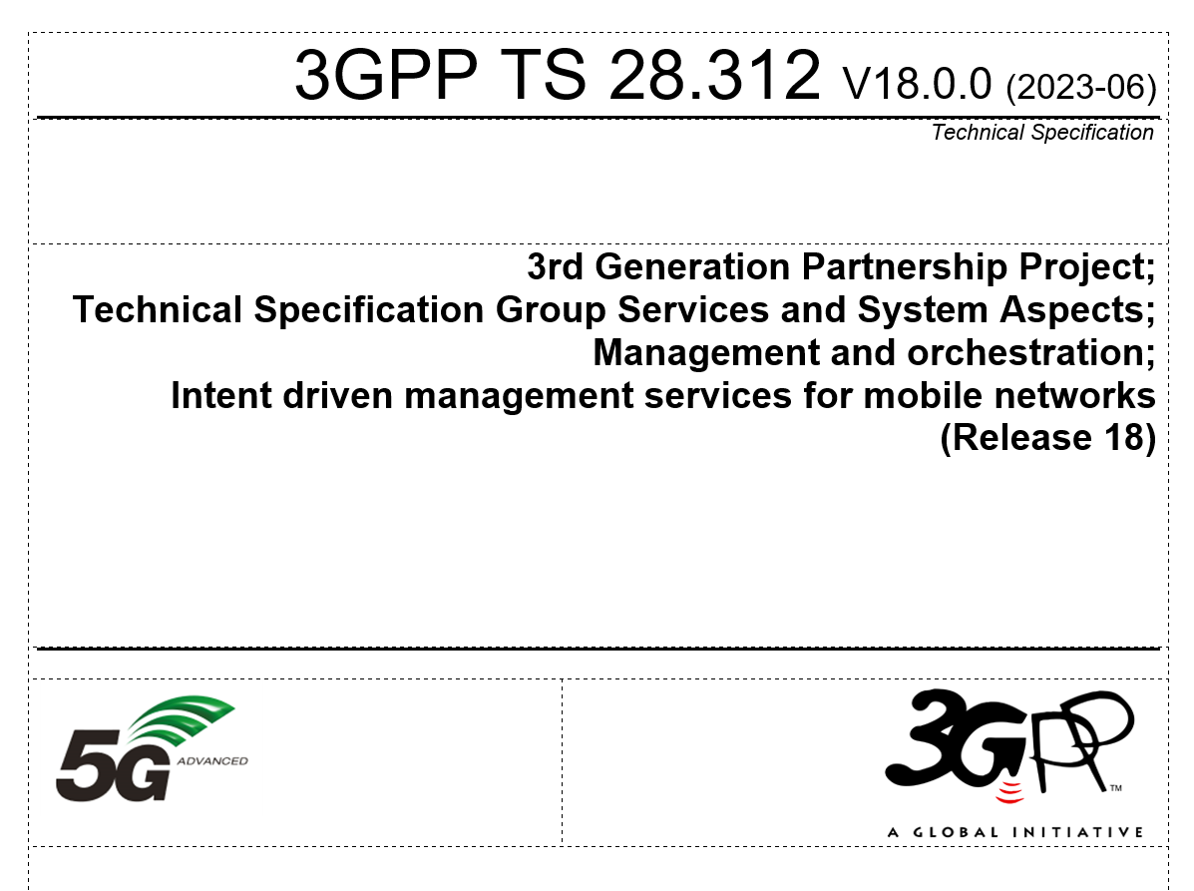
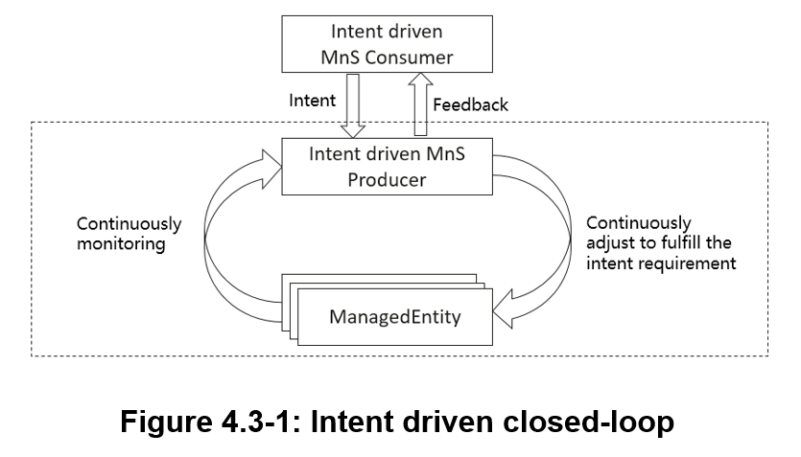
Standardization Works in 3GPP SA5

Slide 8
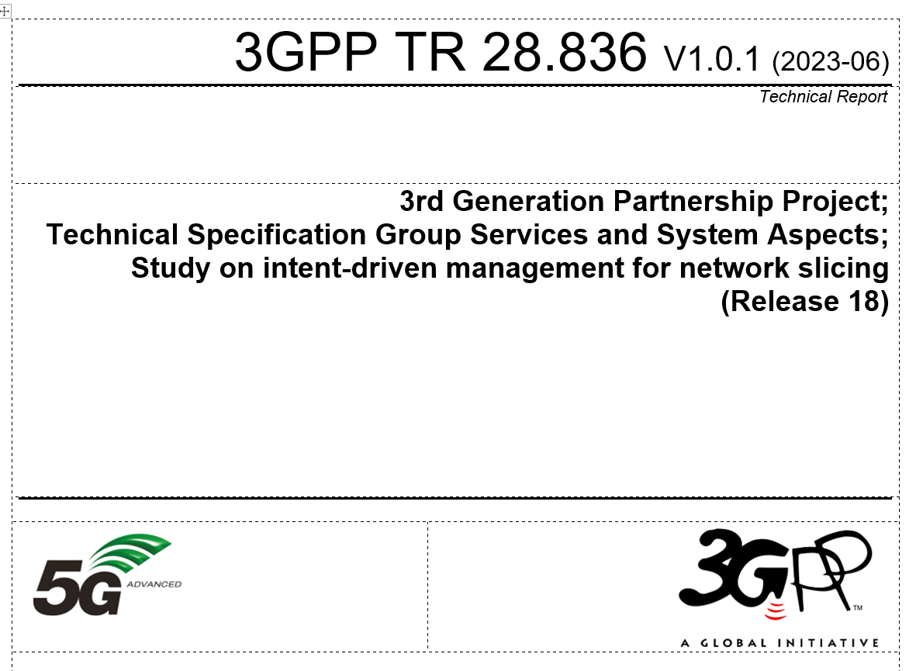
Standardization Works in 3GPP SA5
On going works…
5.1 Intent driven management for Network slice life cycle management
5.2 Intent driven management for network slice service assurance

Slide 9
Outline
1
Implementation of IBN with E2E Slicing Use case
2
Implementation of 3GPP SA5 about IBN and E2E Slicing
3
REQ of R13 Alignment with 3GPP SA5 for IBN with E2E Slicing

Slide 10
Alignment Tasks
Deploy E2E Slicing usecase following the Guide of R9 Istanbul Release and R10 Jakarta Release, fix the bugs and update the User Operation Guidance for R13.
Align with TS 28.312 on Intent driven management services for mobile networks and TR28.836 on intent-driven management for network slicing.
Optional:
Align with other SA5 TSs for further development of Intent-driven Smart Slicing usecase.
Contribute to the Standardization Works of SA5.

Slide 11
REQ-1583: Alignment with 3GPP SA5 for Intent-driven Autonomous Services of E2E Slicing Usecase in R13
Intent-based networking is applied to support the smart interaction between users (customers/operators) and networks. Based on the closed-loop automation of ONAP, the proposal of Intent-driven Closed-loop Autonomous Networks is proposed for the smart operation of networks. In R13, the work proposes to align with 3GPP SA5 for Intent-driven Autonomous Services of E2E Slicing Usecase.
Key Contacts - Dong Wang, Zhen Li (China Telecom), Xiqing Liu (BUPT), Rongpeng Li (Zhejiang University), Chungang Yang (Xidian University)
Executive Summary - Intent-based networking (IBN) is a self-driving network that uses decoupling network control logic and closed-loop orchestration techniques to automate application intents. An IBN is an intelligent network, which can automatically convert, verify, deploy, configure, and optimize itself to achieve target network state according to the intent of the operators, and can automatically solve abnormal events to ensure the network reliability. In R13, the work proposes to align with 3GPP SA5 for Intent-driven Autonomous Services of E2E Slicing Usecase.
Business Impact - It is a challenging problem for networks to satisfy users’ intents in real time. The REQ intent-based networking provides intent interaction and guarantee functions for users.
Business Markets - This REQ provides a novel solution of Intent-driven Closed-loop Autonomous Networks with two closed-loops, intent interaction closed-loop and intent guarantee closed-loop. And intent instance is used to manage users’ real-time intents.
Funding/Financial Impacts - Intent-based networking simplifies interaction and network configuration to save OPEX cost. It also provides the services to satisfy users’ real-time intents, so as to increase the income of operators with few investments.
Organization Mgmt, Sales Strategies - There is no additional organizational management or sales strategies for this requirement outside of a service providers "normal" ONAP deployment and its attendant organizational resources from a service provider.

Slide 12
Projects Impact
Project | Impact | Notes
UUI | Align with 3GPP SA5 TS28.312 Management and orchestration; Intent driven management services for mobile networks Contribute to TR28.836 on intent-driven management for network slicing
SO | Test the slicing life cycle management functions based on intent

Slide 13
Thanks!

