Slide 1
ONAP: Streamlining – The Process
Update
August 3rd, 2023
Presenters
Magnus Buhrgard, Byung-Woo Jun (Ericsson)
ARCCOM (Byung-Woo Jun +)
SECCOM (Pawel Pawlak, Amy Zwarico +)
OOM (Andreas Geissler, Florian Bachmann +)

Slide 2
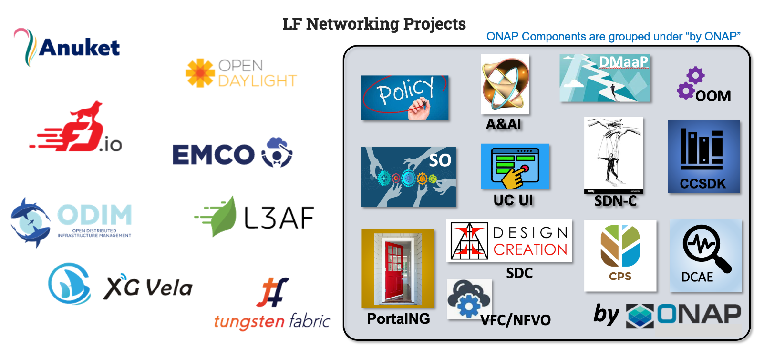
ONAP Streamlining - Proposal
Modularity & independent management
  Stand-alone component
Interface abstraction & loose coupling
  Including standardization where possible
Extensibility & interchangeability
Scalability (component addition, update and deletion without disruption) – native Cloud-based
Autonomous self management
Design for general use (ONAP & non-ONAP consumers)
Conformance to industry security & logging
Clustering components by use cases
  Selection of the best components for a particular task in systems
  Responsive integration and delivery
  ONAP still can provide reference automation for coordination
OOM is not a stand-alone product under "by ONAP". It is collection of scripts for component build, configuration and deployment. Also, it configures for security such as Ingress, oauth2-proxy and Istio.
https://wiki.onap.org/display/DW/ONAP+Streamlining+-+The+Process
Is this ONAP Streamlining proposal reasonable? Yes / No
Is it reasonable that OOM continues to support the “by ONAP” level common scripts, build, deployment, security & logging configurations? Yes / No
2

Slide 3
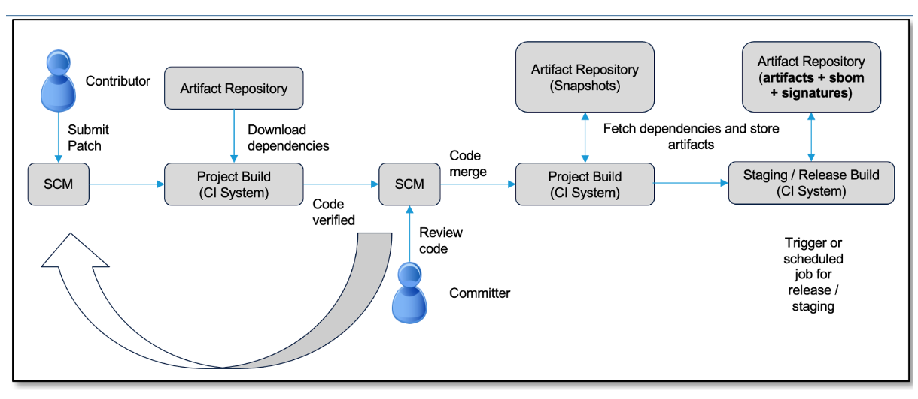
ONAP Streamlining – Component Build
Leveraging the existing LF-based CI pipeline, builds ONAP components
  Check-in ONAP component code and triggering build processes
  Thru the CI pipeline, each ONAP component will be built by scripts (e.g., modified OOM, or project-own scripts), along with SBOM
Helm chart separation, versioning concept and release management
  Currently, all the ONAP component helm charts have the same version number (e.g., 13.0.0). for a start,
    e.g., projects with PTLs can start with 13.0.0. as the major Montreal release, and they can play with minor version(s) based on their release cycle, e.g., 13.0.1, 13.1.0… Projects without PTLs (or no improvement) will have the major Montreal version, e.g., 13.0.0
    Other options: see, Break ONAP’s monolithic version schema (by Florian Bachmann), https://wiki.onap.org/display/DW/Proposal%3A+Break+ONAP%27s+monolithic+version+schema
PTLs need to determine granularities of project function exposures since a project can have multiple sub-components
  e.g., SO, SO-NFVO, SO-CNFM…
  In OOM, there are flags for the sub-component installation. As a result, exposed component scopes can be adjusted, as needed.
A common job will create all the ONAP charts.
Having a separate job per component will be investigated
The current LFN CI pipeline continues to be used for the ONAP component builds. A common job will create all the ONAP charts. A separate job per component will be investigated for the future release. Do you agree to this plan? Yes / No
3

Slide 4
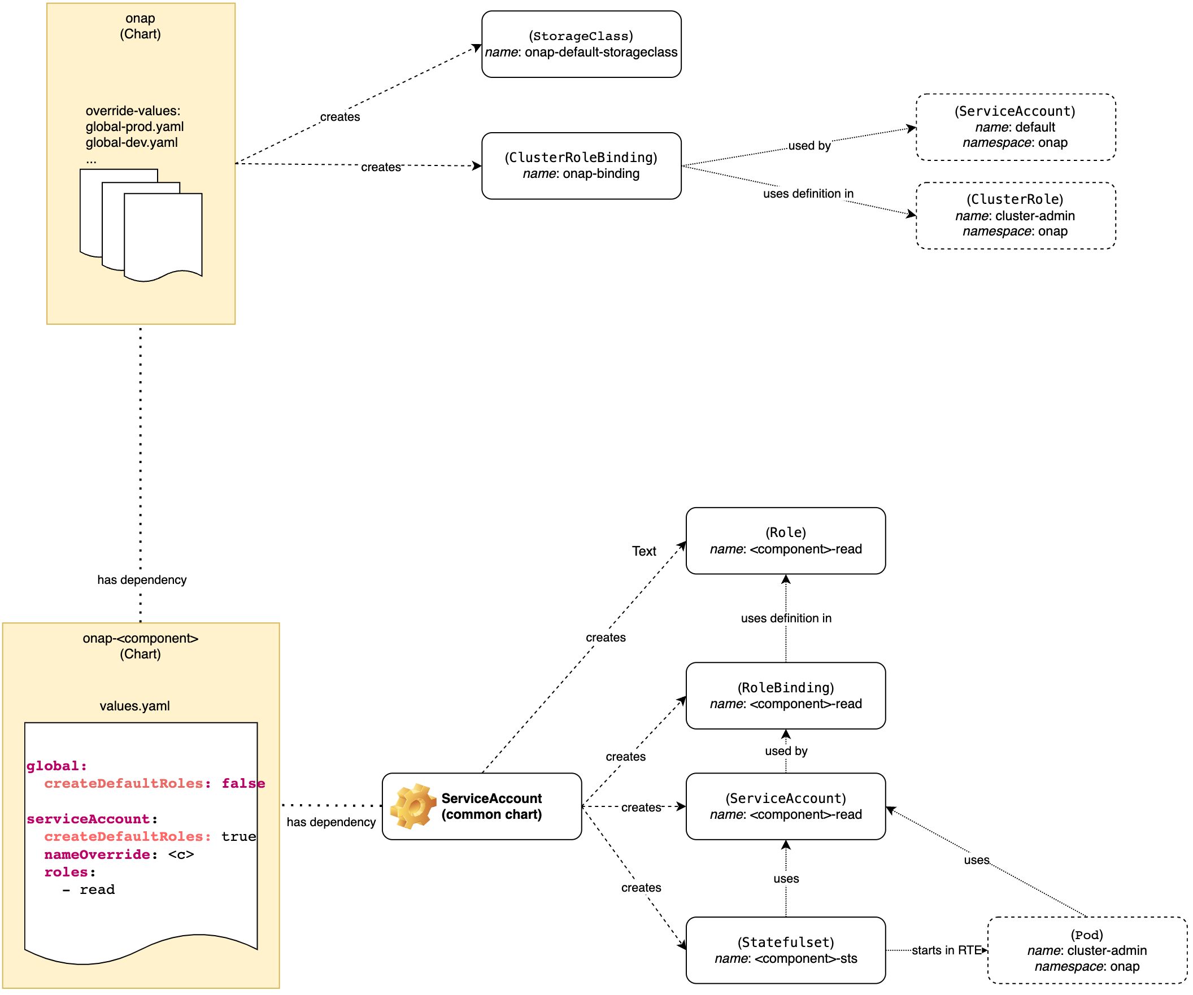
ONAP Deployment Dependencies
At ARCCOM, Andreas Geissler (DT) presented:
  ONAP deployment dependencies, https://wiki.onap.org/display/DW/ONAP+deployment+dependencies
    Proposed a solution for individual component deployment by creating local roles for each ONAP component
    As a result, ONAP components can be deployed without the ONAP master helm charts
    Andreas configured and tested this new configuration
The ONAP component charts will be decoupled from the ONAP master chart. So, the ONAP components can be deployed individually. Do you agree to this plan? Yes / No
4

Slide 5
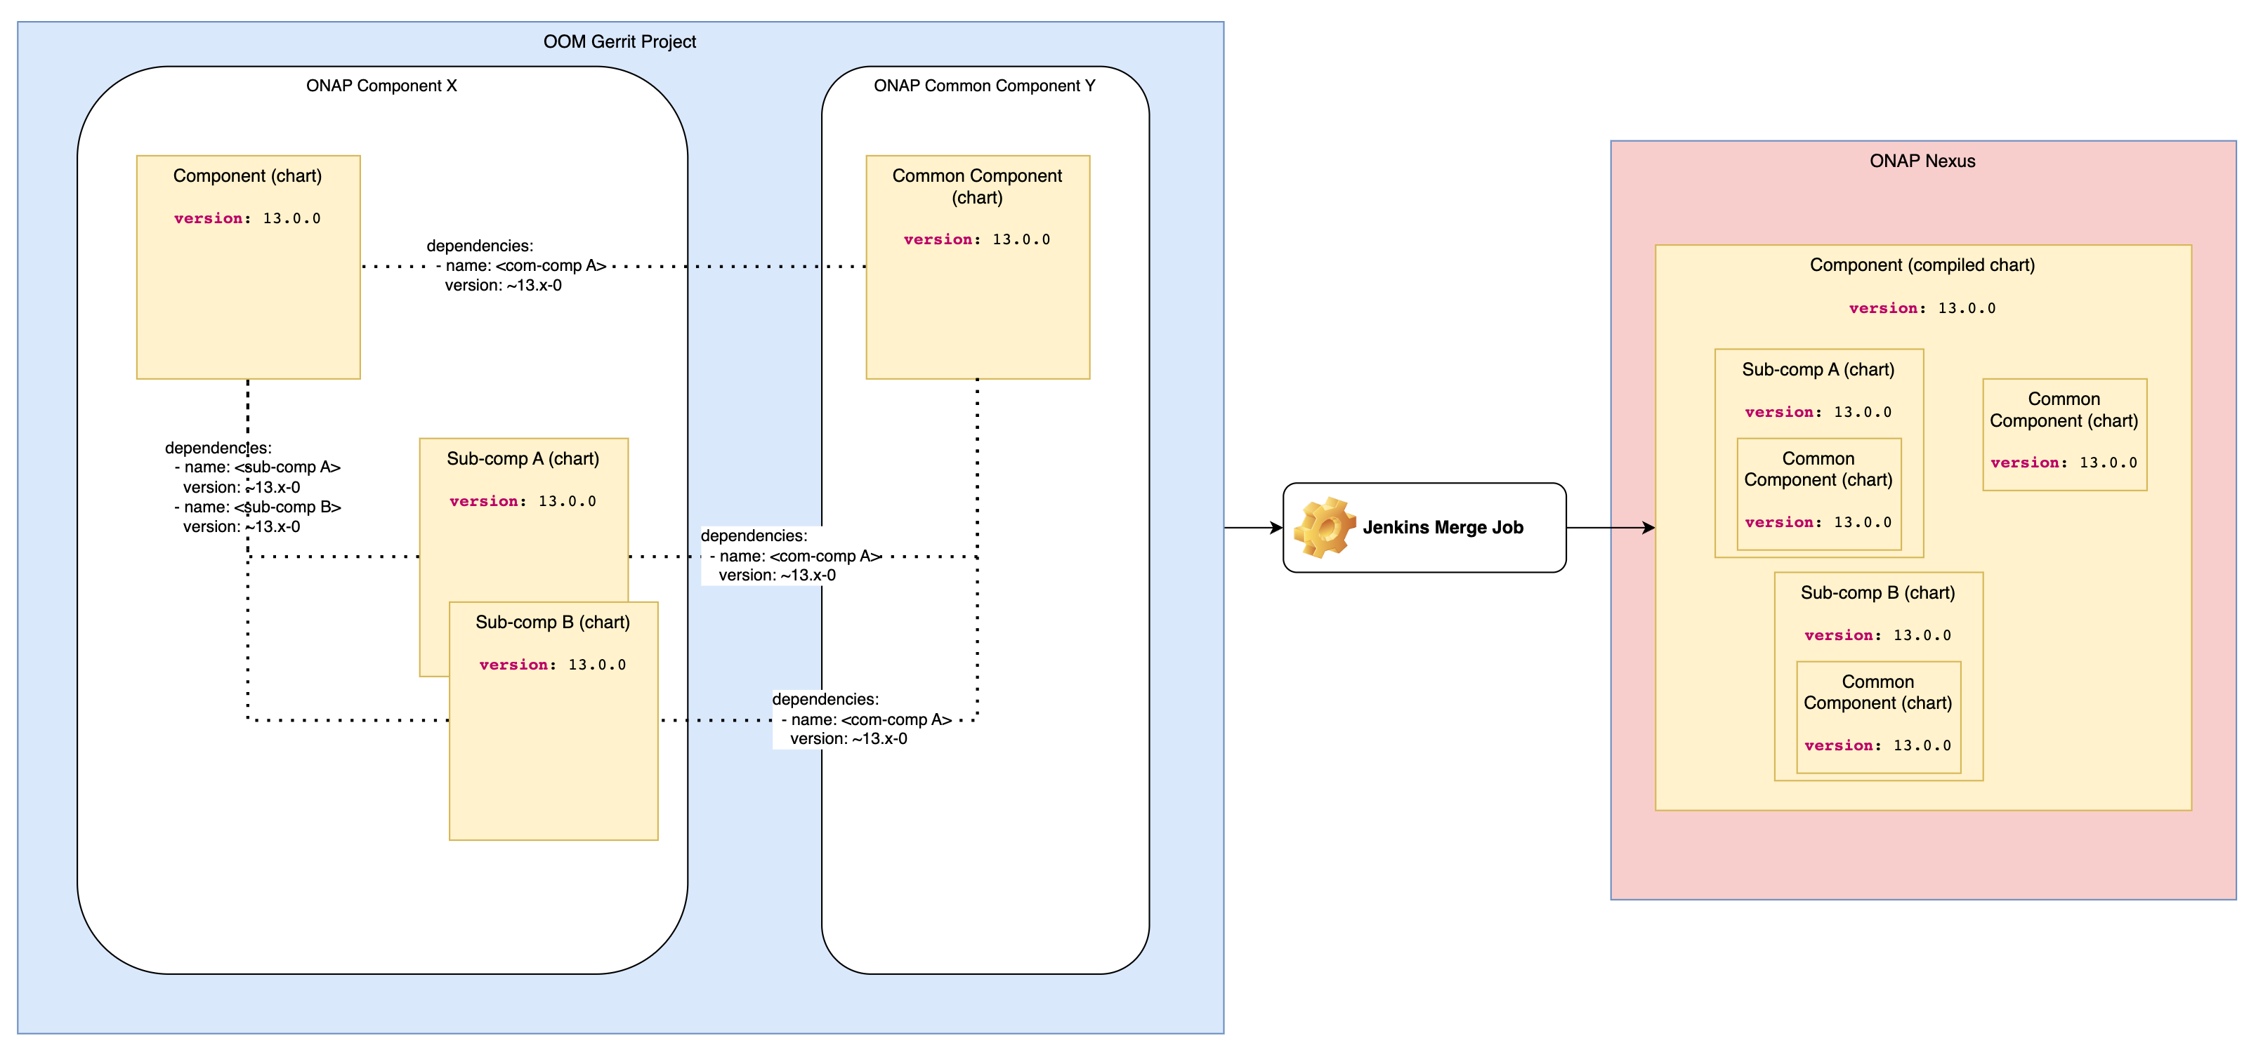
ONAP Helm Chart Dependencies
  ONAP helm chart dependencies, https://wiki.onap.org/display/DW/ONAP+Helm+chart+dependencies
    As a start, all ONAP charts, excluding unmaintained ones, of each release will start with “<rel>.0.0” (e.g., 13.0.0), then, the component minor and patch versions can be changed individually
      For additional options, see the ONAP version Schema options below
    In the normal setup, wildcards in dependencies will be used to pick up the latest version, but a project can set a specific target version
    If a new version of the “common” chart is introduced, each component chart (if wildcard is used) will add the new common chart
    The common chart upgrade needs to be carefully designed to minimize impacts to other ONAP components which depend on the common chart
    It is assumed that version update of a component and its sub-component(s) happens all together.
    For Montreal, a common Jenkins merge job will create all the ONAP compiled charts. A separate job option per component can be considered (to be investigated)
Do you agree to these new configuration rules for handling ONAP helm chart dependencies? Yes / No
5

Slide 6
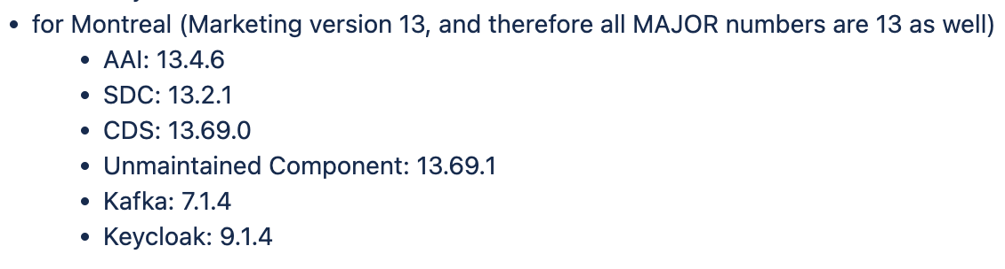
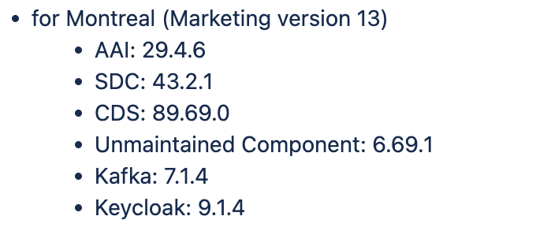
ONAP Version Schema Options
At ARCCOM, Florian Bachmann (DT) presented:
  ONAP version Schema options, https://wiki.onap.org/display/DW/Proposal%3A+Break+ONAP%27s+monolithic+version+schema
    Three possible solutions were proposed
    Option 1: Separate Marketing version (e.g., Montreal / 13) and component version
        The component version can be evolved based on the component feature / API changes individually, by following the SemVer scheme (SemVer.org)
        It could be a target goal, but considering ONAP build impacts, the Option 2 is preferred for Montreal
    Option 2: Use Marketing version as the MAJOR version
      The Marketing/Major version will represent the usual ONAP update cycle, e.g., Montreal/13
      All ONAP components excluding unmaintained ones will start with the same Marketing/Major.Minor.Patch version (e.g., 13.0.0) at the beginning
      Within the marketing/major release, each ONAP component can have multiple minor / patch versions depending on its development cycle(s)
    Option 3: Leave it as is. - this is “not” applicable for ONAP Streamlining
    It would be a study item for migrating from the Option 2 to the Option 1 in the future
Do you agree to the short-term and long-term plans for handling ONAP version controlling? Yes / No
Short-term plan (e.g., Montreal)
Long-term plan
for a future release (Marketing version xyz)
6

Slide 7
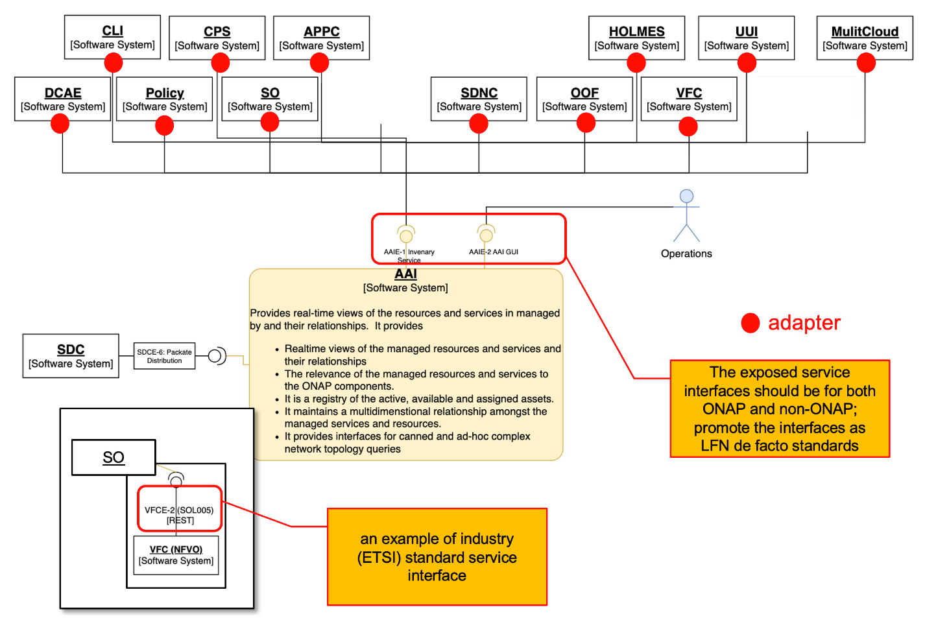
Component Interface Abstraction 1/2
ONAP component functions should be designed/used for/by not only ONAP but also non-ONAP.
ONAP component functions can be substituted and/or extended by vendors/operators
Component dependencies and couplings to other ONAP components should be removed.
  Those dependencies and couplings could be both syntactic and semantic
  Intra-ONAP component interfaces and communications should not be ONAP-specific.
  Aligning with standards where possible (e.g., ETSI NFV MANO, ASD, 3GPP SA5…) should be global requirements
  If there must be a deviation, that can be done in an extensible way that enables the standard-based approach
The exposed service interfaces should be for both ONAP and non-ONAP; promote ONAP component interfaces as LFN de facto standards
  If exposed service interfaces conform to industry standards (e.g., ETSI SOL005, ETSI SOL003, 3GPP SA5), the interactions between the service provider and consumer would be simplified (e.g., VFC case in this diagram)
For now, the service consumers can use “adapters” which choose a desired service interface
Action Points:
  Promote ONAP Component API models and interfaces as open-source de facto APIs
Do you agree to the plan for component interface abstraction and LFN-level de facto standardization? Yes / No
7

Slide 8
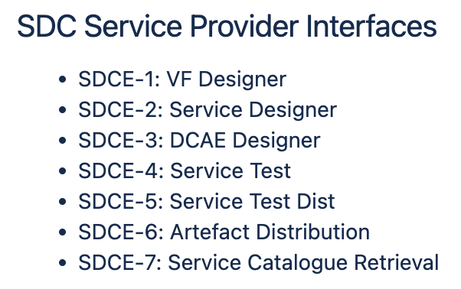
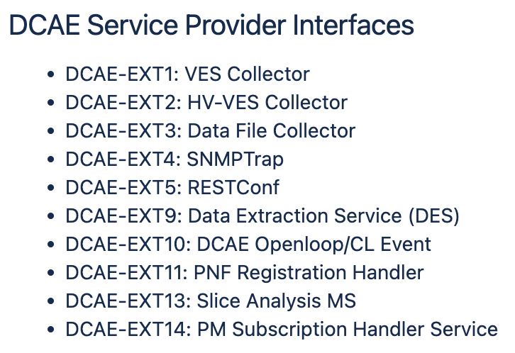
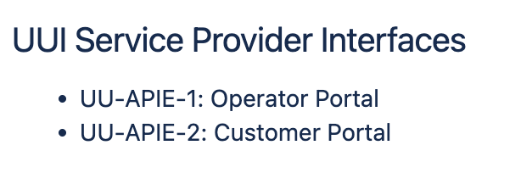
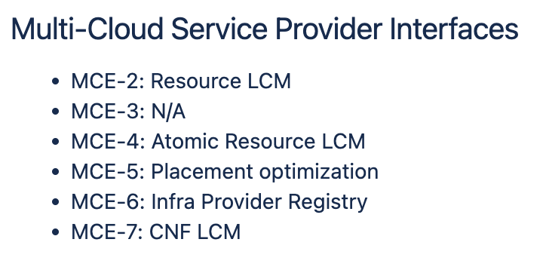
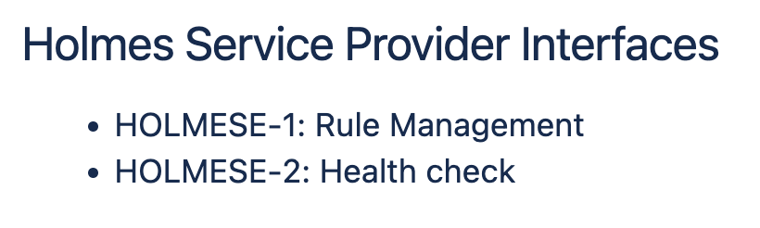
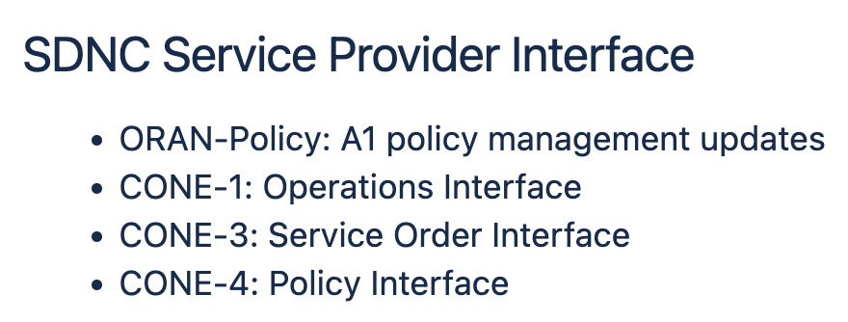
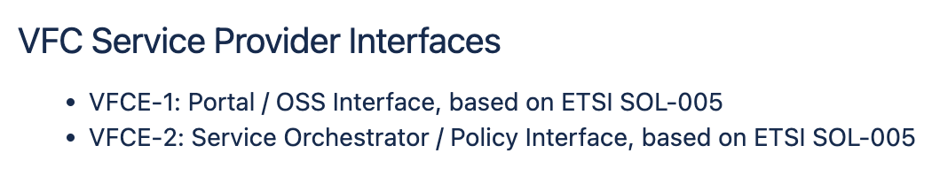
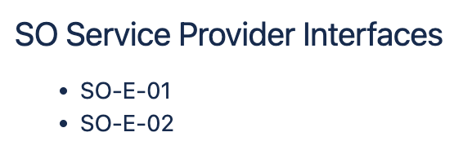
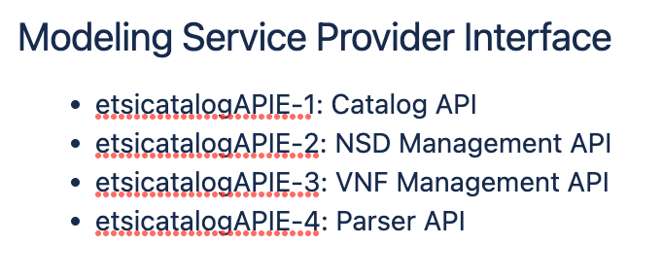
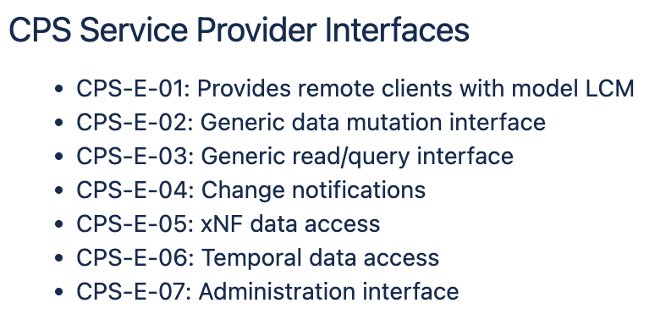
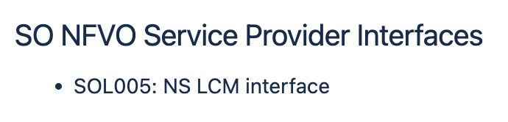
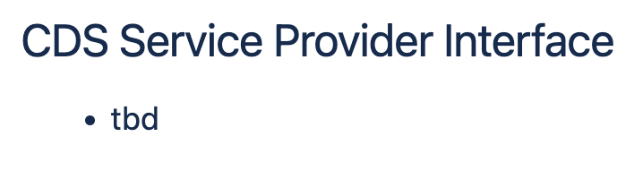
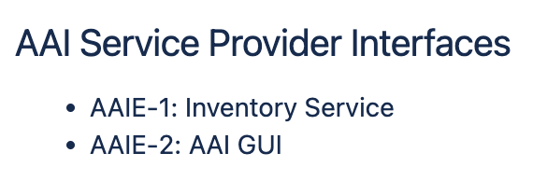
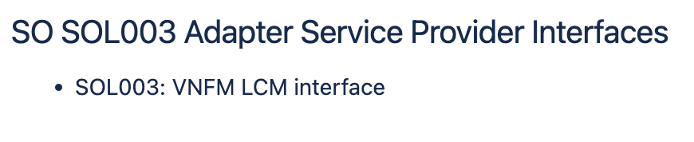
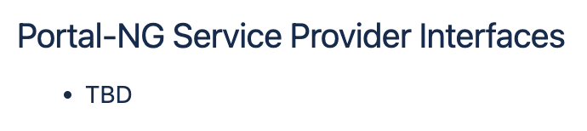
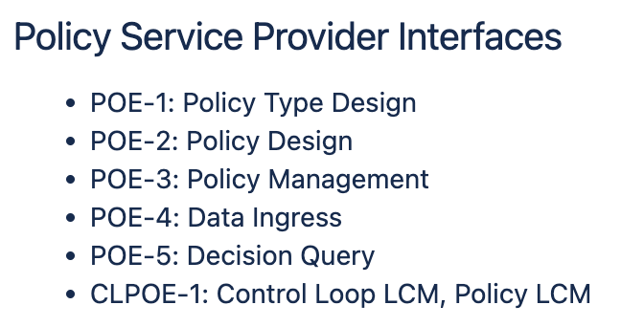
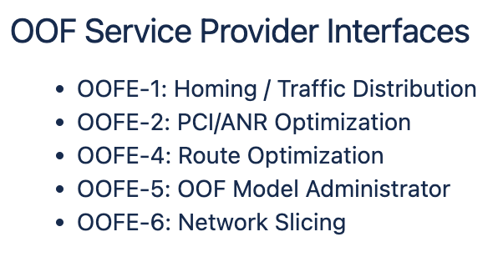
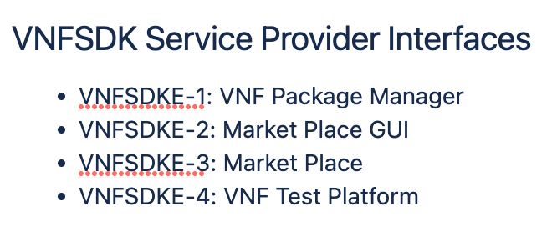
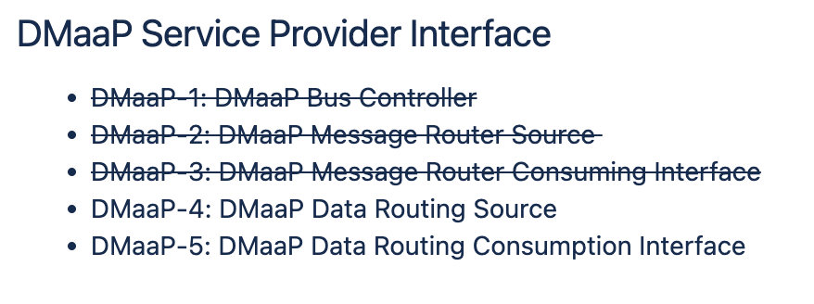
Component Interface Abstraction 2/2
Expose the ONAP component service API models and interfaces, as LFN-level de facto APIs for network automation.
  Create catalog of APIs for each ONAP project (Information Model, Data Model, OpenAPI)
Do you agree to this plan? Yes / No
8

Slide 9
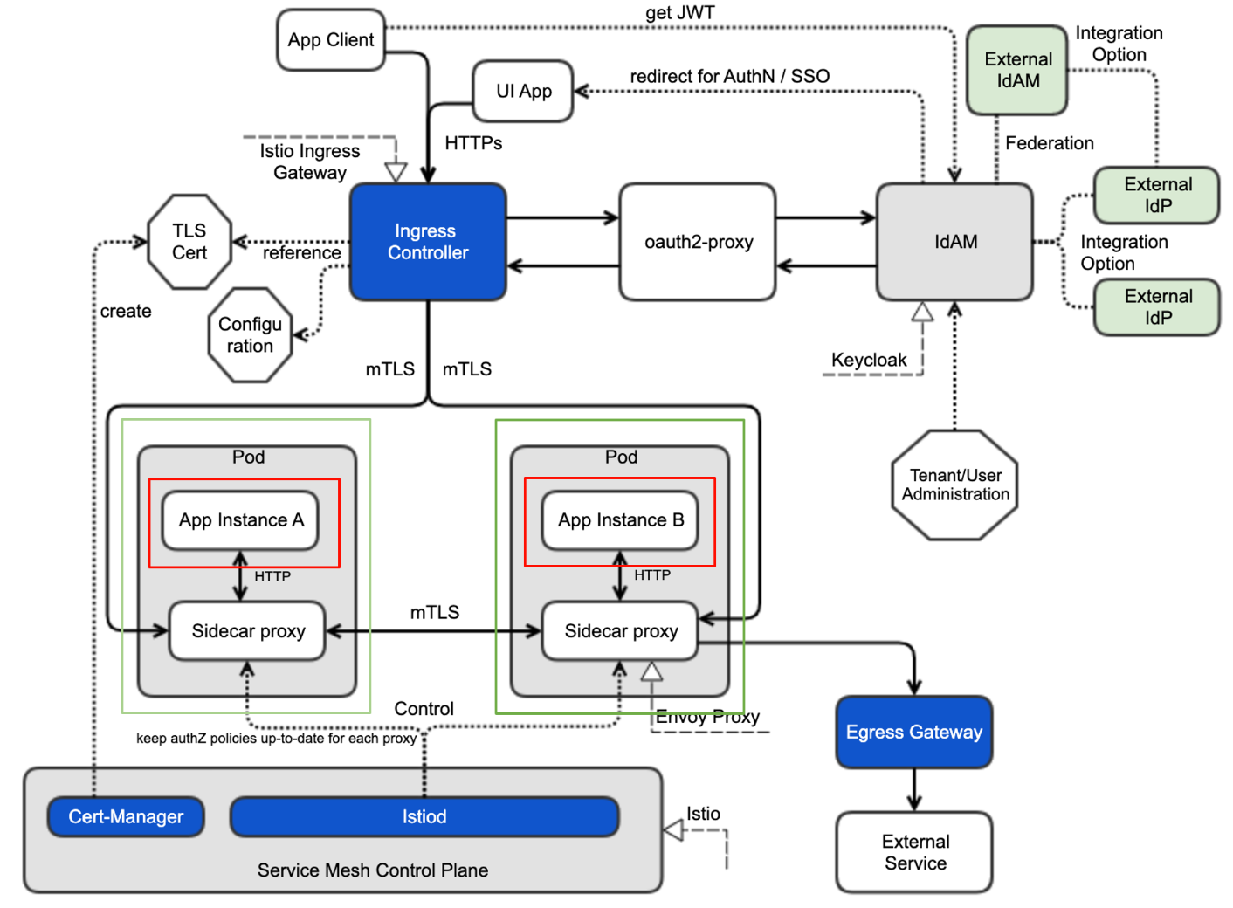
SECURITY
ONAP components are protected by Ingress Controller, Keycloak (IdAM) and Istio (Service Mesh), with AuthN/Authz, intra-secure communications, external-secure communications.
ONAP components themselves do not have their own/ proprietary protection any longer (e.g., removal of HTTP Basic Authentication and HTTPs).
Current OOM-provided security support as described above will be provided as ONAP reference security mechanism.
It is assumed that vendors/operators support industry de facto security mechanism like ONAP security and imported ONAP components are protected by the security mechanism.
ONAP will provide documentation of security architecture, global requirements and best practices, informing how to protect/secure selected ONAP components.
  For secure external communications, Ingress Controller, aouth2-proxy and IdAM are used
  For intra-secure communications, Istio is be used with Cert-Manager and policies
  For user authentication and authorization, KeyCloak is used, with SSO support and OAuth2-based token generation and validation
SECCOM recommendations:
  Create catalog of APIs for each ONAP project
  Best practices and global requirements will still apply to each project
  Keep SECCOM as a resource
  ONAP becomes service-based on integration
  Definition of the unmaintained project may have to be modified
  TSC may have to decide on the bindings and projects
  need a task force for disaggregation
  Action Item: Create a best practice for documenting APIs for the Montreal release
ONAP (OOM) provides security reference implementation and configuration by leveraging service mesh (Istio), ingress (Istio GA) and IdAM (Keycloak). The reference implementation and configuration can be replaced by the vendor/operator-provided security mechanism. Do you agree to this plan? Yes / No
9

Slide 10
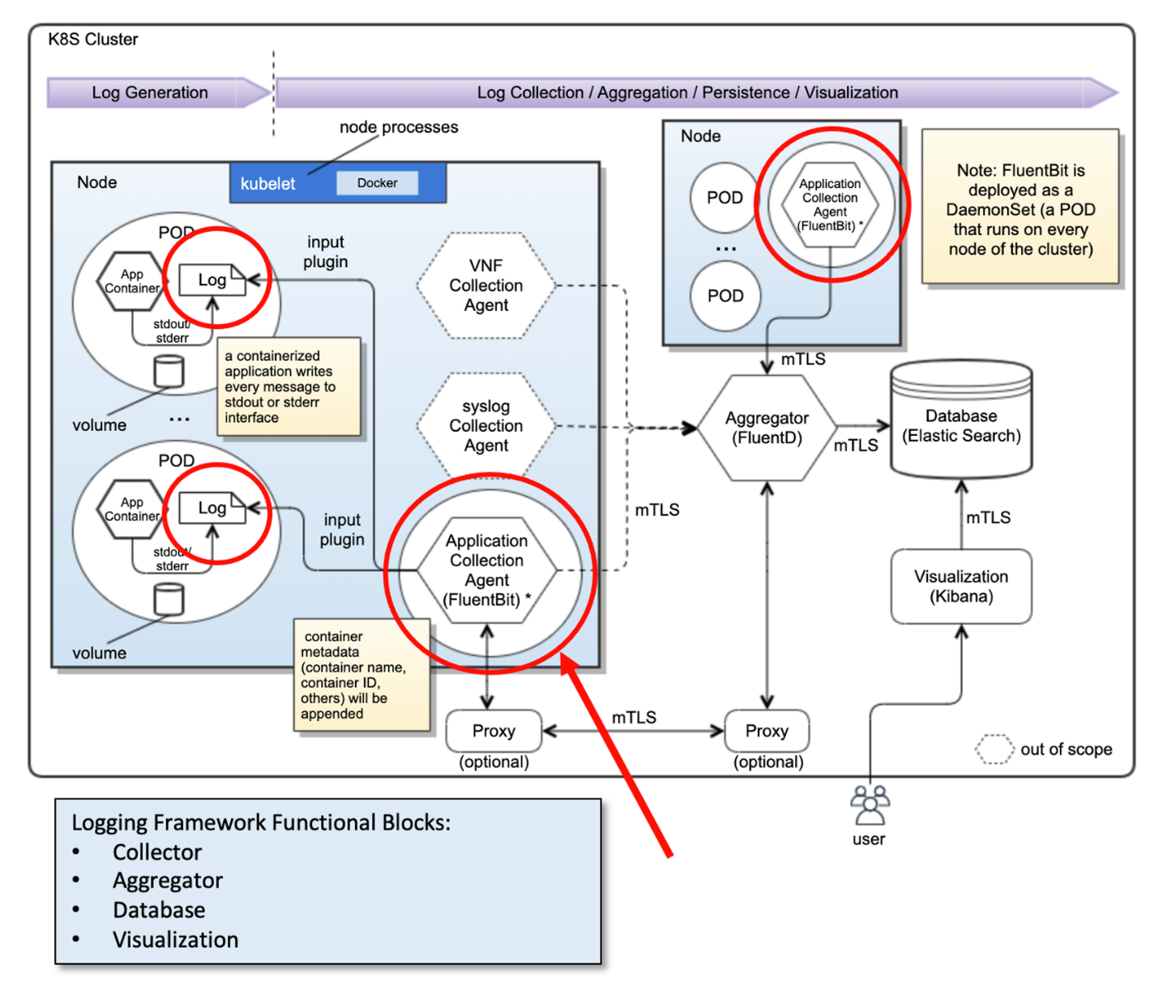
Logging
ONAP supports open-source and standard-based logging.
ONAP already separates log generation from log collection / aggregation/persistence/visualization/analysis.
  Each ONAP component handle log generation only thru STDOUT and STDERR, by following ONAP security logging fields – global requirements, https://wiki.onap.org/display/DW/Security+Logging+Fields+-+Global+Requirement
  The log destination will be configured
  Log collection agent(s) will be configured; ONAP reference configuration is using FluentBit as the collection agent;
      ONAP uses a separate privileged namespace to deploy FluentBit for security reasons
      Vendors/operators can configure it differently, based on their needs
  Vendors/operators can realize and configure the log collection/ aggregation/persistence/visualization with their own logging ecosystem
There will be no/minor impact on logging due to ONAP component disaggregation
ONAP provides security reference implementation and configuration for logging. Vendors / operators can realize and configure with their own logging ecosystem. Do you agree to this plan? Yes / No
10

Slide 11
Documentation Versioning - Proposal
Use of Marketing version along with minor and patch version(s).
  https://docs.onap.org/en/latest/
  https://docs.onap.org/en/london/
  https://docs.onap.org/projects/onap-cps/en/london/index.html
  https://docs.onap.org/projects/onap-cps/en/london/overview.html
Suggestion (checking possibilities):
  https://docs.onap.org/en/latest/
  https://docs.onap.org/en/London/
  https://docs.onap.org/projects/onap-cps/en/London/index.html
  https://docs.onap.org/projects/onap-cps.13.1.1/en/London/index.html // use project-specific versions
  https://docs.onap.org/projects/onap-cps.13.0.1/en/London/index.html // use project-specific versions
11

Slide 12
General Recommendations
Create catalog of APIs for each ONAP project
Best practices and global requirements will still apply to each project
Keep SECCOM as a resource
ONAP becomes service-based on integration
Definition of the unmaintained project may have to be modified
TSC may have to decide on the bindings and projects
Need a task force for disaggregation
Create a best practice for documenting APIs for the Montreal release
12

Slide 13
Release Plan - Proposal
Marketing version, Montreal, will be scheduled as the previous releases.
  Setting release schedule plans for Montreal
  The Marketing version will be used as the Major version by ONAP projects
  PTLs decide the minor and patch versions, based on their project release cycles and share the project versioning with TSC
    provide each project release flexibility and evolution
Integration & Pair-wise testing
  Integration testing will continue to increase ONAP project overall qualities
  Pair-wise testing will continue but it will be based on use cases
  Project testing will be performed by each project team
For Montreal, security scanning will continue as before
Based on feedback during the Montreal, the release plan can be revisited
13

Slide 14
Decisions
Is this ONAP Streamlining proposal reasonable? Yes / No
Is it reasonable that OOM continues to support the “by ONAP” level build, deployment, security, logging scripts? Yes / No
The current LFN CI pipeline continues to be used for the ONAP component builds. A common job will create all the ONAP charts. A separate job per component will be investigated for the future releases. Do you agree to this plan? Yes / No
The ONAP component charts will be decoupled from the ONAP master chart. So, the ONAP components can be deployed individually. Do you agree to this plan? Yes / No
Do you agree to these new configuration rules for handling ONAP helm chart dependencies? Yes / No
Do you agree to the short-term and long-term plans for handling ONAP version controlling? Yes / No
Do you agree to the plan for component interface abstraction and LFN de facto standardization? Yes / No
Expose the ONAP component service API models and interfaces, as LFN de facto APIs for network automation. Do you agree to this plan? Yes / No
ONAP provides security reference implementation and configuration by leveraging service mesh (Istio), ingress (Istio GA) and IdAM (Keycloak). The reference implementation and configuration can be replaced by the vendor/operator-provided security mechanism. Do you agree to this plan? Yes / No
ONAP provides security reference implementation and configuration for logging. Vendors / operators can realize and configure with their own logging ecosystem. Do you agree to this plan? Yes / No
14

