Slide 1
Advanced Security Primitives
For Edge/5G scenarios
Rahul Jadhav, Cofounder, Engg Lead, AccuKnox
Presented to ONAP Security Committee

Slide 2
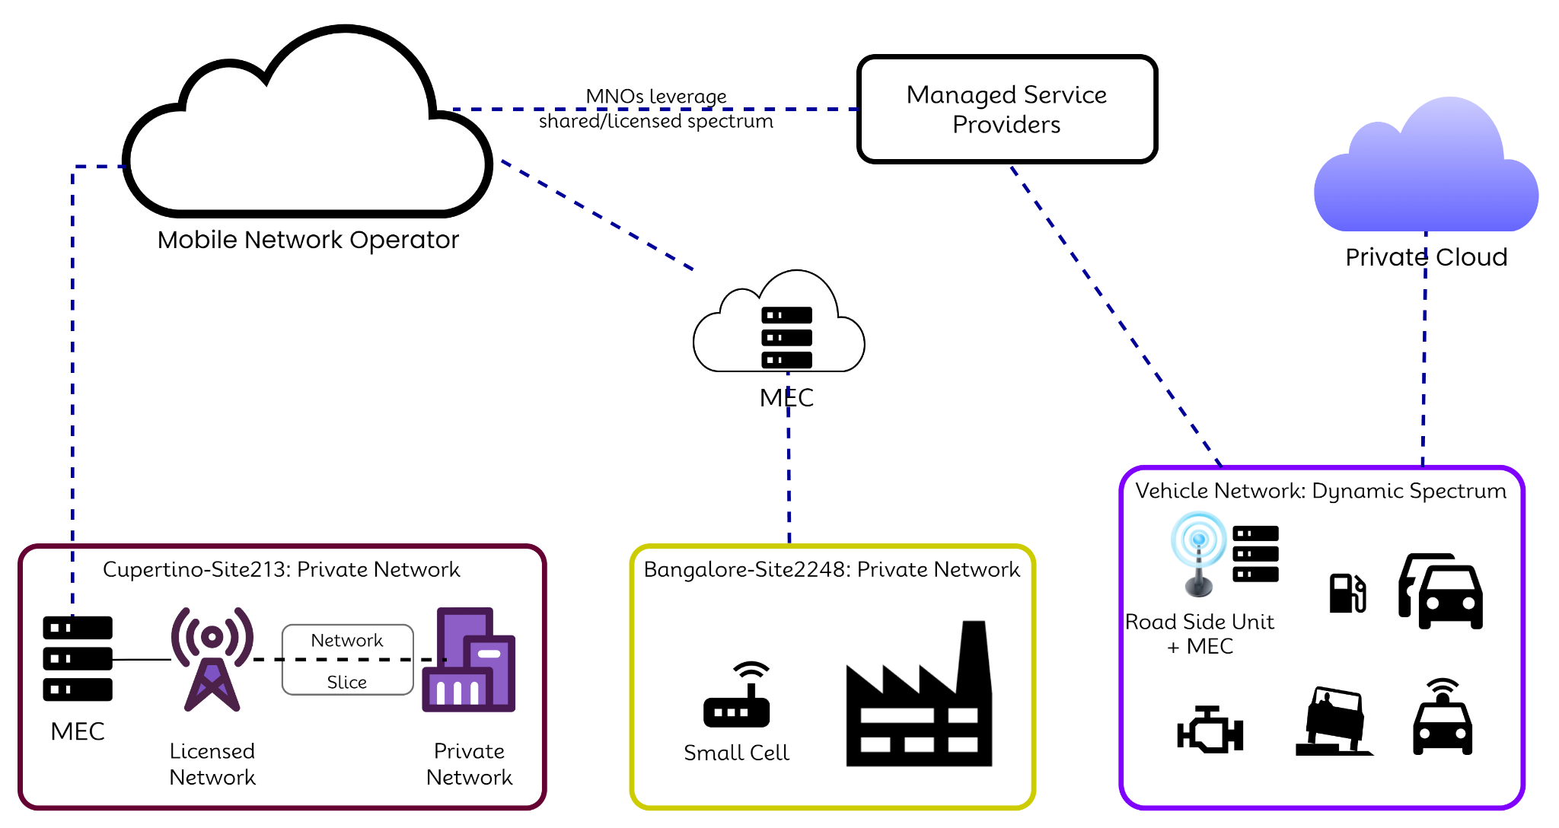
Changing landscape for Telco
Increased Attack Surface
Processing at the edge
Distributed Arch, multiple layers/vendors
Wide range of devices
Use of general cloud providers
Running mission critical apps
Notes:
How the threat model for Telco is changing?

Slide 3
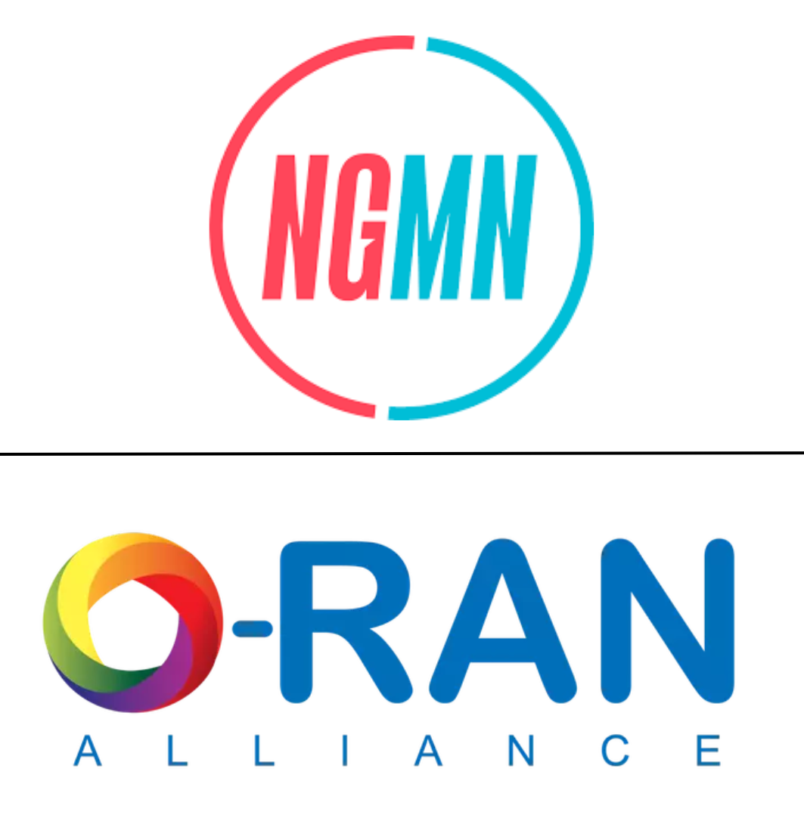
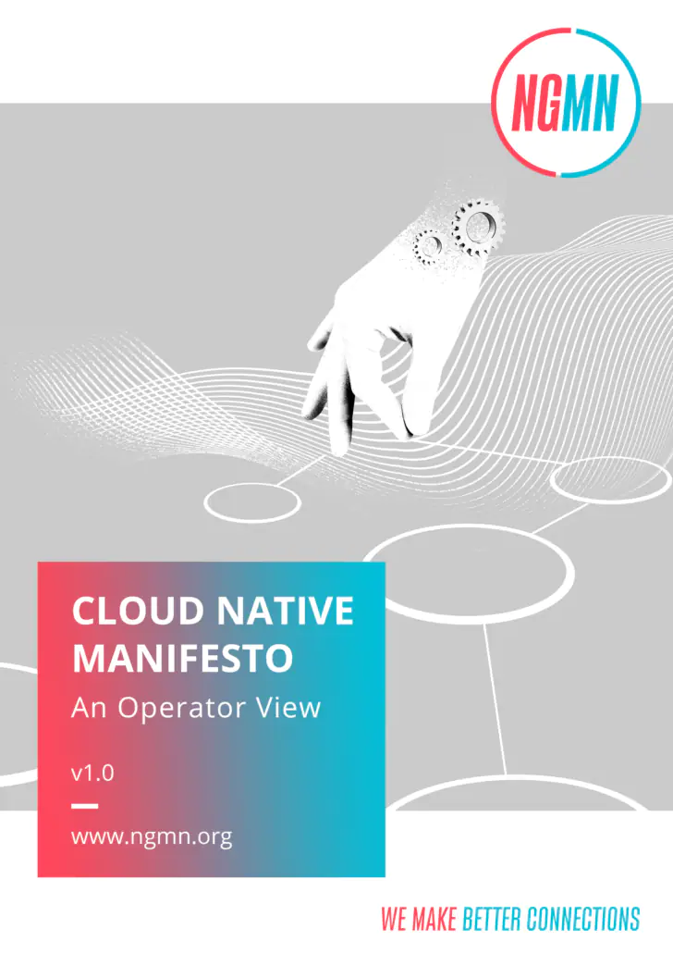




Changing Deployment Models
Nephio’s Mission
Nephio’s goal is to deliver carrier-grade, simple, open, Kubernetes-based cloud native intent automation and common automation templates that materially simplify the deployment and management of multi-vendor cloud infrastructure and network functions across large scale edge deployments. Nephio enables faster onboarding of network functions to production including provisioning of underlying cloud infrastructure with a true cloud native approach, and reduces costs of adoption of cloud and network infrastructure.
Decoupled infrastructure and application lifecycles over vertical monoliths
‘API first’ over manual provisioning of network resources
Declarative and intent-based automation over imperative workflows
GitOps principles over traditional network operations practices
Unified Kubernetes resource consumption patterns over domain-specific resource controllers
Unified Kubernetes closed-loop reconciliation patterns over vendor-specific element management practices
Interoperability by well-defined certification processes over vendor-specific optimisation.

Slide 4
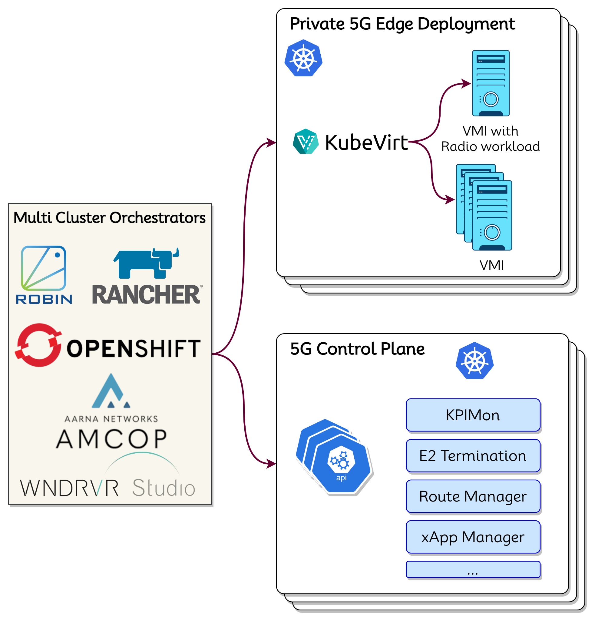
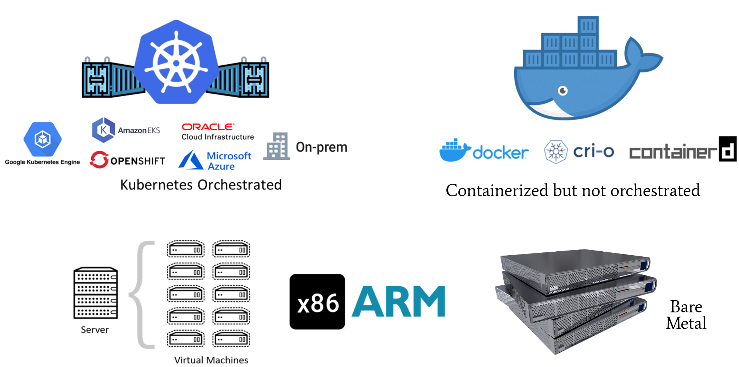
Workload Deployment Models
Virtual Machine, Bare Metal
Containerized/Orchestrated

Slide 5
General 5G Security solutions today
Two trends seen in general:
Incremental improvements to network firewall solutions
  For e.g., NGFWs (Next Generation Firewalls)
  UE security (USIM/UICC)
  Secure transport for SBA
Moving CNAPP to 5G security
  Service mesh
  Network Microsegmentation
5G enables new architectures
  Multi Cluster Deployments at scale
  Federal agencies mandates Zero Trust based security
  Network Slicing as a pattern
    Extreme Isolation requirements with shared resources
Notes:
NGFW
3GPP TS 33.501

Slide 6
eBPF as a security primitive

Slide 7
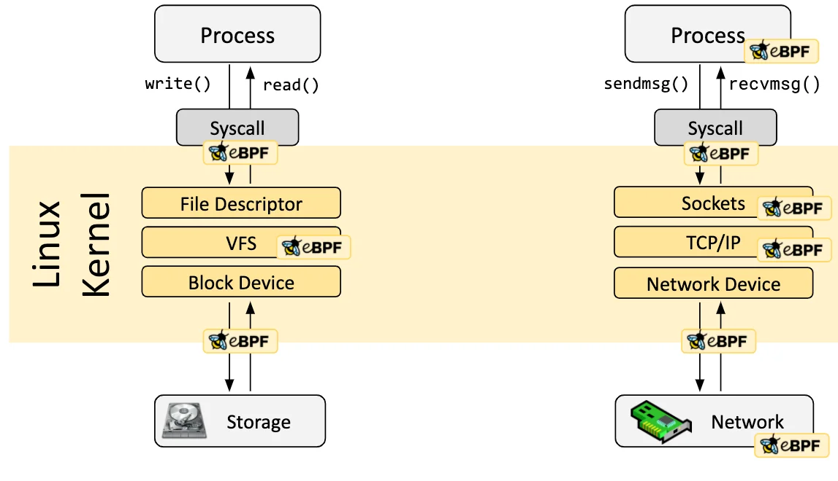
eBPF
eBPF for Observability/Monitoring
  kprobes , kretprobes, tracepoints
  Syscall, tc ingress/egress, XDP
eBPF for Policy Enforcement
  Network Control, Packet Drop/Allow/Redirect
  BPF-LSM for system policy enforcement
uBPF and its role

Slide 8
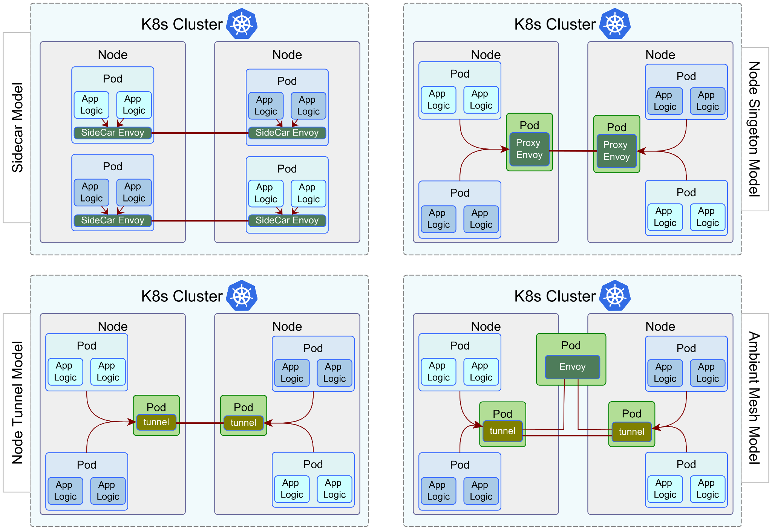
Service Mesh Models

Slide 9
Service Mesh & eBPF
eBPF for packet redirection
  Removing dependencies on iptables
  Scaling packet redirection efficiency
Granular visibility
  Visibility down to the container/process level
  Pin point which processes are serving what traffic endpoints
Direct Service Return
  Sidecars/Proxies induce latencies.
  DSR can help reduce comm legs when proxies are located on same node
Can eBPF help in decoding HTTPS?
  Uprobes are userspace probes that can be applied on dynamic libs
  Using eBPF with uprobes that intercept openssl.so symbols (SSL_Write, SSL_Read, …)

Slide 10
uBPF
Why?
  How to handle solutions using kernel bypass?
  Kernel space license issue. Most of eBPF is GPL.
Where is it used currently?
  P4 and uBPF
  p4c-ubpf compiler allows to translate P4 programs into the uBPF programs.
    P4₁₆ -> C -> uBPF
Vendors can use ubpf with their custom code
  For e.g., Enable custom O-RAN K2SM service models using ubpf (ref)

Slide 11
Network MicroSegmentation & eBPF
Two models to get microservice communication graph:
eBPF with network hook points that trace TCP control packets (syn/fin)
eBPF with system call hook points that trace socket calls (accept/connect)

Slide 12
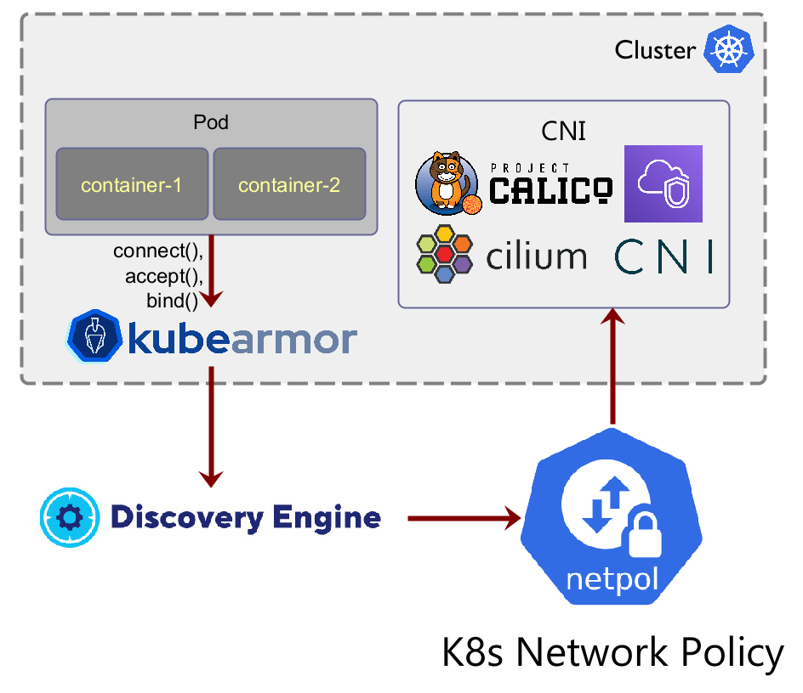
Segmentation: What we do in AccuKnox?
eBPF to watch syscalls and generate communication graph
Derive k8s network policies from this communication graph
Existing CNI enforces these network policies

Slide 13
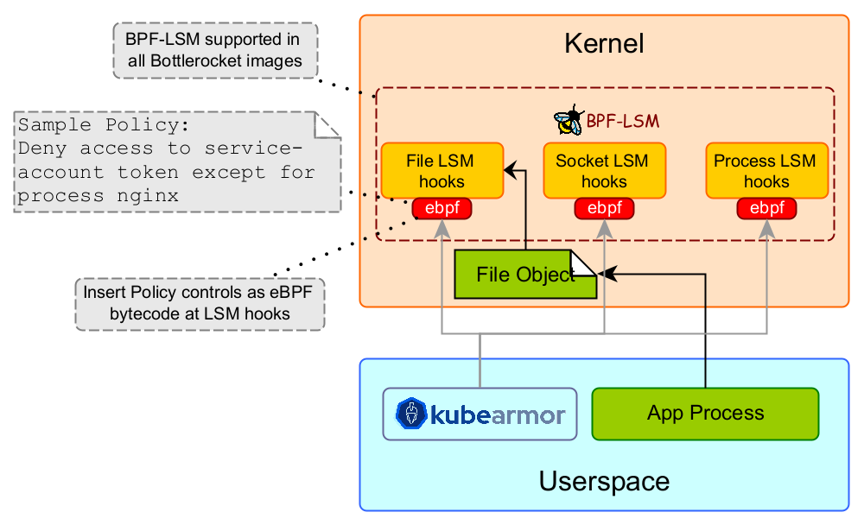
BPF-LSM
Programmatic policy control
Hardened LSM hooks
KubeArmor generates eBPF bytecode based on policy controls that is deployed at LSM hooks.
BPF-LSM is enabled on most managed k8s providers (EKS, GKE, OKE, Azure, IBM Cloud, OpenShift)
KubeArmor is the first k8s security engine to leverage BPF-LSM.

Slide 14
Known issues with eBPF
Not all primitives are supported on all platforms
  Certain LSM hook points are not supported on RHEL/CentOS
  Plan for contingencies
  BPF-LSM not supported on ARM64 (ref)
Problems with managed models
  Such as AWS Fargate, GKE Autopilot
  Daemonsets cannot be used
Issues with hooking userspace dynamic lib events
  Userspace code gets changed more frequently and thus the symbols may change requiring continuous maintenance tasks
Packet parsing with uprobes has perf impact
  Requires one to tap into network IO calls.
Possibility of eBPF event loss

Slide 15

K8TLS: Identify TLS security posture for services
Identify use of insecure ports
Check for TLS best practices
Check for X.509 certificates best practices
Deployment: K8s Job. No service mesh. No proxy required.
Assessment in <30 seconds
Notes:
KubeTLS was renamed to k8tls (pronounced cattles)

Slide 16
KIEM: K8s Identity & Entitlements Management
Identify over-provisioned k8s service accounts
Identify service accounts with access to key resources
Identify roles with write/patch/update/delete permissions and service accounts associated with it and what workloads are managed by those SA.
Identify risky service accounts created in last 1 week
KIEM is a WIP @ AccuKnox … To be released by end of October 2023

Slide 17
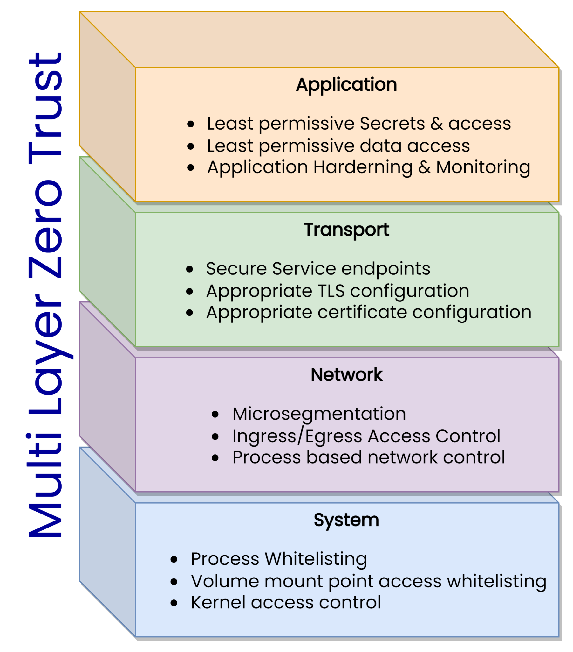
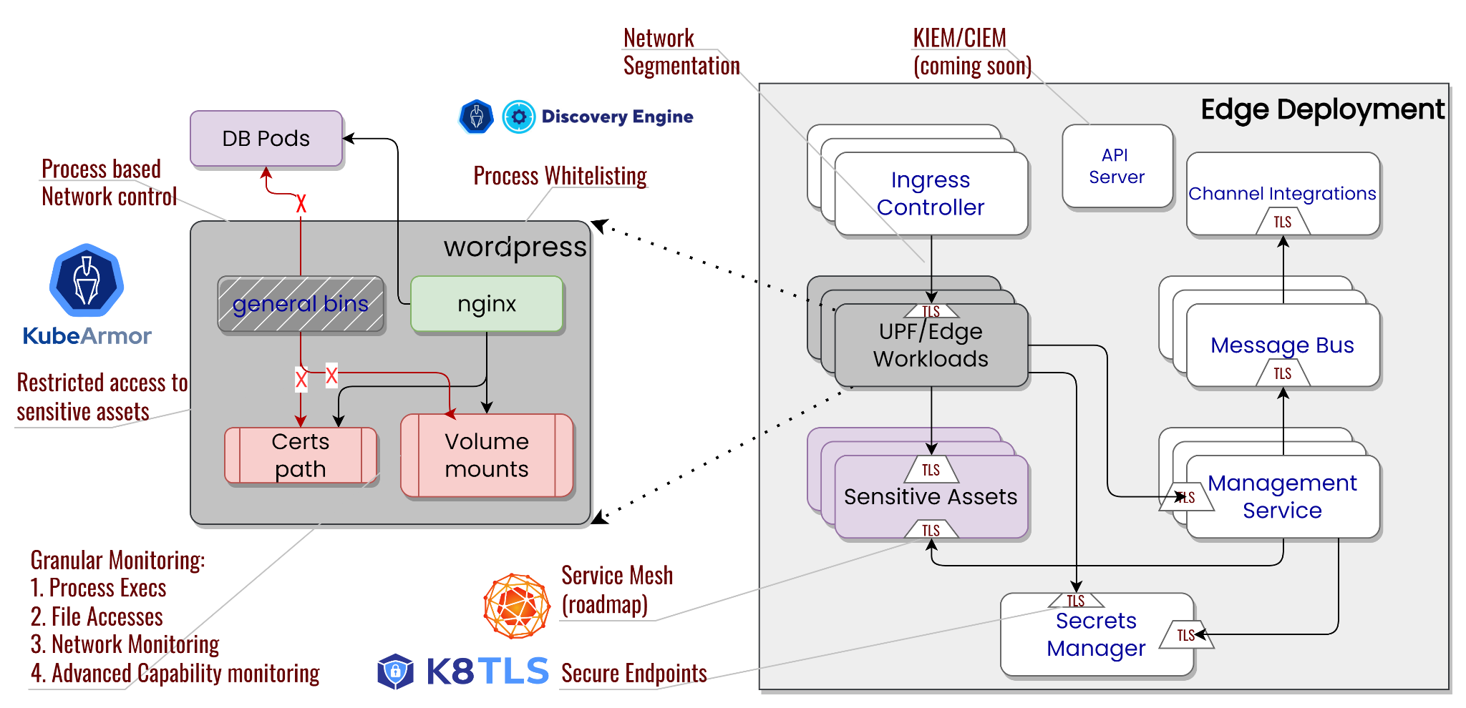
Multi Layer Zero Trust

Slide 18
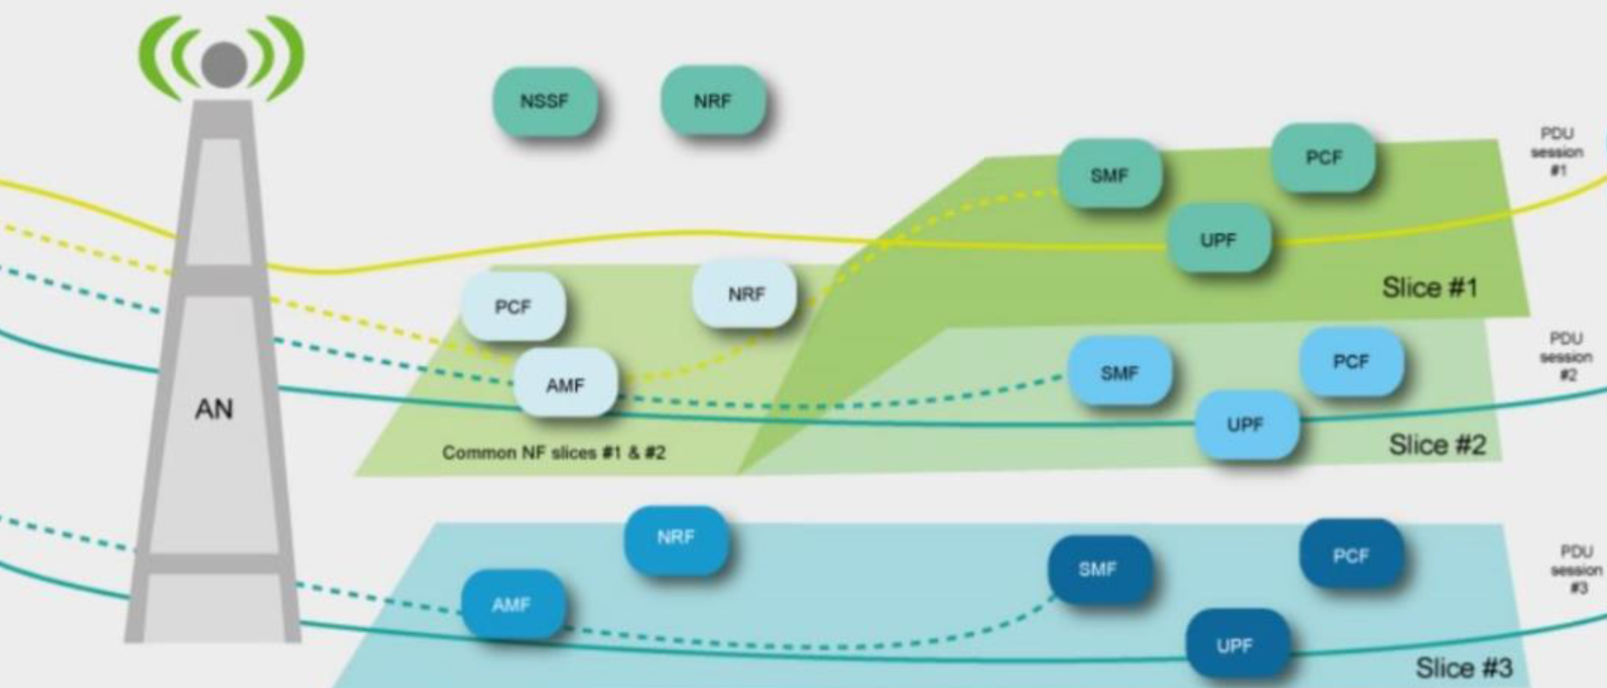
Network Slicing Security
Service based arch require NFs communicate with each other over a interface after NFs are authenticated and authorized.
If NFs are authorized in a traditional way based on entity, e.g. an authorized NF to handle one network slice will be able to have processing rights to all other network slices. This scenario is undesired and against the Principle of Least Privilege.
An NF should be authorized to handle specific network slices. All other slices not authorized will not be accessible to the NF.

Slide 19
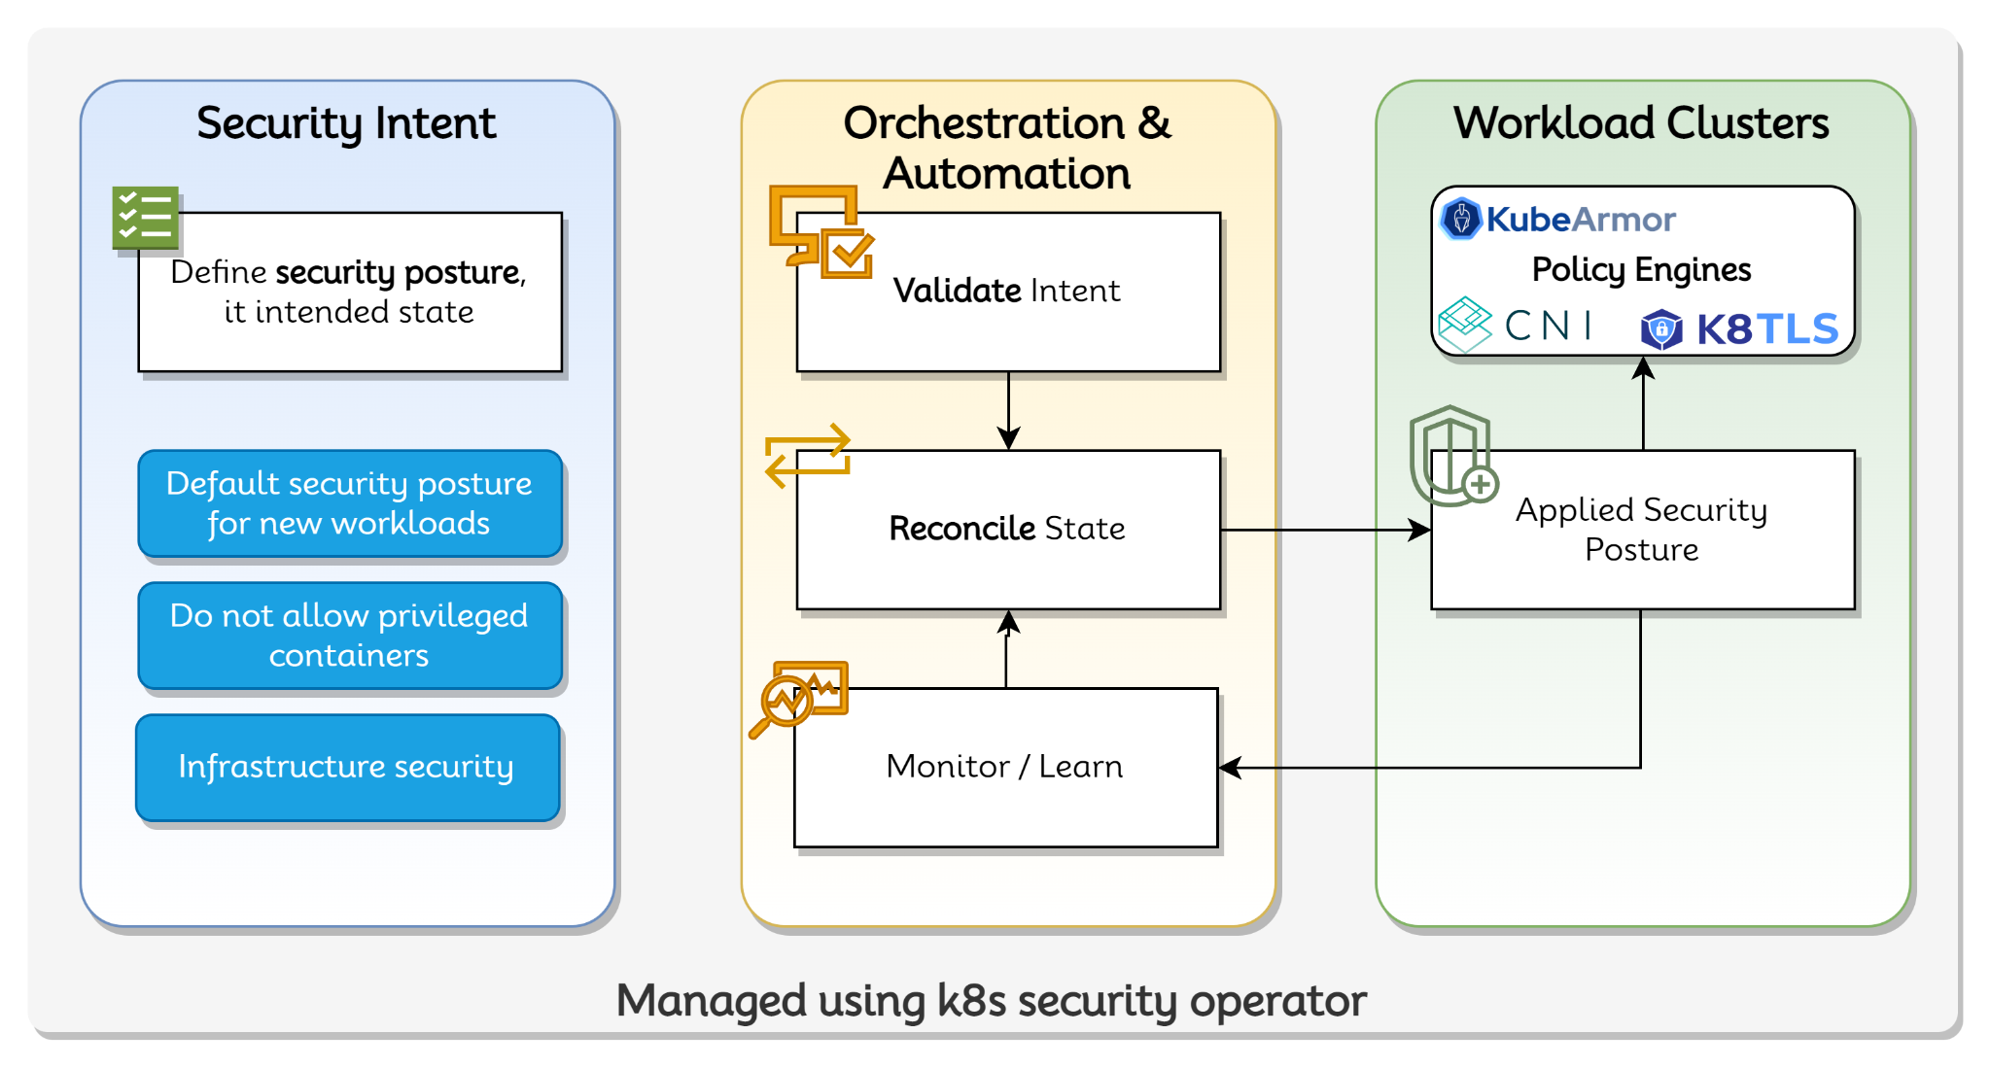
Tie all of these things together with Security Operator

Slide 20










AccuKnox in 5G communities
LF Nephio TSC member
Intel Smart Edge Partner
Linux Foundation - Open Horizon TSC
Open Source Policy Templates for
  ENISA
  MITRE FiGHT
CNCF KubeArmor Project Lead Maintainer
5GSec.com:
  AccuKnox, Stanford Research, Ohio University effort
NSF DoD Awards
RedHat Telco Partner
5G-SBP participant
5G Open Innovation Labs
K8TLS Service Endpoint scanner

Slide 21
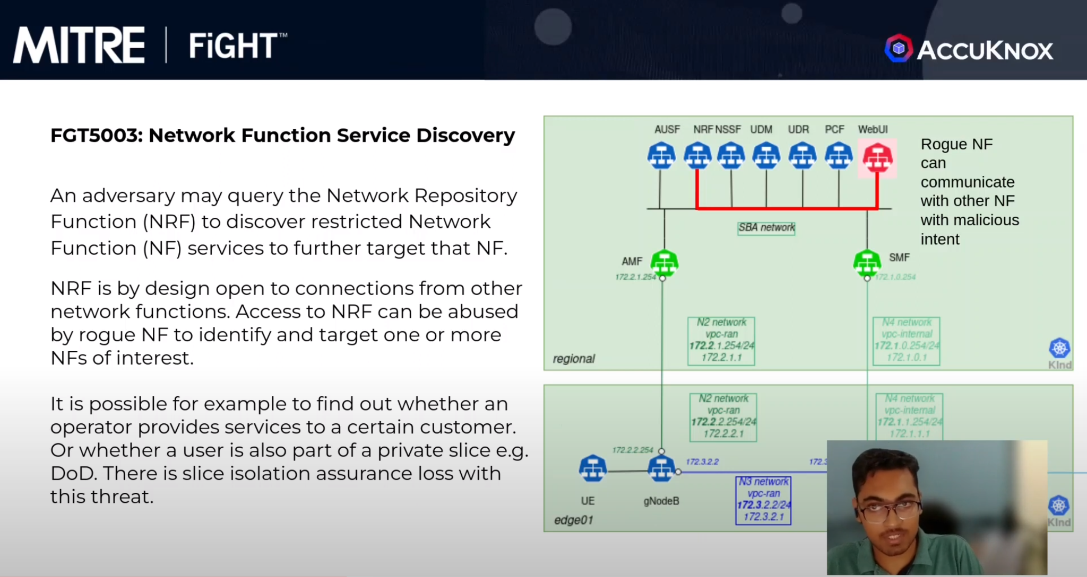
Demo: Zero Trust with Nephio
Video Demo of Nephio free5GC Security

Slide 22
To Summarize …
eBPF, BPF-LSM, uBPF primitives present great opportunity to secure edge/5G based deployments at scale
AccuKnox has worked on various tooling that leverage these primitives
  KubeArmor, K8TLS, Policy Templates for ENISA/FiGHT, Network Segmentation
eBPF primitives can help expand scope, improve performance of Service-Mesh based security
Multi Layer Zero Trust will be the key to securing mission critical 5G applications

Slide 23
rahul@accuknox.com

Slide 24
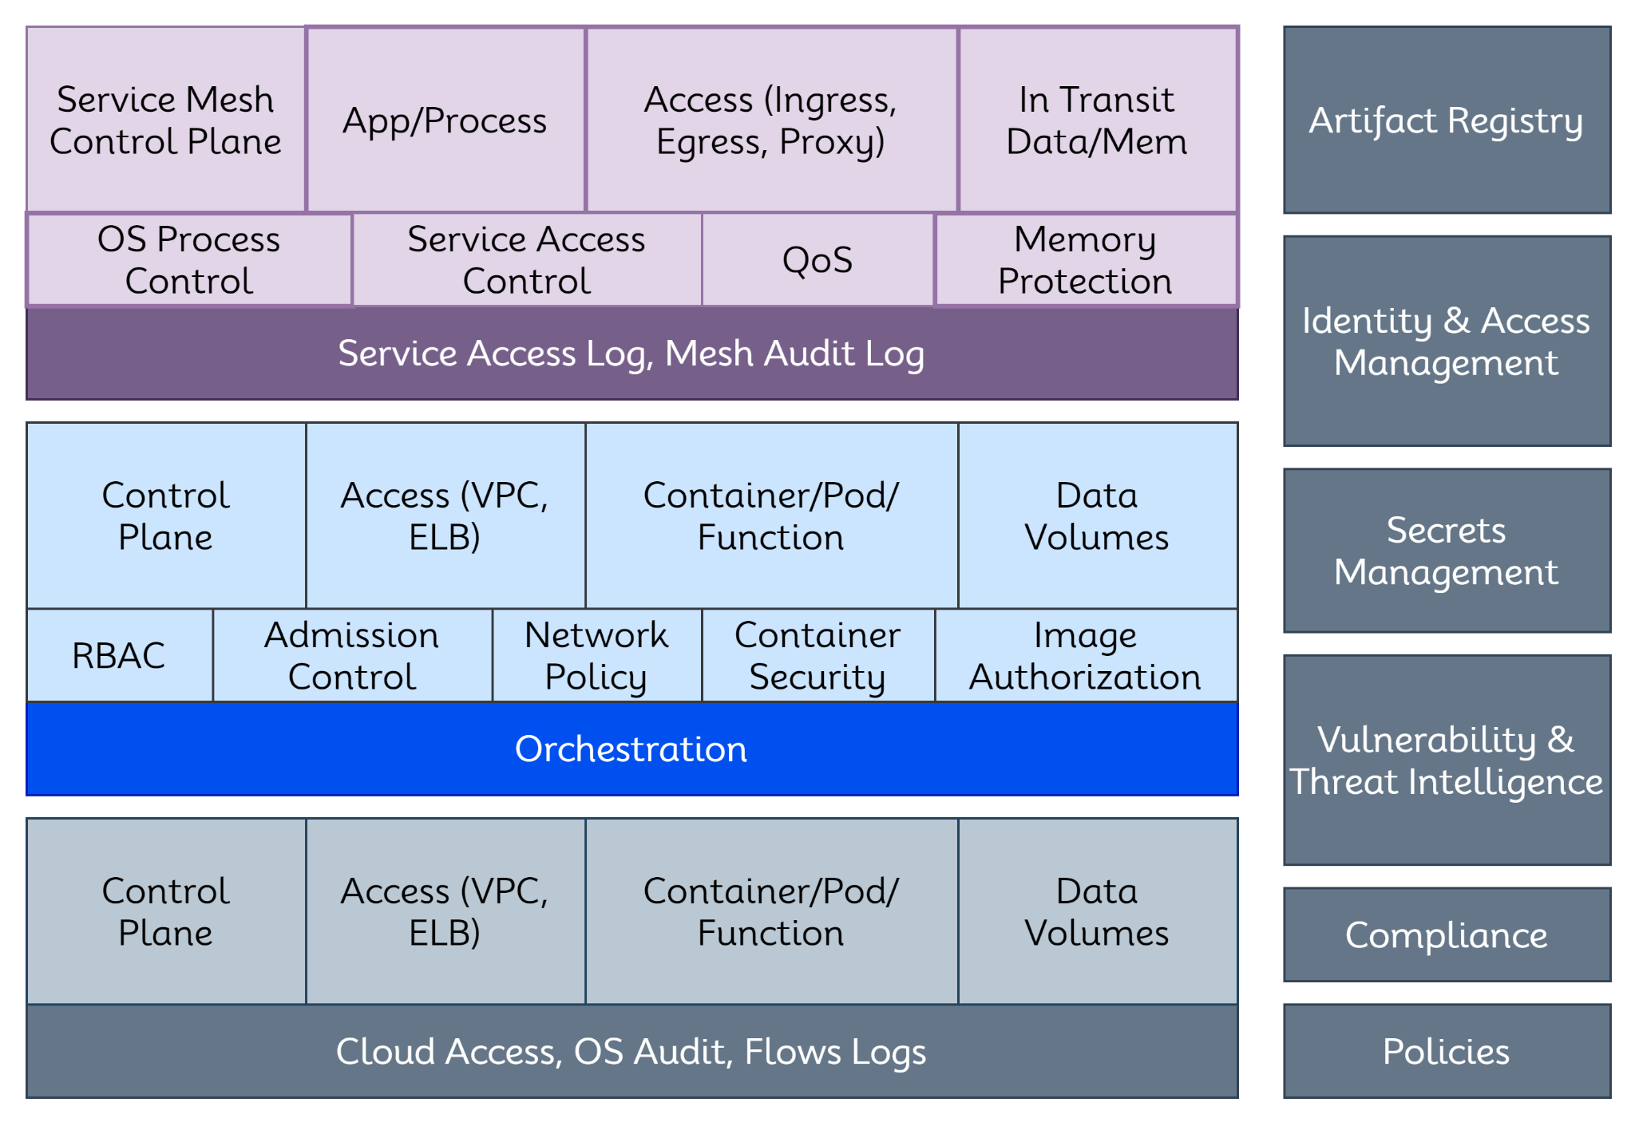
K8s Security Landscape

