Slide 1
NFV specifications for VNFD/NSD, VNF package
- ONAP Modeling workshop -
Andrei Kojukhov & Shitao Li
ETSI ISG NFV

Slide 2
Agenda
VNFD and NSD Info Models Specifications – IFA specs
VNFD/NSD and VNF Package TOSCA YAML Data Model Specifications – SOL001 and SOL004

Slide 3
part 1: The ETSI NFV Information model in context of IFA and SOL specifications

Slide 4
High Level Overview
Link to latest published document
UML
UML
NFV-IFA016
Papyrus
Guidelines
NFV-IFA017
UML Modeling
Guidelines
NFV-IFA015
Information
Model (UML)
NFV-IFA024
External IM
Touchpoints
Information
Model
doc
doc
doc
doc
“Paper”
Requirement
Specification
(Stage 2)
NFV-IFA011
VNF Descriptor
& VNF Package
NFV-IFA014
Network
Service
Descriptor
NFV-IFA007
Or-Vnfm
NFV-IFA008
Ve-Vnfm
NFV-IFA013
Os-Ma-Nfvo
doc
doc
doc
doc
doc
Protocol &
Datamodel
Specification
(Stage 3)
NFV-SOL004
VNF Package
(TOSCA CSAR)
NFV-SOL001
VNF & NS
Descriptor
(TOSCA)
NFV-SOL003
Or-Vnfm
(REST)
NFV-SOL002
Ve-Vnfm
(REST)
NFV-SOL005
Os-Ma-Nfvo
(REST)
Draft
Draft
doc
doc
doc
doc
doc
© ETSI 2017. All rights reserved

Slide 5

ETSI NFV IM and DM standards
ETSI NFV-IFA 011 specifies the functional requirements applicable to a VNFD and VNF Package
ETSI NFV-IFA 014 specifies the functional requirements applicable to a NSD
ETSI NFV-SOL 001 specifies a TOSCA-based representation for a VNFD and NSD
ETSI NFV-SOL 004 specifies a TOSCA CSAR-based format applicable to a VNF package
ETSI NFV-SOL 006 specifies a YANG-based representation for a VNFD and NSD (just starting)

Slide 6
part 2: VNF Package Data Model

Slide 7

VNF Package Info Model
The VNF Package contains:
  the VNF descriptor (VNFD) that defines metadata for package onboarding and VNF management,
  the software images needed to run the VNF, and
  Manifest file that provides package integrity and authenticity
  (optional) additional files to manage the VNF (e.g. scripts, vendor-specific files etc.).
The VNF Package is delivered by the VNF provider as a whole and is immutable (protected from modification).
The VNF Package or its Manifest file is digitally signed
The VNF Package is stored in a repository by the NFVO.
The VNF Package can be accessed by VNFM.
VNF Package
Manifest
file
VNFD
Software image(s)
Additional files
Reference:
ETSI GS NFV-IFA 011
ETSI GS NFV-SOL 004
© ETSI 2017. All rights reserved

Slide 8
VNF Package Data Model (Option 1):
TOSCA YAML CSAR with Metadata File
The TOSCA.meta file includes block_0 with the Entry-Definitions keyword pointing to a TOSCA definitions YAML file used as entry for parsing the contents of the overall CSAR archive – MRF.yaml
TOSCA-Meta-File-Version: 1.0
CSAR-Version: 1.1
Created-by: Company Name
Entry-Definitions: Definitions/ MRF.yaml
  Any TOSCA definitions files besides the one denoted by the Entry-Definitions can be found by processing respective imports statements in the entry definitions file (or in recursively imported files)
  Any artifact files (e.g. scripts, binaries, configuration files) can be either declared explicitly through blocks in the TOSCA.meta file or pointed to by relative path names through artifact definitions in one of the TOSCA definitions files contained in the CSAR file.
!------TOSCA-Metadata
!------TOSCA.meta
!------Definitions
!----- MRF.yaml
!----- OtherTemplates (e.g., type definitions)
!------Files
!----- ChangeLog.txt
!----- MRF.cert
!----- image(s)
!----- other artifacts
!------Tests
!----- file(s)
!------Licenses
!----- file(s)
!------Scripts
!----- install.sh
!----- MRF.mf
References:
ETSI GS NFV-SOL 004
TOSCA-Simple-Profile-YAML-v1.1
© ETSI 2017. All rights reserved

Slide 9
VNF Package Data Model
Standard Artifacts and Directories
Change History File
  Humanly readable text file
  All the changes in the VNF package shall be versioned, tracked and inventoried
Testing Files
  Goal is to enable VNF package validation
  VNF Provider includes files containing necessary information (e.g. test description)
Licensing Information for released VNF
  Include a single license term for the whole VNF.
  In addition may include license terms for each of the VNF package artifacts if different from the one of the released VNF
A directory for artifacts serving 3-rd party extensions (work in progress)
  Allow adding artifacts supporting external (non-MANO) extensions e.g. ONAP extensions
© ETSI 2017. All rights reserved

Slide 10
Adding Security to VNF Package
Public Key Based Integrity and Authenticity
Option 1: Manifest file - based if there are both local and external artifacts
  A Digest hash per each artifact
  Manifest file is signed with VNF provider private key
  VNF provider’s certificate includes a VNF provider public key
  The certificate may be a separate artifact or included in the signature container, e.g. CMS
Option 2: CSAR-based if all artifacts are located inside a CSAR
  CSAR file is digitally signed with the VNF provider private key
  VNF provider delivers one zip file containing a CSAR file, a signature file and a certificate file that includes a VNF provider public key
  The certificate may be a separate artifact or included in the signature container, e.g. CMS
Manifest file
VNF Package metadata
Artifact 1
Path/URI
Hash
. . . . .
Artifact N
Path/URI
Hash
Manifest file Signature
Signing Certificate
Signing Certificate
VNF Package.zip
VNFPackage.csar
VNFPackage.csar
VNFPackage.csar Signature
or
VNFPackage.csar Signature
Signing Certificate
Signing Certificate
Both options rely on existence in the NFVO of a root certificate of a trusted certificate authority, delivered via a trusted channel separately from a VNF package
© ETSI 2017. All rights reserved

Slide 11
VNF Package Data Model
Manifest File with Security support
VNF package metadata
A list of blocks each is related to one file in the VNF package, including
Source: artifact URI
Optional Algorithm: name of an algorithm used to generate the hash
Optional Hash: text string corresponding to the hexadecimal representation of the hash
Optional Manifest file Signature
metadata:
vnf_product_name: vMRF-1-0-0
vnf_provider_id: Acme
vnf_package_version: 1.0
vnf_release_data_time: 2017.01.01T10:00+03:00
Source: MRF.yaml
Algorithm: SHA-256
Hash: 09e5a788acb180162c51679ae4c998039fa6644505db2415e35107d1ee213943
Source: scripts/install.sh
Algorithm: SHA-256
Hash: d0e7828293355a07c2dccaaa765c80b507e60e6167067c950dc2e6b0da0dbd8b
Source: https://www.vendor_org.com/MRF/v4.1/scripts/scale/scale.sh
Algorithm: SHA-256
Hash: 36f945953929812aca2701b114b068c71bd8c95ceb3609711428c26325649165
-----BEGIN CMS-----
MIGDBgsqhkiG9w0BCRABCaB0MHICAQAwDQYLKoZIhvcNAQkQAwgwXgYJKoZIhvcN
AQcBoFEET3icc87PK0nNK9ENqSxItVIoSa0o0S/ISczMs1ZIzkgsKk4tsQ0N1nUM
dvb05OXi5XLPLEtViMwvLVLwSE0sKlFIVHAqSk3MBkkBAJv0Fx0=
-----END CMS-----
References:
IANA register for Hash Function Textual Names
https://www.iana.org/assignments/hash-function-text-names/hash-function-text-names.xhtml
© ETSI 2017. All rights reserved

Slide 12
part 3: The VNFD / NSD SPECIFICATION

Slide 13
VNFD Info Model
The VNFD defines VNF properties and requirements, such as:
  Resources needed (amount and type of Virtual Compute, Storage, Networking),
  Connectivity:
      External Connection Points (described via CP Descriptors, CPD).
      Internal Virtual Links (described via VL Descriptors, VLD)
      Internal Connection Points (described via CP Descriptors, CPD)
  LCM behavior (e.g. scaling, instantiation), operations, and configuration
  References to SW images, LCM scripts and other files located or referred in VNF package
  Affinity / anti-affinity and other policy rules
  Deployment flavours (size-bounded deployment configurations, e.g. related to capacity).
The VNFD is the main input to VNF instances lifecycle management
VNFD
VDU
Compute
Storage
Internal CPD
SW image Descr
Internal VLD
External CPD
Deployment Flavour
References:
ETSI GS NFV-IFA 011
ETSI GS NFV-SOL 001
© ETSI 2017. All rights reserved

Slide 14
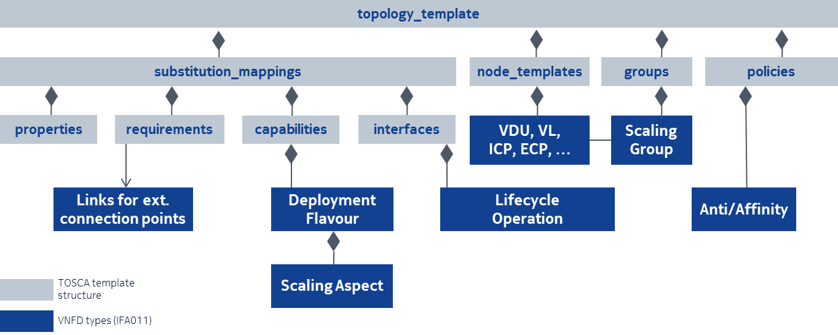
Mapping VNFD Info Model elements to TOSCA constructs
(In progress)
A VNFD represents as one or multiple TOSCA service templates, including:
  Node templates: VDU, VL, CP
  Policies: anti/Affinity
  Interface: LCM operation
  Capabilities: VirtualBindable, Metric, VirtualLinkable, VirtualCompute
ETSI NFV Element [IFA011] | TOSCA VNFD [TOSCA-Simple-Profile-NFV-v1.0] | Derived from
VNF | tosca.nodes.nfv.VNF | tosca.nodes.Root
VDU | tosca.nodes.nfv.VDU | tosca.nodes.Root
Cpd (Connection Point) | tosca.nodes.nfv.Cpd | tosca.nodes.Root
VduCpd (internal connection point) | tosca.nodes.nfv.VduCpd | tosca.nodes.nfv.Cpd
VnfVirtualLinkDesc (Virtual Link) | tosca.nodes.nfv.VnfVirtualLinkDesc | tosca.nodes.Root
VnfExtCpd (External Connection Point) | tosca.nodes.nfv.VnfExtCpd | tosca.nodes.Root
Virtual Storage
Virtual Compute | tosca.capabilities.nfv.VirtualCompute | tosca.capabilities.Root
Software Image | tosca.artifacts.nfv.SwImage | tosca.artifacts.Deployment.Image
Deployment Flavour | tosca.capabilities.nfv.DeploymentFlavour | tosca.capabilities.Root
Scaling Aspect | tosca.datatypes.nfv.ScalingAspect | tosca.datatypes.Root
Element Group | tosca.groups.nfv.ElementGroup | tosca.groups.Root
Instantiation Level | tosca.datatypes.nfv.InstantiationLevel | tosca.datatypes.Root

Slide 15
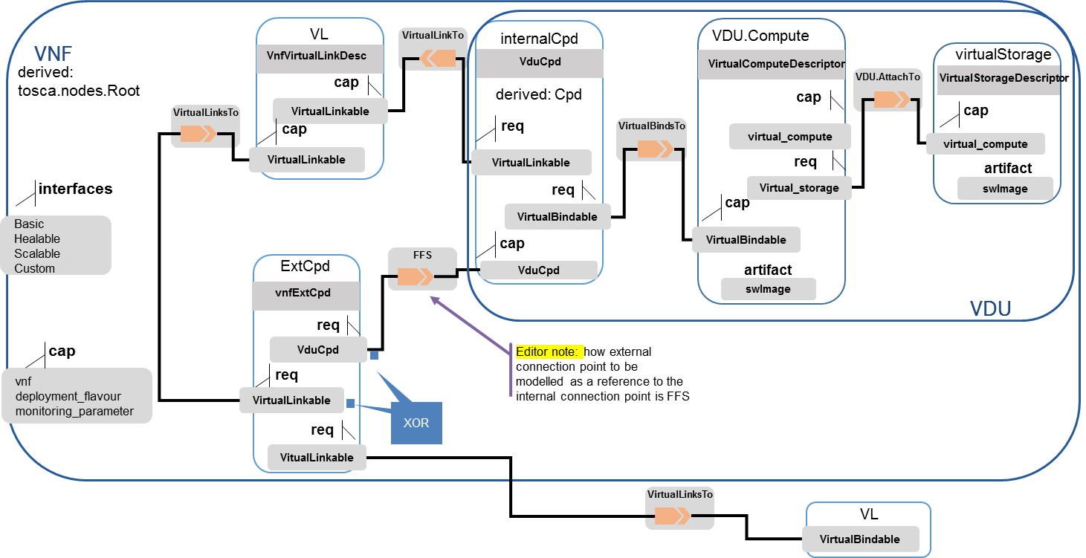
VNFD TOSCA Service Template - Example

Slide 16

More information:
NFV Technology Page (information)
http://www.etsi.org/nfv
NFV Portal (working area)
http://portal.etsi.org/nfv
NFV Proofs of Concept (information)
http://www.etsi.org/nfv-poc
NFV Plugtest (information & registration)
http://www.etsi.org/nfvplugtest
Open Area:
  Drafts http://docbox.etsi.org/ISG/NFV/Open/Drafts/
  Issue tracker http://nfvwiki.etsi.org/index.php?title=NFV_Issue_Tracker

