Slide 1
NSD modeling: Rel2
Nagesha Subramanya nagesha.subramanya@nokia.com
Thinh Nguyenphu, Nokia thinh.nguyenphu@nokia.com
Mar 13, 2018

Slide 2
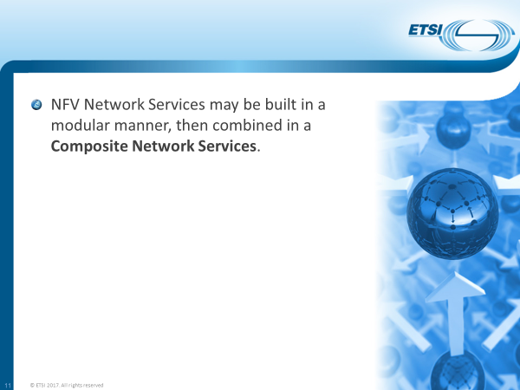
ETSI NFV Concept: Composite Network Services
Ref: ETSI NFV Tutorial at Layer123 The Hague

Slide 3
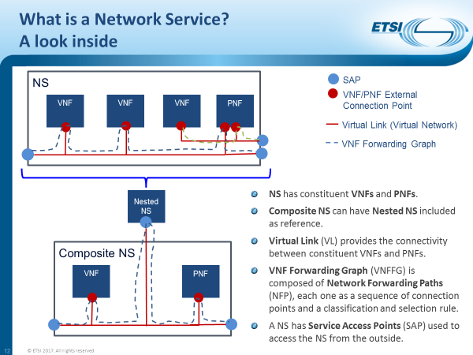
Ref: ETSI NFV Tutorial at Layer123 The Hague

Slide 4
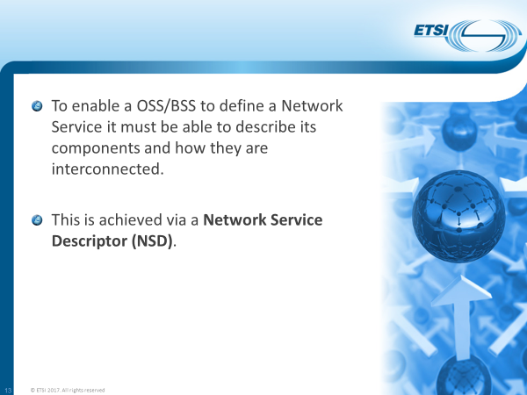
Ref: ETSI NFV Tutorial at Layer123 The Hague

Slide 5
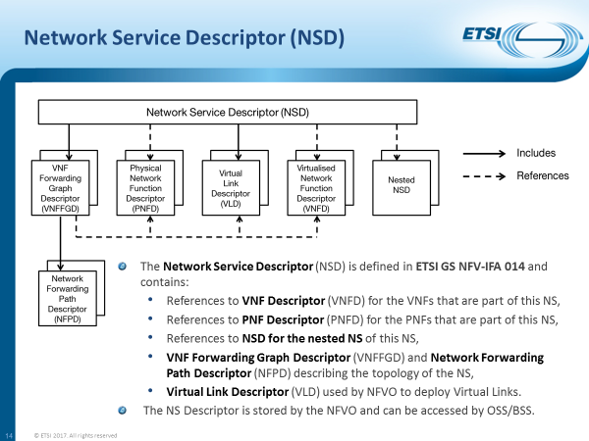
Ref: ETSI NFV Tutorial at Layer123 The Hague

Slide 6
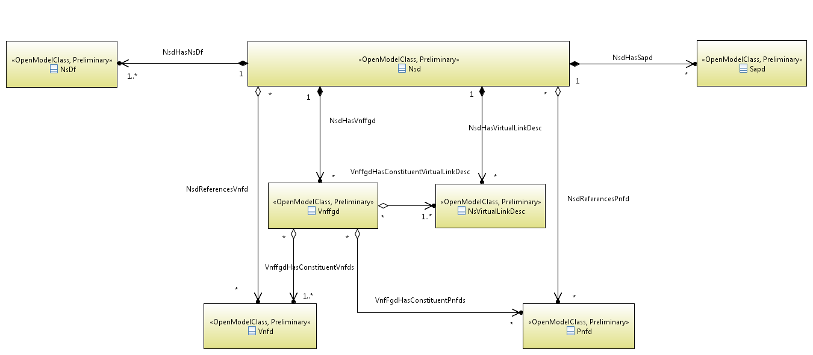
IFA014: Figure 6.2.1-1: UML information diagram of NSD (v2.3.1)

Slide 7
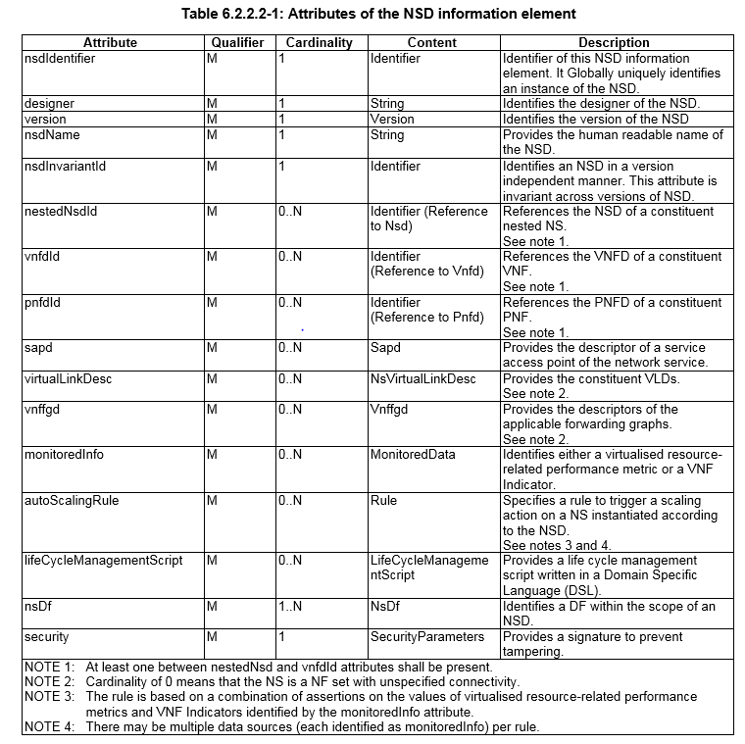
NSD IE
Node Type: tosca.nodes.nfv.NS
Node Type: tosca.nodes.nfv.VNF
Node Type: tosca.nodes.nfv.PNF
Node Type:tosca.nodes.nfv.SAPD
Node Type: tosca.nodes.nfv.VL
Groups Type
Tosca.Capabilities.nfv.NsMonitoring
Interface Type:
Node Type

Slide 8
NS – As a Node
NS1
(abstract)
NS1
req: sap1
SAP1
req
req
⇔
input
req: vnf1 ext cp
input
req
req
output
VL1
output
property
VNF1
NS2
PNF1
interfaces
cap: DF
cap: DF
NS2
NS2
…
NS is modelled a Node Type.
NS can have NS nodes
NS can be nested, referenced.
NS is substituted with a service template.
  which provides implementation
  combination of VNF, VL, NS…
req
req
⇔
property
VNF2
…
VNF3
…
interfaces
cap: DF
cap: DF

Slide 9
Network Service Nodes
tosca.nodes.nfv.NS.NS1
tosca.nodes.nfv.NS.NS3
NS1
(abstract)
NS3
(abstract)
req
input
req
input
output
output
property
interfaces
tosca.nodes.nfv.NS.NS2
property
NS2
(abstract)
interfaces
cap: DF
req
cap: DF
input
output
property
interfaces
cap: DF

Slide 10
BACK Slide

