Slide 1
ONAP API documentation
Amsterdam status
René Robert
February 2nd, 2018

Slide 2
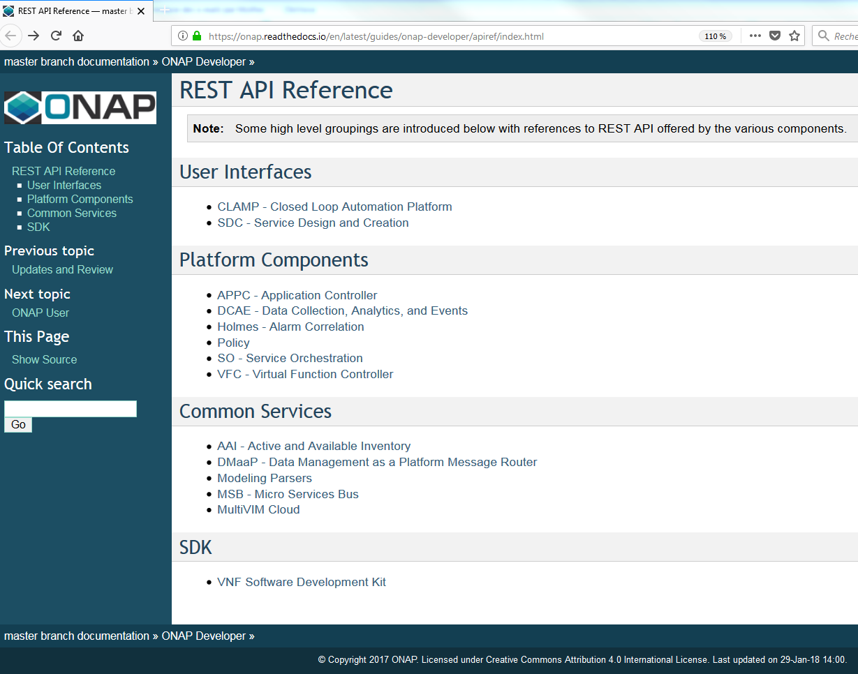
Where is the ONAP API Documentation ?
Onap.ReadTheDocs should be the reference
https://onap.readthedocs.io/en/latest/guides/onap-developer/apiref/index.html

Slide 3
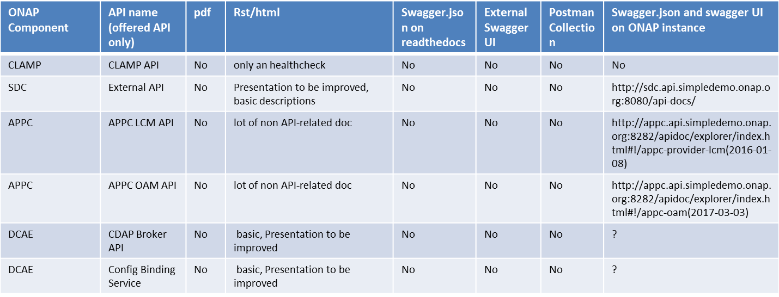
What is available about API Documentation on ReadTheDocs ?

Slide 4
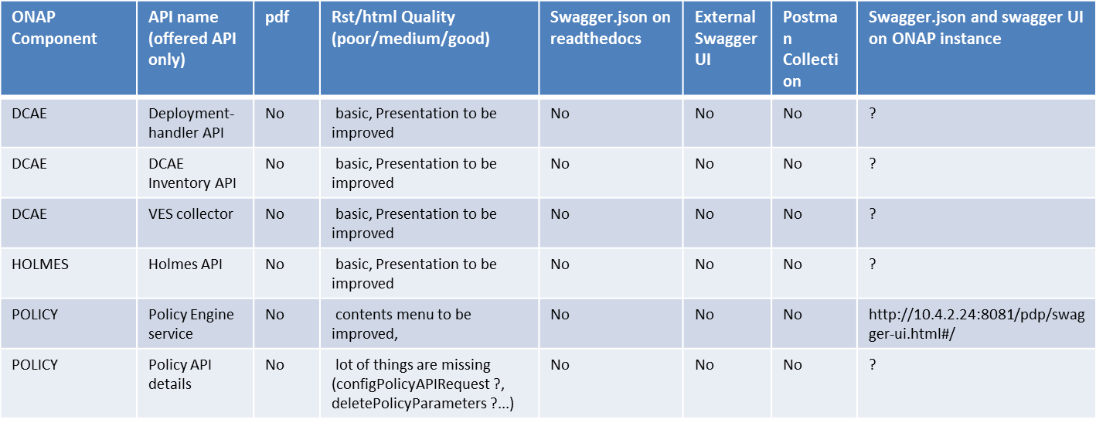
What is available about API Documentation on ReadTheDocs ?

Slide 5
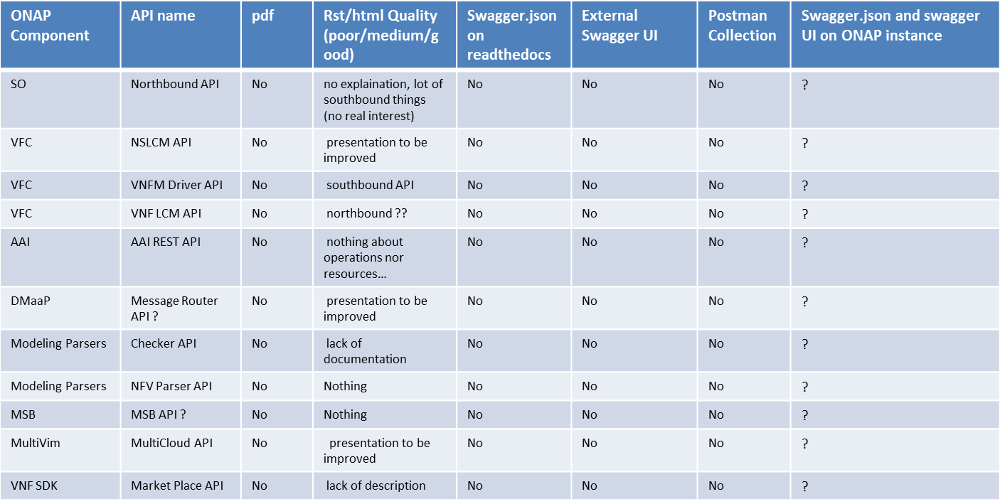
What is available about API Documentation on ReadTheDocs ?

Slide 6
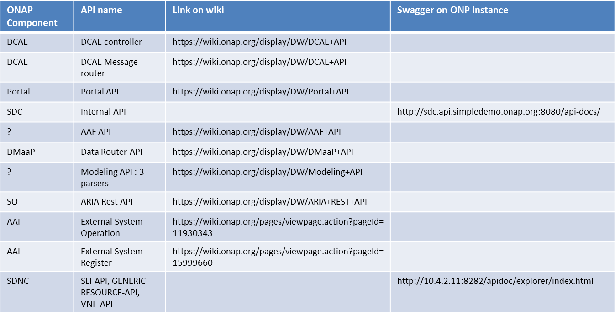
Missing API Documentation (but available on wiki)

Slide 7
Main point to improve about API documentation
Overview chapter for each API with main concerned objects
Swagger.json should be available via ReadTheDocs
Postman collections should be available via ReadTheDocs
HTTP Headers (params/values) available via ReadTheDocs
Lack of “howTo” tutorial fully based on API
howTo onboard VSP / VF / Service
howTo create Service instance / VNF instance / VF module instance
howTo remove Service instance / VNF instance / VF module instance
howTo change Service configuration
howTo scale Service
Current « look&feel » for API documentation : not satisfaying (personal vision)

Slide 8
About versioning
An ONAP component may provide several version of the same API
  API versioning must be different than Component versioning
  Developers should have access to all available versions (old, current)
An API documentation should have its own version compare to the API version
  We need consistency
  API versioning is usually available in the URL
  API versioning is usually available in the swagger specification
  API versioning is sometimes available via API request
  API versioning is usually available in the word/pdf/html documentation
  API versioning is based on number and/or Onap version naming

Slide 9
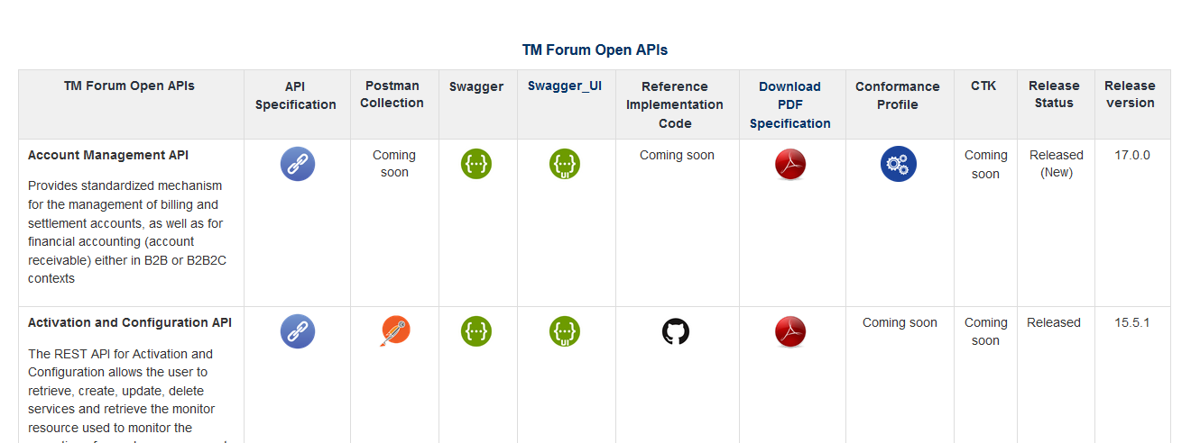
Option 1 : TM Forum approach

Slide 10
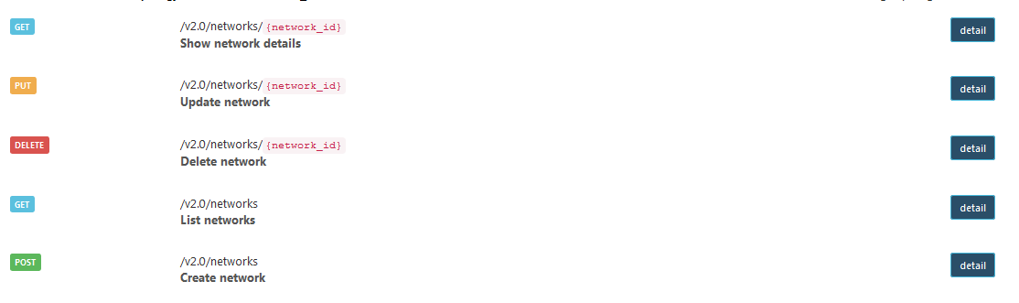
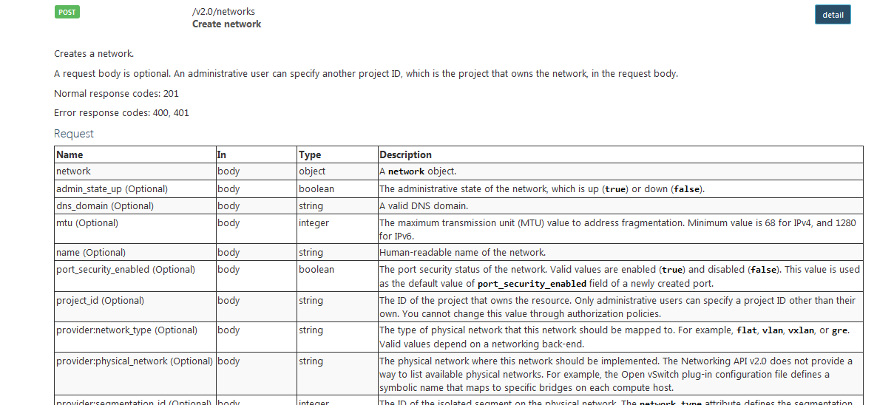
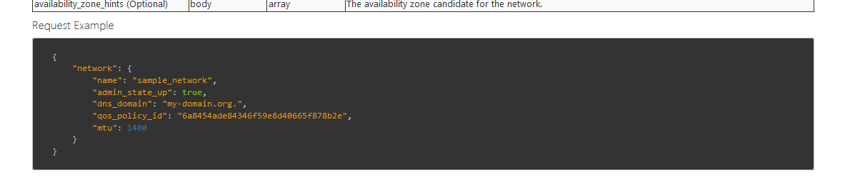
Option 2 : Openstack approach

Slide 11

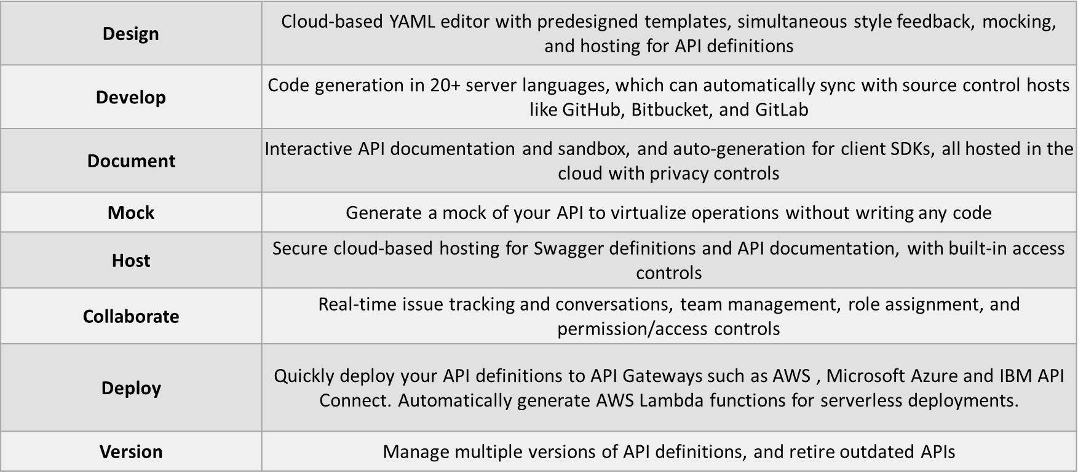
Option 3 : SwaggerHub

Slide 12
Options Comparison

