Slide 1
Microservice Bus Tutorial
Huabing Zhao, PTL of MSB Project, ZTE

Slide 2
Agenda
MSB Overview
Service Registration
Service Discovery
Example & Demo
Suggested Integration Approach
Future plan

Slide 3
MSB Overview-Introduction
Microservices Bus(MSB) provide a reliable, resilient and scalable communication and governance infrastructure to support Microservice Architecture including including service registration/discovery, external API gateway, internal API gateway, client SDK. It's a pluggable architecture so it can integrate with auth service provider to provide centralized Authentication & Authorization. MSB also provides a service portal to manage the REST APIs.
MSB doesn’t depend on a specific environment. It can work in bare metal, virtual machine or containerized environment.

Slide 4
MSB Overview-Functionalities
Service Registration
Load Balancing
API Gateway
Service Registration
TCP/UDP Forwarding
Service requests statistics and analysis
Service Discovery
FTP Forwarding
Pluggable Architecture
Transformation
Flow tagging
Rate Limiting
Circuit Breaker
Authentication
Other Plug-in …
Service Change Notification
HTTP/HTTPS Forwarding
Service Status Change Notification
WEB Socket Forwarding
Service Healthy Check
Route dynamically update

Slide 5



MSB Overview-Components
MSB
ONAP Microservices
MSB Discovery
1 Service discovery
Microservice A
Registry
MSB Discovery
MSB SDK
External service
Internal service
2 Service request
Microservice C
1 Service request
External Gateway
Internal Gateway
Microservice B
External Gateway
Internal Gateway
External service request
2 Route request to service provider
Mobile
Desktop
External Systems
Registry
Service information storage, MSB uses Consul as the service registry.
MSB Discovery
Provides REST APIs for service discovery and registration
API Gateway
Provide service request routing, load balancing and service governance. It can be deployed as external Gateway or Internal Gateway.
MSB SDK
Java SDK for point to point communication

Slide 6
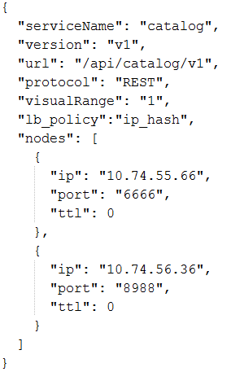
Service Registration-Information Model
Attribute | Description
serviceName | Service Name
version | Service Version
url | the actual URL of the service to be registered
protocol | supported protocols: 'REST', 'UI', 'HTTP','TCP'
visualRange | Visibility of the service. External(can be accessed by external systems):0 Internal(can only be accessed by ONAP microservices):1
path | The customized publish path of this service. If path parameter is specified when registering the service, the service will be published to api gateway under this path. Otherwise, the service will be published to api gateway using a fixed format: api/{serviceName} /{version}. The customized publish path should only be used for back-compatible.
lb_policy | Load balancing method, Currently two LB methods are supported, round-robin and ip-hash.
enable_ssl | True if the registered service is based on https. False if the registered service is based on http.
nodes | ip: the ip of theservice instance node port: the port of the service instance node ttl: time to live, this parameter is reserved for later use

Slide 7
Service Registration-RESTFul API
http method: POST
url: http://{msb_ip}:{msb_port}/api/microservices/v1/services
Example:
curl -X POST \
-H "Content-Type: application/json" \
-d '{"serviceName": "test", "version": "v1", "url": "/","protocol": "REST", "lb_policy":"round-robin","nodes": [ {"ip": "127.0.0.1","port": "9090"}]}' \
"http://127.0.0.1:10081/api/microservices/v1/services”

Slide 8
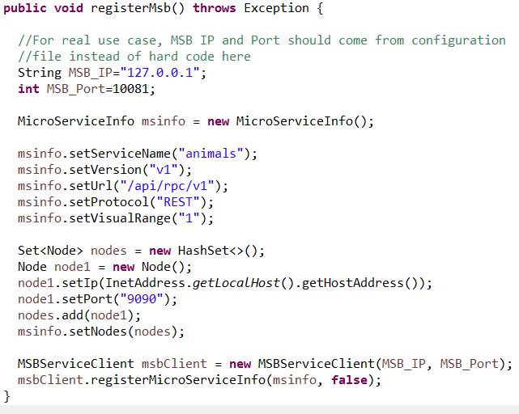
Service Registration-MSB SDK
Microservices can use MSB SDK to register themselves to MSB.
MSB
REST API
MSB SDK
ONAP
Microservice

Slide 9

Service Registration-Kube2msb Registrator
MSB
ONAP Operations Manager
k8s
deployment specs
(annotation)
2 Register Service
Update Service
Registry
MSB Discovery
Kube2msb registrator
External service
Internal service
1 Pod Even (Start, Stop etc.)
External Gateway
Internal Gateway
ONAP
Policy
SO
A&AI
VF-C
SDC
VF-C
Kube2msb registrator can register service endpoints for the microservices deployed by OOM
OOM(Kubernetes) deploy/start/stop ONAP components.
Registrator watches the kubernetes pod event .
Registrator registers service endpoint info to MSB. It also updates the service info to MSB when ONAP components are stopped/restarted/scaled by OOM

Slide 10
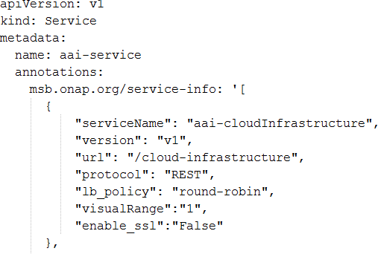

Kube2msb Registrator-Service configuration
Use Kubernetes annotations to attach service endpoint metadata to objects.
Service endpoint can be defined at Pod level or Service level
Pod level: leverage the LB capabilities of MSB to distribute requests to multiple pods
Service level: MSB send the request to service(Cluster IP), K8s dispatch the request to the backend Pod
Register at service level
Pod
Register
Service
MSB
Pod
Register at pod level
Pod
Register
MSB
Pod

Slide 11
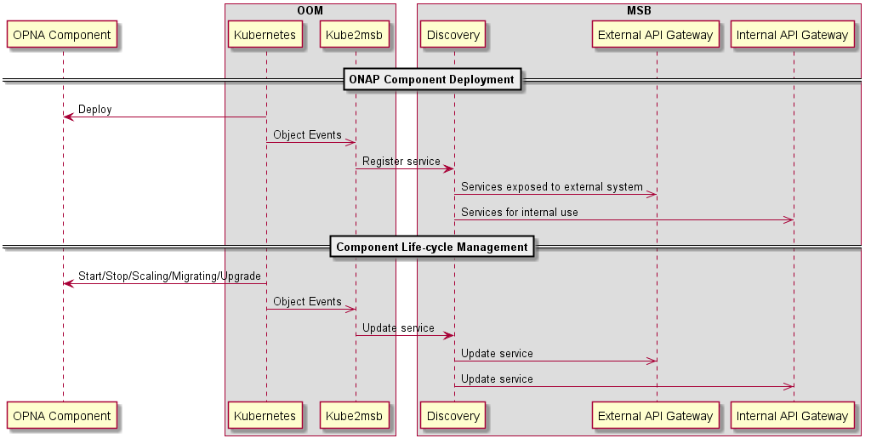
Kube2msb Registrator-flow chart

Slide 12



Service Discovery-Server Side Discovery
Compared to client-side discovery, the client code is simpler since it does not have to deal with discovery. Instead, a client simply makes a request to the router.
One more network hop is required than when using client-side discovery
Example: Curl http://msb_ip:msb_port/api/sdc/v1/catalog/resources
ONAP
10.74.215.33:3564
Micorservice Instance A
Micorservice
(Consumer)
Invoke
Router
10.74.215.211:1522
Micorservice Instance B
Load balance & invoke
Query
10.74.215.8:3281
Micorservice Instance C
Service Registry
Register

Slide 13
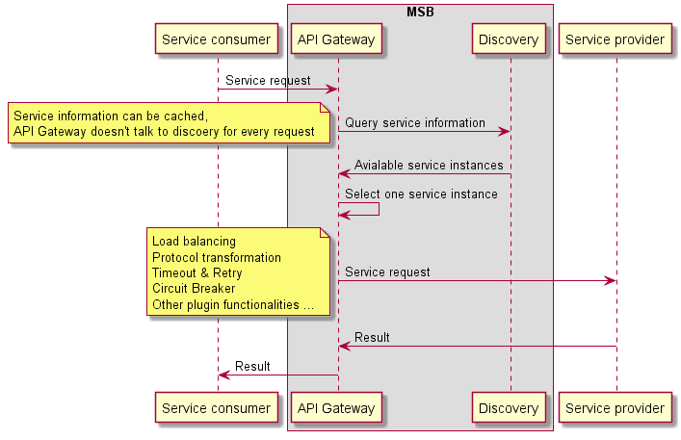
Service Discovery-Server Side Discovery

Slide 14
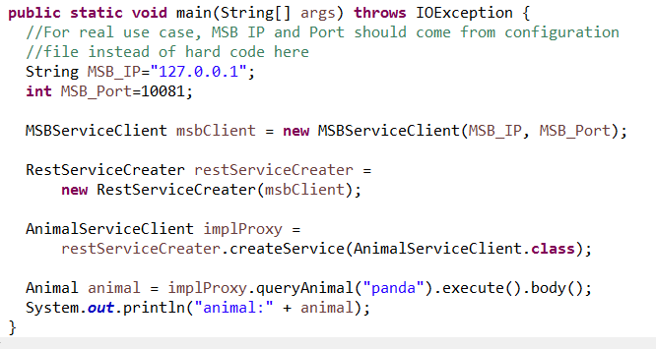
Service Discovery-Client Side Discovery
Microservices can use MSB SDK to discovery and access other microservices within ONAP.
ONAP
10.74.215.33:3564
Micorservice Instance A
Micorservice
(Consumer)
MSB
SDK
10.74.215.211:1522
Micorservice Instance A
Load balance & invoke
Query
10.74.215.8:3281
Micorservice Instance A
Service Registry
Register

Slide 15
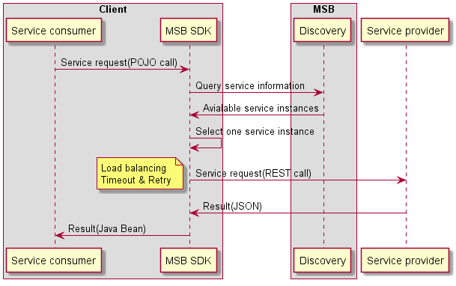
Service Discovery-Client Side Discovery

Slide 16
Example & Demo-Without OOM
Start MSB services
1. Run the Consul dockers.
sudo docker run -d --net=host --name msb_consul consul:0.9.3
2. Run the MSB dockers.
Login the ONAP docker registry first: docker login -u docker -p docker nexus3.onap.org:10001
sudo docker run -d --net=host --name msb_discovery nexus3.onap.org:10001/onap/msb/msb_discovery
sudo docker run -d --net=host -e "ROUTE_LABELS=visualRange:1" --name msb_internal_apigateway nexus3.onap.org:10001/onap/msb/msb_apigateway
Explore the MSB portal.
http://127.0.0.1/msb
Register and test your REST service with MSB via curl
https://wiki.onap.org/display/DW/MSB+Test+Environment+Setup

Slide 17
Example & Demo-Within OOM
Precondition
Have kubernetes cluster, kubectl and helm installed.
Login the ONAP docker registry first: docker login -u docker -p docker nexus3.onap.org:10001
Download oom from ONAP gerrit
git clone https://gerrit.onap.org/r/oom
Install MSB and Kube2MSB registrator
cd ~/oom/kubernets/config
./createConfig.sh -n onap
cd ~/oom/kubernetes/oneclick/
../createAll.bash -a msb -n onap
./createAll.bash -a kube2msb -n onap
Install AAI for testing
./createAll.bash -a aai-n onap
Open the MSB IAG portal in the browser
You are able to see the registered AAI services at http://${Node_IP}:30080/msb

Slide 18
Suggested Integration approach-minimum impact to existing codes
Automatically MSB registration by OOM Kube2MSB
Access services via MSB Internal API Gateway
Follows the standard URI structure
http://[host]:[port]/api/{service name}]/v{version number}/{resource}
https://wiki.onap.org/display/DW/RESTful+API+Design+Specification

Slide 19


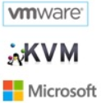





The way going forward-OMSA
(ONAP Microservice Architecture)
Gateway
Orchestration
OMSA is the vision of ONAP Microservice Architecture to support carrier-grade requirements of ONAP microservices, which includes service registration/discovery, service communication, API gateway, service orchestration, service governance and service monitoring, etc.
Next step: Investgate Istio service mesh and integrate Istio into OMSA when it's production ready.
External API Gateway
Deployment
Discovery
Scaling/Healing
Service Discovery
Update/Change
Registration
Registration
Governance
Microservices
Service A
agent
agent
Configure Management
sidecar
RPC
sidecar
Service B
Instance 1
监控采集
Instance 1
API
Management
HTTP/JSON
Instance 2
GRPC/protobuf
Instance 2
Policy/Security
Instance n
Instance n
ADF
JAVA ADF
Python ADF
Go ADF
Monitoring
Async Message Bus
Metrics
Kafka
ActiveMQ
Infrastructure
Logging
Bare Metal
Virtual Machine
Containers
Clouds
Distributed
Tracing
Note: this diagram is a functional view of OMSA, which is not mapped to specific projects

