Slide 1
Python Tools
VF2F Meeting – February 6th, 2018
Catherine Lefèvre

Slide 2
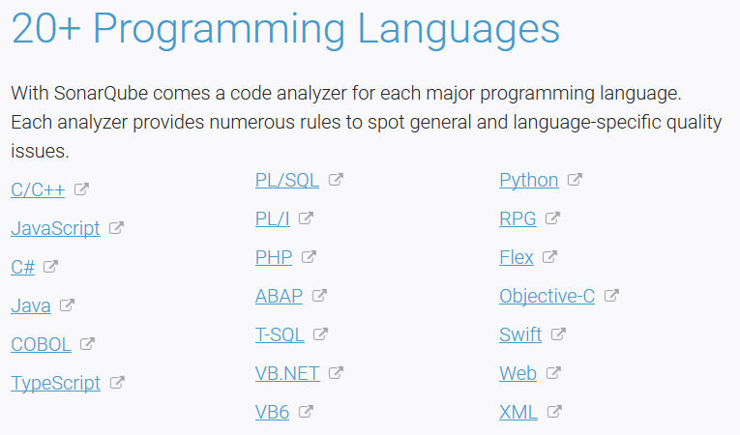
Test Coverage
SonarQube is used for continuous inspection of code quality to perform automatic reviews with static analysis of code to detect bugs, code smells and security vulnerabilities
SonarPython capability is available in Eclipse
and IntelliJ for developers (SonarLint)
as well as throughout the development chain
for automated code review with self-hosted
SonarQube or on-line SonarCloud
import Unit Tests Execution Reports
import Coverage Results
import a Pylint Report
create your own Custom Rules
https://docs.sonarqube.org/display/PLUG/SonarPython
v3.x
v8

Slide 3
Python Package Index
Python Package Index (PyPi) is a repository of software for the Python programming language.
https://pypi.python.org/pypi
PTL’s Requests:
PyPi server for hosting python packages
The release procedure for ONAP developed Pypi packages
Package | Description
mypi 0.0.3 | An api that can automatically build and serve python packages that are hosted on github
mypy 0.560 | Optional static typing for Python
pyflakes 1.6.0 | Passive checker for Python programs
Pep8 1.7.1 | Python style guide checker

Slide 4
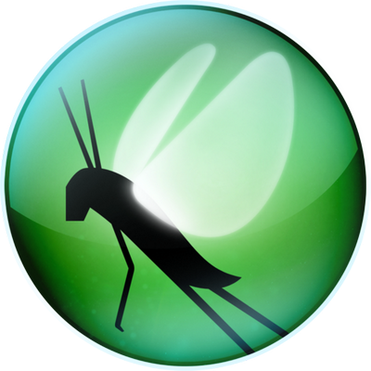
Load Testing Framework
Locust is an open source Python-based user load testing tool.
This lightweight, distributed and scalable framework helps to find out how many concurrent users a system can handle by writing test scenarios in Python code. It can be used for web applications, websites and web-based services.
Locust is completely event based and uses the async approach, so it can support running thousands load tests on a single machine or distributed over multiple machines to simulate millions of concurrent users. Each locust runs inside it’s own process (greenlet). Any number of test users will act independently with their own session data. When the tasks are defined, each Locust node can handle thousands of users in a single process. This framework even allows running in a distributed master/worker fashion with only a few configuration adjustment.
https://locust.io/

