Slide 1
Security@ONAP virtual developers event (Feb, 2018)
ONAP security subcommittee
Stephen Terrill
Feb 5, 2018

Slide 2
Topics
ONAP Security Subcommittee Update
Security S3P Overview
  CII Badging program
    Introductory Video
    CII Badging Program Guide Walkthrough

Slide 3
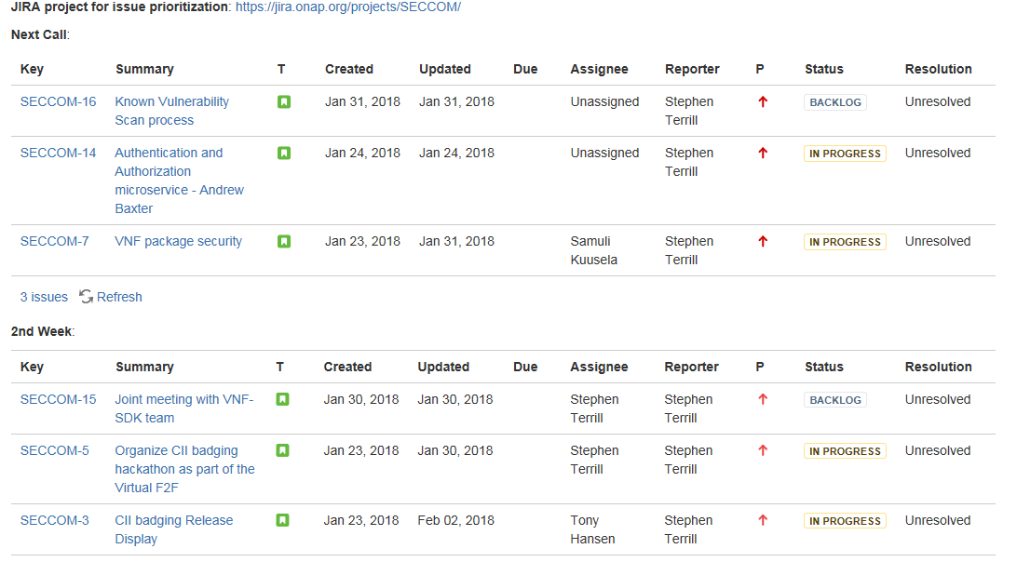
ONAP Security Sub-Committee Update
Certificate Authority.
  Agreed approach to ONAP certificate authority
    ONAP deployment can host own
    Or access to existing
    ONAP applications isolation
    In AAF project
Discussing
  User Authentication
  VNF Package Security
Security sub-committee has created JIRA for issue tracking.
  VNF Security Jira
  Priorities visible on ONAP security coordination page

Slide 4
S3P (Platform Maturity)
Project-level requirements
Level 0: None
Level 1: CII Passing badge
Level 2: CII Silver badge, plus:
  All internal/external system communications shall be able to be encrypted.
  All internal/external service calls shall have common role-based access control and authorization.
Level 3: CII Gold badge
ONAP Platform-level requirements per release
Level 1: 70 % of the projects passing the level 1 •with the non-passing projects reaching 80% passing level
  Non-passing projects MUST pass specific cryptography criteria outlined by the Security Subcommittee*
Level 2: 70 % of the projects passing silver •with non-silver projects completed passing level and 80% towards silver level
Level 3: 70% of the projects passing gold •with non-gold projects achieving silver level and achieving 80% towards gold level
Level 4: 100 % passing gold.
AAF Dependency

Slide 5
CII Badging Program
Introductory Video (How to get started)
  https://youtu.be/dhLYLpsvvc0
CII Badging Guide for ONAP walkthrough
  CII Badging Program Guide for ONAP

Slide 6
ONAP, the Secure Open Networking Platform

