Slide 1
SDC Test Automation API
Jan, 2019

Slide 2
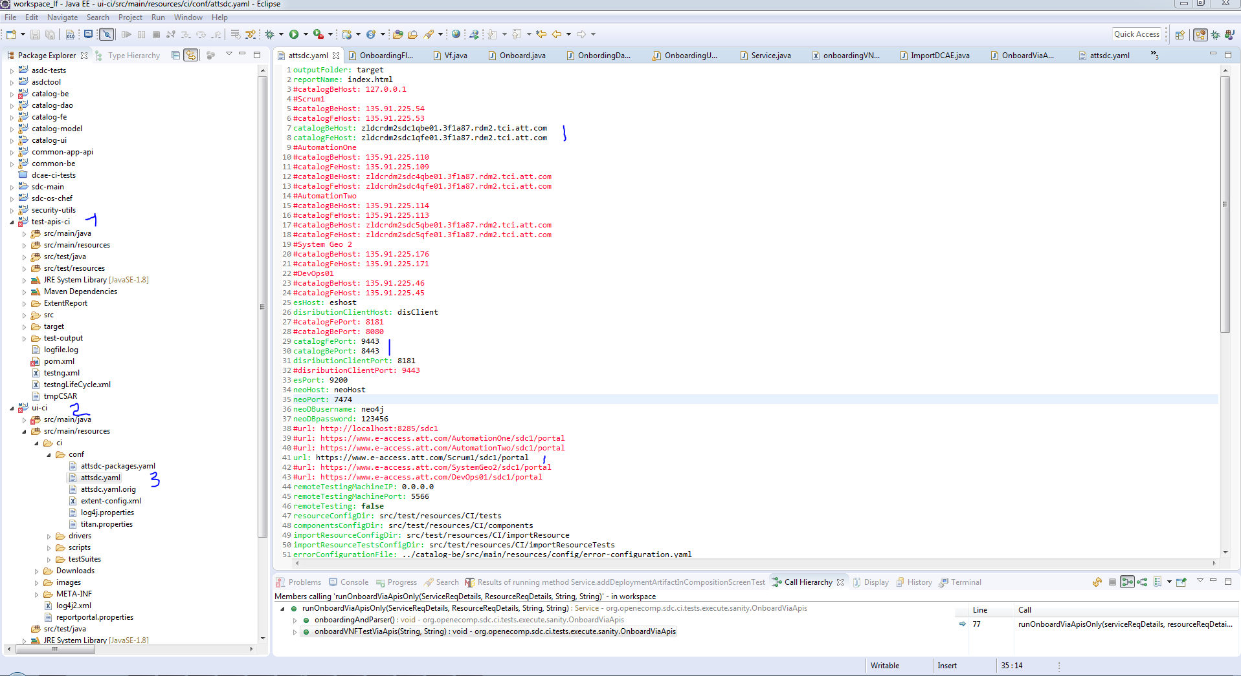
SDC Test API Project and Config

Slide 3
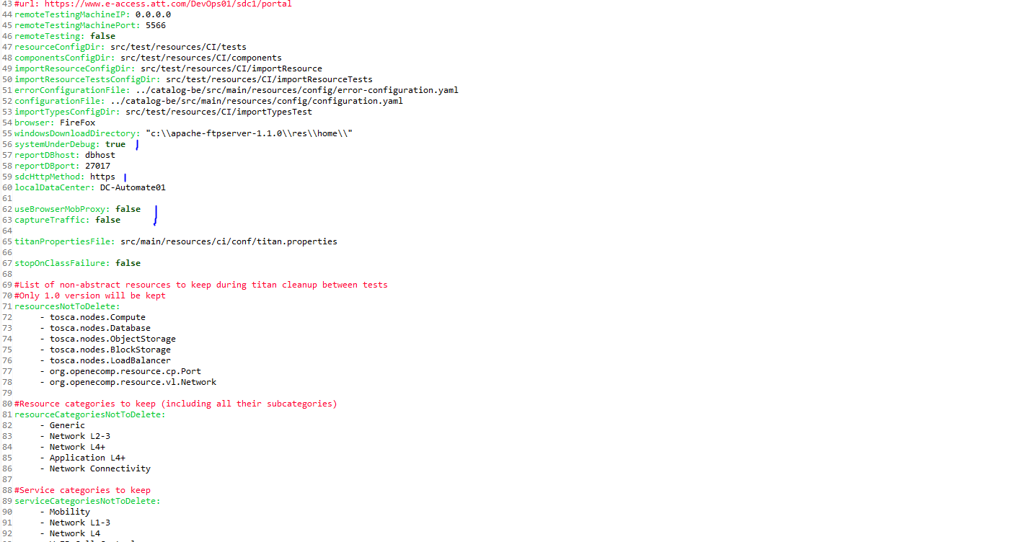
SDC Test API Project and Config

Slide 4
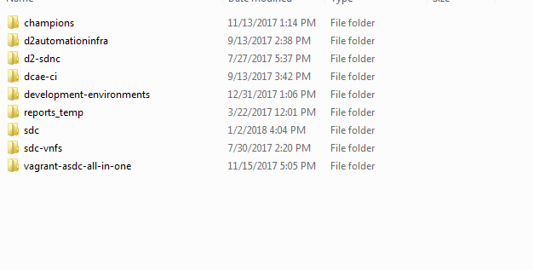
SDC Test Automation API File Repository
File repository , from here https://codecloud.web.att.com/scm/st_sdc/sdc-vnfs.git , should be placed on same level as sdc project

Slide 5
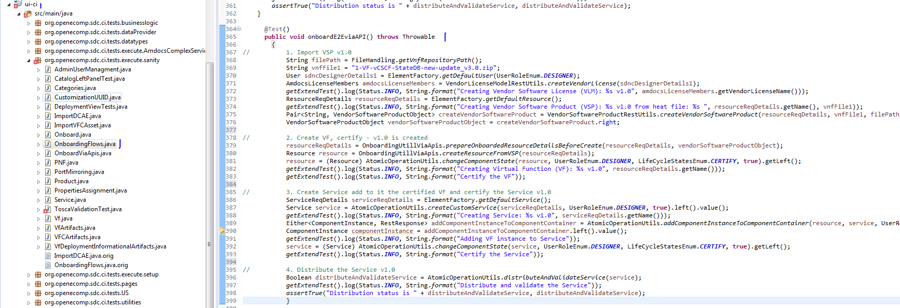
SDC Test Automation API Example

Slide 6
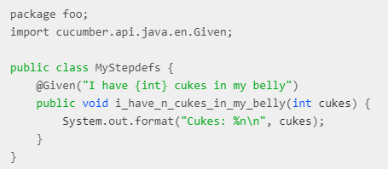

SDC Test Automation Cucumber/Gherkin
Cucumber - reads executable specifications written in plain text and validates that the software does what those specifications say. The specifications consists of multiple scenarios.
Gherkin - simple set of grammar rules that makes plain text structured enough for Cucumber to understand . Keywords most in use – Given, When, Then .
Scenarios – scenarios are like tests , stored in .feature text files .
Steps - Step definitions map (“glue”) each Gherkin step into code, Java code in our project.
Examples :
Scenario: eat 5 out of 12
Given there are 12 cucumbers
When I eat 5 cucumbers
Then I should have 7 cucumbers

Slide 7
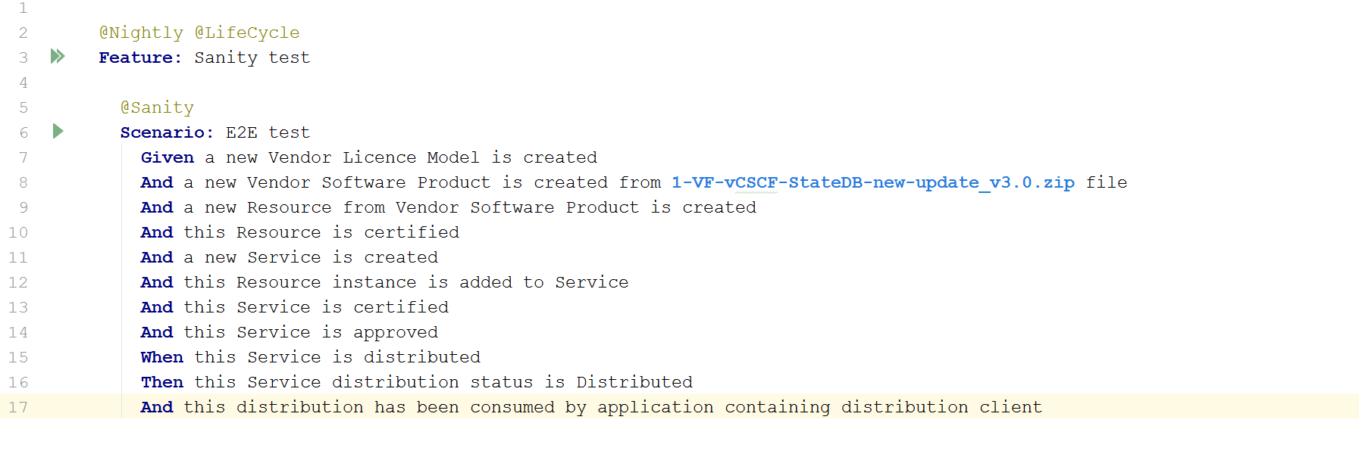
SDC Test Automation API Scenario Example

Slide 8
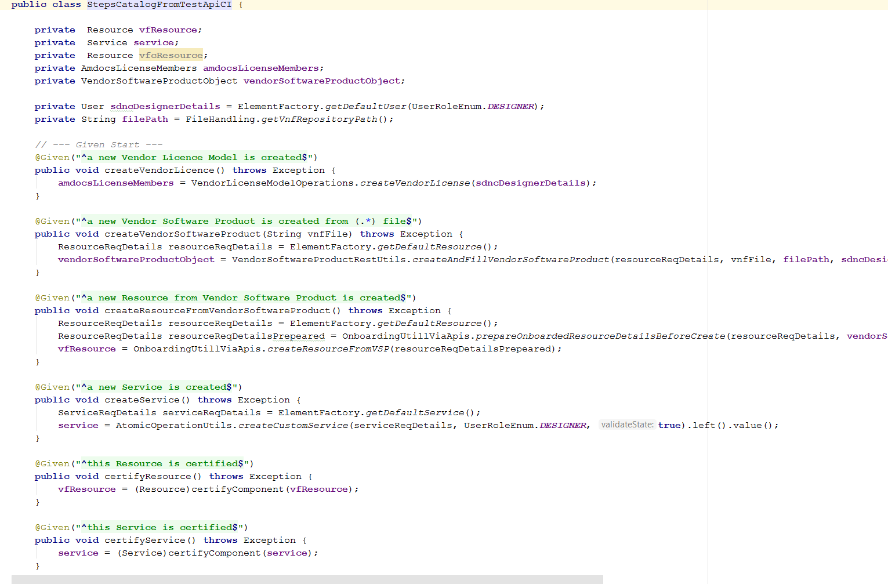
SDC Test Automation API Steps Example

Slide 9
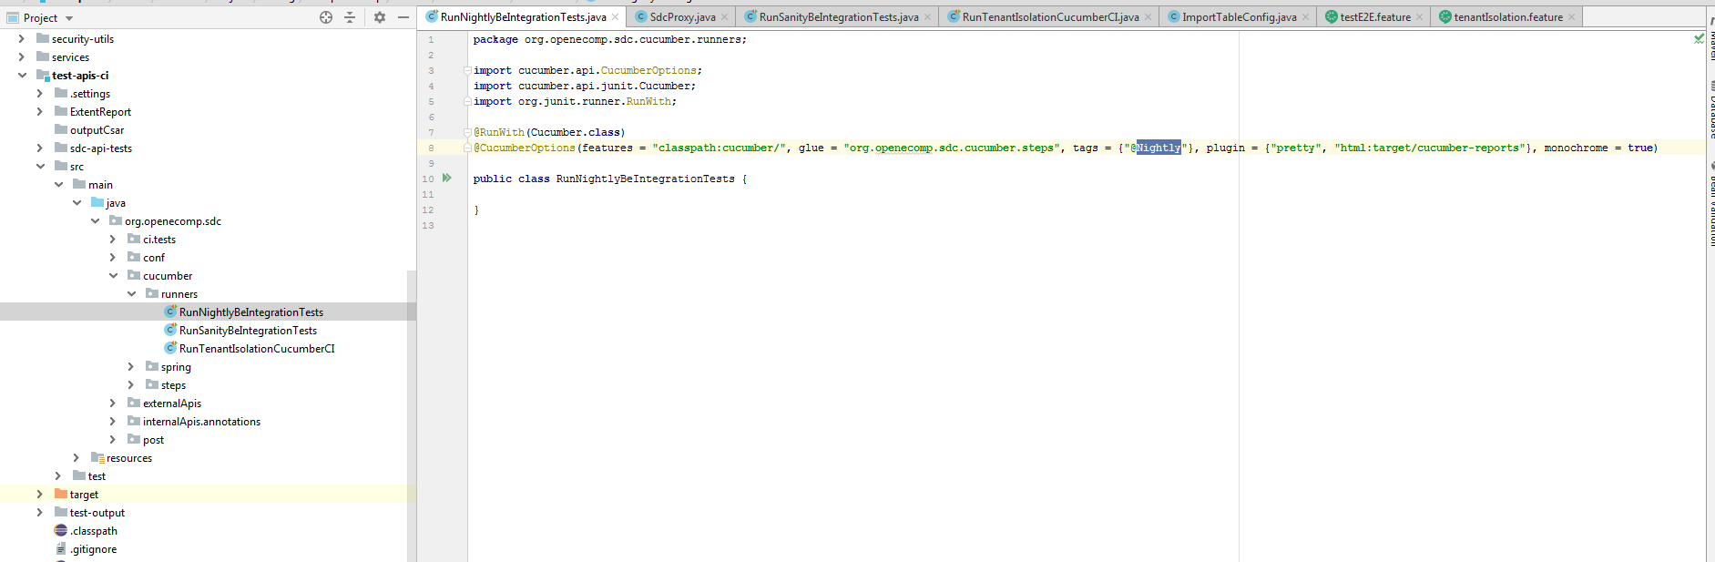
SDC Test Automation API Runner

Slide 10
SDC Test Automation API Example
Main Classes:
URLs - org.openecomp.sdc.ci.tests.api , contain all URL’s
AtomicOperationUtils - org.openecomp.sdc.ci.tests.utils.general, REST operations
ElementFactory - org.openecomp.sdc.ci.tests.utils.general,
generate default SDC objects ( User, Resource, Service, Artifact … )

Slide 11
Thank you
Notes:
Start preparing on 1 pager
Missing architecture and deployment

