Slide 1
SDC Test Automation UI
Jan, 2019

Slide 2
SDC Test UI Flow
Read conf file
Open X browsers
Delete old resources
Navigate to URL
Login (Webseal\ATT)
Test
Reopen browser
Test failed ?
No
Yes
No
Different role for new test ?
Yes
Delete cookies
Notes:
Selenium installed on windows server (over HVD or other)
Selenium via Global login hitting all ASDC elements including vLB
We already received 10 mechIDs which were associated with Staging, IST and ETE, will be also associated with Dev sub environments
Are those mechIDs on webseal production ?
Can we execute commands on servers such as stop/start as Nagios ? This way we can test Resiliency as well?
I need example of use case …

Slide 3
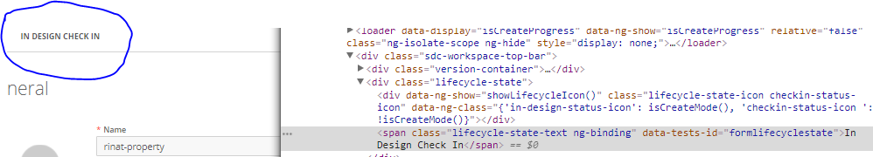
SDC Test UI Find Element on Page
“data-tests-id” attribute is added to every element that we interact with
Xpath selectors are mostly in use
Example on page :
Example on code:
Notes:
Selenium installed on windows server (over HVD or other)
Selenium via Global login hitting all ASDC elements including vLB
We already received 10 mechIDs which were associated with Staging, IST and ETE, will be also associated with Dev sub environments
Are those mechIDs on webseal production ?
Can we execute commands on servers such as stop/start as Nagios ? This way we can test Resiliency as well?
I need example of use case …

Slide 4
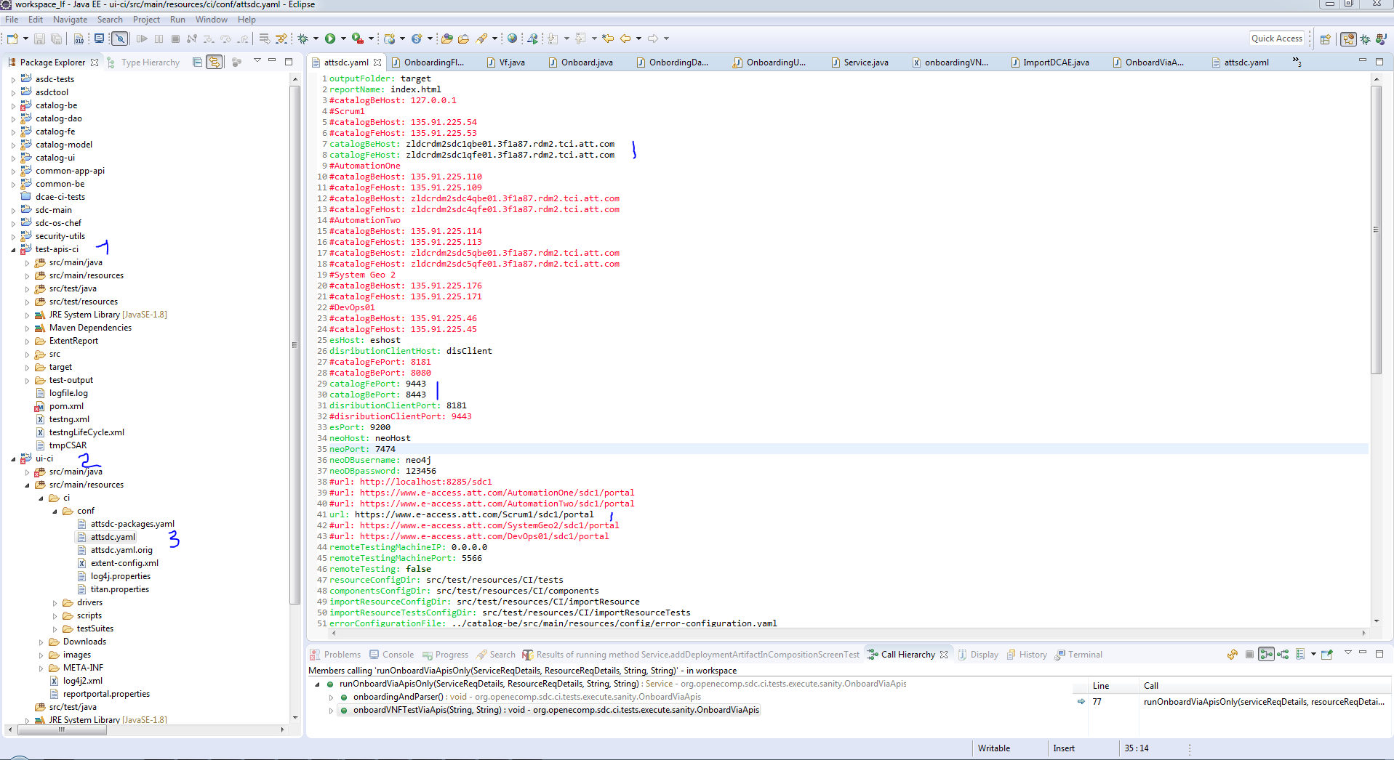
SDC Test UI Project and Config
Notes:
Selenium installed on windows server (over HVD or other)
Selenium via Global login hitting all ASDC elements including vLB
We already received 10 mechIDs which were associated with Staging, IST and ETE, will be also associated with Dev sub environments
Are those mechIDs on webseal production ?
Can we execute commands on servers such as stop/start as Nagios ? This way we can test Resiliency as well?
I need example of use case …

Slide 5
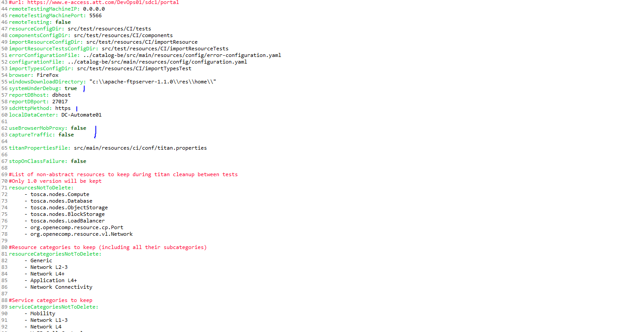
SDC Test UI Project and Config

Slide 6
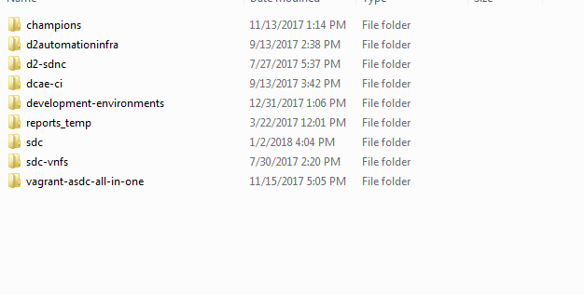
SDC Test Automation UI File Repository
File repository , from here https://codecloud.web.att.com/scm/st_sdc/sdc-vnfs.git , should be placed on same level as sdc project

Slide 7
SDC Test Automation API and UI Main Classes
Main Classes API:
URLs - org.openecomp.sdc.ci.tests.api , contain all URL’s
AtomicOperationUtils - org.openecomp.sdc.ci.tests.utils.general, REST operations
ElementFactory - org.openecomp.sdc.ci.tests.utils.general,
generate default SDC objects ( User, Resource, Service, Artifact … )
Main Classes UI:
DataTestIdEnum - org.openecomp.sdc.ci.tests.datatypes, all data-tests-id
GeneralUIUtils - org.openecomp.sdc.ci.tests.utilities, all infra for operations with page
Verificators – classes with verification for specific objects or pages
Pages– classes with methods for specific page
Utilities – classes with methods for specific features or useful methods

Slide 8
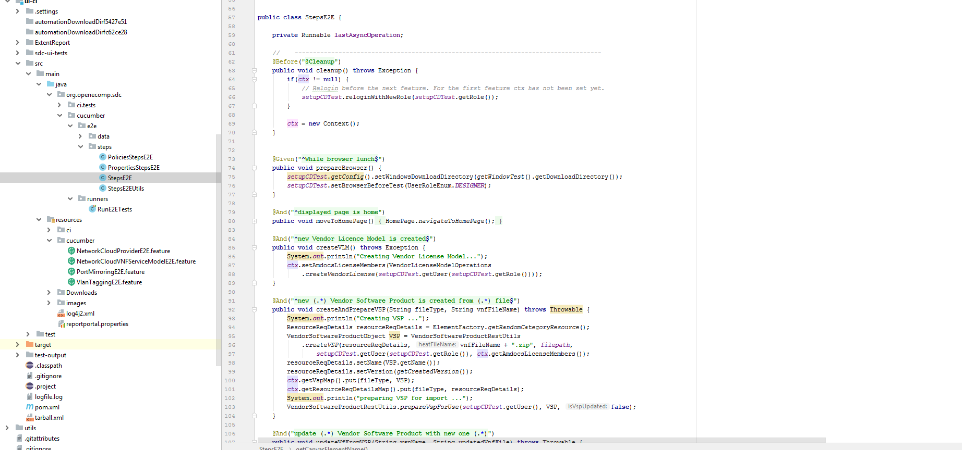
SDC Test Automation UI Cucumber Steps

Slide 9
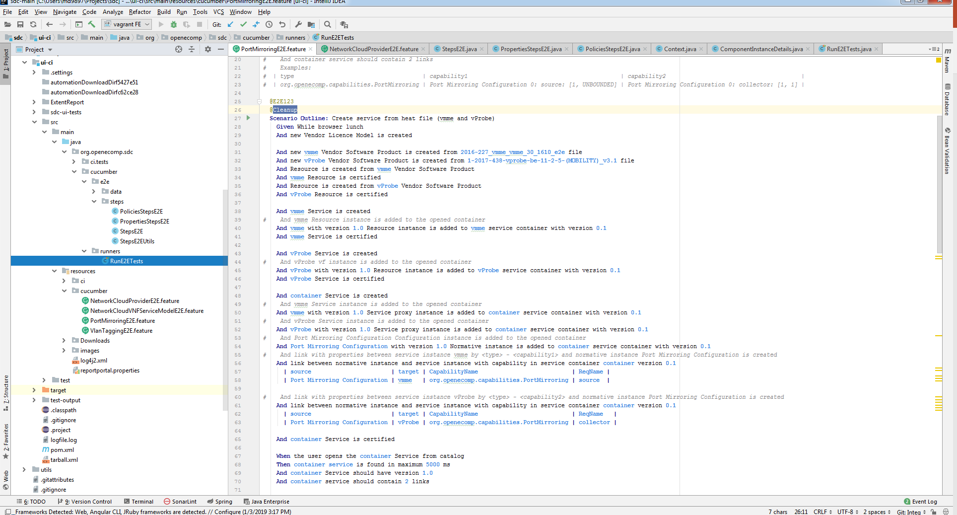
SDC Test Automation UI Cucumber Example

Slide 10
Thank you
Notes:
Start preparing on 1 pager
Missing architecture and deployment

