Slide 1
Distribution Client

Slide 2
Agenda
• High Level Design
• Example For Usage By Third Party
• Detailed Level Flow
• Distribution Client APIs
• Notification Data & Callback
• Distribution Client Configuration
• Notified/ Not Notified Mechanism
• Component Done Mechanism
• Repository Details

Slide 3
High Level Flow

Slide 4
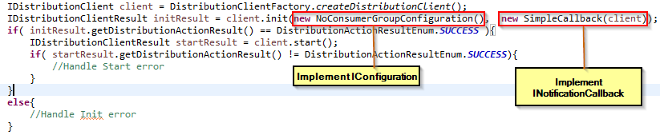
Example For Usage By Third Party
      Basic Example of usage by third party

Slide 5
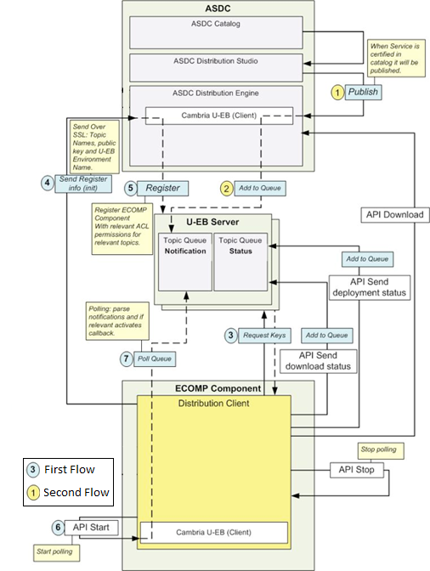
Detailed Level Flow

Slide 6
Distribution Client APIs
This Interface represents the APIs provided by the distribution client

Slide 7
Notification Data & Callback
This Interface represents the notification sent by SDC to the UEB
This Interface should be implemented by the 3Rd Party application – it has the logic on what to do when the distribution client notify the application.

Slide 8
Distribution Client Configuration
This Interface Contains the configuration the distribution client requires – it’ll be implemented by the 3rd party application.

Slide 9
Notified/ Not Notified Mechanism
When a notification is fetched by the distribution client it will automatically send a status: Notified / Not Notified
In case the notification will be passed to the the 3rd party app and its callback will be activated a Notified status will be sent.
Otherwise a Not Notified status will be sent.

Slide 10
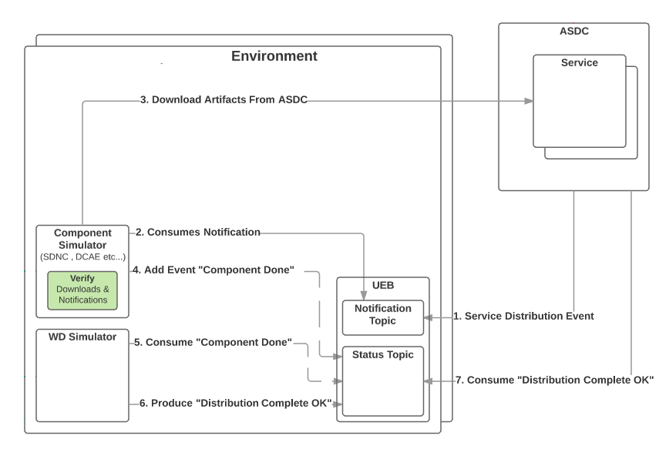
Component Done Mechanism
This Mechanism was developed in order to allow One distribution client to perform action according to status sent by several other distribution clients

Slide 11
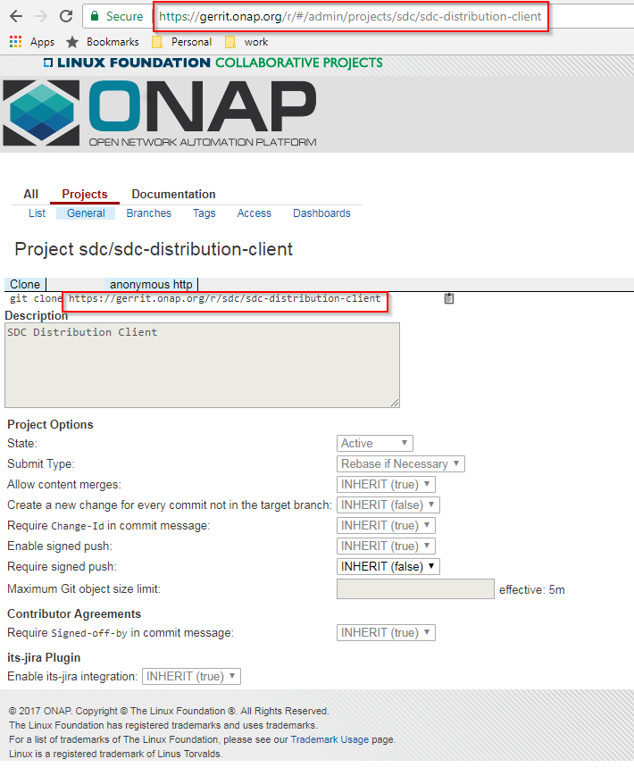
Repository Details
Repository
https://gerrit.onap.org/r/p/sdc/sdc-distribution-client.git
ONAP Link
https://gerrit.onap.org/r/#/admin/projects/sdc/sdc-distribution-client

Slide 12
Thank You

