Slide 1
ONAP Casablanca Architecture Draft for Community Review
Chris Donley
6/20/18

Slide 2
ONAP Casablanca Release

Slide 3
Casablanca Deployability focus
Deployability: ONAP can be deployed in multiple operator environments
  Does not imply level of quality
  Continuous improvement, similar to S3P
ARC priorities supporting deployability
  Microservices
  Modular
  Standards alignment
  API standardization/improvement
  VNF/PNF Onboarding
  Containers
  External controllers

Slide 4
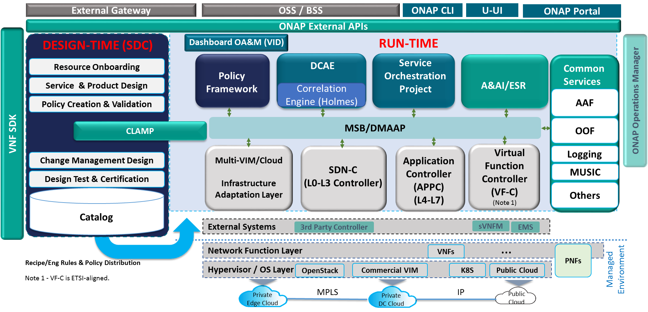
ONAP Beijing Architecture for Reference
(High-Level View with Projects)
Version 2.0.3
3/15/2018
Modeling (Utilities)
Integration
VNF Requirements
VNF Validation Program

Slide 5
ONAP Casablanca Architecture (Draft)
(High-Level View with Projects)
Version 2.0.4 6/20/2018
Modeling (Utilities)
Integration
VNF Requirements
VNF Validation Program

Slide 6
Casablanca ARC Recommendations RTSA/uS
Real-time streaming analytics
  DCAE enhancements to support real-time streaming analysis:
  Enhance DCAE collector to support high volume streaming data collection (Using Socket and/or DDS)
  Add Bulk data collector to DCAE
  Add real-time streaming analytic framework (Flink)
  Support AAF for VNF to DCAE secure communication
  DMaaP Enhancements:
  Add file routing capabilities for bulk data movement
Microservices:
  Identify and harmonize common components
    For example, reduce number of databases in ONAP using OOM. Projects should use common DB where appropriate or clearly state why they need an alternate approach.
  Initial support for K8S VNF in Multi VIM/Cloud
  Include OPNFV Clover project (Spinnaker) in CD pipeline (part of Integration)
  Interest (but no consensus) regarding service mesh/Istio – no recommendation for Casablanca

Slide 7
Casablanca ARC Recommendations APIs
External APIs: External actors view ONAP as a black box. This should simplify the ONAP architecture/interfaces, leveraging the APIs developed by the Ext API project (eg, MEF LSO, TM Forum etc).
  MEF: Legato, Interlude (new functionality for orchestration federation)
  TMF: the API as NBI to BSS and West-East API with another ONAP instances, include (service catalogue-633, service inventory-638, and service order -641)
API Improvements: Currently, ONAP internal interactions are mostly handled via REST-like APIs.
  All APIs between internal components & external APIs should be generated by Swagger,
  APIs align with ONAP-published DM,
  Messages exchanged in JSON format.
API Versioning Support
  https://wiki.onap.org/display/DW/ONAP+API+Common+Versioning+Strategy+%28CVS%29+Proposal

Slide 8
Casablanca ARC Recommendations PNF, Controller, CPU
PNF Support:
  PNF Registration
  PNF Packaging guideline and verification
  PNF orchestration and lifecycle management (including monitoring, closed loop automation, change management)
Physical network discovery
  Register 3rd party controller in ESR
  Sync up the abstract topology in A&AI
  Onboard yaml file for the resource in the physical network in SDC.
CCSDK Enhancements:
  Create Generic Network Function Controller (GNFC) Persona to support 5G (L0-L7) network elements
  Add needed artifacts to Support 5G network elements (DU, CU, etc.), including radio configuration in CCSDK library
  Support configuration and lifecycle management from a single controller persona
  Enhance CDT to support Generic Network Function Controller (L0-L7)
Multi-CPU architecture
  Develop common Docker templates which include multi-CPU arch support

Slide 9
Casablanca ARC Recommendations SO/SDC/ETSI
Integrated design environment (SDC) – take incremental steps towards target:
  Run-Time Catalog
  DCAE-DS enhancements to support CLAMP flow design
  Policy Designer integration to support Control Loop MS configuration policies (Xacml) and Operations Policies (drools).
  Flow Designer - GUI and BPMN artifact generations for SO Change Management support.
SO Enhancements
  Extend the SO “decomposition” Building Block to support decomposition of Services that include VNFs and PNFs.
  Model the “Service Instantiation” sequencing relationships [in SDC] that SO must enforce among the Resources within a Service.
Support VNF packaging compliant with SOL-004
Align with ETSI SOL specifications
  SOL-001, -003, -004, -005

Slide 10
Modularity/Functional Decomposition
No consensus for Casablanca
  Forming a Task Force to analyze functional components inside projects and provide recommendations
  Face-to-face meeting later in the release

