Slide 1
Deployability requirements from a service provider perspective
Eric Debeau, Sylvain Desbureaux
June 21 , 2018

Slide 2
Many PoC (done and ongoing)
MEF PoC Ethernet on Demand
Diversity Path for Ethernet services
Radisys vMRF service onboarding + deployment at MWC
Probe on Demand service onboarding + deployment
NBI external API showcase at TMF
SD-WAN service onboarding + deployment
Testing robot on demand

Slide 3
OpenLab
Huge success of this lab (more than 60 users)
Several companies are very active
Upgrade planned starting July with some hardware upgrades (new Ceph cluster, more compute nodes,…) and new OpenStack version (based on Queens)

Slide 4
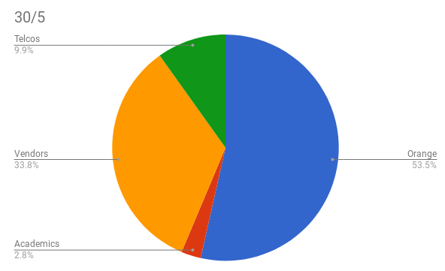
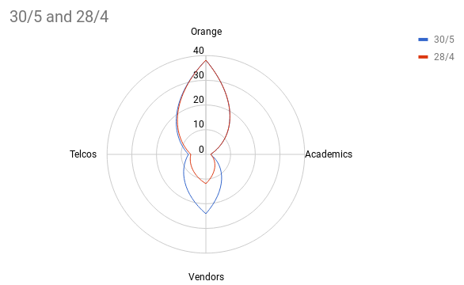



















Orange ONAP Openlab : facts & figures

Slide 5
Orange ONAP Openlab : facts & figures
Account creation :
  procedure automated (but key&user must be declared in gitlab)
  Mailing list management (moderation, answer to the mails,...)
Support :
  Level 0 : how to connect ? what is SSH ? Where do I find a key ? How to configure my putty ?
  Level 1 : access issues (forget to use DNS from the lab – to be configured at SOCK proxy level), using IP rather than FQDN, SSH key not properly pushed to the rebound, rebound unreachable, ...
  Level 2 : question on ONAP module : how to onboard, how to instantiate ? Issue due to resources (everybody trying the same example reusing the same template/IPs)
Monitoring/supervision of the lab :
  Lots of tests have been automated
  But resources must be monitored, alarms managed, resources cleaned if not done properly (automated tests create lots of resources…)

Slide 6
Tools to configure ONAP platform
ONAP deployment requires some default parameters
  APPC, SO, NBI
ONAP platform is « living »
  New VIM/tenants to be added and configured in AAI, SO…
  Old VIM/tenants may be removed
  License Model may be obsolete, or a VF is not needed anymore
    But nothing proposed to delete
  Authentication to be configured in various components « manually »

Slide 7
Tools to operate ONAP platform
Many actions on the platform
Possible errors
  eg delete a service by error
How to recover ?
  Add several issues, « restart » some Docker containers once in a while
Logging is eating the whole disk if no further configuration is done
  Is Debug logging per default a good stuff?
How to copy content from a platform to another one

Slide 8
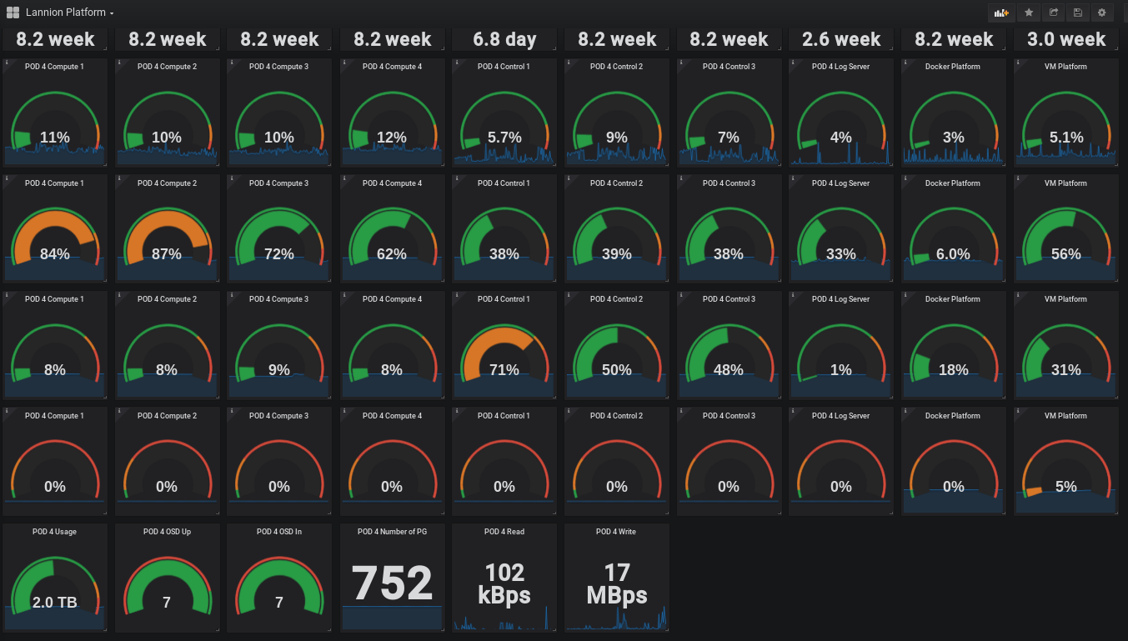
Tools to monitor ONAP and associated infra
Using InfluxDB, Prometheus to gather data
Grafana to make a dashboard
Docker Functest running robot healthcheck
Also created a status page for the customers gathering data (still ongoing)

Slide 9
Tools to ‘audit’ deployments
Is the SDC CSAR has been well deployed?
Does AAI in line with reality?
Does DCAE receive expected data from a particular VNF?
…

Slide 10
Storage stability
Currently our storage is a Ceph cluster with HDD
Beijing is starting to use Cassandra databases.
  Cassandra writes to disk at every action (write, heartbeat…)
  Ceph is replicating each write 3 times
  OOM is using NFS as common storage and we slow down more our deployment
  HDD are slow
  → OOM is failing on our platform and modules using Cassandra have to be restarted several times to be OK using HEAT deployment

Slide 11
Deployment in operational IT
Inside Orange IT network, we have strong security rules
For example a VM may speak to the network but not to BSS modules
So single Kubernetes deployment would be an issue today
  Double / Triple Kubernetes deployment (upper part of ONAP on one, lower part on another for example) ?
  Our operational security rules may change in future but not expected soon…
Heat deployment is also not really an option as cloud-init is not reliable

Slide 12
Proposal for Casablanca
Develop some ops tools
Share experience with other labs
Share such tools in ONAP repo to defined
…and provide documentation

