Slide 1
POMBA
An Introduction
June 21, 2018

Slide 2
Overview
What is POMBA?
How does it work?
Network Discovery
ONAP Status
Where to learn more
Come Join Us

Slide 3
Data Integrity Concerns – an operations pain point
Compare service design intent with reality
Data Integrity
over the entire
Lifecycle
Initial orchestration
After the instantiation the resource may differ from the design intent because of either implementation issues in ONAP or problems with the resource itself
Design Intent: SDC (Service Model)
Orchestration Intent: SDNC, A&AI, etc.
Over time (LCM)
  Change Management, Self-healing and manual changes can contribute to further differences between design intent and what is actually defined in ONAP and within the actual resources
Actual Result: Primary Sources (Openstack, Network, VM etc.)

Slide 4

The value of
Post Orchestration Model Based Audit
POMBA
POMBA enables ONAP operations with…
  improved automation efficiency
  improved manual virtualization efficiency
  improved migration to the NFV orchestration environment
… by
  Providing event-driven audit of the operational data integrity across the NFV orchestration environment and NFV infrastructure using model driven approach
  Reporting discrepancies & anomalies between model and instance artifacts:
    compare the initial service type model intent
      with the service instance artifacts stored in the ONAP controllers
      and the resulted service instance components attributes in the NFVI
      and he A&AI records

Slide 5

POMBA
ONAP Portal – Design Studio & Dashboard
OSS
BSS
Service Design
Design-time (SDC)
Run-time
ONAP Operations Management (OOM)
External Data Movement & APIs
Service Audit
Resource Onboarding
Orchestration (SO)
Inventory/Topology (AAI)
Data & Analytics (DCAE)
Policy
VNF/PNF SDK
Service & Product Design
Service Level Orchestration
Active / Available
DCAE Analytic µServices
Policy Execution Engine
Resource Level Orchestration
Entitlements
CDAP
Holmes
…
Policy Creation & Validation
Resource / Service Topology
Data Distribution
Analytic Application Design
ESR
Data Collection Layer
Common
Services
Catalog
DMaaP
AAF
Logging
Micro Services Bus
Service Instantiation
Testing & Certification
Multi-VIM Interface
L0-3 Network Controller (SDN-C)
L4-7 Controller (App-C)
Vendor VNFM
Adaption Layer
(VF-C)
Products
Services
Infrastructure
Adaption Layer
Config
Database
Service Logic
Interpreter
Life Cycle Mgmt Func
Config Database
Service Logic Interpreter
Life Cycle Mgmt funcs
Resources
Policies
Life Cycle Mgmt funcs
Eng. Rules
Analytics
Adaption Layer
Standard Adaption Layer
Vendor OA&M Adaptor
Vendor
A
Vendor
B
Recipe / Engineering Rules & Policy Distribution
Open
Stack
AWS
Azure
MEC
Netconf
Yang
CLI
3rd Party Network
controller
Chef
Netconf
Ansible
sVNFM
sVNFM
sVNFM
Further Rationalization
Opportunities
VNF1
VNF2
VNF3
PNF 1
…
VNFn
Infrastructure
OpenStack
VMware
RackSpace
Azure
Peripherals

Slide 6
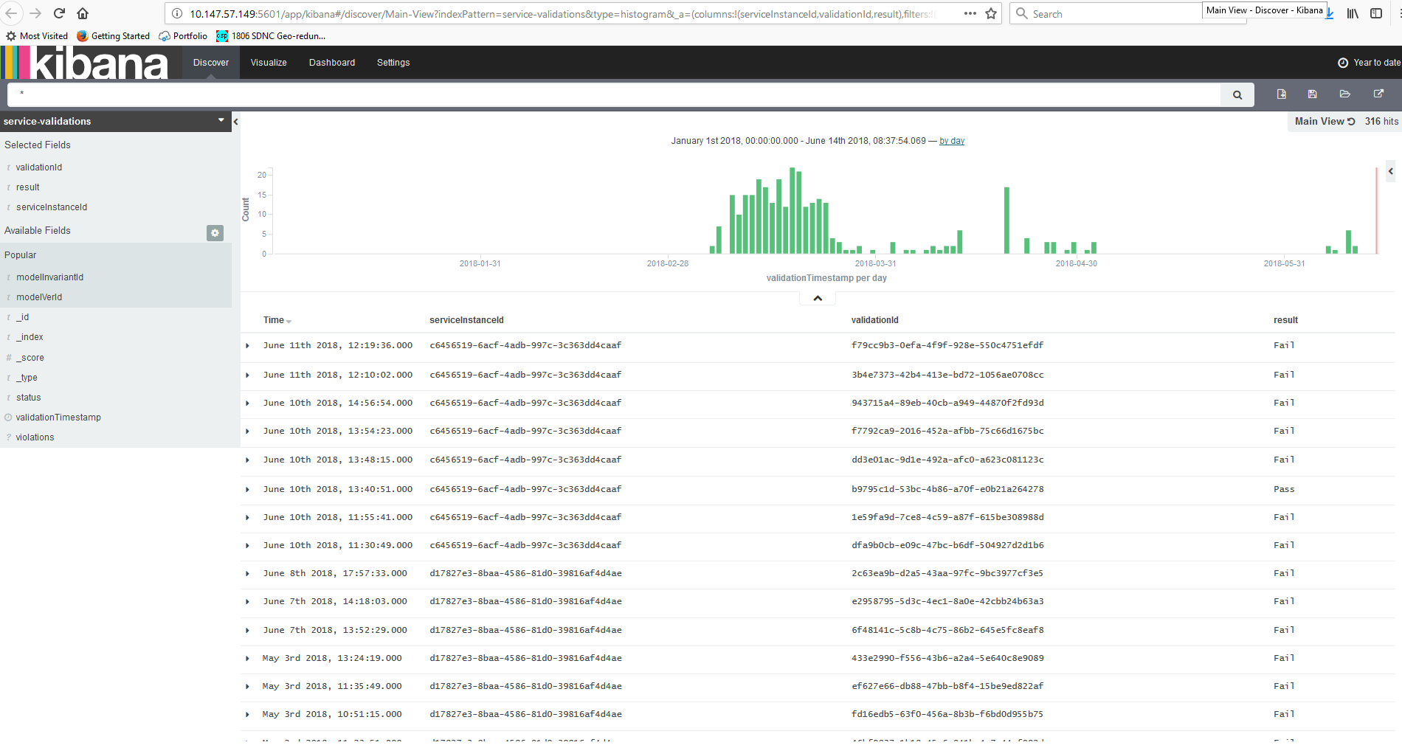
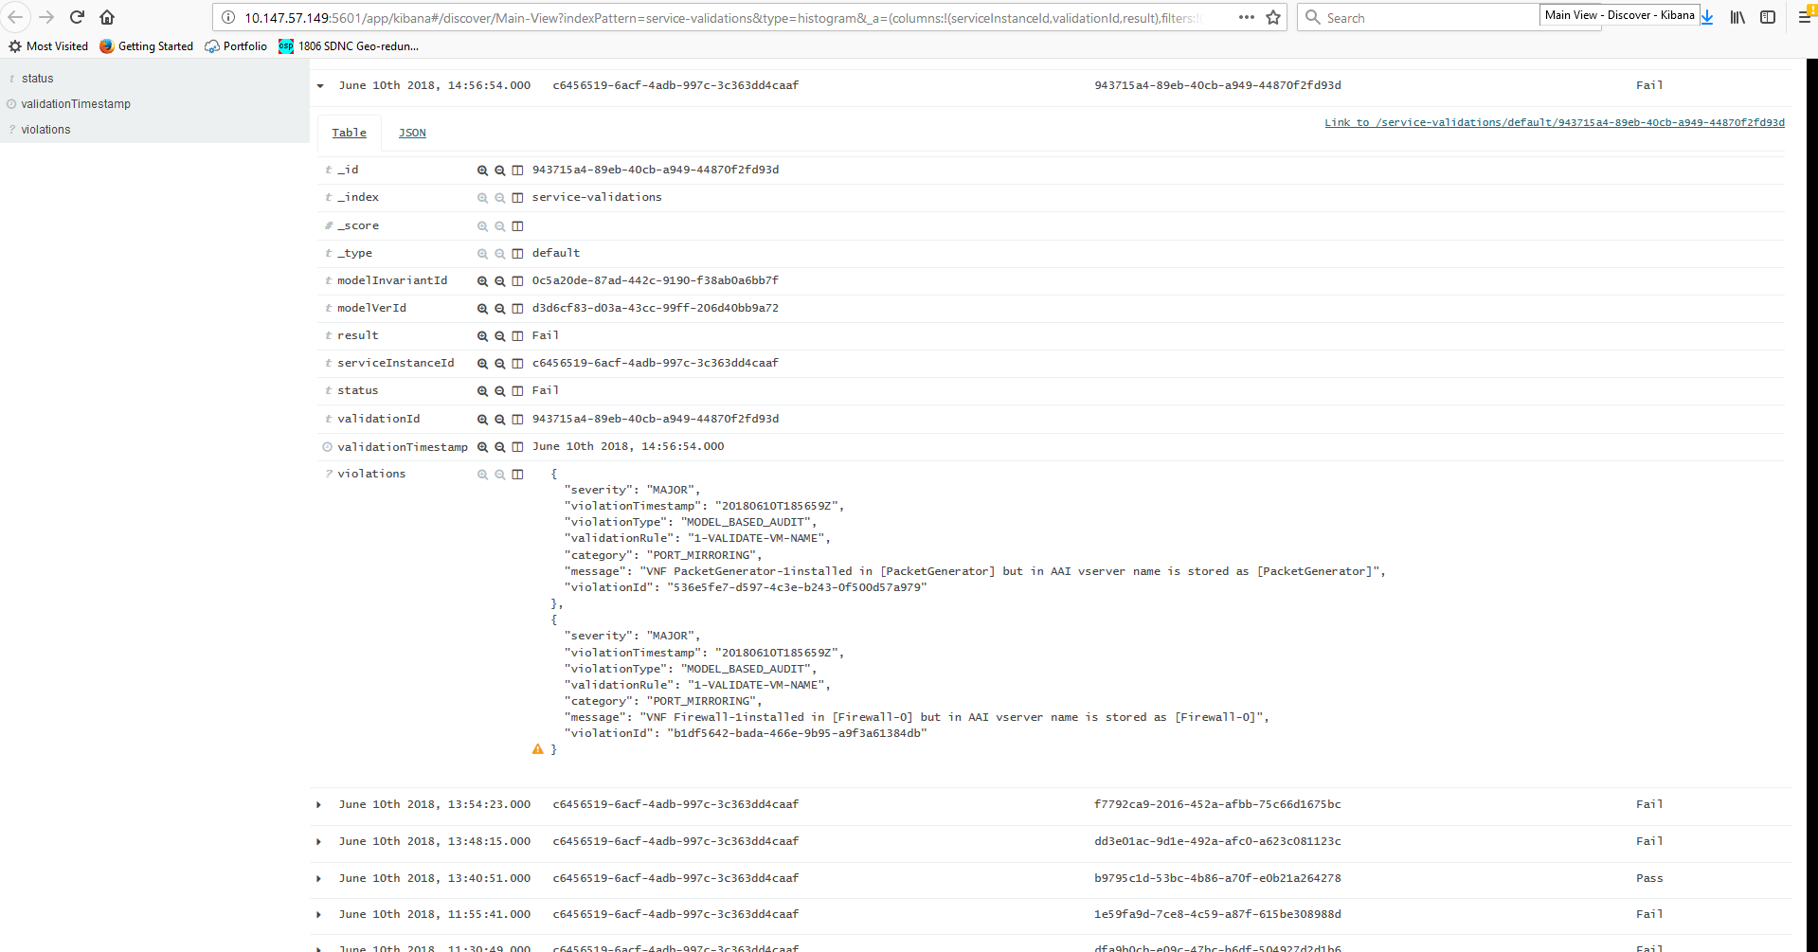
Audit Report
One Reported generated for each audit.
  Result field indicates “Pass” or “Fail”
Audit Records sent as events; consumed by Kibana
Expanded view with details of audit

Slide 7
Audit Report
Report Fields being tuned
Audit Summary
  Result field indicates “Pass” or “Fail”
  Other fields provide information about inputs to audit
    Mode-version-id
    Service-instance-id
    Etc.
In case of failure, one violation listed for each issue found
  Severity
  Timestamp
  Violation type
  Validation Rule
  Category
  Message
  etc
Enough information to understand what was audited when
Enough information to clearly understand where and what the problem is

Slide 8

Report Demo

Slide 9
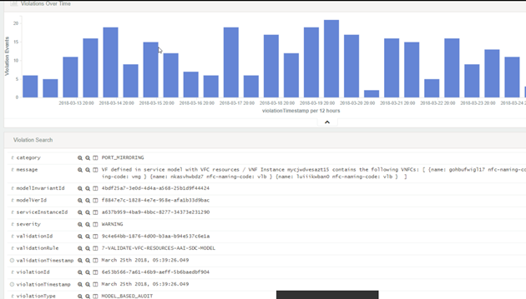
Reporting highlights
At the end of an audit:
Results are stored in Elasticsearch
Results are accessible via Kibana
Event is published to indicate audit completed
In the Kibana view user may
View results over time (color code)
Can locate single audit result
Can identify individual discrepancies/anomalies
Resulting in quicker identification of potential issues and reduction in resolution time.

Slide 10
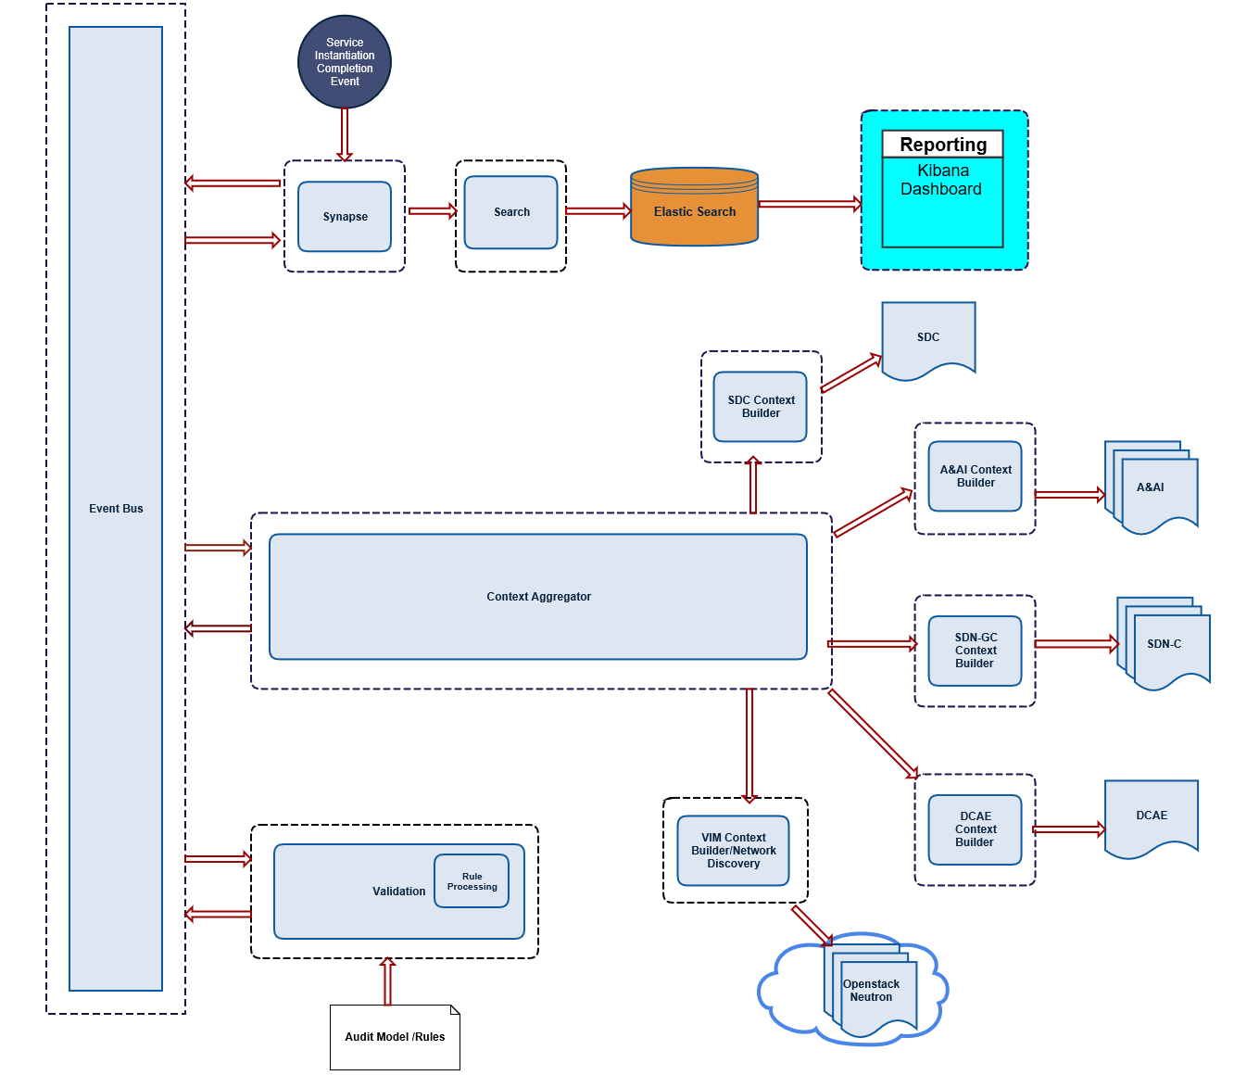
POMBA Architecture
https://wiki.onap.org/display/DW/POMBA+Architecture
Message
Router
Synapse
Search
Elastic Search
SDC
A&AI
Context Aggregator
SDN-C
DCAE
Network Discovery
Context Builder
Validation
Data Dictionary

Slide 11
Deep Dive on Architecture Pieces
Component | Description
Message Router | Component for distributing event messages through the system (DMaaP)
Context Aggregator | Context Aggregator is a Microservice that orchestrates the calls to various context builders which are pluggable into POMBA upon receiving the Orchestration Completion Event from Message Router
Context Builder | Is a Microservice that provides information from a particular data source and presents it via a well defined Context Builder API.
Validation Service | Validation service is a core Microservice which implements rule processing engine.
Synapse | Synapse Microservice was created in order to encapsulate interaction with message router (DMaaP).
Service Search | The Search Service Microservice was created to be an abstraction layer above indexable storage engine (i.e Elasticsearch).

Slide 12
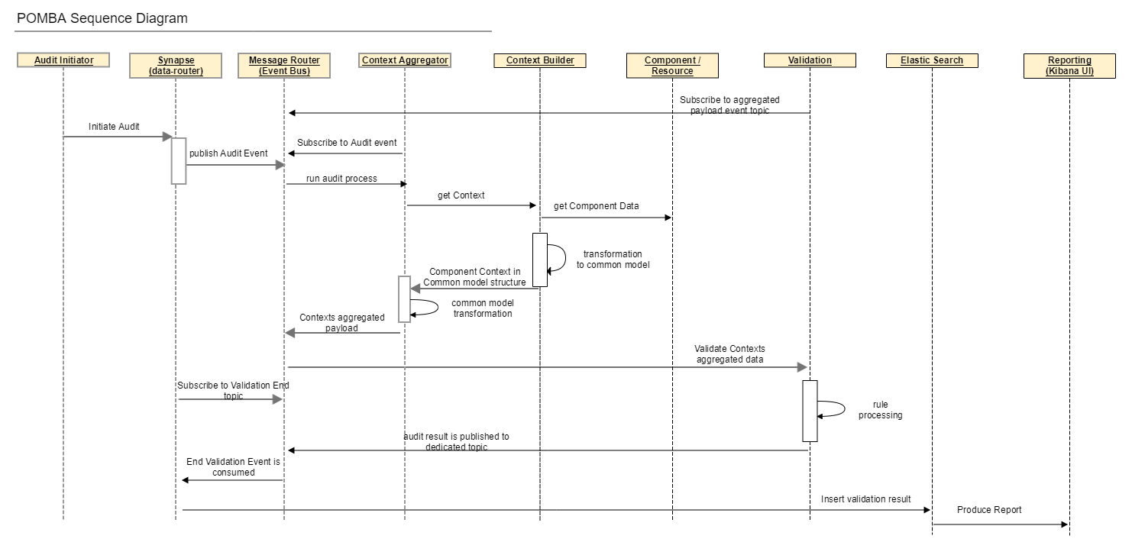
POMBA Detailed Flows
https://wiki.onap.org/display/DW/POMBA+Architecture
Audit Initiator
Synapse (Data-router)
Message Router
Context Aggregator
Context Builder
Component/Resource
Validation
Elastic Search
Reporting (Kibana UI)

Slide 13
POMBA Flow Steps
Audit initiated via end of transaction event or manually
Context Aggregator receives request/event
Context Aggregator initiates calls to various Context Builder to get normalized data from platform components and primary data sources
Context Aggregated payload is published on message router
Rule Processing receives that event and activates audit rules processing
Audit results published to message router
Audit result payload is consumed by synapse service
Reporting tools, such as Kibana, displays the data

Slide 14
Context Builders
https://wiki.onap.org/display/DW/POMBA+Context+Builders
Each one provides access to a new Data source
  Data Models
    SDC
    Data Dictionary
  Data Instance
    A&AI
    SDN-C
    Network Discovery
Support Common API
  https://wiki.onap.org/display/DW/POMBA+Context+Builder+Swagger

Slide 15
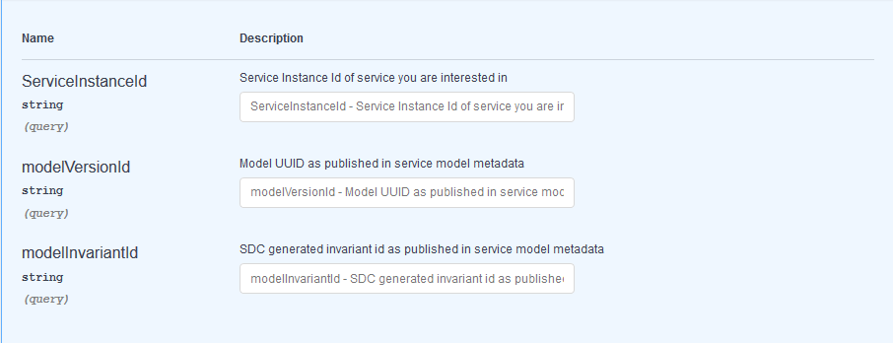
Context Builder API Swagger
https://wiki.onap.org/display/DW/POMBA+Context+Builder+Swagger

Slide 16
Context Builder
Parameter | Description | SDC | SDN-C | A&AI | Network Discovery
Model Version ID | Model UUID as published in service model metadata | Mandatory | Not Supported | Not Supported | Not Supported
Model Invariant ID | SDC generated invariant id as published in service model metadata | Optional | Not Supported | Not Supported | Not Supported
Service Instance ID | Instance id of the service being audited | Not Supported | Mandatory | Mandatory | Mandatory

Slide 17
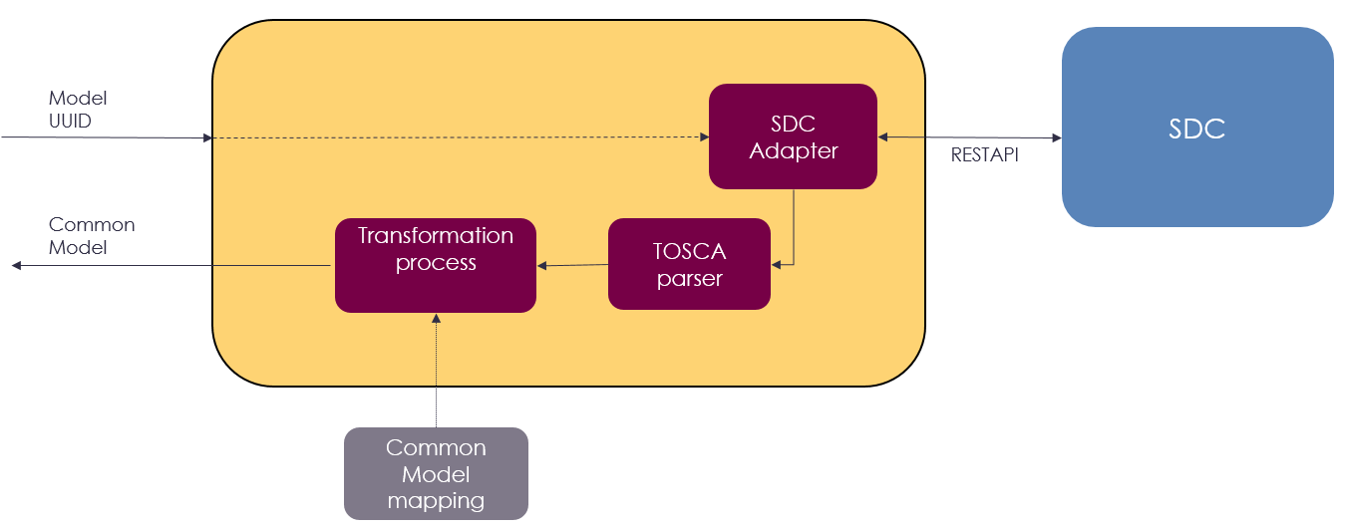
Example Context Builder - SDC

Slide 18
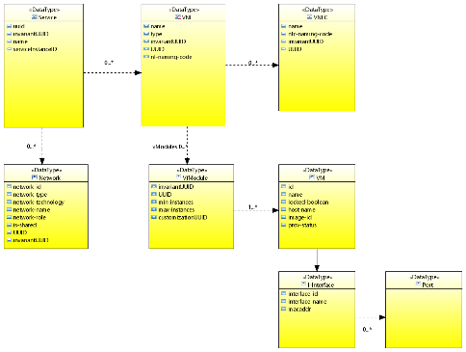
Returned Results
In addition, each resource and attribute contains a data quality measure
Status = ok or error
Error message
This enables
fine grain error reporting, if desired
Ability to differentiate
  Don’t know how to report info (blank)
  Tried to report info, but experience error
  Am reporting info, and the value is null
Will eventually align to ONAP Common Model

Slide 19
Data Dictionary
Not a Context Builder, enables validating information against well-defined set of enumerations.
Use of Data Dictionaries provides a useful alternative to provide extensibility without having to put extreme detail in the SDC model
Note that we will also be defining a southbound API, that any data dictionary that is compliant to can plug in and use this context builder
Input
  Attribute name
Could be used in other Use Cases as well

Slide 20
Network Discovery

Slide 21
High-level Use Case
Discovery of data from primary data sources (outside of ONAP) for use to help improve
data quality
information completeness
In Casablanca, we will be providing data to POMBA.
Ensuring appropriate building blocks for reuse

Slide 22
Network Resource Discovery
The goal is to provide a building block to enable discovering data from primary data sources (those outside of ONAP)
Network Resources
  Overlay, Underlay and between data centre
  Eventually be model-driven, self-service onboarding leveraging SDC
  Discover specific network resource
    Keep complex modeling and stitching to higher-level code
Initial support for REST-based interfaces, can be expanded to other protocols
Uses an A&AI enrichment Microservice, but the discovery API and use case driven from SDNC
  Same Microservice used to support other use cases, but this is out of scope.
https://wiki.onap.org/display/DW/SDNC+Network+Discovery

Slide 23
Network Resources
Service
VNF 1
VNF 2
Composed-of
VM 1
Virtual Network
subnet 1
VM 4
VM 2
subnet 2
VM 5
VM 3
Virtual Interface
Hosted-on
P-Server 1
P-Server 3
Network
Network
Network
P-Server 2
physical
connections
Physical Interface
P-Server 4
23

Slide 24
POMBA Architecture
https://wiki.onap.org/display/DW/POMBA+Architecture
Message
Router
Synapse
Search
Elastic Search
SDC
A&AI
Context Aggregator
SDN-C
DCAE
Network Discovery
Context Builder
Validation
Network Discovery
Data Dictionary

Slide 25
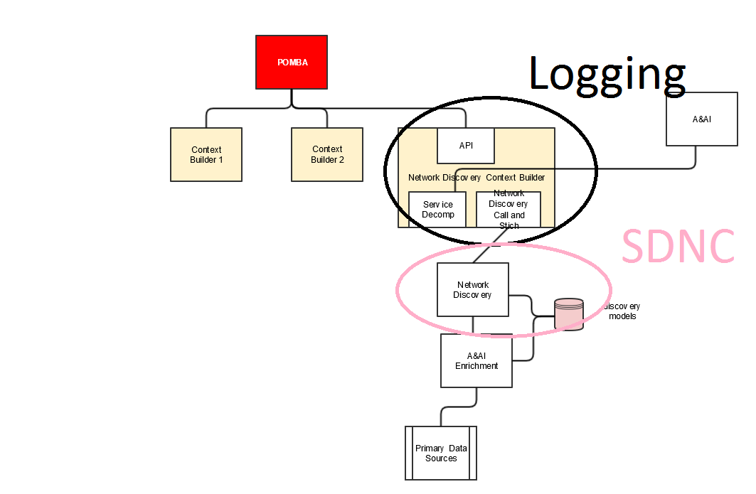
Network Discovery Block Diagram
A&AI Context Builder Builder
API can be run independently
A&AI
A&AI
Proposed distribution; Will align recommendations
openstack
multivim

Slide 26
Network Discovery API
Generic API that can be used for POMBA and other Use Cases
  René Robert from Orange asked helpful questions and provided feedback, which I have started to incorporate.
Draft Swagger
  https://wiki.onap.org/display/DW/Network+Discovery+API+Swagger
Inputs
Resource Type
Resource ID
Outputs
Generic Model of resource, suitable for eventually being model-driven.

Slide 27
VM Attributes
Demo
Openstack Attribute | Name on Network Discovery API | Name of POMBA Context Builder
Id | id | uuid
name | name | name
locked | inMaintenance | attributeList lockedBoolean
OS-EXT-SRV-ATTR:hostname | hostname | attributeList hostName
image.id | imageId | attributeName imageId

Slide 28
L3 Network
Demo
Openstack Attribute | Name on Network Discovery API | Name of POMBA Context Builder
Id | id | uuid
name | name | name
admin_state_up | AdminState | attributeList adminState
shared | sharedNetwork | attributeList sharedNetworkBoolean

Slide 29
Early Data Example
{
"service": {
"name": "Firewall1",
"invariantUuid": "0c5a20de-87ad-442c-9190-f38ab0a6bb7f",
"uuid": "d3d6cf83-d03a-43cc-99ff-206d40bb9a72"
},
"vf": [
{
"name": "PacketGenerator",
"type": "vFW-vSINK-service/vPKG 0",
"invariantUuid": "99f1fd3f-845c-48f5-a0ba-11fbde6ae557",
"uuid": "a5565bf4-d55a-4964-8fbc-6a7674a2e676",
"vfModules": [ {
"invariantUuid": "2a8844a8-f5f7-46dd-a732-472c6972a28e",
"uuid": "d6d4a002-a584-4640-bdce-a50e9bce552b",
"maxInstances": 1,
"minInstances": 0
}],
"vnfc": []
},
{
"name": "zdfw1fwl01snk01",
"type": "vFW-vSINK-service/vFWvSINK 0",
"invariantUuid": "59dd4d63-8f21-406c-98c0-3b057bb86820",
"uuid": "e2d52f32-a952-46f5-800c-c250903625d6",
"vfModules": [ {
"invariantUuid": "74bc1518-282d-4148-860f-8892b6369456",
"uuid": "4e3d28cf-d654-41af-a47b-04b4bd0ac58e",
"maxInstances": 1,
"minInstances": 0
}],
"vnfc": []
}
]
}
GET REST
  http://10.147.112.154:8080/network-discovery/service/context?serviceInstanceId=c6456519-6acf-4adb-997c-3c363dd4caaf
Network Discovery Context Builder

Slide 30
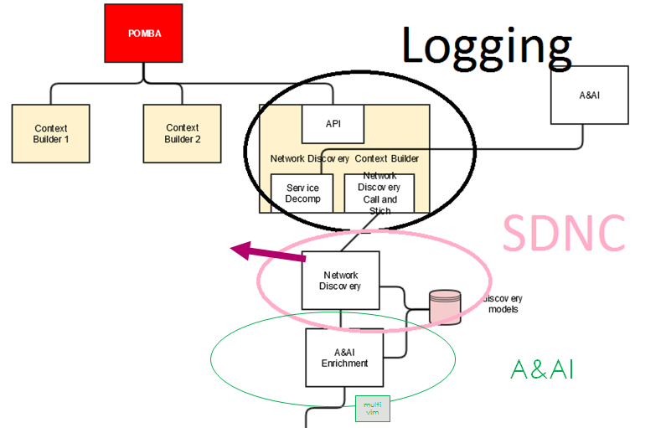
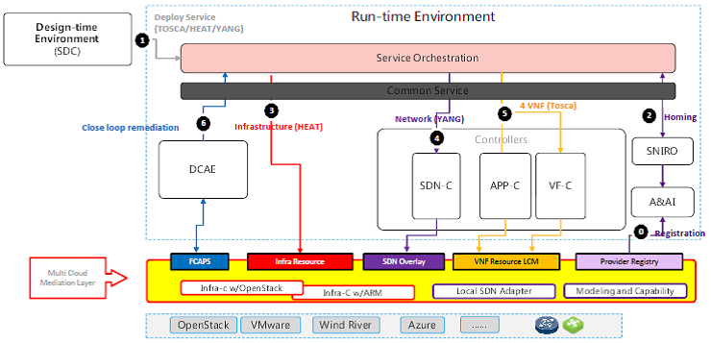
How to support Multi-VIM
Multi-VIM Enrichment Adapter

Slide 31
Potential Roadmap Items
Multi-VIM Adapter, when appropriate
Fully model-driven network discovery, including on-boarding using SDC
  Reuse of enrichment means invest once and both features can be model-driven
Reconciliation of data
  Policy driven
  Updating of data sources or raising alarms based on report findings

Slide 32
Status, Next Steps and How to get Involved

Slide 33


Planned work for Casablanca timeframe
Amdocs has committed a development team to work on POMBA
  This is a new team that does not work on other ONAP deliverables
  Other ONAP partners are supporting, including AT&T. Your company?
Others…
?
?
?

Slide 34

POMBA – Available and planned functionality
Functionality | available | plan Casablanca timeline
Audit against the SDC model intent | * | *
Audit A&AI Service Instance Artifacts | * | *
Audit SDN-C Service Instance Artifacts | * | *
Validation engine (Data Integrity) | * | *
On-demand event based audit | * | *
Audit results stored in Elastic Search | * | *
Audt reports provided in Kibana |  | *
Retrieve VIM (Openstack) Service Instance Artifacts |  | *
Support for Data Dictionary service to Validation |  | *
Address error handling (rainy day scenarios) |  | *
logging compliance for Casablanca spec |  | *
Support ONAP Operations Manager |  | *

Slide 35
Get Involved
POMBA will have its own separate call as part of the Logging Project
  https://wiki.onap.org/display/DW/POMBA
Network Discovery being delivered/discussed in SDNC
  https://wiki.onap.org/display/DW/SDNC+Network+Discovery
Want to make more information available to POMBA? Consider developing
  New Context Builder
  New Discovery Pluggin

Slide 37
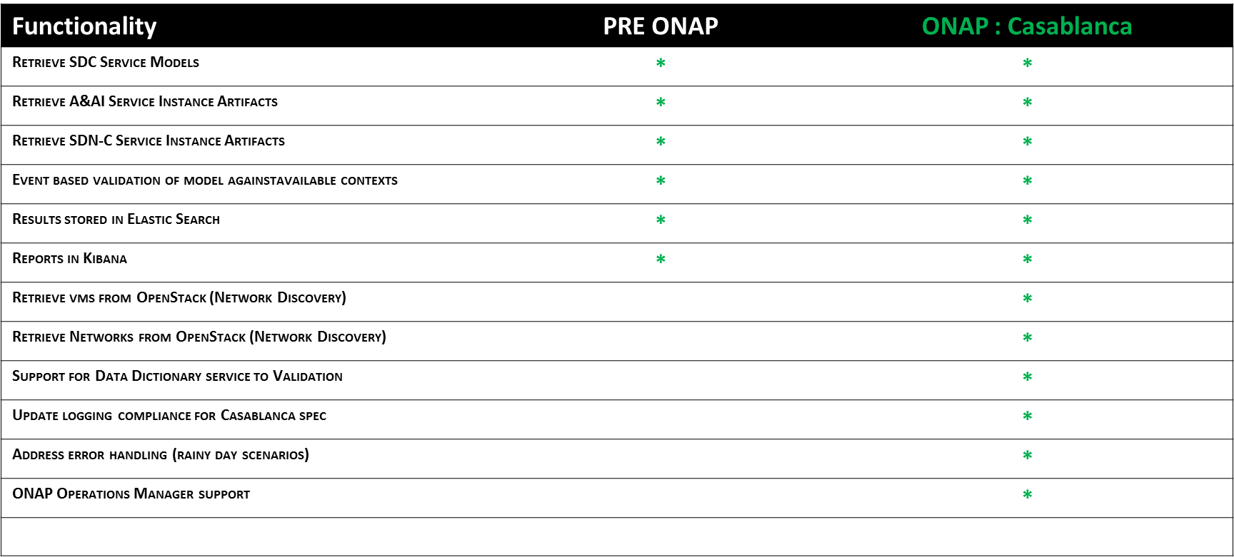
Planned work for Casablanca timeframe
Upstream existing POMBA code to ONAP
Include demo from VIM (OpenStack)
  Multi-VIM being considered (when mature)
Integrate data dictionary with validation engine
Address error handling(rainy day scenarios)
Update logging compliance for Casablanca
ONAP Operations Manager support

Slide 38
POMBA as part of Logging Project
LOG-192
Proposal is that:
Microservices for Post Orchestration Model Based Audit (POMBA) to be added to the scope of the logging project and included in ONAP for the Casablanca release.
Rationale:
  POMBA is a platform feature that is closely related to the Logging project (platform).
  Team members from Logging project are working with the POMBA team.
  Amdocs team assigned is largely based in Ottawa, Canada.
  Additional team members, with ONAP experience, will be added.

Slide 39
Overlapping work?
POMBA makes use of existing components and their available APIs to query instance artifacts for comparison to service model (SDC).
POMBA makes use of:
  SDC service model
  A&AI inventory
  A&AI Data Integrity tools
  SDN-C APIs (generic vnf)
  Published VIM APIs (MultiVIM)
Other projects / stories that may relate to auditing have not been identified but there is potential for collaboration / reuse.
Currently the following components are in scope for POMBA:
SDC
A&AI
SDN-C
VIM

Slide 40
Audit Report Example

Slide 41
Service Decomposition
VNFC
VM
Service Instance
VNF
VNFC
VM
VNFC
VM

Slide 42
High-Level Flow
MSO
POMBA
POMBA Context Builder
Data Source
POMBA Context Builder
Data Source
End of workflow
report

Slide 43
Network Discovery Next Steps
Providing POMBA Session next week in face to face meeting
POMBA piece being added to Logging Project
  Architecture committee agreed it could be brought in front of TSC for approval of scope change
  Will call separate weekly meetings
Will start discussions with A&AI shortly
Network Discovery piece targeted for SDNC working group
  Present to working group
  Epic and User Story drafted
  Resources lined up to do work
  Looking for thumbs up from working group (done)
  Additional help reviewing or providing supporting content always welcome

Slide 44
Network Discovery Block Diagram
report
POMBA
AAI Context Builder
Network Discovery Context Builder
Service Instance Decomp
Logging/Platform
Service lookup
Network Discovery
A&AI
SDNC?
Primary Data Sources

Slide 45
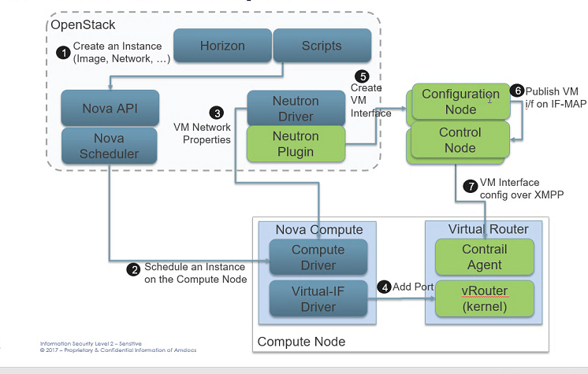
Openstack
Demo

