Slide 1
VID Demo
Michael Lando
Notes:
VID is all about the instantiating new VNFs & services and performing Change-Management activities on already-instantiated services.
VID supports all major use-cases as vCPE, VoLTE, PNF and more.
Now, I’m going to show you how we can instantiate a service and later update the VNF version using VID.

Slide 2
  VID - Virtual Infrastructure Deployment Portal
Virtual Infrastructure Deployment (VID) is an ONAP VNF & Service lifecycle management platform.
What does it do?
VID gives Operation Teams the capability to instantiate new VNFs & Services and perform Change-Management activities on already-instantiated services.
What else can it do?
The VID user can also search for, and display existing service instances and direct the instantiation of subsequent instance components.

Slide 3
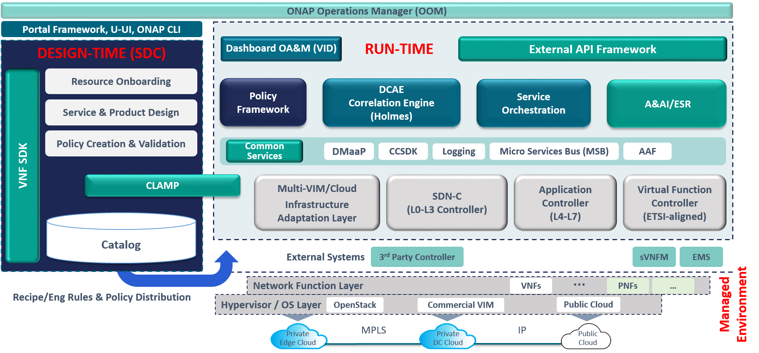
  VID in ONAP HL Architecture

Slide 4
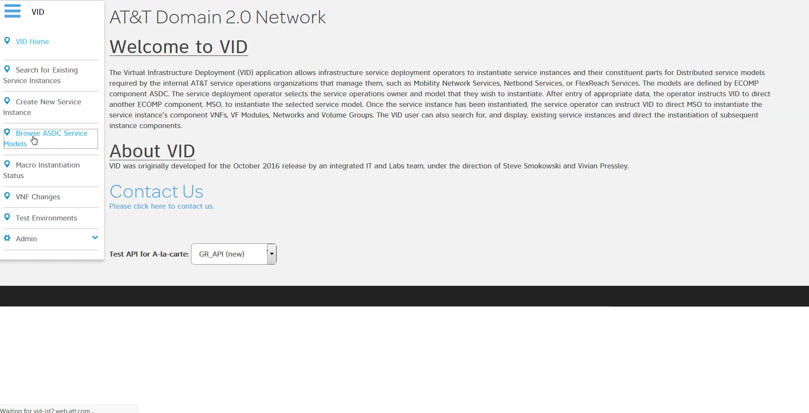
  DEMO

Slide 5
  Q&A

Slide 6
VID in R3
Notes:
VID is all about the instantiating new VNFs & services and performing Change-Management activities on already-instantiated services.
VID supports all major use-cases as vCPE, VoLTE, PNF and more.
Now, I’m going to show you how we can instantiate a service and later update the VNF version using VID.

Slide 7
  Casablanca Contribution
Support Bulk Macro Instantiation.
Break the Assignment Process to Phases.
Association of VNFs to an already-instantiated Networks.
Network Service Instantiation.
Change-Management Operation will include the ability to Schedule an Operation.
We are evaluating approved use-cases that might include more platform enhancements.
  PNF plug & play.
  Change Management enhancements:
    Integration with workflow designer, canceling a workflow execution.
    Scale out – enhancements to Beijing’s scaling out.
  VoLTE – continue supporting and enhancing Volte support in VID.

Slide 8
  Q&A

Slide 9
Thank you

Slide 10
  Demo script
Topic | Image/Screen/Short video | Script
Title | VID app homepage/VID title page | VID is all about instantiating new VNFs & services and performing Change-Management activities on already-instantiated services. VID supports all major use-cases as vCPE, VoLTE, PNF and more. Now, I’m going to show you how we can instantiate a service and later update the VNF version using VID.
Distributed Service list | Browse SDC service models | Here you can see all the distributed services designed in SDC, you can select or search for one and start the instantiation flow(by clicking the deploy button)
Instantiation | Macro service instance popup (SRIOV) | The first step is selecting some values related to the cloud you would like to deploy your service on and to categorize the instance. Clicking the “Set” button move you to the next step.
Instantiation | Drawing board | This is the drawing board. Here you can go on with the VNF and the VF module instantiation, by adding the nodes from the left side to the right side while selecting more cloud-related values. After that, you click the “Deploy” button to send the instantiation request to the SO
Notes:
Browse SDC service models
Here you can see all the distributed services designed in SDC, you can select or search for one and start the instantiation flow by clicking the deploy button
The instantiation type can be defined in SDC based on modeling configuration called instantiation type in the service definition.

Slide 11
  Demo script
Topic | Image/Screen/Short video | Script
Instantiation Status | Dashboard | After this is done, you can view your work status in this dashboard.
Instantiation Status | Service status popup | You can view the instantiation progress and details in this audit screen
CM | CM dashboard | Let’s move to the Change Management section. After succeeding with the instantiation, you can change the VNF instance at any given time by different workflow. All you have to do is searching the VNF instance by querying the A&AI.
CM | The “New” popup | Here you can choose the VNF instance and the workflow to apply. In this demo, we select the scale-out workflow which is (TBD) The additional workflows you can perform are software update, configuration update and replace. Also planned to add the scheduling capability, so you will able to schedule a change to a future time. Vid also provide the ability to track the status of the workflow exacution.
Notes:
Browse SDC service models
Here you can see all the distributed services designed in SDC, you can select or search for one and start the instantiation flow by clicking the deploy button
The instantiation type can be defined in SDC based on modeling configuration called instantiation type in the service definition.

Slide 12
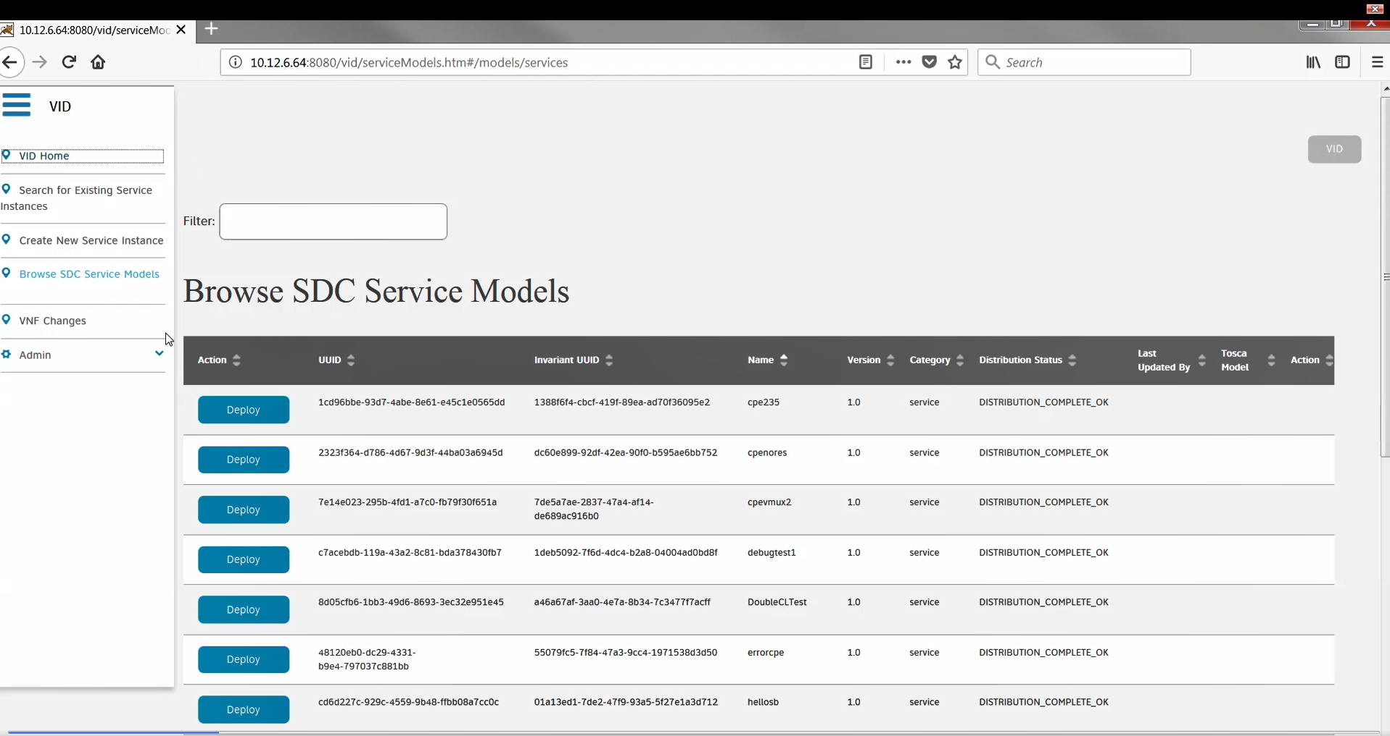
  Browse service models
Notes:
Browse SDC service models
Here you can see all the distributed services designed in SDC, you can select or search for one and start the instantiation flow by clicking the deploy button
The instantiation type can be defined in SDC based on modeling configuration called instantiation type in the service definition.

Slide 13
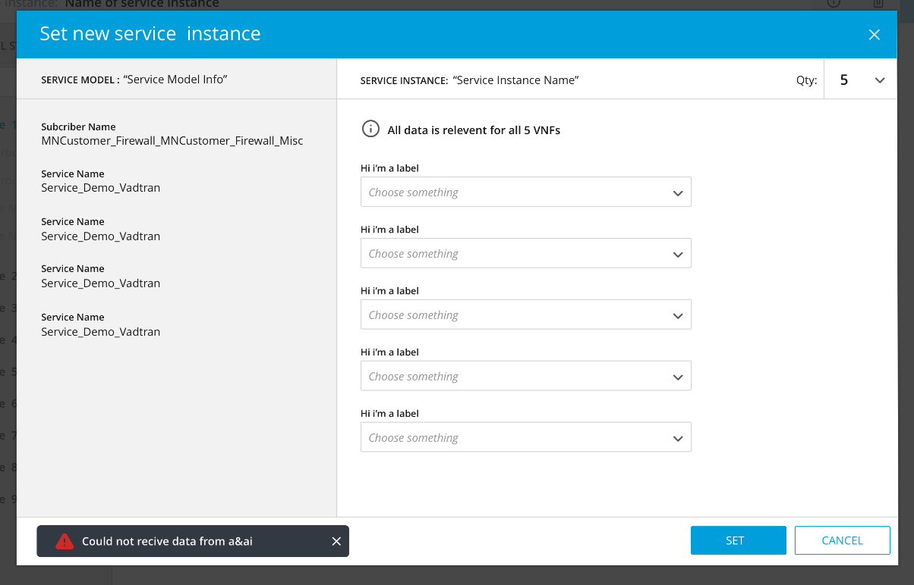
  Macro service instance popup
Notes:
The first step is selecting some values to categorize the service instance.
Defines the subscriber service type owning entity and project which will be reflected in AA&I
Press set.

Slide 14
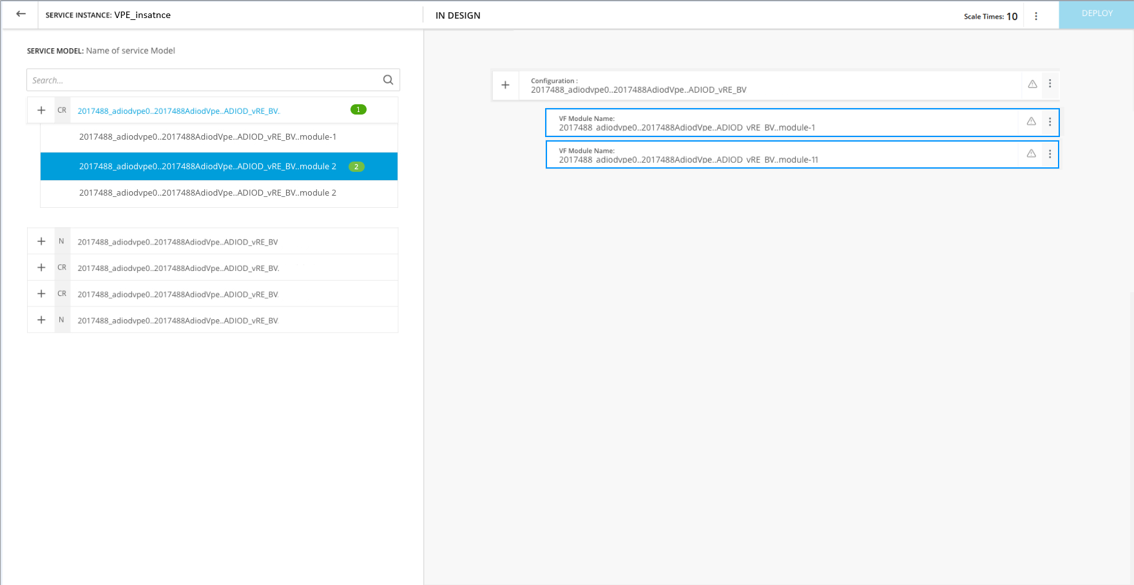
  Drawing board
Notes:
Clicking the “Next” button leads you to this drawing board and here you can go on with the VNF and the VF module instantiation, by adding the nodes from the left side to the right side.
Press deploy

Slide 15
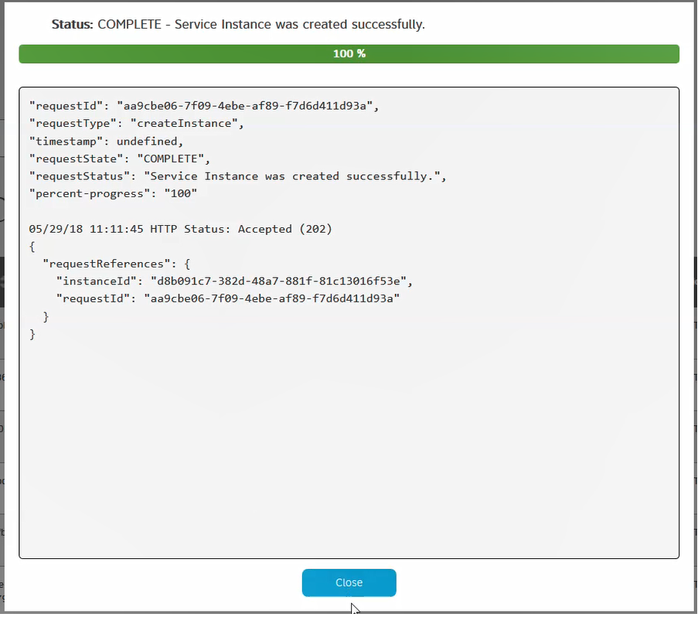
  Progress popup
Notes:
After that, you click the “Deploy” button to send the instantiation request to the SO

Slide 16
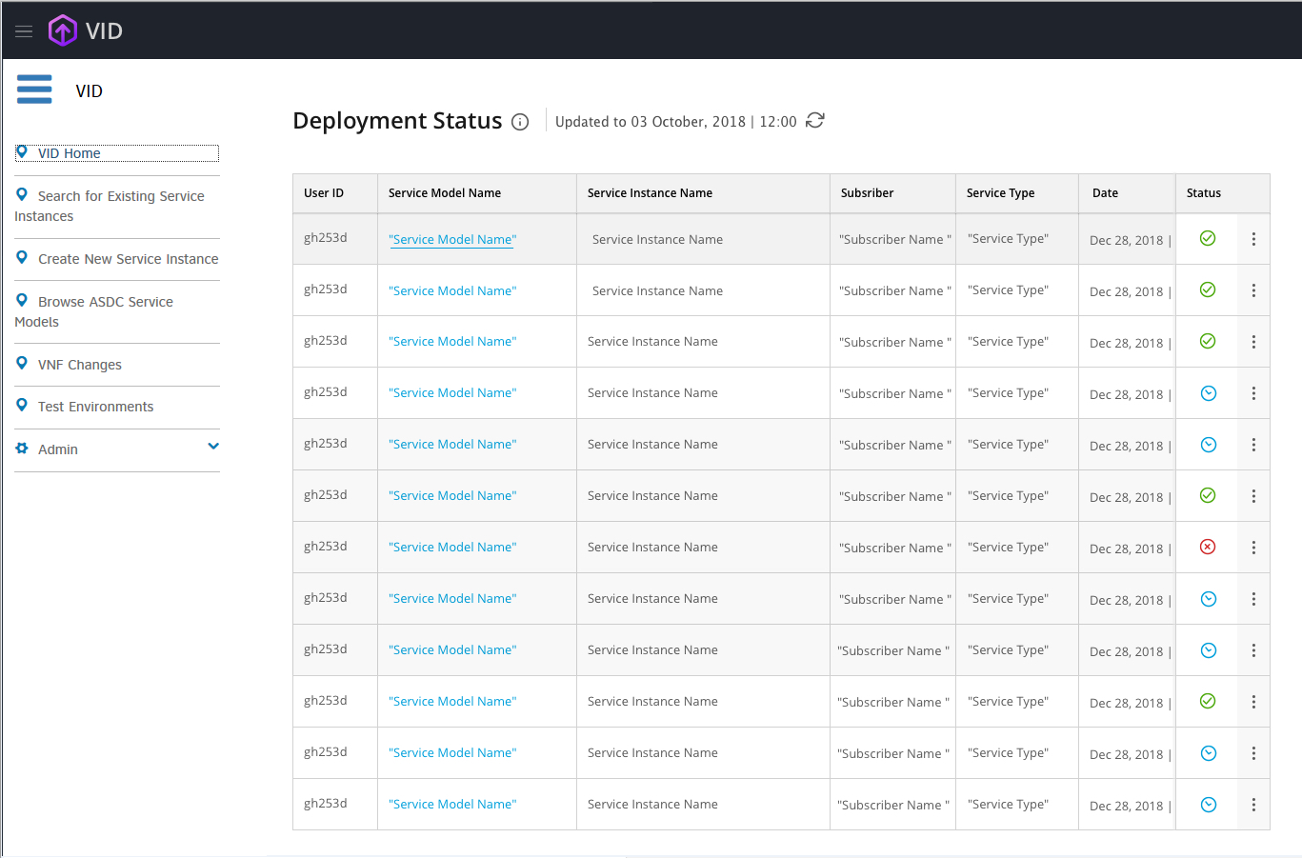
  Dashboard
Notes:
After this is done, you can view your work status in this dashboard.

Slide 17
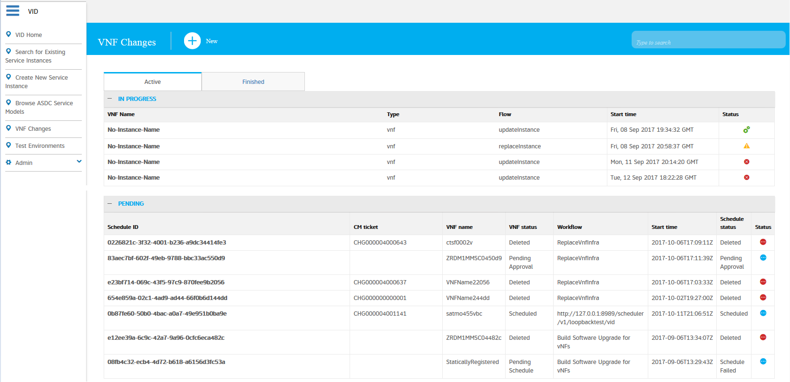
  Change Management dashboard
Notes:
Let’s move to the Change Management section.
After succeeding with the instantiation, you can update the version of the VNF instance at any given time.
All you have to do is searching the VNF instance by querying the A&AI.
New operation is done by pressing +new

Slide 18
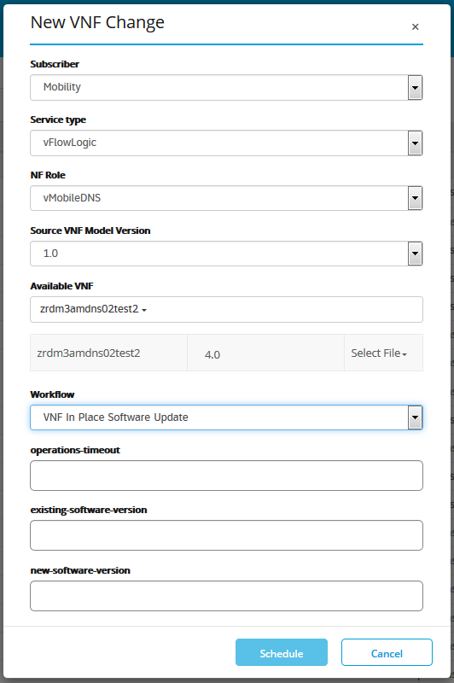
  The New popup
Notes:
Here you can choose the VNF instance and the workflow “change Software version” to apply.
The additional workflows you can perform are scale-out, configuration update and replace.
Also planned to add the scheduling capability, so the workflows will be scheduled.

