Slide 1
NS Virtual Link modeling: Rel2
Nagesha Subramanya nagesha.subramanya@nokia.com
Thinh Nguyenphu, Nokia thinh.nguyenphu@nokia.com
13 Mar 2018

Slide 2
Virtual Link Node Concept
VL Node with necessary info
VL DF
VL DF
1…N
VL DF
1
qos
serviceAvaibilityLevel
NSD
VL
latency
packetDelayVariation
packetLossRatio
priority
1
0...N
1
VL
ConnectivityType
layerProtocol
flowPattern
1
1
1
1…N
0...N
VL Profile
NS DF
VL Profile
NS DF
1…N
NS Level
VirtualLinkToLevelMapping
NS Level
localAffinityOrAntiAffinityRule
affinityOrAntiAffinityGroupId
maxBitrateRequirements
minBitrateRequirements
1
bitRateRequirements
0..N
defaultNsInstantiationLevelId
1
NSD -> a NS DF -> a NS Level -> multiple VL profiles[] -> a VL with a DF

Slide 3
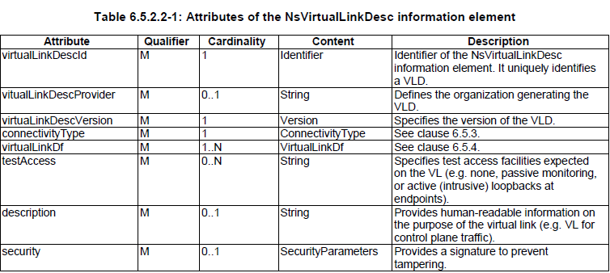
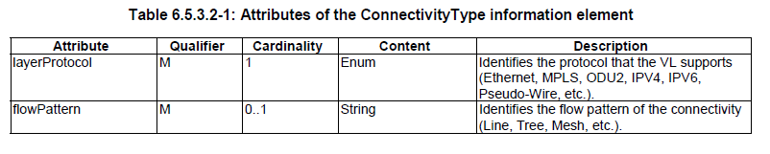
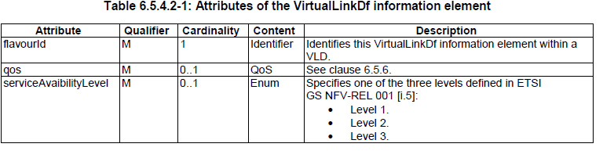
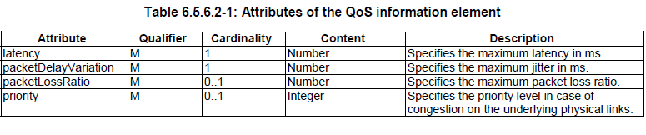
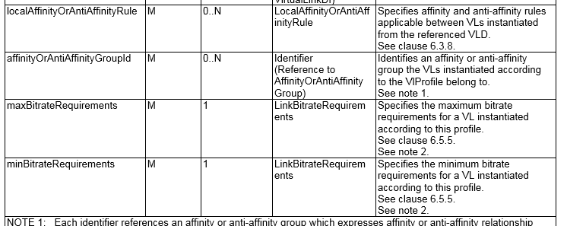
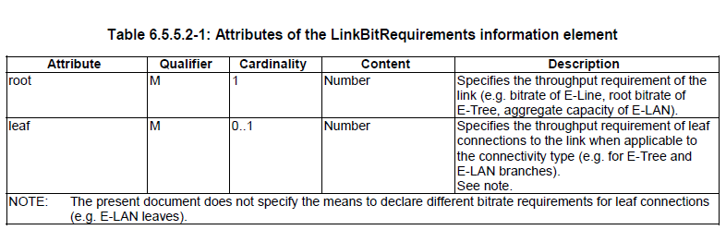
VL – Virtual Link
Node Types
Properties - Data types
Properties - Data types (from VL DF)
Properties - Data types
Input/ Attribute (from NS Level)
Groups & Policy (From VL Profile)
Properties - Data types

Slide 4
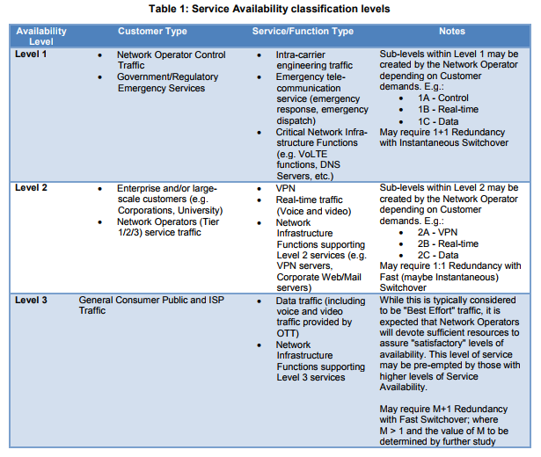
VL – Virtual Link (cont.)

Slide 5
VL
Virtual Links need to be realized on a physical infrastructure.
Virtual Links are concerned with how the different VNFs are connected, and how data flows across those connections, regardless of the location and placement of the underlying physical network elements.
TOSCA orchestrator must be able to infer a suitable logical connectivity model from the Service Template and then decide how to provision the logical connectivity, referred to as “fulfillment”, on the available underlying infrastructure
Ref: Tosca Simple Profile 1.2 :
(sec 8.5 Network Provisioning )
CP = connection point, VL = Virtual Link
NS
VNF1
VNF2
VNF3
CP4
CP5
CP6
CP8
CP10
CP7
CP11
VL1
VL2
VL4
CP14
CP1
VL3
VL1 = {CP1,CP4}
VL2 = {CP5,CP8,CP10}
VL3 = {CP6,CP7}
VL4 = {CP11,CP14}

Slide 6
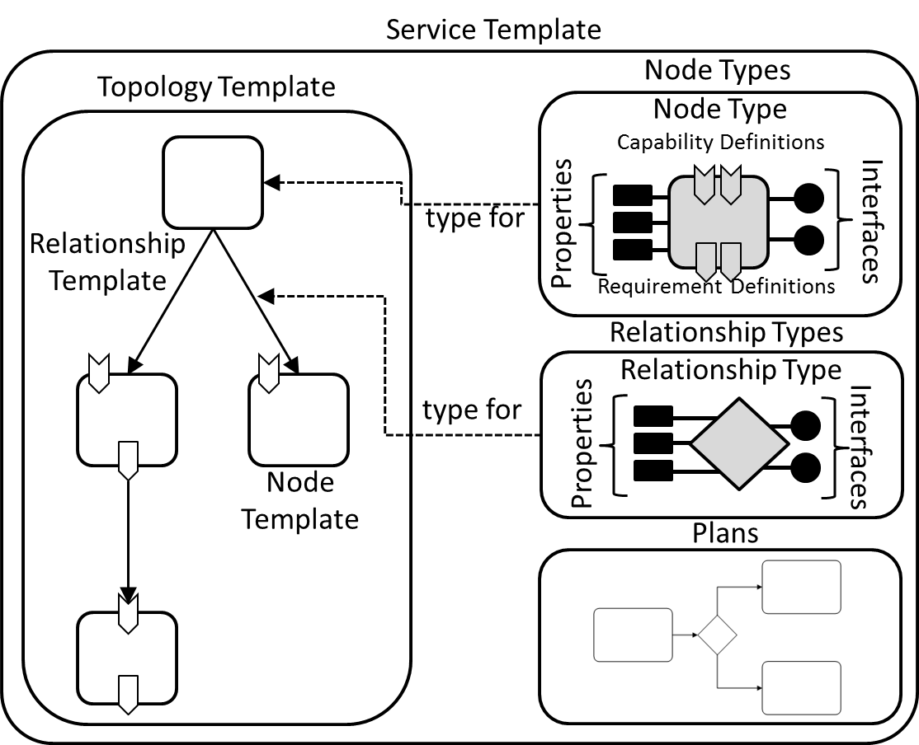

Network Service Design Time Model
NSD
VL-1
CP
VNF-1
CP
CP
VNF
CP
VL-2
VNF1
Network-1
Subnet-1
Subnet-2
Network-2
Virtual Link can be realized using multiple implementations depending on the available infra structure
VNF2
Implementation model - 1
VNF1
Network-1.1
Subnet-1.1
Subnet-2.1
Network-2.2
router1
router2
Network-1.2
Subnet-1.2
Subnet-2.2
Network-2.2
Implementation model - 2
VNF2
Notes:
Demo use-case: vCPE and 2 VNFs in the data-center

Slide 7
VL – Substitution
NS
VirtualLinkable
VirtualLinkable
Service Template
input
NSD would contain abstract design model
  Implementation can be in another yaml
  Implementation model depends on the physical infrastructure.
output
VNF1
NS2
PNF1
VL
Implementation Models
Service Template
Service Template
There can be another implementation for WLAN link
VL Imp 1
VL Imp 2
Network
Network
Network
Network
subnetOf
subnetOf
Subnet
Subnet
Subnet
Subnet
wait_for_subnet
wait_for_subnet
tosca.capabilities.Connection
wait_for_subnet
wait_for_subnet
wait_for_subnet
wait_for_subnet
router
tosca.capabilities.Dependable

Slide 8
Changes to already proposed types
ConnectivityType
https://wiki.onap.org/display/DW/Design-Time+Data+Model%3A+Network+Service
1 2 3 4 5 6 7 8 9 10 11 12 13 | tosca.datatypes.nfv.ConnectivityType: derived_from: tosca.datatypes.Root properties: layer_protocol: type: string required: true constraints: - valid_values: [ethernet, mpls, odu2, ipv4, ipv6, pseudo_wire ] flow_pattern: type: string required: false constraints: - valid_values: [Line, Tree, Mesh]
NOKIA Proposal (Abstract node & substituated nodes)
tosca.datatypes.nfv.ConnectivityType:
derived_from: tosca.datatypes.Root
description: virtual link connectivity type
properties:
protocol:
type: list
required: true
default:
- ipv4
entry_schema:
constraint:
-valid_values: [ethernet, mpls, odu2, ipv4, ipv6, pseudo-wire]
flowPattern:
type: string
required: false
default: line
constraint:
-valid_values: [line, tree, mesh]

Slide 9
Changes to already proposed types
NsVirtualLink
https://wiki.onap.org/display/DW/Design-Time+Data+Model%3A+Network+Service
tosca.nodes.nfv.NsVirtualLink:
derived_from: tosca.nodes.Root
description: External virtual link used in network service.
properties:
id: #virtual_link_desc_id:
type: string
required: true
description: Identifier of the NsVirtualLinkDesc information element. It uniquely identifies a VLD.
provider: #vitual_link_desc_provider:
type: string
required: false
description: Defines the organization generating the VLD.
version: #virtual_link_desc_version:
type: string
required: true
description: Specifies the version of the VLD.
connectivity_type:
type: tosca.datatypes.nfv.ConnectivityType
required: true
description: Specifies the protocol exposed by a VL and the flow pattern supported by the VL.
test_access:
type: list
entry_schema:
type: string
required: false
description: >
Specifies test access facilities expected on the VL
(e.g. none, passive monitoring, or active (intrusive) loopbacks at endpoints).
description:
type: string
required: false
description: >
Provides human-readable information on the purpose of the virtual link (e.g. VL for control plane traffic).
capabilities:
virtual_linkable:
type: tosca.capabilities.nfv.VirtualLinkable
NOKIA Proposal
bitrate:
type: tosca.datatypes.nfv.Bitrate
description: required bitrate
qos:
type: tosca.datatypes.nfv.Qos
description: virtual link quality of service
required: false
service_availability:
type: tosca.datatypes.nfv.ServiceAvailability
description: virtual link service availability levels
required: false
attributes:
bitrate:
type: tosca.datatypes.nfv.Bitrate
description: current bitrate

Slide 10
WLAN
https://wiki.onap.org/display/DW/Design-Time+Data+Model%3A+Network+Service
Can WAN be represented by NS Virtual Link
With a substituted design time model.
tosca.nodes.nfv.NS:
derived_from: onap.nodes.ServiceComponent
requirements:
- virtualLink:
capability: tosca.capabilities.nfv.VirtualLinkable
relationship: tosca.relationships.nfv.VirtualLinksTo
- wanLink:
capability: tosca.capabilities.wan.VirtualLinkable
relationship: tosca.relationships.wan.VirtualLinksTo

