Slide 1
VF-C Weekly Meeting
Yan Yang
Mar 12 , 2018

Slide 2
Agenda
Team work progress summary
Key Tasks need to be done before March 19th
Other topics

Slide 3

Team work progress summary – S3P updates(1/2)
S3P Updates
Security
  VFC-660 - Support platform Maturity Requirements-Security Level 1 IN PROGRESS
  CII Badge:
  Solved some License and Vulnerability Thread reported from Linux Foundation and Security Subcommittee
  Increase test code coverage to reach 50%, only two components haven’t meet the requirement: nokia driver/ Multivim proxy
  Update the python components and enable sonar display the python file test coverage. Work with LF to update the jjb template
Manageability-Logging
  VFC-639 - Support platform Maturity Requirements-Manageability Level 1 IN PROGRESS
  Update log configuration for VF-C components according to Logging guideline
    Log output location to standard directory: /var/log/ONAP/<component>[/<subcomponent>]/*.log
    Python components should update the logging library to use the python AOP library provided by Logging project which can help us to transit the configuration form from directory to file.
  Filebeat container packed with VF-C existing container for shipping logs to ONAP ELK logging stack.

Slide 4
Team work progress summary – S3P updates(2/2)
S3P Updates
Resiliency and Scalability
  VFC-659 - Support platform Maturity Requirements-Scalability Level 1 TO DO
  Depend on kubernetes to manage multiple instances of VF-C stateless components
  Research the configuration in OOM
Usability
  VFC-664 - Support platform Maturity Requirements- Usability Level 1 IN PROGRESS
  Document APIs in Swagger and solve inconsistent problem between code and API
  Improving the deployment and configuration documentation
Performance and stability
  VFC-663 - Support platform Maturity Requirements-Performance Level 1 TO DO
  VF-C team will work with Integration team to do performance testing

Slide 5
Team work progress summary – R2 use case updates
Use Case Updates
Manual Scaling
HPA

Slide 6
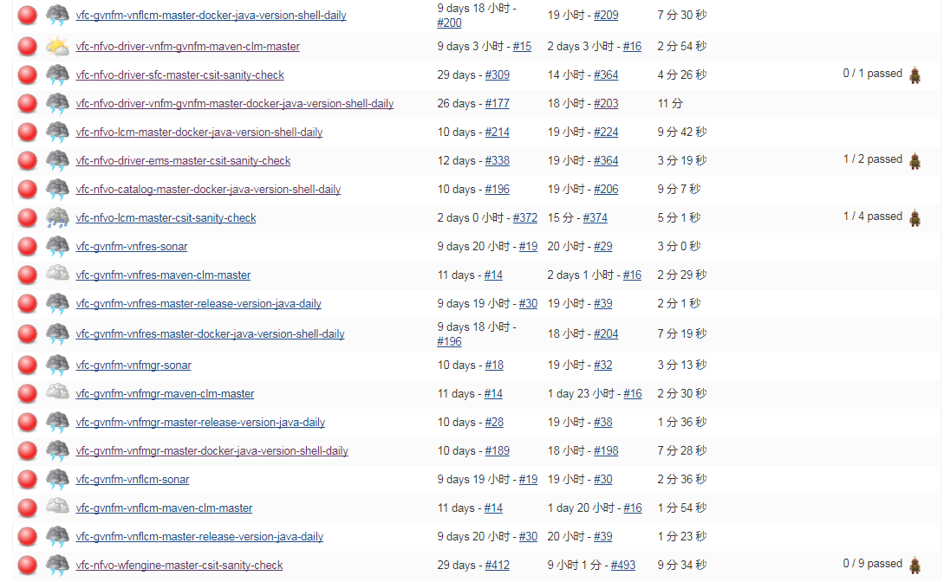
Team work progress summary – Jenkins status

Slide 7
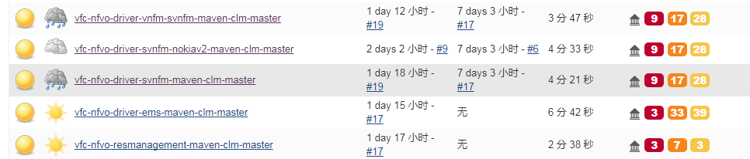
Team work progress summary – Sonar & Nexus IQ status
Sonar status : https://sonar.onap.org/projects?search=vfc&sort=-analysis_date
Nexus IQ server status: https://nexus-iq.wl.linuxfoundation.org/assets/index.html#/reports/violations
It is recommended to first update the latest version of the third party components available.

Slide 8
Agenda
Team work progress summary
Key Tasks need to be done before March 19th
Other topics

Slide 9
Key Tasks need to be done before March 19th
nokia driver/ Multivim proxy to increase test code coverage
Work with LF to enable test coverage data display in sonar for Python components
Solve License and Vulnerability Thread form Nexus IQ server.
If you can’t solve them, please Add them to https://wiki.onap.org/pages/viewpage.action?pageId=25437810
All components update the log out put location and work with Yanan to add Filebeat to OOM VF-C existing container. Python components update log configuration and integrate with new python AOP library
Work with OOM to manage multiple instances of VF-C stateless components.
Fix failed jenkins job
Other code development tasks: use case (Scaling/HPA) components(Multivimproxy)

Slide 10
Other topics
IPR issue

