Slide 1
Distributed Management (ONAP/3rd Party) Orchestration
(Progress Update)
Source: Edge Automation through ONAP Arch. Task Force
- Lead: VMware
- Core Team: Amdocs, AT&T, Bell Canada, Intel, Huawei, VMware
Others: Fujitsu, Nokia, Red Hat, Vodafone, Verizon
- Date: March 2019
- Link: https://wiki.onap.org/display/DW/Edge+Automation+through+ONAP+Arch.+Task+Force+-+Distributed+Management+%28ONAP+etc.%29+components

Slide 2
Agenda
Problem Statement
Distributed Management (ONAP/3rd Party) - Key Use Cases
Analytics (3rd Party) Use Case – Exemplary Deployment Scenario
Distributed Management Components Orchestrator
  Dublin & Future Req. Summary
  Detailed Reqs.
Architectural Progress & Next Steps

Slide 3
Problem Statement
Managed Workloads (SDC, SO, OOF etc.)
  Full Support for containerized network functions (work in progress)
  Support for non-network functions (VM and Container based), e.g. vProbe, Automation Apps
Management Workloads (or Components)
  Currently, Multiple Orchestrators for Management Workloads.
    Cloud Native K8S Ecosystem – driven by ONAP Operations Manager (OOM)
    DCAE Controller* - Analytics Application Management
  There is an opportunity to get some alignment across multiple orchestrators which will be greatly beneficial especially in Distributed Edge environment
* DCAE is composed of Data Collection and Analytics functions and a Controller

Slide 4
Problem Statement
Managed Workloads (SDC, SO, OOF etc.)
  Full Support for containerized network functions (work in progress)
  Support for non-network functions (VM and Container based), e.g. vProbe, Automation Apps
Management Workloads (or Components)
  Currently, Multiple Orchestrators for Management Workloads.
    Cloud Native K8S Ecosystem – driven by ONAP Operations Manager (OOM)
    DCAE Controller* - Analytics Application Management
  There is an opportunity to get some alignment across multiple orchestrators which will be greatly beneficial especially in Distributed Edge environment
* DCAE is composed of Data Collection and Analytics functions and a Controller

Slide 5
Distributed Management (ONAP/3rd Party) - Key Use Cases
Analytics functions at Edge
Address WAN bandwidth challenges
Improve Resiliency
Closed Loop functions at Edge
Real-time response for Latency sensitive Apps
Support 3rd party Management component LCM across multiple sites
Geo-redundancy support for Management components
Note:
Only Management components are in scope. Managed components *are out of scope*.
Notes:
Infrastructure LCM – bring up necessary K8S clusters, only if needed

Slide 6
Analytics (3rd Party) Use Case – Exemplary Deployment Scenario
Distributed Management Orchestration
One training app consists of three services, expected to run in a sequence (DAG based flow requirement)
One app requires multiple components in various regions
Site
Site
Training App2
Training App3
Training App1
Visualization
Very few
Training stack
Training stack
Model Repo
When new workload is brought up, need for configuring existing collection, and inferencing app (Day2 config as a bundle) that are in various regions. (may also require new inferencing app)
Site
Site
Site
Inferencing app
Inferencing Apps
Inferencing Apps
In hundreds
Inferencing stack
Inferencing stack
Inferencing stack
Site
Site
Site
Site
Custom Collection service
Placement of compute intensive services on nodes that have HW accelerators (GPU, FPGA etc…)
10s of
thousand
Collection stack
Collection stack
Collection stack
Collection stack

Slide 7
Dist. Mgmt. Components Orchestrator – Dublin & Future Req. Summary
Dublin
All ONAP projects are deployed/bootstrapped through helm under OOM
DCAE Service components are deployed using Cloudify/blueprint
ONAP deployment is single site
HA not enforced as single orchestration fn.
Infrastructure(k8s) is assumed to installed on compute/VM nodes
Dynamic instantiation of application limited to DCAE
Support Geo-Redundant Deployment and Failure Recovery - geo redundancy already supported in K8S environment
Future Summary Requirements
Need for multi-site, deployment and Life-Cycle Management of components either near or co-located at cloud-regions (e.g customer edges, network edges, RICs, core network centers etc..) requiring scale-out across locations.
Need for multi-tenant infrastructure management (install relevant K8S clusters) (Req. 1)
Provide Flexible Policy Driven Configuration and Deployment Management
Centralized LCM (view etc.) for distributed ONAP components
Support for K8S-based workload deployment
Support for non-K8S based workload deployment (Req. 2)
Consistent onboarding and modelling for all management components
Single dashboard / system to onboard cloud-regions.
Real-time Dashboard and inventory of all management apps & components that are deployed and active including cross site failures.
Support for third party management components
-- Req. 1, 2 – differing view on operator priorities – immediate vs long-term
-- Need input from more operators and/or end-user advisory committee on these Req. priorities and any additional Req./Priority
Notes:
Requirement Clarification question(s)
Note 1:
Is Multi-tenant infra management (for Central and Edge) a mandatory or optional requirement
Public or private cloud supports relevant K8S cluster by default (ONAP does not need to anything)
From Bell Canada and others?
AT&T - mandatory
Note 2:
Is VM-based support a mandatory or optional requirement?
AT&T – mandatory
Note 3:

Slide 8
Dist. Mgmt. Components Orchestrator – Detailed Reqs. (1)

Slide 9
Dist. Mgmt. Components Orchestrator – Detailed Reqs. (2)

Slide 10
Architectural Progress & Next Steps
Consensus
  Cloud Native K8S Ecosystem approach for addressing current and future requirements through “OOM”
  Migration of DCAE controller functions towards “OOM” solution
Next Steps
  Requirement clarification to be finalized by 04/16/2019
  Finalized Architecture Presentation to Arch. Sub Committee on 04/23/2019
Upcoming Presentations
  Progress update on “OOM” K8S Ecosystem Architectural Baseline
  Overview on DCAE Controller components + Demo

Slide 11
  “OOM” K8S Ecosystem Architectural Baseline Progress Update
  Mike Elliott – Amdocs

Slide 12
How we configure and deploy ONAP today to central…
helm deploy central onap --namespace onap -f central-onap.yaml

Slide 13
How we configure and deploy ONAP today to an edge…
kubectl config use-context edge-cloud1
helm deploy edge edge-cloud1 --namespace onap -f edge-cloud.yaml
Notes:
Part of the WG mandate is to propose how we build on this to address all Edge automation requirements.

Slide 14
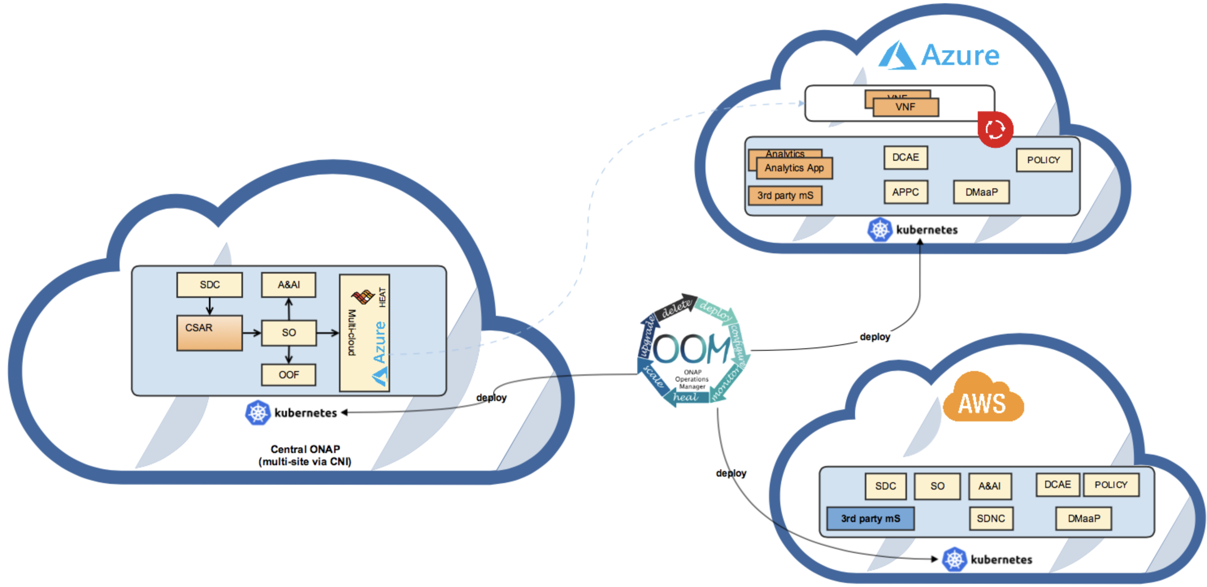
OOM Distributed Mgmt. Component Orchestration - leveraging K8S Ecosystem
Notes:
Consistency in configuration and orchestration.
OOM Scope:
- Kubespray, Rancher, Cloudify, OpenShift, Airship, public/private clouds.
- Independent of infra – anywhere there is a hosted Kubernetes cluster.

Slide 15
Guiding Principles
We are taking a k8s-first approach to addressing Edge Automation requirements
  K8s is the industry standard for production-grade orchestration
  Not limited to containers – lots of capabilities exist
For requirements that can’t be or will not be solved (out-of-scope) we will look to
  where the industry is heading
    5G is a huge industry disrupter - leverage when it makes sense (prevent duplication of effort)
    allows us to focus on problems that ONAP needs to solve
  complimentary Open Source projects (e.g. Helm, Istio, kubevirt, Akraino Edge Stack)
  experiences/key learnings gained by Operators/Service Providers
Notes:
Options:
Not here to dictate solutions – here to allow ONAP to be used by as many Operators as possible

Slide 16
Migrating DCAE-C components to OOM (Combined Orchestration support of Tosca & Helm)
Vijay Venkatesh Kumar, Kailash Deshmukh – AT&T

Slide 17
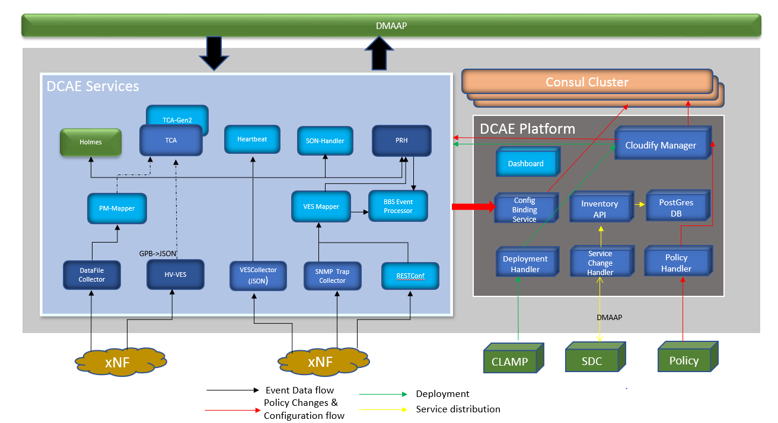
DCAE Platform (Controller) Overview
Stateful entities supporting LCM of management of DCAE applications. Primary orchestrator is Cloudify, combined with other platform modules enables flexible, pluggable, micro-service oriented, model based component deployment and LCM support.
Support dynamic (standalone or composite) applications deployment to support open and closed loops flows in ONAP.
Platform design standardizes several Service Component functions
  Control Loop Driven deployment and configuration Interfaces (CLAMP/SDC/Policy)
  Dynamic topics/feed provisioning and role assignment for MS*
  Configuration model standardization and common API for sourcing configuration
  AAF Integrations
  Support docker or K8S deployment (transparent to application) by providing a configuration management layer
Support infrastructure setup/deployment for management application if required

Slide 18
DCAE-C Dublin (Platform Enhancement)
  Platform components – migrated to Helm charts
  Healthcheck Enhancement for static and dynamic deployed components
  Dynamic secure topic/feed provisioning*
  Multisite K8S cluster deployment support
  Dashboard (UI for deployment/verification and access control management)
  Support deployment of Helm chart

Slide 19
OOM (K8S Native approach) – Key Functional Gaps
  No design flow integration (SDC) and standardized configuration modelling enforced (under Helm templates)
  Control Loop flow deployment and support through CLAMP/Policy Integration
  Dynamic configuration management through central ONAP Policy
  No support on Tosca based ONAP management application and workflow
  Lack of consolidated view of deployed MS and their relationship
  Note: Refer backup slide for complete list

Slide 20

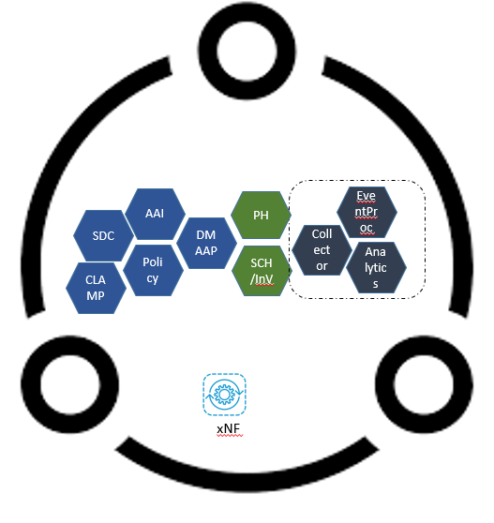

Enhanced OOM - Implementation (proposal)
Central Cloud Workflow
ONAP CENTRAL
Configuration Binding Service (CBS): Provides API to obtains configuration parameters from Consul during a deployment or reconfiguration process.
Consul: Provides service discovery and key-value storage capabilities
Dashboard API: The Dashboard provides AC and GUI access for orchestrator
Deployment Handler (DH): Provides an interface to deploy/access information (e.g., blueprints) in Inventory
OTI/Handler: Interface between A&AI and prepares events concerning VNF/topology changes in A&AI and forwards them to controller.
Inventory: Stores blueprints in its PostGres (PG) database
Policy Handler (PH): Interface to external Policy Engine for receiving and processing policy related information including updates
Service Change Handler Provides an interface to SDC for receiving blueprints and storing them into Inventory (PG)
Cloud Native Integration Modules
K8S ETCD: Provides key-value storage capabilities. K8S usage model – config map/secretes
Istio Service Mesh: Provides service discovery, security, traffic management
Helm: App versioning/upgrade/rollback
K8S Operator/CRD: Framework for building custom controllers (CC) e.g. to dispatch app config changes from Central to ER Cloud
OOM-orch (Cloudify)
1
DevOps/User installs OOM-active in the OOM Tenant space, on a VM
2
OOM-active installs K8S cluster (using K8S cluster API) & Helm
Dashboard
Consul
Storage (PG)
Base OOM Orch. Components
K8S CLUSTER
3
OOM-active deploys base ONAP Controller components using either Helm/TOSCA in K8S cluster
Optional OOM Orch. Components
Istio-Plugin
K8S CRD plugin
K8S ETCD Plugin
CBS
DH
Inventory
Policy Hander
ServiceChange
OTI-Handler
4
OOM-active deploys other ONAP controller components using Helm/Tosca in K8S
5
OOM-active deploys ONAP Central mgmt. app using Helm/Tosca in K8S cluster
ONAP Central Mgmt. Application
K8S CLUSTER
AAI
SDC
Policy
Dynamic Mgmt. application (DCAE service components)
DMAAP
AAI
SDC
Policy
EventProc
Deploy dynamic mgmt. app using Helm/Tosca in K8S cluster
DMAAP
6
CLAMP
Analytics
Collector
AAF
SO
Collector
Analytics
Analytics
AAF
SO
CLAMP
Collector
Edge/Regional (ER) Cloud Workflow
1
OOM-active installs K8S clusters in relevant Edge Clouds based on config
2
OOM-active places mgmt. app on ER K8S cluster using ONAP Central OOF and ER K8S API
External Cloud
ONAP at Edge
CL support
APP
COL
VNF-APP package
3
OOM-active monitors mgmt. app metrics on ER K8S cluster using ER K8S API
VNF
4
OOM-active sends central mgmt. app config changes to ER K8S cluster using ER K8S API CRD

Slide 21
Integration - Realization
  Use Cloudify instead of Rancher for K8S setup
  Move DCAE Platform components under OOM
      Policy Handler, ServiceChange-Handler, InventoryAPI, Deployment-handler, ConfigBindingService, Dashboards
  Phased Enhancements based on ONAP priority
  Event driven reconfiguration capabilities to added among ONAP Controller (OTI)
  Onboarding Helm based application through SDC
  Policy based configuration for application deployed through Helm
  Orchestrator sync-up (Kubernetes and Cloudify)
  Add new pluggable modules to support cloud native integration

Slide 22
Key Benefits
Support for Dynamic Control Loop support for management application deployment/LCM and Policy configuration
Complete backward compatibility for both HELM and TOSCA

Slide 23
Other Orchestration features via Cloudify/integrated approach
  Design flow integration for automation of deployment artifact creation
  Support containerized and VM based workload deployment on heterogenous cloud environment
  Provide deployment states, relationship and dependencies
  Supports single and/or multiple management application (allowing service composition design)
  Support dynamic DMAAP topic provisioning capabilities part of orchestration.
  Support Hierarchical and distributed deployment (with central and regional/Edge site)
  Consolidated view of deployed MS and their relationship
  HA and Georedundancy support
  Infrastructure management (if required)
  Standardization of AAF integration through plugin

Slide 24
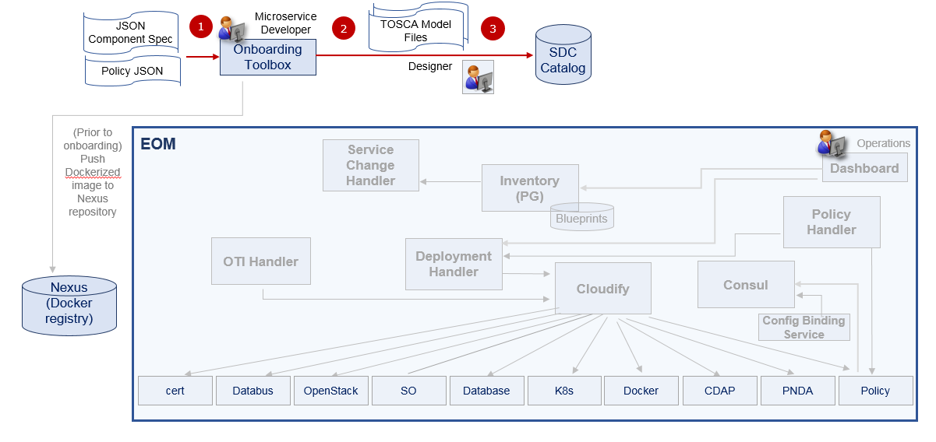
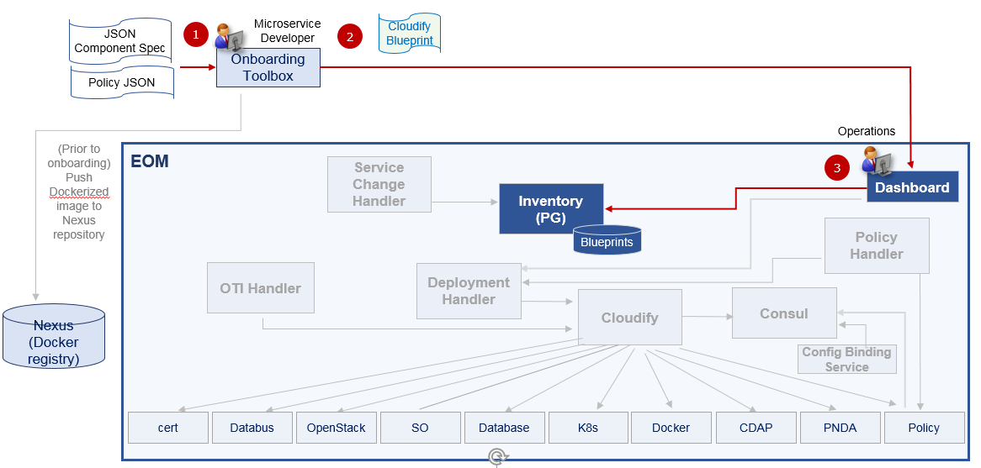
Management Application Onboarding
Stand-alone (non-SDC)
Using SDC
Main Steps
Developer inputs JSON Component Spec (and Policy JSON if applicable) into blueprint generator of the Onboarding Toolbox
Output is the Cloudify blueprint
Cloudify blueprint is added to EOM Inventory via the Dashboard
Main Steps
Developer inputs JSON Component Spec (and Policy JSON if applicable) into blueprint generator of the Onboarding Toolbox
Output is TOSCA Model files
Service Designer adds Model files to SDC Catalog

Slide 25
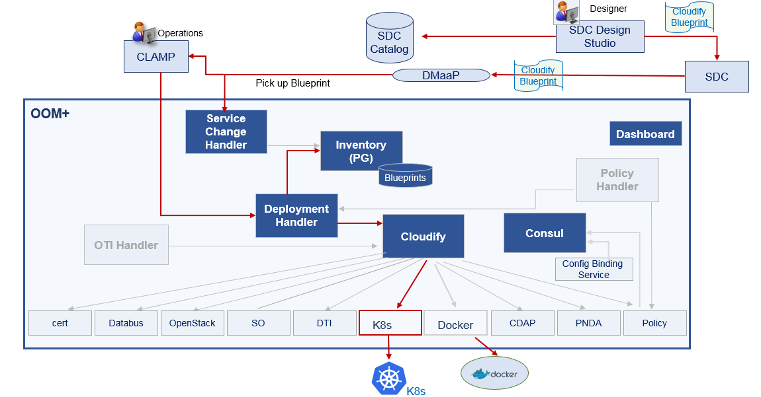
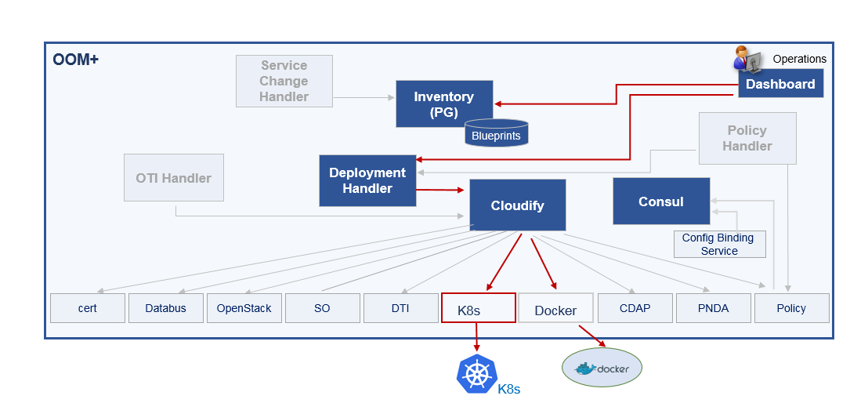
Management Application Deployment
Stand-alone (non-SDC)
Using SDC and CLAMP

Slide 26
Demo on AT&T Operation manager

Slide 27
Backup

Slide 28
OOM Orchestration – Functional Gaps (Dublin)
  Design
  No design flow integration and standardized configuration modelling enforced (under Helm templates)
  On-demand Service design creation and deployment of single/composed management application
  Instantiation
  Control Loop flow deployment and support through CLAMP/Policy/SDC
  xNF Event based application management (deployment and configuration)
  Run-time
  Dynamic configuration management through central ONAP Policy
  No backward support on Tosca based ONAP application and workflow
  Dynamic DMAAP topics provisioning/configuration for management application
  Consolidated view of deployed MS and their relationship
  Platform/Infrastructure
  Deployment of dynamic service components across multiple K8S cluster
  Support for Heterogeneous environment/payload (eg. K8S, VM and Openstack)
  Infrastructure management associated with new service components
  Maintenance (manual) of chart/values.yaml is not scalable approach for operation
  Geo-redundancy management support for ONAP components
  Standardized Security integration

Slide 29
List Kubernetes Cloud Regions
[/oom/kubernetes] kubectl config get-contexts
CURRENT NAME CLUSTER AUTHINFO NAMESPACE
cloud-1 cloud-1 cloud-1
cloud-2 cloud-2 cloud-2
* central-cloud central-cloud central-cloud

Slide 30
Deploy Central ONAP Components
[/oom/kubernetes] kubectl config use-context central-cloud
Switched to context "central-cloud".
[/oom/kubernetes] helm deploy central ./onap --namespace onap -f central-onap.yaml
release "central" deployed
release "central-aaf" deployed
release "central-aai" deployed
release "central-appc" deployed
release "central-dmaap" deployed
release "central-esr" deployed
release "central-msb" deployed
release "central-multicloud" deployed
release "central-nbi" deployed
release "central-oof" deployed
release "central-portal" deployed
release "central-robot" deployed
release "central-sdc" deployed
release "central-sdnc" deployed
release "central-sniro-emulator" deployed
release "central-so" deployed
release "central-vid" deployed

Slide 31
Deploy ONAP Components to Cloud Region 1
[/oom/kubernetes] kubectl config use-context cloud-1
Switched to context "cloud-1".
[/oom/kubernetes] helm deploy edge1 ./onap --namespace onap -f edge-cloud-1.yaml
release "edge1" deployed
release "edge1-dcaegen2" deployed
release "edge1-dmaap" deployed
release "edge1-msb" deployed

Slide 32
Deploy ONAP Components to Cloud Region 2
[/oom/kubernetes] kubectl config use-context cloud-2
Switched to context "cloud-2".
[/oom/kubernetes] helm deploy cloud2 ./onap --namespace onap -f cloud-2.yaml
release "cloud2" deployed
release "cloud2-dmaap" deployed
release "cloud2-msb" deployed
release "cloud2-robot" deployed

Slide 34
Edge Cloud Management
Auto Scaling – driven by metric changes
Remote Management
Need Simple Operations
  Zero-touch provisioning
  Zero-touch operations
  Zero-touch lifecycle
Self-Healing
  No need to manage deployed components like pets
In-service rolling upgrades (and rollbacks) -> OOM Upgrade Framework + Operators and/or ISTIO for traffic management
Align with industry standards and technologies
5G is a huge disrupter and ONAP Edge Automation WG should be participating with the likes of Akraino group
Existing Edge Stacks
  Akraino Edge Stack
  Public/Private Cloud providers (Azure, AWS, Google)
Securing the Edge
  Transparent security and certificate management -> ISTIO
Solved problems
  Need to deploy VMs with consistent failure recovery -> deploy in k8s using Kubevirt (nothing to do with edge though :/)
Kubernetes = Container Orchestration Multi-cloud portability
Identify and work to drive synergies with EdgeX and NEV SDK within
Akraino
⌲ Enable 5G use cases at the Edge vRAN
Do we plan to align ONAP Edge Automation WG with Akraino Edge Stack ??

Slide 35
Health Check Results from Central
Testsuites
==============================================================================
Testsuites.Health-Check :: Testing ecomp components are available via calls.
==============================================================================
Basic A&AI Health Check | PASS |
------------------------------------------------------------------------------
Basic AAF Health Check | PASS |
------------------------------------------------------------------------------
Basic AAF SMS Health Check | PASS |
------------------------------------------------------------------------------
Basic APPC Health Check | PASS |
------------------------------------------------------------------------------
Basic DMAAP Message Router Health Check | PASS |
------------------------------------------------------------------------------
Basic External API NBI Health Check | PASS |
------------------------------------------------------------------------------
Basic Microservice Bus Health Check | PASS |
------------------------------------------------------------------------------
Basic Multicloud API Health Check | PASS |
------------------------------------------------------------------------------
Basic Multicloud-ocata API Health Check | PASS |
------------------------------------------------------------------------------
Basic Multicloud-pike API Health Check | PASS |
------------------------------------------------------------------------------
Basic Multicloud-titanium_cloud API Health Check | PASS |
------------------------------------------------------------------------------
Basic Multicloud-vio API Health Check | PASS |
------------------------------------------------------------------------------
Basic SDNC Health Check | PASS |
------------------------------------------------------------------------------
Basic SO Health Check | PASS |
------------------------------------------------------------------------------

Slide 36
Overview
Orchestrate ONAP Management components the same way as CNFs
Orchestrate ONAP Analytic Applications the same way as CNFs
Orchestrate ONAP 3rd party Applications the same way as CNFs
Treat Edge k8s cloud the same as Central ONAP k8s cloud
Is there a difference orchestrating a VNF or CNF?
No difference deploying ONAP Management Component (core or 3rd party)
  Central k8s cluster of Edge k8s clusters – orchestration is the same
Single orchestrator
  Same flow regardless of type
    NF, ONAP component, 3rd party
CSAR includes Helm chart
  Or even reference a valid accessible helm chart via helm repo???
Management component
ONAP components adhere to OOM Standardized Helm chart specification
3rd party Helm chart (non-standard)
Well documented + test suite to validate ONAP Helm compliancy
Network Policy as part of helm chart
Prometheus for metrics of “dynamic components”

