Slide 1
Centralized Cloud Registry Framework
ONAP Edge Automation
Mike Elliott, Ramki Krishnan, Srini Addepalli, Vijay Venkatesh Kumar

Slide 2
Centralized Cloud Registry Framework - Applicability/Planning
Applicable to both OOM and DCAE management workload options.
Can also be used for deploying managed workloads in the Edge.
Frankfurt Plan
  Confirmed
    Centralized cloud registry development – OOM team
    Centralized cloud registry consumption by ONAP4K8S – Multi-cloud team
  Stretch goal
    Centralized cloud registry consumption for DCAE MS distributed deployment

Slide 3
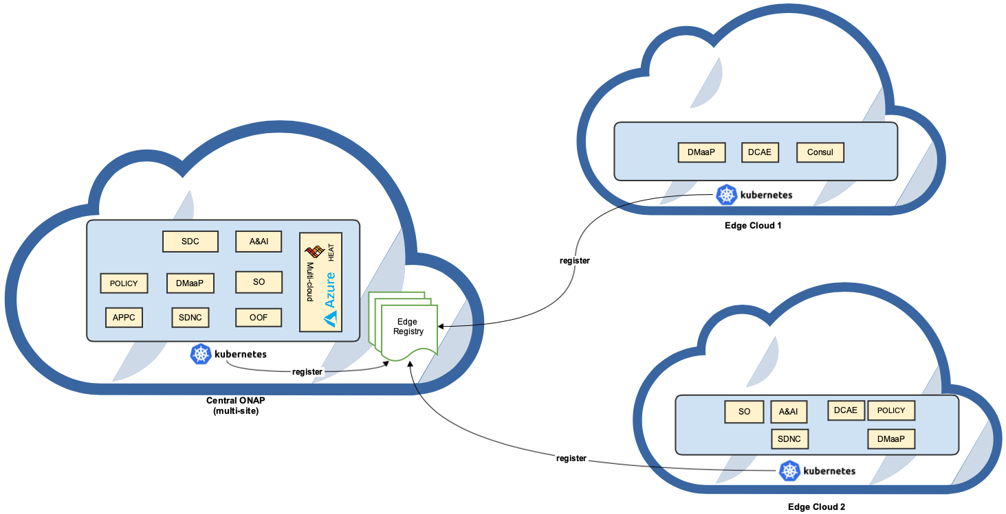
Central Cloud Registry
East US
West US
Notes:
Today we do #1.
By natural extension, can use the exact same mechanism to orchestrate edge clouds (although not restricted to “edges” – anywhere k8s is running)
Helm yaml files

Slide 4
Extend Kubernetes to register Edge Clouds
Centrally manage k8s Edge Clouds (k8s-clusters)
Use Custom Resource Definition create a Registry
  Define and manage k8s-clusters as resources in kubernetes
  kube.configs stored in HA etcd datastore in Central ONAP kubernetes
    No external database required
  Registrations possible via CLI and programmatically via API
  Management of registry via k8s plugins and/or Operators
Provide metadata (i.e. labels) as part of CRD
  Location label
  Edge type (ICN, AWS, Azure, etc.)
  External IP
  Namespaces, Oauth2 AAA
Notes:
K8s clusters as first class citizens
No external db required

Slide 5
Edge K8S Cluster Naming
Leverage Well-known k8s node labels (where possible)
https://kubernetes.io/docs/reference/kubernetes-api/labels-annotations-taints
Label | Example | Description
kubernetes.io/arch | kubernetes.io/arch=amd64 | Can use if mixing arm and x86 nodes
kubernetes.io/os | kubernetes.io/os=linux | Can use if mixing operating systems in your cluster
kubernetes.io/hostname | kubernetes.io/hostname=ip-172-20-114-199.ec2.internal | Populated with the hostname. Note that the hostname can be changed from the “actual” hostname by passing the --hostname-override flag to kubelet
Create K8s logical edge labels
ONAP Label Convention (recommendation)
Label | Example | Description
onap.kubernetes.io/<name> | kubernetes.io/<name>=<value> | ONAP node label extensions

Slide 6
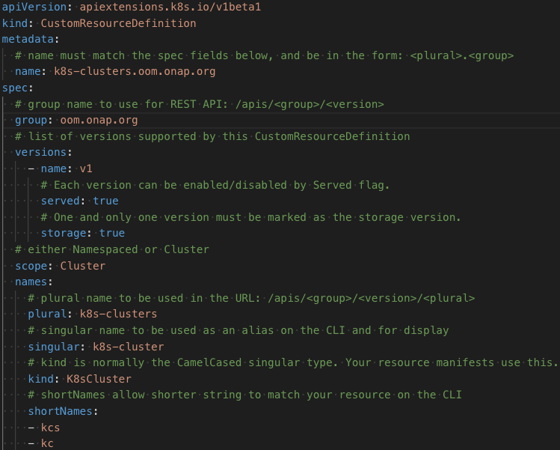
Custom Resource Definition: k8s-cluster
k8s-cluster-crd.yaml
Create k8s-cluster CRD in Kubernetes
kubectl apply -f k8s-cluster-crd.yaml
customresourcedefinition.apiextensions.k8s.io/k8s clusters.oom.onap.org created
List all CRDs registered in Kubernetes
kubectl get crds
NAME CREATED AT
k8s-clusters.oom.onap.org 2019-05-14T18:37:24Z

Slide 7
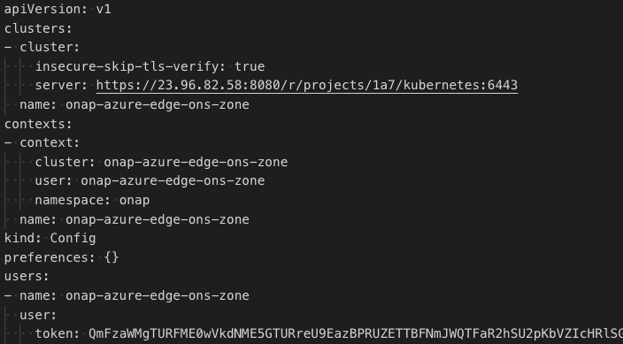
Register kube config for new Edge Cloud
Kube Config contains authorized access to a k8s cluster
Manual registration in ONAP Central
kubectl create -f onap-east-k8s.yaml
k8scluster.oom.onap.org/onap-east created
Programmatic via Kubernetes API
PUT /apis/oom.onap.org/v1/k8s-clusters HTTP/1.1
List registered Edge Clouds (k8s-clusters)
kubectl get k8s-clusters
NAME AGE
onap-central 17h
onap-east 8s
onap-west 14m

Slide 8
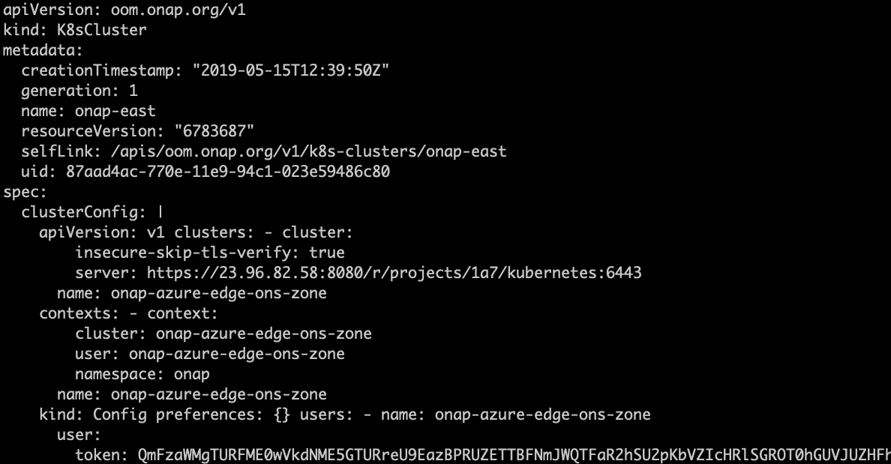
Retrieve Registered Edge Clouds (k8s-clusters)
kubectl get k8s-clusters
NAME AGE
onap-central 17h
onap-east 8s
onap-west 14m
kubectl get k8s-cluster onap-east –o yaml
Notes:
Can programmatically query k8s API endpoint to pull back registrations
Need authorization to access central

Slide 9
Security of Labels, Kubeconfig and other objects
Need input from the security sub committee
Storing sensitive information in vault?

