Slide 1
ONAP – Edge Automation
Raghu Ranganathan (Ciena) / Ramki Krishnan (VMWare)
https://wiki.onap.org/display/DW/Edge+Automation+through+ONAP
September 13, 2018
O-RAN Meeting

Slide 2
SP <> [internal/external] Cloud Regions
1
Broad set of Context Information that can enhance and enrich the delivery of a broad set of applications.
ONAP SBI/NBI: “Context APIs” (e.g. Edge Infra/App Analytics, MEC APIs)
2
@Scale Edge Automation Cloud Service
  Infrastructure LCM w/ XaaS (e.g. Analytics, Resiliency Closed Loop)
3
@Scale Edge VNFs/3rd Party Apps Automation
With ONAP Central/Edge Hierarchy
https://wiki.onap.org/display/DW/Edge+Scoping

Slide 3
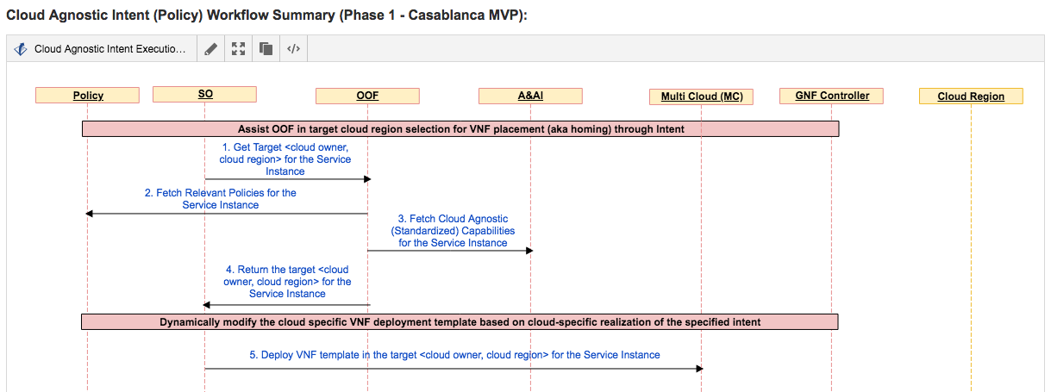
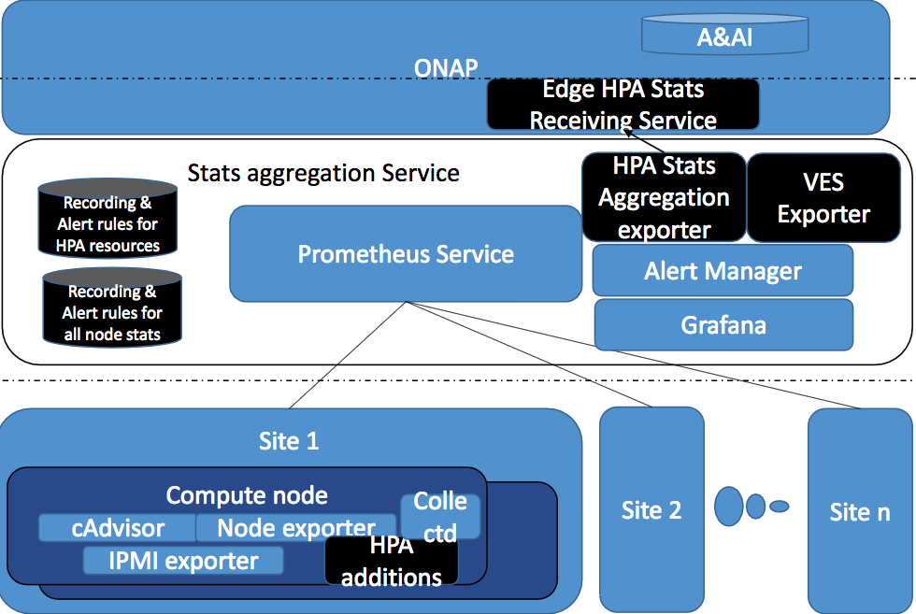
ONAP Edge Automation <> O-RAN Collaboration?
ONAP Edge Automation | ORAN WG6 work
Infrastructure LCM (Multi-Cloud) | Eg., HW acceleration
Edge VNFs/Apps | Eg., Policies
Context APIs | Eg., Telemetry
ONAP Activity Goal #1: ONAP requires IaaS/PaaS attributes from Cloud providers for Infrastructure profiles
ONAP Activity Goal #2: Define hierarchical ONAP Central/Edge Architecture/functional interactions
Aggregated Infra Telemetry Stream
https://wiki.onap.org/display/DW/Edge+Scoping+MVP+for+Casablanca+-+ONAP+Enhancements

