Slide 1
Edge Automation through ONAP WG
Use Case Subcommittee Update – April 30th 2018
Leads: Ramki Krishnan (VMware), Raghu Ranganathan (Ciena)
Wiki: https://wiki.onap.org/display/DW/Edge+Automation+through+ONAP
Meeting Date/Time: Monday, 3:00pm UTC - 5:00pm UTC

Slide 2
Agenda
WG Scope & Progress
Edge Application Profile Summary
Edge Infrastructure Profile Summary
Hierarchical ONAP Central/Edge Architecture
Next Steps

Slide 3
WG Scope & Progress
Edge Application Profile Definition – Casablanca & Beyond
  Status: Complete
Edge Infrastructure Profile Definition – Casablanca & Beyond
  Status: Close to Completion
Define hierarchical ONAP Central/Edge Architecture – Casablanca & Beyond
  Support Edge Application/Infrastructure profile
  Support Any "Cloud" (internal Business Unit or external Partner) at Any "Location" (edge, regional or central)
  Identify MVP components for ONAP Edge for Casablanca
  Status: Close to Completion
Deep Dive on Functional Interactions (API reference points) - Casablanca
  Work closely with Project Teams
  Status: To Start

Slide 4
Edge Application Profile Summary
No | Application Classification (RTT) | Application Examples | Network / Service Behavior Type | Deployment Component/ APIs | ONAP Managed | Edge Location Constraint (RTT) | Potential Application Provider | Casablanca Candidate
1 | Real-time (20ms -100ms) | In service path optimization applications which run in open CU-CP platform (also known as RAN Intelligent Controller, or SD-RAN controller). | Real-Time Network State Control | Open 5G CU-CP (CU - Control Plane) – VNFC. | Yes | Hard | NF Vendor/Service Provider/3rd Party | Yes
2 | Near-real-time (500ms and above) | Slice monitoring, performance analysis, fault analysis, root cause analysis, centralized SON applications, Optimization (SON Drive Test Minimization etc.), ML methodologies for various apps. | Network Analytics & Optimization | DCAE | Yes | Soft | NF Vendor/Service Provider | Yes
3 | Near-real-time (500ms and above) | Video Analytics, Video Optimization, Customer geoLocation information, Anonymized customer data etc. | Workload Analytics, Optimization & Context processing | Cloud Edge or Cloud Central | No | Soft | 3rd Party | Out of scope for ONAP
4 | Real-time (10-20 ms) | Third party applications that directly interacts with the UEs, like AR/VR, factory automation, drone control, etc. | Workload Automation / AR-VR / Content, etc. | UE or Cloud Edge | No | Hard | 3rd Party | Out of scope for ONAP
5 | same as 3) | same as 3) | Value Added Services + same as 3) | same as 3) + MEC/Cloud APIs (Note 1) | Yes | same as 3) | same as 3) | Stretch
6 | same as 4) | same as 4) | Value Added Services + same as 4) | same as 4) + MEC/Cloud APIs (Note 1) | Yes | same as 4) | same as 4) | Stretch
Source: “Edge Scoping,” https://wiki.onap.org/pages/editpage.action?pageId=28381325

Slide 5
Edge Infrastructure Profile Summary
Distributed, Highly-secure, Config/Cloud-diverse, Capacity-constrained and Performance/Isolation-aware Infra Profile
Distributed
  1000's of edge locations of varying capacity
Performance-awareness
  GPU, FPGAs, SR-IOV etc.
Resource Isolation through fine-grained QoS
  Support both Latency-sensitive and General purpose applications
  Support ONAP Management plane components in the same cloud with Workloads
Security
  Workloads are often deployed in external (non-dc-type) locations and need HW security (TPM etc.)
  3rd party applications which need additional HW security (VM, Containers in VM etc.) and SW security (Inter-component TLS etc.)
Capacity constraints
  Very small footprint (few nodes per physical location), Medium footprint (10's of nodes per physical location), Large footprint (100's of nodes per physical location)
Cloud Diversity
  Private and Public Cloud Providers
Configuration Diversity
  5G Factory Automation, 5G General Mobility Services etc. – User Plane components (DU, CU-UP, UPF etc.)
Source: “Edge Scoping,” https://wiki.onap.org/pages/editpage.action?pageId=28381325

Slide 6
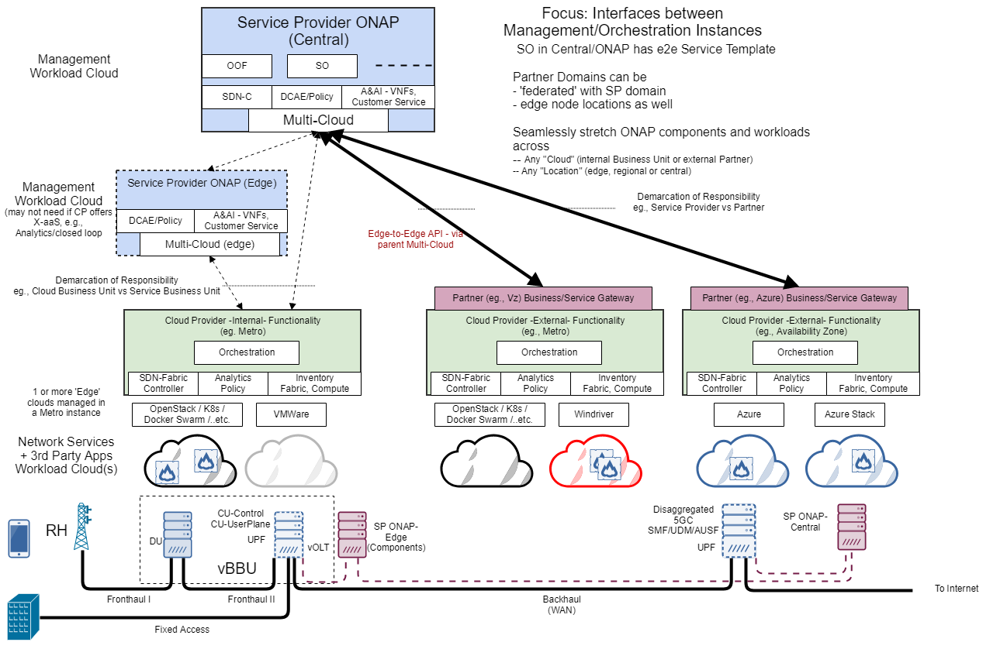
Hierarchical ONAP Central/Edge Architecture
Minimum Viable ONAP Edge (assuming operational aspects only, i.e., in Design/Deploy/Operate)
ONAP Edge - DCAE with RT-collector/Batch-collector:
ONAP Multi-Cloud: can use a Data Router to forward to local only and/or replicate to central also.
ONAP DMAAP
ONAP Edge - Policy: PDP/PEP....
ONAP Edge - A&AI - TBD? may not be needed if only closed loop decisions based on policies for given customer instances
TBD - other ONAP components?
Source: “Edge Scoping,” https://wiki.onap.org/pages/editpage.action?pageId=28381325

Slide 7
Next Steps
Edge Application/Infrastructure Profile
  Feedback needed from End User Advisory Group
    Review Profiles
    Scale numbers for Casablanca
Hierarchical ONAP Central/Edge Architecture
  Feedback from End User Advisory Group will serve as one of the key inputs for ONAP Edge MVP
  Feedback needed from End User Advisory Group
    Casablanca S3P requirements for ONAP Edge
    Additional Casablanca S3P requirements for ONAP Central

