Slide 1
Cloud Region Networking Architectural Approach for Casablanca & beyond
Key Contributors:
Ramki Krishnan, Bin Hu, Dan Timoney, Brian Freeman, Vimal Begwani, Srini Addepalli, Parviz Yegani, Gil Bullard, Raghu Ranganathan, Tuan Nguyen, Avi Chapnick, Gil Hellmann
Contribution Source:
-- Architecture Tiger Team Dicussions
-- "Architectural options for Multi-vendor SDN Controller and Multi Cloud Deployments in a DC“ at ONAP Paris Summit -- https://wiki.onap.org/download/attachments/11928197/ONAP-mc-sdn.pdf?version=1&modificationDate=1506518708000&api=v2
-- Edge Automation Workflows
- https://wiki.onap.org/display/DW/Edge+Scoping+MVP+for+Casablanca+-+ONAP+Enhancements#EdgeScopingMVPforCasablanca-ONAPEnhancements-Cloud-agnosticPlacement/Networking&HomingPolicies(Phase1-CasablancaMVP,Phase2-StretchGoal)
- https://wiki.onap.org/display/DW/Edge+Scoping+-+Beyond+Casablanca

Slide 2
ONAP (Central) ←APIs→ Internal Cloud Region
Gliffy for Internal Cloud Region – Orchestration
Gliffy – Sequence Diagram
Cloud Agnostic Intent Execution
https://wiki.onap.org/display/DW/Edge+Scoping

Slide 3
ONAP-Central: Cloud Agnostic Intent Execution- Workflow
https://wiki.onap.org/display/DW/Edge+Scoping+MVP+for+Casablanca+-+ONAP+Enhancements
1
SO-to-MC
2
MC-to-Cloud Region

Slide 4
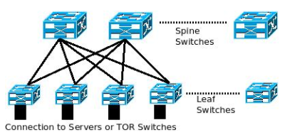
Network Data Model for a Cloud Region (Intra-DC)
Networking within Cloud Region (Private Cloud)
Exhaustive Data Model for Overlay, Underlay and Gateway Networking is beneficial to optimized inter-cloud placement
  Include specific HW details, e.g., SmartNIC, SR-IOV, etc.
  Include Overlay capability, e.g., in DPDK based switch/router, or in TOR
  …etc…
Shown below is an example hierarchy of controllers in a Cloud Region (Private Cloud)
ONAP MC
Cloud Region
Orchestrator
OpenStack Adaptor
REST etc.
OVSDB, REST, Netconf etc.
OVSDB, REST, Netconf etc.
OpenStack Adaptor
Overlay
Controller
SDN-OC
Underlay
Controller
SDN-UC
Gateway
Controller
SDN-GC
HW Gateway
vSwitch Overlay
VM - SW Gateway

Slide 5
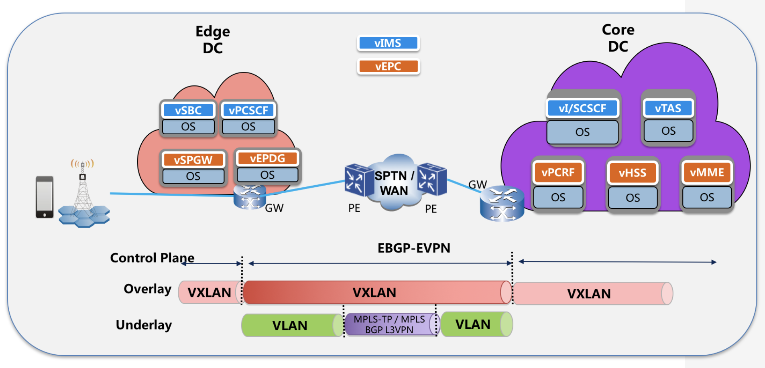
End-to-end Networking APIs (FMO)
ONAP SDN-C
ONAP SO/VF-C
ONAP MC
Cloud Region Orchestrator
3rd Party WAN
Controller
Cloud Region Orchestrator
Cloud Region Orchestrator – Network
OpenStack Neutron Plugin
Other Options …
PE<->GW
EBGP-EVPN
MP-eBGP InterAS
Other Options …
Addresses Private/Public/Partner Clouds
SDN-GC
SDN-UC
SDN-OC
VoLTE use case Link : https://wiki.onap.org/pages/viewpage.action?pageId=6593603

Slide 6
End-to-end Networking APIs (PMO)
ONAP SDN-C
ONAP SO/VF-C
ONAP MC
Cloud Region Orchestrator
3rd Party WAN
Controller
Cloud Region Orchestrator
Static Underlay
Cloud Region Orchestrator – Network
OpenStack Neutron Plugin
PE<->GW
EBGP-EVPN
Addresses Private Clouds
SDN-OC
SDN-GC
SDN-GC
VoLTE use case Link : https://wiki.onap.org/pages/viewpage.action?pageId=6593603

