Slide 1
Edge Cloud Data Model notes
Arun Gupta
December 05, 2018

Slide 2
Key takeaways
ONAP Owner Operated Cloud is different from Public Cloud in terms of information and functions available to ONAP.
Let’s try to fit the Edge Automation use cases with minimal change to the existing data model.

Slide 3
Some differences
Public clouds –
  Don’t reveal their precise location
  Inter-data-center networking choice – SPs or cloud-providers
  Invisibility of physical detail, capacity of
    Compute servers
    Networking
  Limitations on networking
    Limited protocol adjacencies
    Packet-forwarding VNFs – public clouds are not friendly to packet-forwarders.

Slide 4
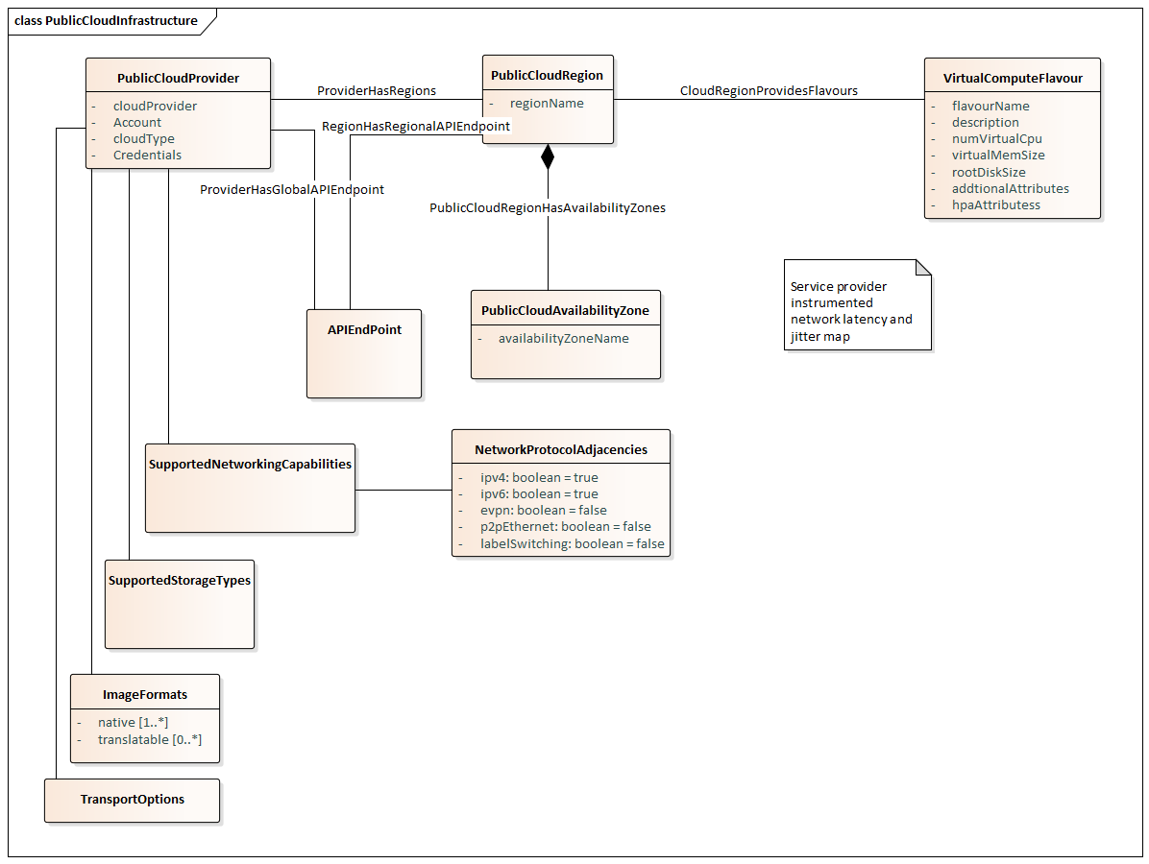
Public Cloud

Slide 5
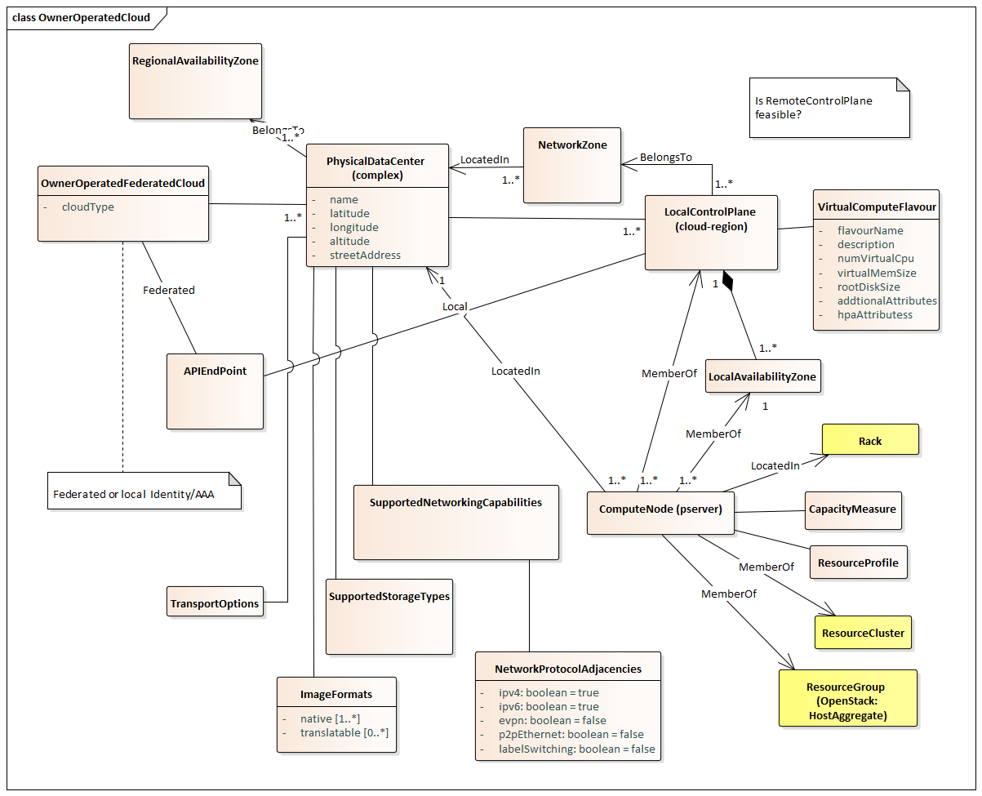
OOOC
Note from 2018/12/05 meeting:
add remote control plane for a physical
data center or set of physical data centers

Slide 6
Info levels
ONAP in an OOOC situation could have info. & function privileges consistent with:
Regular user of the cloud, or
Administrator of the cloud, or
    e.g., in OpenStack this would give visibility into physical hosts and their capacity, would enable creation of provider networks.
Beyond the cloud admin user
    Note that the administrative user of OpenStack would still need to refer to an external source of info. to get rack information. They could represent it within OpenStack as host aggregates.

