Slide 1
WAN IM proposal for R3
Zhuoyao Huang

Slide 2
Class Diagram
Notes:
Forwarding Construct: The Forwarding Construct (FC) class models enabled constrained potential for forwarding between interfaces at a particular specific layerProtocol.
FC Port: Fowarding Construct Port. The association of the FC to interfaces is made via FC Ports. The FC Port class models the access to the FC function.
Forwarding Domain: The Forwarding Domain (FD) class models the topological component that represents a forwarding capability that provides the opportunity to enable forwarding (of specific transport characteristic information at one or more protocol layers) between points.
FC Route: Each instance of an FC Route class models an individual route of an FC. The route of an FC object is represented by a list of FCs at a lower level with the implicit understanding that unmodeled link connections are interleaved between the lower level FCs.
Link: The Link class models effective adjacency between two or more ForwardingDomains (FD).
LinkPort: The association of the Link to LTPs is made via LinkPort. The LinkPort class models the access to the Link function.
LTP: The Logical Termination Point (LTP) class encapsulates the termination and adaptation functions of one or more transport layers represented by instances of LayerProtocol.

Slide 3
WAN IM proposal for R3
Following ONF CIM concept.
Import partly CIM classes and relations but not all of them for easier data modeling and SDC coding.
Just enough classes and relations for use cases in ONAP R3, import rest part of CIM in latter version.
Wiki page:
  https://wiki.onap.org/display/DW/Wan+Descriptor+IM+proposal

Slide 4
General scenario
Site
Subnet
Site
FD
CE
CE
Subnet
FD
XC: FC
XC: FC
XC: FC
XC: FC
PE
PE
LC: FC
LC: FC
LC: FC
PE
Subnet
XC: FC
PE
CE
XC: FC
CE
Site
Site
XC: FC
XC: FC
FD
Subnet
FD
Underlay Vpn: FC
OverlayLink: Link
Overlay Vpn: FC

Slide 5

ONF diagram symbol

Slide 6
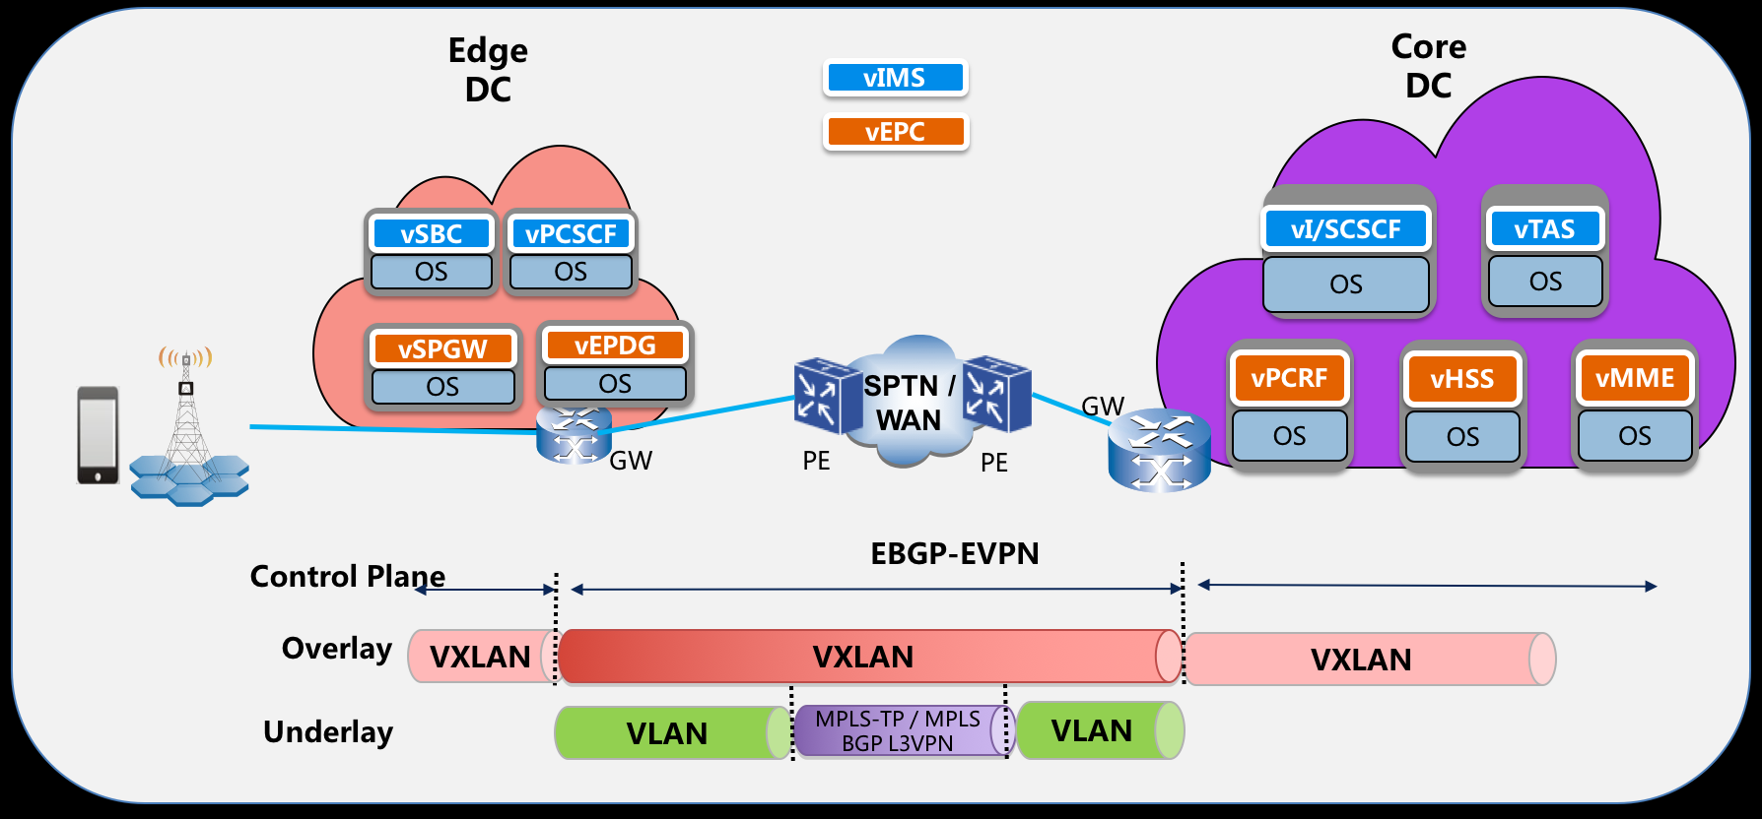
Volte use case mapping: underlay

Slide 7

Volte use case mapping: overlay

Slide 8
Volte use case mapping: underlay supports overlay
Fc (Overlay)
Fc Route (Overlay)
Link (Overlay)
Fc (Underlay) Supports Link (Overlay)
Fc (Underlay)

Slide 9
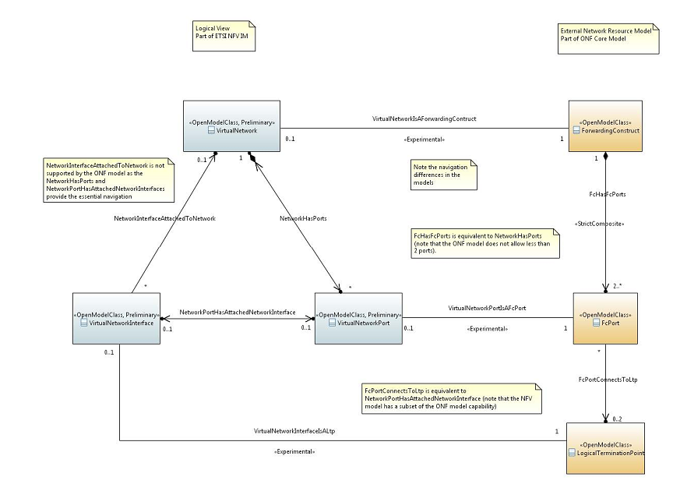
NFV Information Model VS ONF Core Model

Slide 10
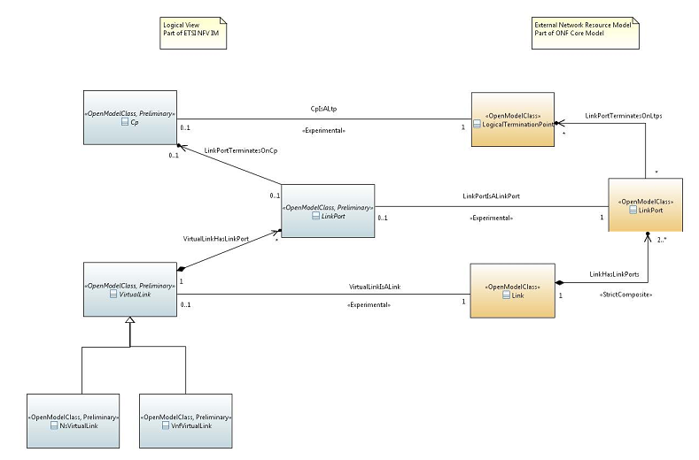
NFV Information Model VS ONF Core Model

Slide 11
Volte use case mapping: NFV IM touching ONF CIM
CP(NFV)
Virtual Link(NFV)
LTP(ONF)

Slide 12
Thank you!

