Slide 1
Instantiate MMB Network Slice
John Quilty

Slide 2
Some preconditions
  There exists a deployed Radio Network and corresponding Packet Core
  These are visible and managed in ONAP
Transport Aspects of end to end slice not included

Slide 3
ONAP Driven E2E Slicing PoC
- Architecture
Tenant Observability and APIs
External Data Movement and APIs
Run Time
Slice Dashboard
Slice API
Design Time
Service Orchestration
SDC
(Service Design Center)
Network Slice workflows
Network Slice Service Model
A&AI
DCAE
Policy
ONAP Controller
SDN-C
Network Slice Model
Network Slice Analytics
Transport Slice
VNF DG & Templates
ONAP component
Network Slice component
3rd party component
Slice State
RAN
CN
Transport

Slide 4
Service Dependency at MBB Slice Instantiation
Create
MBB Net Slice Service
Create
tenant EPC service
Create
Uses
Create
Allotted Resource
Coverage Area
Uses
MME Service
EPG Service
EPC service
LTE RAN Service
Allotted Resource
Uses
Uses
MME VF
EPG VF
LTE RBS PNF
HSS service
EPG Service
MME Service
VNF Object
Service Object
HSS VF
EPG VF
MME VF
Existing Service instance
Contains

Slide 5
Service Dependency at MBB Slice Instantiation (Beijing)
Create
Create
MBB Net Slice Service
Create
EPG VF
Create
Uses
Allotted Resource
Coverage Area
Uses
MME VF
EPC service
LTE RAN Service
Allotted Resource
Uses
LTE RBS PNF
HSS service
VNF Object
Service Object
HSS VF
EPG VF
MME VF
Existing Service instance
Contains

Slide 6
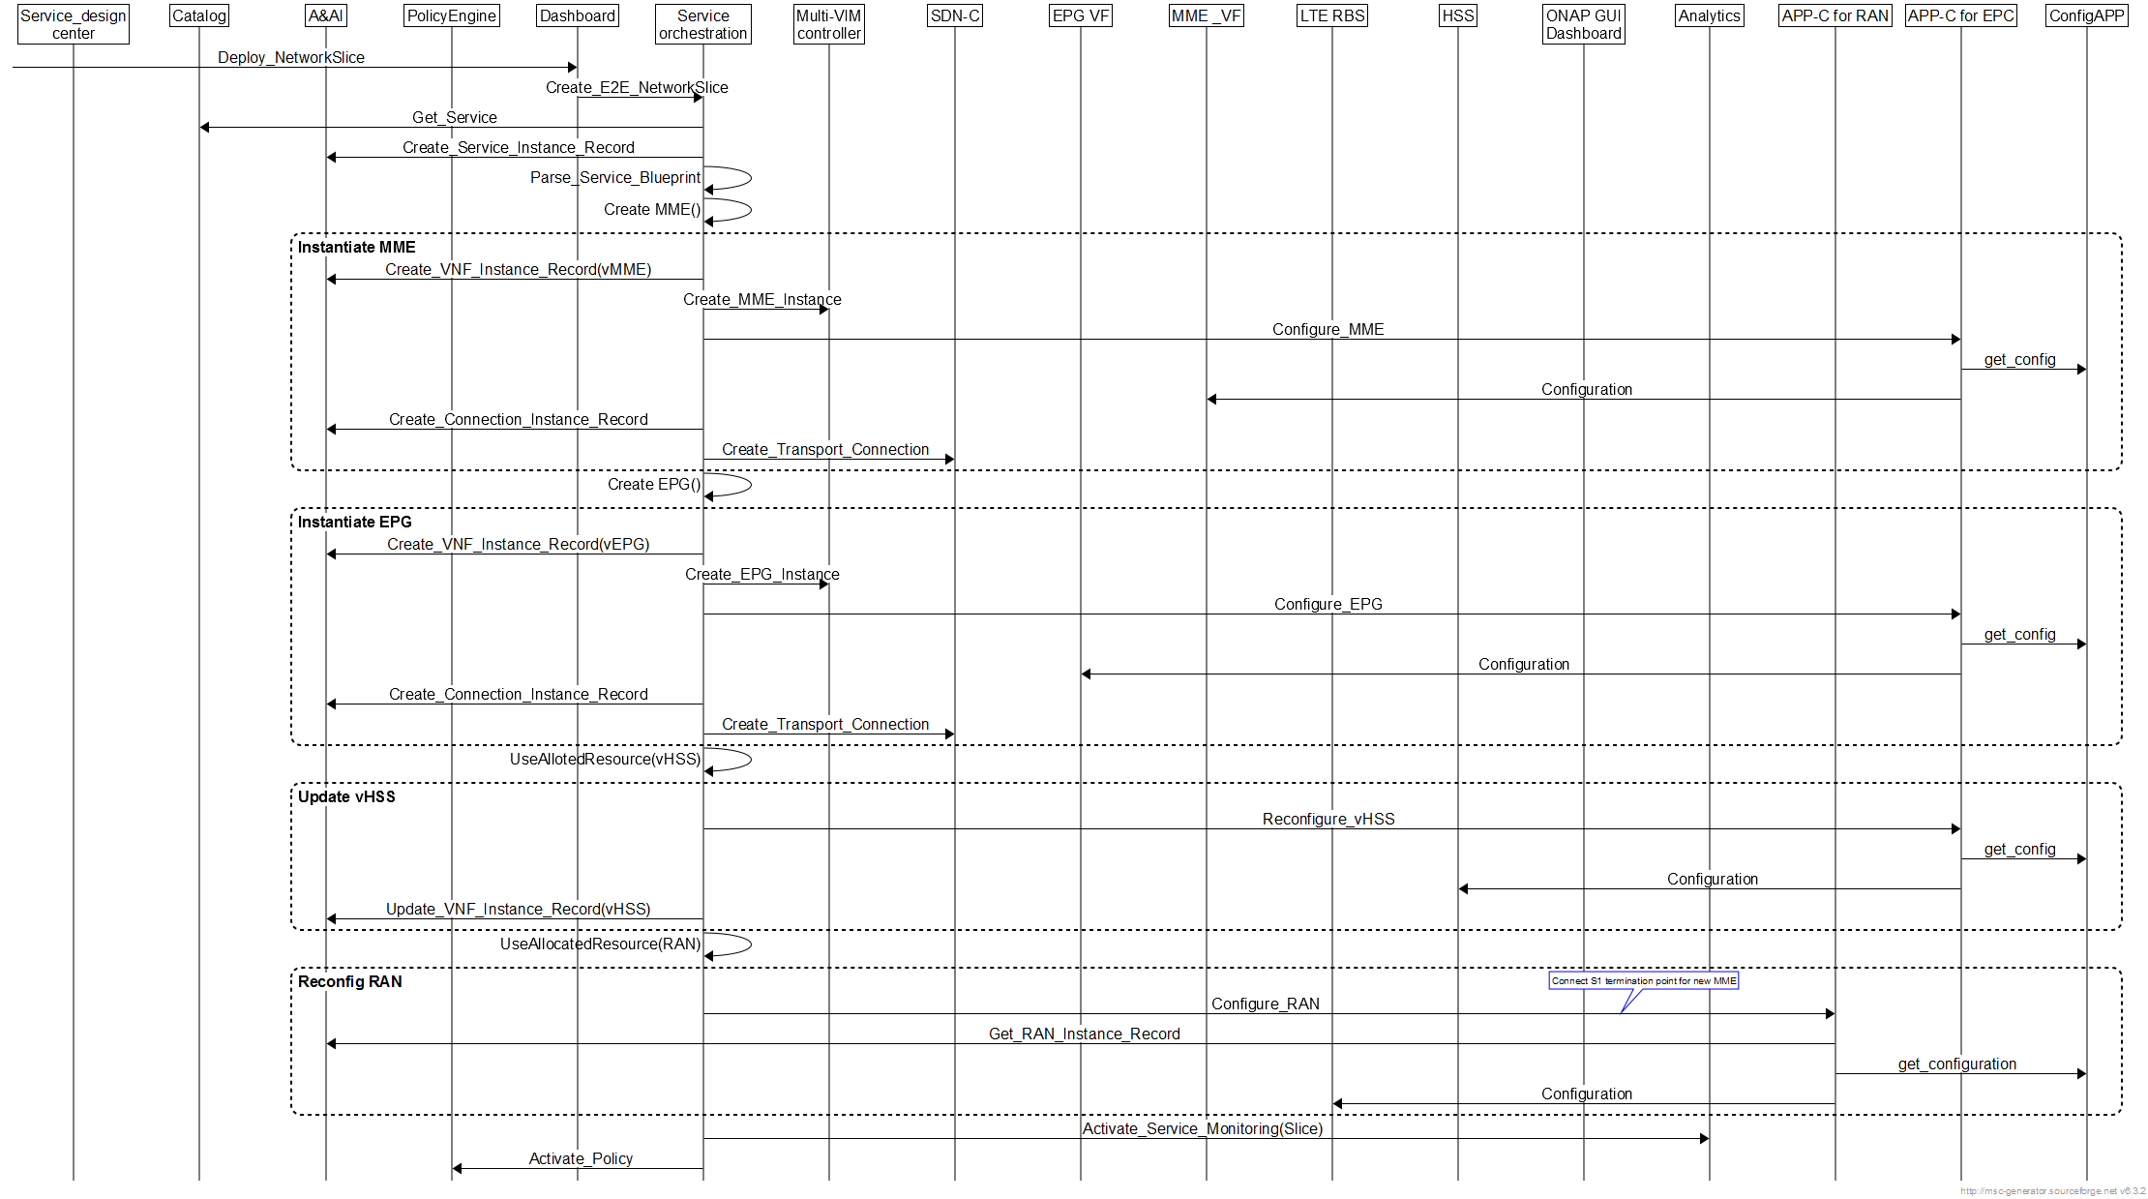
High Level Initial Flow chart

