Slide 1
ONAP Optimization Framework (OOF)
POC for Physical CellID (PCI) Optimization
July 30, 2018

Slide 2
ONAP Optimization Framework (OOF) and PCI
ONAP Optimization Framework (OOF) provides a policy-driven and model-driven framework for creating optimization applications for a broad range of use cases
For Casablanca, OOF enhancements include formulation and solving of optimization problems
We propose an OOF enhancement and Proof of Concept (POC) for Casablanca for
Physical Cell ID (PCI) Optimization
  PCI Optimization is a well-understood problem
  The reading/writing of the Physical Cell ID (PCI) configuration parameter has been included in SDN-R POC
Objective of the POC is to demonstrate disaggregation of the PCI SON functionality, and the data flows needed to implement this in ONAP using OOF
We envision a new PCI-Handler Microservice to facilitate the data flow and trigger mechanism
The focus is on data flow and interfaces, and the role of OOF, PCI-Handler-MS, SDN-C Controller and Policy etc
  Objective is to incorporate an algorithm in ONAP using OOF, not to develop an algorithm

Slide 3
Casablanca - Optimization Framework Enhancements
TOPIC | ICON | DESCRIPTION
Optimal placement of vNF |  | Placement of Mobility Virtual Network Elements (CUs) across the highly distributed edge clouds is a fundamental requirement. Service Providers must also optimize the performance of the 5G RAN in real-time.
Optimization problem formulation |  | Ability to model the problem as a constrained optimization problem, that is driven by policies – Potential use case examples: formulation of optimization problems at various levels: Customer (e.g. provisioning), Service (e.g. slice optimization ), Network (e.g. Routing, problems at the network planning level), Infrastructure (e.g. Placement) & Resource (e.g. License)
Optimization problem solving |  | Ability to use and deploy appropriate analytics, algorithms and solvers to solve the problem in acceptable time frames at various levels: Customer, Service (e.g. Slice Optimization Analytics), Network (e.g. SON network planning analytics), Infrastructure (e.g. Placement) & Resource
 |  | Impacted systems: SDC, SO, Policy, AAI, DCAE, SDN-R, MultiCloud (possibly)

Slide 4
ONAP Casablanca plan for OOF-PCI
Minimum viable product to make incremental progress in ONAP core modules
  The POC will help to develop details of ONAP interfaces and flows needed:
(a) to get the required network data to OOF for optimization,
(b) compute an optimization,
(c) apply policies, and
(c) execute it using the SDN-C Controller
Casablanca test cases involve:
New PCI-Handler-MS (on boarded on DCAE) – interfaces to OOF, Policy, DMaaP
OOF – interfaces to PCI-Handler-MS, Policy, SDN-C, (A&AI?)
Policy – interface to PCI-Handler-MS, OOF, SDN-C
SDN-C – interface to RAN, OOF, Policy, DMaaP

Slide 5
ONAP Casablanca: PCI Optimization using OOF
7
4
Config change
Change Notifn
6
Simulated RAN
~2000 Cells
Nbr_list, PCI values
OOF
Policy
10
SDN-C
1d
(Netconf/Yang)
1c
8
PCI Handler MS
9
1b
1a
Config DB
2
3
11
5
(SDN-C work done in SDN-R team)
Step | Functionality |  | Step | Functionality
1a-1d | All modules loaded to support PCI |  | 6 | OOF gets PCI optimization policies from Policy
2 | PCI-Handler MS fetches configuration policies from Policy |  | 7 | OOF queries SDN-C database to fetch data for cells in the region.
3 | Config change notification from RAN to SDN-C (e.g. Nbr list change) |  | 8 | OOF provides PCI Optimization result to PCI Handler MS
4 | SDN-C publishes config data change on DMaaP to PCI-Handler-MS. |  | 9 | PCI-Handler-MS provides PCI recommendation to Policy
5 | PCI-Handler MS invokes OOF for pre-defined workflow for PCI Optimization. |  | 10 | Policy sends message to SDN-C with instruction for PCI configuration changes
 |  |  | 11 | SDN-C applies config changes via Netconf

Slide 6
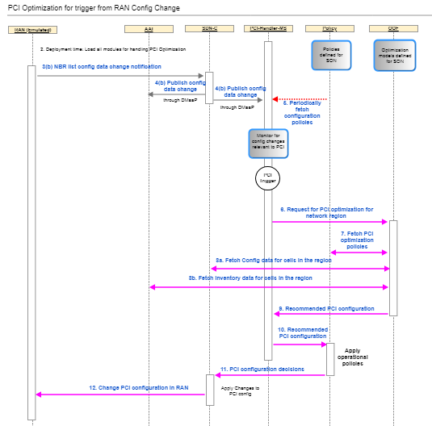
Flow / test case
See latest flow and test case at:
ONAP OOF-based PCI wiki page
https://wiki.onap.org/display/DW/5G+-+OOF+(ONAP+Optimization+Framework)+and+PCI+(Physical+Cell+ID)+Optimization

Slide 7
Support Needed
New PCI-Handler-Microservice
  Develop microservice and onboard on to DCAE
  Interfaces to OOF, Policy, DMaaP
  Programmed to trigger PCI optimization request based on message from SDN-C (S-1b)
  Fetches and applies configuration policies, which specify rules for processing input messages from SDN-C (S-2)
  Gets config change message from SDN-C via DMaaP (S-4)
  Requests PCI Optimization from OOF (S-5)
  Receives PCI Optimization result, and forwards recommendation to Policy (S-8,S-9)
OOF
  Request/Response interface to provide PCI optimization results to PCI-Handler-MS (S-5, S-8)
  Use new API in SDN-C to query database – could be via DMaaP (S-7)
  Modify existing interface to Policy to fetch PCI optimization policy (S-6)
  Modify models to incorporate solver for optimization of PCI
  Host solver algorithm (existing)

Slide 8
Support Needed
Policy
  Provide configuration policies to PCI-Handler-MS (S-2) – new interface
  Modify existing interface to OOF to provide PCI optimization policies (S-6)
  Send message to SDN-C with action request via DMaaP (S-10)
SDN-C (as part of SDN-R team)
  Interface to RAN (simulated RAN for this project)
    Modify RAN Information/Yang models to support PCI use case
    Netconf interface to RAN: change PCI value (S-11), accept change notification (e.g. NbrList) (S-3)
  Publish RAN config change on DMaaP (S-4)
  Database
    Maintain database with RAN element / config data
    Provide API for database query from other ONAP modules (S-7) – could use DMaaP interface
  Get and process action request message from Policy via DMaaP (S-10)
  Extend Directed Graphs to support PCI use case, as needed

Slide 9
Support Needed
RAN Simulator
  Simple simulator program with about 2000 cells
  Accurate representation of netconf interface to SDN-R
  Include: Cellid, Nbr_List, PCI value, location (?)
  Initial Nbr_list and PCI value computed offline and assigned
  Ability to simulate change in Nbr_list to create potential for PCI conflict/confusion
  Ability to send Nbr_list config change notification to SDN-C
  Ability to accept PCI value config change from SDN-C

Slide 10
Thank You!

