Slide 1
Resource IM Discussion

Slide 2
Agenda
“Class” vs “Data type”
R3 Plan

Slide 3
“Class” vs “Data type”
Current wiki page has all objects categorized as “Class”
Comments received state that some of them should be “Data type” instead of “Class”
According to IFA015 v2.4.1:
According to SOL001 v0.6.1:
  The following objects are “data type” instead of “class”:
          VduProfile
            VirtualNetworkInterfaceRequirements
            VirtualLinkProfile
            InstantiationLevel
            VduLevel
            LifecycleManagementScript is supported using interface type
            MonitoringParameter is modeled as capability type
Class | Data type
Vnfd | VirtualCpuData
Vdu | VirtualMemoryData
SwImageDesc | LogicalNodeData
VirtualComputeDesc | LinkBitrateRequirements
VirtualStorageDesc | ScaleInfo
Cpd | QoS
VduCpd | LocalAffinityOrAntiAffinityRule
VnfExtCpd | AddressData
VduProfile | L2AddressData
VirtualNetworkInterfaceRequirements | L3AddressData
VnfVirtualLinkDesc | CpProtocolData
VnfDf | ConnectivityType
VirtualLinkProfile | VirtualCpuPinningData
VirtualLinkDescFlavour | RequestedAdditionalCapabilityData
InstantiationLevel | VnfConfigurableProperties
VduLevel | VnfcConfigurableProperties
AffinityOrAntiAffinityGroup | LifecycleManagementScript
VnfIndicator | MonitoringParameter
VnfdElementGroup | VnfInfoModifiableAttributes
PlacementGroup (Experimental)？
BaseConfigGroup (Experimental)？
DeploymentGroup (Experimental)？

Slide 4
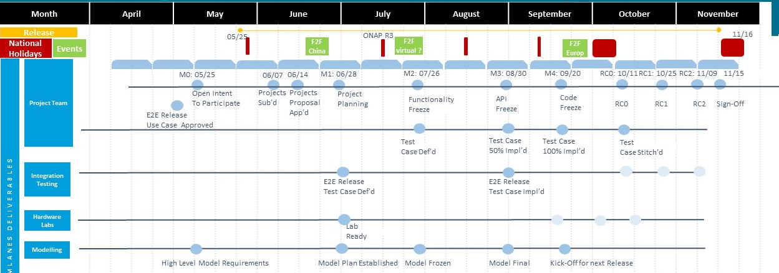
R3 Plan
Time schedule (from wiki, not approved yet)
Before M0: R2 model clean up and requirements collection
M0~M2: requirement frozen, build up R3 model
M2~M3: model review

Slide 5
R3 Plan
Topics collected in the last call:
  Initiation parameters
  Deprecate HPA related legacy attributes
  KVP definition
  MonitoringParameter/Events (DCAE)
  ElementGroup enhancement
  Indicator
  Scaling details
  Off-line feedback:
  Run-time model
  Package
  container

Slide 6
R3 Plan
Next call

Slide 7
Thank you

